Slide 1
Project Team Presentation Order
5Guys
BleacherReport
Bytes & Bars
CHAJ
Data Wizards
Forward Thinkers
Highway Riders
PowerBall Winners
Rotten Potatoes
Shipman Sergeants
TARAN
Team Spotify
The Eras Tour
Traffic Totalities

Slide 2
5Guys: Covid Cases
Vincent LoBello, Jon Kutsch,
Fisher Byers, Trey Smith,
Tommy Garriga

Slide 3
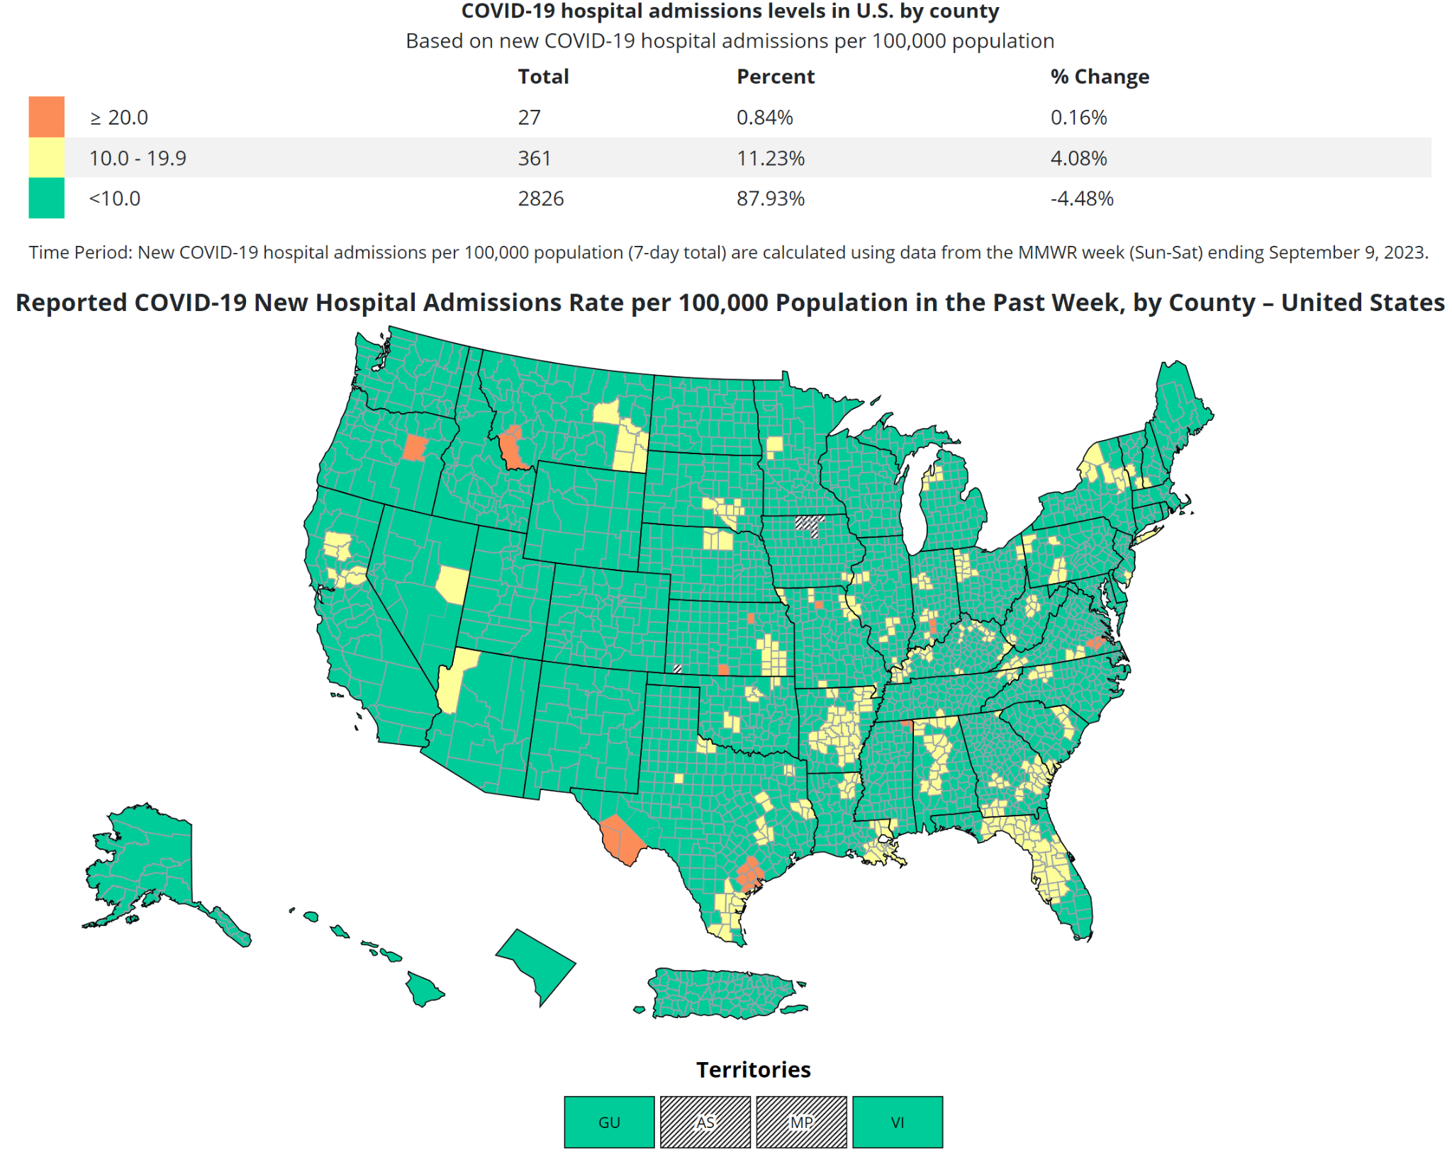
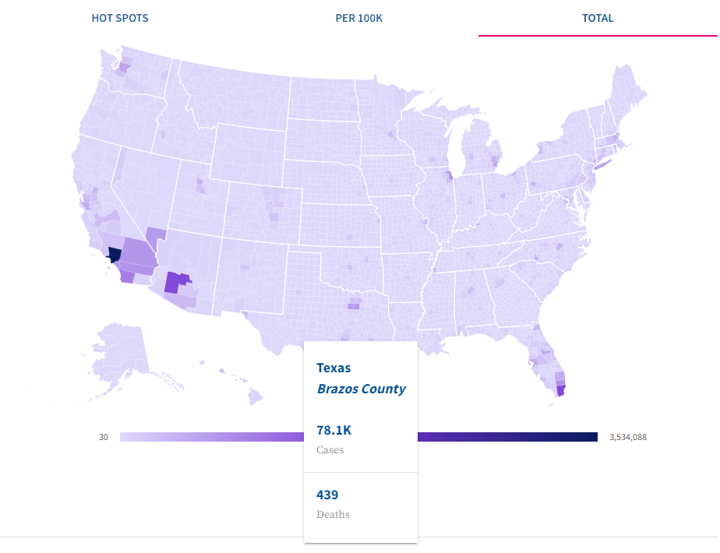
Related Designs
Related design 1
  Visualization of where COVID is hospitalizing most people
  It is only per 7 day period
Related design 2
  Shows a lot of data and information
  Too broad, can’t get specifics just by looking at the visualization
  2 outliers (CA/FL) that skew rest of United States
Image of related design 1
Image of related design 2

Slide 4
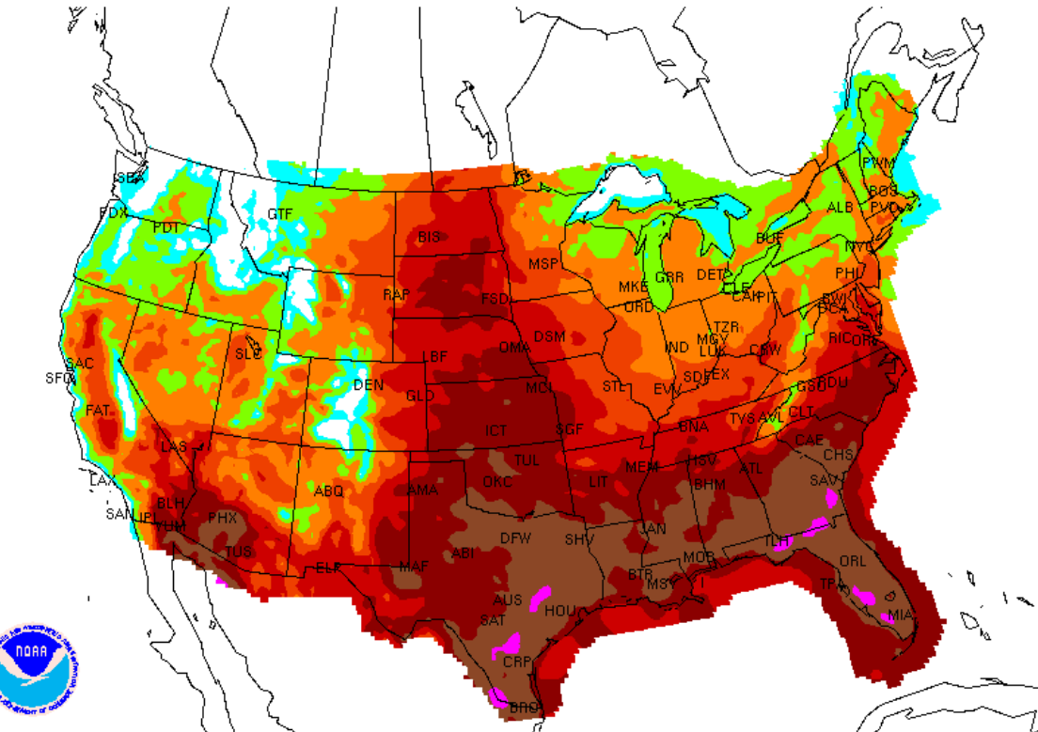
Our Design & Rationale
Design choice 1
We will do a heat map with correlation to how much at risk you are to covid with your considered health conditions
  The good
    The user will get a real time analysis of how much at risk they are in a certain area
  The bad
    There will be limited information on details of covid
Image(s) of design

Slide 5
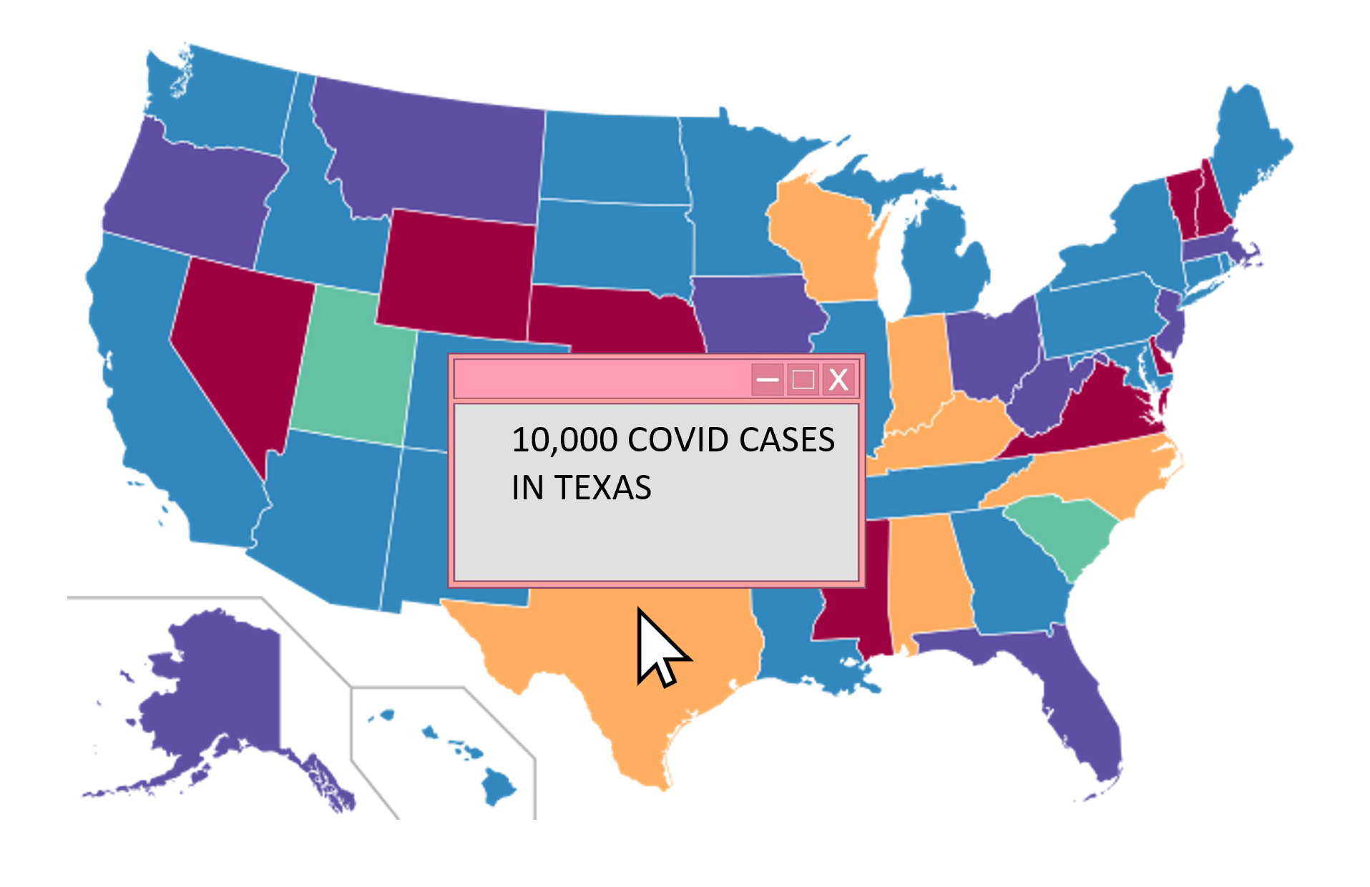
Our Design & Rationale
Tooltip hovering
  It will display more information about the covid cases for the states that are hovered over
  This could potentially lead to cluttering or maybe the pop up gets in the way of other data
Next up: Bleacher Report

Slide 6
BleacherReport: Volleyball Statistics
Jacob Yin, Justin Liu, Lucas Ma, Nikole Arredondo

Slide 7
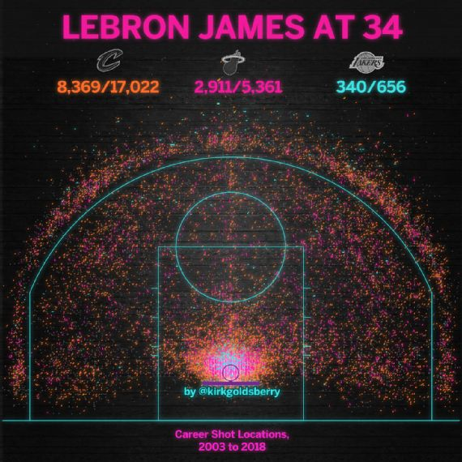
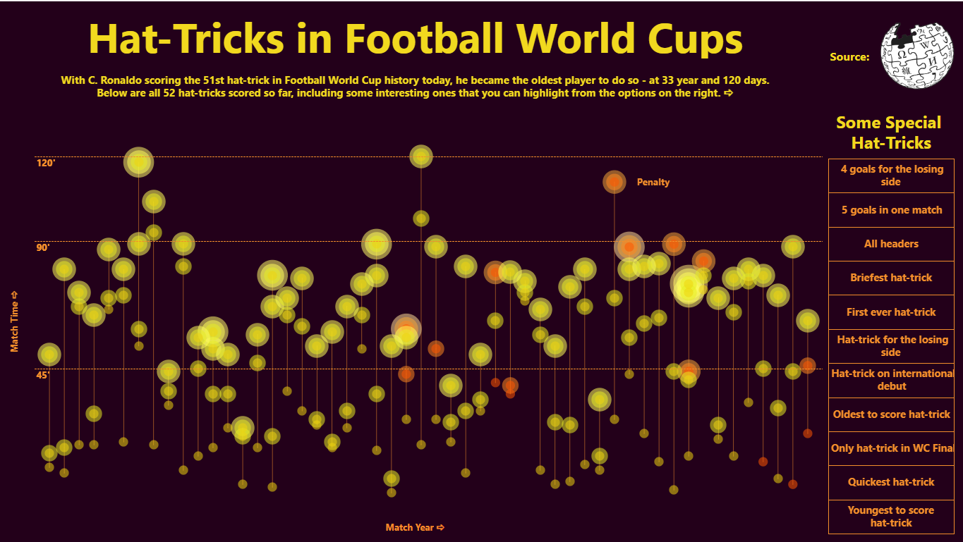
Related Designs
Career Shot Location
  Visually appealing while still displaying information
  Only shows half court
Hat-Tricks in Football World Cups
  Eye catching and interactive
  Slightly confusing at first glance

Slide 8
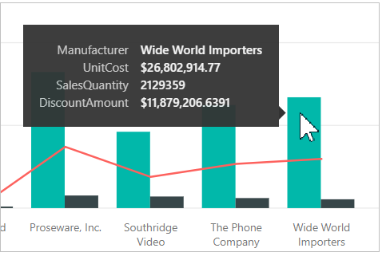
Our Design & Rationale
Mouseover Labeling
  The good
    Provides more detailed information.
    Interactive design
  The bad
    The label may obtrusive and make it hard to view data.

Slide 9
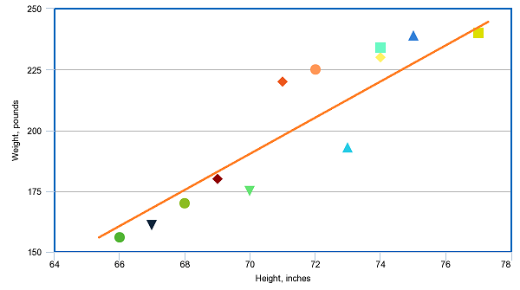
Our Design & Rationale
Scatter plots
  The good
    Can show correlation between data
  The bad
    Can only show correlation between 2 variables
Filter
  The good
    Data is customizable for individuals
  The bad
    Filters can lead to bias and loss of context
Next up: Bytes & Bars

Slide 10
Bytes & Bars: Internet Usage & Correlations Around the World
Robert Eads, Tyler Felton, Julian Stoicoviciu, & Justin Van Nimwegen

Slide 11
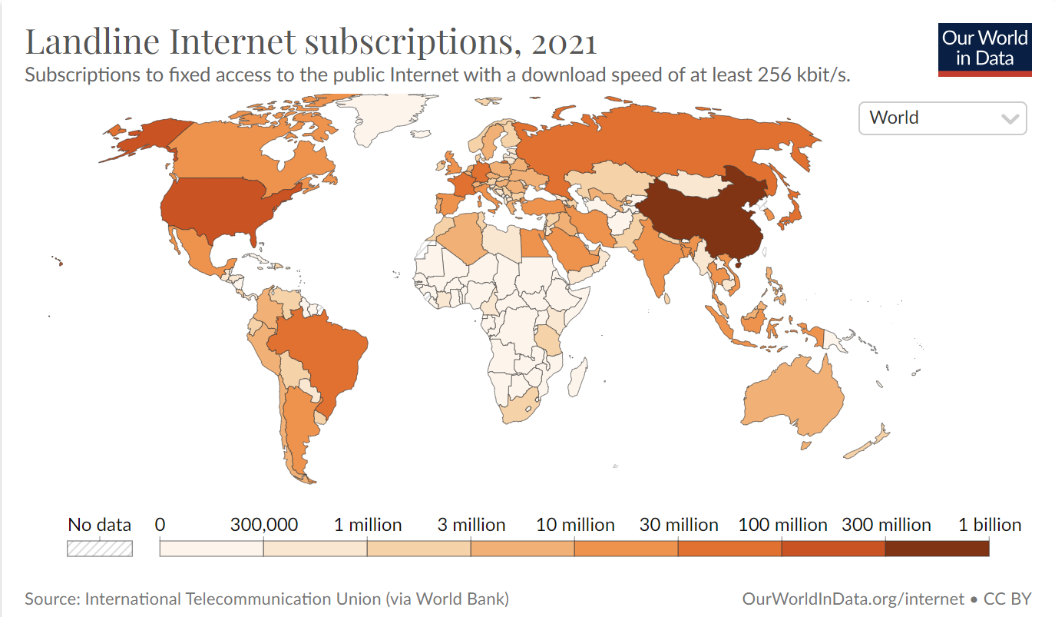
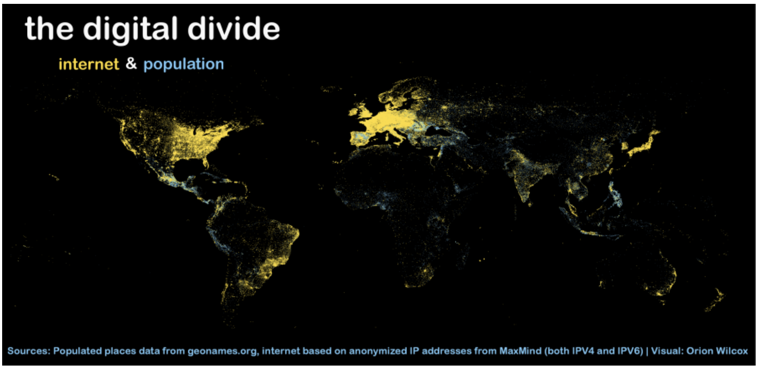
Related Designs
Landline Internet subscriptions
  Good:
    Clear world map
    Color gradient & scale
  Bad:
    Shows total subscribers instead of population %
Digital Divide
  Good:
    Color contrast
  Bad:
    Poor Background
    Hard to read/decipher
    Non-interactive

Slide 12
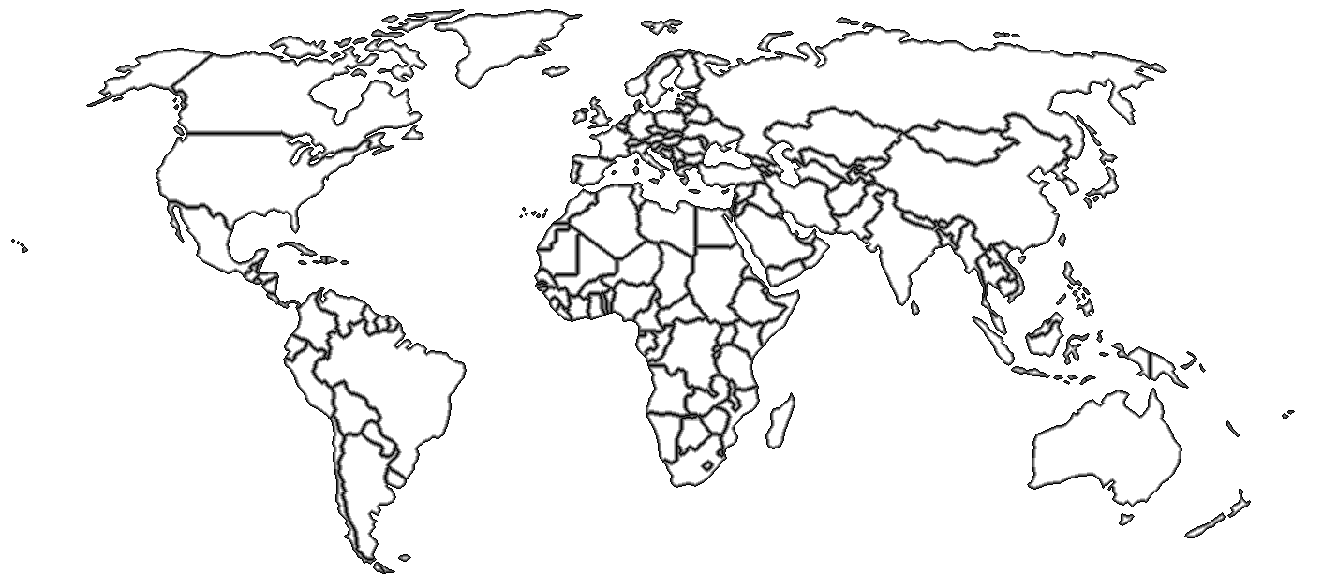
Our Design & Rationale
Interactive World Heat Map
  The good
    Main display in a single view
    Interactive for country specifics
  The bad
    Map overview can obscure smaller countries
    Potentially hard to interpret variable density

Slide 13
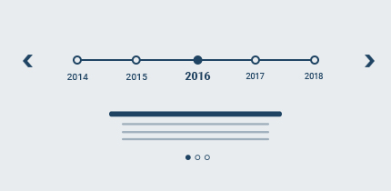
Our Design & Rationale
Timeline
  The good
    Allows viewing each year as snapshot in time
    Easy movement around relativity similar years
  The bad
    Can limit comparisons over large gaps of time depending on scale

Slide 14
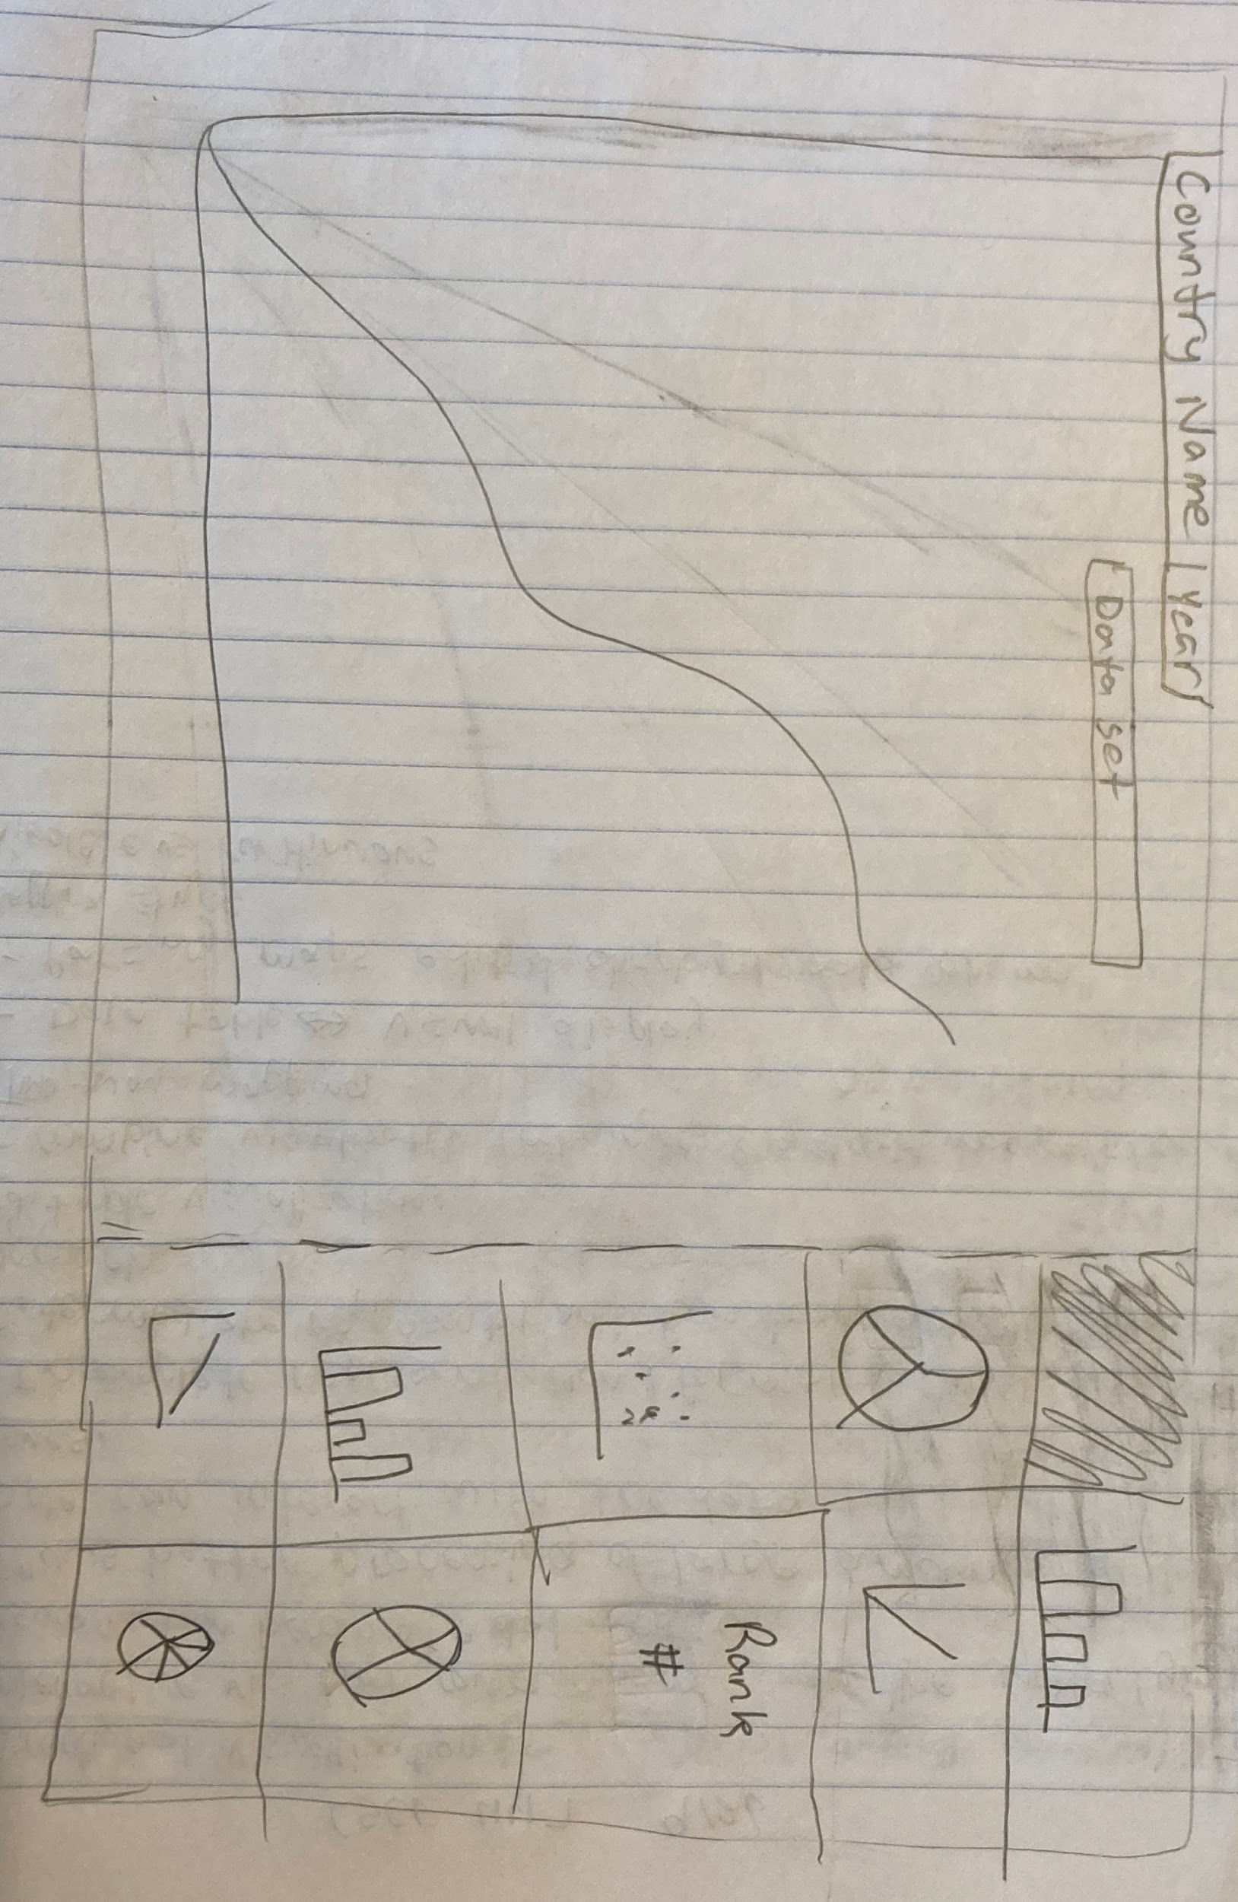
Our Design & Rationale
Pop Up/Country View
  The good
    Allows various forms of comparison between different types of data sets
  The bad
    Might not be intuitive to a first time user
    Can be hard to read depending on screen size
Next up: CHAJ

Slide 15
CHAJ: Video Game Speedruns
Connor Hill, Haden Johnson,
Alan Perez, John Harrell

Slide 16
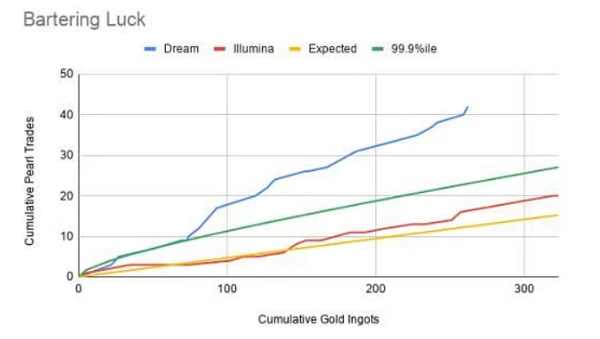
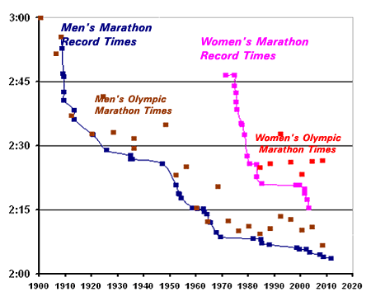
Related Designs
Multi-line Chart Design
  What is good
    Color distinguishes different data sets well
    Shows change over time well
  What is not so good
    Hard to distinguish between two lines that are close together
Multi-line / Scatterplot
  What is good
    Can compare lots of data
    Uses points for discrete data
  What is not so good
    Messy labeling
    Cluttered graph

Slide 17
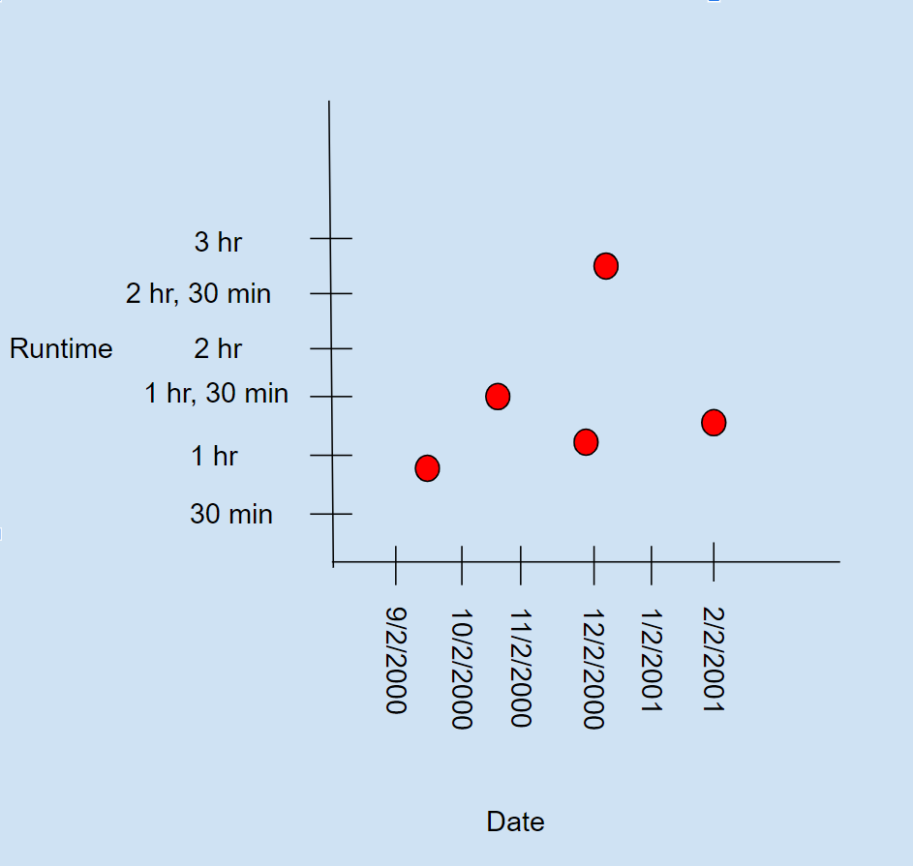
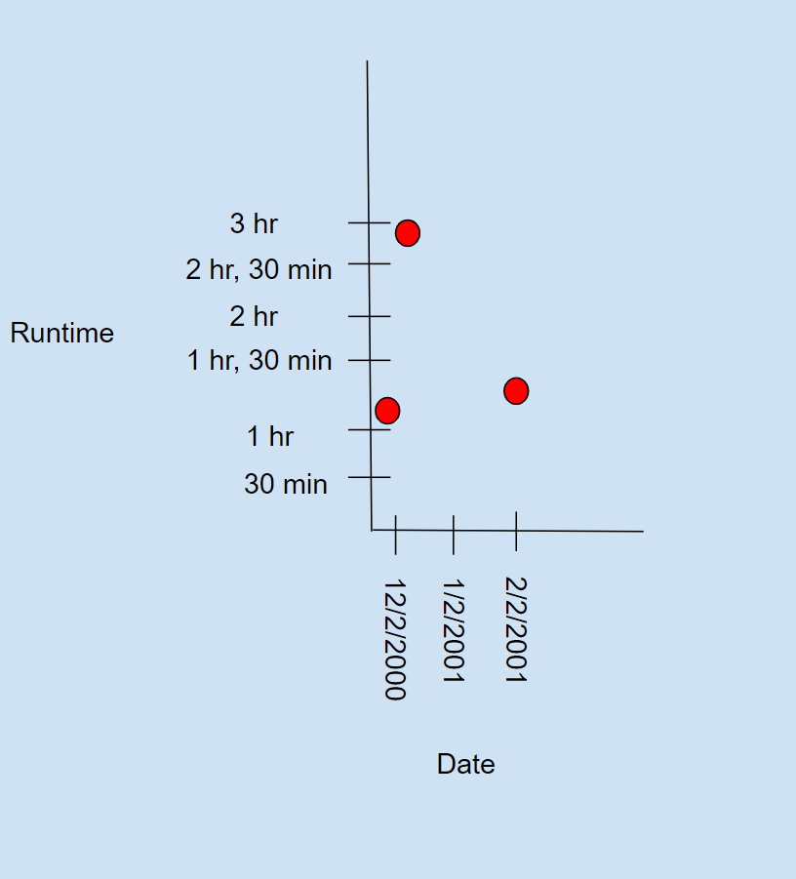
Our Design & Rationale
The ability to isolate and focus on specific date ranges
  The good
    Allows the user to analyze a specific date range of interest for research purposes
  The bad
    Need specific instructions in order to guide the user into executing the action correctly
After selecting a specific data range

Slide 18
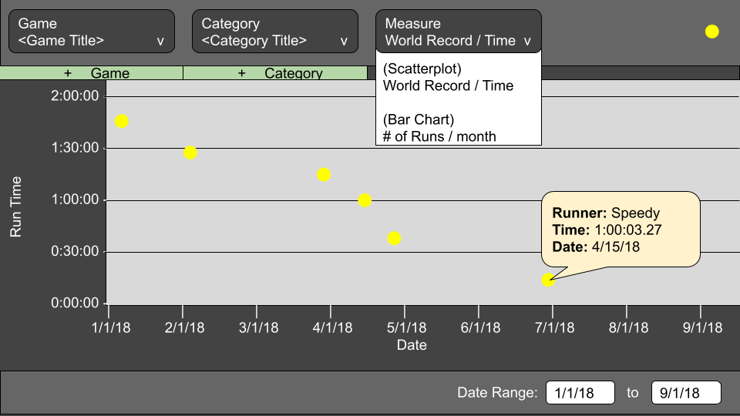
Our Design & Rationale
Scatterplot w/ Overlay
  The good
    Can view multiple datasets simultaneously
    Can get datapoint information
  The bad
    Overlaying different sets may clutter the graph
Next up: Data Wizards

Slide 19
Data Wizards: Harry Potter Movie Statistics
Rawan Alzubaidi
Helen Mah
Alireza Mahdaviarab
Emily Sawyer
Noah Thompson

Slide 20
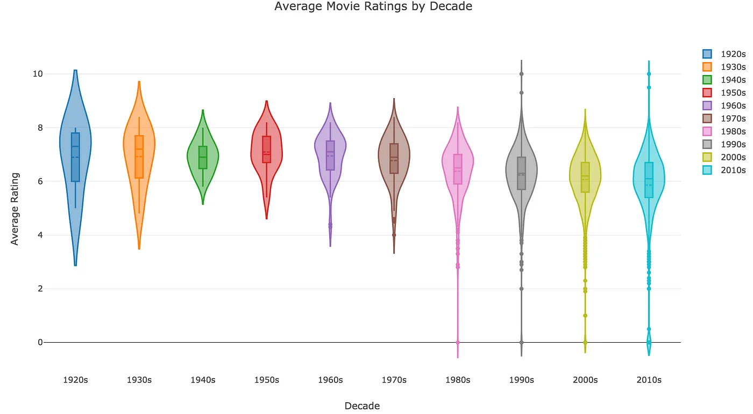
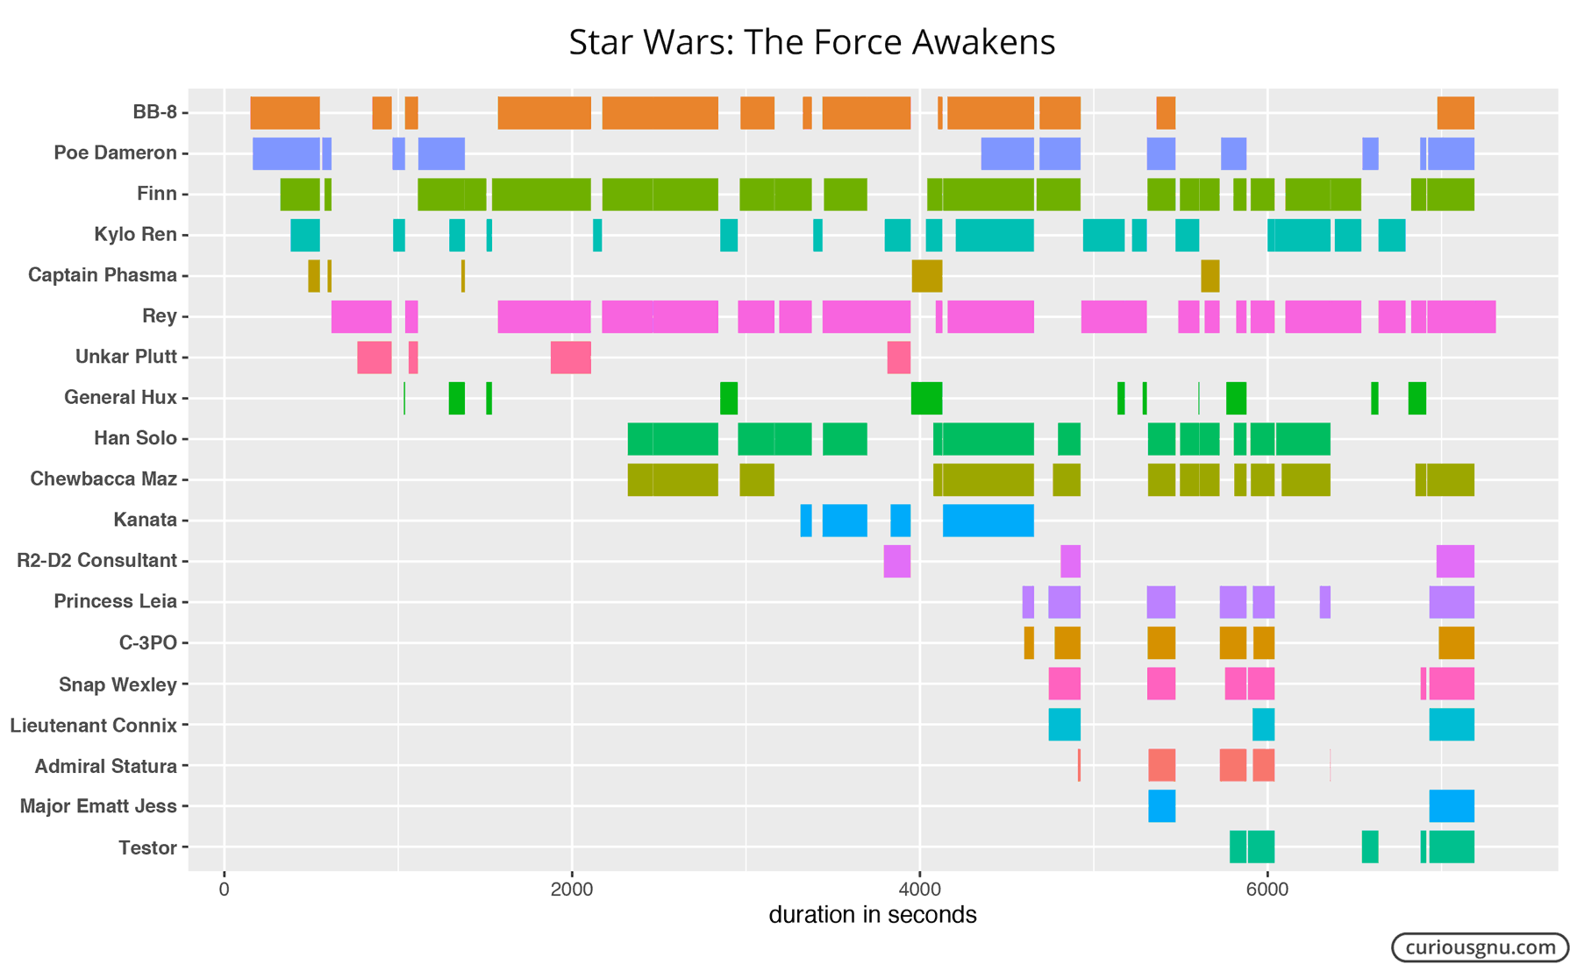
Related Designs
Average Movie Ratings By Decade
  What is good:
    contrasting colors for easy differentiation
  What is not so good
    unnecessary legend
The Force Awakens Character Screentime
  What is good
    detailed and specific
    ordered logically
  What is not so good
    exact values are difficult to see
    no total times listed

Slide 21
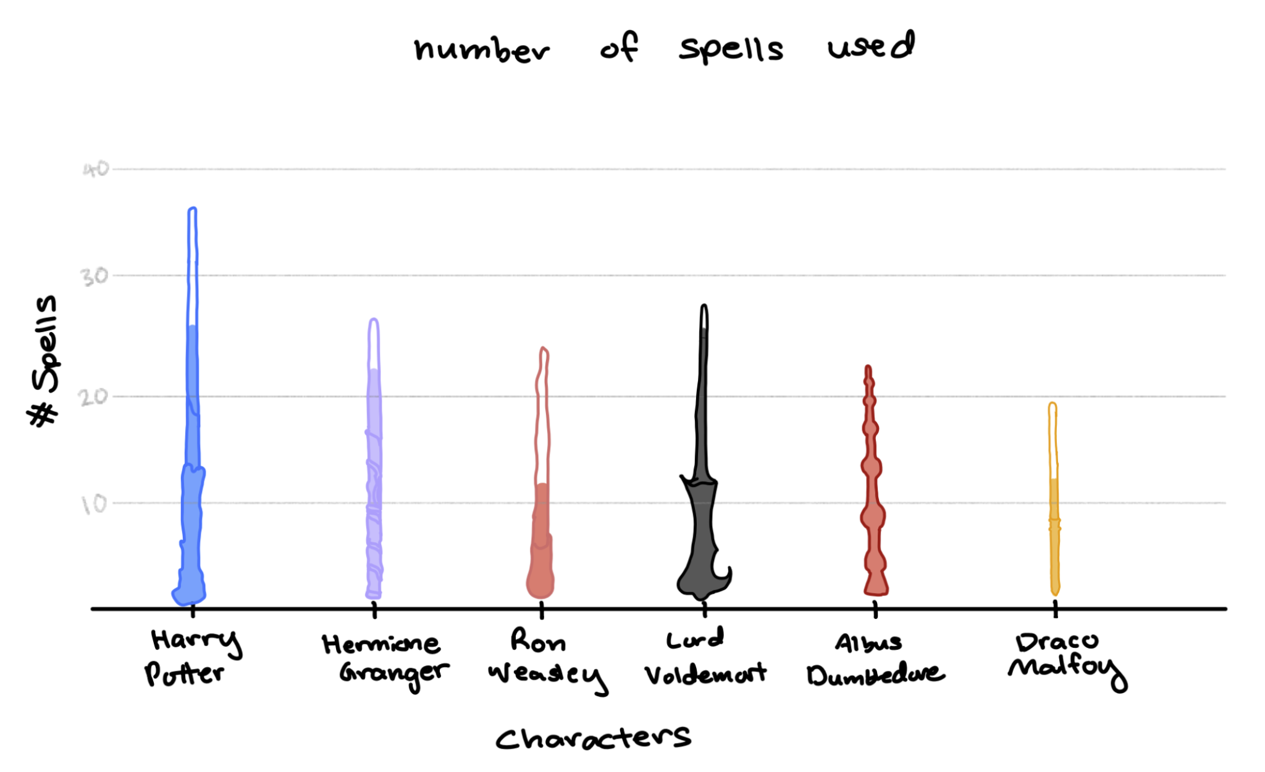
Our Design & Rationale
Design choice 1
  The good
    Used some elements from the movie to visualize the spells
  The bad
    if a character doesn't have a lot of casts in a specifics spell, the visualization might look weird
Sketch of design

Slide 22
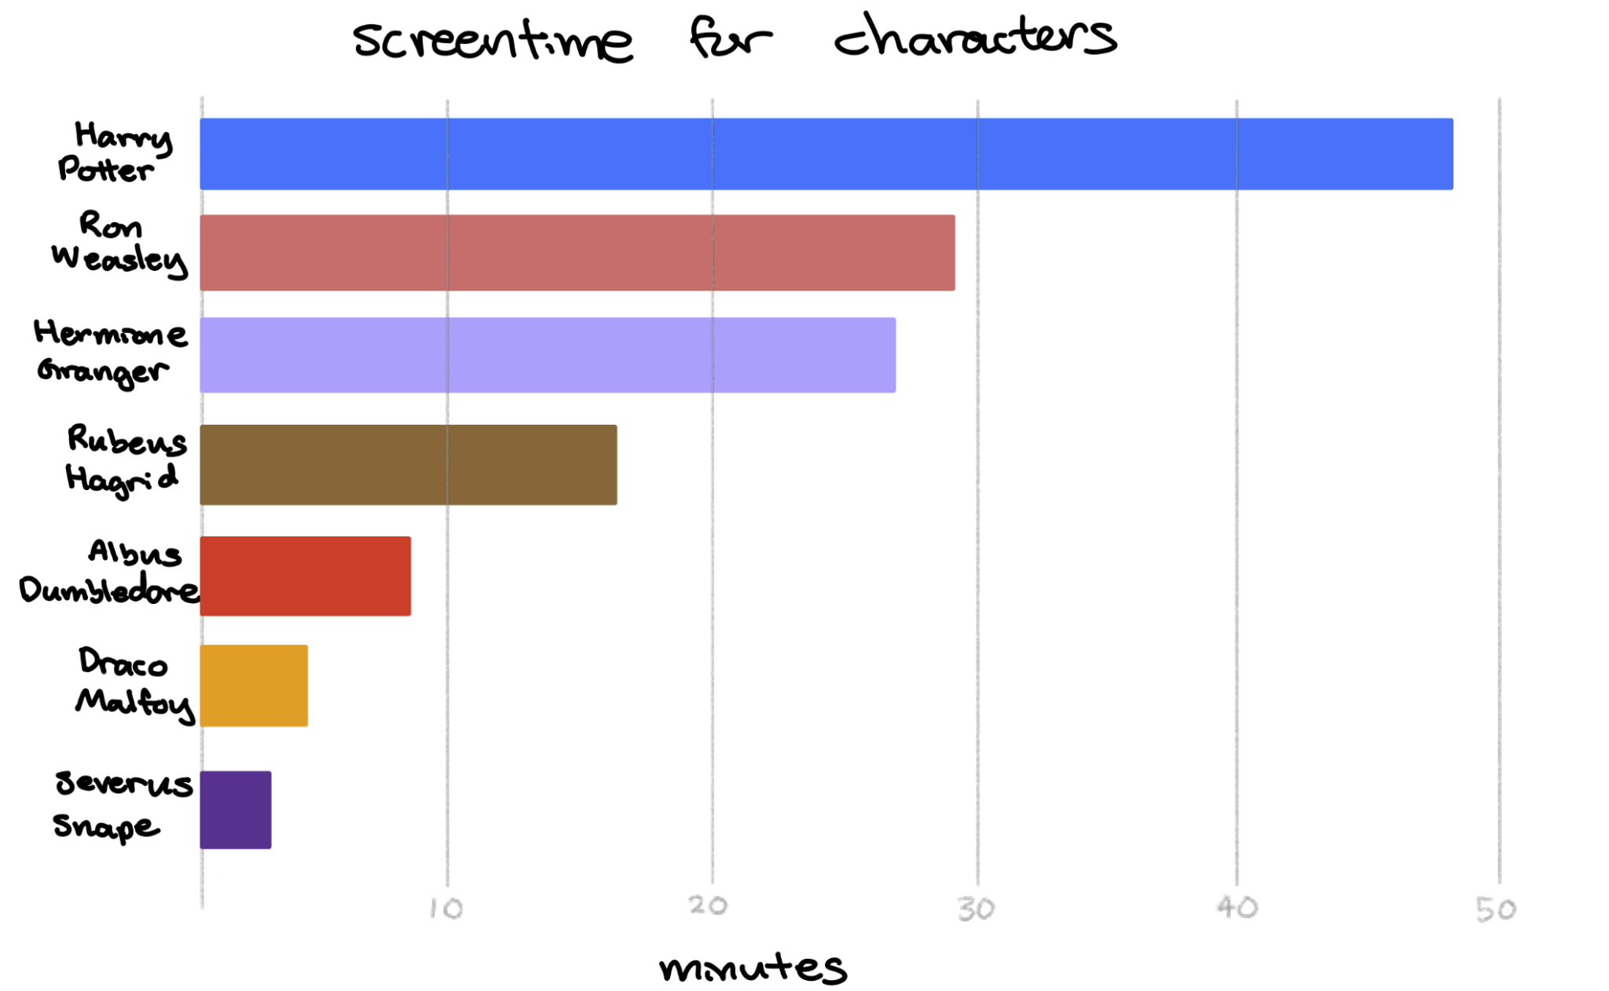
Our Design & Rationale
Design choice 2
  The good
    easy to understand and compare the time between all main characters
  The bad
    not as interactive (we will try to animate the bars when the data is loaded)
Sketch of design
  different screen time for each movie

Slide 23
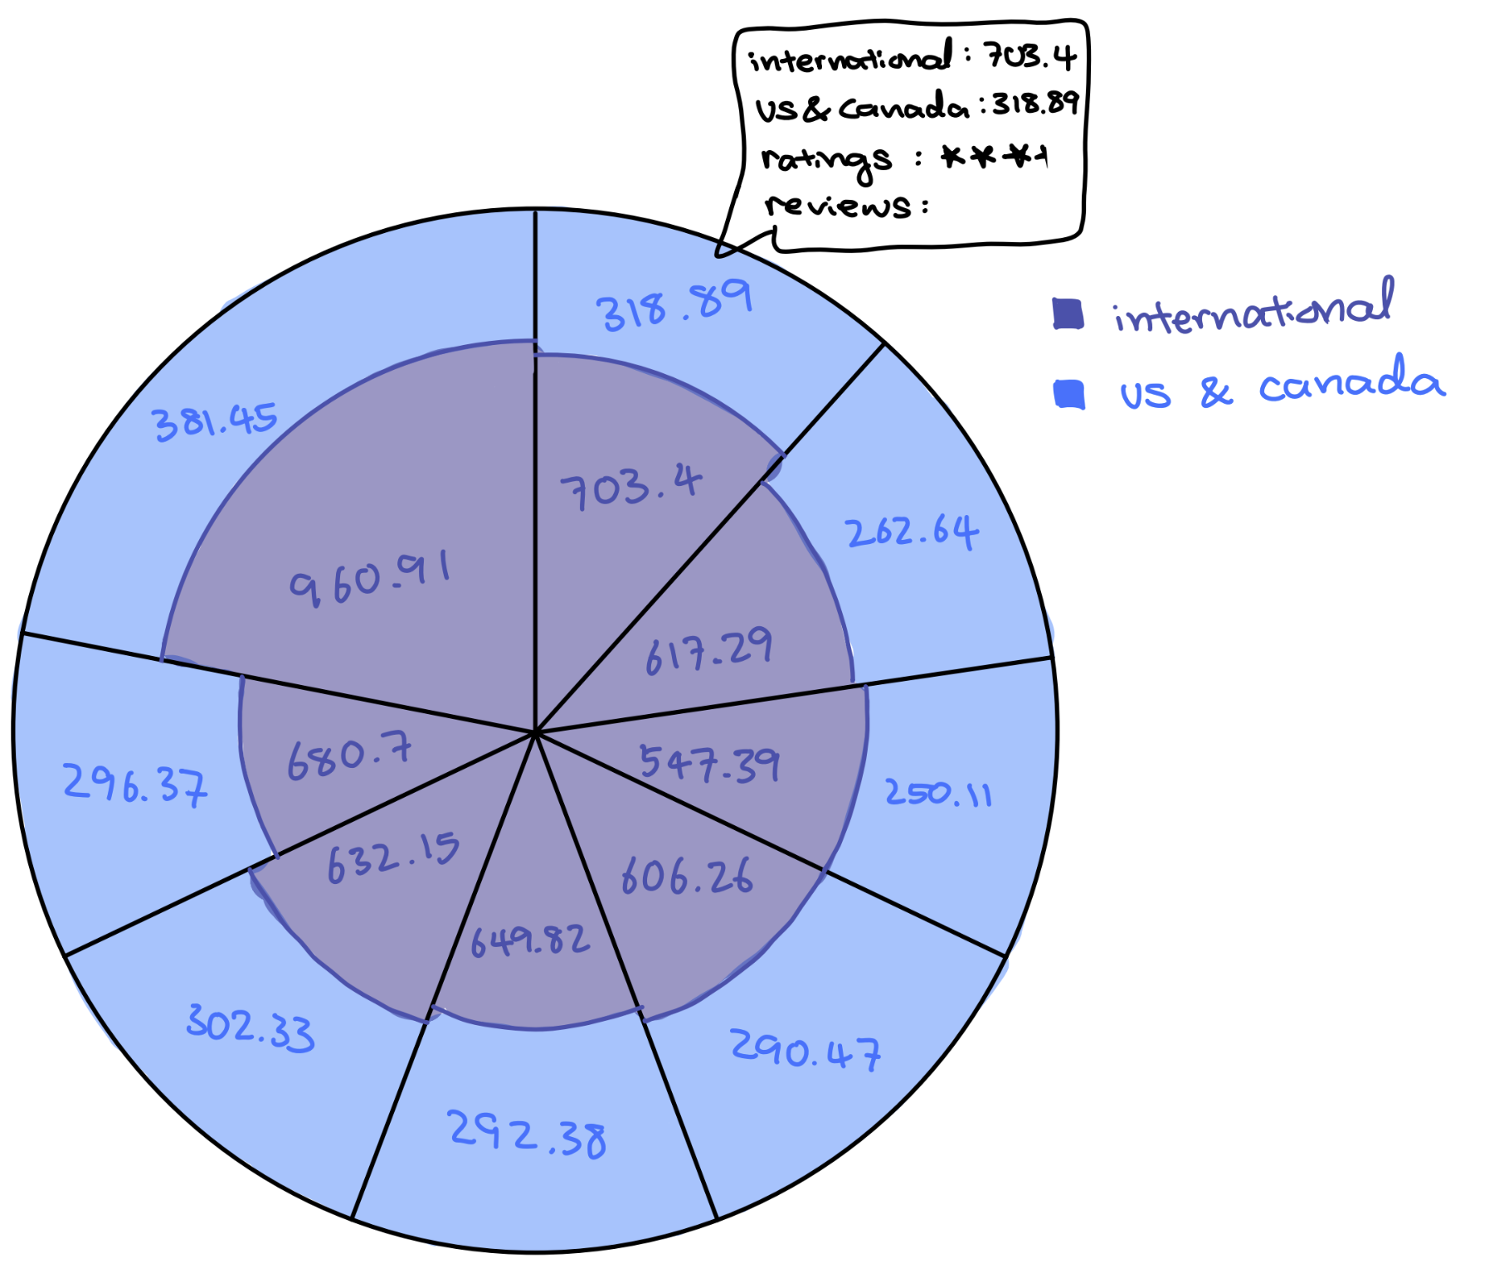
Our Design & Rationale
Design choice 3
  The good
    visually appealing and interactive
    effective representation of multiple data types
  The bad
    the shapes of the slices make it difficult to understand the values at a glance without hovering over them
Sketch of design
  hover over for more details

Slide 24
Work plan (only include if significantly changed from prior presentation)
Rawan Alzubaidi – UX Lead
Helen Mah – Data Cleaning Lead
Alireza Mahdaviarab – Data Collection Lead
Emily Sawyer – UI Lead
Noah Thompson – Documentation Lead
Next up: Forward Thinkers

Slide 25
Forward Thinkers: Soccer
Sydney L, Shyam R, Nurrivan G,
Alex P, Anjali H

Slide 26
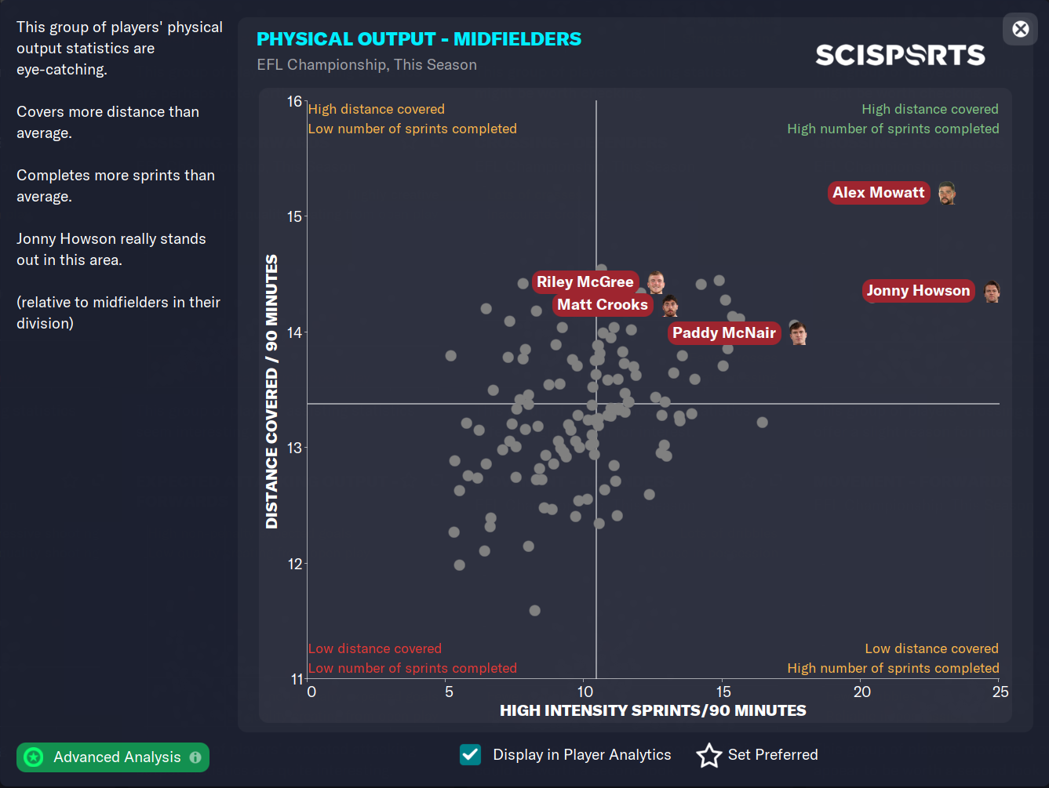
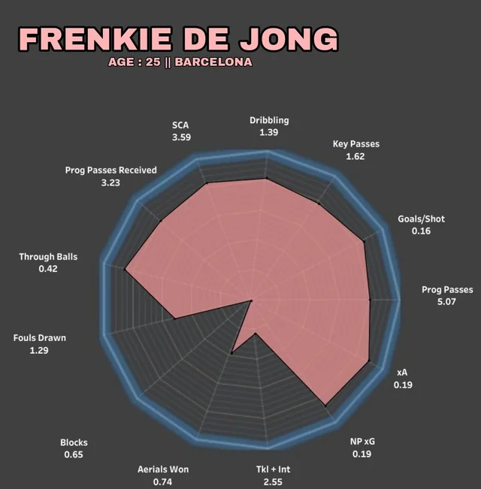
Related Designs
Related design 1
  Good:
    Shows stats from every player with little overlap
  Not so good:
    No detailed descriptions
    Hard to tell which point represents which player
Related design 2
  Good:
    Shows detailed strengths and weaknesses for a player
  Not so good:
    Hard to compare against other players
    Unclear what the numbers mean and what the scale is

Slide 27
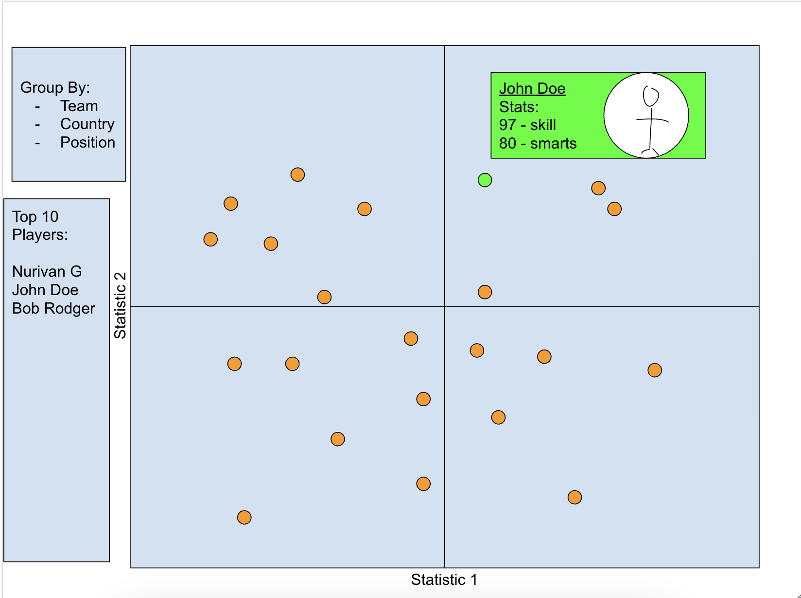
Our Design & Rationale
Grouping by categories
  The good
    Allows for easy identification of teams and their overall levels.
  The bad
    Limits user to only organizing by designer-defined categories

Slide 28
Our Design & Rationale
Player Leaderboard
  The good
    Gives quick, easy info to user
  The bad
    Only shows the top 10 players
Hover For Stats
  The good
    user can see player details, and how player compares to others at the same time
  The bad
    You can only see one player at a time

Slide 29
Work plan (updated)
Shyam Ramachandran - Vetting and finishing overall visualization
Sydney Lipar - Collecting and cleaning data
Anjali Hole - Analyzing data for individual player stats and making visualization interactive
Nurivan Gomez - Setting up visualization environment
Alex Pantazopol - Creating visualizations of all players stats over the seasons
Next up: Highway Riders

Slide 30
Highway Riders
Vehicle Accident Visualization
Joshua Wood,
Xiaohu Huang, Arnav Sood, Art Young, Sam Hollenbeck

Slide 31
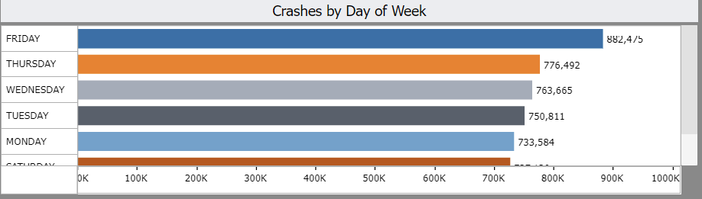
Related Design 1
Source: Texas Dept. of Transportation
Comparing crashes by day of week
Good: easy to read, good comparison between days
Bad: days not in order
Source:https://tableau.txdot.gov/views/CRISDashboardforTxDOT_gov20230419/CRISCrashDataAnalysis?%3Aembed=y&%3AshowAppBanner=false&%3Adisplay_count=n&%3AshowVizHome=n&%3Atoolbar=n&%3Aorigin=viz_share_link

Slide 32
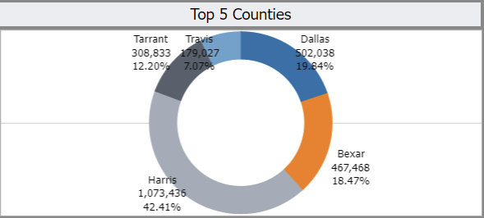
Related Design 2
Source: Texas Dept. of Transportation
Showing top 5 counties in Texas by crashes
Good: shows which counties have the most crashes
Bad: labels hard to read, pie chart not good for this data
Source:https://tableau.txdot.gov/views/CRISDashboardforTxDOT_gov20230419/CRISCrashDataAnalysis?%3Aembed=y&%3AshowAppBanner=false&%3Adisplay_count=n&%3AshowVizHome=n&%3Atoolbar=n&%3Aorigin=viz_share_link

Slide 33
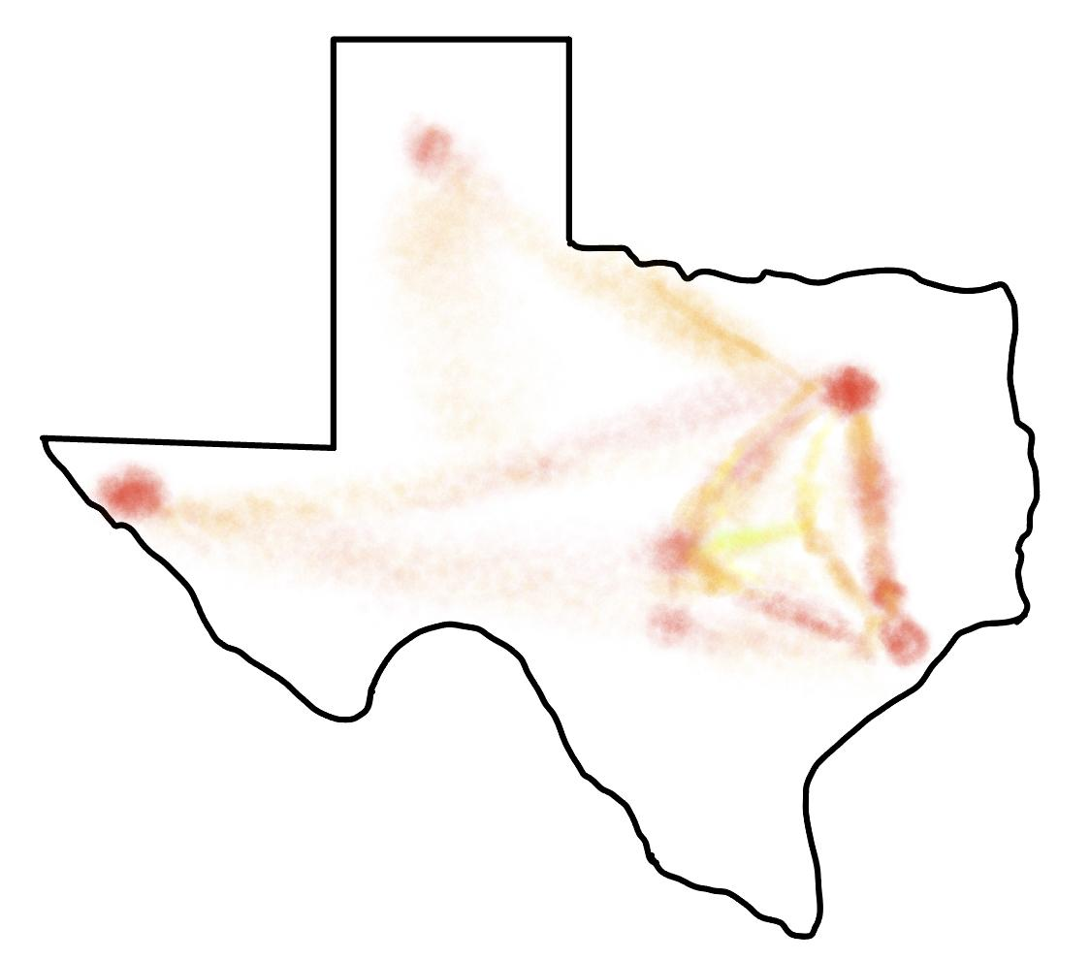
Our Design & Rationale
Heat map showing frequency of crashes in various locations. Option to zoom on regions of Texas would be available.
  The good
    Easily lets the viewer see what areas have greater concentration with car crashes.
  The bad
    Doesn’t explain what the causes are.

Slide 34
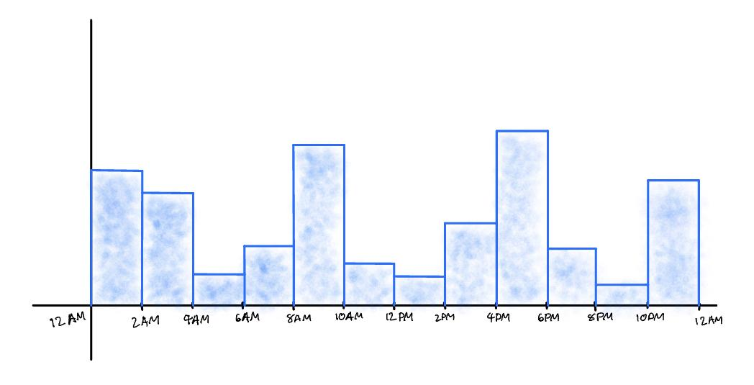
Our Design & Rationale
Histogram showing frequency at times of crash. Filterable data to highlight any special points.
  The good
    Easily readable and digestible to find what times have the worst crash frequencies.
  The bad
    Data is generalized when crash data could very depending on day of the week or time of the year.

Slide 35
Work plan (only include if significantly changed from prior presentation)
Documentation: Josh, Sam, Arnav
Visualization: Max, Art
Next up: Powerball Winners

Slide 36
Powerball Winners:
Video Game Sales
Robbie Clark, Arya Gupta, JP Pham, Ismat Syah, Michael Tao

Slide 37
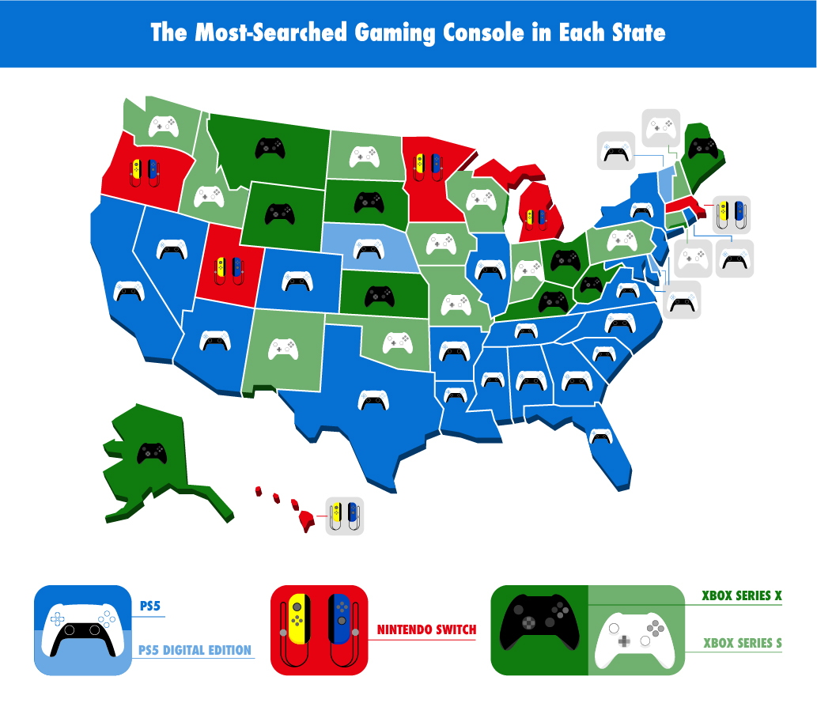
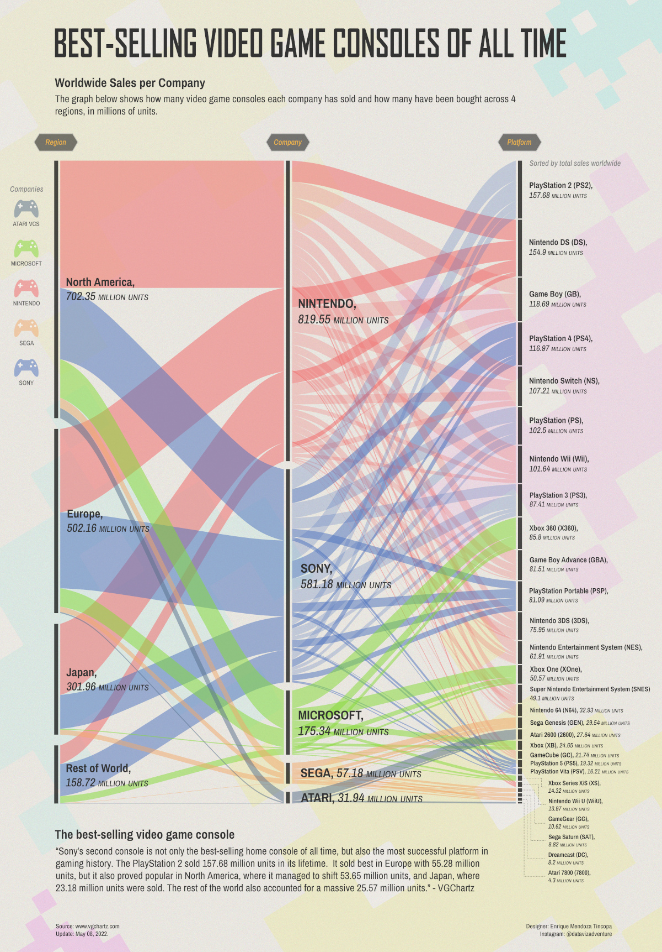
Related Designs
Related design 1
  Advantage: Very easily identifiable, graphic images make it easy especially for gamers that use those consoles frequently, neat/clean
  Disadvantages: Doesn’t go too much in depth; mainly only displaying consoles as a whole
Related design 2
  Advantages: Showcases many different regions and displays trendlines
  Disadvantages: Convoluted and hard to understand

Slide 38
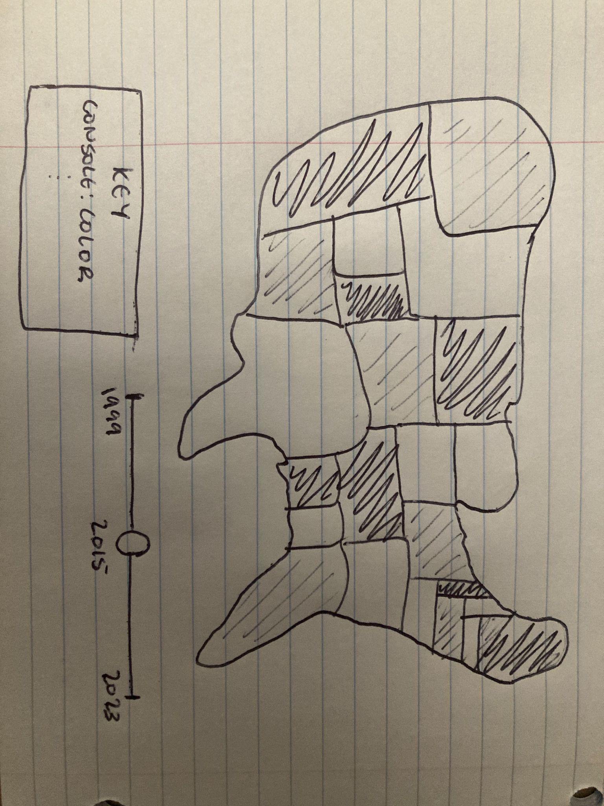
Our Design & Rationale
Map showing console sales by region
  The good
    Easy to identify dominance of certain console in a region
  The bad
    Specific sales numbers of each console is obscured for the sake of comparison

Slide 39
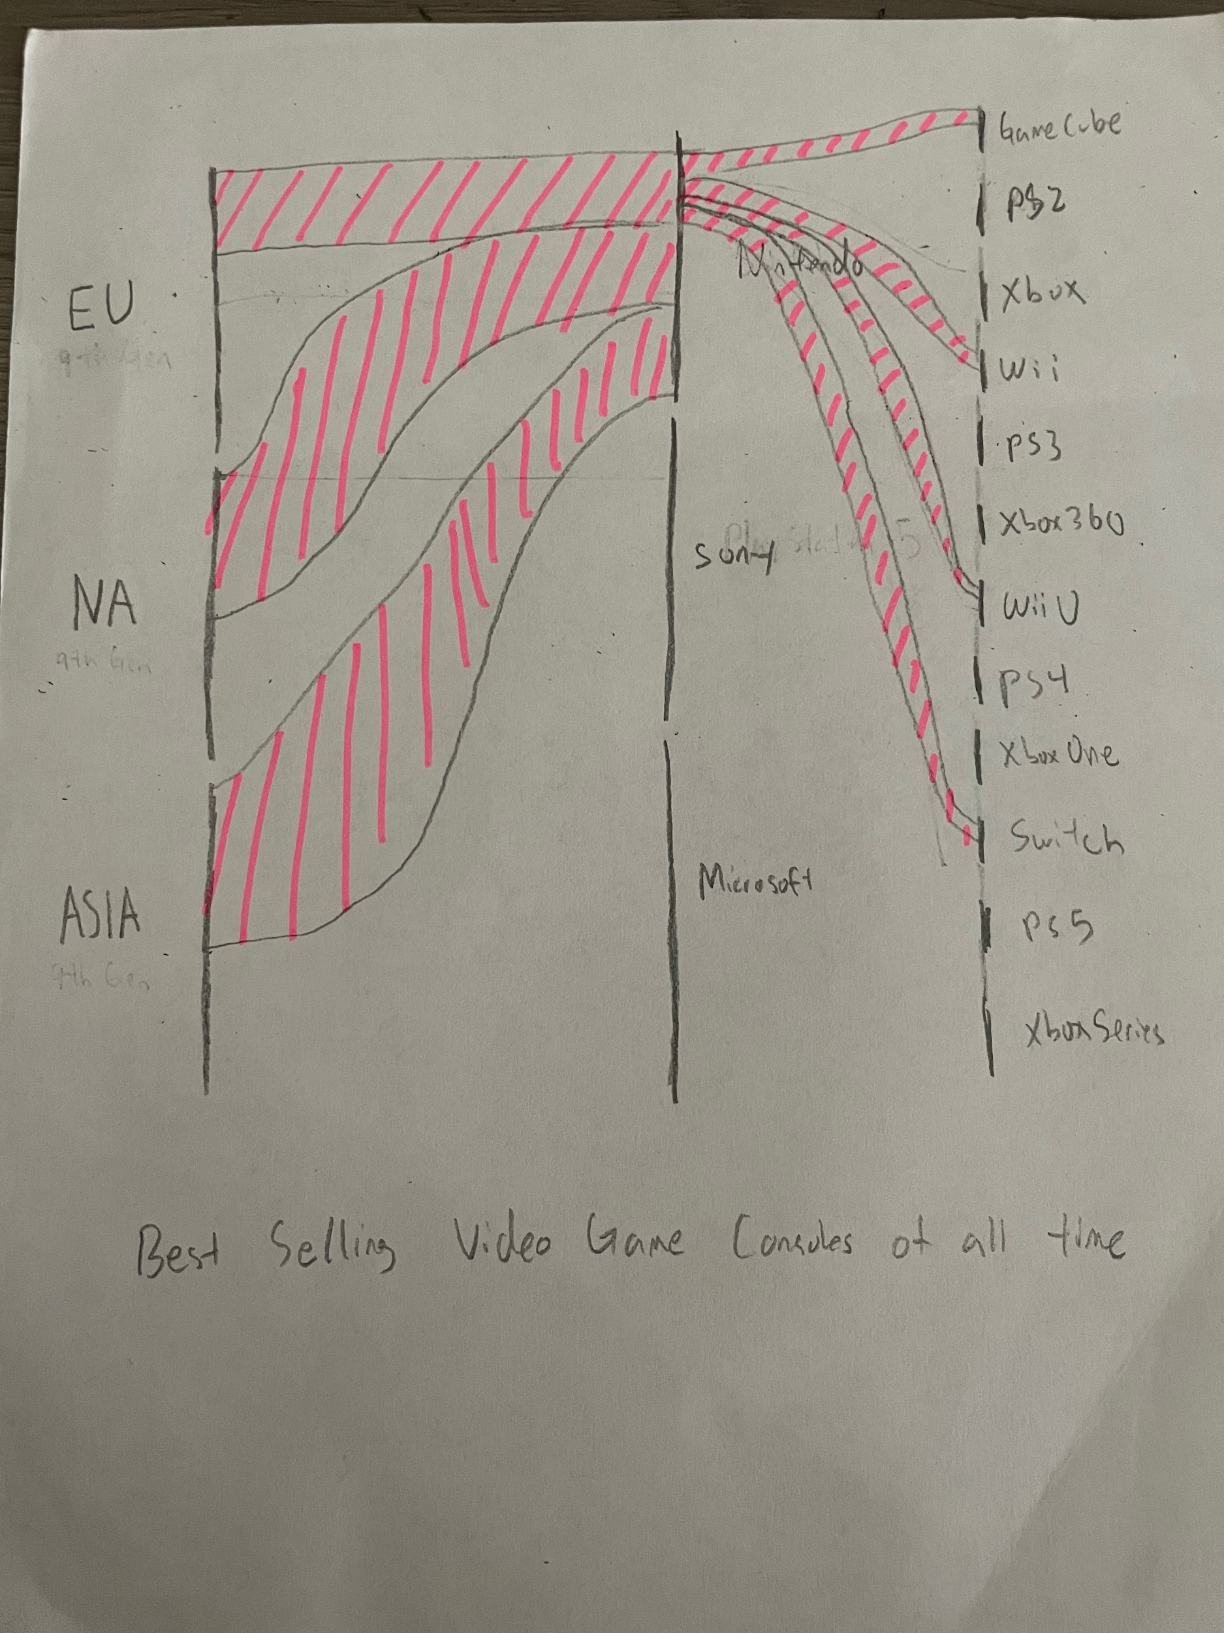
Our Design & Rationale
Time series graph showing console sales
  The good
    see which consoles were most popular during specific era
  The bad
    May not paint the whole picture of why consoles sales went up without context
Image(s) of design
  Can be sketch, diagram, drawing, screenshot, etc.

Slide 40
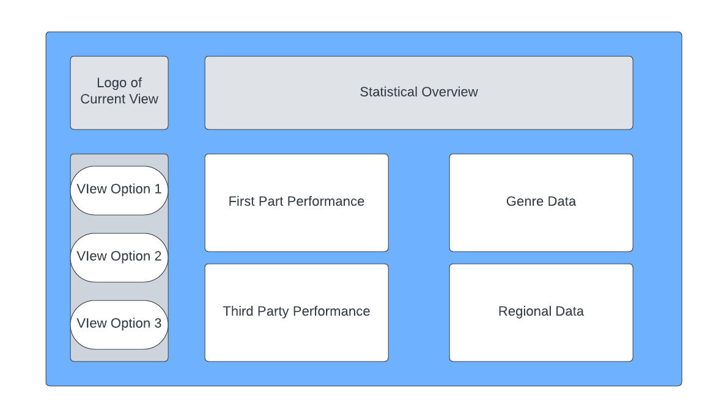
Our Design & Rationale
Multipurpose Graph
  The good
    Combines several different types of charts in one area
    Can click into a certain console/era for more details and context
  The bad
    Presenting too much information at once can be intimidating
Next up: Rotten Potatoes

Slide 41
Rotten Potatoes:
Popular Streamed TV Shows/Movies
Matthew Barry, Ana Jimenez, David Roh, Sid Venkatraman

Slide 42
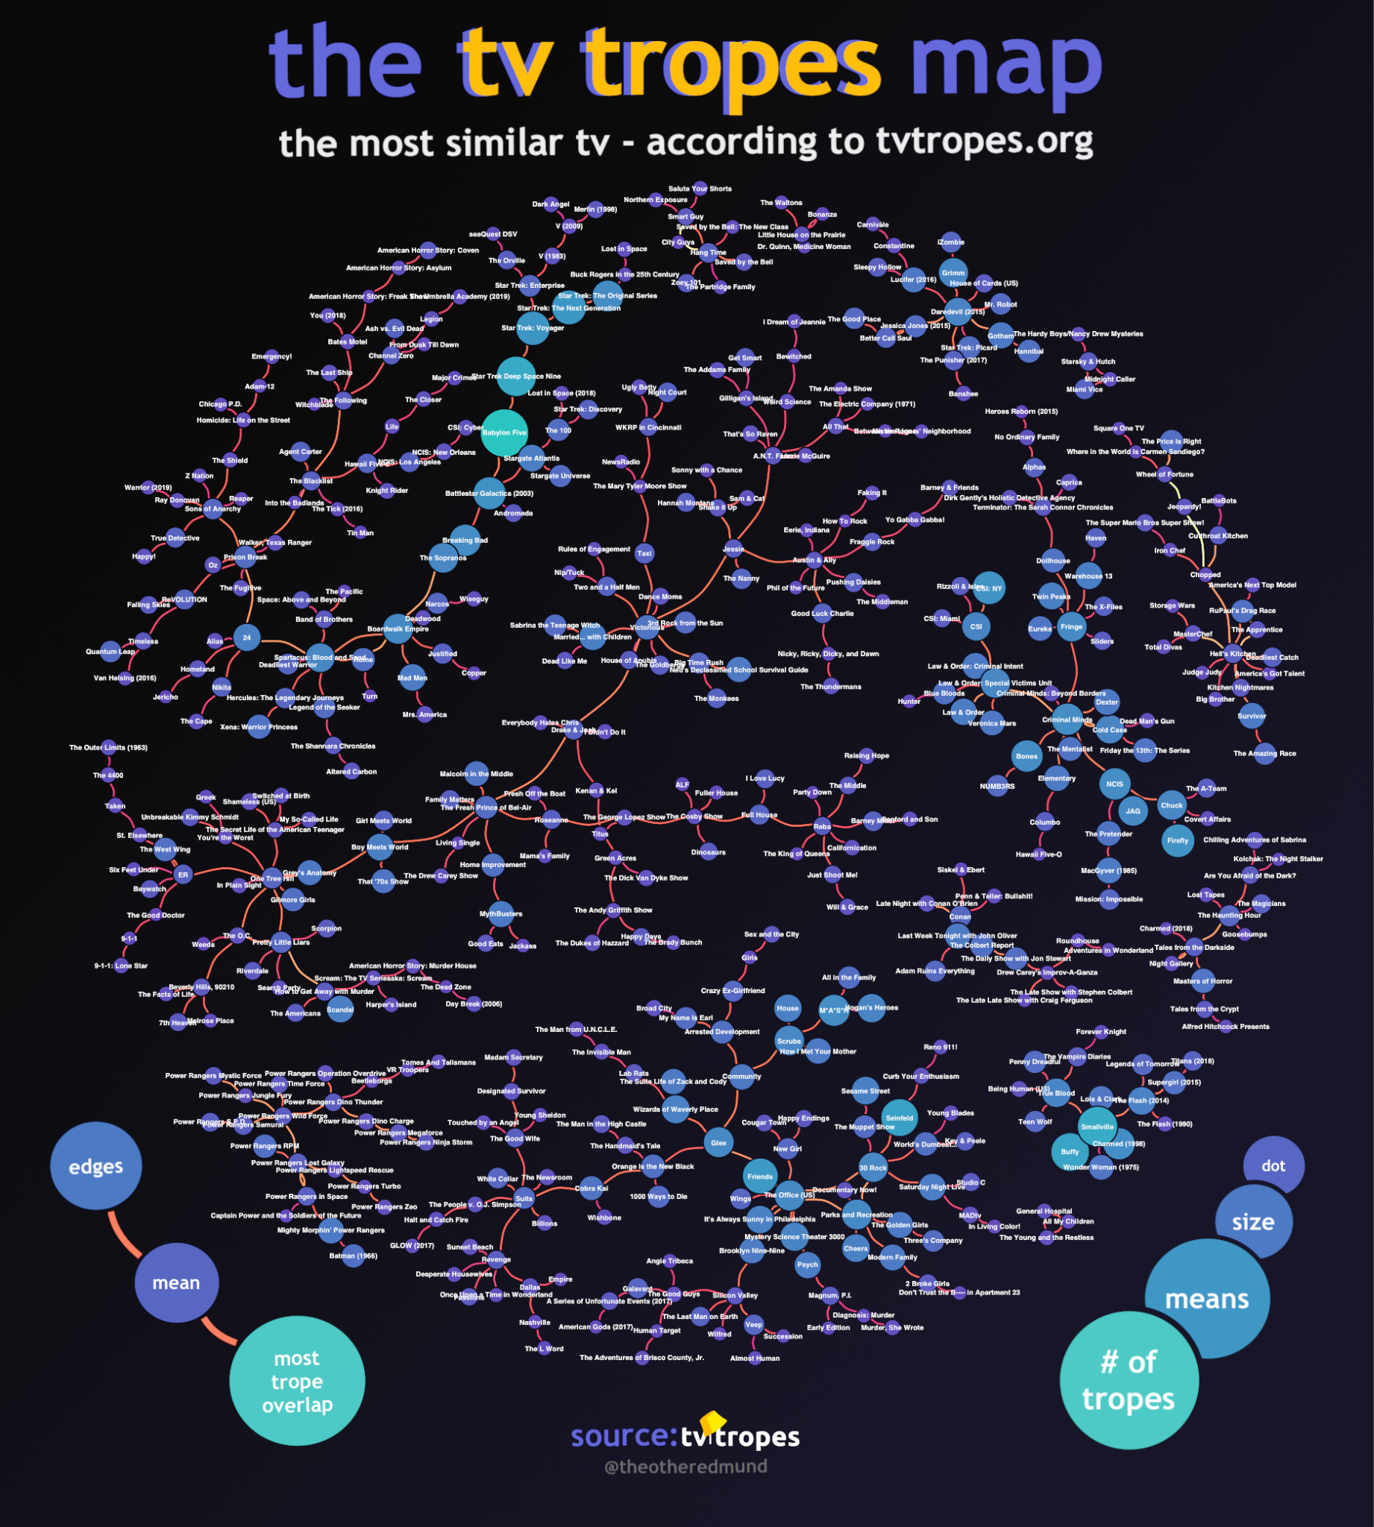
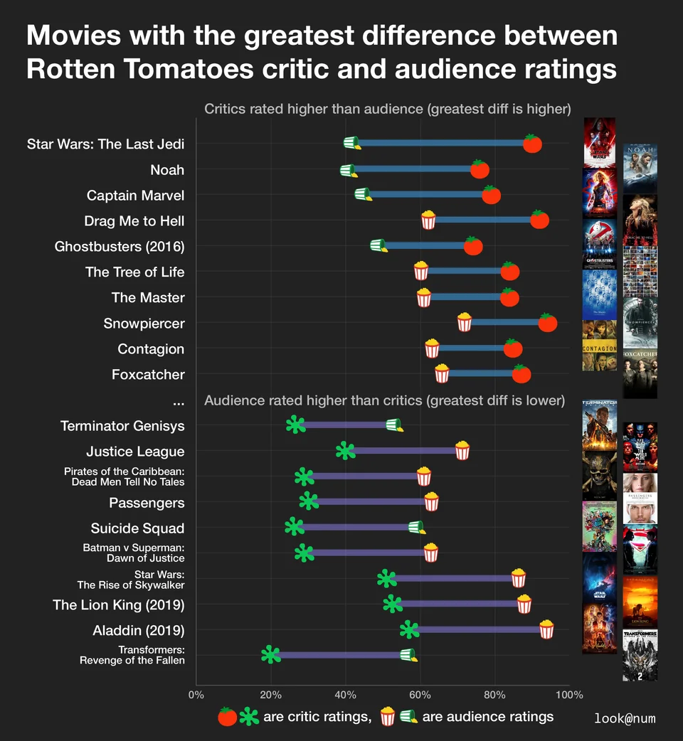
Related Designs
The TV tropes Map
  What is good
    Size difference is clear
    connections are unweighted
  What is not so good
    Not interactive, Difficult to navigate
    the connections between some of chains don't seem to be that meaningful
Movies with Greatest Difference between Critic/Audience Ratings
  What is good
    Relevant icons
    Easy to compare between movies
  What is not so good
    The Rotten Tomato metric: % of user or critics that rated the movie 6/10 or above.
    Only recent movies

Slide 43
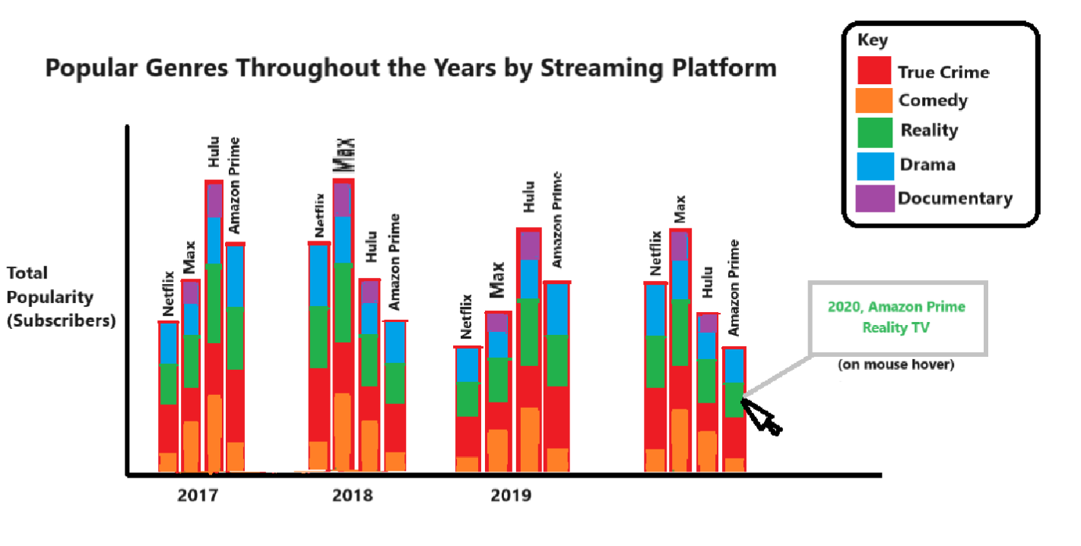
Our Design & Rationale
2020
The good: clear display of multiple categories and layers of data allows for lots of visual information within a single visualization.
The bad: limited amount of interactivity, relies on finding a lot of information and streaming statistics.
Multiple categories within each bar, with a key and the ability to hover the mouse over a category for more info.

Slide 44
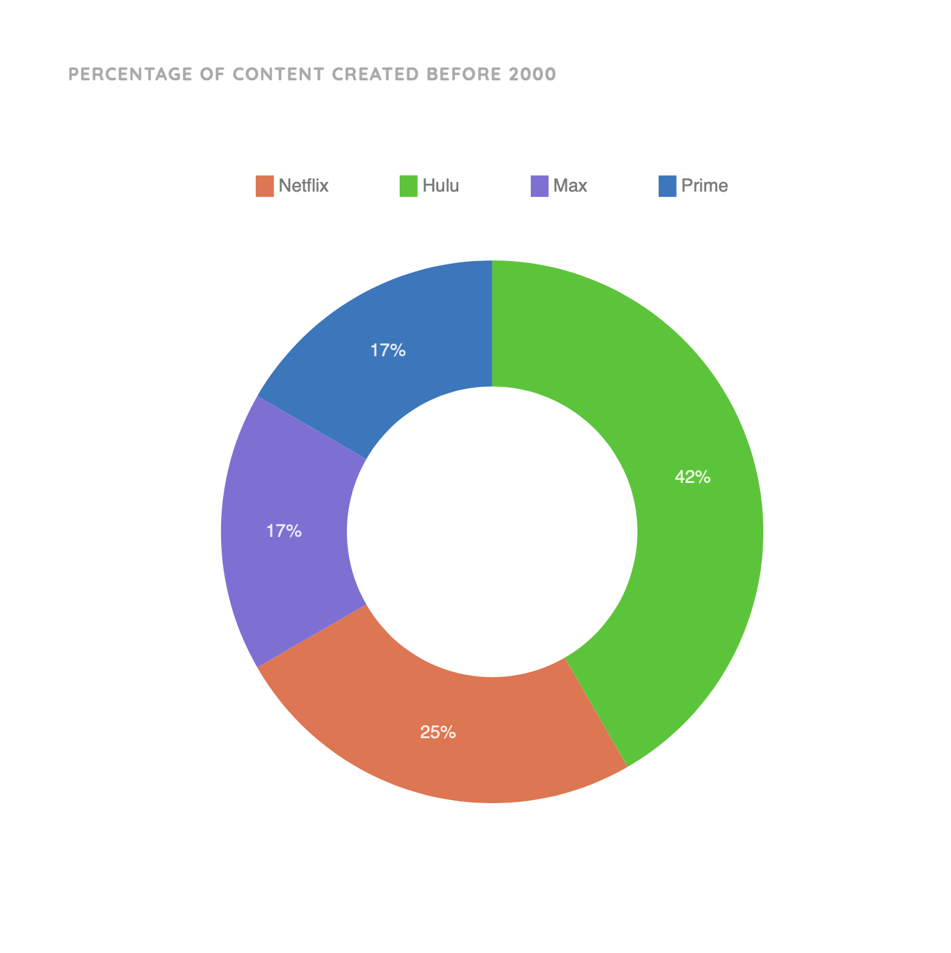
Our Design & Rationale
Design choice 2
  The good: Easy to identify proportionality between streaming services
  The bad: Hard to convey changes over time to indicate improvements of a streaming service when addressing the issue

Slide 45
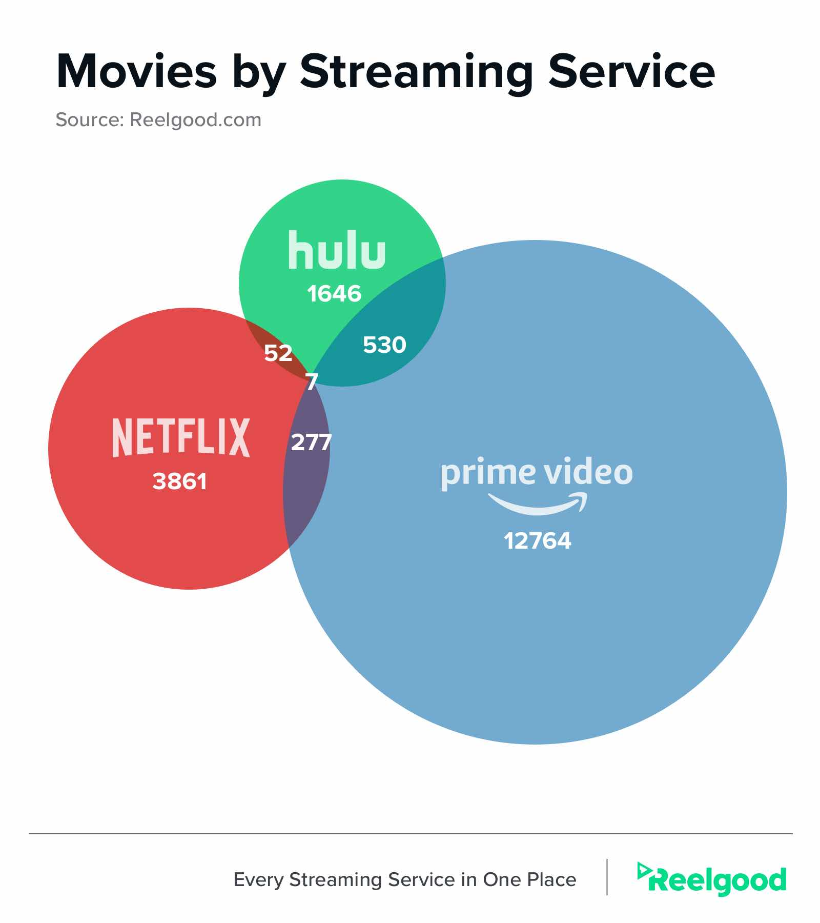
Our Design & Rationale
Design Choice 3
  The good: Insights regarding movies shared between platforms depicted
  The bad: Unable to easily add additional platforms, this would make the visualization difficult to interpret.

Slide 46
Citations:
https://www.reddit.com/r/dataisbeautiful/comments/mmqb8w/movies_with_the_greatest_difference_between/
https://www.reddit.com/r/dataisbeautiful/comments/lbpbit/a_map_of_tv_shows_based_on_tvtropeorg_similarity/
https://blog.reelgood.com/movies-and-shows-that-overlap-on-netflix-hulu-and-amazon-prime
Next up: Shipman Sergeants

Slide 47
Shipman Sergeants:
Popular Trends on Spotify
Cristoff Navarro, Jack Sanchez, Punit Nookala, Steven Mao, Cyril John, Jiangyuan Liu

Slide 48
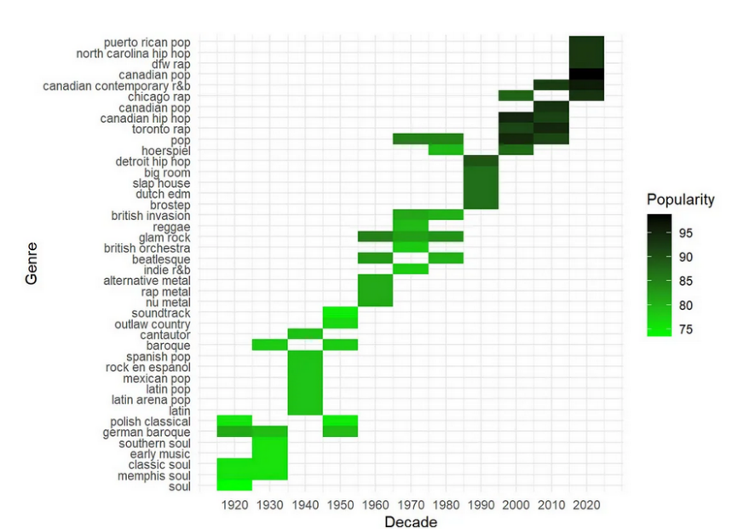
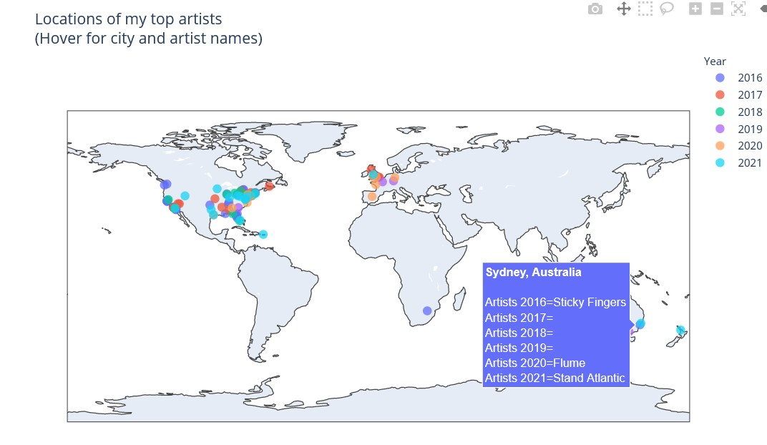
Related Designs
Genres over the decades
  https://medium.com/@shrunalisalian97/spotify-data-visualization-4c878c8114e
  It allows the users to see the popularity of genre that is unique in a specific area
  It is really clustered, so it is hard to read and the popularity gradiant’s meaning is unknown
    What does it mean 95 popularity? 95% listen or 95% like the genre?
Location of my top artist
  https://chart-studio.plotly.com/~areevesman/40/#/
  It charts the artist around the world and hover to get more details
  In the hover text box, there is redundant years which takes up space

Slide 49
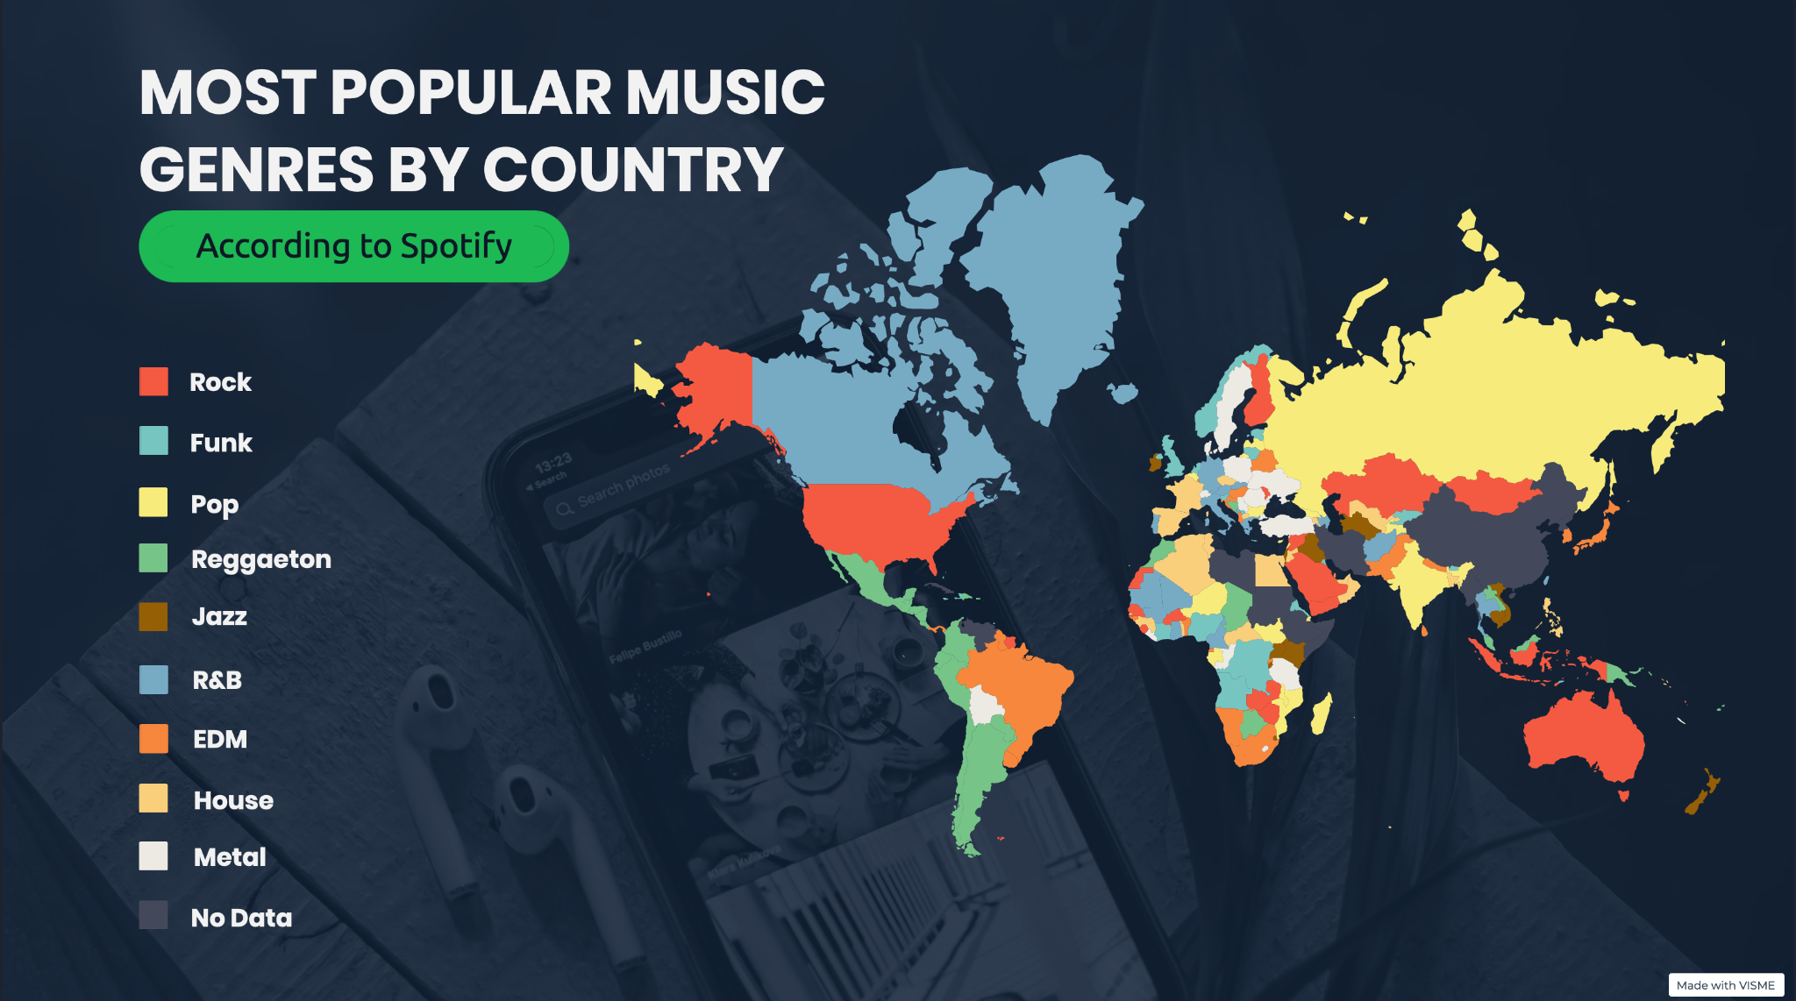
Our Design & Rationale
Design choice 1
  The good
    Showcases relevant information in an easily digestible way with clear attention to pleasing design
  The bad
    There are a lot of genres; could lead to a lack of visual clarity, or the grouping of genres into an “other” section, which could hide relevant information and patterns found within the data
Image(s) of design

Slide 50
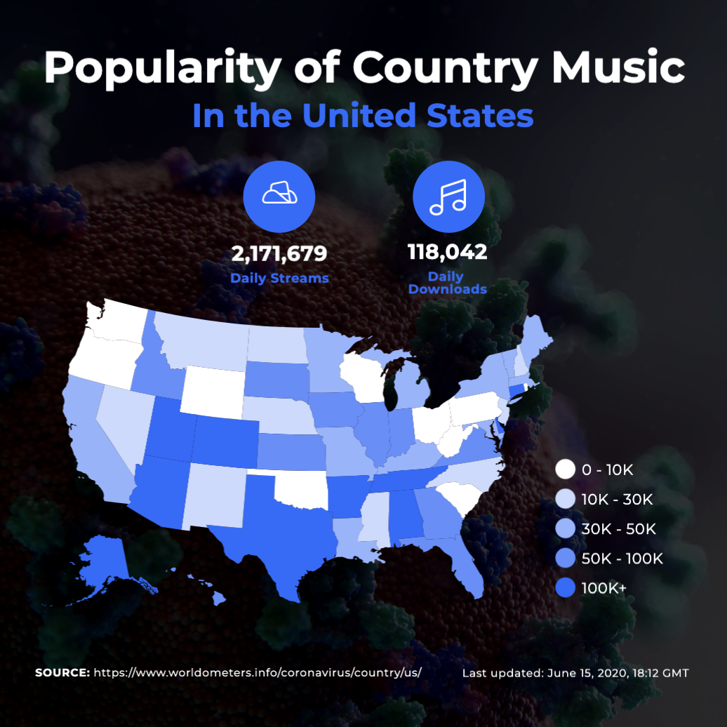
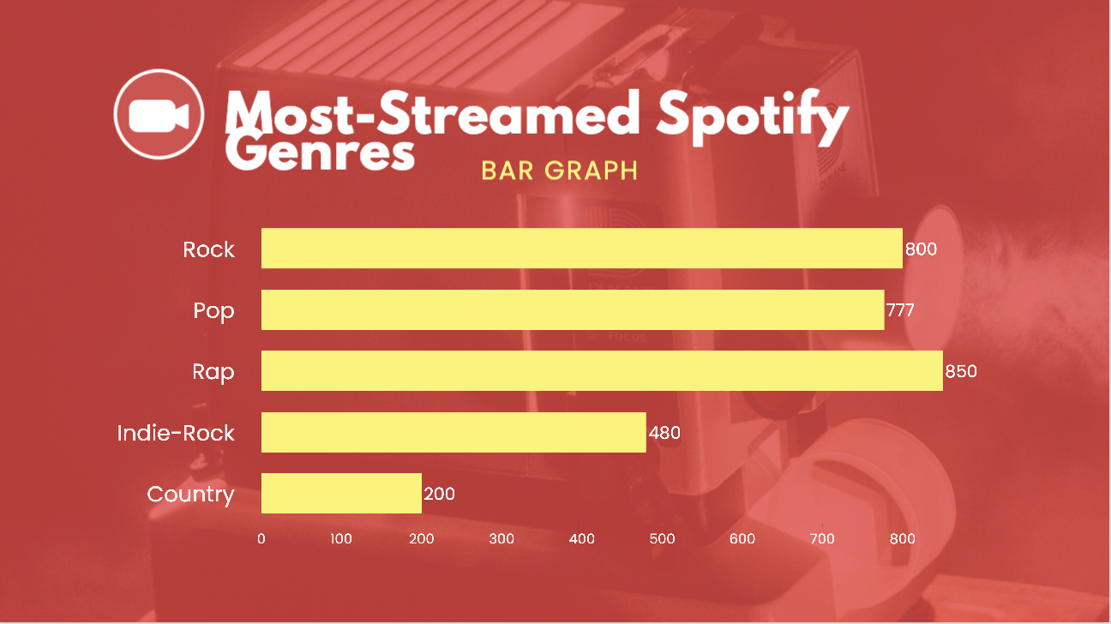
Our Design & Rationale
Image(s) of design
Design choice 2
The good
Clear and concise representation of a specific genre of music with different shades of one color, making the visualization easy to grasp
The bad
Limited information of different genres of music and lack geodemographic data
Design choice 3
The good
Very simple and easy to understand chart on the most listened to genres. Helps users discover popular music trends
The bad
Lack of data on other genres that don’t have a popular user base
Next up: TARAN

Slide 51
TARAN: Poverty
Timothy Reynolds
Andrew Hooper
Ravish Shardha
Andrew Wheir
Nicholus Campbell

Slide 52
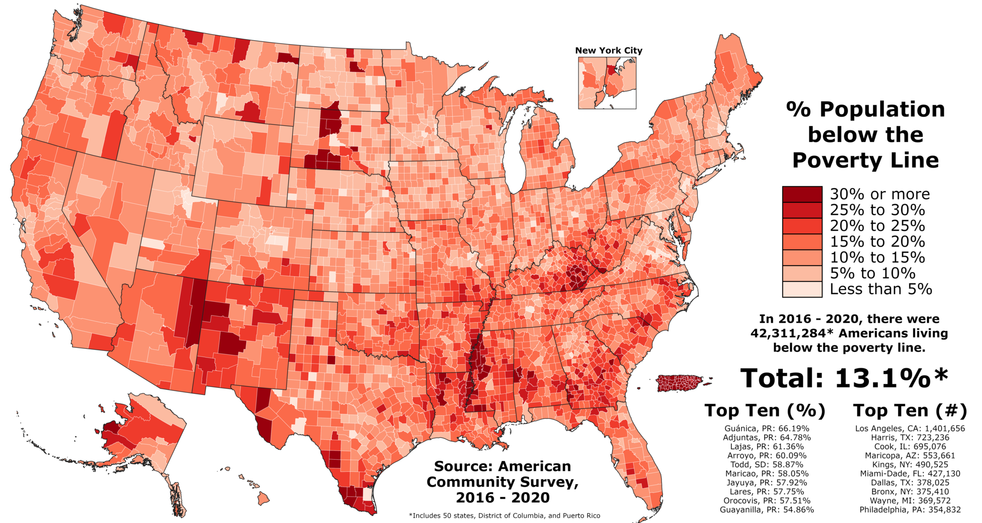
Related
Design
1
What is good
Shows poverty by county in the US
Legend and color are useful and accurate
Top ten is interesting
What is not so good
Title is small and not in the traditional location
Visualization feels cluttered
Has a breakout but no lines showing where

Slide 53
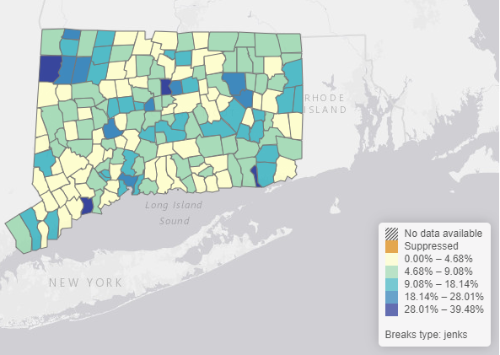
Related Design 2
What is good
  Shows poverty by county
  Well separated and good use of colors
  Hoverability (Hovering over a county gives more specific data)
What is not so good
  Intractability (Clicking on a county does not have an intuitive action)
  Legend shows irrelevant classifications (axiom of relevance)

Slide 54
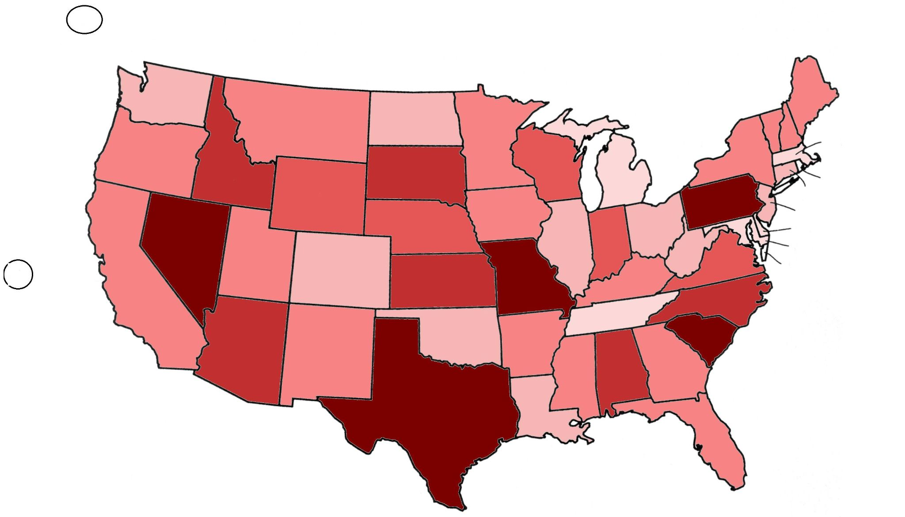
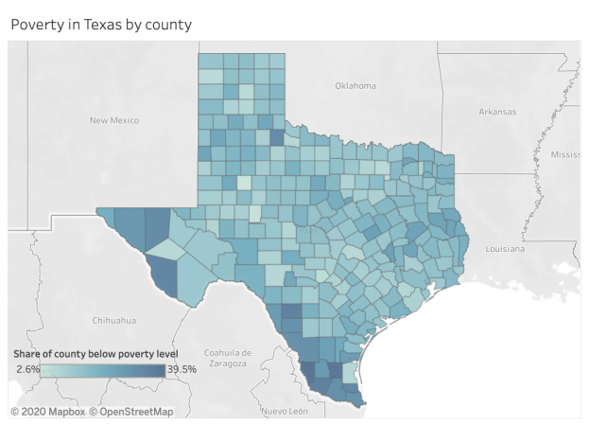
Our Design & Rationale
Design choice 1
We will initially show a heat map of poverty on state level. Clicking or zooming into a specific the state will show county details
  The good
    Will not overwhelm the user with all the county details. Would be more concise and easy to see.
  The bad
    Can obscure finer details that could be gleaned from an overview

Slide 55
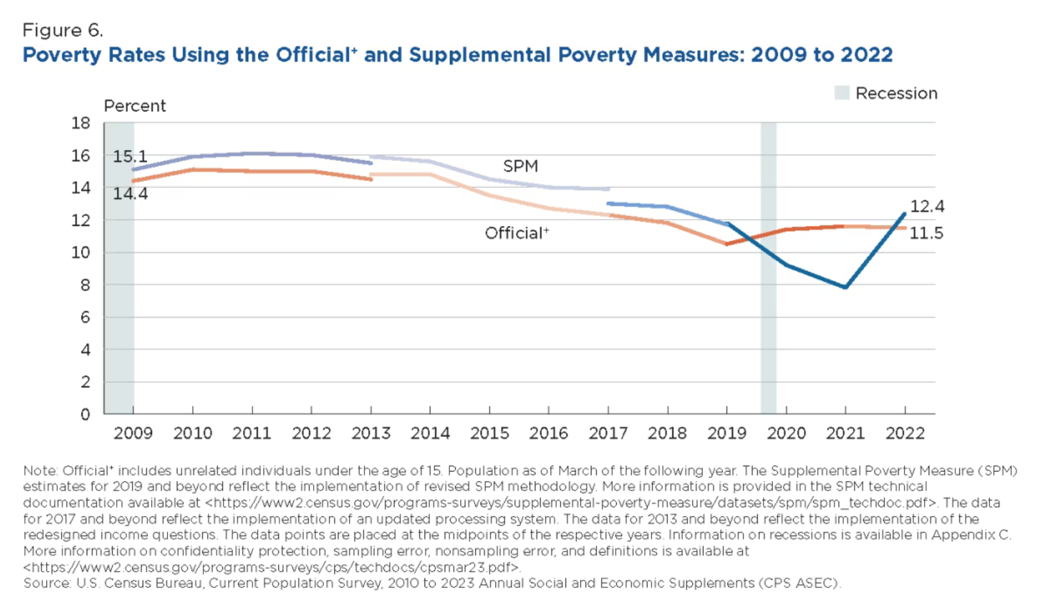
Our Design & Rationale
Design choice 2
Clicking on each state and county will pull visualizations that demonstrates poverty based on that state or county demographics
  The Good:
Users would be able to compare the demographic details between each state and/or county.
  The Bad:
The amount of visualization/ details can potentially overwhelm the user.

Slide 56

Our Design & Rationale
Design choice 3
We will add a filtering system that will allow the user to only select the information which they deem useful.
  The good
    Allow more customization for the user and make the visualization more interactive and user-friendly.
  The bad
    Too many filtration options could potentially complicate the presented data.
Next up: Team Spotify

Slide 57
Team Spotify: Popularity of Genres Over The Years
Navya Mittal, Minji Choi,
Anton Hugo Ramirez, Linh Nguyen, and Vittoria Cicalese

Slide 58


Related Designs
Treemap
  Clear distinction
  Reuse of colors, confusing and a little cluttered
Line graph
  Shows the rise/fall of a genre
  It can be hard to tell the exact datapoint visually

Slide 59

Our Design & Rationale
Treemap
(will use treemap to show different genre and subgenres popularity)
  The good
    More descriptive than other visualization tools and easy to interpret
  The bad
    Could be difficult to make precise quantitative comparisons

Slide 60

Our Design & Rationale
Line graph (measures popularity of genres over time)
  The good
    Presents trends clearly
    Can display multiple dependent variables
  The bad
    Overwhelming to look at first
    Very cluttered at the bottom
Next up: The Eras Tour

Slide 61
The Eras Tour
Asha Aare, Harshitha Dhulipala,
Molly Frost, Shawn Mathen,
Lasya Shilpi, Aarthi Srinivasan
Notes:
Taylor’s Data Vizion
The Eras Tour (Vizion’s Version)
The Data Viz Tour (Taylor’s Version)
The Eras Tour (The Visual Version)
T-Swizzle DataVizzle

Slide 62

Related Design 1
Interactive US MAP
  Good: Very clear where you can click
  Bad: Unclear what the colors represent

Slide 63

Related Design 2
Spotify Listening Data
  Good: Splits music into very distinct and clear categories
  Bad: Not very interactive, top right one has a lot of empty bubbles

Slide 64

Our Design & Rationale
Design choice 1
Visualizations split up into sections
  The good
    All data is in a single view and compartmentalized
    Interactive
  The bad
    The visualizations may not work together
    The data in each compartment is different

Slide 65



Our Design & Rationale
Design choice 2 :
Virtualization Combined in an Interactive Map
  The good
    Interactive
    Visually appealing and the interaction is easy to understand for the user
  The bad
    All the data will not be on this visualization. Will have to add it elsewhere
    Not all the data will be available for every city

Slide 66
Work plan
Asha – Venue Data, Economic Impact, Demographics
Harshitha – Spotify listens on all of Taylor’s albums (trends in listening during her tour), Lyric Data
Molly – Surprise Song Data and Set List Song Data
Shawn – Spotify Music Analysis on Set List Songs
Lasya – Impact on attendance and money on tour
Aarthi – Ticket sales/album sales under different production companies

Slide 67
Work plan
Asha – Collect and store data for US Country Eras Tour Stats
Harshitha – Front End Development for Music Stats
Molly – Front End Development for US Eras Tour Stats
Shawn – Generate visualizations for Music Stats
Lasya – Collect and store data for Music Stats
Aarthi – Generate visualizations for US Eras Tour Stats
Next up: Traffic Totalities

Slide 68
Traffic Totalities: Traffic Incidents in New York
Roope Raikaa, Rong Xu, Erin Lapko, Aaron Weast

Slide 69


Related Designs
Fatality Line Chart Over Time
  Shows fatality trends by month over time
  Does not show specifics such as location or type
Heat Map for Increasing Trends
  Shows areas that are becoming more or less dangerous
  Does not show current levels or filter by type

Slide 70

Our Design & Rationale
Interactive option to filter by type of crash, cause, location
  The good
    Allows user to focus on what they are interested in investigating
  The bad
    Will limit the user to only filter by what we allow

Slide 71
Our Design & Rationale
Heat Map
  The good
    Very simple for users to visualize where the most dangerous areas of the city are (based on history)
  The bad
    It is difficult to gain additional insights into the collisions, outside of just seeing where they occurred.

Slide 72

Our Design & Rationale
Tree-map showing time slots with most crash occurrences, as well as which day during this time
  The good
    Allows users to understand what times / days are the most risky
  The bad
    The “day” behind the time slots is difficult to visualize clearly

Slide 73

Our Design & Rationale
Line chart showing crashes over time, on different years
  The good
    The good - Gives the user an understanding of not only which months are the most dangerous, but also insights into the direction this trend has gone over the years
  The bad
    Some of the data overlays on top of each other so it may be difficult for the user to get granular insights from the visualization without a toggle for specific years

Slide 74
Assignments
Sept. 14: Phase 1 written report due
  1-2 pages in the 2-column format
  Will be edited and extended over the course of the semester
Sept. 19: “Interacting with Visualizations” readings write-up
Sept. 21: “Visualization as Distortion” readings write-up and D3 mini assignment
Questions?

