Slide 1
Interacting with
Information Visualizations

Slide 2
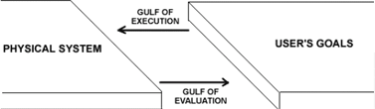
Abstraction of User Interaction
What is going on in computer-human interaction?
How do users decide what to do to achieve their goals?
How do users know whether they have been successful?

Slide 3
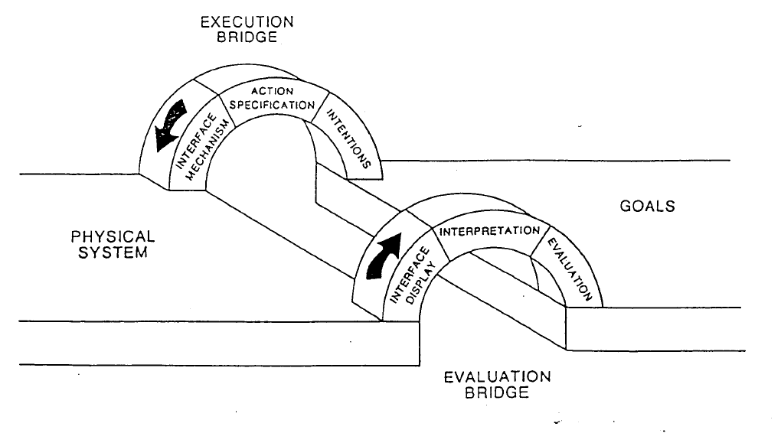

Slide 4

How To Help?
Reducing the gulf of execution
  Good physical designs (good operators in Chi/Riedl terms)
  Understanding user knowledge and goals
Reducing the gulf of evaluation
  Comprehsible visualizations
  Presentation/explanation generation
Designing for iterative action
  Dialogue management
  Error remediation

Slide 5
Interactive Visual Structures
Dynamic queries – user adjusts which set of objects are visualized
Magic lens – movable filters that alter visualization under them
Overview+detail – can identify which portion of a visualization gets the focus
Linking and brushing – links presentations across visualizations and as user brushes the mouse over objects in one visualization they highlight in others
Extraction and comparison – details of selected objects are compared
Attribute explorer – allows investigation of a number of object features

Slide 6
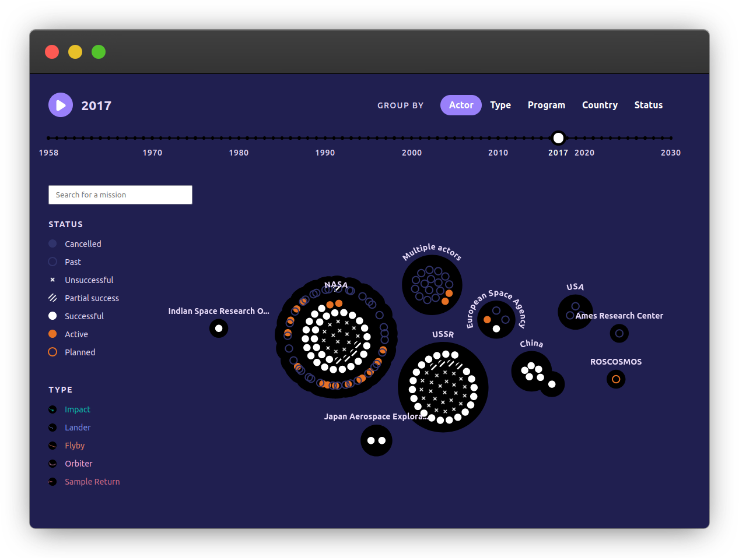
Dynamic Queries
A commonly available interaction
User selects data to be visualized
  Selection can be enabled by many different interface mechanisms

Slide 7
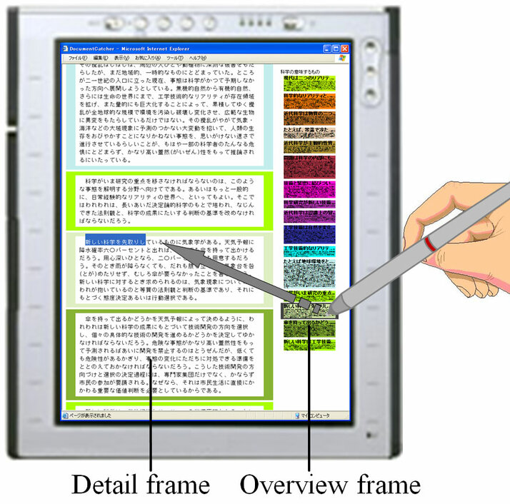
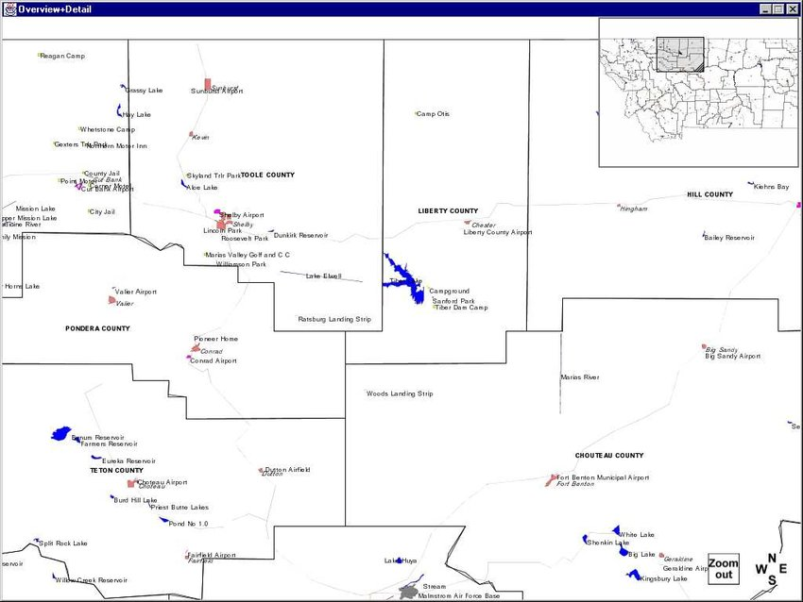
Overview + Detail
Enables interaction at different scales
Also used for selection of data presented in detail view
  Particularly common for maps
  Also for overviews of images or documents

Slide 8
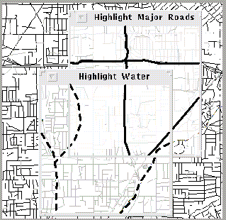
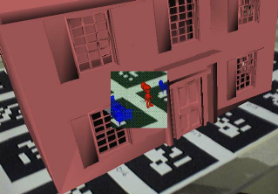
Magic Lens
User has control over a movable subregion of the visualization that changes the visualization in that subregion.
  Example of composition
  Example in 3D visualization

Slide 9
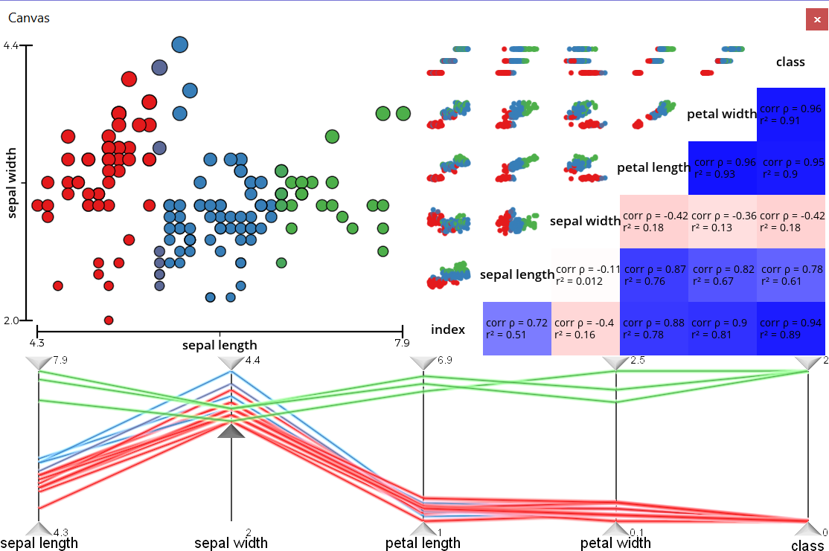
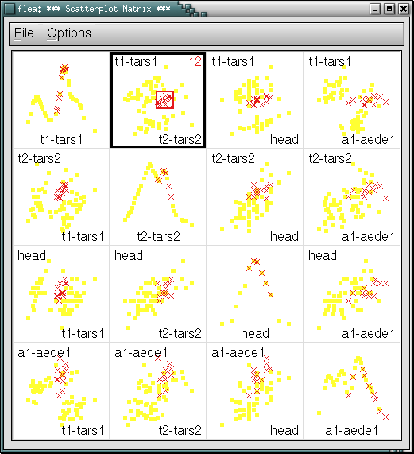
Linking and Brushing
Synchronizes selections across multiple visualizations
  Implementation with similar visualizations
  Implementation across different visualizations

Slide 10
Interactive Visual Structures
Also mentioned by Card
  Extraction and comparison – details of selected objects are compared
  Attribute explorer – allows investigation of a number of object features

Slide 11
Interaction Examples for COVID-related data
Brazos County COVID-19 cases - by the numbers
  https://www.kbtx.com/2021/03/22/brazos-valley-covid-19-dashboard/
Vaccine distribution
  https://www.bloomberg.com/graphics/covid-vaccine-tracker-global-distribution/
CDC visualizations
  https://covid.cdc.gov/covid-data-tracker/#datatracker-home

Slide 12
Examples from Other Domains
200 Years of Immigration to the U.S.
  https://insightfulinteraction.com/immigration200years.html
Rising sea levels
  https://choices.climatecentral.org/#12/40.7117/-74.0008
Government policies and happiness
  https://govdna.sudox.nl/#layout/data/country/TUN/x/23/y/32/z/20/a/0

Slide 13
More Examples
Comparing scales of objects
  https://www.nikon.com/company/corporate/sp/universcale/scale.html
Features of tweets
  https://www.heavy.ai/demos/tweetmap

Slide 14
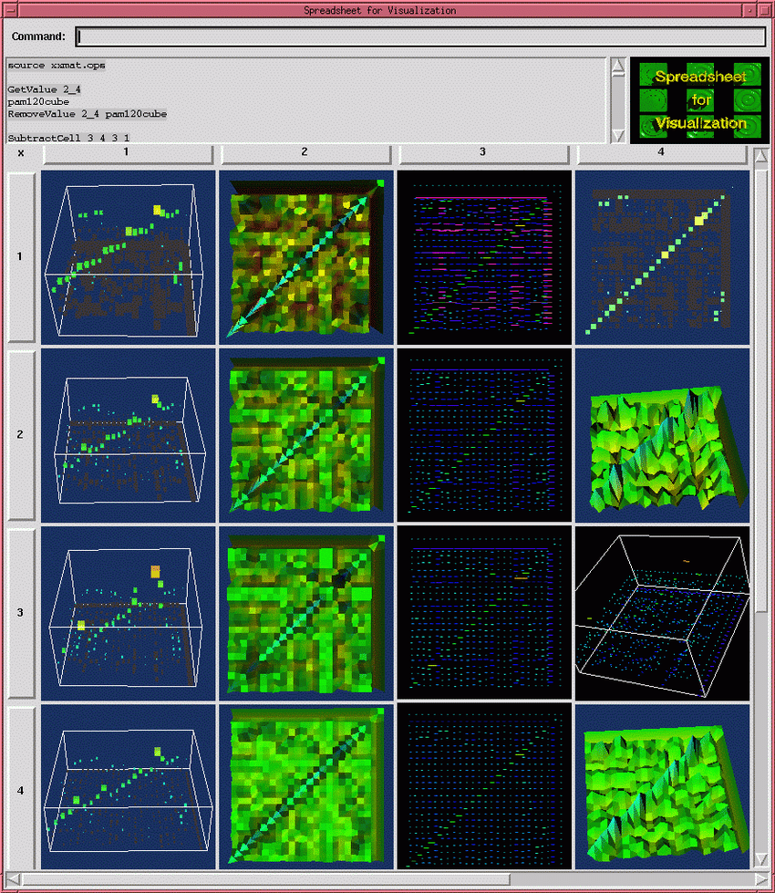
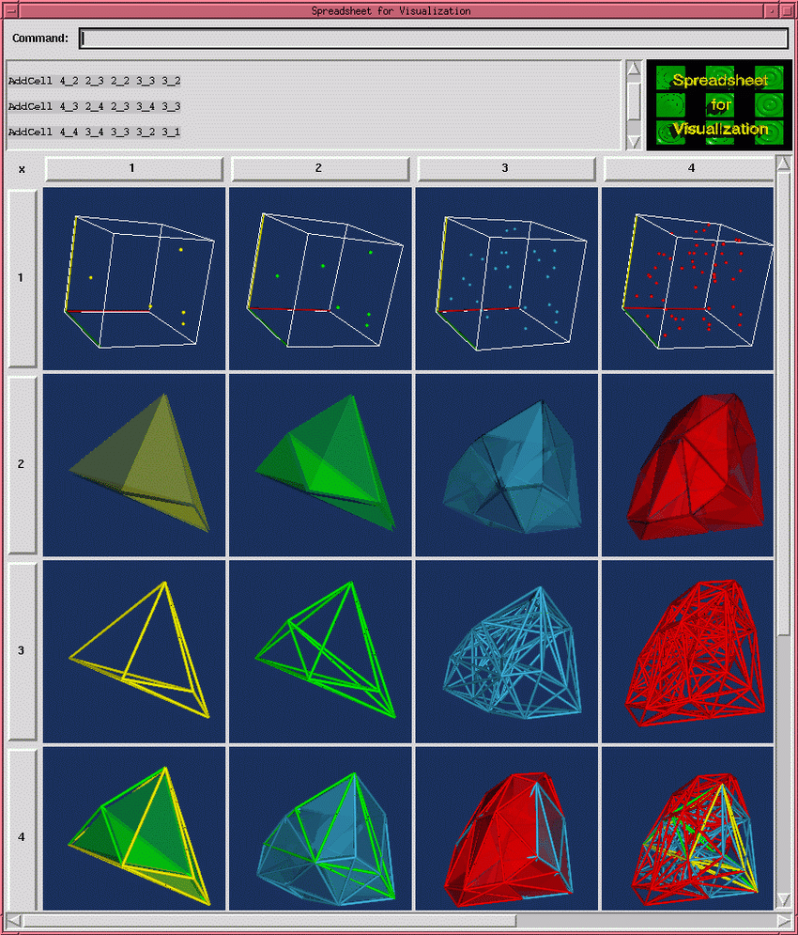
Visualization Spreadsheet
Backdrop of work described in paper you read
Grid where relations between elements in grid are defined by users
Enables multiple simultaneous visualizations that are coordinated based on user goals
But what are the operators available to connect grid elements?

Slide 15
Operator Interaction Framework
There is not just one desired result for each type of interaction with a data visualization
  Different actions make sense in different contexts
Issues for visualization system designers:
  Operator reuse – operators tend to be specific to particular data types and visualizations, making their reuse difficult
  View/value separation – changes to the visualization should not (always) change the original data (e.g. what if scenarios)
  Operand focus – keeping focus on results rather than the process for generating those results

Slide 16
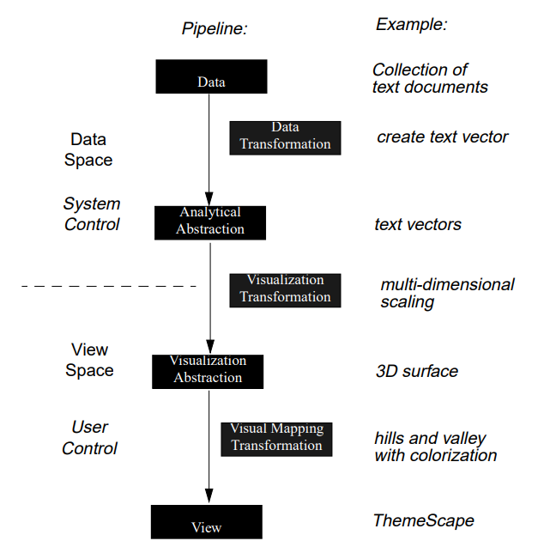
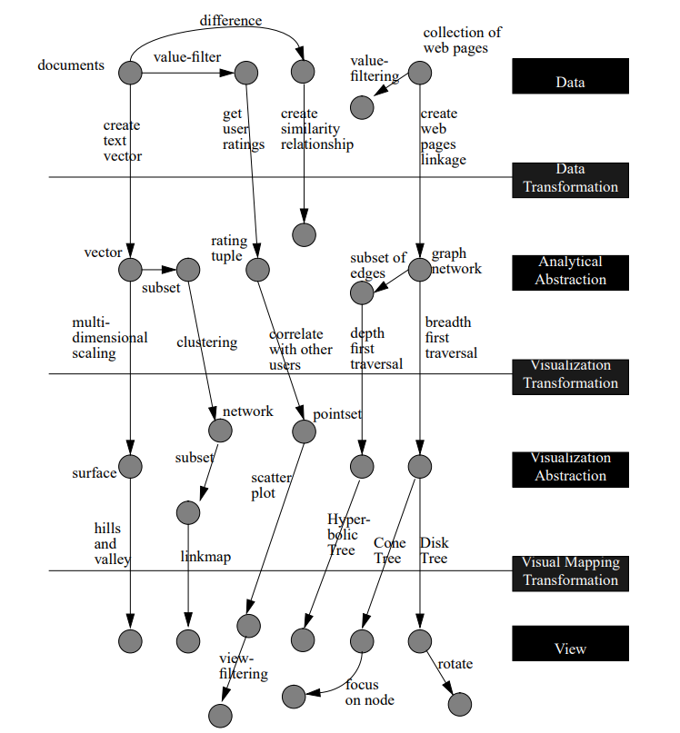
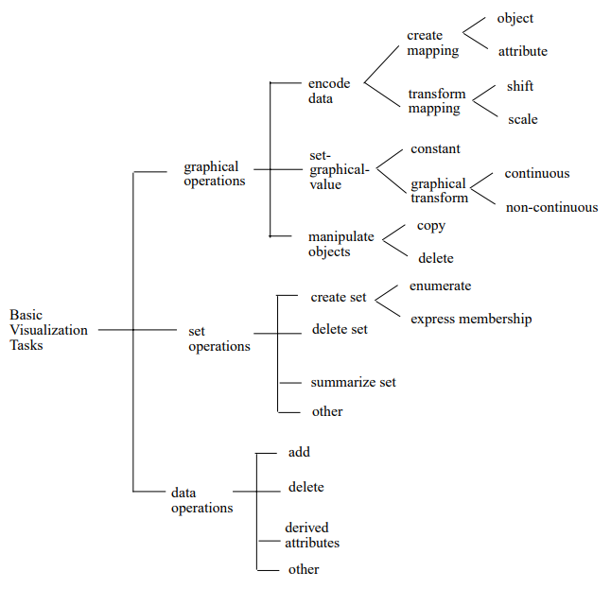
What is an Operator Framework
Conceptual model describing possible user interactions
Example: Chua and Roth’s interaction taxonomy
Can be tied to a visualization pipeline
Chi & Riedl framework

Slide 17
Assignments
Sept. 19: “Interacting with Visualizations” readings write-up
Sept. 21: “Visualization as Distortion” readings write-up and D3 mini assignment
Sept. 26: “Bidirectional Visualization” readings write-up and Phase 2 presentation
Sept. 28: Phase 2 report
Questions?

