Slide 1
Groupware and Social Dynamics:
Eight Challenges for Developers
Jonathan Grudin

Slide 2
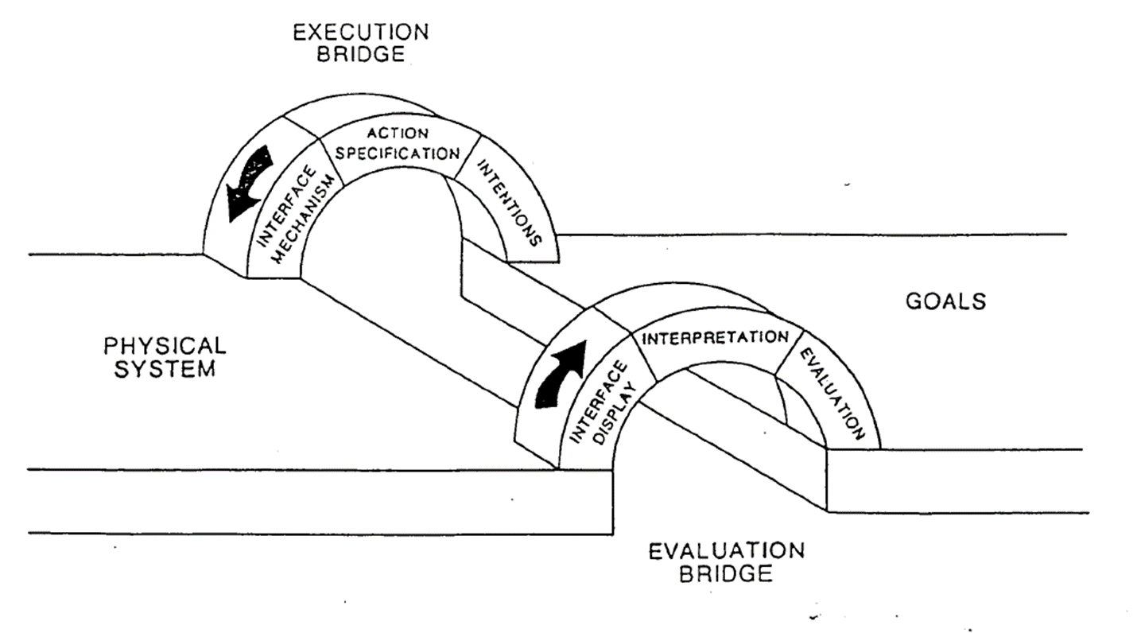
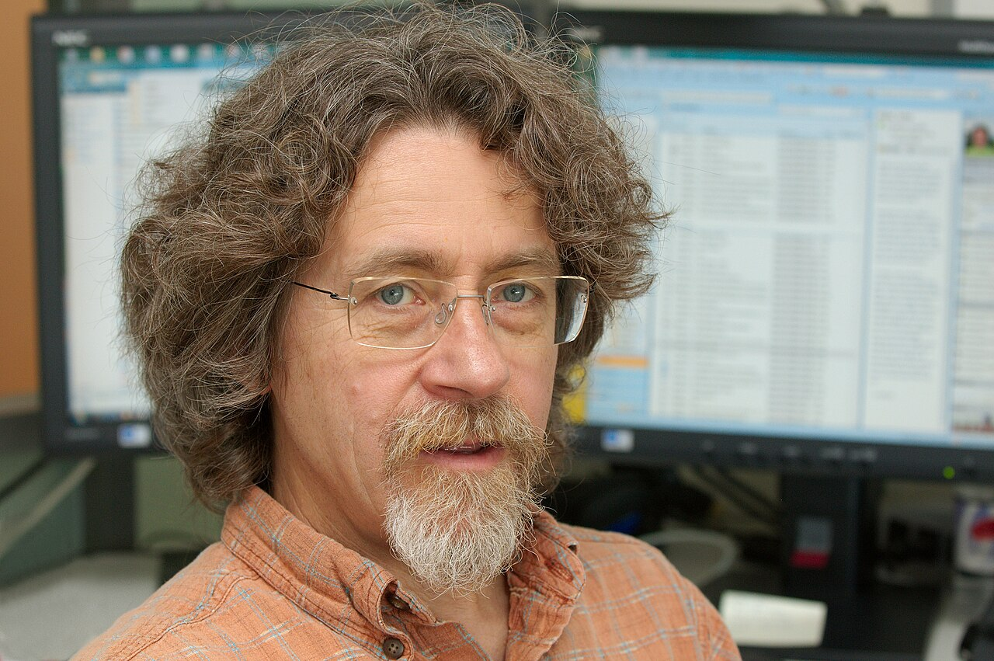
Who is Jonathan Grudin
Ph.D. in cognitive psychology (1981) from UC San Diego
  Advisor Don Norman
Worked at:
  Wang Laboratories,
  MCC,
  Aarhus University,
  UC Irvine, and
  Microsoft among others
Many interesting/insightful papers
  Focus on tensions in software design for communities

Slide 3
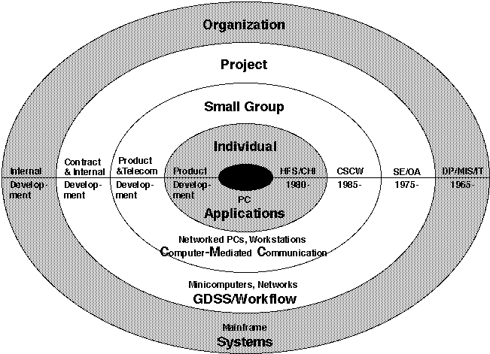
CSCW in the History of Computer Science

Slide 4
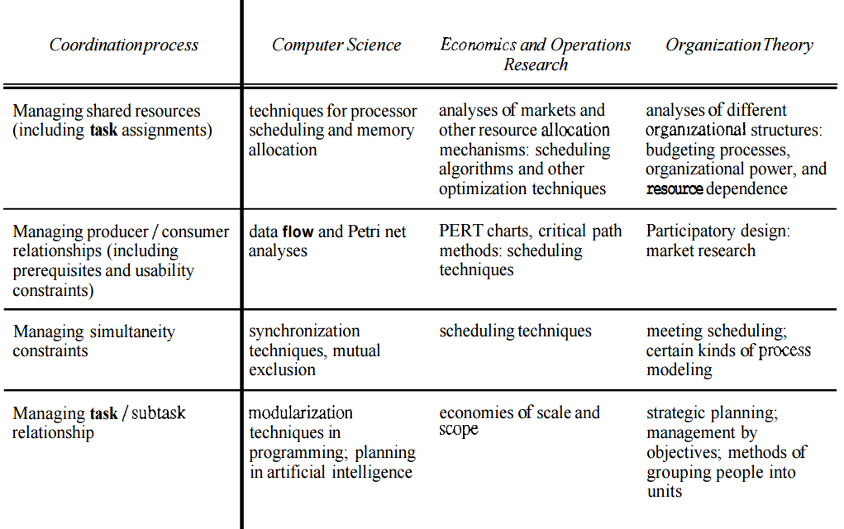
Coordination Viewed by Different Disciplines
(from Malone, Crowston 1994)

Slide 5
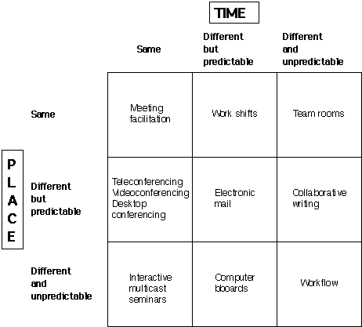
Expanding the Time/Space Categorization

Slide 6
Extending the CSCW Framework (a 3rd dimension)
Directed Communication (select/know your audience)
 | Different Time | Same Time
Different Place | Email | Phone, Instant Messaging, Videoconferencing
Same Place | Notes on the Fridge | Conversation (Augmented with technology)
Broadcast Communication (do not select/know your audience)
 | Different Time | Same Time
Different Place | Discussion Forums, Blogs, Podcasts, Wikis | Traditional and new broadcast forms
Same Place | Bulletin Boards | Public speaking, meeting room support

Slide 7
Discussing Grudin’s Eight Challenges
Disparity in work and benefit
  "What may be in the managers' best interests may not be in the interests of individual contributors, and therefore not used.“
  – the Grudin paradox
  Why does this happen?
  When does it happen and when is it less of an issue?

Slide 8
Discussing Grudin’s Eight Challenges
Disparity in work and benefit
Critical mass and Prisoner’s dilemma problems
  Challenge of replacing defacto standards
  Need for building quick on-ramps
    But intellectual property policy can get in the way
  What about today? Why might it be different?

Slide 9
Discussing Grudin’s Eight Challenges
Disparity in work and benefit
Critical mass and Prisoner’s dilemma problems
Disruption of social processes
  Groups have existing social practices and expectations – new software undermines these
  Any examples?

Slide 10
Discussing Grudin’s Eight Challenges
Disparity in work and benefit
Critical mass and Prisoner’s dilemma problems
Disruption of social processes
Exception handling
  The problems of Ellis’ OfficeTalk
  Do we see this issue today? How are exceptions handled?

Slide 11
Discussing Grudin’s Eight Challenges
Disparity in work and benefit
Critical mass and Prisoner’s dilemma problems
Disruption of social processes
Exception handling
Unobtrusive accessibility
  Why is this an issue?
  Is it still an issue?

Slide 12
Discussing Grudin’s Eight Challenges
Disparity in work and benefit
Critical mass and Prisoner’s dilemma problems
Disruption of social processes
Exception handling
Unobtrusive accessibility
Difficulty of evaluation
  How can we evaluate CSCW applications?
  What is still hard to do?

Slide 13
Discussing Grudin’s Eight Challenges
Disparity in work and benefit
Critical mass and Prisoner’s dilemma problems
Disruption of social processes
Exception handling
Unobtrusive accessibility
Difficulty of evaluation
Failure of intuition
  What about CSCW applications undermines our intuition about their use?

Slide 14
Discussing Grudin’s Eight Challenges
Disparity in work and benefit
Critical mass and Prisoner’s dilemma problems
Disruption of social processes
Exception handling
Unobtrusive accessibility
Difficulty of evaluation
Failure of intuition
Adoption process
  How is the adoption process for CSCW applications different?

Slide 15
Tools & Techniques for CSCW Support
Type of Support | Real time | Asynchronous
Communication | Telephone Video conferencing Instant messaging Texting | Email Voice mail Blogs Social networking sites
Information sharing | Whiteboards Application sharing Meeting facilitation Virtual worlds | Document repositories Wikis Web sites Team workspaces
Coordination | Floor control Session management Location tracking | Workflow management CASE tools Project management Calendar scheduling

