Slide 1
How to Think about Today’s Readings
This paper was published ~35 years ago.
The paper takes a systems view while describing
  the need for,
  experiences with, and
  issues in developing CSCW/Groupware.
Today we can read this paper and reflect on where the authors were right, what they said was important that turned out not to be so, and where these types of systems have evolved

Slide 2
Groupware: Issues and Experiences
Clarence “Skip” Ellis, Simon Gibbs, and Gail Rein

Slide 3

About the First Author
Received his Ph.D. in 1969 from UIUC
Worked at Xerox PARC, MIT, MCC, and University of Colorado, Boulder among other places

Slide 4
What is Groupware?
1st view: synonymous with CSCW – a system that integrates information processing and communication activities
2nd view: software for small or narrowly focused groups
3rd view: applications that merge large information bases with communications technology
Context: Prior to the CSCW and groupware communities forming there were few systems that supported user-to-user interaction
  ACM Conference on Computer-Supported Cooperative Work (CSCW)
  ACM International Conference on Supporting Group Work (GROUP)

Slide 5
The Three Cs
Communication
  Email and bulletin boards were separate from “common” communication media of the telephone and face-to-face conversation
  Communication does not need to be explicit
Collaboration
  Support for the sharing of information, but not the hiding of sharing
  Systems “go to great lengths to insulate users from each other”
Coordination
  Enabling the distribution of activities among a group of people
  Coordination is an activity in itself

Slide 6
Authors Definition of Groupware
“Computer-based systems
that support groups of people engaged in a common task (or goal) and
that provide an interface to a shared environment”

Slide 7
Common Task and Shared Environment Dimensions of CSCW Applications
Common Task Dimension
Low
High
Timesharing System
Software Review System
Shared Environment Dimension
Low
High
Electronic Mail System
Electronic Classroom System

Slide 8
Time Space Taxonomy for CSCW
 | Same Time | Different Time
Same Place | Face-to-face interaction | Asynchronous interaction
Different Places | Synchronous distributed interaction | Asynchronous distributed interaction

Slide 9
Classes of Applications
Message Systems
Multiuser Editors
Group Decision Support and Electronic Meeting Rooms
Computer Conferencing
Intelligent Agents
Coordination Systems

Slide 10
Perspectives
Distributed Systems Perspective
Communications Perspective
Human-Computer Interaction Perspective
Artificial Intelligence Perspective
Social Theory Perspective

Slide 11
Real-Time Groupware
Some concepts:
Shared Context
Group Window
Telepointer
View
Synchronous or Asynchronous Interaction
Session
Role

Slide 12
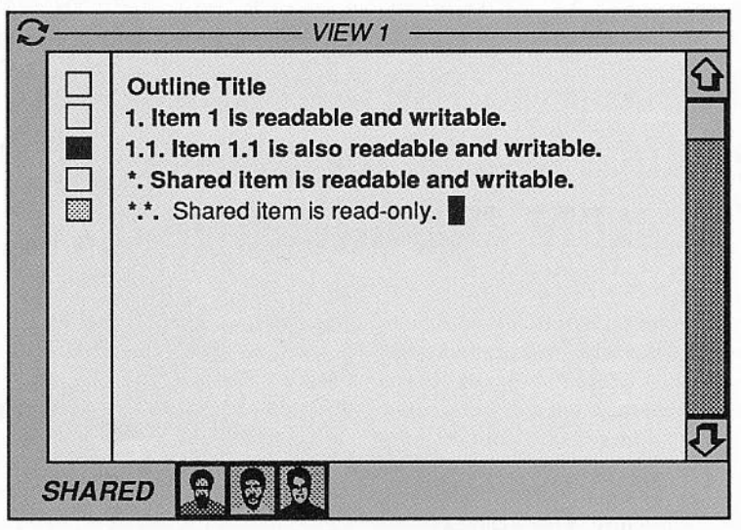
GROVE

Slide 13
Effects from Use of Groupware
Increases information access
Encourages parallel work / can improve efficiency
Makes discussion more difficult
Makes group focus more difficult
Can be confusing, unfocused, and chaotic
Cuts down on social interaction
Collisions are surprisingly infrequent
Can make learning of software natural

Slide 14
Group Interfaces
WYSIWIS issues
Group focus and distraction issues
Issues related to group dynamics
Issues related to screen space management
Issues related to group interface toolkits

Slide 15
Group Processes
Group protocols
Group operations
Organizational and social factors
Exceptions and coordination
Integration of activity support

Slide 16
Concurrency Control
Simple locking
Transaction Mechanisms
Turn-Taking Protocols
Centralized Controller
Dependency-Detection
Reversible Execution
Operation Transformations

