Slide 1
TagFlip
Putting Users Back in Control of Music Discovery
A presentation on:
TagFlip: Active Mobile Music Discovery with Social Tags
Mohsen Kamalzadeh, Christoph Kralj, Torsten Moller, Michael Sedlmair
Presenter:
Bidwat Raj Pokhrel

Slide 2
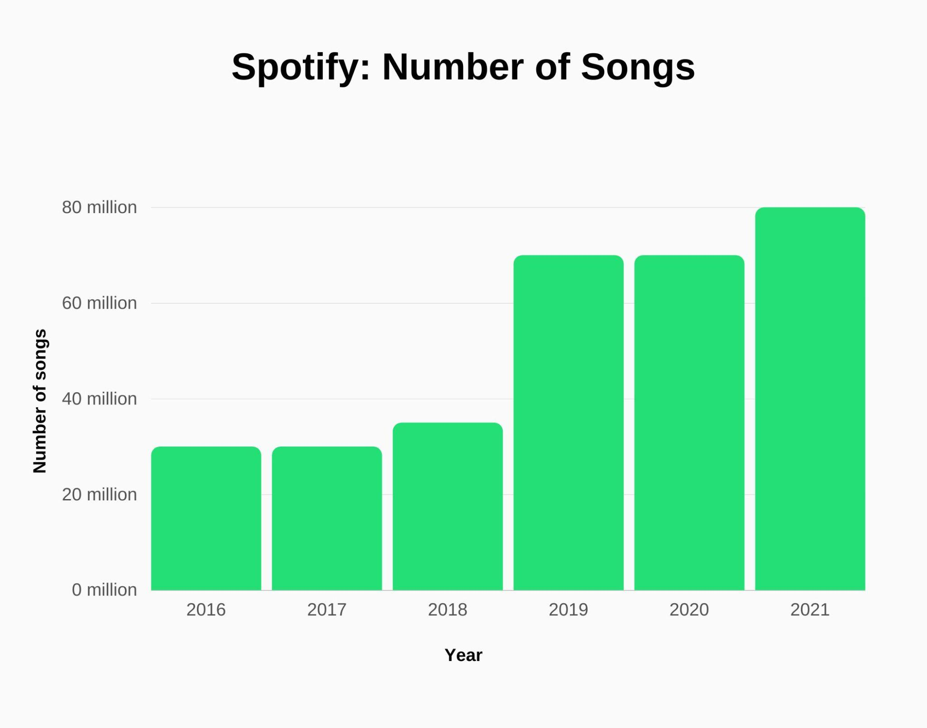
Music Streaming Explosion
Over 100 million songs available on streaming platforms
Immediate access to vast music libraries
Examples: Spotify, Apple Music
Notes:
https://usesignhouse.com/blog/spotify-stats/

Slide 3

Too Many Choices?
Abundance of options can be overwhelming
Difficult to decide what to listen to next
Reference: The Jam Experiment (Iyengar & Lepper, 2000)
Paradox of Choice
Notes:
10x more likely when 6 jams vs 24 jams

Slide 4

Enter the Algorithm
Recommendation algorithms suggest music for users
Minimal user interaction required
Users just press play

Slide 5
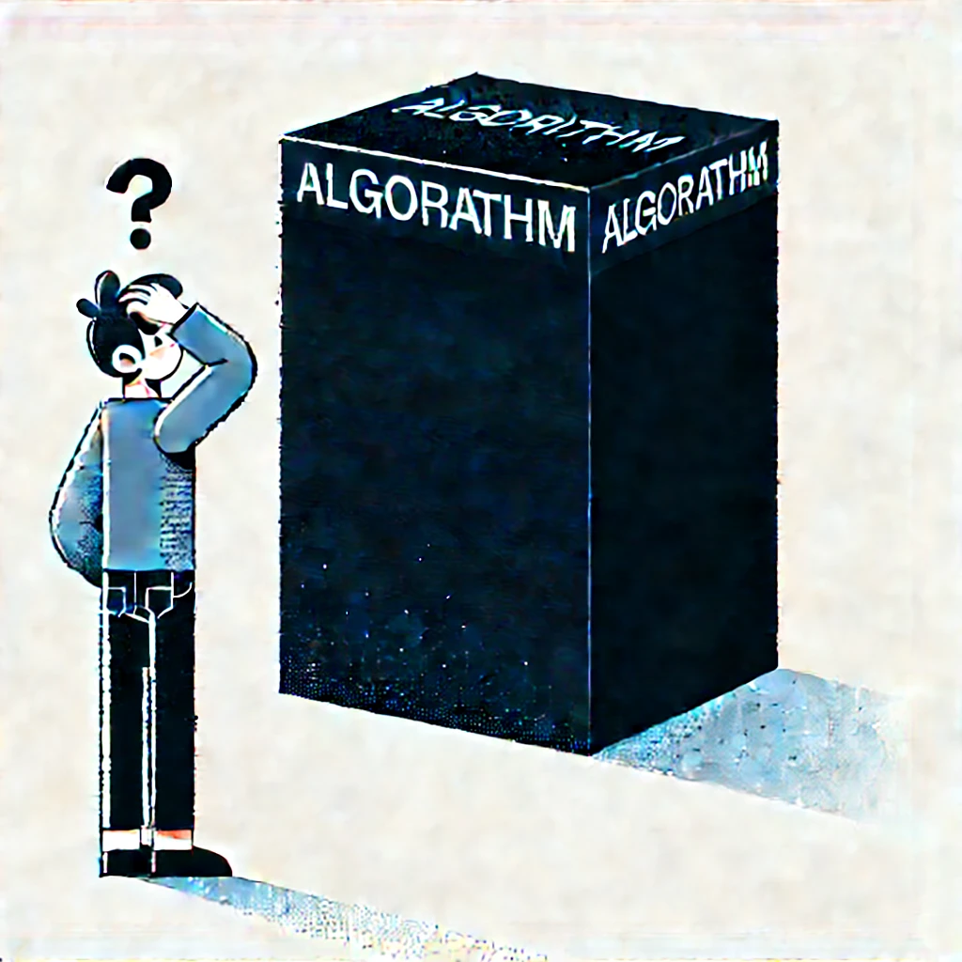
Issues with Current Black-Box Algorithms
Lack of transparency: How are recommendations made?
Lack of user control: Limited ways to influence recommendations
Pigeonholing: Getting stuck in a narrow preference profile

Slide 6
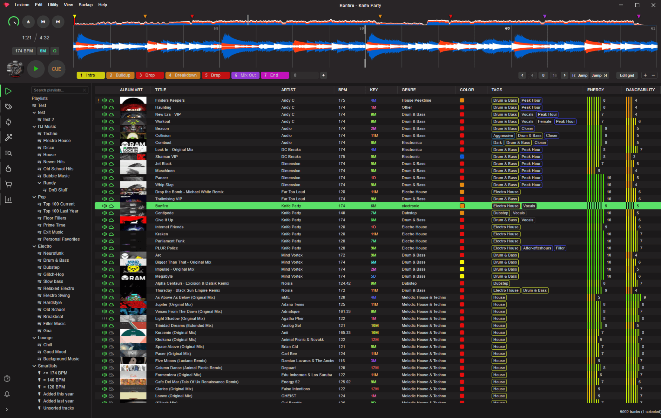
The Other Extreme: Maximum user control
Elaborate interfaces with extensive options
Users can choose anything
Drawbacks:
Too complex for average users
Requires prolonged engagement
Not suitable for mobile use
Notes:
https://www.lexicondj.com/

Slide 7

Satisficing vs. Maximizing
Maximizers seek the best possible option
High effort, detailed control
Satisficers seek a 'good enough' option
Low effort, minimal control
Need for a balance between the two
Satisficing
Maximizing

Slide 8
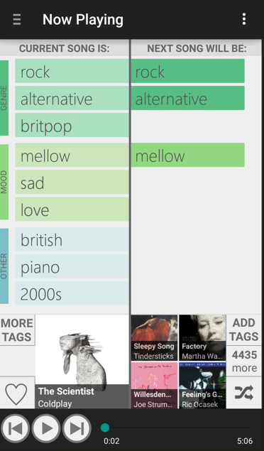
Introducing TagFlip: A Balanced Solution
Puts users back in control with minimal effort
Uses social tags to facilitate music discovery
Designed for mobile devices

Slide 9
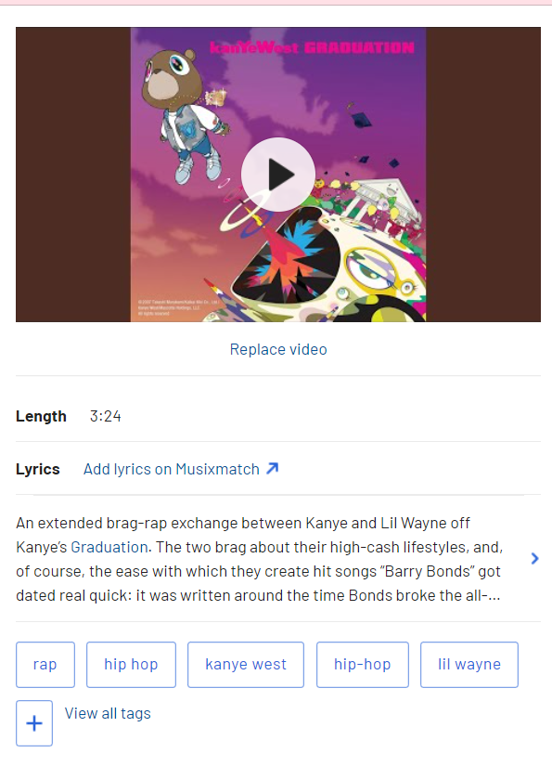
What are Social Tags?
User-generated labels describing music
Examples: 'rock', 'happy', 'acoustic', 'chill'
Source: Last.fm's folksonomy

Slide 10
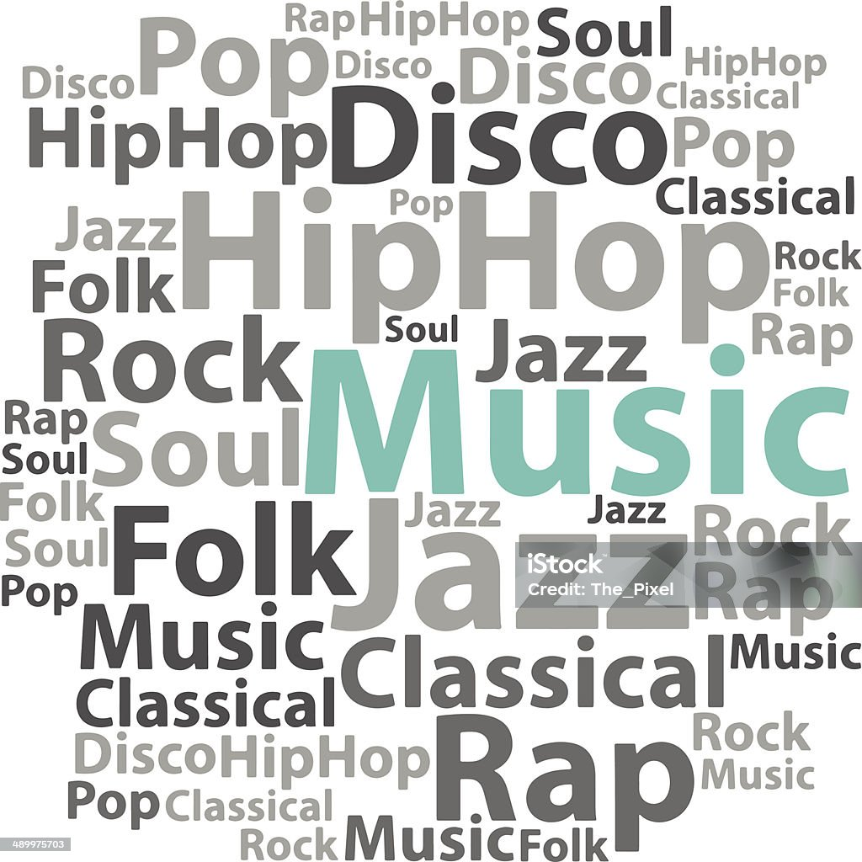
Issues with using Tags
Cold Start: New songs lack tags
Synonymy: Multiple tags with the same meaning
Polysemy: Tags with multiple meanings
Noise: Spelling errors, subjective or meaningless tags
Notes:
https://www.istockphoto.com/vector/text-cloud-music-wordcloud-tag-concept-vector-illustration-gm489975703-39800314?irclickid=WlhzNey4sxyKWfyXgQQYrTruUkCU2GX7kTm8UU0&irgwc=1&cid=IS&utm_medium=affiliate_SP&utm_source=FreeImages&clickid=WlhzNey4sxyKWfyXgQQYrTruUkCU2GX7kTm8UU0&utm_campaign=adp_premphotos_download-button-maxi&utm_content=270501&irpid=246195

Slide 11
The Design Process
Goal: High user control with minimal interaction
User-Centered Design:
Iterative development with user feedback
Three stages of usability testing
Key Design Decisions:
Interface layout
Interaction paradigm
Tag presentation and categorization

Slide 12
Key Design Considerations
Interface Layout:
Option 1: Individual tag blocks with sliders
Option 2: Left-to-right flow from current to next song
Decision: Left-to-right flow for clarity
Tag Strength Control:
Considered adding sliders for tag strength
Users found it confusing
Decision: Simplify by using pin/unpin actions
Communicating Song Availability:
Early designs showed bars indicating song set sizes
Users found it confusing
Decision: Show number of matching songs instead

Slide 13
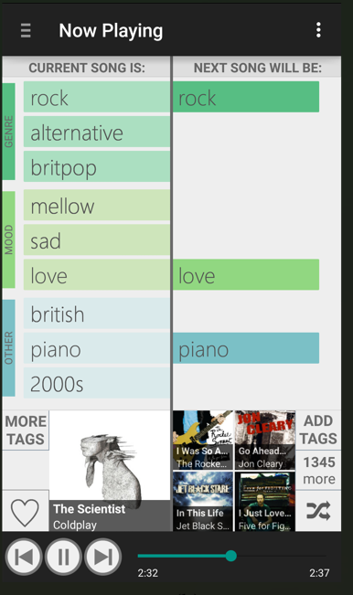
Final Design Features
Tag Categorization:
Grouped into genres, moods, and others
Helps reduce cognitive load
Limiting Main Screen Tags:
Displayed top 9 tags (3 from each category)
Additional tags accessible via 'More Tags' button
Optimized for Small Screens:
Simplified interface elements
Minimal scrolling required

Slide 14
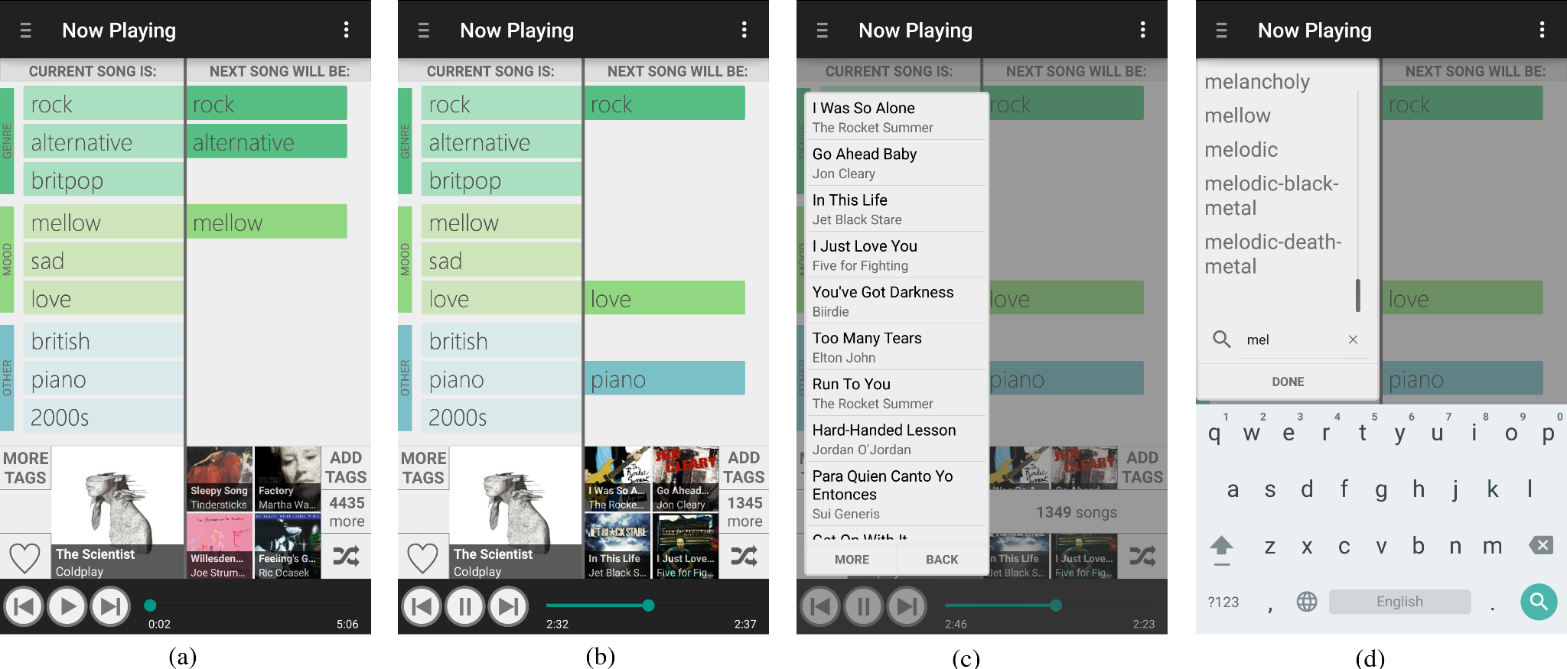

Slide 15
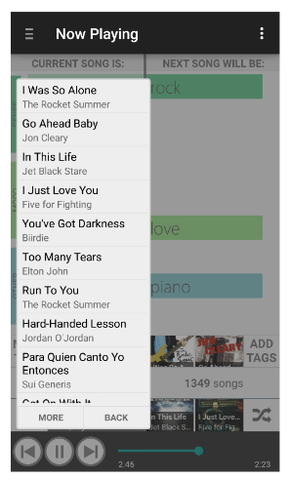
TagFlip User Interface
Start by playing a song or searching for a tag
Tags of the current song are displayed
Users can 'pin' or 'unpin' tags to influence next songs
Immediate feedback on upcoming songs
Easy addition of new tags

Slide 16
What Makes TagFlip Unique
High-impact interactions
Fine-tuning based on tags
Minimal interaction effort
Low mental load
Transparency in recommendations
Designed for mobile use

Slide 17
Overcoming Tag Issues
Preprocessing tags to clean data
Spelling corrections
Removing subjective or meaningless tags
Resulted in 358 high-quality tags
Ensures rich and understandable tag set

Slide 18

Evaluation: Comparing TagFlip to Spotify
Lab study with 16 participants
Compared usability and recommendations
TagFlip rated higher in:
Control and transparency
Interface and interaction adequacy
Attitudes and behavioral intentions
Fewer interactions per liked song with TagFlip
TagFlip
vs

Slide 19
User Feedback
Appreciated control over music selection
Liked the fine-tuning capability
Found TagFlip transparent and trustworthy
Saw it as a complement to existing services

Slide 20
Drawbacks and Limitations of TagFlips
Limited Music Library:
Only 100,000 songs vs. millions in other services
Users noticed lack of certain songs/artists
Tag Data Limitations:
No synonym modeling (e.g., 'hip-hop' vs. 'hip hop')
Some tags may still be ambiguous
Complexity in Excluding Music:
Difficult to exclude certain types of music
No 'dislike' or 'exclude' tag functionality
Integration Challenges:
Users wanted more features (e.g., artist pages)
Not fully integrated with conventional app features
Potential Demand Effect:
Users may rate higher due to novelty or courtesy
Need for long-term studies to validate findings

Slide 21
Implications for Recommendation Systems
Users desire more control over recommendations
Transparency builds trust and satisfaction
Balancing control and effort is key
Tag-based interfaces can enhance music discovery
Need to address limitations for broader adoption

Slide 22
Conclusion
TagFlip balances user control and effort
Demonstrated benefits of tag-based music discovery
Potential for integration into commercial services
Future work:
Expanding music library
Enhancing tag processing
Long-term user studies

Slide 23
Thank You!

