Slide 1
Dynamic Dramatization of Multimedia Story Presentations
Esben Egholm

Slide 2
Purpose and Applications
The purpose of this system is to enhance storytelling through dynamic effects
Aims to improve user engagement by highlighting key dramatic elements
Used for educational storytelling systems and interactive entertainment

Slide 3
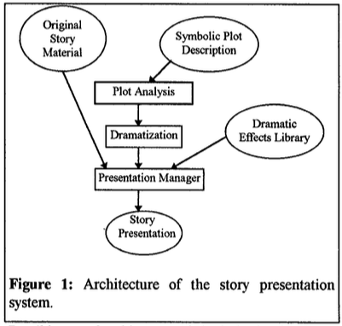
Architecture of the Story Presentation System
plot analysis accepts as an input a description of the story plot in a simple special-purpose language
Analyzes plot description in terms of the interactions between story characters
Dramatization model determines dramatically interesting points and events
PM uses these results to retrieve data from a library
Integrates the effects in the original story material

Slide 4
Plot Analysis
Purpose of Plot Analysis:
  Identify dramatically significant events in the story
  Analyze interactions between characters, focusing on goals and social norms
Types of Character Interactions:
  Goal Interference: Character actions affect others’ goals (help or hinder)
  Normative Interference: Actions relate to social norms (respecting the dead)
Example: Achilles story analysis with symbolic events like “Hid Achilles,” “Met Agamemnon”
C+ or C- event according to whether it benefits or not the story character
I+ or I- represent favorable or unfavorable inferences towards other cast members

Slide 5
Dramatization Categories
Lifeline: Problem followed by a positive event
Rising Complication: Escalating problems for the character
Reversal of Fortune: Positive moment disrupted by a setback
Dramatic Irony: Expectation of good outcome followed by a twist
Happy End: Problems resolving favorably

Slide 6
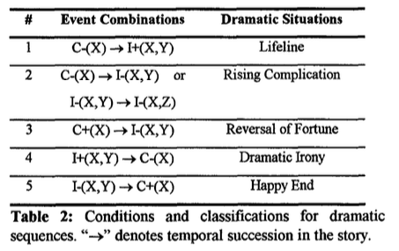
Dramatization Categories (Cont)
This is the table in the reading describing the different dramatic situations

Slide 7
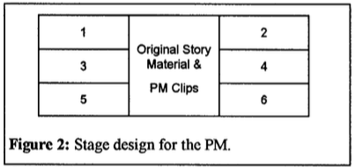
Presentation Manager Role
Structures the story into presentation units ending on suspenseful moment
Adds multimedia effects to enhance emotional impact
-Middle area for displaying original story material
-The rest allows PM to map antagonistic or Synergistic relations between story characters into opposite or adjacent regions

Slide 8
Effect types
Suspense effects
  Aims to capture user interest in the story
Atmospheric effects
  Aims to communicate the mood f=of the events and the nature of the relationships in the story
Suspense effects take precedence over atmospheric effects
Effects associated with interactions take precedence over those with events
Effects associated with the protagonist take precedence over those associated with other characters
Effects scheduled later in the unit take precedence over earlier ones

Slide 9
Multimedia Effects and Story Segmentation
Multimedia Effects Controlled by PM:
Stage Layout: Positioning of characters
Color: Background changes (e.g., dark colors for conflict)
Sound: Effects for suspense or atmosphere
Scheduling rules:
Suspense effects take priority
Effects involving protagonist are emphasized

Slide 10
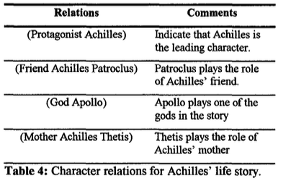
Achilles Example in PEGASUS
PEGASUS System: Uses dynamic dramatization for storytelling based on Greek mythology

Slide 11
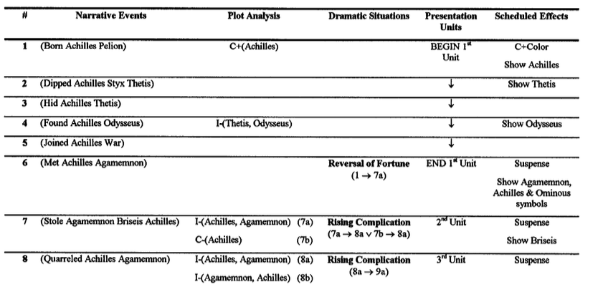
Achilles Example (Cont)

Slide 12
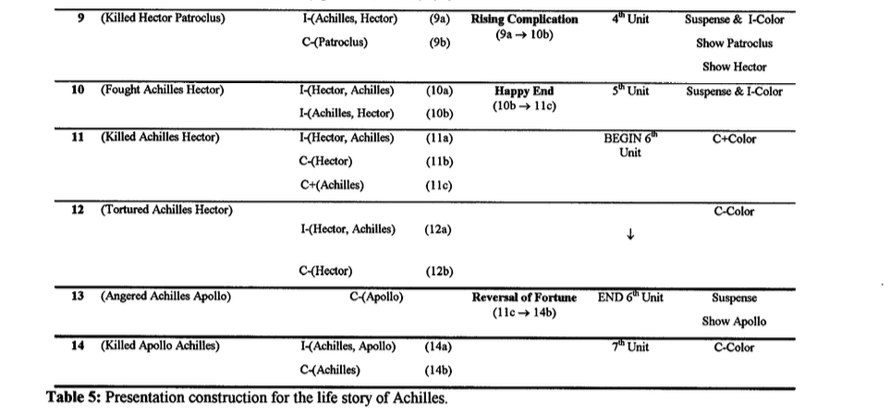
Achilles Example (Cont)

Slide 13
Related Research and Impact
Related Works:
Storytelling systems and multimedia presentation tools
Reactive user interfaces and their application in storytelling
Integration of drama techniques for immersive narrative experience
Contributions:
Framework for intelligent multimedia storytelling interfaces
Expanded application in education, interactive entertainment

Slide 14
Future Work
Extensions Planned:
Develop more complex character interactions (like treason or revenge)
Integrate with a web-based interface for broader access
Additional multimedia effects for more immersive experiences
Goal: To enhance dynamic storytelling systems and make them more adaptable for educational and entertainment uses

Slide 15
Conclusion
Summary:
Dynamic Dramatization offers a way to engage users by emphasizing dramatic story points.
The system intelligently applies effects that reflect the mood and character relationships.
This approach makes digital storytelling more immersive and could transform interactive narratives in both learning and entertainment.

