Slide 1
Appropriate Reliance on AI Advice: Conceptualization and the Effect of Explanations
Schemmer M, Kuehl N, Benz C, Bartos A, Satzger G.
Presenter: Jiwon Chun

Slide 2
Introduction
Background
  nowadays AI advisors are becoming frequent in research and practice
    e.g.) cancer screening, loan decisions
Problem
  past research: reliance, trust, utilization, compliance, acceptance of AI advise
  but, maximising AI reliance doesn’t fully exploit the potential of state-of-the-art human-AI decision making
    increasing usage of imperfect AI advisors
    increasing alignment of the objectives of human decision-makers and AI advisors
    increasing potential for complementary team performance

Slide 3
Related Work
Appropriate reliance in human advice: judge-advisor system
  judge: the person responsible for making the final decision
  advisor: the source of the advice
  focus on advice acceptance
Appropriate reliance in automation and robotics
Appropriate reliance in human-AI decision-making
  doesn’t provide a unified measurement that measures the degree of appropriateness
Explainable AI and appropriate reliance
  researchers proposed to use explanations of AI as a means for appropriate reliance
Lack: a clear definition of appropriate reliance, a standard way to measure it, a clear understanding of when and why AI advisor explanations affect it

Slide 4
Conceptualization of AR-1
Reliance and Appropriateness
  reliance
    defined as a behavior, not a feeling or attitude, but an actual action
    trust, perceived risk, self-confidence
  appropriateness: depends on different types of AI errors
    systematic error: if humans can detect patterns to spot bad advice, case-by-case judgment with AI collaboration is needed
    random error: humans should always rely on the AI’s advice when the AI performs better on average, and never when the AI performs worse on average

Slide 5
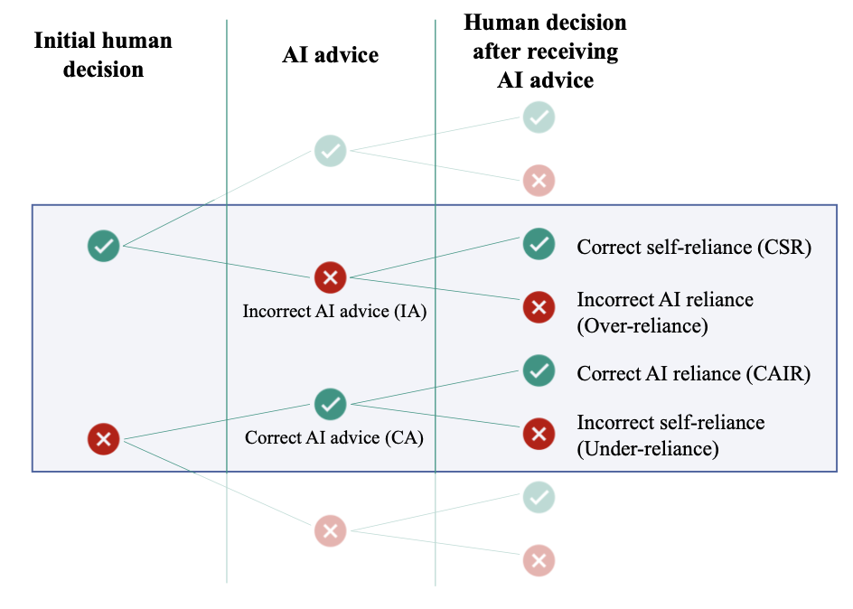
Conceptualization of AR-2
Towards a Measurement Concept—Appropriateness of Reliance
  follow the approach of the judge-advisor system
CSR: after an initial correct decision, ignore incorrect AI advice
Over-reliance: follow incorrect AI advice, change an initial correct decision
CAIR: after an initial wrong decision, accept correct AI advice
Under-reliance: reject correct AI advice and stick to a wrong decision

Slide 6


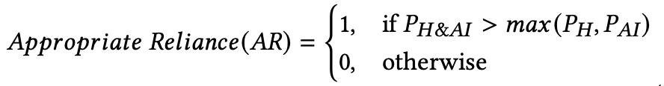
Conceptualization of AR-3
Definition of Appropriate Reliance
  achieved when the human-AI team performance (complementary team performance) surpasses the performance of either the human or AI alone
  : the individual human performance
  : the individual AI performance

Slide 7
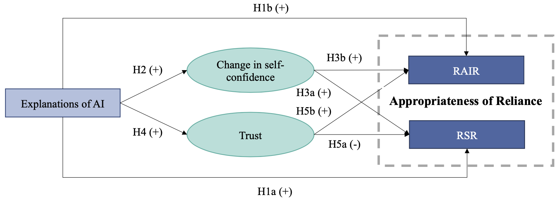
Theory Development and Hypotheses
develop hypotheses on the effect of explanations on Appropriateness of Reliance (AoR)
  H1a: Providing explanations of the AI advisor influences the relative self-reliance (𝑅𝑆𝑅).
  H1b: Providing explanations of the AI advisor increases the relative AI reliance (𝑅𝐴𝐼𝑅).
  H2: Providing explanations of the AI advisors increases the change in self-confidence.
  H3a: An increased change in human self-confidence increases the relative self-reliance (RSR).
  H3b: An increased change in human self-confidence increases the relative AI reliance (RAIR).
  H4: Providing explanations of the AI advisor increases trust in the AI advisor.
  H5a: Trust decreases the relative self-reliance (RSR).
  H5b: Trust increases the relative AI reliance (RAIR).
mediating variables

Slide 8
Experimental Design
Hotel review classification: human determine if it is deceptive or genuine
  400 deceptive and 400 genuine dataset by crowd-workers, with ground truth labels
AI advisor: based on a Support Vector Machine with 86% accuracy
Explanations:
  LIME(Local Interpretable Model-agnostic Explanations) for feature importance
  numerically represents the influence assigned by the AI model to specific words
  highlights key words, showing their impact (positive or negative) on decisions
Between-subject: AI advice without feature importance, feature importance conditions
  participants initially decide if a review is genuine or deceptive
  receive AI advice (with/without explanations) and can revise or keep their decision
  they rate their self-confidence in their judgment

Slide 9
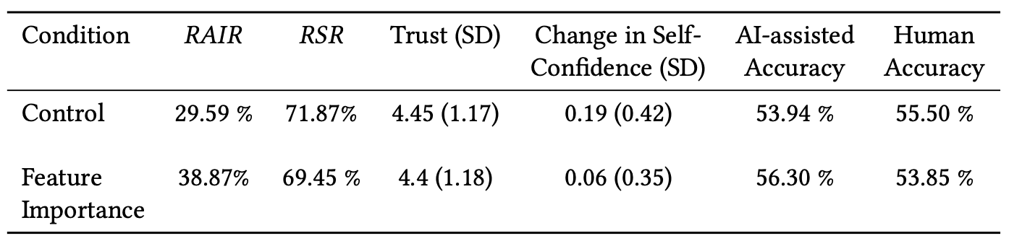
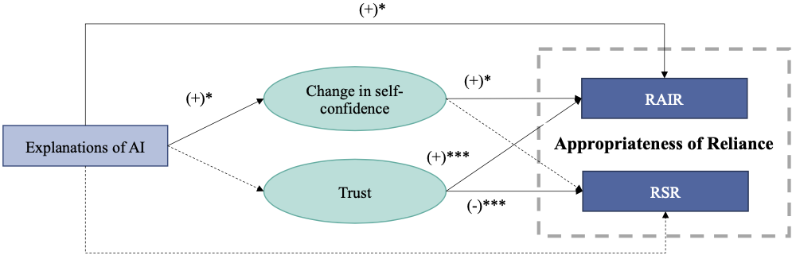
Results
Descriptive analysis
Appropriateness of reliance & appropriate reliance
  human-AI team performance is not significantly different from the human accuracy
  it means don’t reach CTP and therefore appropriate reliance is not displayed
Structural equation model

Slide 10
Conclusion
Providing explanations increases RAIR, helping participants appropriately accept AI advice.
Changes in self-confidence partially mediate the effect of explanations, contributing to the increase in RAIR.
Trust boosts RAIR, but excessive trust can lead to accepting incorrect AI advice, reducing RSR.
Explanations didn’t increase RSR, suggesting that they have little impact on the ability to reject incorrect advice.
Appropriate reliance on AI advice represents the next step toward effective human-AI collaboration, moving beyond research focused solely on AI adoption and acceptance.

