Slide 1
Use of Intelligent Voice Assistants by Older Adults with Low Technology Use
Alisha Pradhan, Amanda Lazar, Leah Findlater
Shreyas Shivakumar Kasetty

Slide 2
Introduction
Research Goal:
  Explore how voice assistants in smart speakers (e.g., Amazon Echo) can make technology more accessible for older adults who rarely use digital devices.
Purpose:
  Understand how older adults perceive and use voice assistants, and identify challenges to improve these technologies for this user group.
Research Questions:
  How do older adults with limited tech experience view smart speakers?
  What are the common uses of these devices?
  What challenges do they face, and how can we address them?

Slide 3
Methodology
Participants
Total: 7 participants (1 male, 6 female).
Age: 65+ years old.
Technology Usage: Used digital devices less than once a day.

Slide 4
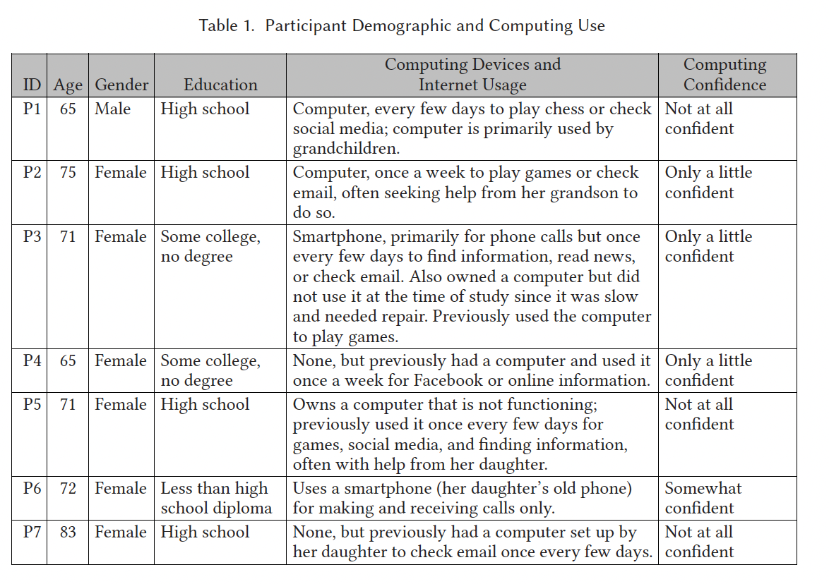

Slide 5
Methods of Data Collection
Weekly Semi-Structured Interviews
  Frequency: 3 interviews per participant (initial, mid-point, final).
  Duration: 30-75 minutes per interview.
  Topics: Device usage, challenges, benefits, and security concerns.
Daily Diary Entries via Automated Calls
  Frequency: 18 calls over 22 days.
  Response Rate: Average of 16 responses per participant.
  Average Call Duration: 1 minute 28 seconds.
  Purpose: Capture daily interactions and reflections on usage.
Usage Logs
  Total Commands Logged: 4,150 commands.
  Filtered Commands Analyzed: 1,049 commands after removing repeated or unclear commands.
  Categories: Information requests, weather checks, alarms, etc.

Slide 6
Data Analysis
Thematic Coding: Qualitative analysis of interview transcripts and diary entries.
  Total Codes: 23 primary codes (e.g., device usage, challenges, privacy).
Coding Agreement: Cohen’s kappa = 0.87 (high inter-rater reliability). Three research team members were involved in creating the initial code book, which was validated by a multi step validation process.

Slide 7
Results and Key Findings
Increased Comfort Over Time
  Initial hesitancy turned into comfort by the end of the study.
  Participants felt more confident using Alexa, appreciating the ease of voice commands.
Primary Uses
  Information finding: 34.9%
  Unstructured conversation: 13.6%
  Playing music: 13.3%
  Checking the weather: 9.8%
  Health information was a major category (16% of info queries).
Supporting Memory
  Participants relied on Alexa for small reminders but often used backup methods like paper notes.

Slide 8
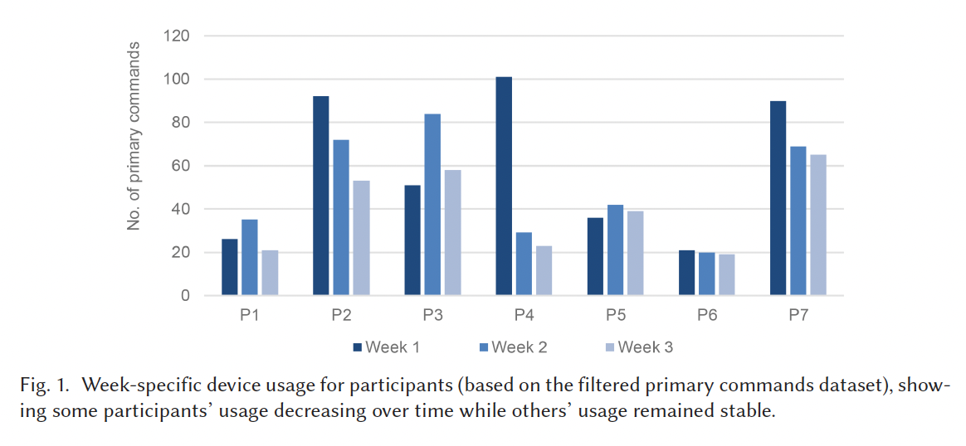

Slide 9
Major Challenges
Voice Recognition Issues
  Participants had to repeat commands due to Alexa's difficulty recognizing variations (e.g., confusing “Alexis” for “Alexa”).
Command Structure Complexity
  Participants struggled to remember specific keywords for features like reminders or alarms.
  Compound commands (e.g., “stop music and tell me the weather”) were often misunderstood, causing frustration.
Limited Discoverability of Features
  Difficulty finding certain features, such as emergency skills.
  Desire for a printed manual to help discover Alexa’s capabilities.
Dependence on Paired Device
  Actions like deleting items required using the paired tablet, which some participants were less comfortable with.

Slide 10
Comparison with Traditional Technology
Confidence Boost
  Participants found Alexa simpler and faster than computers, which boosted their confidence in using tech.
  Some participants, who typically needed help with computers, felt empowered to use Alexa independently.
Accessibility Benefits
  Voice interface was useful for participants with arthritis or vision challenges.
  Avoided need for typing or adjusting text size.
Shift in Technology Use Habits
  Alexa replaced some traditional devices for daily tasks, such as checking the weather (instead of TV).
  Participants found Alexa convenient and appreciated how it easily integrated into their routines.

Slide 11
Design Improvements
Enhancing Health Information Credibility
  Participants often trusted or needed to verify health information from Alexa but lacked resources.
  VUIs (Voice User Interfaces) should incorporate credibility indicators, such as source reliability scores or verified health information, to support users with limited digital literacy.
Improving Memory Support Features
  Current reminder, timer, and alarm features are not fully utilized due to concerns over reliability (e.g., internet dependency) and complex commands.
  Design should consider collaborative memory strategies (allowing family or caregivers to set reminders) and simplify command structures to improve usability.
Addressing Discoverability and Consistency in Commands
  Participants struggled with inconsistent and hard-to-remember commands across Alexa features and third-party skills.
  Designers should ensure consistent keyword usage and explore visible command options (e.g., projected interfaces or companion screens) to enhance discoverability.

Slide 12
Conclusion
This study shows that voice assistants can improve technology access for older adults, making digital interaction more approachable.

