Slide 1
Dynamic Text Management for See-through Wearable and
Heads-up Display Systems
Jason Orlosky, Kiyoshi Kiyokawa, Haruo Takemura

Slide 2
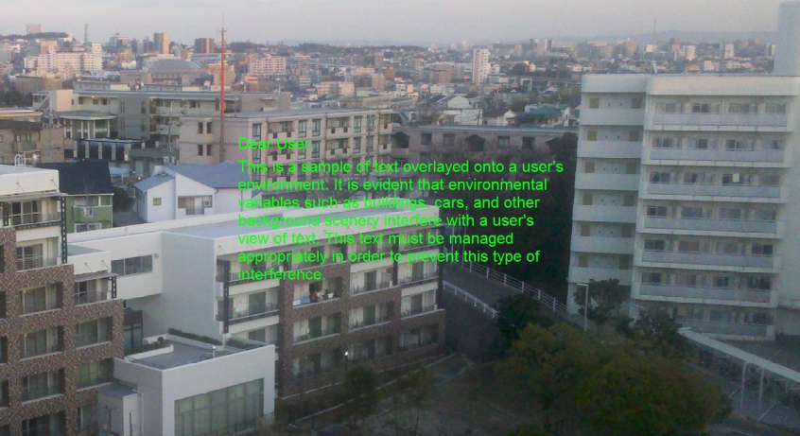
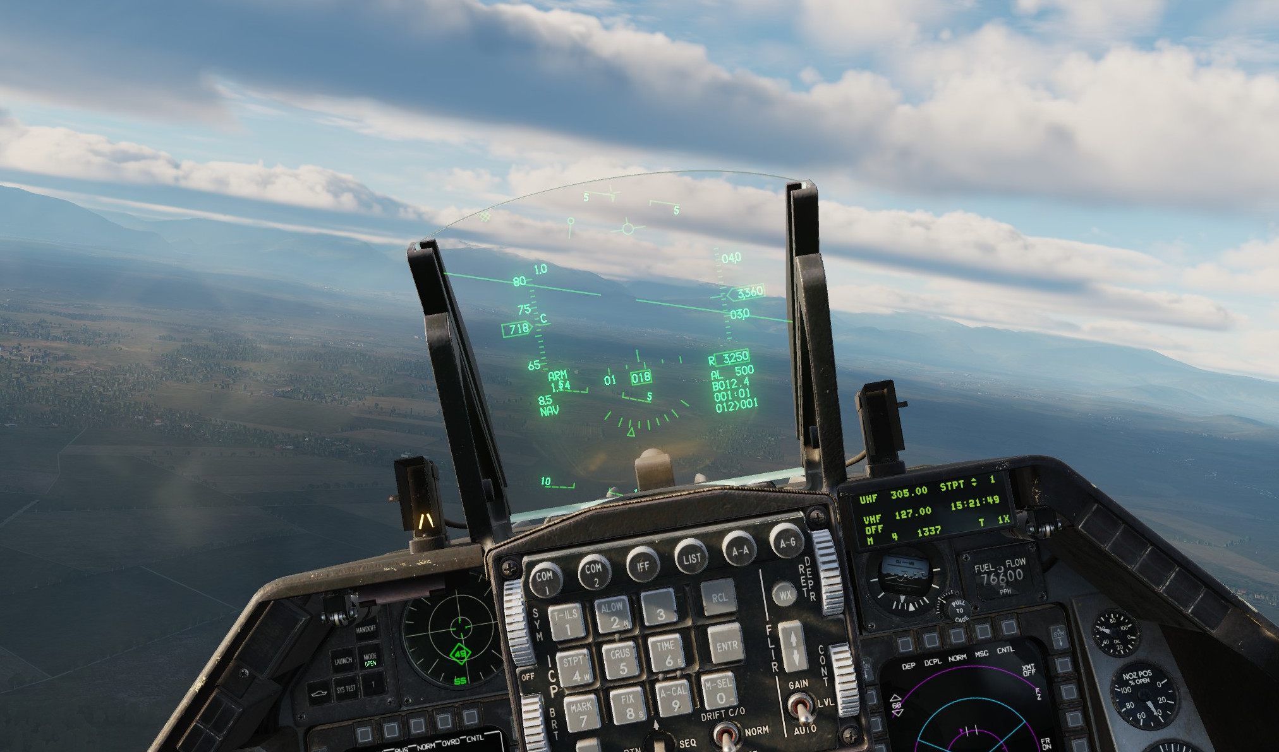
Background
Augmented Reality & Head Mounted Displays & Heads Up Displays
  See-through displays allow users to view both the real world and digital information simultaneously.
  Increasingly used in fields like vehicle navigation, military applications, and mobile devices.
Challenges:
  Text readability remains a major issue in dynamic environments (e.g., changing lighting conditions, background distractions).
  Current solutions (e.g., fixed text positions) lack flexibility, leading to difficulty in reading and a poor user experience.

Slide 3
Related work
Readability Studies
  text color and background
  we chose bright green text for use in our method
Annotation and View Management
  how to display annotations, labels, and descriptive information
Environment Centric vs. User Centric Information
  Environment Centric: Content and environment location matters
  User Centric: The location of text in the environment is irrelevant to the content.
The question of how to appropriately manage and move user-centric text still remains unanswered.
Furthermore, algorithms for detecting readable areas exists, but are not always implemented in real time, do not find the best area for readability, and provide no methodology for moving text from one readable area to the next

Slide 4
Framework
Selecting Viable Regions for Text
Content Movement
Text Orientation and Stability
Sparse sampling for efficiency

Slide 5
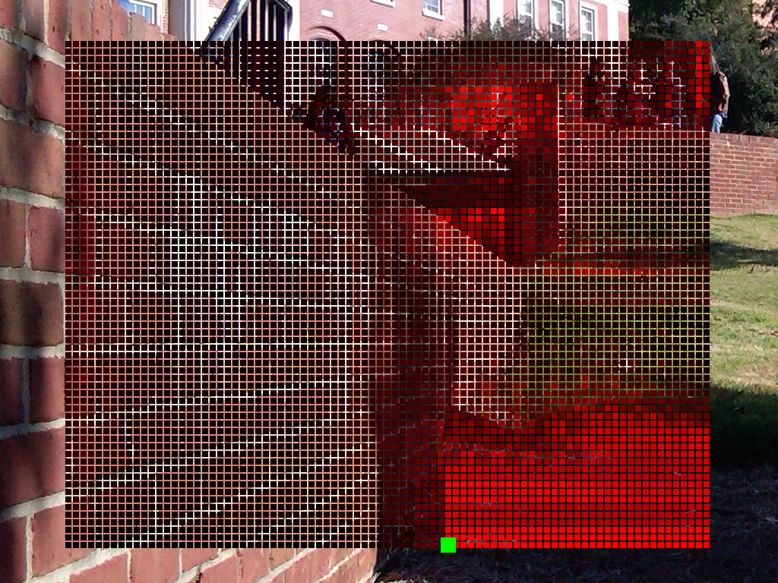
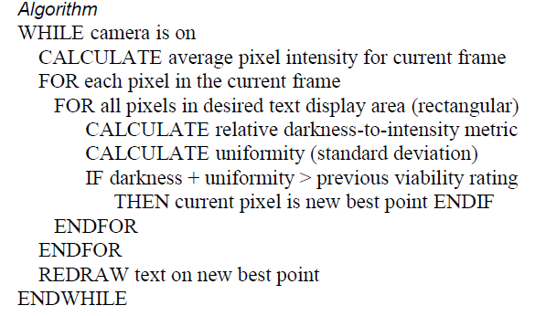
Selecting Viable Regions for Text
Out of light text colors, bright green (#00FF00) was chosen due to its contrast with colors of a majority of man-made structures, predominantly gray.
Though bright green works in many environments, complement colors should also be considered, especially in environments with dense foliage or greenery.

Slide 6
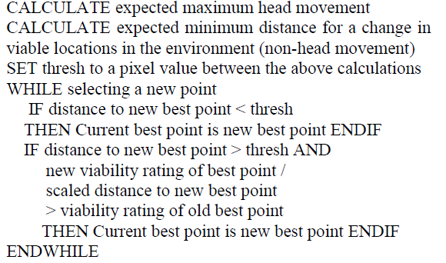
Content Movement
Ideal regions for text often change significantly from frame to frame due to changing lighting conditions.
Move to ideal regions every time will reduce readability.
1) Move text directly to the next ideal location if the change in ideal location is only due to camera movement
2) only move to new, distant locations in the environment if the current location has become much worse than the new one.

Slide 7
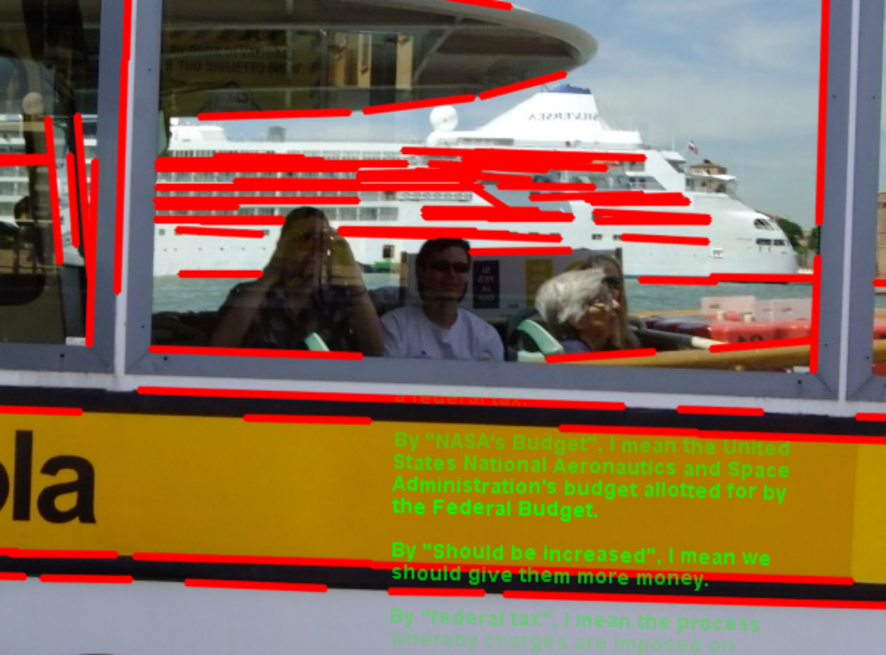
Text Orientation and Stability
In order to relieve technologically induced intersensory conflict, we built stabilization into our method.
Gravity-stable: accelerometers.
Region-stable: text is aligned to the surface or surrounding surfaces on which text is overlayed.

Slide 8
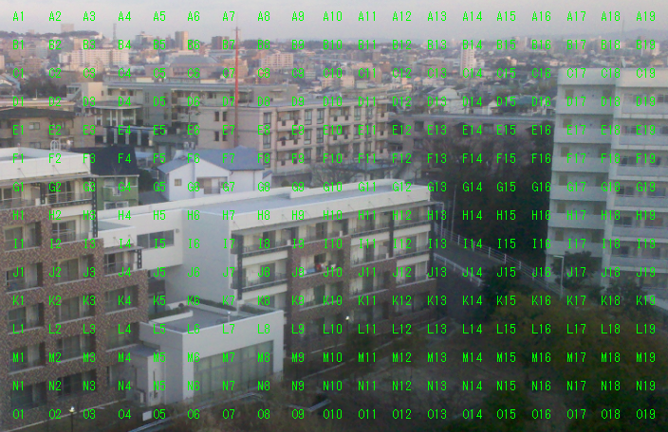
Experiment
Setup:
  19 participants, ranging from age 19 to 67
  20 images (1024x768) with the same 25x25 matrix of bright green character strings.
  asked to enter the character string corresponding to the most appropriate region for text in each image

Slide 9
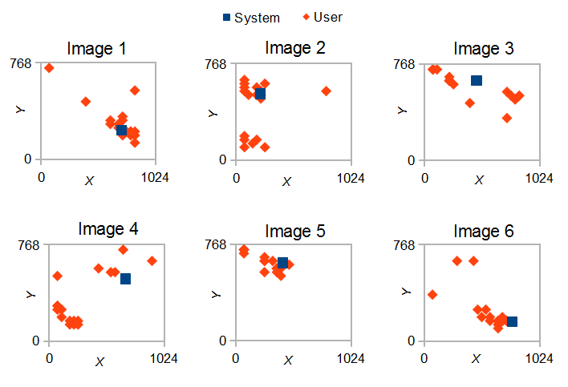
Results

Slide 10
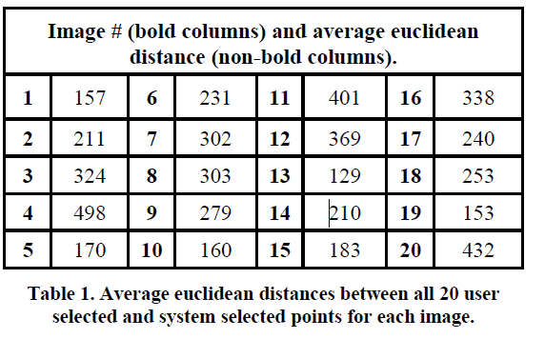

Slide 11
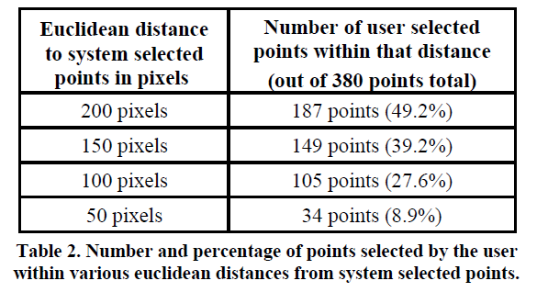

Slide 12
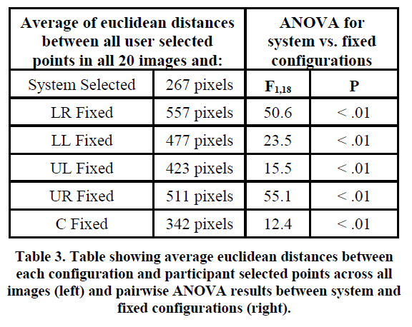

Slide 13
Future work
developing a learning algorithm that adapts region selection methodology based on user selected areas. Much like using training data, a learning algorithm would not only make our method more effective, but allow for automated customization based on individual users.
implement fast feature tracking in order to improve our stabilization method as well as expand methodology for moving text through the environment.

