Slide 1
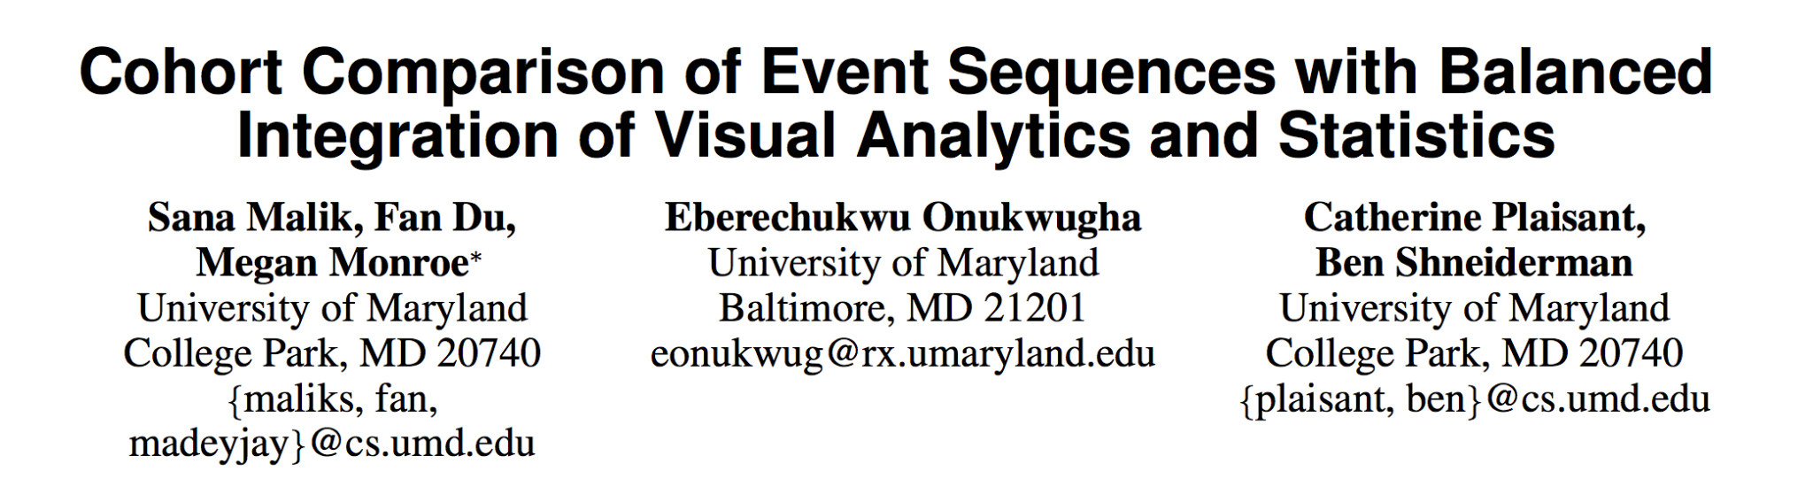
Presented by Junru Liu

Slide 2
Background
Finding the differences and similarities between two datasets (cohorts)
  a typical e-commerce site tracking each of its users through a series of search results and product pages until a purchase is made
  a database of electronic health records containing the symptoms, medications, and outcomes of each patient who is treated
Common yet complex as they as differ in
  structure of the event sequences: event order, co-occurring events, or event frequencies
  attributes of events and records: patient gender
  metrics about the timestamps themselves: event duration
Time consuming to cover all cases and tough to determine which is significant

Slide 3
Background
Current analytics tools
  purely statistical or purely visual
  Human eyes: see context, accountability, and most notably, things that they may not have even been looking for
  Statistical tests: see metrics, uncertainty, and statistical significance
Visualization tools strive to capitalize on human strengths
  The more that a visual analytics tool is designed around open-ended questions and flexible data exploration, the less it is able to effectively integrate automated, statistical analysis.
  Automated statistics can provide answers, but only when the questions are known
Combining these two, to automatically generate concrete answers to open-ended questions.
  CoCo (for “Cohort Comparison”)

Slide 4
Related Work
A single group
  EventFlow & OutFlow:
    Create simplified visualizations of collections of event and interval sequences
    Both aggregate a single cohort and the complete sequences of records
      EventFlow allowing users to view details about individual records as well
    While they only support visualizing a single group of records, comparison of multiple cohorts can be facilitated by using multiple instances of the visualization and visual inspection by the user.

Slide 5
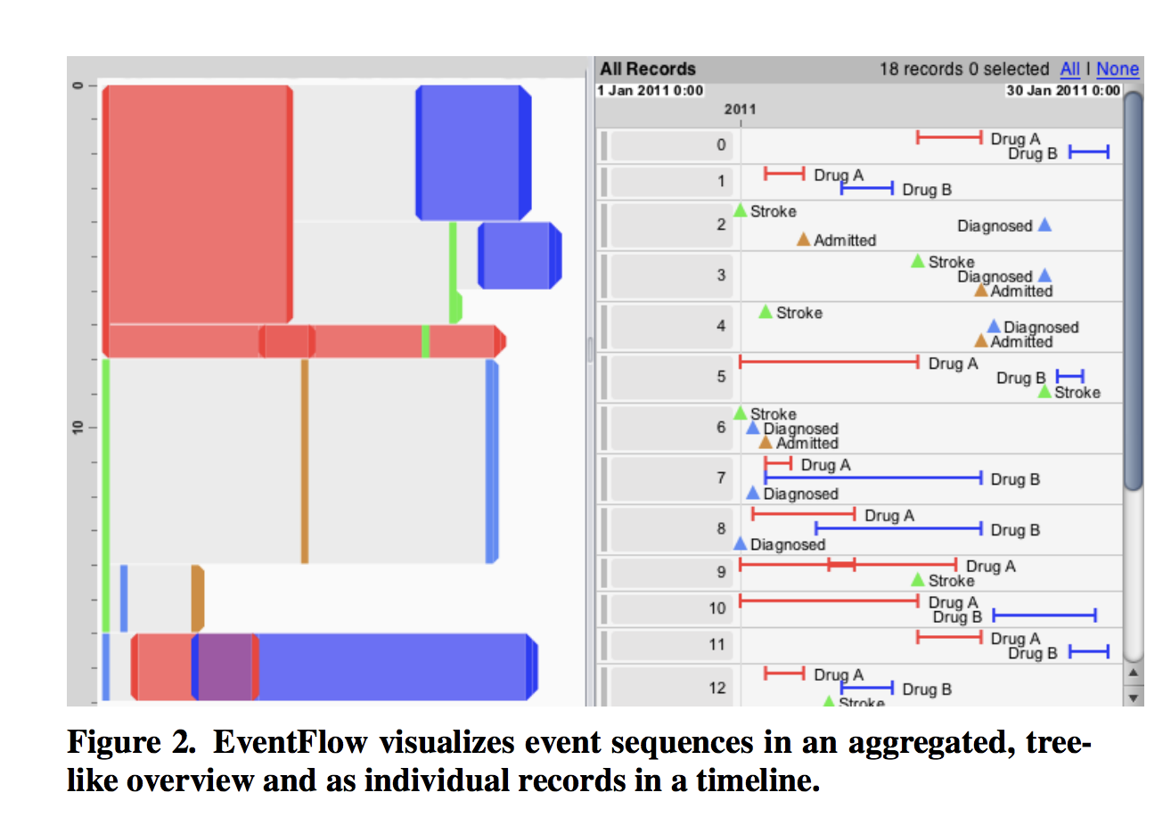
Related Work
Do not provide statistical information about the differences.
  CoCo borrows some event icon motifs from EventFlow (such as triangles for point events and T-shaped markers for interval events).

Slide 6
Related Work
Event Sequence Comparison
  comparative genomics
    MizBee measures the similarity between genomes by visualizing the regions of shared sequences
    Variant View, cBio, and MuSiC only support displaying sequence variants
  text mining
    FeatureLens define an n-gram as a contiguous sequence of words and use a visualization approach to compare the co-occurrences of frequent n-grams in texts.
  tree comparison
    Temporal event sequences
    TreeJuxtaposer helps biologists explore structural details of phylogenetics, but focuses only on structural differences in the trees and not any attributes about the nodes (such as timestamps)
    TreeVersity2 compares by tree structure and the node values and is general to all trees, it leaves out temporal-specific analysis such as duration of or between interval events

Slide 7
Key Takeaways
A taxonomy of metrics for comparing groups of temporal event sequences
A visual analytics tool which demonstrates balanced integration of automated analysis and user-guided analysis with an intelligent user interface
Case studies that illustrate the benefits of CoCo’s utility while suggesting further refinements

Slide 8
Taxonomy
Summary metrics
  Number of records, events, unique records, each event
  Minimum, Maximum, and Average length of records
Event sequence metrics
  Prevalence of an event, a subsequence, a whole sequence, Outcomes
  Order of sequential events in a subsequence
  Commonly Co-occurring (non-consecutive) events
Record attribute metrics
  population statistics such as patient gender or age

Slide 9
Taxonomy
Time metrics
  Absolute time of an event
  Duration of interval events, a subsequence, overlap in interval events
  Duration between sequential events
Event attribute metrics
  In a medical dataset, we might be interested in seeing how a particular emergency room doctor might be related to the outcome of a patient.

Slide 10
Cohort Comparison with Coco
Design
  an iterative design process based on feedback from on-going case study partners and a user study
G1. Automatic, efficient computation of metrics
  current implementation computes a metric as the user selects it.
  offers less guidance than if the metrics were pre-computed.
  future goal is to minimize wait time, but give prompt feedback on which metrics might be meaningful to look at immediately

Slide 11
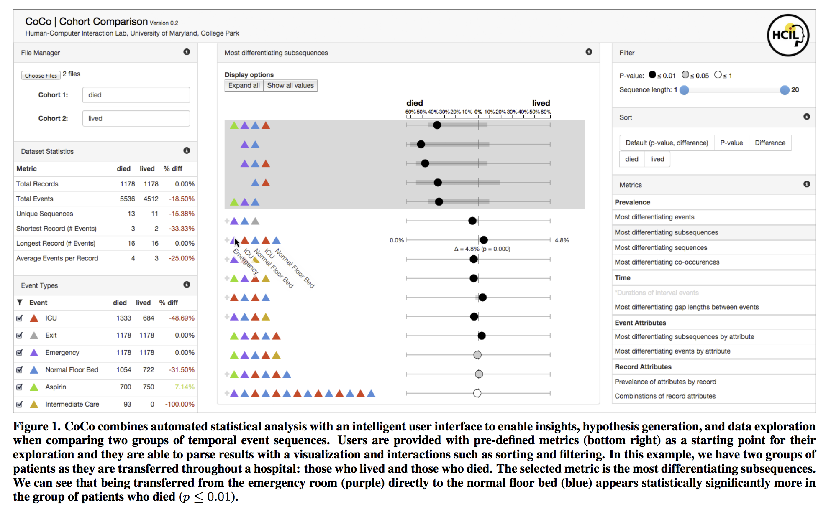
Cohort Comparison with Coco
G2. Guided process for reading results
  CoCo consists of a file manager pane, a dataset statistics pane, an event legend, a list of available metrics, the CoCo visualization, and options for filtering and sorting the results

Slide 12
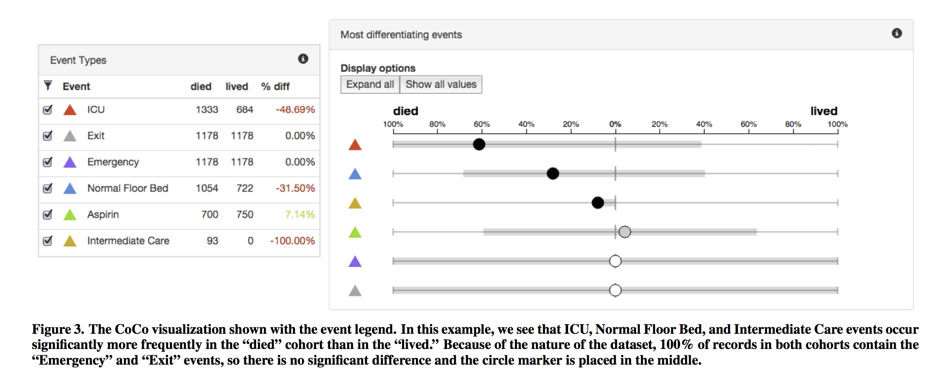
Cohort Comparison with Coco
G3. Visualization
  a back-to-back bar chart in order to emphasize the magnitude and direction of the difference, so users can more easily scan across multiple rows for results they are interested in

Slide 13
Cohort Comparison with Coco
G3. Parsing and sorting results
  CoCo allows users to sort and filter the results based on their needs.
  Specifically, the sorting method may be changed based on:
    Magnitude of difference and p-value group (default)
    P-value only • Magnitude of difference only
    Most differentiating towards the alpha group
    Most differentiating towards the beta group

Slide 14
Case Study: Exploring Adherence to Advanced Trauma Life Support Protocol
Assessed CoCo’s utility as a tool for comparing trauma care cohorts in adherence to the Advanced Trauma Life Support (ATLS) protocol.
Researchers at Children’s National Medical Center examined 181 patient records, exploring factors like injury severity, treatment timing, and protocol deviations.
Key findings included less adherence to airway checks and greater sequence variation at night, potentially due to staffing differences.
The study demonstrated CoCo’s value in hypothesis generation for trauma care, though further research is needed to confirm its effectiveness.

Slide 15
On-going Case Study: Comparing Algorithms for Distinguishing Types of Radiation to the Bone
Researchers from the University of Maryland are using CoCo to test algorithms that distinguish bone-targeted radiation from prostate radiation in claims data.
While the team found CoCo valuable for visual comparisons, they suggested improvements in metric labeling.
This study also prompted new CoCo features and expanded its use to other fields, such as transportation analysis.

Slide 16
Conclusion & Future Work
CoCo is a novel visual analytics tool with balanced integration of visual analytics and statistics.
Limitations of the complexity of datasets, current emphasis on two cohorts, and the need for more user control on which events to study
Fresh possibilities for statistical comparisons, supported by visual presentations and an intelligent user interface, opens many doors for further research

