Slide 1
End-User Programming of Mashups with Vegemite
James Lin, Jeffrey Wong, Jeffrey Nichols, Allen Cypher, and Tessa A. Lau
Spencer Cho, 11/11/2024

Slide 2
Background
Mashups
  Integrate data from multiple web sites to fill need
  Con:
    Often requires substantial technical knowledge
Solution:
  Extension of CoScripter web automation tool known as Vegemite

Slide 3
Background
Vegemite
  Begin with empty table (VegeTable)
  Manually enter data or copy from source
    Spreadsheet
    Website (direct manipulation tool)
  Users record action for scripting
    Ex: Driving distance on Yahoo! Maps
    Important difference from other mashup tools
    Arbitrary low-level web actions

Slide 4
Background
Advantages
  Scripts are performed in context of web browsing
  Mixed-initiative interaction style
    Automation with ability to correct actions manually
Disadvantages
  Each script must be executed for each row in table

Slide 5
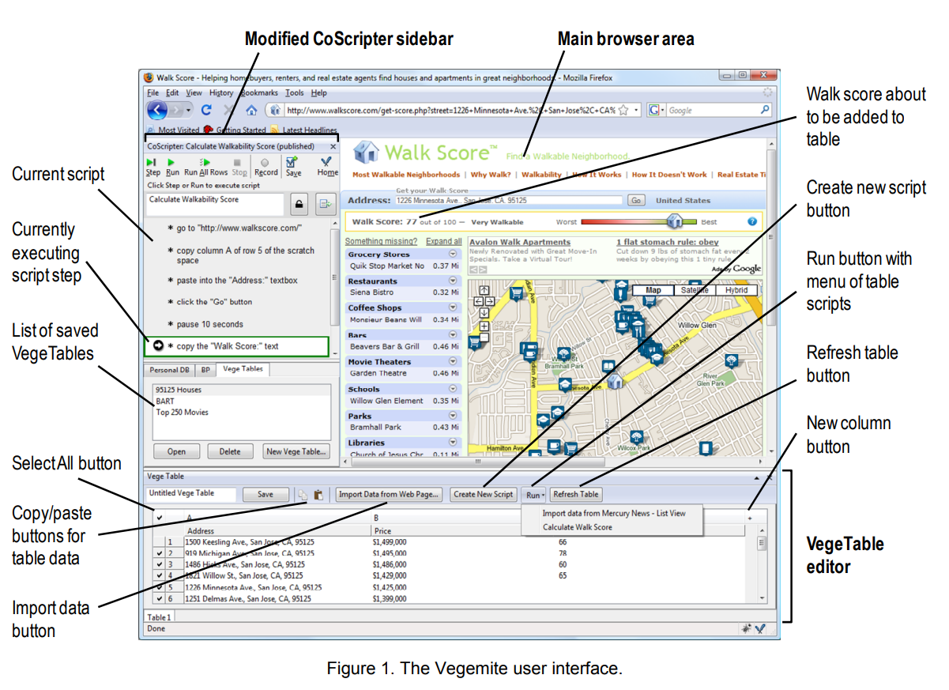

Slide 6
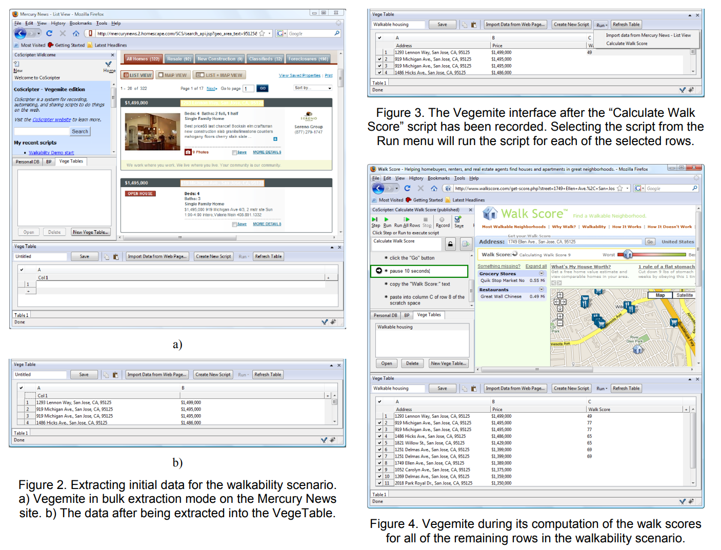

Slide 7
Related Work
Mashup Tasks
  Extracting data
  Aggregating data from different sources into a single data set
  Visualizing data in a way that users understand
Mash Maker
Karma
Sifter
Solvent
Piggy Bank
Potluck
Summaries, Relations, Cards, and Templates (SRCT)
Marmite

Slide 8
Applications
Walkable homes within a neighborhood
  i.e. within walking distance of shopping, jobs, and transit
Closest yogurt shop within certain address
The processing rate of visas
Annotating information regarding movies from IMDb

Slide 9
Architecture
Two main components
  VegeTable
  CoScripter
Coscripter
  Firefox extension that records and plays back actions on web page
VegeTable
  Set of tabular data and scripts that extract data into the table or perform operations on the table data

Slide 10
Architecture
Additional capabilities provided by Vegemite
  Recording and playback of copy and paste interactions
  Recording and playback of operations that modify the VegeTable
  Generalization of row labels for applying scripts to different rows than they were recorded on
  Labeling for certain non-form elements
  Identification of any page element via XPath

Slide 11
User Study
Conducted with eight volunteers from the research lab
  Six had significant programming experience
Participants received a short demo and were then asked to construct three mashups
  Calculating walk scores for real estate
  Finding nearby yogurt shops
  Aggregating Visa Bulletin dates
Subjects were encouraged to think aloud and could request help, though assistance was minimized to preserve study integrity

Slide 12
Results
Out of 24 tasks, 18 were completed successfully, four failed, and two were skipped due to time constraints
Initial struggles were noted due to Vegemite's learning curve, especially with the first task
Non-programmers faced more challenges, indicating areas for improvement in user interface for broader accessibility

Slide 13
Discussion
Users found some steps in constructing mashups to be complex and suggested improvements for interface clarity and discoverability
Modifications were made post-study, such as aligning the data extraction and script-based interfaces to reduce confusion
Specific UI elements, like the addition of a "Run All Rows" button, were incorporated to streamline operations

Slide 14
Future Work
Additional interface improvements needed for better user experience, particularly for non-programmers
Plan to explore integrating Vegemite more tightly with either the web browser or spreadsheet tools
Potential for more data cleaning tools, like automatic transformations similar to Karma
Developing methods for selecting specific search results to improve accuracy in returned data

Slide 15
Conclusion
Vegemite distinguishes itself from other mashup tools by
  Focusing on programming by demonstration
  Use of iterative, interactive transformation of data by the user
  Principle of mixed-initiative interaction
Lowers the barrier to creating mashups
  Relaxes assumption that program must be perfect in handling all cases or not handle any at all
Allows for creation of on-the-fly mashups for immediate needs

