Slide 1
Prediction of Users’ Learning Curves for Adaptation while Using an Information Visualization
Sébastien Lallé, Dereck Toker, Cristina Conati, Giuseppe Carenini
Presented by: Marshall McIlyar

Slide 2
Goal of the Paper
GOAL: “The goal of this paper is to compare the performance of models that leverage these various data sources, as well as basic information on past task performance, to predict users' skill acquisition in real-time. “
LONG TERM IDEA: adapt visualization tools based on predicted learning curves of the user in real time
NOTE: “can we predict a user’s learning curve while a user is learning to use a visualization tool like ValueChart?”

Slide 3
Learning Curves
Initial level of expertise
Rate of learning over time
For this study: it relates to InfoViz, meaning the learning curve of someone acquiring visualization skills

Slide 4
How does this paper model learning curves?
Legacy: Observe past performance
Novel:
1. Eye tracking
2. Pupil dilation
3. Historical data on Cognitive abilities and personality traits

Slide 5
Related Work
>used learning curves as a metric for evaluating a tool’s ability.
>used in education based on results
>used for skilled and unskilled use
>gaze and pupil data shown to have success in modelling user abilities during problem solving
BOTTOM LINE: related works don’t develop a continuous, predictive learning curve model

Slide 6
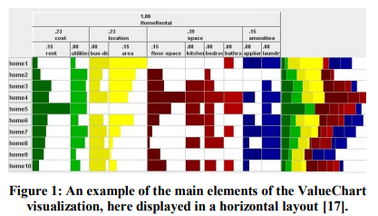
Value Chart
>visualization that helps users select the best option out
>alternatives on the left
>metrics on the top
>crossbar contains how well an alternative performs for a given metric
>far right is cumulative performance

Slide 7
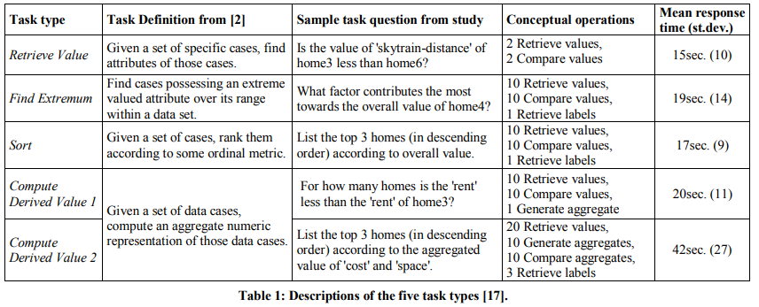
Study construction
>users must solve tasks
>vertical and horizontal Value Chart layouts
>40 total tasks (5 types, 4 repetitions, 2 layouts)
>20 total tasks per layout
>eye tracker for gaze tracking
>eye tracker for pupil dilation measuring

Slide 8
Novel Learning Curve Parameters
Gaze Pattern
  Where the user fixates their gaze
  How long do they look there
Pupil Size
  Percentage change in size measured
Long Term Characteristics
  Perceptual speed
  Verbal working memory
  Visual working memory

Slide 9
Prediction models
Task performance metrics
>response time and accuracy as a base model
Machine Learning Metrics
> each novel learning curve parameter then measured individually
> machine learning uses existing datapoints to predict new ones

Slide 10
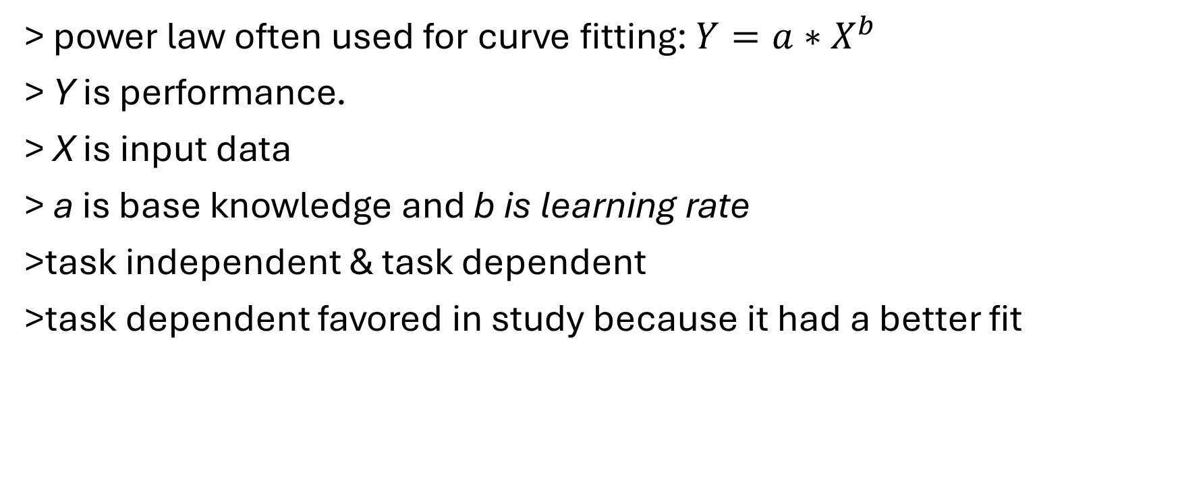
Learning Curve Construction
> power law often used for curve fitting: $Y=a∗X^{b}$
> Y is performance.
> X is input data
> a is base knowledge and b is learning rate
>task independent & task dependent
>task dependent favored in study because it had a better fit

Slide 11
Results
QUALITATIVE
> combining all 3 novel learning curve parameters was best
> prior task performance performed the worst
> this is true for both intercept and slope of learning curve
> all 3 individual metrics are better than or equal to baseline
QUANTITATIVE
> 70% accuracy in predicting a slow or fast learner after only 4 trials
> 80% accuracy after 20 trials

Slide 12
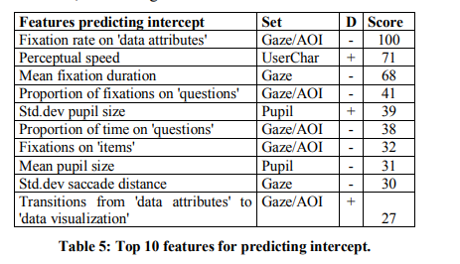
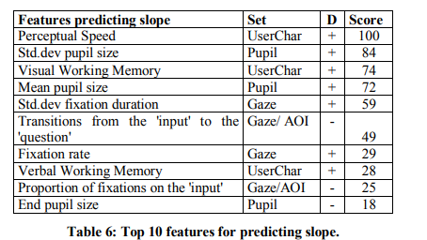
Results

Slide 13
Conclusion
Adaptive technology is key to helping people become proficient with digital skills like Infoviz proficiency
One way to adapt technology to a user’s skills is to predict their learning curve
This study found that user traits, gaze analysis, and pupil dilation can predict a user’s learning curve
It’s feasible to tweak InfoViz software to fit a learner’s needs

