Slide 1
Improving Inquiry-Driven Modeling in Science Education through Interaction with Intelligent Tutoring Agents
David A. Joyner, Ashok K Goel
Annie Ren, 10/14/2024

Slide 2
Background
Constructionist learning approach:
Learning in open-ended environment
Discovery-based, project-based, inquiry-based
Benefits:
Improvement in student engagement and participation
Similar to real-world scientific research experience
Critiques:
Students may lack foundational knowledge for unguided discovery and learning

Slide 3
Background
Need for guided instruction to aid students in inquiry-driven learning
Modeling & Inquiry Learning Application – Tutoring
(MILA-T)
5 intelligent agents that mimic the role of a teacher
Experiment:
track student behavior, feedback, team interaction
238 middle school science students working in groups of 2-3
differences in behavior based on interaction with MILA

Slide 4
Related Work
Modeling and Inquiry in Education:
Approaches that exposes students to authentic scientific practice
Inquiry – scientists examine the domain they are investigating and collect data to gain understanding
Model – make predictions based on data gathered during inquiry
Challenges:
It is difficult for one teacher to guide a classroom of students in open-ended inquiry and discover at once

Slide 5
Related Work
Metacognitive Tutoring
Intelligent agents that teach students metacognitive skills like self-regulated learning, self-explanation, help-seeking
Challenges:
The skills are domain-independent but have to be taught within a domain
Students are most likely to focus on domain-specific skills
Difficult to teach explicitly

Slide 6
Inquiry-Driven Modeling
The modeling process is driven by the inquiry process and future inquiries are directed by the model
Benefits:
Inherently a metacognitive skill
Teaches a broader self-learning process

Slide 7
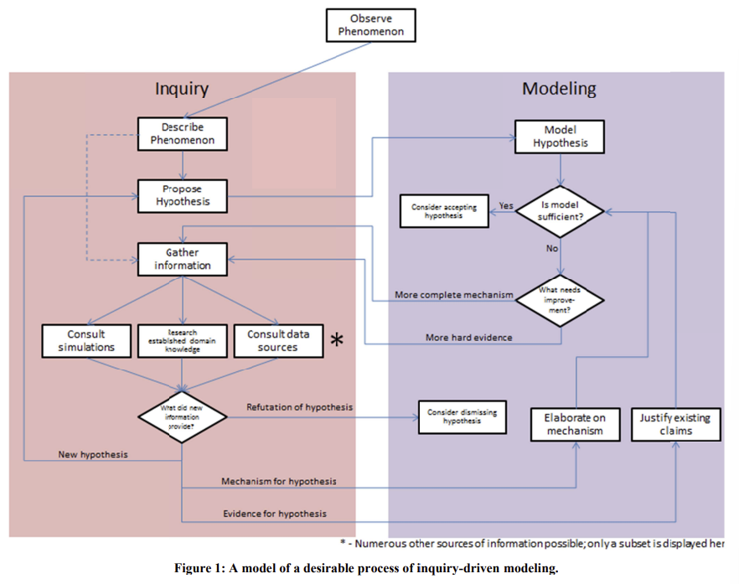

Slide 8
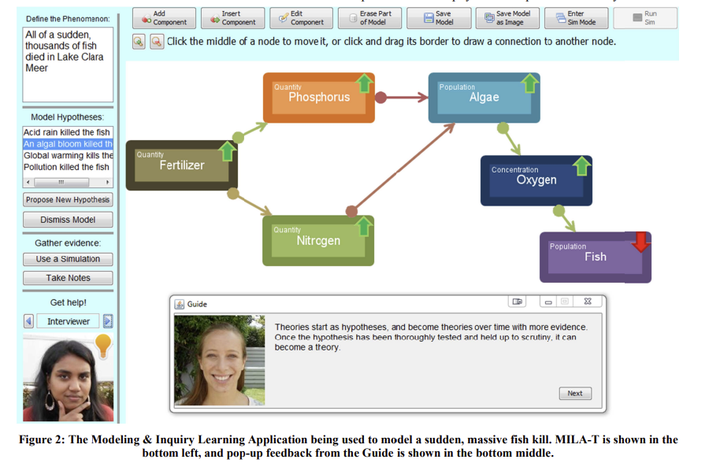
MILA-Tutoring

Slide 9
MILA-Tutoring
The Observer:
Monitors activity of the team and makes a modeling assessment, inquiry assessment, and ecology assessment
Provides models to other tutors to establish team’s ability and provide feedback
Modeling assessment: checks for willingness to propose new explanations over time
Inquiry assessment: monitors quality and quantity of evidence
Ecology assessment: checks for desired components and relationships

Slide 10
MILA-Tutoring
The Guide:
Anticipate questions and provide answers
Examine Observer’s model of the team’s ability, current classroom context, current status of team’s models
Creates rules that allow the Guide to ask certain questions and provide answers
The Critic:
Provide feedback to the teams
Teams can consult if they are unsure about how to proceed
Rules that trigger different explanations and feedback

Slide 11
MILA-Tutoring
The Mentor:
Monitors for weaknesses in the team’s modeling and evidence
Provides unsolicited feedback and help
Rules that trigger different feedback
The Interviewer:
Asks questions to the team that they should answer themselves at critical junctures
Encourages reflexive learning by asking team to reflect on their reasoning

Slide 12
Experimental Design
MILA and MILA-T deployed in 7th grade life science classroom for 2-week unit
Students in teams of 2-3 completed 2 projects
  1 learning project, 1 transfer project
2 teachers each with 5 classes
  2 classes as control, 3 classes as experimental
Control used MILA without MILA-T
Experimental used MILA with MILA-T during the learning project and MILA without MILA-T during the transfer project

Slide 13
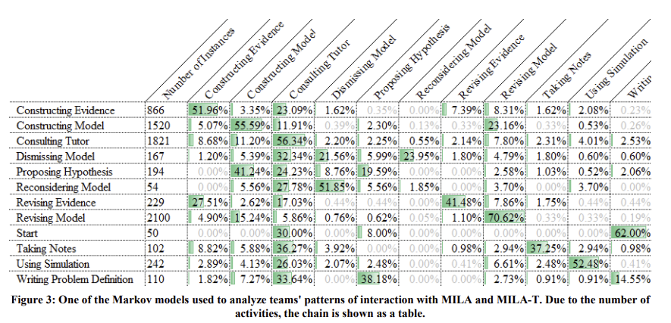
Analysis
Markov Chains:
Summarize transitions among distinct states to describe patterns of interaction within teams

Slide 14
Analysis
Desired Improvements:
Greater incidence of articulating problem before modeling and inquiry
Greater instance of using results from data-collecting to:
  construct new justifications
  revise previous evidential justifications
  refute previous hypothesis
  propose new hypothesis
Greater incidence of revising problem definition
Greater incidence of model revision
Greater incidence of model construction
Greater incidence of note-taking

Slide 15
Analysis
Learning Project:
3/9 criteria showed statistically significant differences between control and experiment
Experiment teams more likely to revise their problem definitions and models over time
Control teams more likely to take notes
Transfer Project:
3/9 criteria showed statistically significant differences
Experiment teams more likely to revise their models and take notes
Control teams more likely to revise their problem definitions

Slide 16
Conclusion
Intelligent tutoring agents to teach students the metacognitive process of inquiry-driven modeling
Engagement with a metacognitive tutoring system improved student participation
Tutors encouraged construction and revision
Inquiry driven modeling process decreases the propensity to accept an explanation too early
Further analysis is needed to validate these ideas

