Slide 1
Models of Attention in Computing and Communication:
From Principles to Applications
Eric Horvitz, Carl Kadie, Tim Paek, David Hovel
Presenter: Jing Cao

Slide 2
Introduction
Research Area
Cognitive psychology and human-computer interaction (HCI)
Problem
Humans have limited attention and working memory. We can only focus on a few things at once, and we often struggle to manage multiple tasks effectively. These limitations affect how we communicate and interact with technology and system.
Objective
The paper explore how attention models can be integrated into computing systems to enhance user experience.
Key focus including:
Sensing and predicting user attention
Minimizing disruptions in communication and interaction
Improving task efficiency through attention-sensitive systems

Slide 3
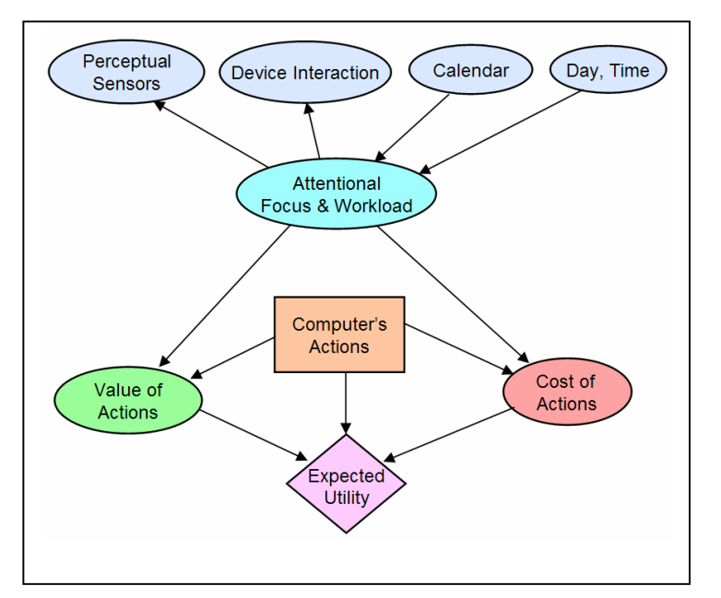
Research Approach and Methods
Attentional Models
Use of Bayesian networks (a probabilistic approach) and sensor fusion to infer a user’s attention state.
Data Source
Bayesian models predict attention under uncertainty by combining data from multiple sources. Data sources including sensors such as gaze trackers or accelerometers, traditional sources of events and background informations.

Slide 4
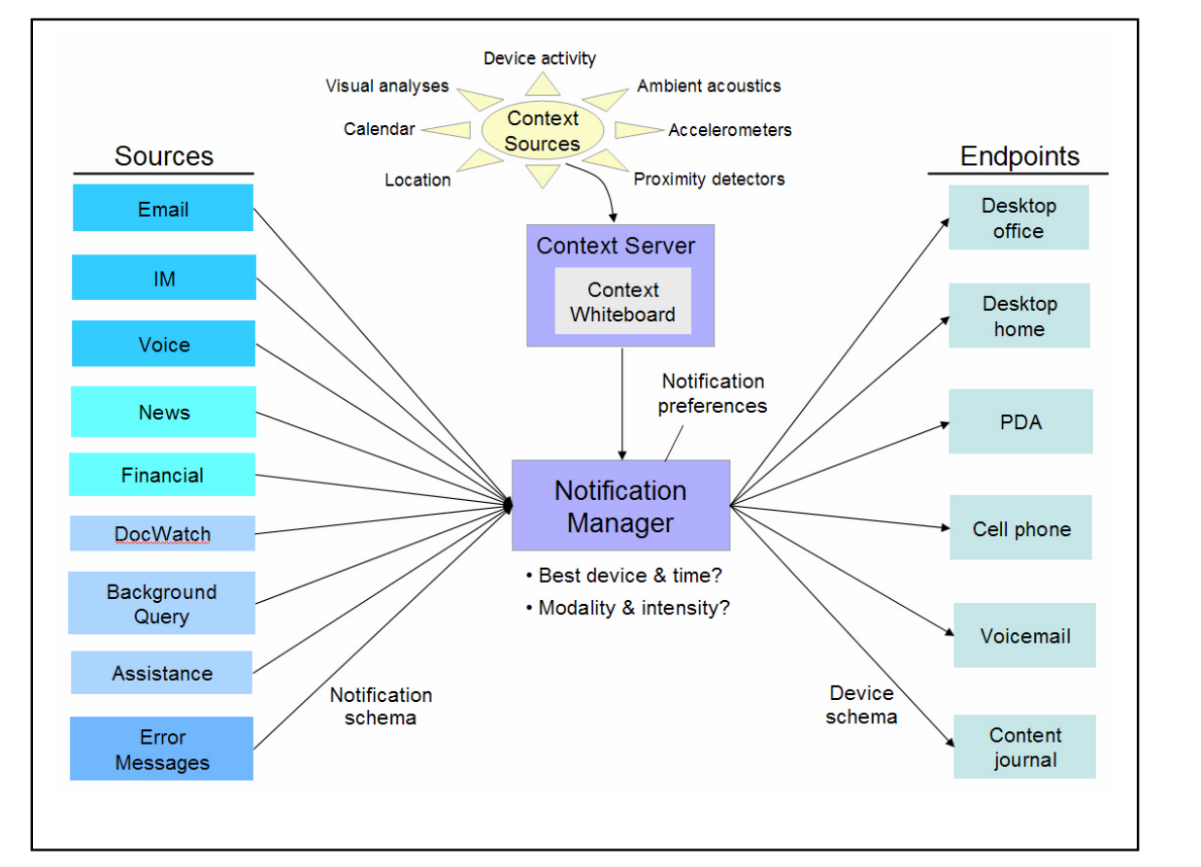
Key Result:Attention-Sensitive Notifications
Problem: Notifications often disrupt users at inappropriate times.
Solution: Attention-sensitive systems like the Notification Platform decide when and how to alert based on user focus. Uses attentional data to weigh the value of information vs. the cost of disruption.
Result: Improved user experience with fewer interruptions during high-focus tasks.

Slide 5
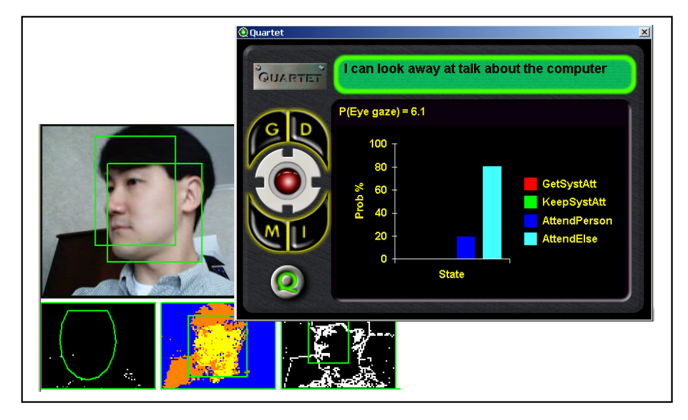
Key Results: Mixed-Initiative Interaction
Problem: Computers often fail to recognize when a user wants to interact.
Solution: Systems like DeepListener and Quartet infer when they are the target of speech. Quartet uses attention cues like speech patterns and gaze to determine when to engage in conversation.
Result: More fluid and responsive human-computer interaction.

Slide 6
Conclusion
Summary
Integrating attention models into systems can significantly improve interaction by adapting to user focus.
Results
More effective notifications, fewer distractions, and better human-computer collaboration.
Future Potential
Continued refinement of attentional models will lead to more seamless and intuitive technology.

