Slide 1
Principles of Mixed-Initiative User Interfaces
Eric Horvitz
Microsoft Research
Discussant: Yi Wen 27th Sep

Slide 2
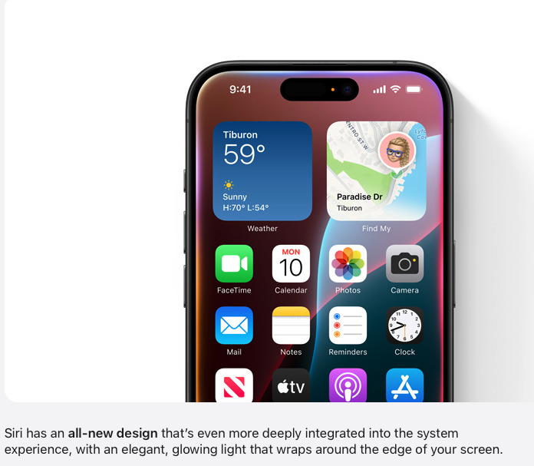
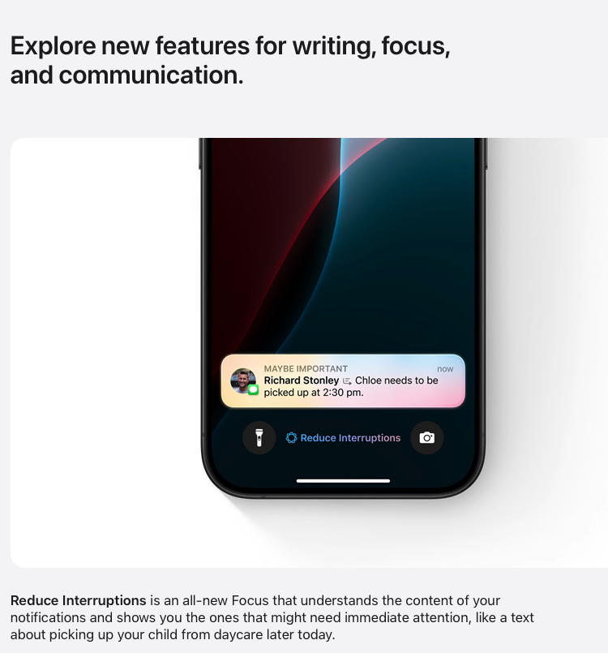
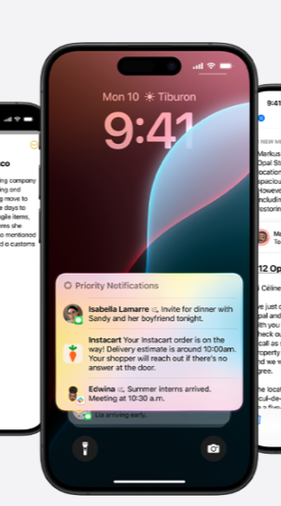
Relevance to today’s research
Interface agents that provide automation ➡️ AI agents that understand natural language to execute various tasks
Might make poor guesses about users ➡️ less likely to have error

Slide 3
Mixed initiative user interface
⬇️
Human-AI collaboration

Slide 4
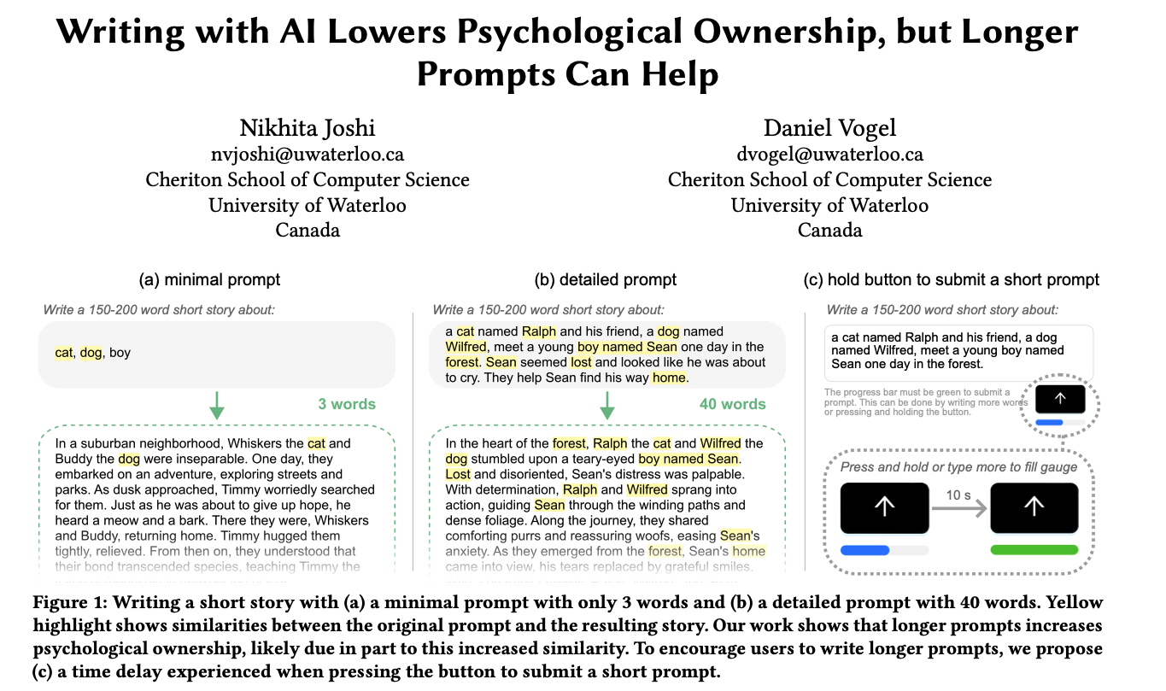
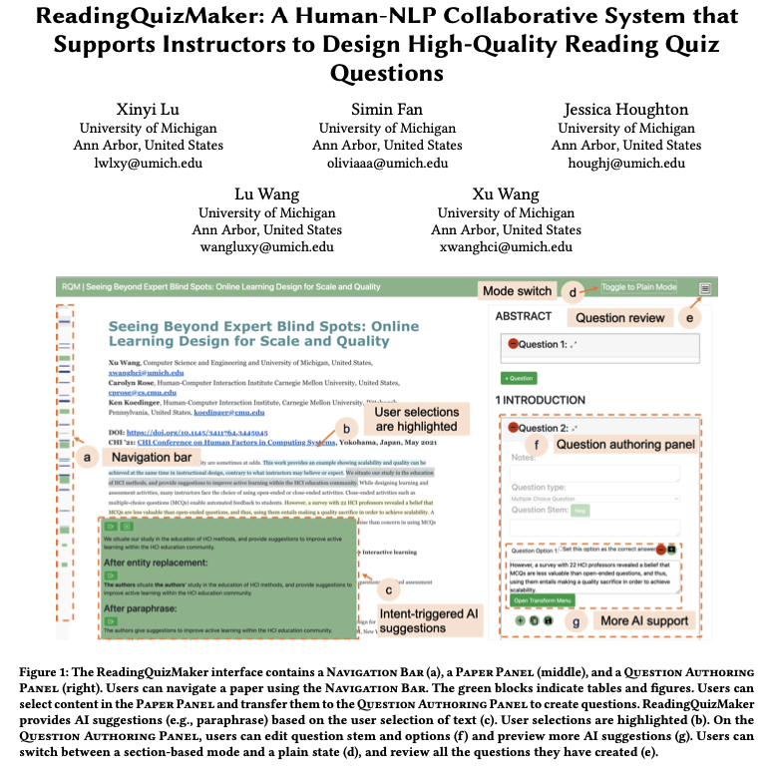

Towards Process-Oriented, Modular, and Versatile Question Generation that Meets Educational Needs
Xu Wang et.al. NAACL 2022
Xu Wang Simin Fan Jessica Houghton Lu Wang

Slide 5
What Lucy has said about this research?
Lucy’s viewpoint on interface agent: They can oversimplify complex human interactions and decision-making processes
Importance of understanding the context in which technology is used
Systems should support human interaction rather than replace it
A more collaborative approach, where technology assists and augments human activity rather than attempting to act independently

Slide 6
What Simon has said about this research?
Bounded rationality of human beings
importance of combining human intuition with computational assistance to achieve better outcomes

Slide 7
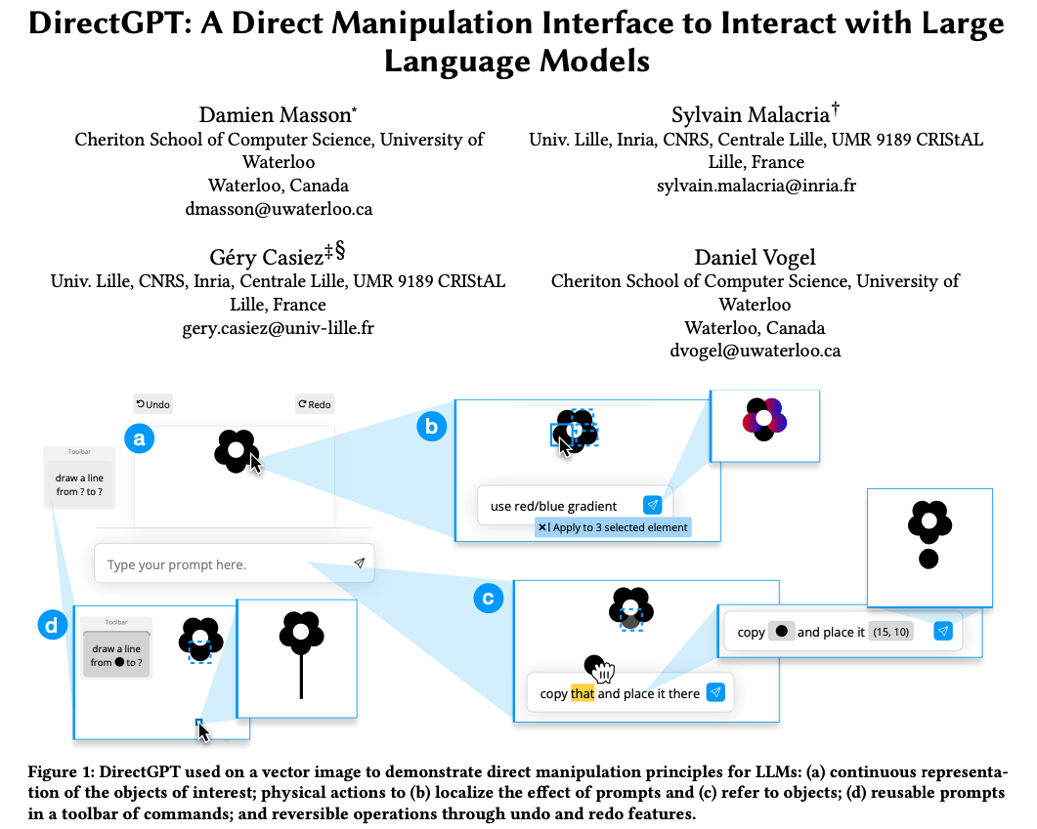
How projects might learn from these results
Considering the status of a user’s attention in the timing of services.
Maintaining working memory of recent interactions.
Providing mechanisms for efficient agent-user collaboration to refine results.

