Slide 1
Gamut: A Design Probe to Understand How Data Scientists Understand Machine Learning
Arunesh Mishra

Slide 2
Introduction
Machine Learning (ML) models are often complex and hard to interpret for experts.
There can hidden biases, false patterns, and wrong correlations can lead to poor decision-making.
Need for tools to interpret models in a meaningful way.
Question: How can we help data scientists better understand and explain ML models?

Slide 3
Current Challenges
No clear or universal definition of interpretability.
Different audiences (e.g., model builders vs. users) need different explanations.
Various levels of expertise in the field
Interpretability is often a trade-off between simplicity and completeness.
GDPR’s Right to Explanation highlights the importance of this issue in legal contexts.

Slide 4
What is Gamut?
Gamut is an interactive visual analytics tool designed to support data scientists in interpreting ML models.
It was developed through iterative design with expert machine learning researchers.
Contains graphs and tables for users to play with.
Focuses on both global and local model explanations.
Purpose: Probe how interactive interfaces can support model interpretation.

Slide 5
Gamut’s Design Overview
Human-centered approach to understanding interpretability.
Combines Global Explanations (whole model) with Local Explanations (single instance).
Uses Generalized Additive Models (GAMs), which offer intelligibility and accuracy.
Uses PowerBI type interface to explain model
Key design principle: balance between simplicity and detailed accuracy for users.

Slide 6
Features of Gamut
Shape Curve View: Visualizes how each feature affects the prediction globally.
Instance Explanation View: Breaks down individual prediction values with a waterfall chart.
Interactive Table: Allows exploration and comparison of data instances and features.
Interactivity: Users can adjust feature values, see nearest neighbors, and explore counterfactuals (what-if scenarios).

Slide 7
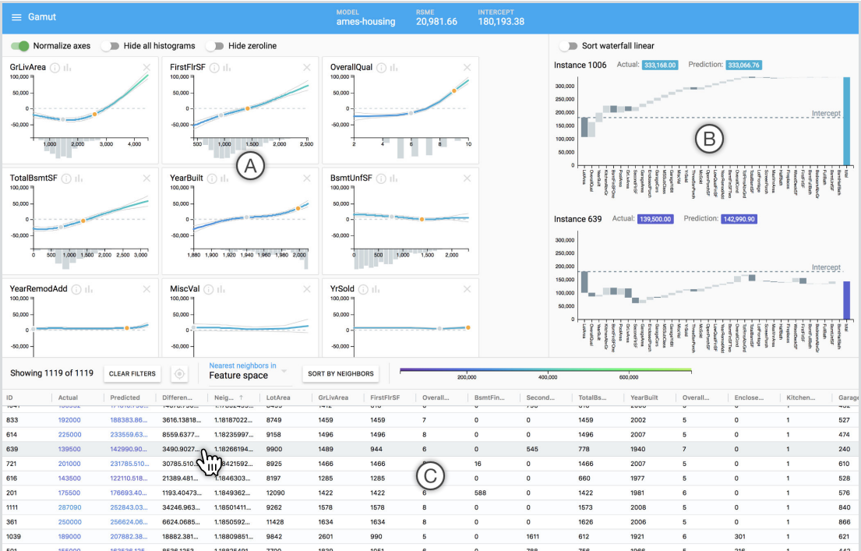

Slide 8
Methodology
12 professional data scientists participated in the study (range of expertise from novice to advanced).
Participants explored models in Gamut to answer interpretability questions.
Models used: Regression (e.g., housing prices) and Classification (e.g., heart disease prediction).
Participants were encouraged to think aloud while using Gamut.

Slide 9
Key Findings from the Study
Every participant was successful at answering both their own and our prepared questions about the different models, despite being new to GAMs and Gamut.
Participants wanted to use Gamut in their everyday work.
Exploration of interpretability -
  Hypothesis generation, data understanding, communication with stakeholders.
Global vs. Local Explanations -
  Global helps understand model behavior, local helps explain specific predictions.
Interactivity is essential: Data scientists valued the interactive features, making model exploration easier and more intuitive.

Slide 10
Gamut’s Contributions
A human-centered framework for model interpretability.
An interactive system designed for Generalized Additive Models (GAMs).
Insights into how professional data scientists interpret models and use interface affordances.
Highlighted the importance of interactivity in understanding complex machine learning models.

Slide 11
Conclusion and Future Directions
Gamut demonstrates the importance of visual and interactive tools for model interpretation.
It provides a foundation for designing tools that support both global and local explanations.
Future research could include integrating more complex models and scaling Gamut to handle larger datasets.
End-Note: Human-centered, interactive visualizations are crucial for making machine learning models more interpretable.

