Slide 1
Paper:
Gamut: A Design Probe to Understand How
Data Scientists Understand Machine Learning Models
Authors:
Fred Hohman (Georgia Institute of Technology)
Andrew Head (UC Berkeley)
Rich Caruana (Microsoft Research)
Robert DeLine (Microsoft Research)
Steven M. Drucker (Microsoft Research)
Presented by: Soumyajyoti Dutta • 10.21.2024

Slide 2
Overview
Discussion Points
Model Interpretability Challenges
Gamut - A Visual Analytics System
Human-Centered Approach
User Study Findings
Interactive Explanations
Research Questions
Why do data scientists need model interpretability?
How do they use global and local explanations?
What role does interactivity play in explainable AI interfaces?

Slide 3
Purpose
The paper titled presents a visual analytics system, Gamut
This aims at helping data scientists explore and interpret machine learning models.
The primary focus of the paper is to address the growing need for model interpretability, a critical issue in machine learning
Complex models can lead to biased or misleading outcomes if not properly understood.

Slide 4
Model Interpretability Challenges:
Notes
Without adequate tools to interpret models, data scientists face risks of making biased decisions based on spurious correlations
Interpretability is not a monolithic concept
Explanations
A situation where two variables appear to be statistically linked, but the relationship is actually coincidental and caused by a third, unseen factor, meaning there is no true causal connection
Data scientists interpret models differently depending on the audience and context

Slide 5
Gamut - A Visual Analytics System
Contributions
Introduces a system designed to explore both global and local explanations of machine learning models
Focuses on generalized additive models (GAMs)
Interactive visualizations, such as shape function charts and instance-level explanations.
Accomplishment
Help data scientists understand the model's behavior at both a macro (global) and micro (instance-level) level.

Slide 6
Attention areas
Human-Centered Approach
The research takes a human-centered approach by involving machine learning professionals in the design process
The system was used as a design probe in a user study with 12 professional data scientists to investigate their interpretability needs and behaviors
Interactive Explanations
Interactivity is found to be crucial for understanding model predictions
Emphasis on the interactive visual analytics is significantly more effective than static explanations, as users can explore counterfactuals, compare instances, and better engage with the model through tools like Gamut.

Slide 7
We will see the user study findings as we talk about the research questions

Slide 8
Answer the Research Questions

Slide 9
Why do data scientists need model interpretability?
Hypothesis Generation
Feature Importance
Future Development
Step 1
Step 2
Step 3
Step 4
Step 5
Data Understanding
Communication

Slide 10
How do data scientists use global and local explanations?
Overall view of the model’s behavior across the entire dataset.
Insights into specific predictions made for individual data instances
GLOBAL
LOCAL
GLOBAL
LOCAL
How features are ranked by importance - aggregate relationships of all features
Participants used local explanations to understand how the model arrived at a particular decision

Slide 11
What role does interactivity play in explainable AI interfaces?
Interactive Exploration
Better Model Understanding
Dynamic Adjustments
Trust and Confidence
Gamut’s interactive features such as brushing over data points, comparing instances, and using counterfactuals helped participants dive deeper into model behavior
Interactivity allowed users to explore how different features impacted predictions dynamically
Interactivity accelerated understanding of both the data and the model
It enabled participants to rapidly test hypotheses, compare results, and perform sanity checks
That makes the process of model interpretation more efficient and effective
Adjust parameters, sort data, and quickly switch between views, which enhanced ability to discover insights.
Many participants found that interactivity gave them more control over the model exploration process
The ability to interact with the model, ask “what-if” questions, and compare different scenarios helped users build trust in the model’s outputs
Reduced uncertainty and increasing confidence in the model’s predictions

Slide 12
GAMUT
Shape Curve View
Instance Explanation View
Interactive Table
Feature Sidebar
Brushing and Linking
Comparative Analysis
Counterfactual Exploration

Slide 13
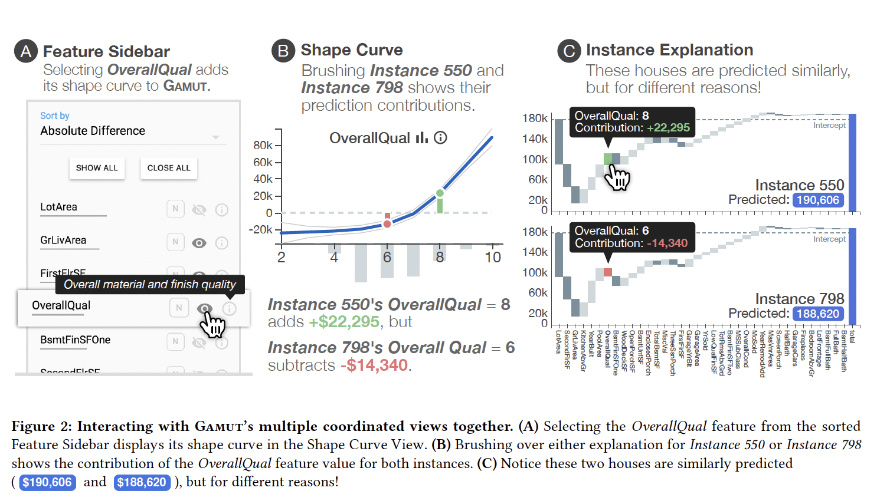
GOALS
Balancing Simplicity and Accuracy
Global and Local Explanations
User-Centered Design
Ease of Use
Design for Specific Use Cases
(Debugging machine learning models, analyzing feature importance, investigating specific model predictions, and communicating insights to stakeholder)

Slide 14
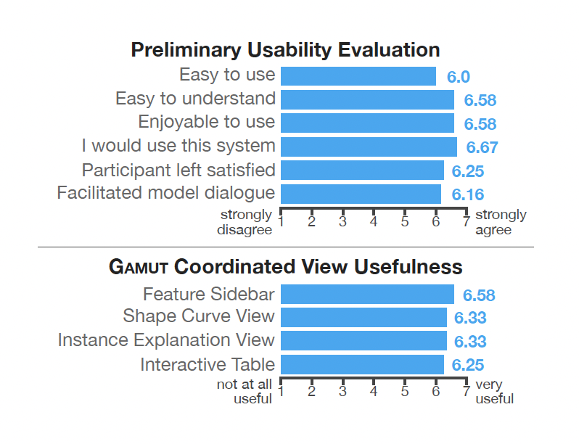
Evaluation
In a preliminary usability
evaluation, participants thought Gamut was easy to use and enjoyable
Gamut’s multiple coordinated views, all were rated favorably
This also supports our finding that both global and local
explanations are valuable for understanding a model’s behavior

Slide 15
Conclusion
The paper concludes by stating that better explanatory interfaces for machine learning are urgently needed as ML increasingly impacts society.
Tools like Gamut, which emphasize human-centered design and interactive explanations, can play a critical role in improving how data scientists interpret models and make decisions.
In essence, the paper contributes to the field of explainable AI (XAI) by offering practical solutions for improving the transparency and interpretability of machine learning models, which is becoming increasingly important in both research and real-world applications.

Slide 16
THANK YOU!!!

