Slide 1
SpiderEyes
Designing Attention- and Proximity-Aware Collaborative Interfaces for Wall-Sized Displays

Slide 2
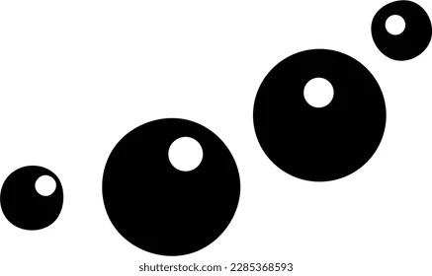
What is it?
This paper presents SpiderEyes, a toolkit to facilitate collaborative analysis of large multi-faceted datasets, on wall-sized displays by using proxemic interactions.
It aims to provide Real-time tracking and attention awareness while allowing multiple people to collaborate.

Slide 3
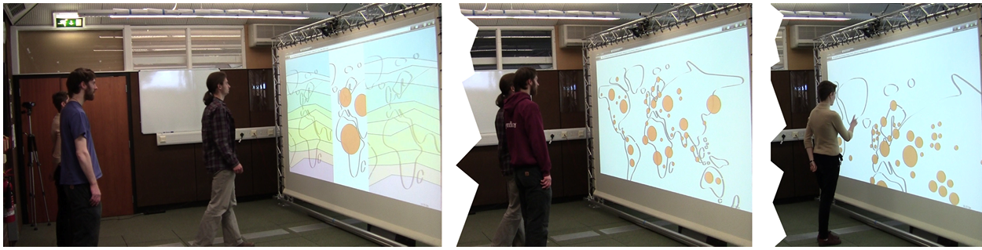
What is it?

Slide 4
Earlier work
Prior systems have adjusted the size of magnification factor of the information or field of view depending on the distance of the user to the display and describe proxemics using distance, orientation, movement and identity.
SpiderEyes builds on these foundations but focuses on the relatively unexplored domain of collaborative interactions, where multiple users work together on wall-sized displays.

Slide 5
Features of the SpiderEyes toolkit
Multi-user tracking
Foreground and Background separation
Markerless tracking
Easy setup
Programming language independent
Distributed development
Visualization Design tool
Notes:
Talk about how the last few points are linked to the class’ motto

Slide 6
How does it work?
User identification
Uses Kinect’s depth-based blob segmentation
Works well except for when people moved out of the range and came back
Head position tracking
Uses 3 levels to track a user’s head position
  Eye pair location
  Skeleton Data
  Depth Blobs
Notes:
Reduce the search area in images through the user identification
Bring up the edge case

Slide 7
How does it work
Attention detection
Used Viola-Jones feature tracking system
It is a 2 step process
  Try to locate user’s eye pair (partial detection)
  Try to find the left and the right eye (full detection)
Distance estimation
Uses a similar 3 part system as the head tracking
  Eye pair
  Head and neck joints from the skeleton
  Top 25% of the blob
Used linear regression model to account for over estimation
Notes:
Reduce the search area in images through the user identification
Talk about the evaluation criteria
The experiment involved eight participants (five males and three females) between the ages of 21 and 39. Each participant was tested under three conditions regarding wearing glasses:
No glasses,
Glasses with a thin frame,
Glasses with a medium-thick frame.
Test with camera, kinect and kinect corrected
Less than 10 cm error in the ideal range

Slide 8
Performance
With a 2.8GHz Quad-Core Intel Core i5 processor they were able to get a latency of 30-40 ms at 20-30 fps.
The systems minimum range is 50 cm and can accurately track upto a range of 5m
Notes:
The maximum distance at which an eye-pair can be detected depends on the amount of pixels occupied by the eye-pair of the tracked person in the image. For a person with 60 mm pupil distance, using a 5 megapixel (2592 1944 pixels) image taken with a camera with a 62 horizontal field of view, the maximum theoretical distance at which the person can be detected is approximately 684 cm.

Slide 9
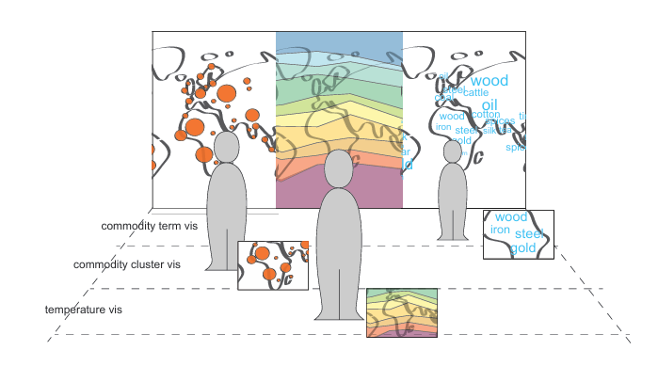
Using the Toolkit
Scenario 1: Vis-Active with Physical Zoom: Changes visualization type based on the user’s distance from the display. This setup allows users to explore different visualizations as they move closer or further away, supporting independent analysis.

Slide 10
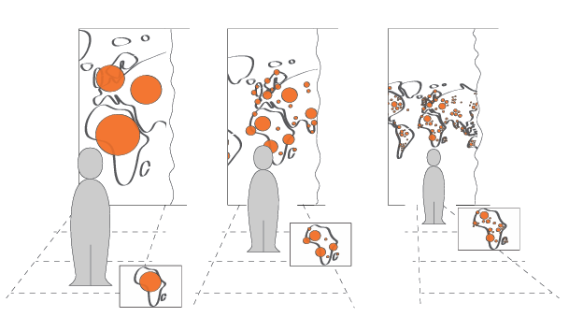
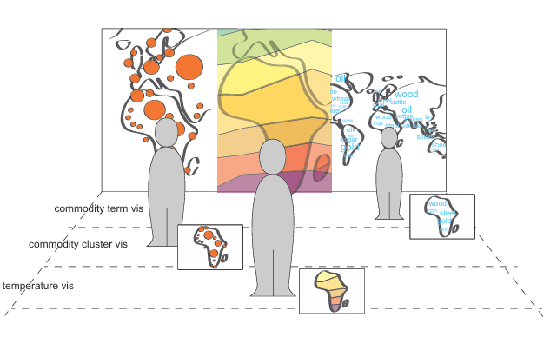
Using the Toolkit
Scenario 2: Vis-Active with Constant Zoom: Adjusts visualization type based on distance but keeps a constant viewing angle. This setup provides more context as users move closer, helpful for interactions that require detailed examination of specific data points.

Slide 11
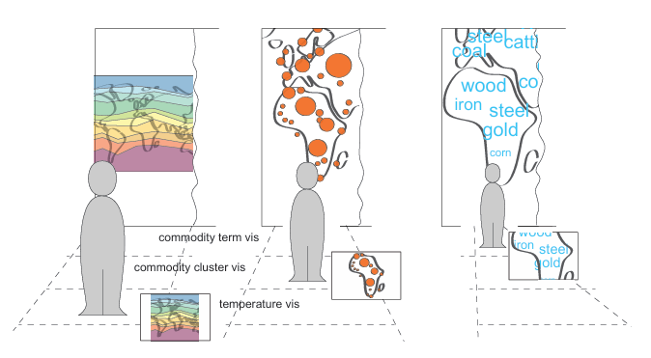
Using the Toolkit
Scenario 3: Vis-Active with Amplified Zoom: Displays more context from a distance and zooms in as the user approaches, making details more visible up close. This setup works well for comparing detailed information across different visualizations.

Slide 12
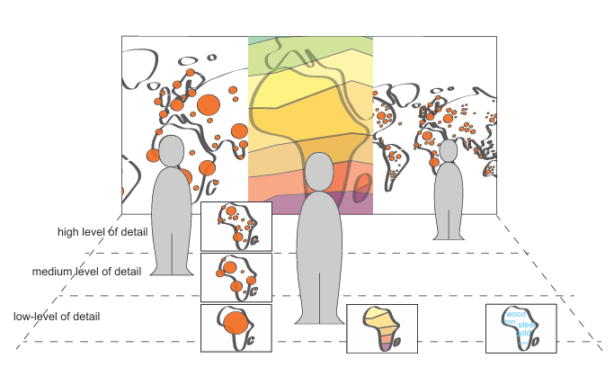
Using the Toolkit
Scenario 4: Detail-Active Display: Adjusts data granularity based on distance, showing more detail as users move closer. This setup allows multiple users to focus on different levels of detail, which can be beneficial for in-depth collaborative analysis.

Slide 13
Flexibility of the toolkit
The authors conducted a case study using D3.js visualization on a dataset on the Wealth and Health of Nations.
How the system was set up
User’s lateral movement was mapped to the temporal aspect of the dataset
Could also integrate Constant zoom to incorporated
Map the translation function so that the data follows the user

Slide 14
Limitations
A series of user studies are necessary to fully understand the limitations and capabilities of our system and application scenarios
Potentially underutilize the attention-divern interactions

Slide 15
Conclusions
SpiderEyes presents a novel approach to creating proximity- and attention-aware collaborative interfaces for wall-sized displays. The toolkit provides designers with tools to build real-time, multi-user applications that support parallel and collaborative analysis of complex datasets.
Notes:
The authors conclude that SpiderEyes has the potential to enhance large-scale collaborative environments in various fields, from business analytics to educational and scientific research.

