Slide 1
Explaining Models: An Empirical Study of How Explanations
Impact Fairness Judgment
Jonathan Dodge, Q. Vera Liao, Yunfeng Zhang, Rachel K. E. Bellamy, Casey Dugan
Kyne Sun, 10/25/2024

Slide 2
Premise
Decision making processes across many domains are beginning to rely on ML systems
ML models are trained historical data, but these datasets can include bias
Biased datasets can lead to biased models
  Techniques exists to “de-bias” data
How do we determine if a model is fair?

Slide 3
Explainable AI
Can provide explanations for decisions that can be utilized to determine fairness
When people trust explanations, they are more likely to trust the system
Large body of research focused on the generation of explanations, but which explanations are relevant for trust and fairness?

Slide 4
Types of Explanations
Global
  How the system works, properties of the model and data
Local
  Why the system made a particular decision
Other ways to organize explanations exist, such as description vs. justification, soundness and completeness, etc.

Slide 5
Differences in Individuals
Different preferences in explanation styles (e.g. long vs. short)
Other factors such as cognitive style and culture may play a role

Slide 6
Research Questions
How do different styles of explanation impact fairness judgment of a ML system?
How do individual factors in cognitive style and prior position on algorithmic fairness impact the fairness judgment with regard to different explanations?
What are the benefits and drawbacks of different explanations in supporting fairness judgment of ML systems?

Slide 7
Methods: Data
Publicly available data set for predicting risk of criminals reoffending with known racial bias
Judging fairness based on racial discrimination
Created two datasets
  Biased dataset (raw)
  Unbiased dataset (processed)
Can people judge which model is biased?

Slide 8
Methods: Individual Factors
Cognitive style
  Need for cognition
Prior position on algorithmic fairness
  Position on ML systems for decision making
  Position on race as a factor

Slide 9
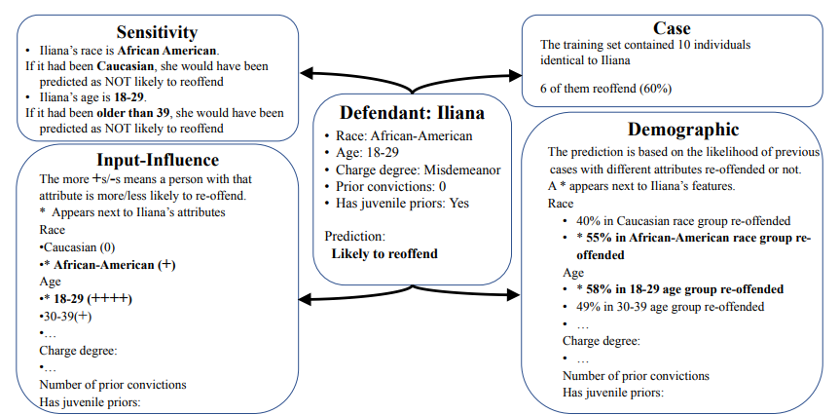
Methods: Explanations

Slide 10
Methods: Survey
160 Amazon Mechanical Turk workers
  Must live in US
  Completed more than 1000 tasks
  98% approval rate
  62.5% male
  78.8% Caucasian
  29.4% under 30
  13.3% above 50
Survey style
  Participant made prediction, then compare with machine prediction
  Asked how the software made the prediction was fair given certain explanation

Slide 11
Results
Case based explanation is generally seen as less fair
For those who trust ML systems, global explanations further enhance perceived fairness
Local explanations are more effective than global explanations at exposing fairness discrepancies
Prior position on ML trust and feature fairness have more impact on how they react to explanations than cognitive styles

Slide 12
Conclusion
Individual differences and varying fairness issues require personalized approaches in explanations
Hybrid approaches (both global and local explanations) are likely to provide more accurate fairness judgement

