Slide 1
Presenting Through Performing: On the Use of Multiple Lifelike Characters in Knowledge- Based Presentation Systems
Elisabeth Andre, Thomas Rist
Sicheng Chen
Notes:
Howdy! Today I will present the paper Presenting Through Performing: On the Use of Multiple Lifelike Characters in Knowledge- Based Presentation Systems by Elisabeth Andre and Thomas Rist.

Slide 2
Introduction and Goals
Research Goal: To explore a new style of information presentation using "presentation teams."
Concept: Presentation teams consist of multiple lifelike characters conveying information through performances rather than direct user interaction.
Innovation: Mimics real-life conversational scenarios, making presentations more natural and engaging.
Notes:
The goal of this research was to investigate a new style for presenting information. Traditionally, most systems that use animated characters rely on settings in which the character directly addresses the user, much like a personal assistant. Instead, the paper’s approach involves what they call "presentation teams"—multiple animated characters that present information collaboratively in the style of a performance for the user to observe.
By creating presentation teams, the paper aimed to replicate the dynamics of real-world conversations, where multiple presenters with different roles and viewpoints come together to share information. This makes it possible to present information from different perspectives and create a more immersive, engaging experience for the audience.

Slide 3
Motivation
Advantages of Animated Characters
  Facial expressions, gestures, and emotional expressions make presentations more lively.
  Multiple characters help structure presentations—each character can focus on different aspects, such as technical and financial.
Audience Perspective: Avoids direct one-on-one interaction, which suits users who may feel uncomfortable with personal interactions.
Notes:
So why use multiple lifelike animated characters for presentation? Well, animated characters have some key advantages when compared to traditional methods like text or static graphics.
First, they can express emotions in a believable way, using facial expressions, body gestures, and affective speech. This makes the presentation more lively, more human, and more engaging for the audience.
Second, animated characters also allow us to effectively present conversational signals like turn-taking or waiting for user feedback. These signals are crucial for making a presentation feel natural, which is something traditional media cannot easily achieve.
Furthermore, having multiple characters helps to structure the presentation effectively. For example, each character can have a specific role—one could focus on technical details, while another could emphasize financial or emotional aspects. This makes it easier for the audience to follow along and understand different sides of a complex topic.
In some cases, users feel uncomfortable when directly approached by a character. By shifting to a model where the characters communicate among themselves, users can passively observe, making the experience more comfortable and enjoyable.

Slide 4
Methodology
Automated Multi-Character Performances:
  Applied in two scenarios:
    Car Sales Dialogue: Characters acted out predefined roles via scripts (e.g., a salesperson and two buyers).
    Soccer Commentary: Semi-autonomous characters provided real-time commentary during a soccer game.
Scripts vs. Autonomy: Script-based roles had predetermined actions, whereas autonomous characters reacted to dynamic changes in real time.
Notes:
Our methodology involves automating the generation of performances with multiple animated characters. We applied this approach to two different scenarios: car sales dialogues and soccer commentary.

Slide 5
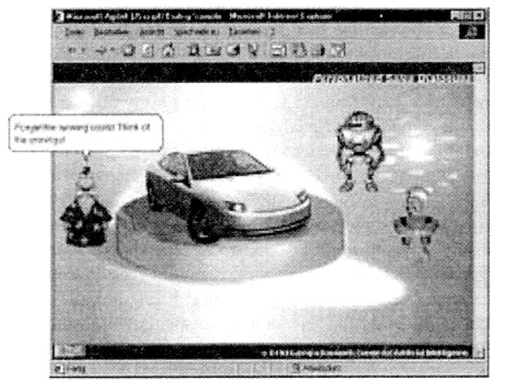
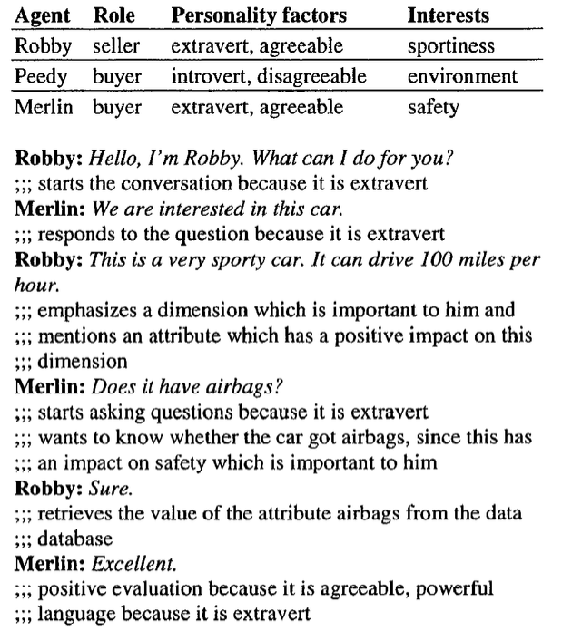
Scenario 1: Car Sales Dialogue
Fig. 1: Screenshot of the Inhabited Market Place
Fig. 2 Dialogue of Car Sales Scenario
Notes:
The first scenario was car sales dialogues. In this scenario, there were three characters—each with a distinct personality and role. One character acted as the salesperson, while the other two acted as potential buyers. A script-based approach was used, where the roles and interactions were predefined. The salesperson character tried to present the car in a positive light, while the buyers asked questions and raised concerns. The dialogue was guided by the script, but the way the characters interacted depended on their personalities.

Slide 6
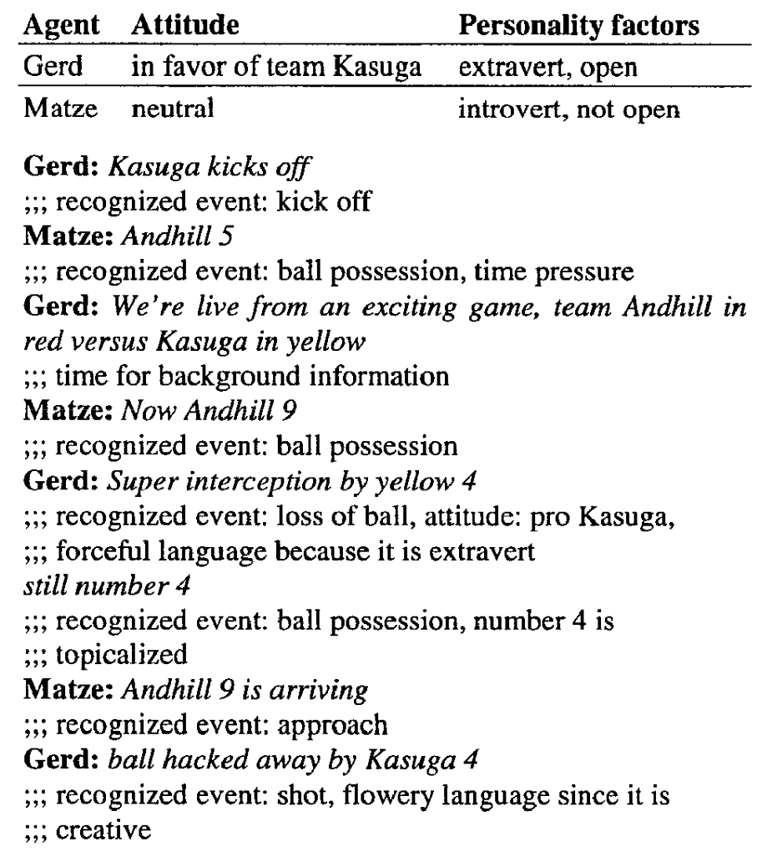
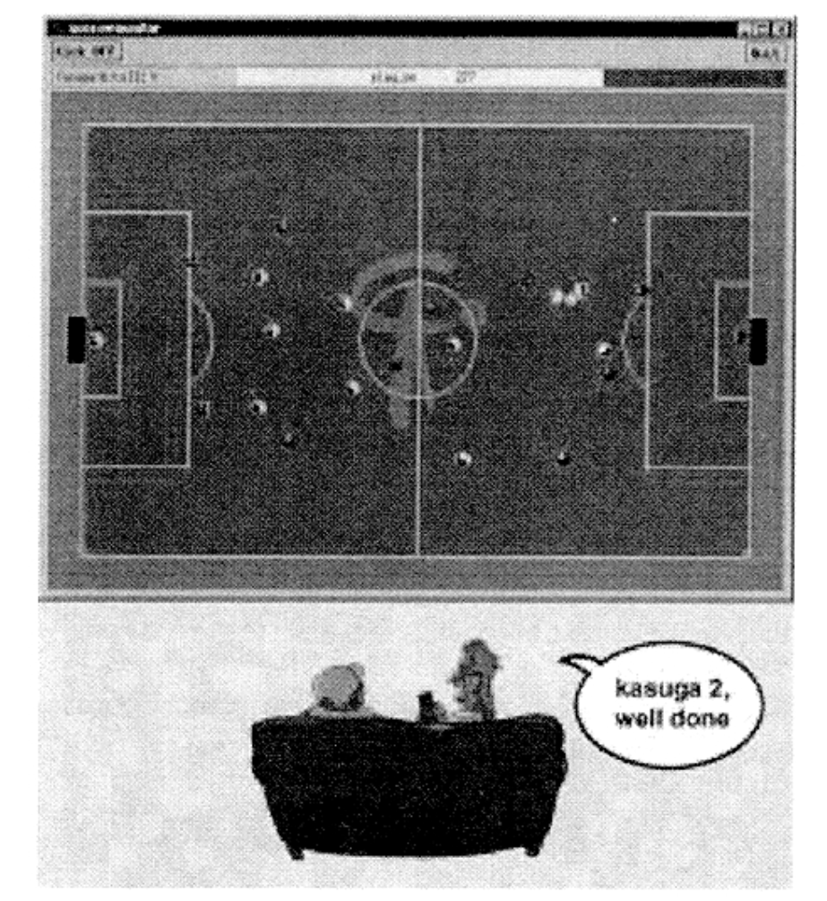
Scenario 2: Soccer Commentary
Fig. 3 Commentator Team Gerd & Matze
Fig. 4 Dialogue of Commentator Team
Notes:
The second scenario was soccer commentary, where two characters provided real-time commentary on RoboCup soccer games. In this case, a different approach was used—semi-autonomous characters. This means that the two characters were not following a fixed script. Instead, they reacted to the live action of the game, responding in real-time to changes in the match. The generation of natural-language relied on a parameterized template-based generator. This allowed the paper to test how well characters could handle a dynamic, fast-paced environment. In this scenario, one commentator was more extroverted and vocal, while the other was more calm and analytical. This diversity helped make the commentary feel realistic.

Slide 7
Key Features of the Approach
Character Personalization: Characters have distinct personalities and emotional traits (e.g., an extroverted salesperson emphasizing product features).
Multi-Character Collaboration: Multiple characters effectively convey different perspectives—ideal for arguments, pros and cons, or different recommendations.
Notes:
The key innovation is in how we designed the characters. Each character had a distinct personality and emotional profile. For instance, some characters were extroverted and optimistic, while others were more introverted or skeptical. This diversity allowed us to present information from multiple perspectives.
In the car sales scenario, for example, one character focused on financial aspects, while another addressed technical features of the car. By having different characters highlight different areas, the presentation became more informative and engaging.
Another unique aspect of the approach is how these characters interact with each other, rather than directly with the audience. This makes it possible to convey different viewpoints naturally. For example, if there are pros and cons to be discussed, two characters could debate them, making it easier for the audience to understand both sides.
This method also has the advantage of using rhetorical techniques effectively. For instance, in a debate format, characters can present arguments and counterarguments, much like a real-life debate, which makes the presentation more compelling.

Slide 8
Important Results
Experimental Results:
  Presentations delivered by animated characters were more engaging for users, making them more entertaining.
  In the car sales scenario, the team effectively demonstrated different viewpoints through natural discussions between the characters.
  In soccer commentary, Gerd and Matze responded dynamically to the game, adding variety and liveliness to the broadcast.
User Feedback: The use of multiple presenters increased content diversity, enhancing user engagement with the system.
Notes:
The experiments showed that presentations delivered by animated characters were more engaging for users. People found the performances by the characters entertaining, even when humor wasn't explicitly used. Users also appreciated the diversity brought by multiple presenters—each with their own personality traits.
In particular, the car sales dialogue was effective in demonstrating the value of splitting perspectives. The salesperson character focused on the positive aspects, while the buyer characters questioned details, leading to a natural discussion that users could observe.
Similarly, the soccer commentary provided a lively commentary on RoboCup games, which users found more entertaining than standard commentary. the two commentator characters showed different levels of excitement based on their emotional states, which added variety to the broadcast.

Slide 9
Conclusion
Summary: Using multiple lifelike characters in presentation systems can significantly enhance engagement, presenting information from different perspectives in a conversational manner.
Future Directions:
  Explore the optimal number of characters and best casting for presentation teams.
  Further investigate how to involve human users—either as co-presenters or interactive audience members.
Notes:
In conclusion, The paper demonstrates that using multiple lifelike animated characters in knowledge-based presentation systems can significantly enhance user engagement. It allows information to be presented from different perspectives and in a more natural, conversational manner.
As for the future, there are several directions to explore. The authors wanted to concentrate on more formal evaluations in order to investigate what the optimal number of characters should be in a presentation and what makes the ideal casting for a team. Additionally, the authors are interested in involving human users more actively—either as co-presenters alongside the animated characters or as audience members providing feedback during the presentation.

