Slide 1
SNOOZE
Smart Notification and Optimised Organization with Zero Effort
Kathan Vyas, Prachi Surbhi, Ashwin Raja, Shreyas Kasetty, Austin McCormick

Slide 2
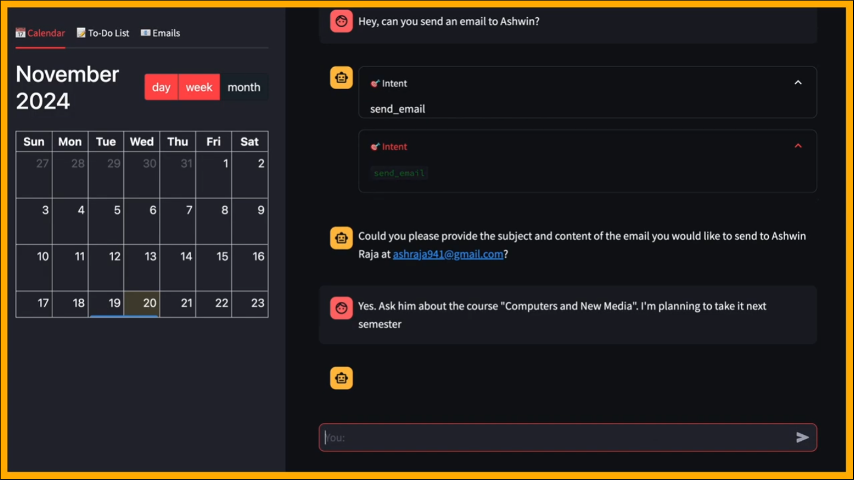
What is SNOOZE?
SNOOZE (Smart Notification and Optimized Organization with Zero Effort) is an AI-powered office assistant designed for efficient email and task management.
Core Functionalities:
Email Summarization: Extracts and prioritizes key information from emails.
To-Do List Automation: Converts email content into actionable tasks.
AI-Assisted Scheduling: Proposes and schedules meetings based on availability.
Smart Replies: Generates professional responses using contextual understanding.

Slide 3

Target Users and Use Cases
Users
Managers managing multiple priorities.
Students and professors overwhelmed with tasks.
Users needing task automation and productivity tools.
Use Cases
Scheduling meetings efficiently.
Generate and send emails with AI assistance.
Summarize and filter emails for decision-making.
Create to-do lists.

Slide 4

Approach
User-Centric Design
Focus on intuitive UI and seamless integration with platforms like Gmail and Outlook.
Simple ChatBot interface
  All functionality on one page
  Low overhead required by user, LLM infers which tool to use through prompt context
  Additional Windows such as Calendar dynamically appear on left-hand window
Works alongside the user
  Asks user for confirmation before performing actions to avoid mistakes
  Flexible: User can ask for modifications/updates to task before confirmation

Slide 5

Approach
Related Systems/Tools
Superhuman AI
Email Summarization
Automated Reply Generation
  Fetches recipient information online for context specific responses
$25/month subscription
Microsoft Copilot Pro
Email management
Drafting Assistance, Automated Reply Generation
Microsoft 365 and Outlook integration
Required Microsoft 365 Pro license
The LookOut Project
Organize and Prioritize emails
Schedule meetings
Outdated, Not commercially released

Slide 6
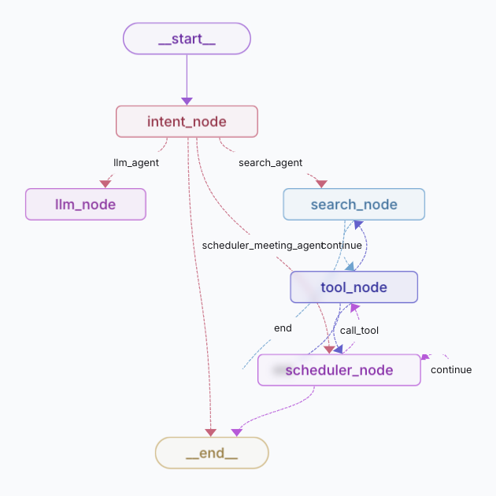
Approach
Our Methodology
SNOOZE utilizes Natural Language Processing for efficient email summarization, scheduling, email/reply creation, and to-do list assistance in a clean chat interface.
Frontend:
Streamlit used for UI and connection to backend
Web Application Interface
Backend:
LangGraph nodes of separate tools`
API Integration: GMail, OpenAI

Slide 7
Demo
link to video

Slide 8
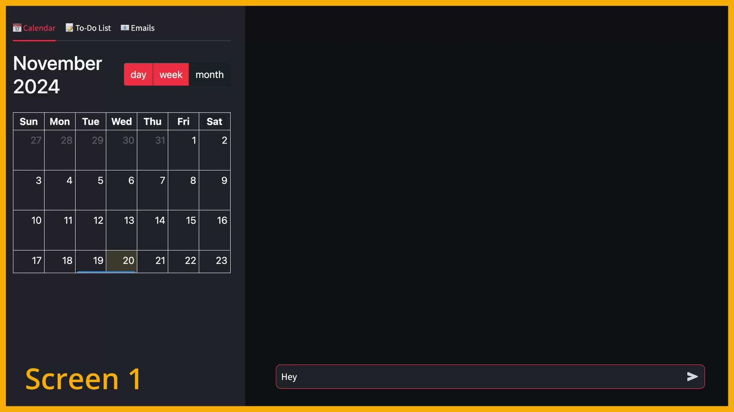

Slide 9

Evaluation Plan
How to measure success?
Evaluate based on user productivity improvements, feedback, and efficiency of email summarization.
What metrics matter?
Focus on user retention, reduced time spent on email management, and system reliability.

Slide 10

Evaluation Plan
Approach:
Conduct controlled experimental studies to assess SNOOZE's performance in specific tasks
Deploy a beta version of SNOOZE in real-world environments with actual users for field studies
Participant Selection:
Target group includes managers, students, and professors managing high email volumes
Participants will be recruited from professional networks, universities, and social groups

Slide 11

Evaluation Plan
Data Collection:
Log user interactions, task completion times, and system responses for quantitative insights
Gather user feedback through interviews and surveys for qualitative insights
Key Metrics:
Efficiency: Time saved in managing emails and tasks
Engagement: User satisfaction and usability ratings
Reliability: Accuracy of email summaries and task prioritization
Learnability: Ease of adapting to and mastering SNOOZE

Slide 12

Challenges and Mitigation
Challenges:
Adapting to diverse workflows and tech proficiency levels
Addressing concerns about data privacy and security
Mitigation Strategies:
Provide user-customizable features and real-time support
Secure API integration to protect sensitive information
Clearly communicate privacy policies to build user trust

Slide 13
Advanced NLP for nuanced summarization
Integration with Outlook
Integration with communication services such as GroupMe, Slack, …
AI-drive prioritization/ranking of tasks
Refined calendar widget
Desktop/Mobile App in addition to Web App
What if we had more time?
Future Directions
Potential Enhancements

