Slide 1
CodeInsight
Zihao Wang, Jing Cao, Longxiang Li, Alex Zheng

Slide 2
Introduction
What is CodeInsight?
A code debugging and generation assistant powered by GPT-4 AI.
Simplifies coding through real-time, natural language interactions.
Why is it needed?
Software development is becoming more complex.
Existing tools often lack intuitive, real-time problem-solving capabilities.
Our Vision:
Enhance productivity by bridging the gap between AI suggestions and user-friendly design.
User Input
AI Analysis
Code Suggestions
User Feedback
Enhanced Code

Slide 3
Target User
Who is CodeInsight for?
Key Audiences:
  Developers: Need faster debugging and code suggestions.
  Students: Learning to code more efficiently.
  Software Engineers: Tackling complex challenges with AI assistance.
Our Competitive Edge:
  While tools like GitHub Copilot / Cursor exist, CodeInsight provides:
    Enhanced interactivity.
    A user-friendly debugging experience.
Whether working on challenging projects, learning coding, or debugging complex issues, CodeInsight aims to simplify coding tasks and enhance productivity.

Slide 4


Related Work
We leverage the GPT-4 API as the core LLM for code analysis, generation, and feedback.
Related works in the code assistant include tools like GitHub Copilot, but CodeInsight focuses on a more interactive and user-friendly debugging experience.

Slide 5



Approach
CodeInsight is a user-friendly web application, built using a front-end framework (Vue.js) integrated with the GPT-4 API for backend (Flask) AI-driven interactions. The interface enables users to input natural language commands, receive code suggestions, and make modifications seamlessly.
Vue+Flask
Text Input
Code with Prompt
Give Feedback
fixed Code with Suggestion
Text Input → AI Generates Feedback → User Reviews → Modified Code with Suggestions

Slide 6
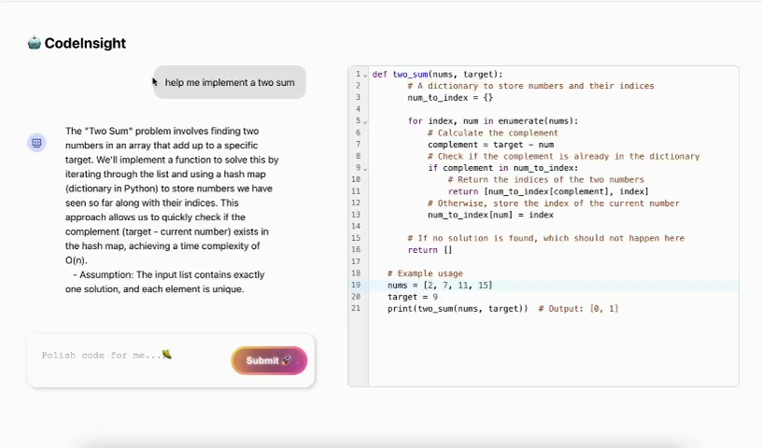
Demo

Slide 7
Evaluation
What we measured:
User Feedback: Clarity, usefulness, and satisfaction.
System Performance: Response time, code accuracy, and scalability.
How we Tested:
User study with 20 developers (10 novices, 10 experts).
Comparison with tools like GitHub Copilot.
Key Findings:
Shared Feedback
  85% found explanations clear and helpful.
  70% said CodeInsight saved them time.
Differences
  Novices: Preferred detailed explanations and examples.
  Experts: Wanted concise suggestions with advanced functionality
Average response time: 1.8 seconds

Slide 8
Future Work
Pre-set Buttons: Simplify tasks with options like Summary, Explain, Optimize, and Debug.
Personalization: Tailor explanations to match user expertise (novices vs. experts)
Collaboration: Enable real-time multi-user coding sessions.
Advanced Models: Train on domain-specific data for better accuracy and explainability.
Multi-language Support: Expand to more programming languages.

