Slide 1
Which Semantic Web?
The semantic web: a vision in the late 90s early 00s about web content including structure to allow automated reasoning
Motivations:
  Perception that the web was too unstructured and unruly
  The web was an underused resource of human knowledge
Visions included agents locating, interpreting, and making decisions based on web content
Back then, a central question was how would this structure be generated
  Today, generating structures that capture aspects of web content are expected from LLMs and similar techniques

Slide 2
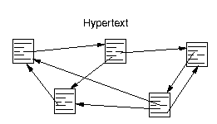
The Connection between Hypertext and Knowledge Representation
Hypertext systems represent content as a graph
  Nodes are traditionally text, images, audio, video, etc.
  Links are navigational options for users
Late 80s and early 90s hypertext
systems expanded this
  Nodes included attribute/value tuples
  Links represented alternative types of relations between nodes
Hypertext authoring and knowledge engineering became part of a spectrum of options

Slide 3
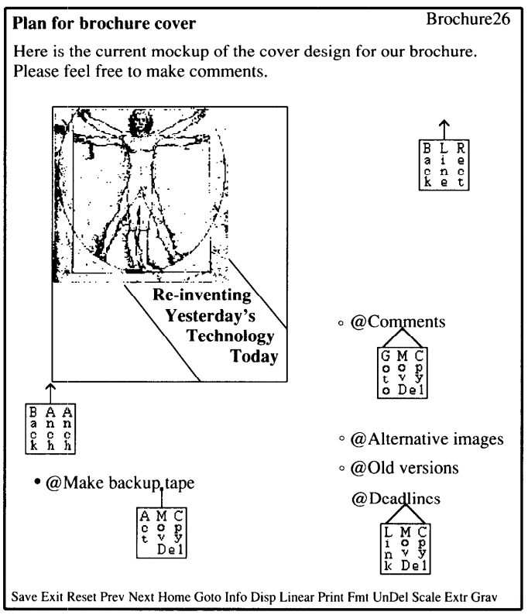
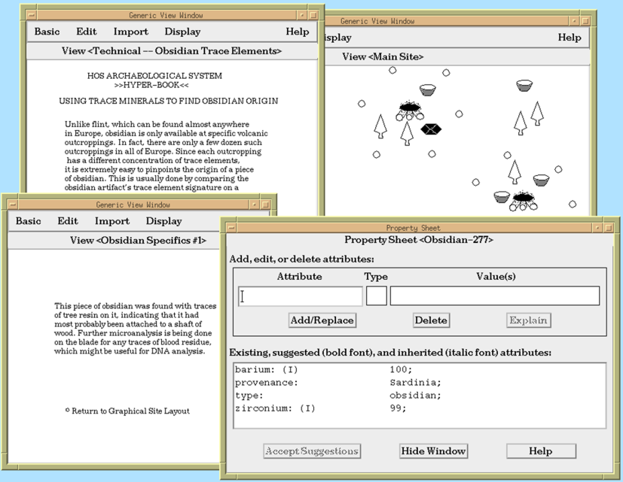
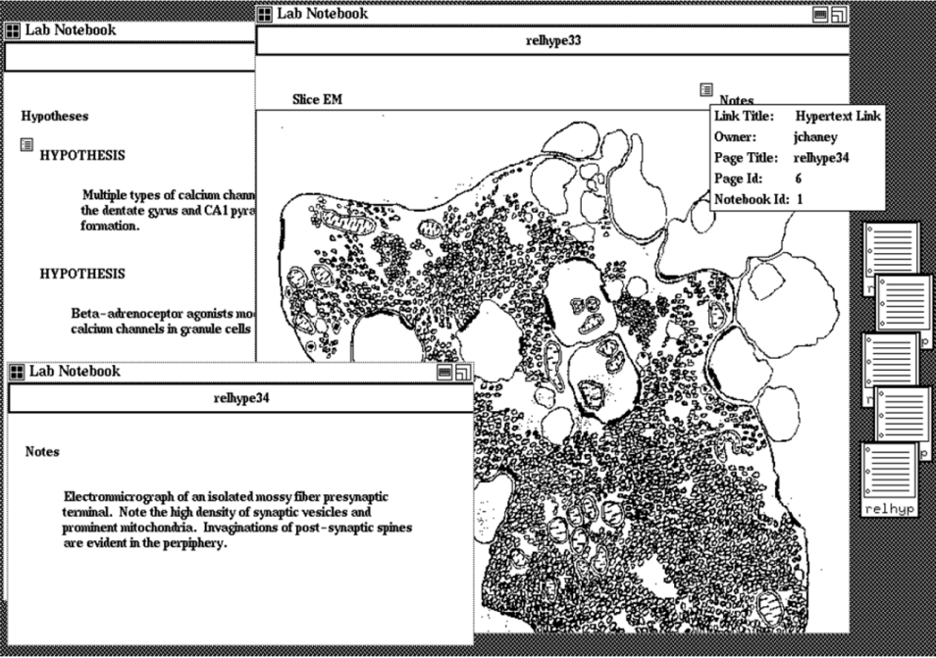
Hybrid Authoring for Human and Computer
Some hypertext systems enabled visual organization of elements on hypertext nodes and included semantic structure for elements.
HOS
Shipman (1993)
KMS
Akscyn et al. (1987)
VNS
Shipman, Cheney, Gorry (1989)

Slide 4
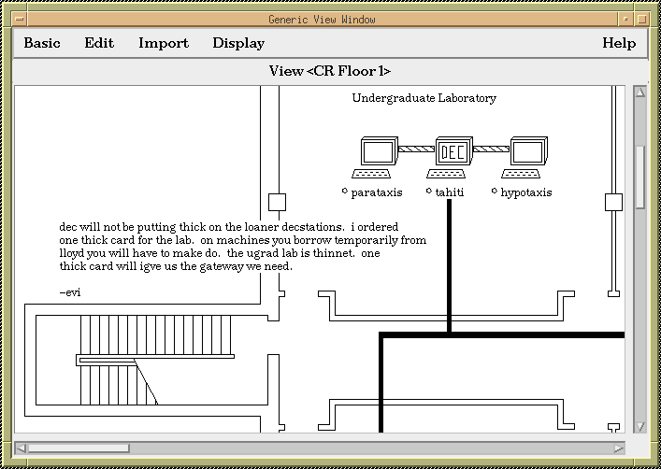
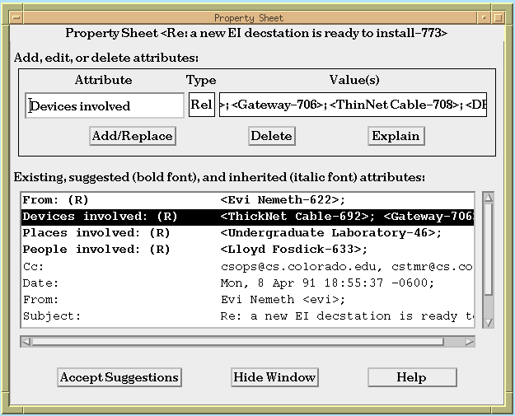
Suggestions and
Incremental Formalization

Slide 5
Framework for Perspectives on the Semantic Web
what?
 |  | particular |  | universal
human |  | much of then current Web use |  | Library of Alexandria/ taming the Web perspective
machine |  | federated knowledge base perspective |  | Knowledge Navigator perspective
who?
Continued relevance:
  applications can focus on domain/task or aim for generality
  applications can automate interpretation or deliver content to user

Slide 6
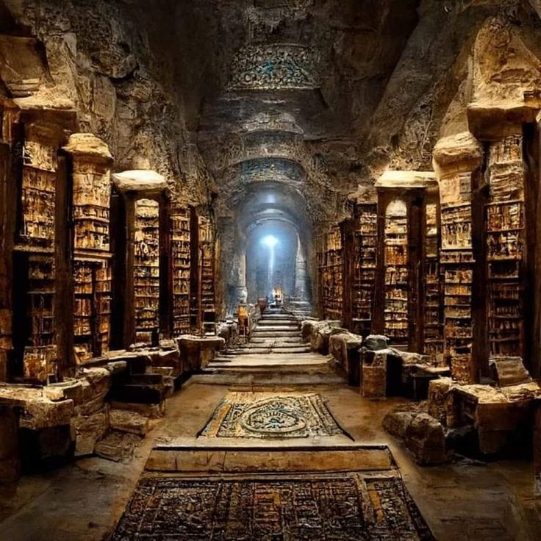
Library of Alexandria/
Taming the Web perspective
“The Semantic Web is an extension of the current Web in which information is given well-defined meaning, better enabling computers and people to work in cooperation. It is based on the idea of having data on the Web defined and linked such that it can be used for more effective discovery, automation, integration, and reuse across various applications.”
The Semantic Web fulfills the vision of a universal library...

Slide 7
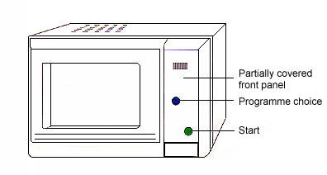
Federated Knowledge Base perspective
“Indeed, one of the driving forces for the Semantic web, has always been the expression, on the Web, of the vast amount of relational database information in a way that can be processed by machines.”
“… a large majority of the information we want to express is along the lines of ‘a hex-head bolt is a type of machine bolt,’ …”
“The Semantic Web will provide an infrastructure that enables not just web pages, but databases, services, programs, sensors, personal devices, and even household appliances to both consume and produce data on the web.”
Burrito: type of
bean product
Weight: 10oz

Slide 8
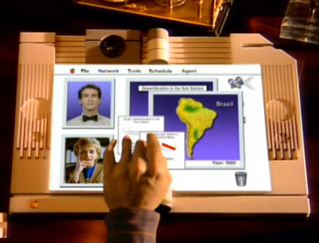
Knowledge Navigator Perspective
“The Semantic Web will bring structure to the meaningful content of Web pages, creating an environment where software agents roaming from page to page can readily carry out sophisticated tasks for users.”
“Software agents can use this information to search, filter and prepare information in new and exciting ways to assist the web user.”

Slide 9
3 Problems
Additional overhead
  e.g. someone will have to learn the syntax and semantics of a formal language to put our microwave on the Web
Tacit and evolving knowledge
  e.g. a microwave is a type-of oven. Or is it?
The situated nature of knowledge
  Different uses have different representational needs
  E.g. Suggestion for use to heat food vs. placement in kitchen
I’m a type-of oven.
Or am I?

Slide 10
Linchpin questions for
Semantic Web applications
knowledge stability: how well are the domain and the practices surrounding it understood?
competing conceptual approaches: is the knowledge intrinsic or extrinsic? Can a heuristic approach suffice?
cost/benefit: who will represent the knowledge and who will benefit? Are there competing interests?
negotiation among information resource stakeholders: what is the role of negotiation, facilitation, or intervention in representing the knowledge within a socio-technical framework?

Slide 11
Recent Webs of Human Knowledge
Freebase, an “open, shared database of the world's knowledge”
  Metaweb acquired by Google in 2010, Freebase shut down in 2016 with some data becoming part of Wikidata
Wikidata, “a collaboratively edited multilingual knowledge graph hosted by the Wikimedia Foundation (launched 2012)
  As of mid-2024, Wikidata had 1.57 billion item statements (semantic triple)
Knowledge graphs used by cloud services
  Automated or semi-automated generation

