Slide 1
Intelligent User Interfaces
A Quick Review

Slide 2
Project Presentations
What to include (plan for 10-12 minutes)
  Project name and team members (<1 minute)
  Who are users and what are they doing (1 minute)
  Your approach to helping them & related systems/work (2 minutes)
  The demo (e.g. design) of your system (3-4 minutes)
  How you would evaluate your system (3 minutes)
  What would you do if you had more time (1 minute)
These should also be in your written report

Slide 3
What we have seen …

Slide 4
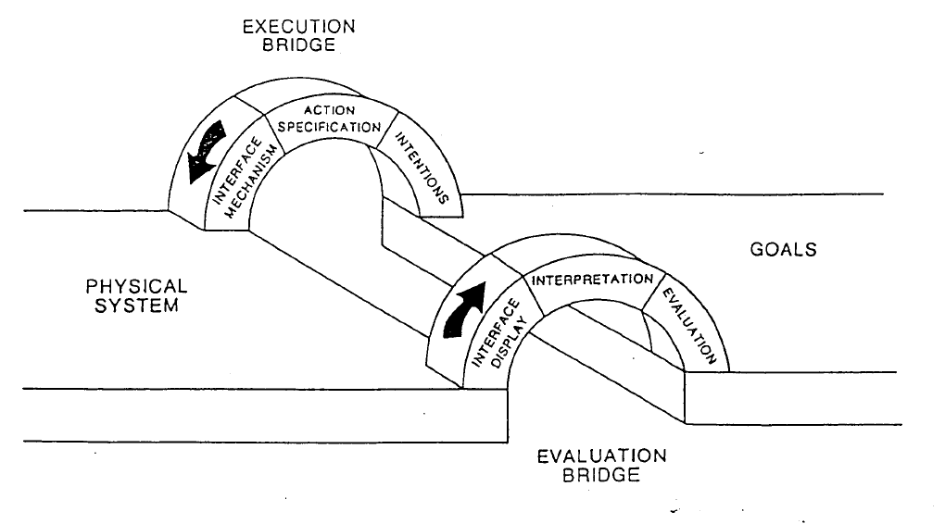
Models for Thinking about
Computer-Human Interaction
Some methods to support execution:
Prediction of user goals
Mapping goals to likely actions/plans
Aiding location of specific UI components
Context-sensitive help/training
Some methods to support evaluation:
Personalizing/contextualizing output
Awareness support in large/complex results
Generating explanations
Context-sensitive help/training

Slide 5
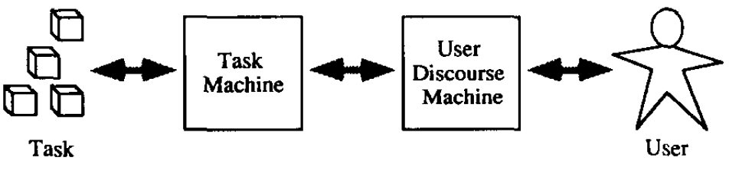
Where is the “Intelligence”?
Intelligent interfaces: in the user discourse machine
Interfaces to intelligent systems: in the task machine
Need to put intelligence in both, or bridge the two components
Cooperative problem solving systems integrate interaction mechanisms with domain knowledge
  Vision of software as assistant – volunteering suggestions and completions but leaving user in control

Slide 6
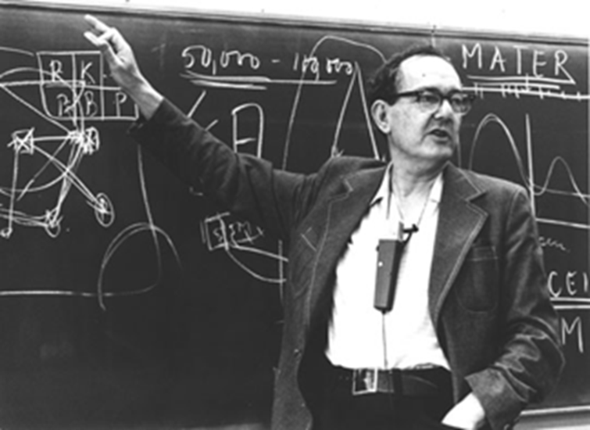
Herb Simon
    Bounded rationality
    Hierarchy and markets
    Perceived complexity
    Satisficing
    “a physical symbol system of the sort I have just described has the necessary and sufficient means for general intelligent action.”
    Relevance today:
      Goal of AI is to support user in the context of bounded rationality and satisficing behavior

Slide 7
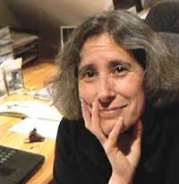
Lucy Suchman
Plans and Situated action
  Plans as resource for action, not
  prerequisite for action
Communication as action
Difficulty of enumerating
  Knowledge needed for interpretation
  Concepts communicated
Shared understanding & mutual intelligibility
Importance of locating and remedying trouble
Relevance today:
  Awareness of the complexity of human-human interaction and the difficulty of achieving the same in human-computer interaction

Slide 8
Lots of Papers
Early and recent papers on IUI projects
Cover a range of techniques and domains
Lots of examples of evaluating the effects of the novel techniques being explored

Slide 9
Systems and Techniques
Examples of how to assign tasks to human/computer and how to bridge gulfs of execution/evaluation
  Mixed-initiative interfaces
    Models for when to interrupt/recommend
  User modeling
    Implicit vs. explicit feedback
  Helping users express their knowledge
    Incremental formalization and visual/spatial expression
    Supporting procedural expression (e.g. PBD)
  Presentation generation
    Generating language, effects, agent-based dialog

Slide 10
Application Domains
Data analysis, data science, machine learning
  System components/features that help users comprehend data and its algorithmic analysis
  Tools to aid human analysts aggregate, interpret, and make decisions based on data/ML
Media analysis
  Applications based on aggregated/deep analysis of media content
Education/Training/Life-long Learning
  Personalization via systems modeling user’s domain knowledge and users’ knowledge of system

Slide 11


If only one thing …
Remember
  As software designers we need to consider the cooperative system that includes both software and human components
    What to automate
    What to communicate
    What to support
    These will drive the decisions of what to model and how

