Slide 1
Project Presentations
What to include (plan for 10-12 minutes)
  Project name and team members (<1 minute)
  Who are users and what are they doing (1 minute)
  Your approach to helping them & related systems/work (2 minutes)
  The demo (e.g. design) of your system (3-4 minutes)
    Focus on interesting bits, go quickly through standard components such as login screens, etc.
  How you would evaluate your system (2-3 minutes)
  What would you do if you had more time (1 minute)
These should also be in your written report

Slide 2
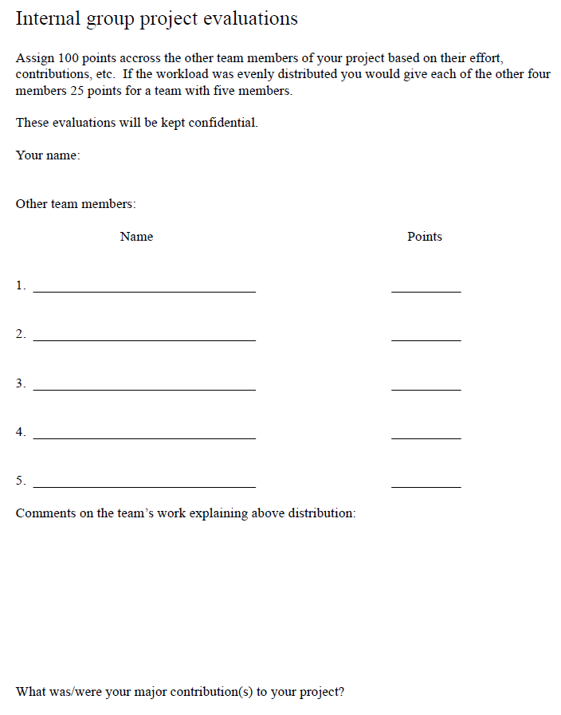

Slide 3
Do your course evaluations
They are valued
  By faculty as they update their courses
  By the department during annual faculty review
  By the department when deciding which courses are taught and where each semester

Slide 4
What is Left?
List all the team members present in class for the discussion
List anything left to be done and talk about how your team plans to get it done
No other prescribed activity for today – use the time to do whatever your group needs to get done

