Slide 1
Project Plans
Presentation over current implementation status next week
  4 weeks since design phase presentation
  Show slide template in a moment
Report will now have an implementation section describing and showing through screenshots the current state and what is left to do
Final presentation with demo and evaluation plan in one month
Today’s team activity
  Check on team member’s progress
  Reflect on risks and integration tasks
Don’t be the team flake …

Slide 2
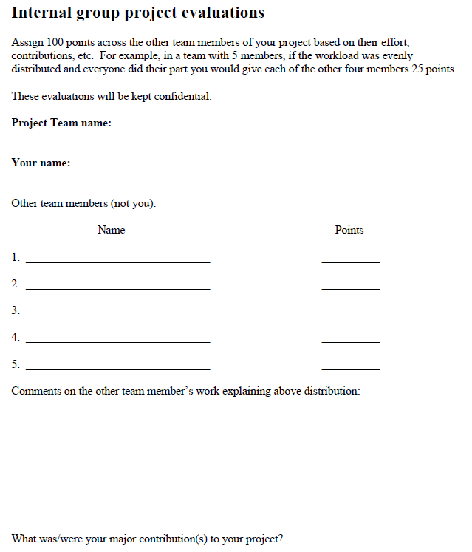

Slide 3
TeamName: Your Topic
Team member names

Slide 4
What is Done: Tasks
Completed Tasks

Slide 5
Current State
Image(s) of current version of the system

Slide 6
What is left to do
Things that need to be done before final demo

Slide 7
Work Plan
Team member 1 – what they will do
Team member 2 – what they will do
Team member 3 – what they will do

Slide 8
Goals for today
Step 1:
  Each person take 3-4 minutes to report what you have done towards implementation and what you have left to do
  Also, identify the biggest risk to completing your efforts
Step 2:
  Now, as a group, identify the top risks to your project team
  Discuss how stable/fixed is your design and plan
  Identify questions you would like feedback on
What to turn in: Team members participating, notes from the steps of your discussion as described above

