Slide 1
Order of Project Presentations
CrashLanding
Game Rec
HelloPentagon
Intellicrew
Intellifish
Inventory Advisor
JobSeekers
SNOOZE
The Cashiers
The Doctor is (In)
CodeInsight
To keep us on time today
  Be ready to quickly come up front
  4 minutes is all you have
  Avoid tangents
  Avoid details of design or tools/infrastructure
Remember
  Not everyone has to come up front
  If we have time we will assign final presentation slots

Slide 2
CrashLanding: Intelligent assistant to facilitate information elicitation in qualitative interview
Jiwon Chun, Shuning Gu, Junru Liu,
Yi Wen, Hangxiao Zhu

Slide 3
What is Done: Tasks
UI and workflow design
Front end development(question editing&grouping, minimap to show the overview of questions and answers)
Back end development(real-time speech to text)

Slide 4
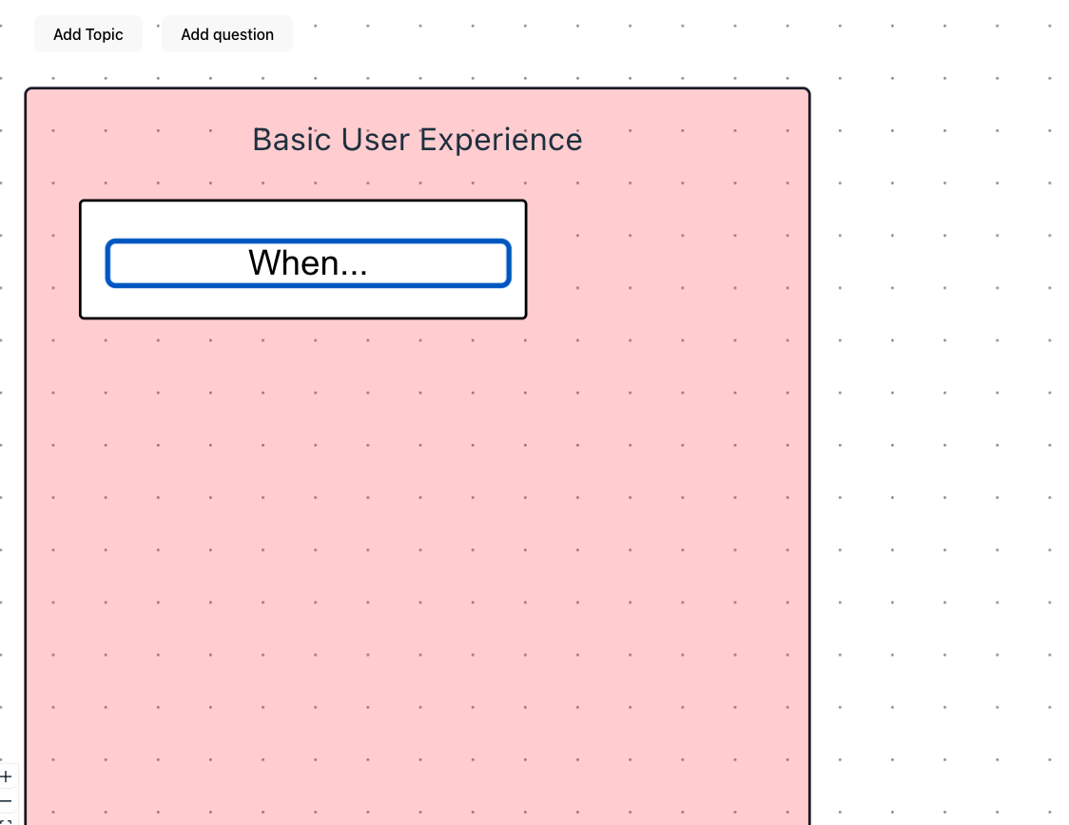
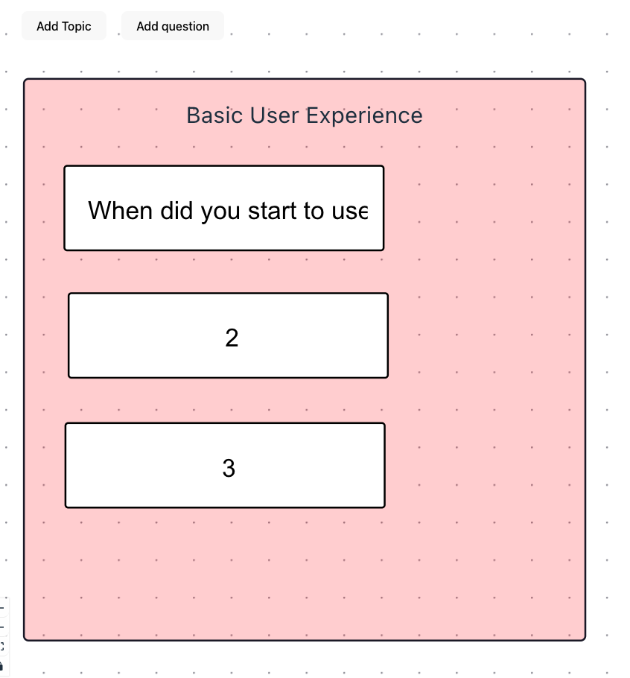
Current State
Image(s) of current version of the system

Slide 5
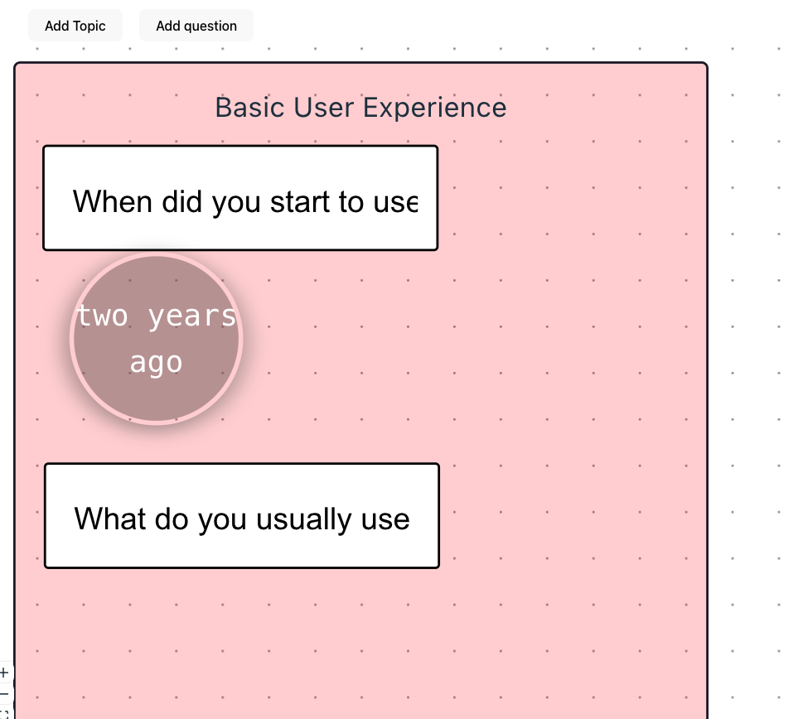
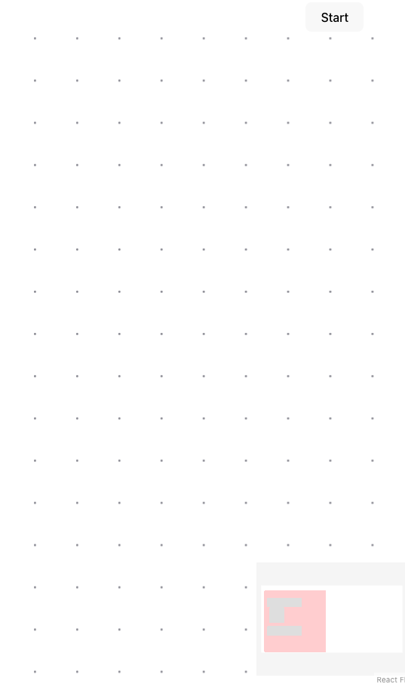
Current State
Image(s) of current version of the system

Slide 6
What is left to do
Things that need to be done before final demo
  Modify the visual design of each UI element
  Identify ongoing topic and map to interview script
  Process user input during interview
  Analyze the transcribed content
  Generate context-aware follow-up question

Slide 7
Work Plan
  Jiwon Chun: Modify the visual design of each UI element
  Yi Wen: Process user input during interview
  Hangxiao Zhu: Analyze the transcribed content
  Shuning Gu: Identify ongoing topic and map to interview script
  Junru Liu: Generate context-aware follow-up question
Next up: Game Rec

Slide 8
GameRec: Game Recommendation
Akash Jothi, Spencer Cho, Annie Ren, Kyne Sun, Erik Day, Esben Egholm

Slide 9
What is Done: Tasks
Basic frontend templates for all pages
Initialized databases for users, reviews, and games
Created initial APIs and frontend connections

Slide 10
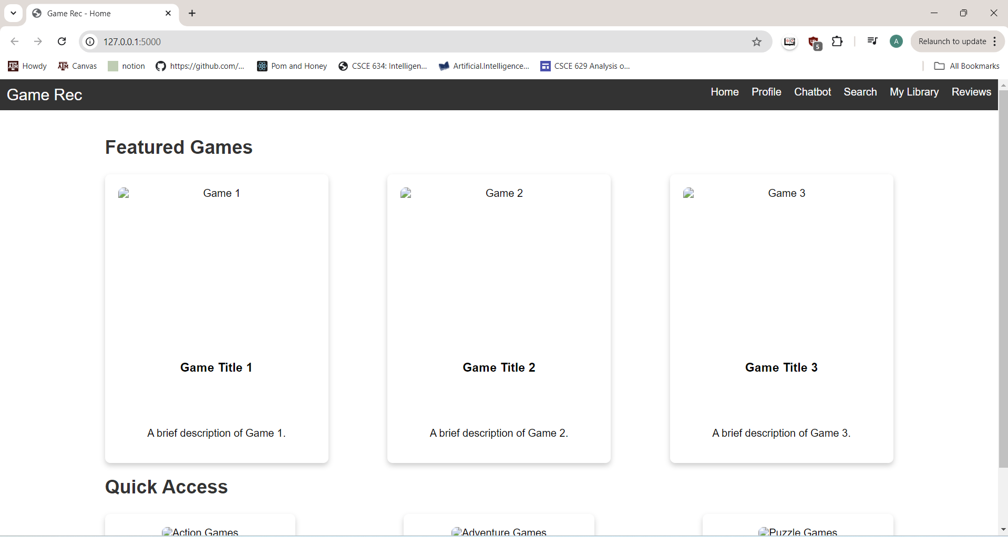
Current State
Image(s) of current version of the system

Slide 11
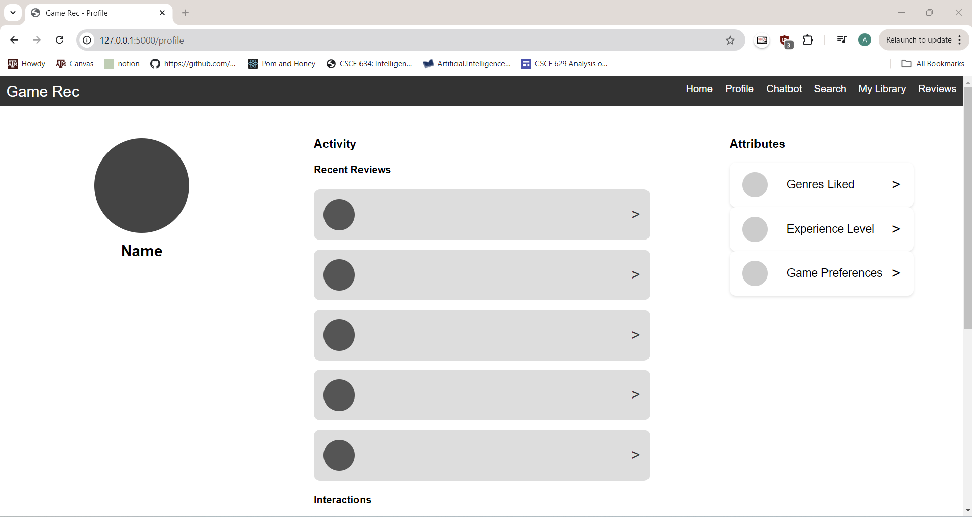

Slide 12
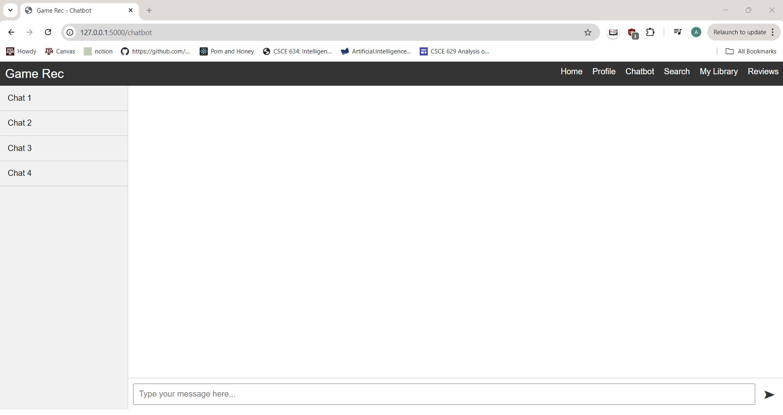

Slide 13
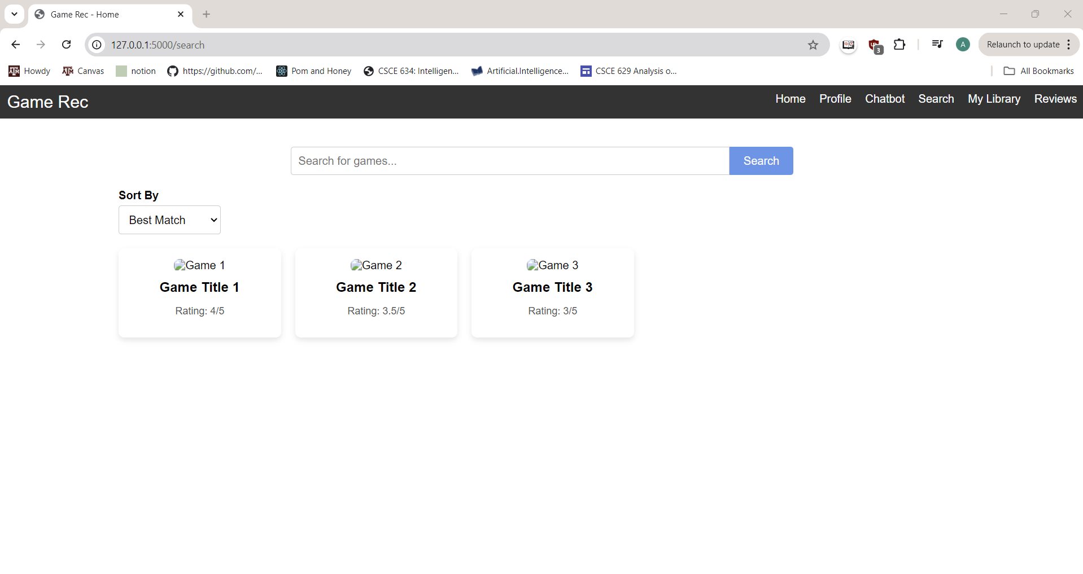

Slide 14
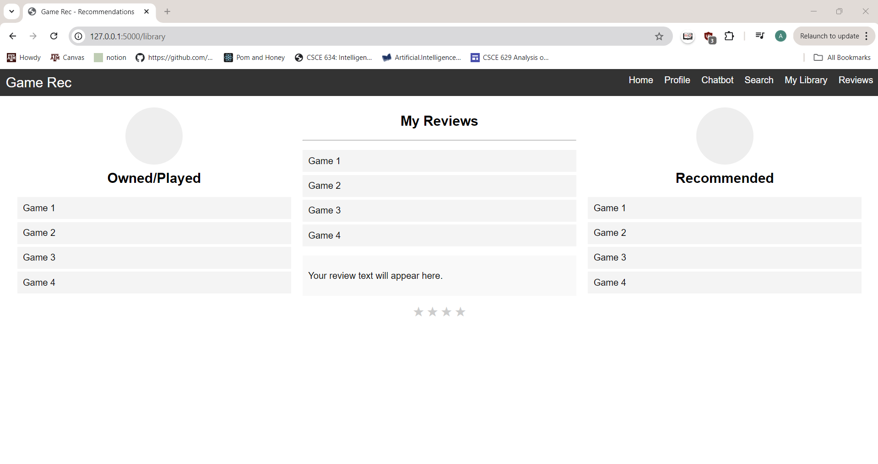

Slide 15
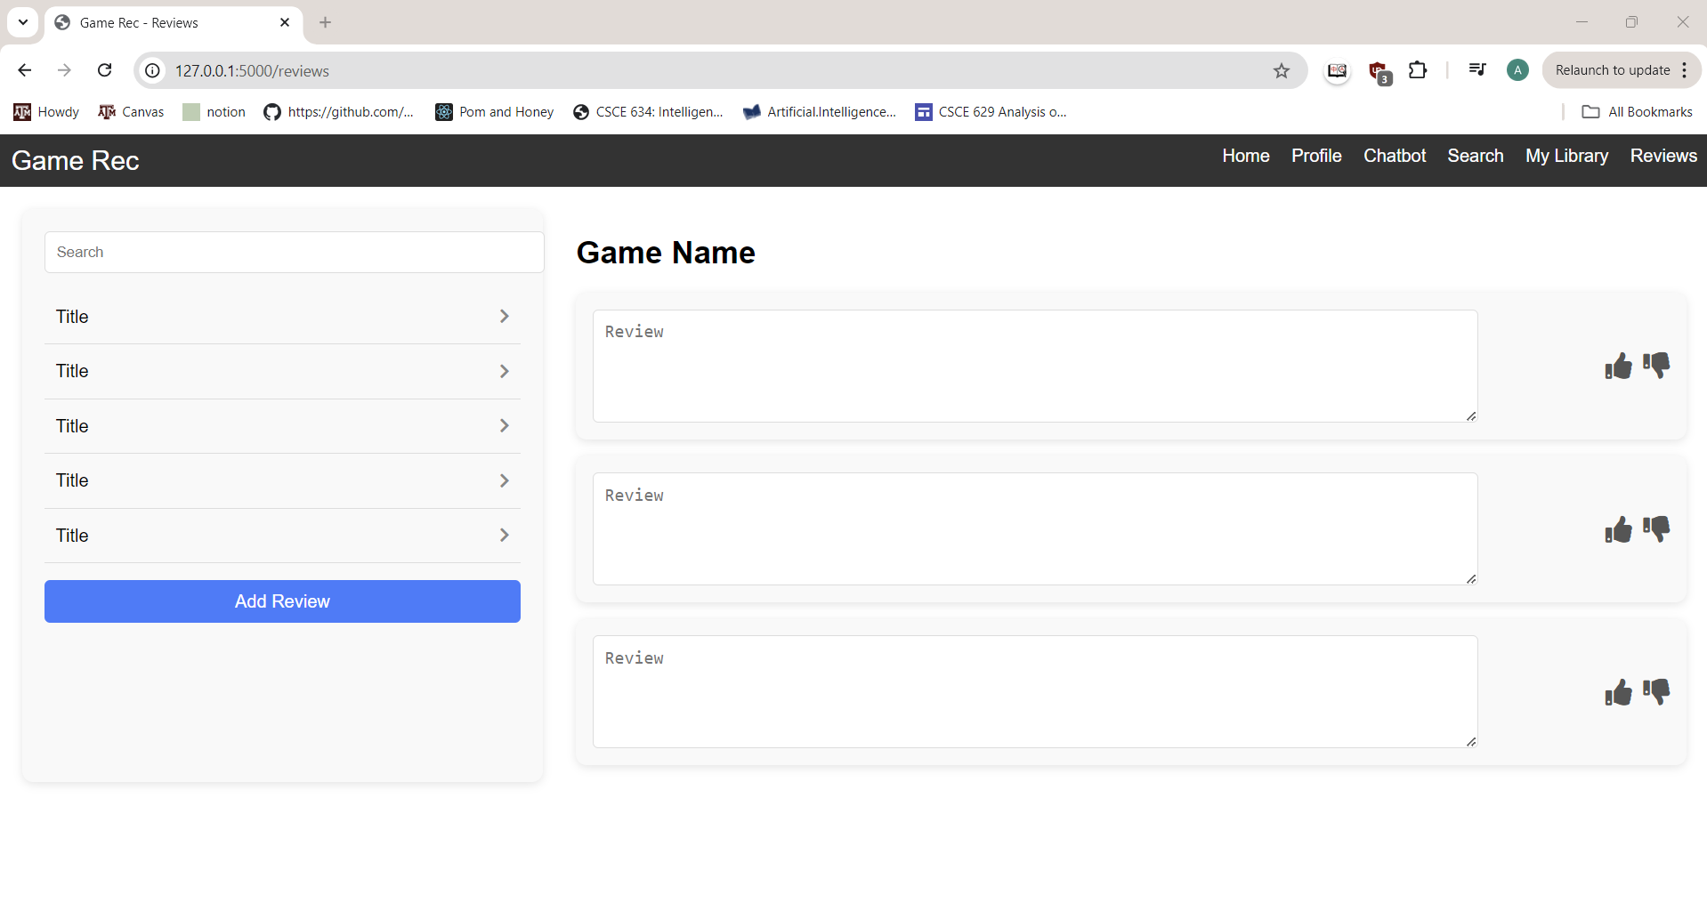

Slide 16
What is left to do
Refine frontend pages and implement all basic functionalities
Implement recommendation algorithms and tags to use
Implement chatbot functionality that utilizes recommendation algorithm

Slide 17
Work Plan
Akash: Refine recommendation and chatbot pages
Esben: Build database and queries
Annie: Refine home and search pages
Spencer: Refine profile and review pages
Kyne: User profiles, reviews
Erik: Connect chatbot to frontend/recommendation algorithm
Next up: HelloPentagon

Slide 18
HelloPentagon
An Interactive Interface for
Malware Detection
Arunesh Mishra
Steve Wang
Johnny Le
Yoojun Kim
Soumyajyoti Dutta

Slide 19
What is Done: Backend
Backend (Soumya & Arunesh)
  Dataset Bodmas Ready (Change)
  ML model for soft classifier is ready (99.5%)
  ML model for Hard Classifier is ready (92.3%)
Need to be done:
  Have a Fail check script for both classifiers
  Provide the output to the frontend
  Need to do oversampling as a tell

Slide 20
What is Done: Frontend
Developed preliminary UI design
Basic framework on the user interface with scalable and intuitive to navigate through the application
Clear direction in how we want to tackle the creativity (resorting to Material UI package)

Slide 21
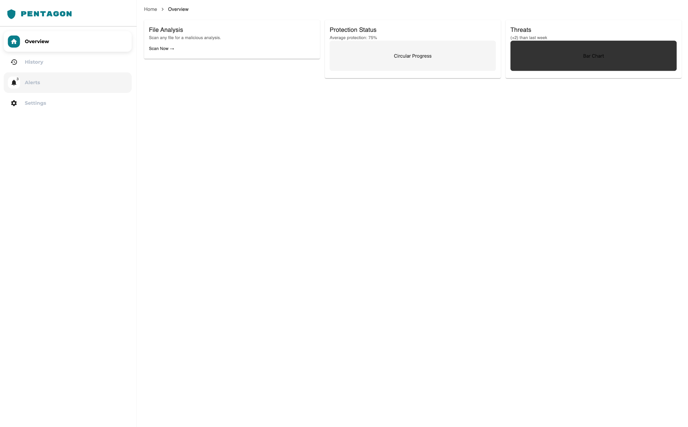

Slide 22


Current State
XGBoost (Soft Classifier)
SVM (Hard Classifier)

Slide 23
What is left to do
Recommendation part, investigating the potential use of generative AI for interactive and flexible instructions. Maybe include user feedback (surveys) for personalized AI responses

Slide 24
What is left to do
Evaluation plans for the usability and interactivity based on our mock-up application.
Finishing up front-end UI and integrating it with our backend algorithm

Slide 25
Work plan
Arunesh
  Dataset Accessibility, Preprocessing and Intelligent Features Dev
Soumya
  Backend ML Pipeline
  Ideation and partial implementation of additional intelligent features
Steve
  Frontend UI, integration with backend
Yoojun
  Assisting with incomplete development tasks, documentation, evaluation plans
Johnny
  Develop UI Mockups
  Continue leading the frontend development/progress
  Look at adaptive options for application
Next up: IntelliCrew

Slide 26
IntelliCrew: Adaptive Task Manager for ADHD Users
Ayesha Ahmed
Nihar Chauhan
Shubham Chorage
Prakhar Singh
Kexuan Shen

Slide 27
What is Done: Tasks
User Authentication:
Users log in using predefined credentials.
Upon successful login, users are welcomed and redirected to the main application interface.
Main Interface Setup:
Displays the productivity timer and user’s task list.
Includes labels for task and timer display, as well as buttons for various actions.
Task Management:
Add Task: Allows users to add tasks to the local task list.
Task Navigation: Provides controls to move tasks up, down, or to the top of the list.
Task Swapping: Swaps the active task with a selected task from the list.
Fetch Tasks: Retrieves tasks stored locally for the logged-in user.
Move to Next Task: Automatically loads the next task from the list after the current task is completed.

Slide 28
What is Done: Tasks
Task Synchronization with Todoist:
Fetch Tasks: Retrieves active tasks from Todoist.
Add Task: Adds tasks to Todoist, synchronizing with the local task list.
Complete Task: Marks tasks as complete in Todoist.
Task Timer and Reminder:
A timer starts when a task is active and displays elapsed time.
Reminders prompt the user to stay on track or note the reason for task incompletion.
Focus Mode Toggle:
Switches between a simplified UI (focus mode) and the main UI, allowing users to focus on a single task.
Task and Timer Controls:
Start/Complete Task: Begins or completes the current task, updating the timer and task status.
Pause/Resume: Pauses and resumes the timer.
Reset Timer: Resets the timer for the current task.
Mute/Unmute Sound: Controls sound notifications.

Slide 29
What is Done: Tasks
Task Logging and Tracking:
Logs completed tasks, including task name, start, and end time.
Logs incompletion reasons and optional notes for unfinished tasks.
Stores logs in a local file for future reference.
File and Folder Selection: Allows users to select files or folders to associate with specific tasks or completion notes.
Logout and Session Saving:
Logs out the user, returning to the login page.
Saves the current state (task name, start time, and timer) upon logout or window close to restore on the next login.

Slide 30
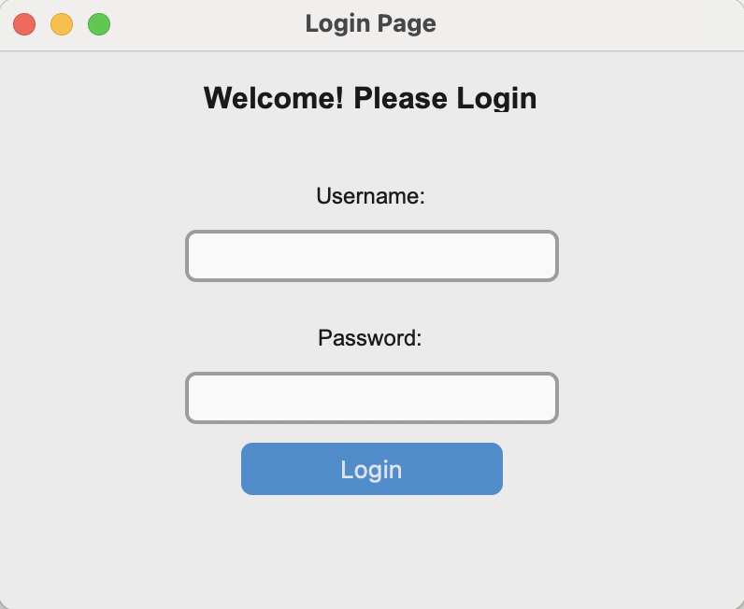
Current State
Login Screen

Slide 31
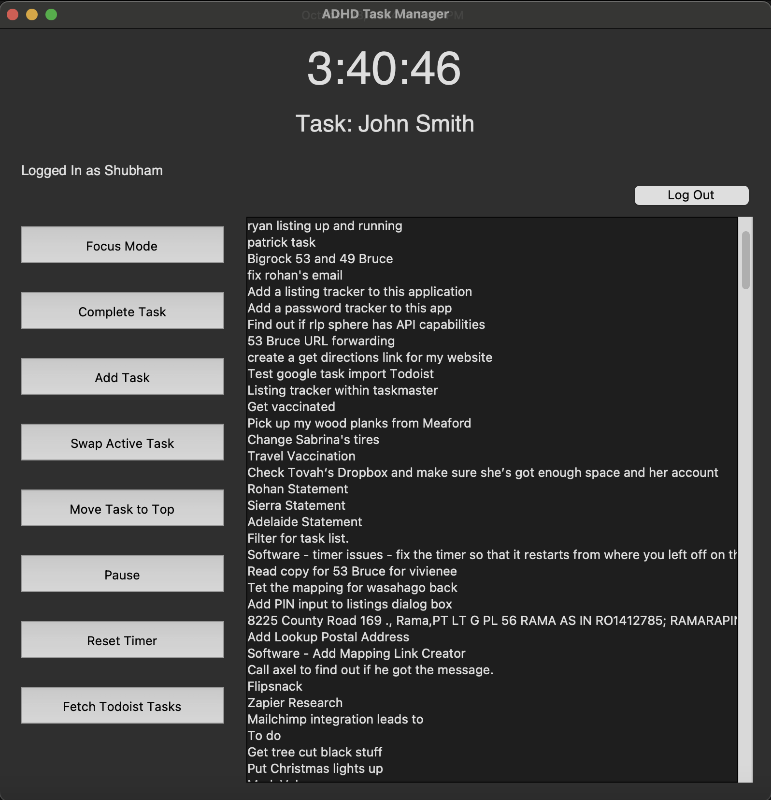
Current State
Main Screen

Slide 32
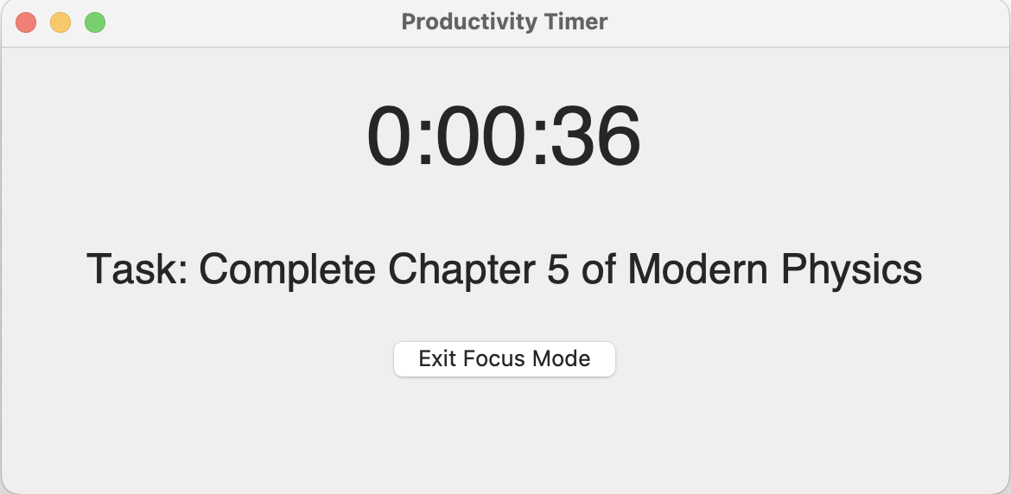
Current State
Focus Mode Screen

Slide 33
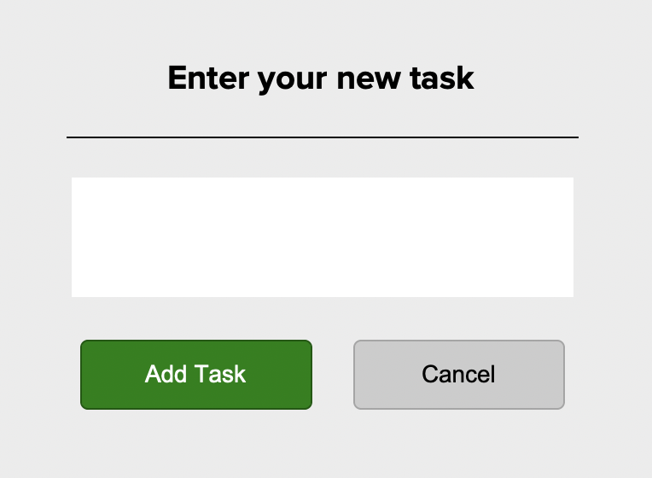
Current State
Add Task Screen

Slide 34
What is left to do
Integrating NLP-driven task breakdown is still underway. We need to fully incorporate Natural Language Processing to automatically parse and break down user-entered tasks into smaller, manageable steps. This will involve refining the NLP model to interpret various task descriptions and generate subtasks that are clear and actionable.
Implementing timely, adaptive reminders is also in progress. We’re working on configuring an adaptive reminder system that prompts users at intervals tailored to their progress and engagement levels. This feature will require setting up a backend scheduler to deliver reminders based on user behavior, such as task-switching patterns or completion rates, to provide timely, supportive nudges without causing overwhelm.
Incorporating user feedback mechanisms remains a key task. We plan to implement a feedback module to allow users to provide input on task breakdowns, reminders, and the interface. This system will collect insights on user satisfaction and usability, helping us make data-driven adjustments and continuously improve the user experience.

Slide 35
Work Plan
Ayesha Ahmed: Works on integrating NLP to parse user tasks into manageable steps, refining the model to interpret task descriptions and generate clear subtasks.
Nihar Chauhan: Focuses on setting up an adaptive reminder system that schedules prompts based on user engagement and task-switching behavior.
Shubham Chorage: Develops a feedback module for collecting user input on task breakdowns, reminders, and interface usability to guide improvements.
Prakhar Singh: Handles backend support and scheduling to ensure data consistency and integration for NLP, reminders, and feedback collection.
Kexuan Shen: Designs the front-end interface, including task display, reminders, and feedback forms, making it accessible and user-friendly.
Next up: IntelliFish

Slide 36
Intellifish:
Personalized Resumé/CV Builder
Yichen Tao
Lianhao Zhou
Hanyun Yin
Yafei Li
Zhenrui Wang

Slide 37
What is Done: Tasks
Mock-Interview demo

Slide 38
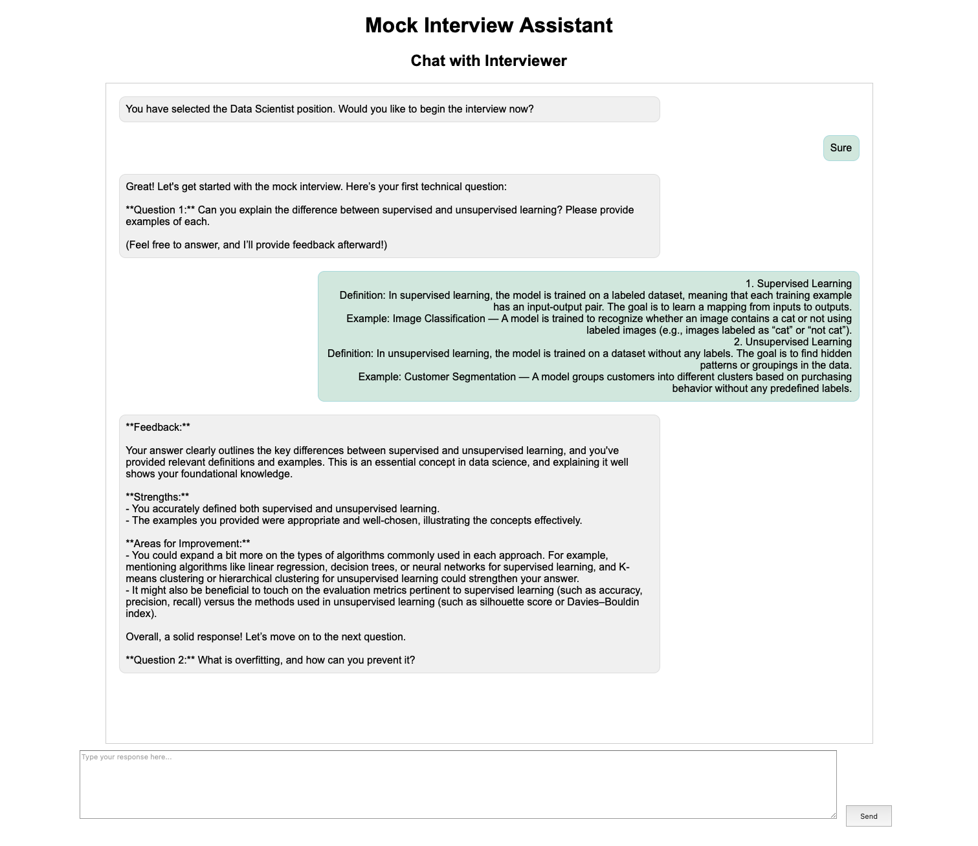
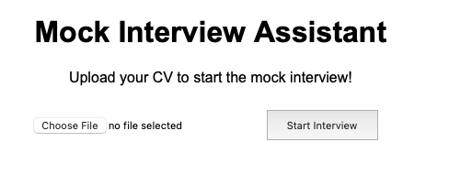
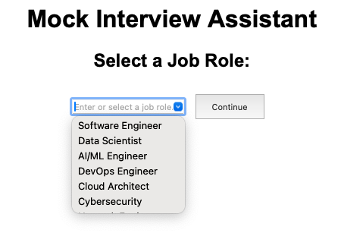
Current State
Mock-Interview

Slide 39
What is left to do
Mock-Interview webpage’s Compatibility with the main webpage

Slide 40
What is Done: User Interface
Graphical user interface is implemented
Questionnaire functionality is coded
Résumé generation integration and download feature is functional

Slide 41
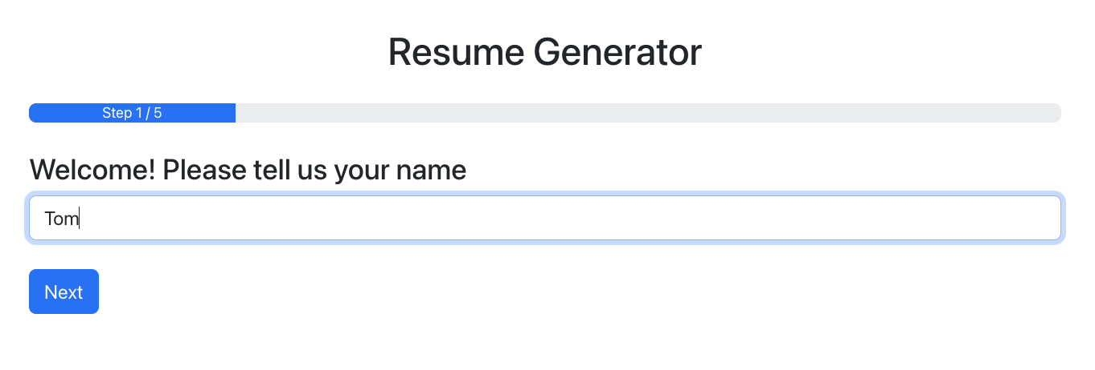
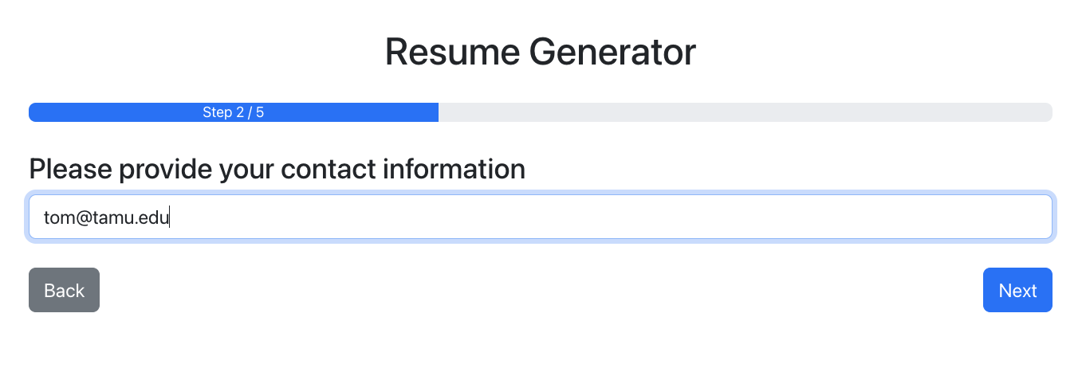
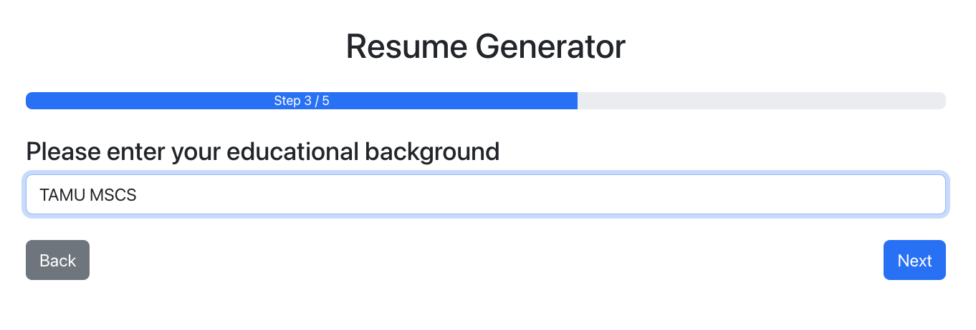
Current State
JSON format data return
{
"name": "Tom",
"contact": "tom@tamu.edu",
"education": "TAMU MSCS",
"experiences": [
"Software Engineer at ABC Corp, 2020-2022 - Developed scalable web applications.",
"Intern at DEF Inc, 2019 - Assisted in backend API development."
],
"skills": [
"JavaScript",
"Python",
"React",
"Node.js"
]
}

Slide 42
What is left to do
Expand the question tree
Implement feedback mechanism and dynamic chain of question based on user input
Add tailoring feature for customized résumés
Integrate job descriptions for tailored résumé generation

Slide 43
What is Done: Backend
Resume renderer integrated into frontend workflow
Blockwise render based on user input is coded with pre-defined template
Translate open source template into renderer framework

Slide 44
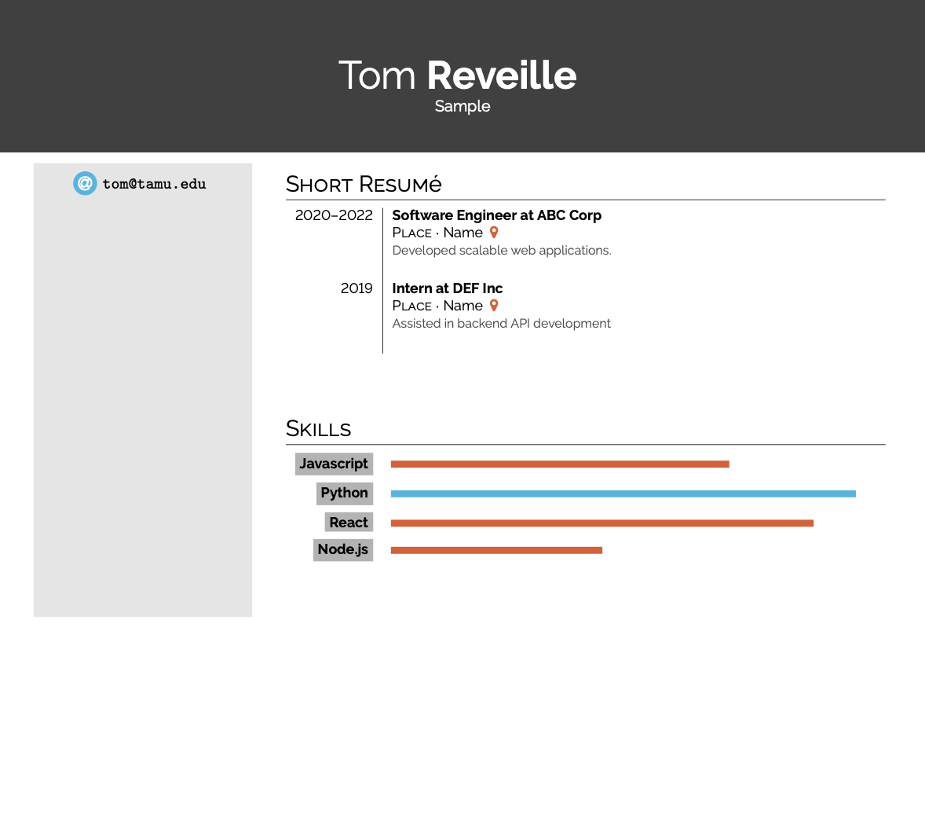
Current State
Data package from frontend interface -> rendered resume pdf
{
"name": "Tom",
"contact": "tom@tamu.edu",
"education": "TAMU MSCS",
"experiences": [
"Software Engineer at ABC Corp, 2020-2022 - Developed scalable web applications.",
"Intern at DEF Inc, 2019 - Assisted in backend API development."
],
"skills": [
"JavaScript",
"Python",
"React",
"Node.js"
]
}
Simple Hipster CV Template @Sarah Lang (https://www.overleaf.com/latex/templates/simple-hipster-cv/cnpkkjdkyhhw)

Slide 45
What is left to do
Expand the template library
Create an intelligent matching engine for matching different user inputs to different templates
Potential integration towards job recommendation workflow

Slide 46
What is Done: Job Recommendation
Basic search of relevant job positions based on user’s profile and requirements
Score system providing a relevance score for each job
Summary of each job post
Search again based on user’s feedback

Slide 47
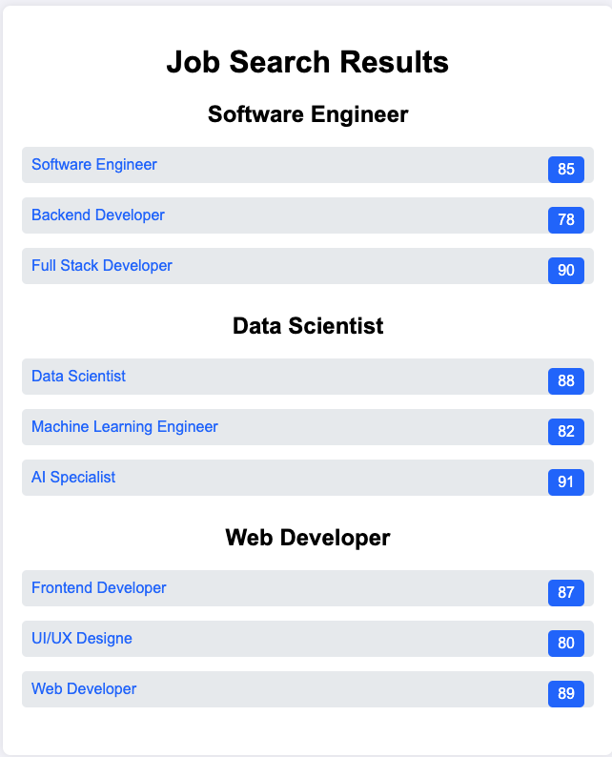
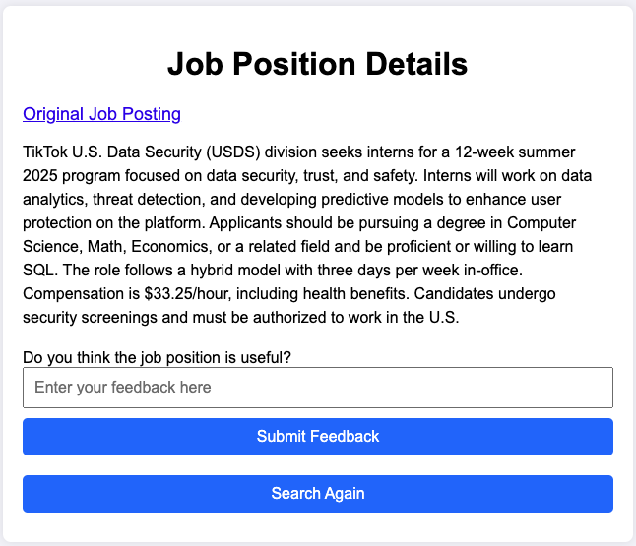
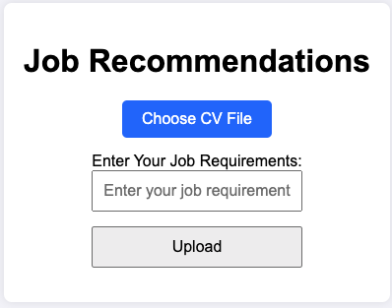
Current State
enter requirements->search job market->click on one link of the results

Slide 48
What is left to do
Design user-driven search filters to allow users to prioritize certain factors (e.g., remote work, salary, company size) with customizable weights
Enhance the analysis of user’s profile and job positions

Slide 49
Work Plan
Lianhao Zhou – Mock-Interview webpage
Hanyun Yin – Job Recommendation
Yafei Li – Frontend & GUI
Yichen Tao, Zhenrui Wang – Backend renderer and matching engine
Next up: Intelligent Advisor

Slide 50
Intelligent Advisor: Automatic Generation of Hardware and Software Upgrades
By: Nazar Oladepo, Bidwat Pokhrel, Esau Hutcherson

Slide 51
What is Done: Tasks
Set up database and API for users and system specifications
Create terminal commands for fetching system specifications
Have the top 50 games in the steam library and their pc system requirements

Slide 52
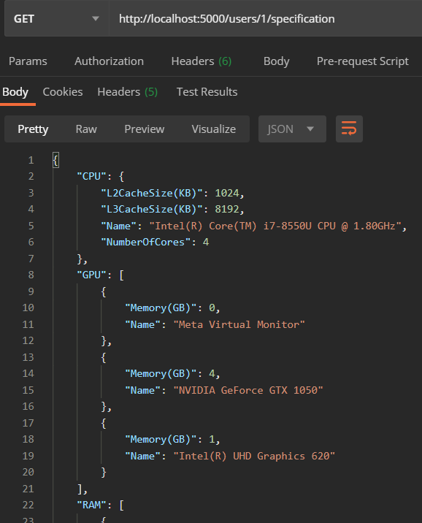
Current State: REST API

Slide 53
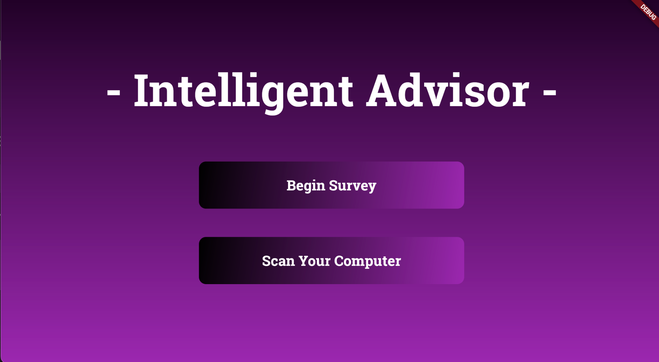
Current State: UI/UX Design

Slide 54
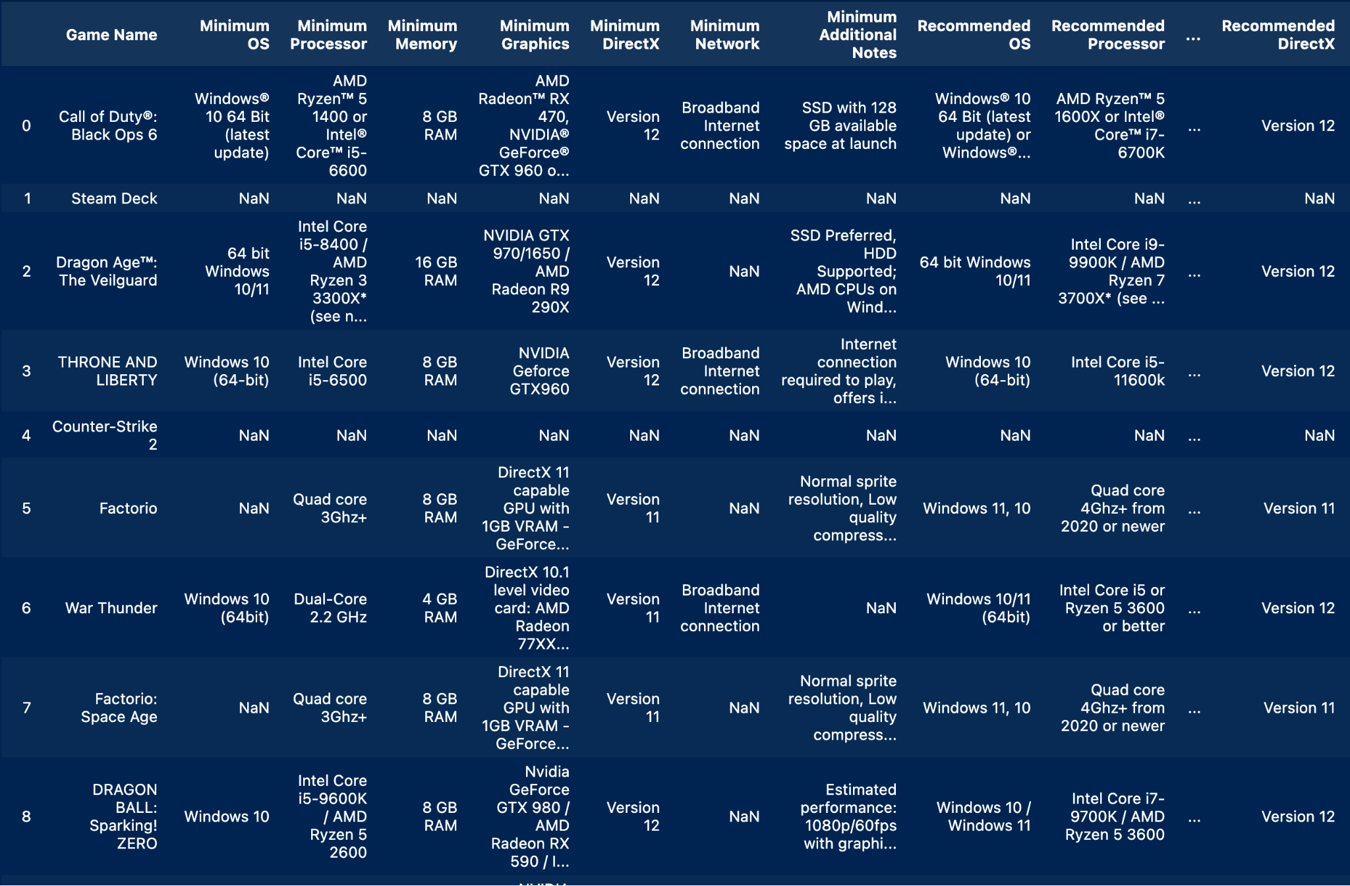
Current State: Web Scraping Data

Slide 55
What is left to do
Integrate API with the Frontend
Seed database with the data scraped from the web
Add the Survey
Display Scan Data
Build Page of Recommendations
Have the LLM’s hardware recommendations bounded by the user’s budget

Slide 56
Work Plan
Esau Hutcherson– Work on hardware LLM recommendation and figure out a way to have the budget considered while the LLM makes recommendations.
Bidwat Pokhrel – Work on Running System Commands using Flutter and Make progress on the backend.
Nazar Oladepo – Continue Building the pages of the app and making sure that everything is being displayed properly.
Next up: JobSeeker

Slide 57
JobSeeker: Easy Job Hunting
Amalesh Arivanan, Emory Lu,
Mahirah Samah

Slide 58
What is Done: Tasks
OpenAI API integration for normalizing user inputs (job title, location, contract type, remote work, visa sponsorship)
Job Filtering Based on User Preferences
Chatbot Interaction for collecting User preferences and displaying job recommendations.
Initial database design

Slide 59
Current State
Chatbot Development: The chatbot interacts with users to gather job preferences through a conversational interface.
Input Normalization: User inputs like job title, location, and remote work preferences are standardized to ensure accurate filtering.
Job Filtering Logic: An algorithm filters jobs based on user preferences, ensuring relevant results are displayed.
User Interaction Flow: The system provides job recommendations in batches, allowing users to request more results or refine their search.
Dataset Integration: The system utilizes a dataset of US Software Engineer jobs from Kaggle to match user preferences with available positions.
Iterative Job Search: Users can continuously interact with the chatbot to explore more job options or ask additional questions.

Slide 60
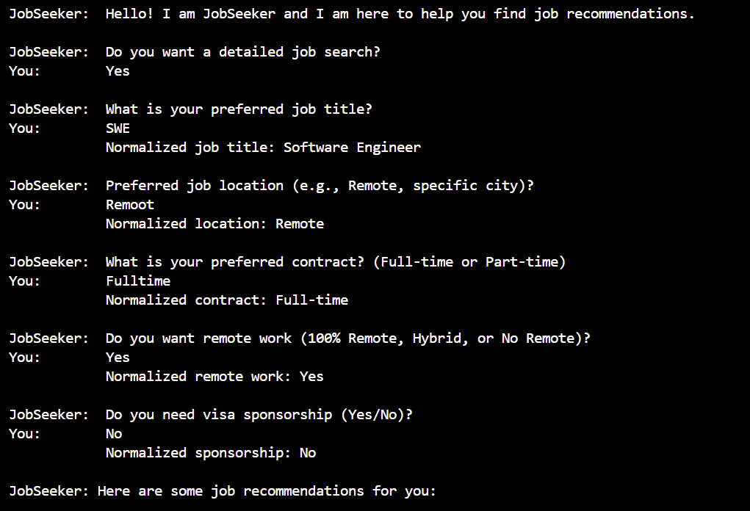
Current State
The chatbot can handle basic job searches and normalize inputs for an accurate job matching experience

Slide 61
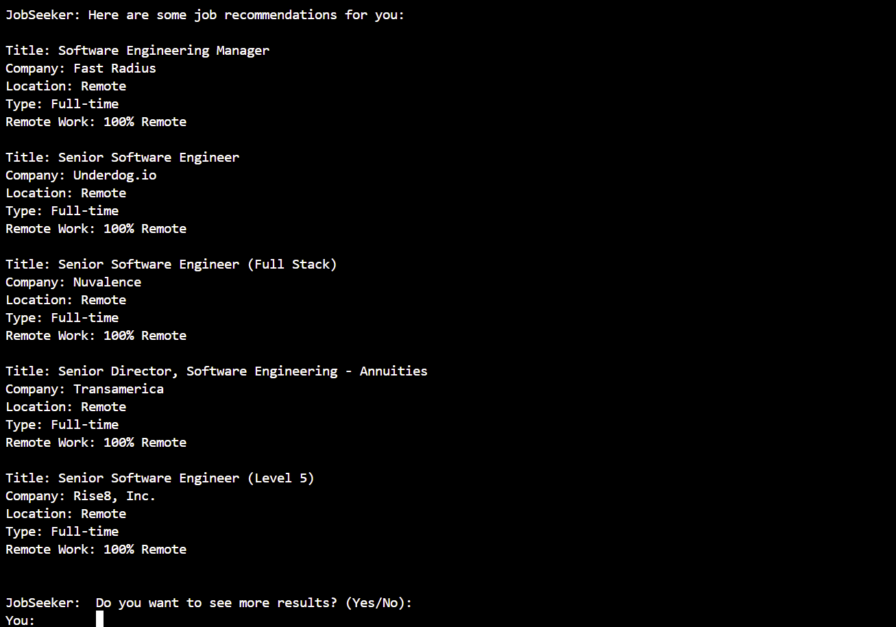
Current State
The chatbot can handle basic job searches and normalize inputs for an accurate job matching experience

Slide 62
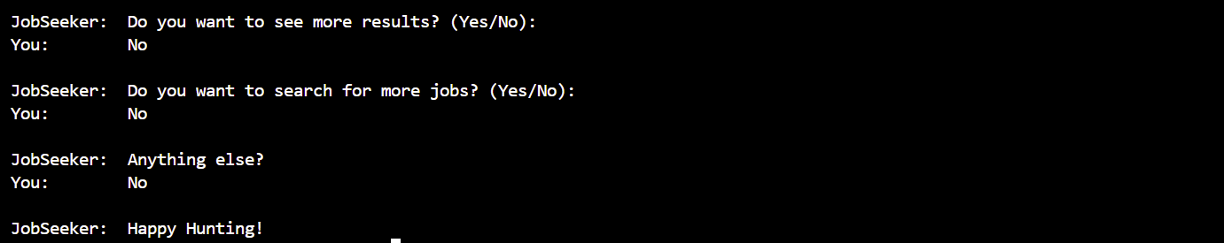
Current State

Slide 63
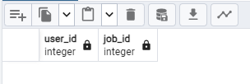
Current State - database
User table
Jobs table (user_id as secondary key)

Slide 64
What is left to do
Further improvements on handling broader edge cases in user input and testing.
Provide recommendations based on users’ skill-set.
Storage of user job preferences and job list from Chatbot conversations
Implement Chatbot interface
Implement User interface
Frontend-backend connection

Slide 65
Work Plan
Amalesh Arivanan – Refine backend logic for job filtering and handle more complex user queries
Mahirah Samah – Set up job preferences database and connect to current Chatbot backend; implement frontend for Chatbot communication interface
Emory Lu – finish implementing user interfaces (login, landing/home page, result page); connect with backend
Next up: SNOOZE

Slide 66
SNOOZE
Smart Notification and Optimised Organization with Zero Effort
Kathan Vyas, Prachi Surbhi,
Ashwin Raja, Shreyas Kasetty,
Austin McCormick

Slide 67
What is Done: Tasks
Backend: LangGraph Integration with GMail
  Retrieving emails from client GMail for processing
  Sending replies from client email address
  Chatbot linked with email agents when prompted
Frontend: User Interface
  React Chatbot interface for user input
  Framework for LLM Output in separate window

Slide 68
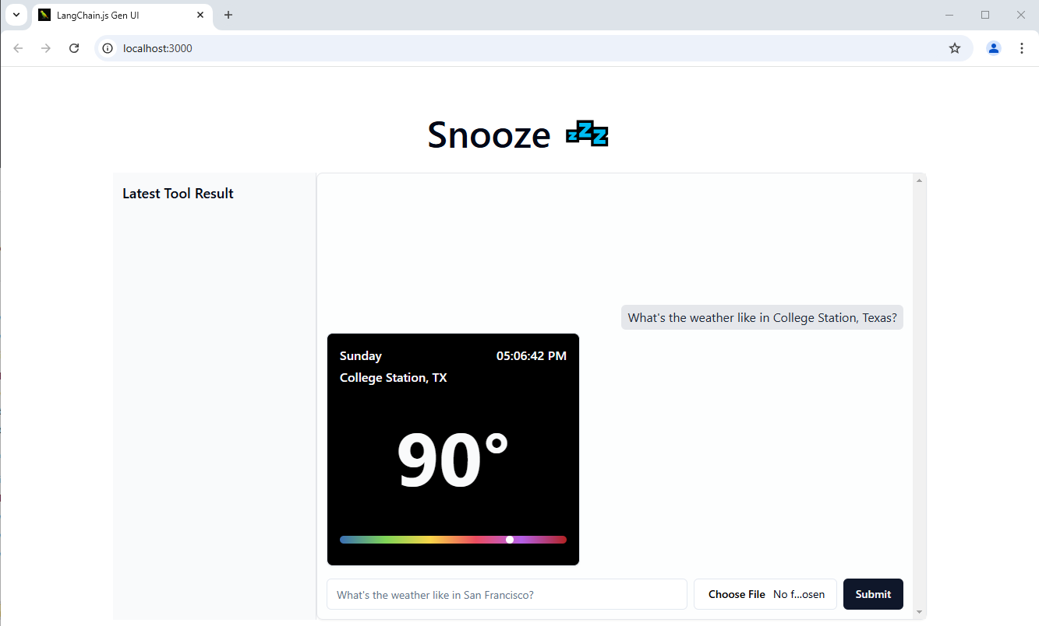
Current State
Front-End Current State

Slide 69
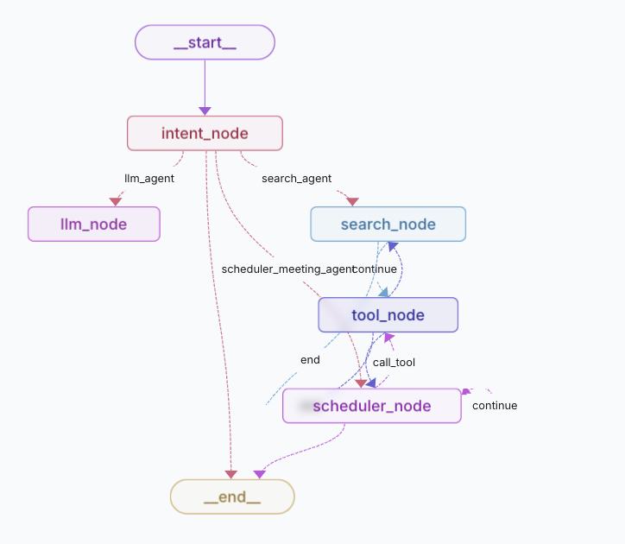
Current State
Back-End Current State

Slide 70
What is left to do
Connect backend tools with frontend UI
Finish Implementing Email Summarization Agent
Format email summarization output
Implement confirmation functionality for automatic email replies
Implement separate output widgets for email summarization and email replies

Slide 71
Work Plan
Ashwin – Develop summarization UI and email reply confirmation UI
Shreyas – Finish email summarization agent and connect to LangGraph
Kathan – Finish email reply agent and connect to LangGraph
Prachi – Integrate design templates with UI frontend
Austin – Develop summarization UI and email reply confirmation with Ashwin
Next up: The Cashiers

Slide 72
The Cashiers: Shoptimum
Marshall McIlyar
Akshath Venkataraman
Hector Cardenas
Benson Nguyen

Slide 73
What is Done: Tasks
Completed Tasks
  Completed mock front end
  Completed basic frontend based on that mock to talk to our backend

Slide 74
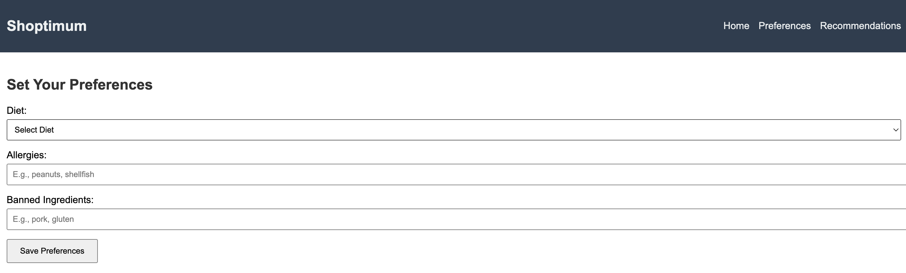
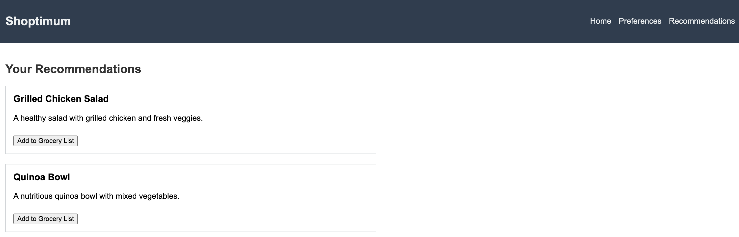
Current State: Front-end
Image(s) of current version of the system

Slide 75
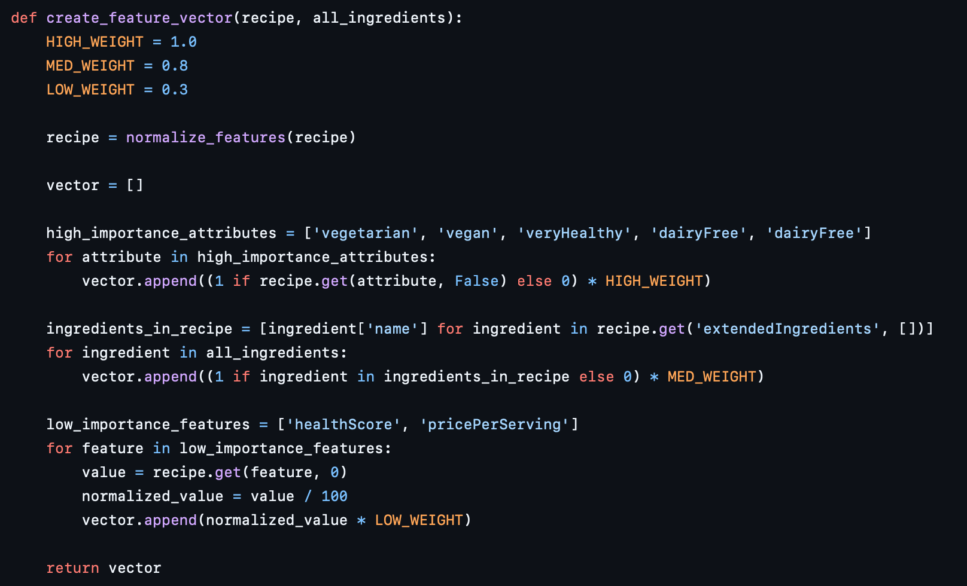
Current State: Algorithm
The algorithm is the most complex part of our system
Taking into consideration weights, feature vectors, etc.

Slide 76
What is left to do
Things that need to be done before final demo
  Connect the front-end to properly interact with the backend to store diet, preferences, and allergies
  Finalize balancing the weights and what features of various foods to keep and which ones to discard
  Look into stretch goals
    recommend ingredient substitutions that can be better for their macro goals

Slide 77
Work Plan
Akshath Venkataraman & Benson – Continue to expand the frontend to reflect backend changes
Hector & Marshall – Finalize balancing the weights and what features of various foods to keep and which ones to discard
Next up: The Doctor is (In)

Slide 78
The Doctor Is [In]: Interactive Rare Disease Database
Qizhuo Shen, Sicheng Chen, Annan Zou

Slide 79
What is Done: Tasks
Front End (Basic Features of UI)
  User Query
  Chatbot Response (Redo, Discard, Examine Encode)
  Patient Info and Provider Info fetching (Mock Data)
  Manual Context Encoding Modal
Back End
  MongoDB Database
  Basic REST endpoints
  Inference Engine
ML
  OpenAI and Vector Database Set Up
  Data Collection and Preprocessing

Slide 80
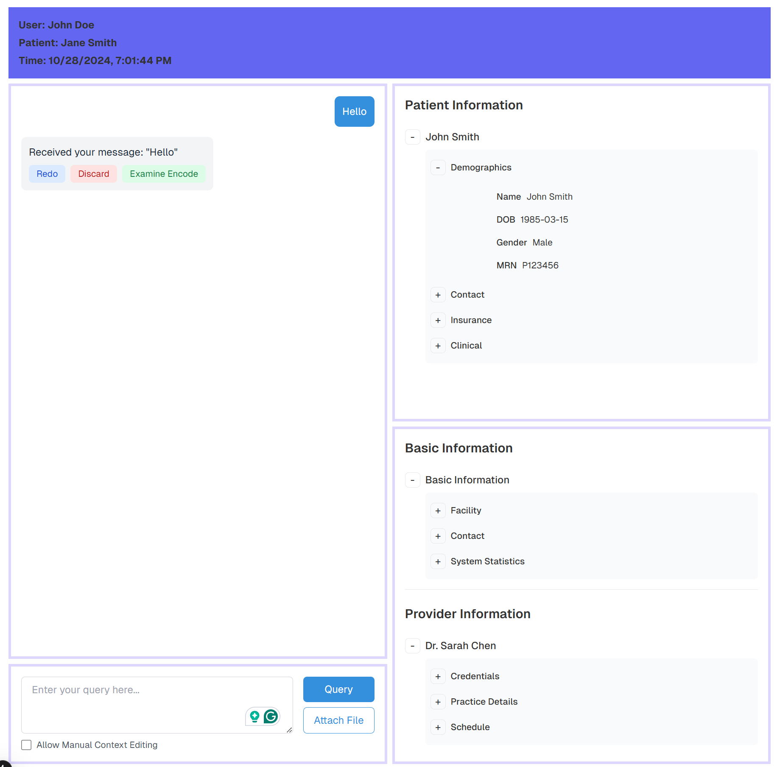
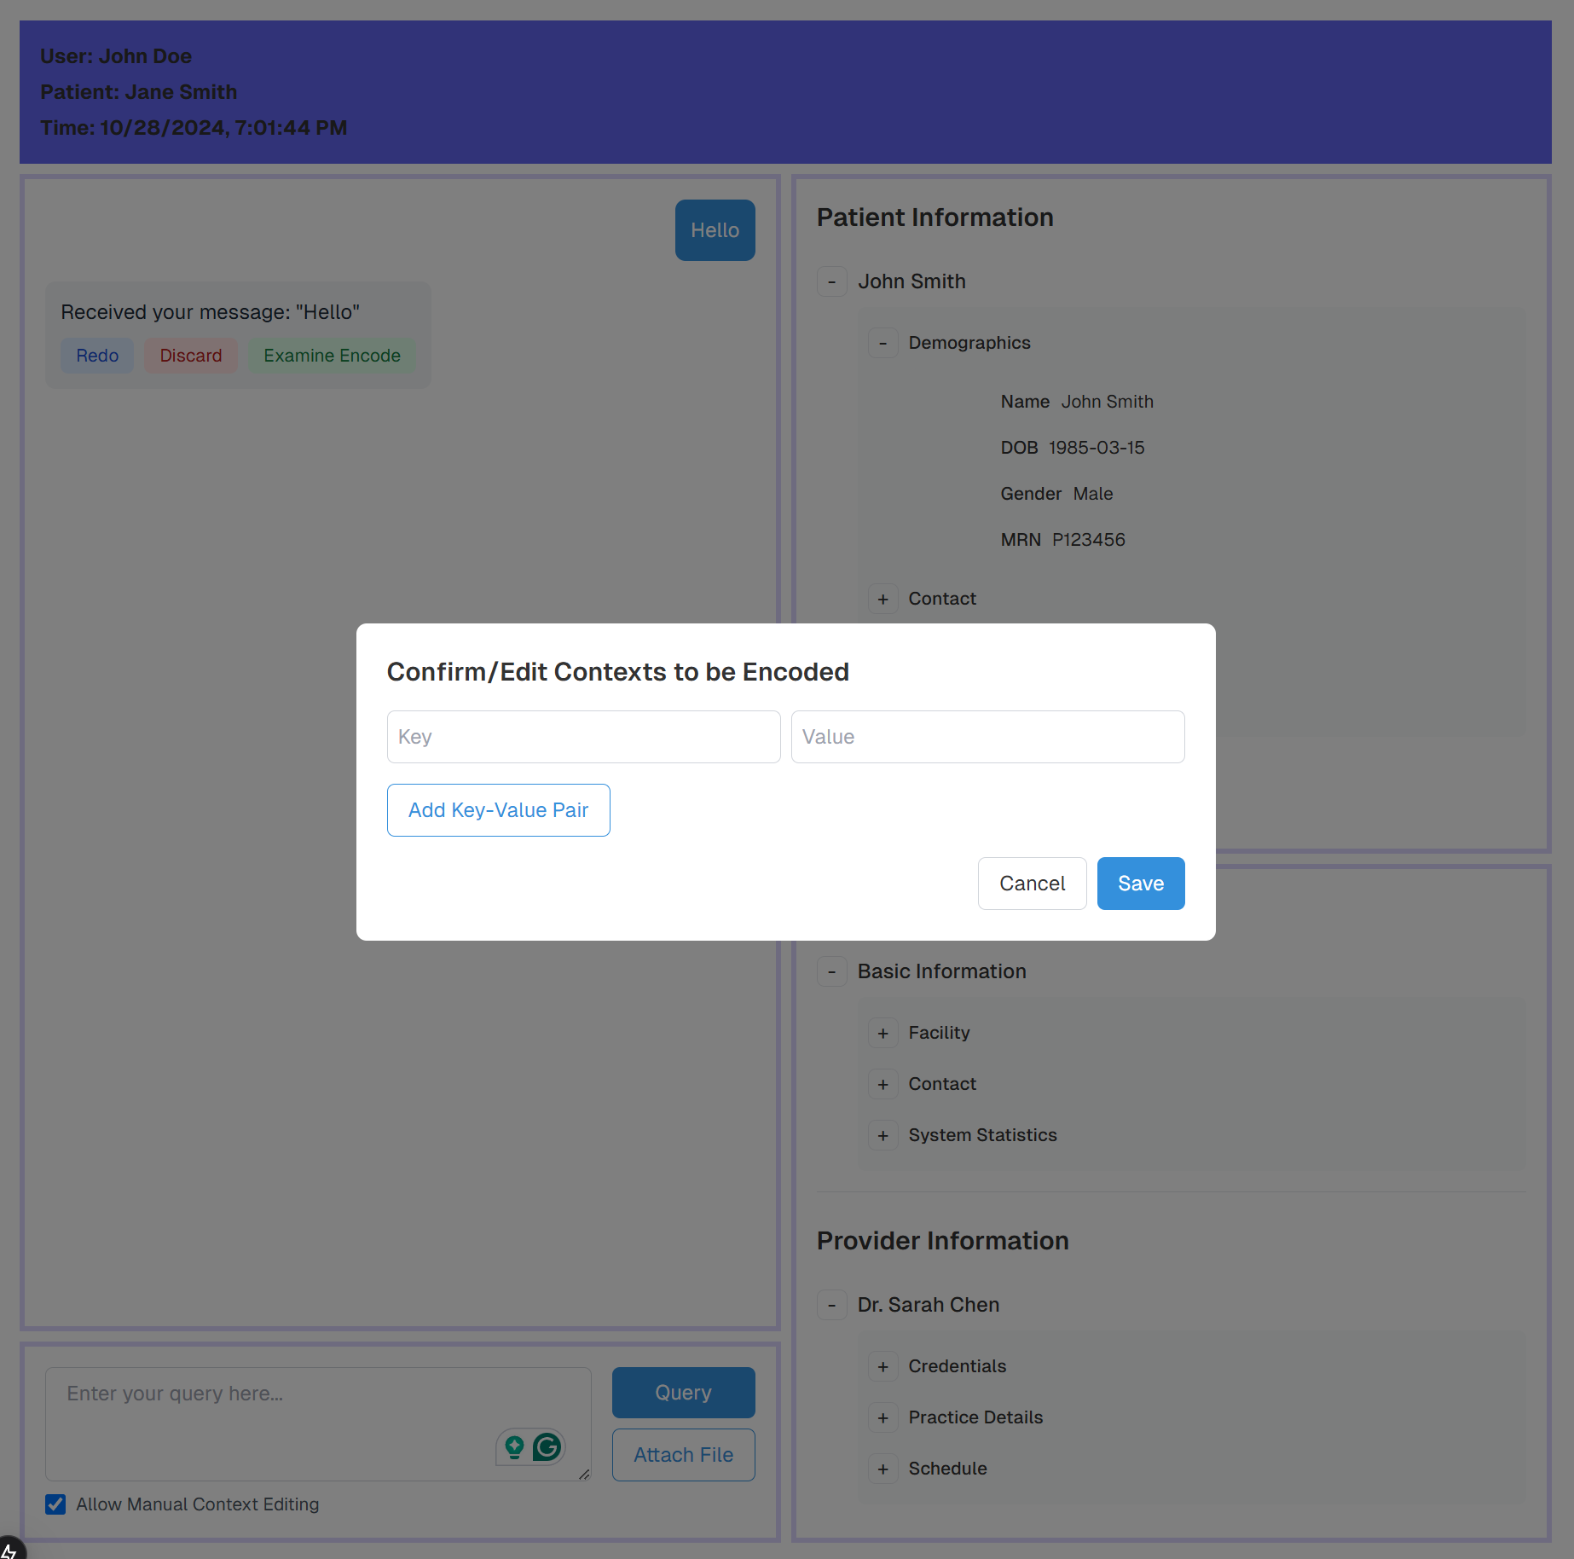
Current State of Interface

Slide 81
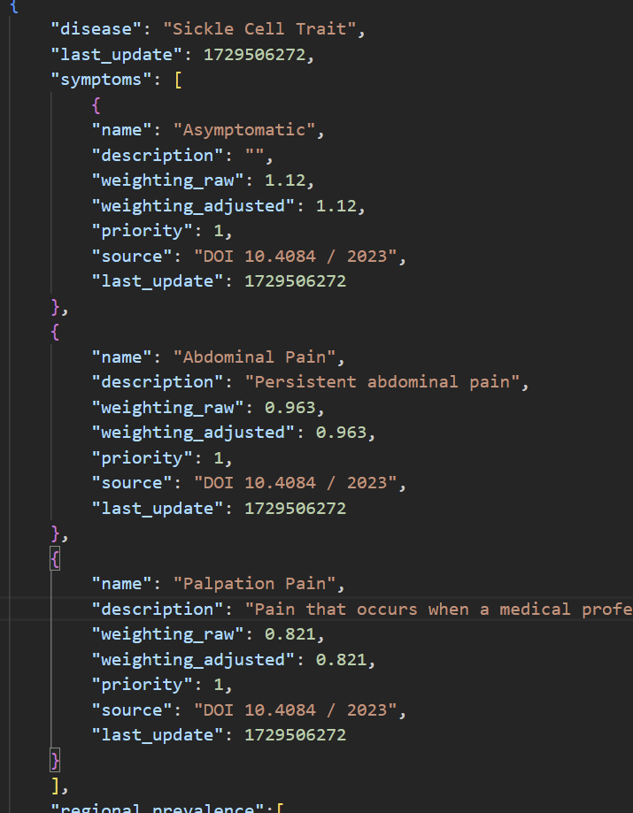
Backend
-Utilizes Python/Flask to integrate better with ML components
-Implemented a weighted inference mode in py_rete inference engine and explanation/choice ranking function
-Implemented persistence/retrieval of knowledge engine context via MongoDB
-Encoded a testing sample fact base (weighting created manually based on disease demographics) in MongoDB

Slide 82
ML
Langchain for Data Chunking
  Before passing documents to OpenAI for vectorization, Langchain is applied to chunk the data into smaller segments. This helps to avoid memory constraints and improves processing efficiency.
OpenAI API for Vector Embeddings
  The chunked data segments are sent to OpenAI's APIs, which generate vector embeddings for each segment. These embeddings capture the contextual information of the text, enabling semantic similarity analysis.

Slide 83
What is left to do
Frontend
  File uploading and processing
  Data Exchange with Backend
Backend
  Properly integrate knowledge based inference with machine learning agents
  The rest of RESTs
ML
  Differentiation of agents need more training
  Fine-tune NLP key-value embeddings

Slide 84
Work Plan
Qizhuo Shen: Continue the implementation of UI, with a focus on file upload handling and backend integration
Sicheng Chen: Continue to work on ML agent system, train more epochs.
Alan Zou: Properly integrate knowledge based inference with machine learning agents. Work on explanation stage of NLP embeddings.
Next up: CodeInsight

Slide 85
TeamName: CodeInsight
Jing Cao, Alex Zheng, Zihao Wang, Longxiang Li

Slide 86
What is Done: Tasks
Prototype Design:
Defined project scope and set clear milestones for the prototyping phase, focusing on core features like code generation, modification, and natural language input.
Created a structured plan for building the prototype, outlining user flows and minimum viable features.
LLM support fundamentals：
Selected the AI models for code generation and explanation.
Started fine-tuning the models for better accuracy.
Frontend Framework:
Developed the basic layout for the interface.
Implemented code editor features and preliminary code suggestion display.
Backend Framework:
Designed and set up the database structure to store essential data;
Built the initial backend framework to support AI integration;
Established communication protocols to handle requests and responses from the frontend, ensuring a foundation for real-time interaction.

Slide 87
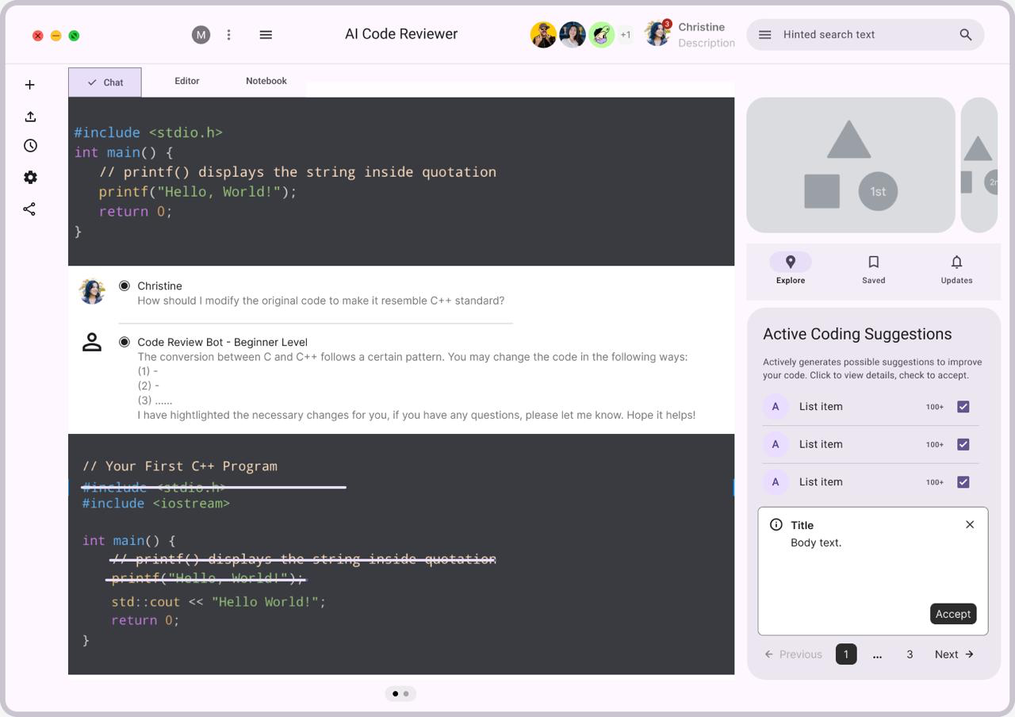
Current State
Prototype & Frontend Framework

Slide 88
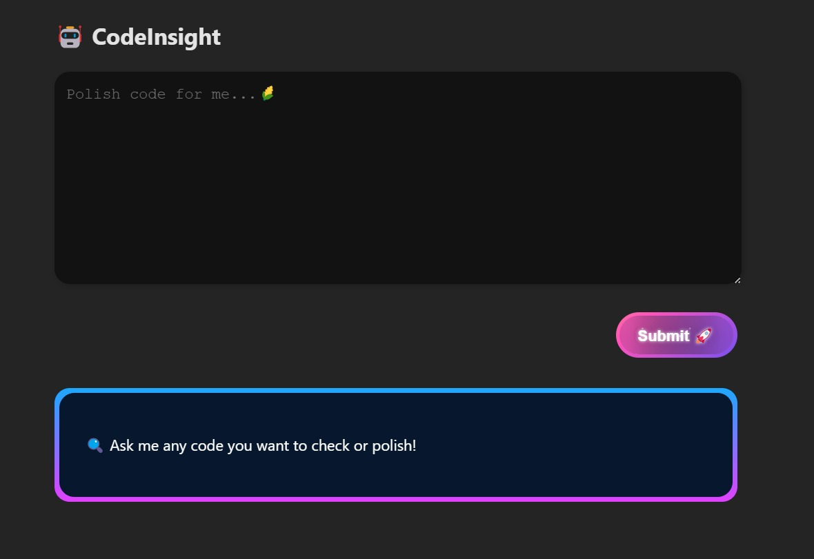
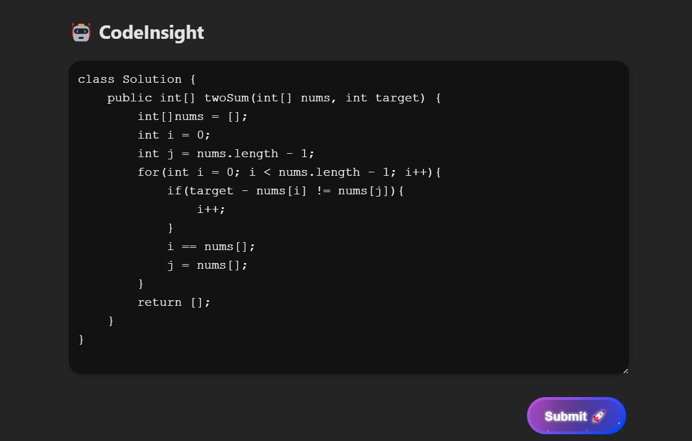
Current State
Frontend Implementation

Slide 89
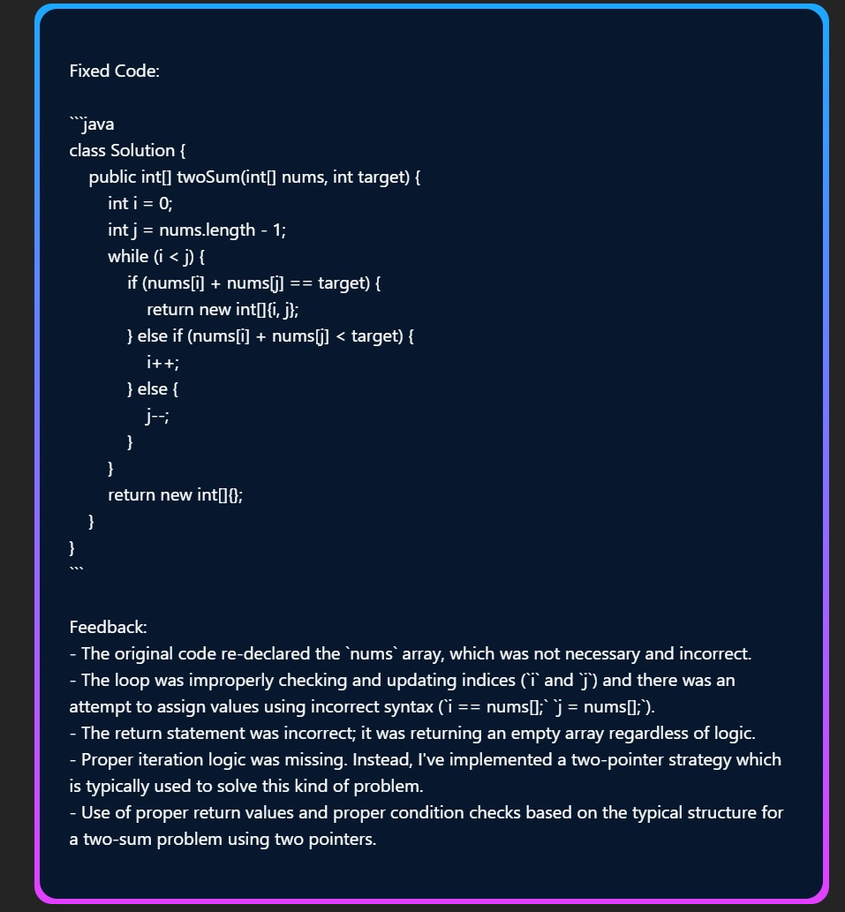
Current State
Code Review Output Demo

Slide 90
What is left to do
Optimize User Experience:
Gather more user feedback to refine the requirements.
Prioritize tasks as new challenges arise.
LLM support fundamentals：
Improve the AI’s interpretation of natural language commands.
Continue refining the model based on testing results.
Frontend Framework:
Enhance the interface for better responsiveness and usability.
Add natural language input handling to allow users to interact with the AI using plain English commands.
Backend Framework:
Optimize the backend for low-latency performance to support real-time code suggestions.
Implement user profiling and personalization mechanisms that leverage stored user data.

Slide 91
Work Plan
Alex Zheng: Finalize the workflow, coordinating frontend, backend, and model integration to ensure a cohesive user experience.
Jing Cao: Complete model benchmarking and testing, validating debugging capabilities with real-world examples.
Longxiang Li: Develop and integrate the backend, ensuring seamless communication between the AI models and the user interface.
Zihao Wang: Refine the interface layout and editor features, focusing on usability and smooth integration with backend functionality.

Slide 92
Final Presentation Schedule
November 22
  ?
  ?
  ?
  ?
November 25
  ?
  ?
  ?
  ?
December 2
  ?
  ?
  ?
  ?

