Slide 1
Order of Project Presentations
CrashLanding
Game Rec
HelloPentagon
Intellicrew
Intellifish
Inventory Advisor
JobSeekers
SNOOZE
The Cashiers
The Doctor is (In)
CodeInsight
To keep us on time today
  Be ready to quickly come up front
  4 minutes is all you have
  Avoid tangents
  Avoid details of design or tools/infrastructure
Remember
  Not everyone has to come up front

Slide 2
CrashLanding: Intelligent assistant to facilitate information elicitation in qualitative interview
Jiwon Chun, Shuning Gu, Junru Liu,
Yi Wen, Hangxiao Zhu

Slide 3
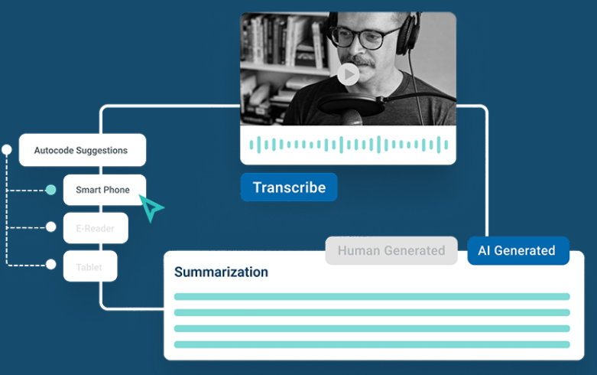
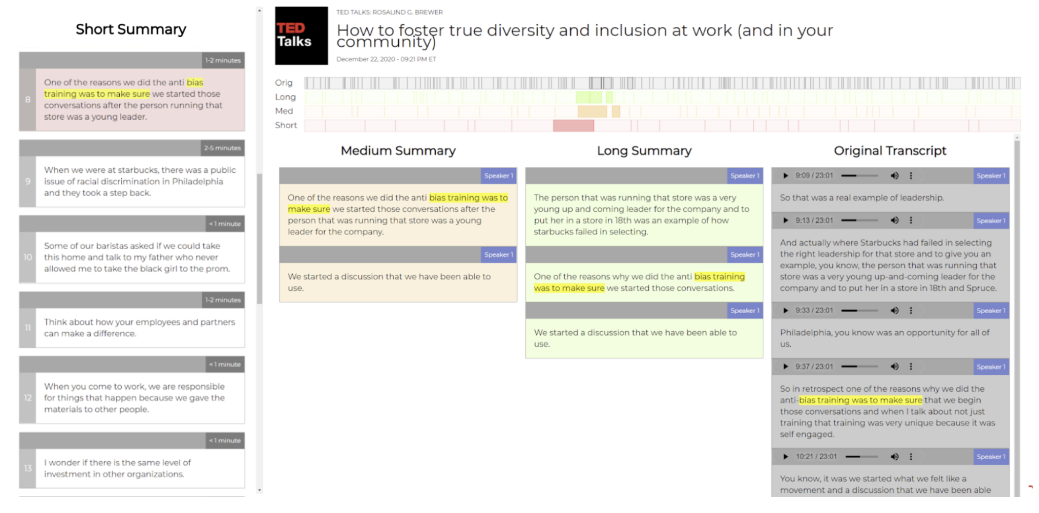
Related Designs
NVivo, Qualitative Analysis Software
  Linking audio, transcript, and summarization together, good for retrieving information
  Complex interaction, might be overloading for users during interview
Hierarchical Summarization for Longform Spoken Dialog, research paper
  Hierarchical summarization to enable user to easily browse and navigate content
  Using AI-generated automatic summary only can make user miss interesting information
Image of related design 1
Image of related design 2

Slide 4
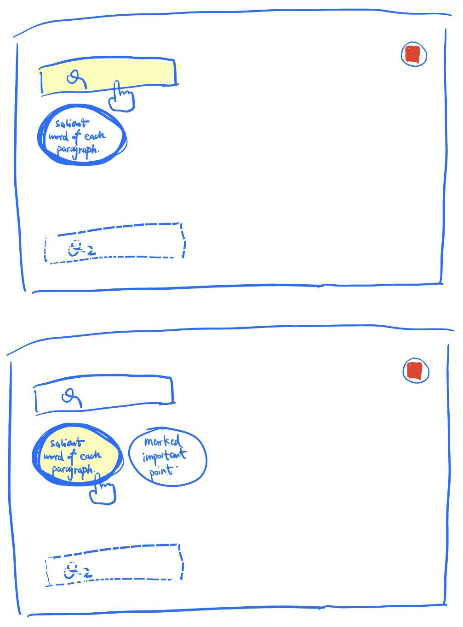
Design & Rationale
Layout of the interface
Summary and marked key points are put under the question
  User’s attention will only be within certain area
  A lot of information(both questions, summarized bullet points, and marked key points) will be displayed together
Image(s) of design

Slide 5
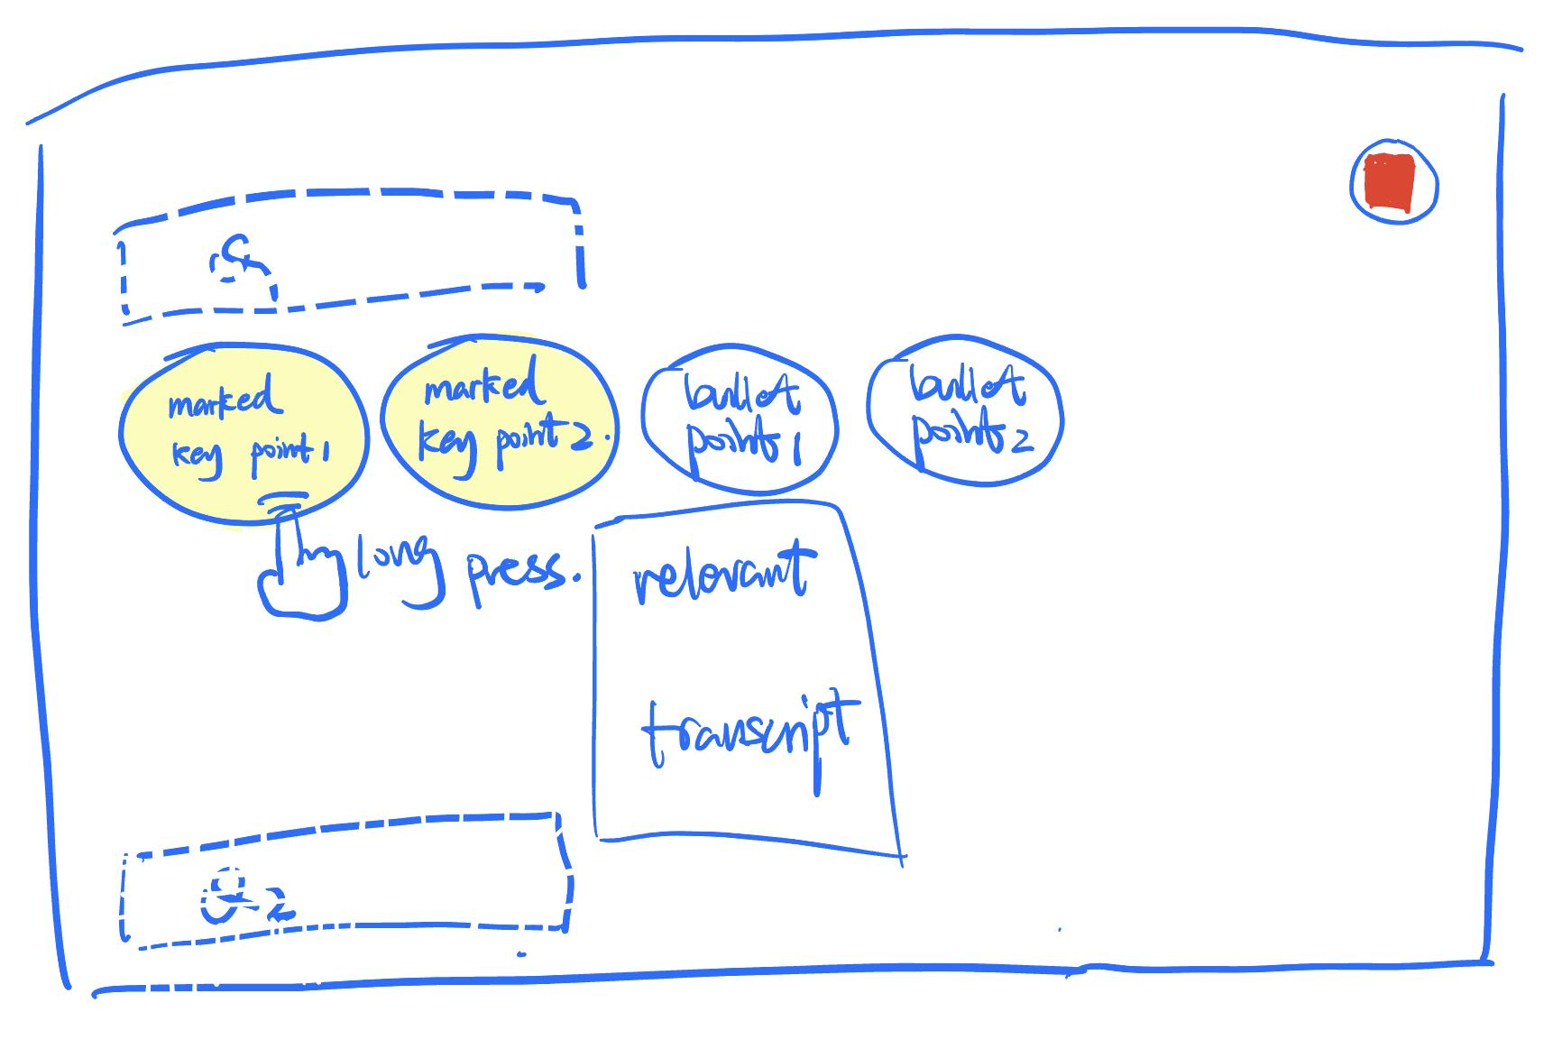
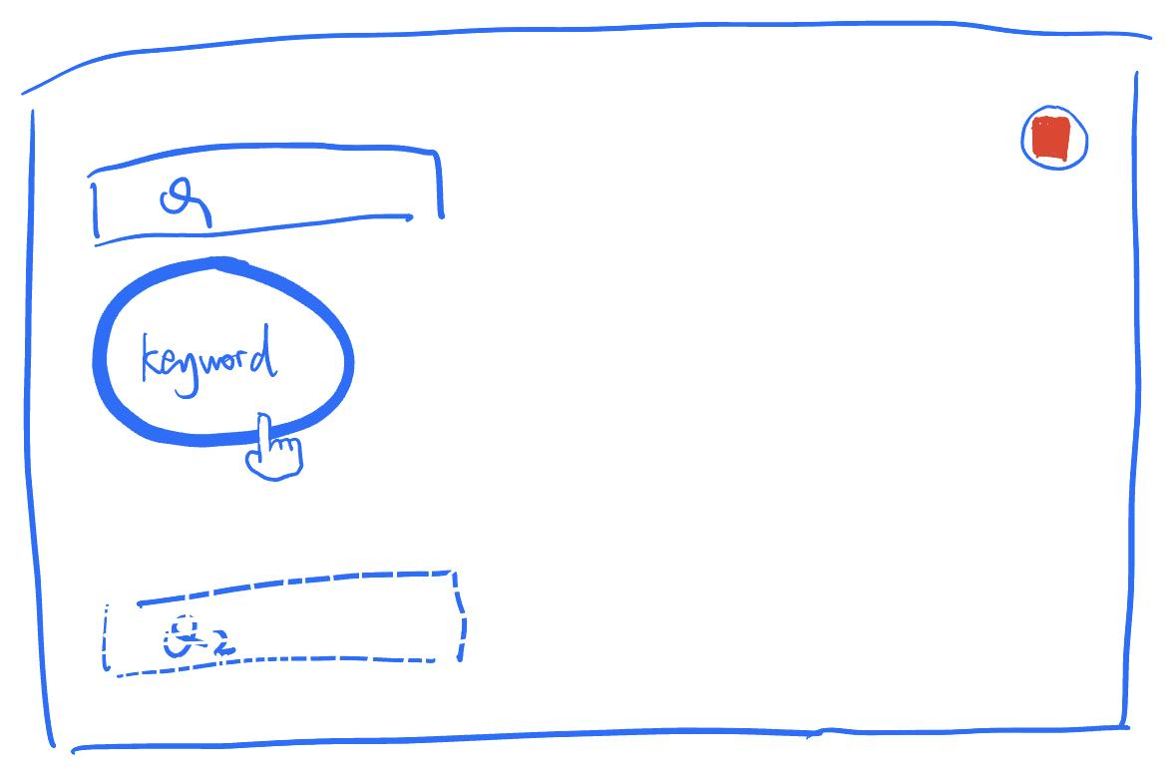
Design & Rationale
Long-press the key point bubble to display the related detailed information
  The details will be provided on demand, avoid overwhelmed continuously changing information to be distracting
  User need to perform another action to see the the detail
Display the most recent keyword in the conversation and let user mark by a single click
  Low-effort and won’t be distracting as the frequency of content changing is low
  Might not be that accurate to mark the exact information the user want
Image(s) of design

Slide 6
Work plan (only include if significantly changed from prior presentation)
Jiwon Chun: UI/UX design
Yi Wen: frontend development
Hangxiao Zhu: backend development
Shuning Gu: technical optimization
Junru Liu: evaluation design
Next up: Game Rec

Slide 7
GameRec: Game Recommendation
Akash Jothi, Spencer Cho, Annie Ren, Kyne Sun, Erik Day, Esben Egholm

Slide 8
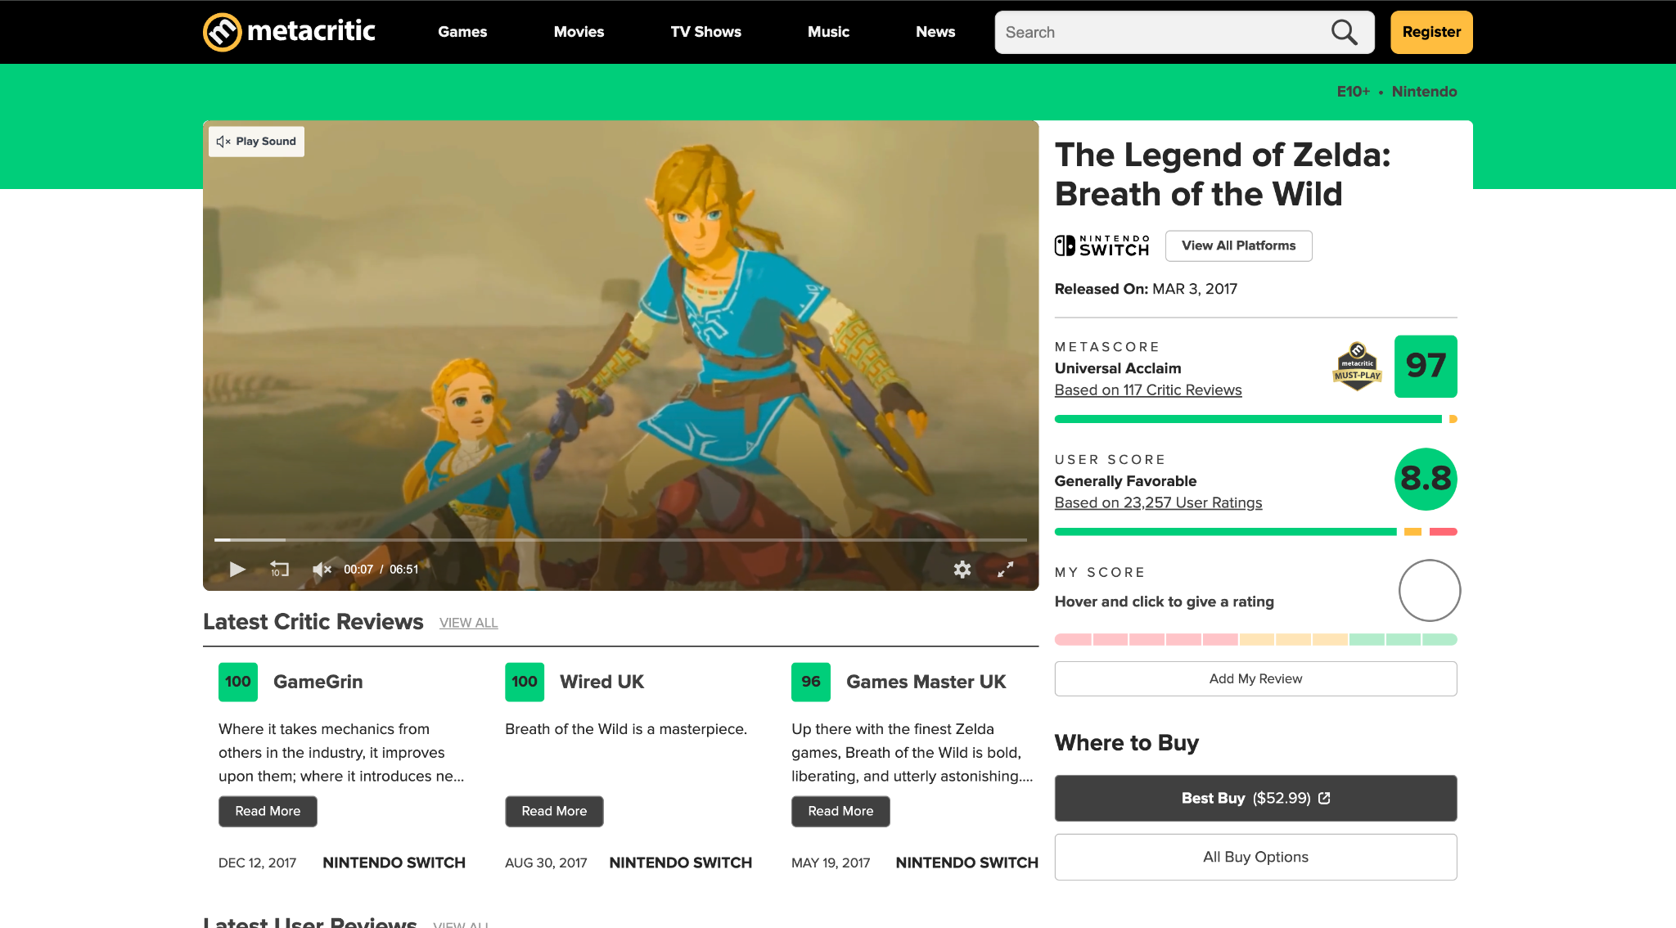
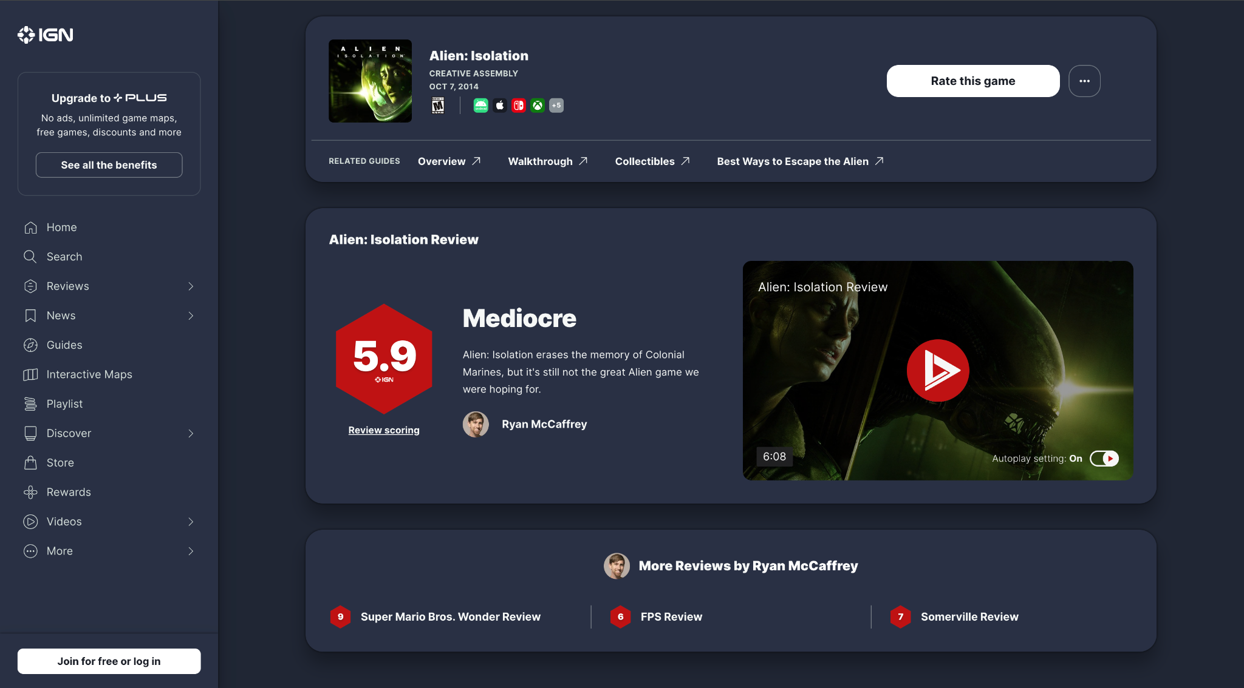
Related Designs
Metacritic
  Aggregate score that allows users to view general consensus
  Susceptible to review bombing from malicious users
IGN
  Detailed review from game journalist
  Opinions may not reflect true quality of game due to journalist’s own preferences
Image of related design 1
Image of related design 2

Slide 9
Design & Rationale
Home and Search Pages
  The good
    Home Page: Provides a snapshot of user activity, easy access to most recently viewed and trending games
    Search Page: Exploration and discovery
  The bad
    Home Page: May require users to navigate to other views for detailed actions
    Search Page: Spend more time navigating between sections

Slide 10
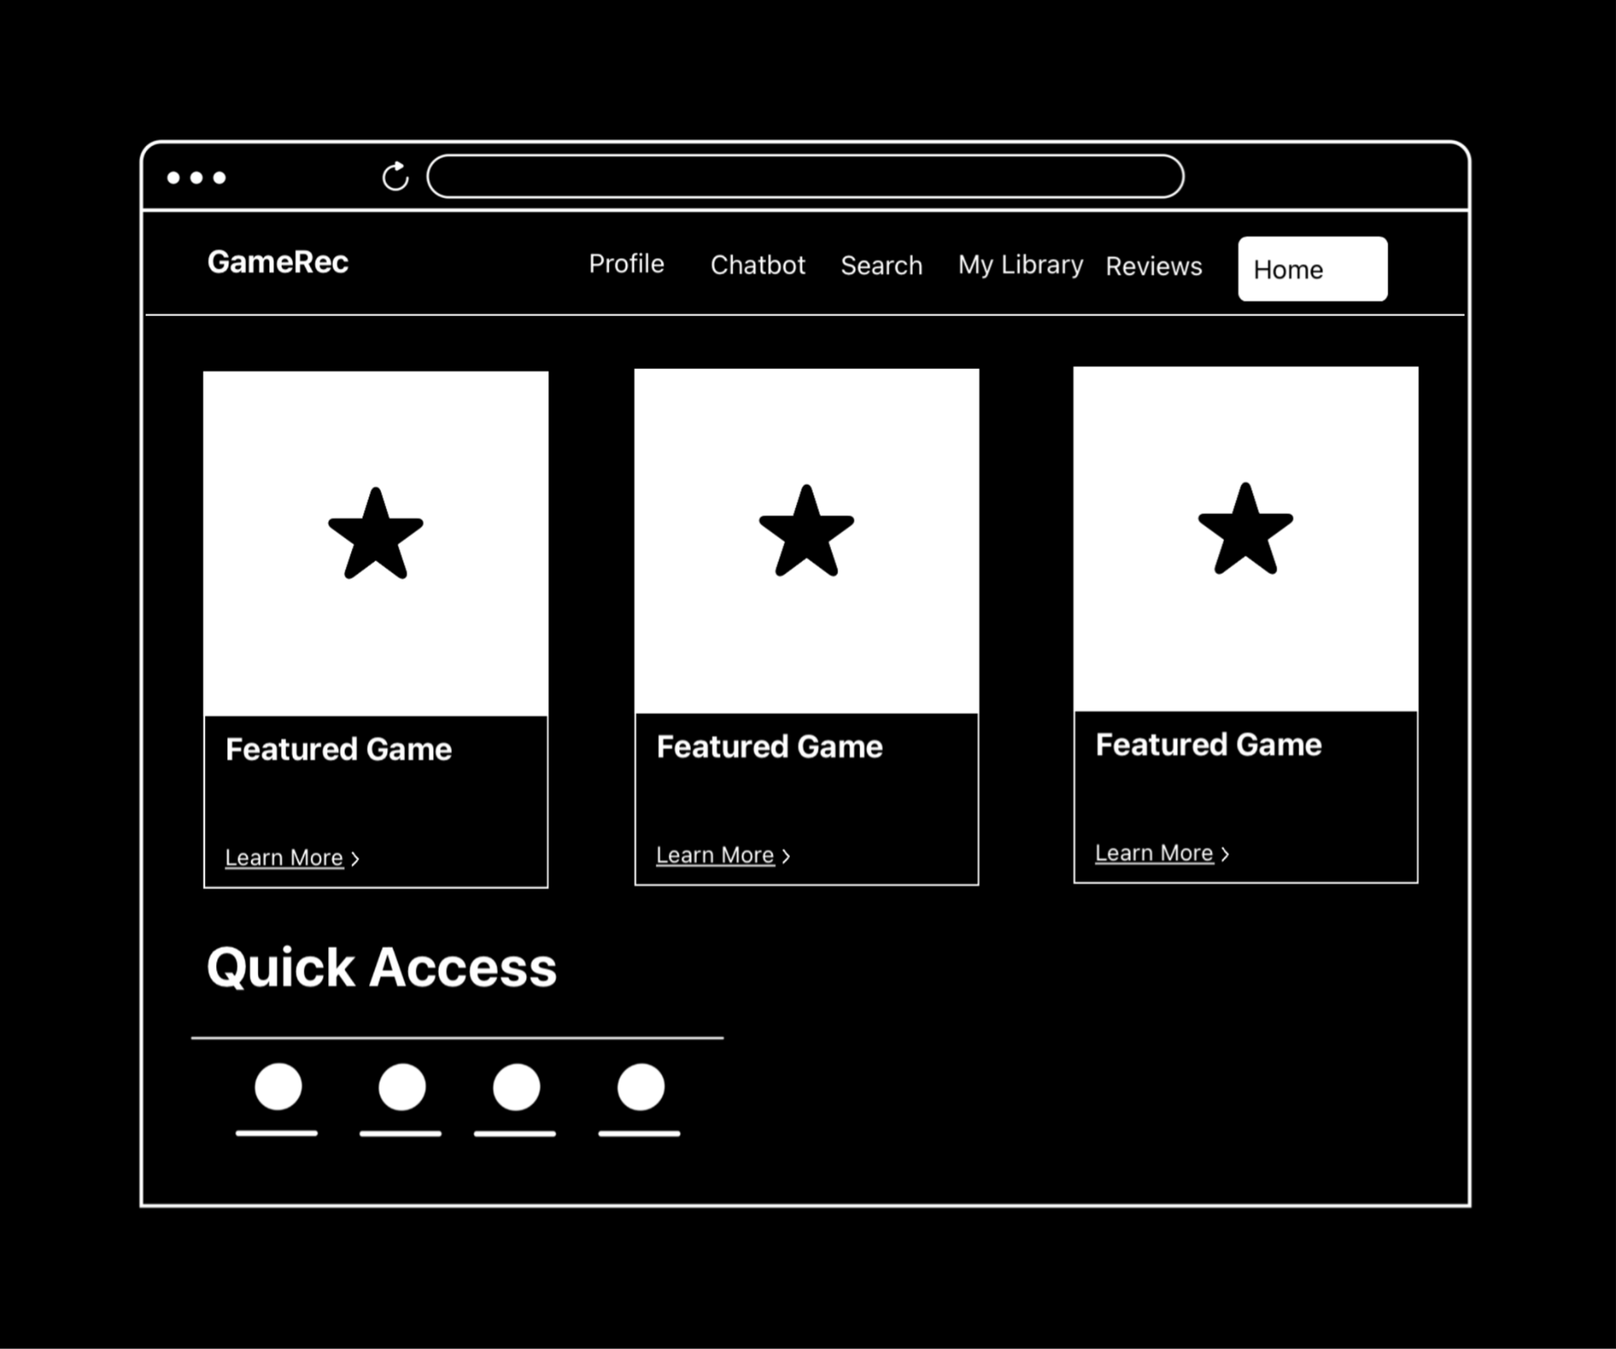

Slide 11
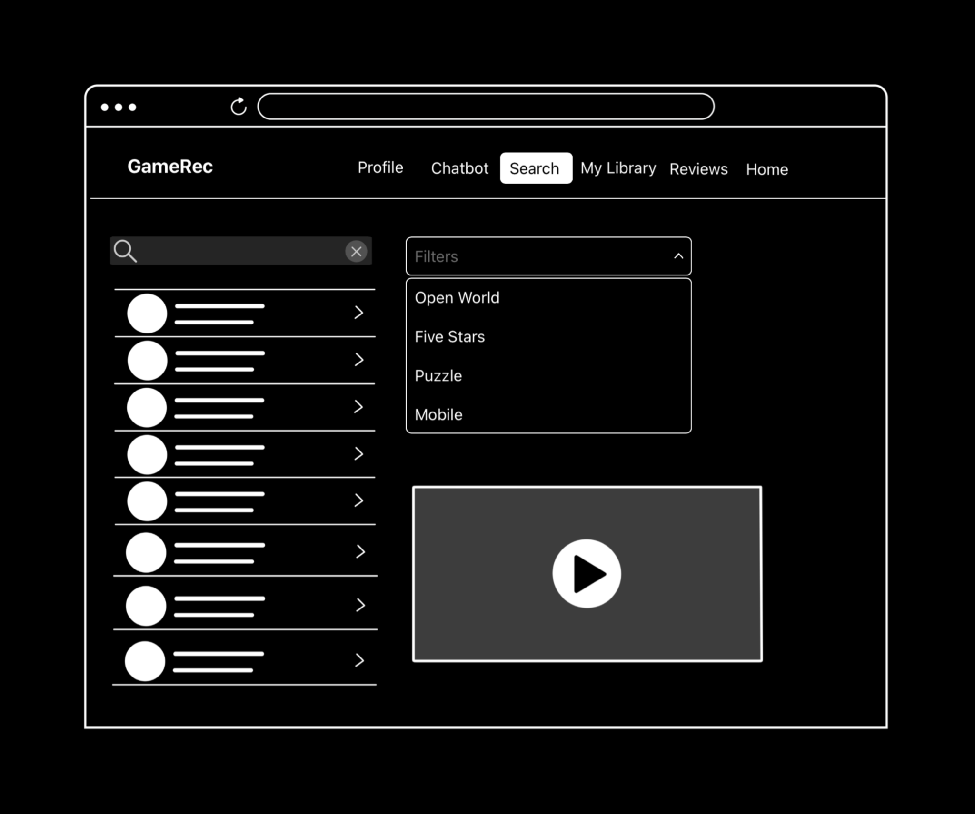

Slide 12
Design & Rationale
Recommendation and Reviews
  The good
    Recommendation Page: Clear focus on recommendations, users can browse for new games catered to their taste
    Reviews Page: Dedicated space for reviews, helps users make informed decisions when purchasing games
  The bad
    Recommendation Page: Users might miss integrated recommendations elsewhere
    Reviews Page: Requires navigation to access library features

Slide 13
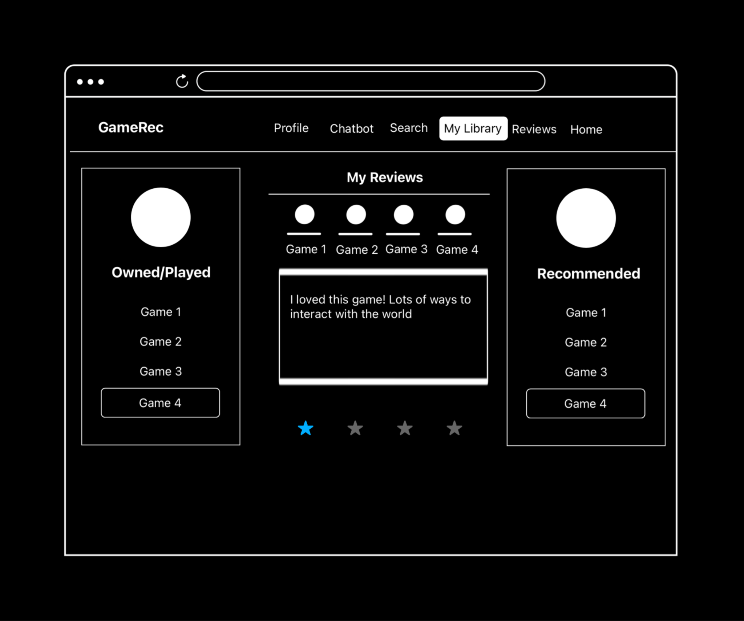

Slide 14
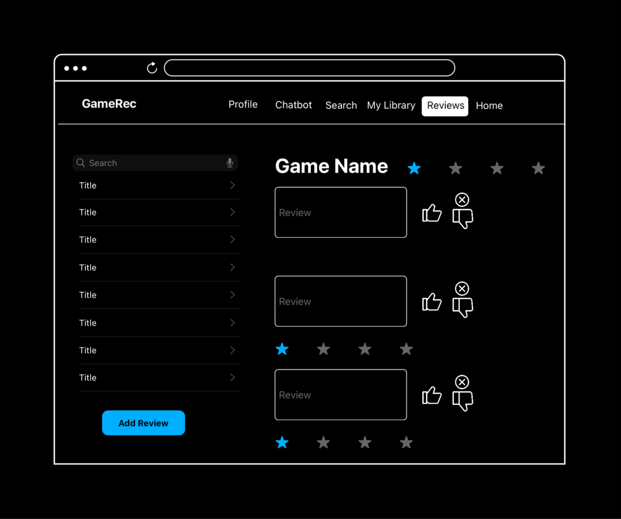

Slide 15
Design & Rationale
Profile and Chatbot
  The good
    Profile Page: Highly customizable and detailed, data used to recommend games most likely to interest user
    Chatbot Page: Clear separation of chatbot functionality, users can describe what they are looking for in natural language
  The bad
    Profile Page: Potentially overwhelming for users who want simplicity, may be incomplete for new users who are unfamiliar with games
    Chatbot Page: May feel isolated from other interactive elements

Slide 16
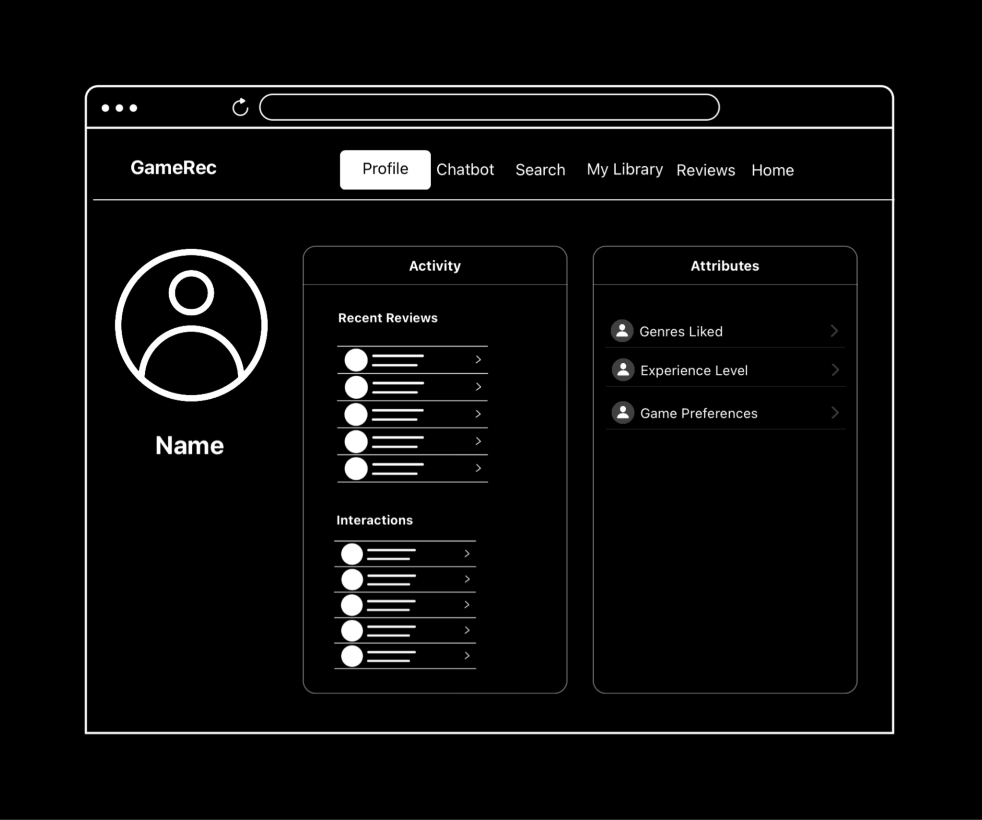

Slide 17
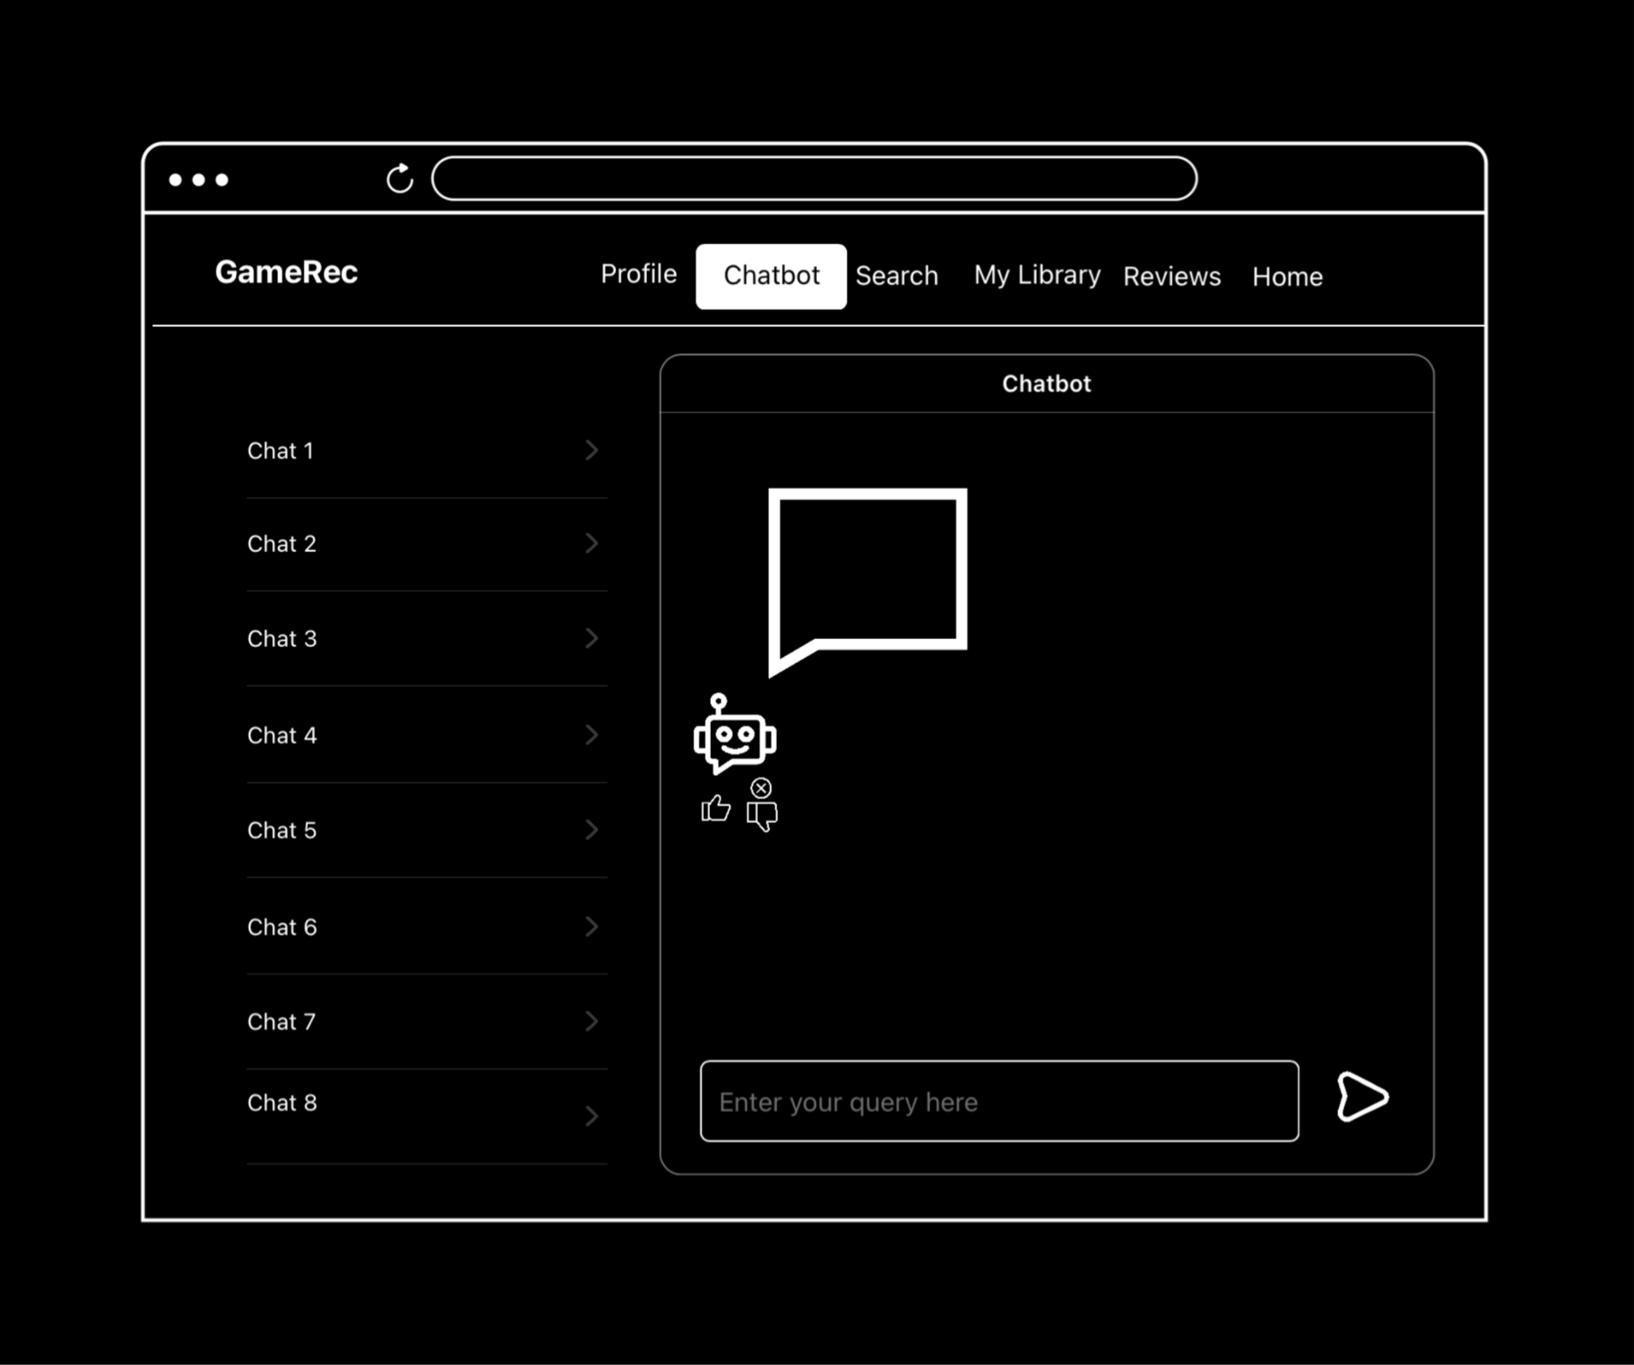
Next up: HelloPentagon

Slide 18
HelloPentagon
An Interactive Interface for
Malware Detection
Arunesh Mishra
Steve Wang
Johnny Le
Yoojun Kim
Soumyajyoti Dutta

Slide 19
Overview
High-level Design Idea
  Content-aware interactive user interface for malware detection
Goals
  Train a reliable machine learning model for the desired classification task
    Evaluate the model performance w.r.t standard benchmark
  Design and implement an interactive & User-friendly UI
    Implementation of features (hashing, signature patterns, family-clusters, VirusTotal integration, dashboard, severity rating, drift detection)
  Documentation
Notes:
Phase 1 Presentation

Slide 20
Issues
  Technical Issues
    Accuracy of detecting malware.
    Malware can possibly escape while it is analyzed online if not careful.
    The front-end and back-end for this project has a lot of intricacies. How to represent tasks with multiple sequences of steps and combine them?
  Cognitive Issues
    Users may have a difficulty understanding complex malware reports.
    A compilation of user behaviors i.e., suggestive and interactive with same UI?
  Social Issues
    User Diversity - expert cybersecurity users may want a more elaborate malware report, while general users may not be able to understand such information.
    With a more advanced UI, the application takes away jobs from cyber security analysts.
  Other Issues
    Catching dangerous files is always tricky as malware evolves: Concept Drift.
Notes:
Phase 1 Presentation

Slide 21
Solution
Primary Features
  We’ll give access to our standard data and model to detect the malware
  The model is open-source so user can update the model by introducing additional data
  We’ll provide information about the malware family and ssdeep hash for a given file
  User can decide whether to flag a file or not based on severity rating
Intelligent Features
  Provide information about drift and malware evolution
  Benchmark test using VirusTotal - providing user an option to go beyond
  Dashboard and statistics of user’s database
  Provide evolution information for better understanding of the sample
  Adaptive Behaviour based on user needs
Notes:
Phase 1 Presentation

Slide 22
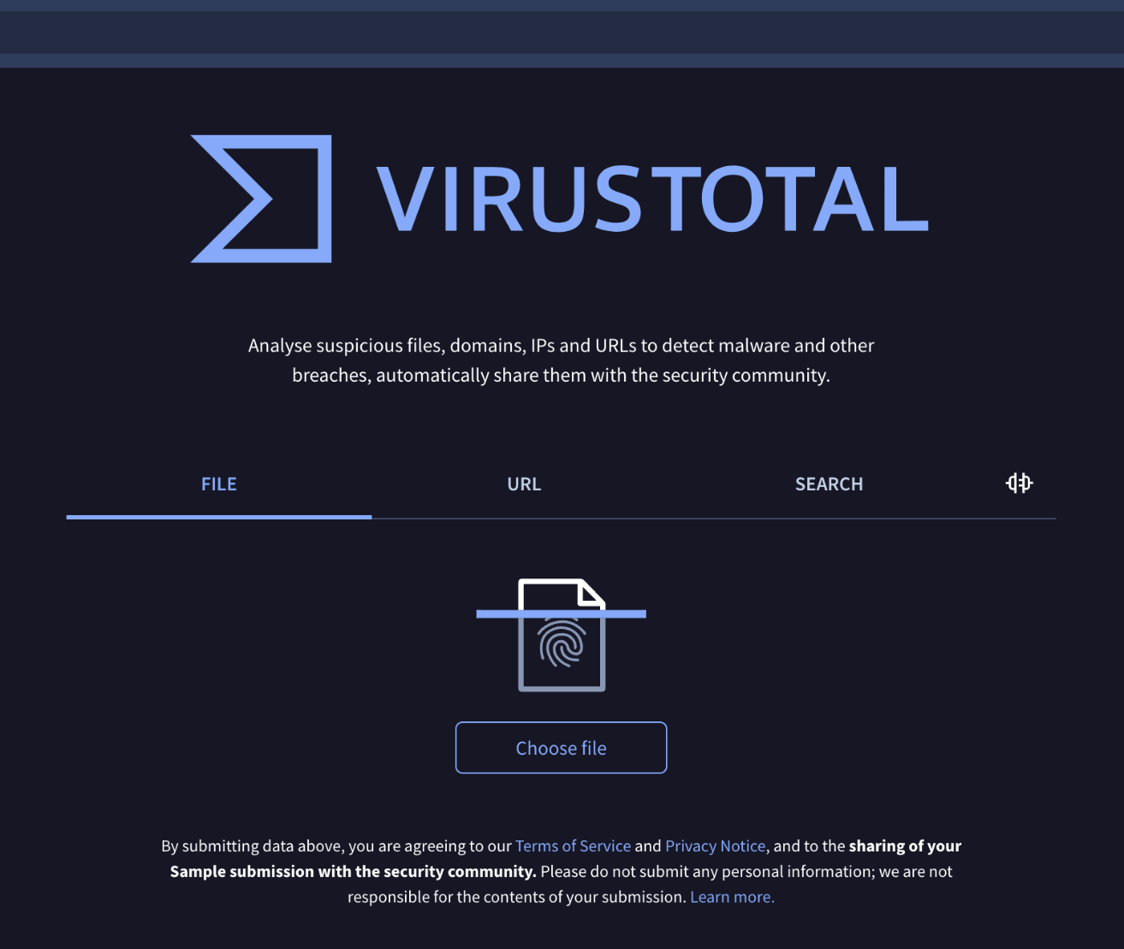
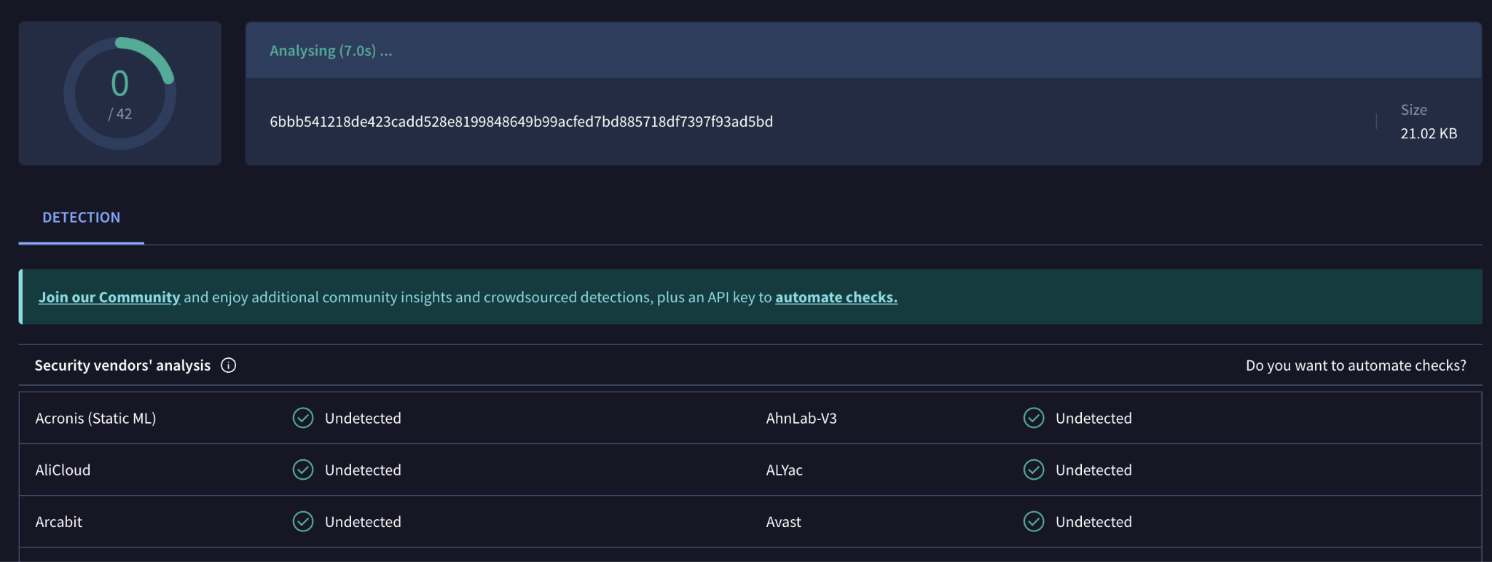
Related Designs
Virus Total
User-friendly and simple
User uploads files
Doesn’t give recommendation
Doesn’t provide confidence score

Slide 23
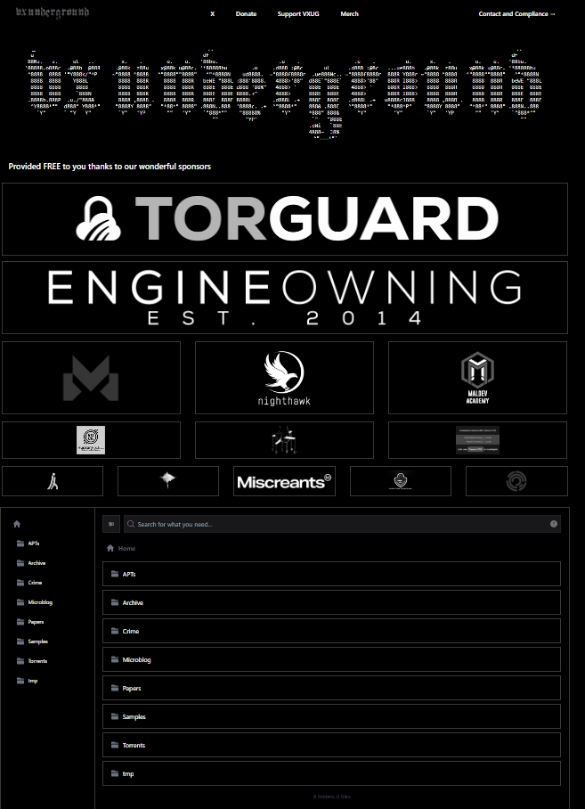
Related Designs (cont.)
Vx Underground
Simple UI & APIs for your file
Large collection of malware samples
Information about family of virus
Can’t direct upload malware files & Results analysis
Does not provide guide to navigate folders

Slide 24
Design
Upload File
Extract Important features*
Analyze file**:
  Go to ML-1 for 1st Filter:
    If X1 > (Threshold +- 10%)
      Get results & recommendations
    Else: Go to ML2 for 2nd Filter:
      Get results & recommendations
*Ember Feature extractor - Takes different sections of .exe file like entry point or header, etc. | Checks for packers or droppers such as UPX
** Looking for suitable ML algorithms for each model

Slide 25
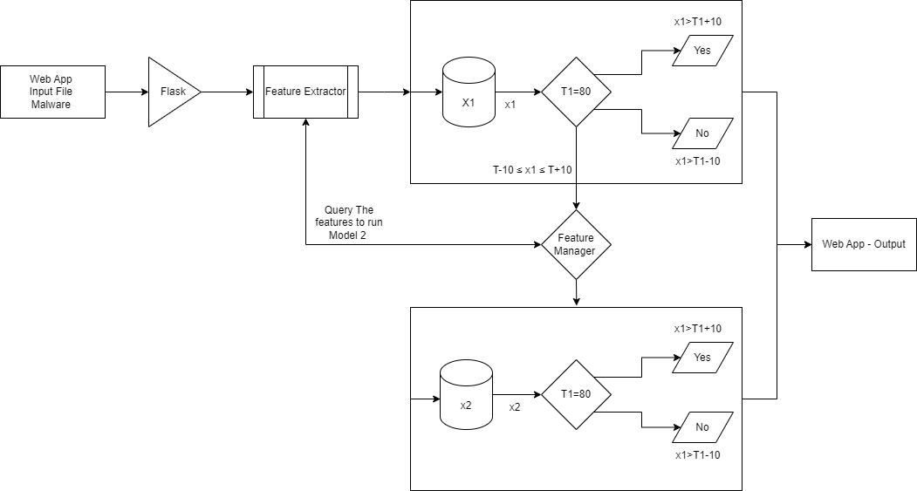
Flow Diagram - Design

Slide 26
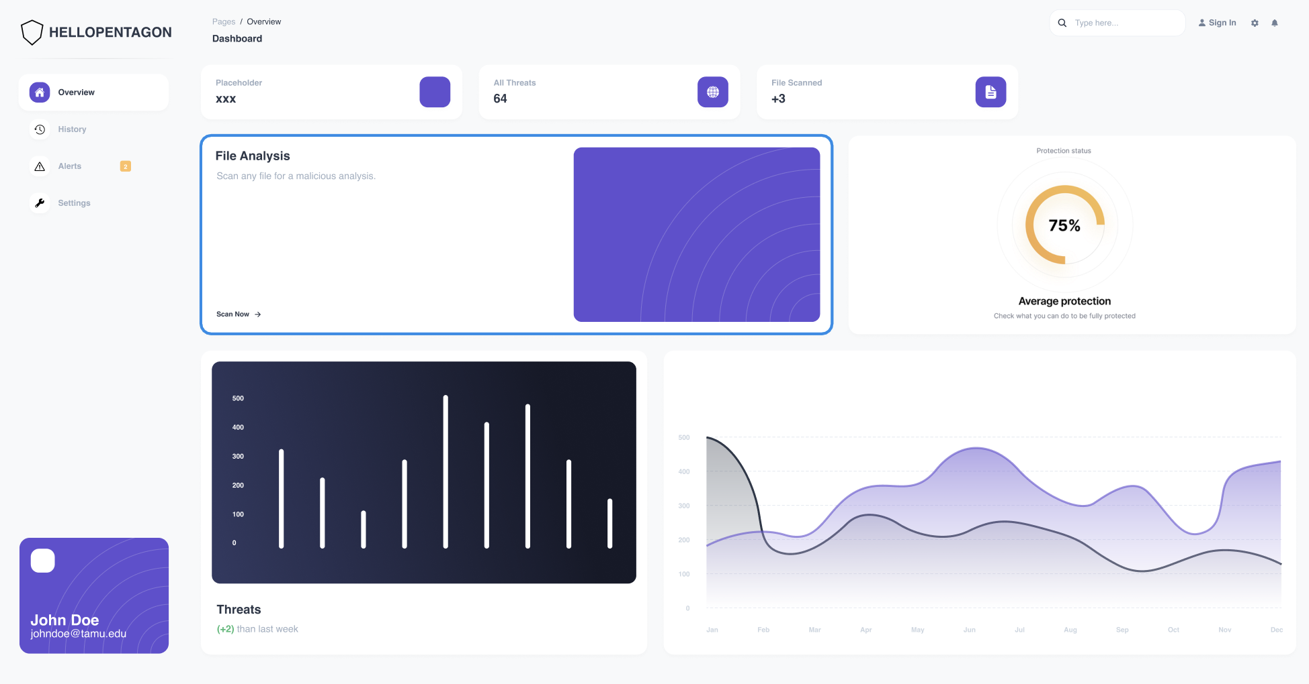
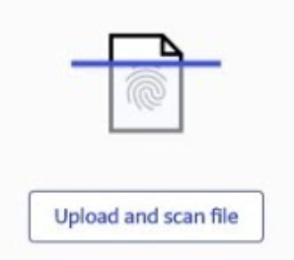
Next up: IntelliCrew

Slide 27
IntelliCrew: Adaptive Task Manager for ADHD Users
Ayesha Ahmed
Nihar Chauhan
Shubham Chorage
Prakhar Singh
Kexuan Shen

Slide 28
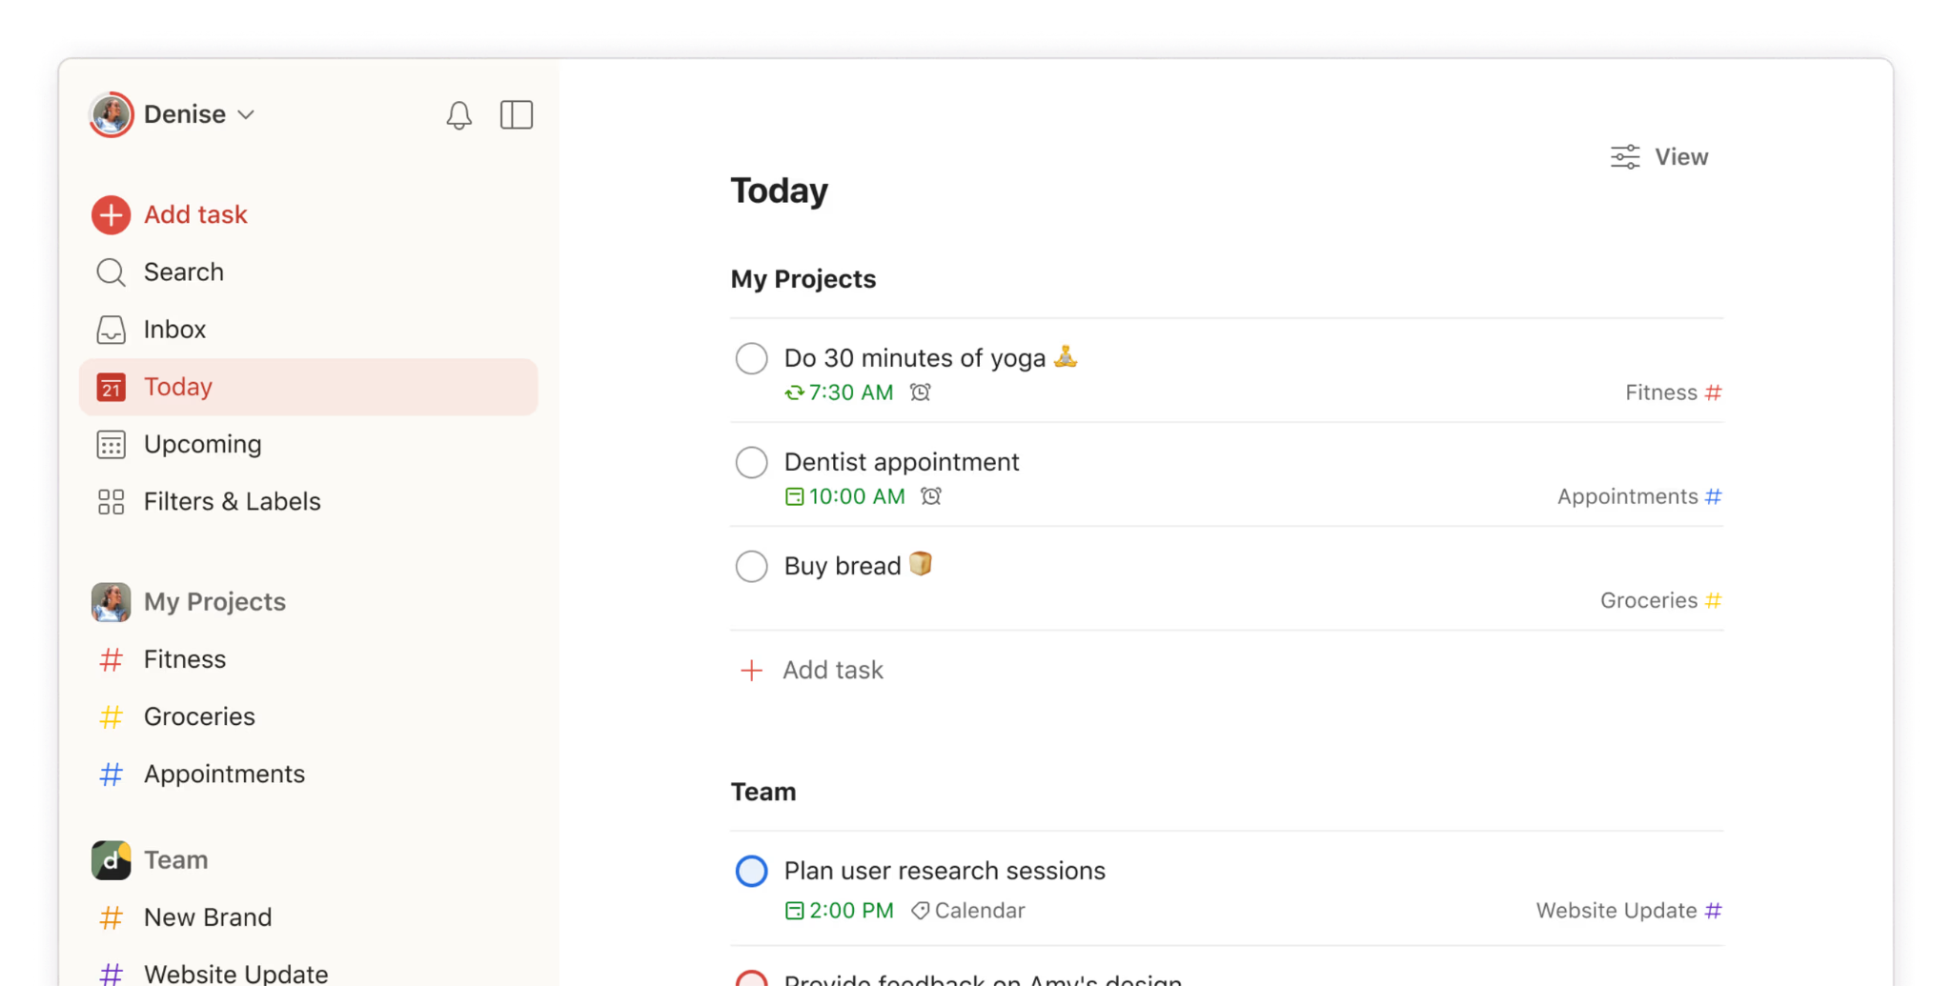
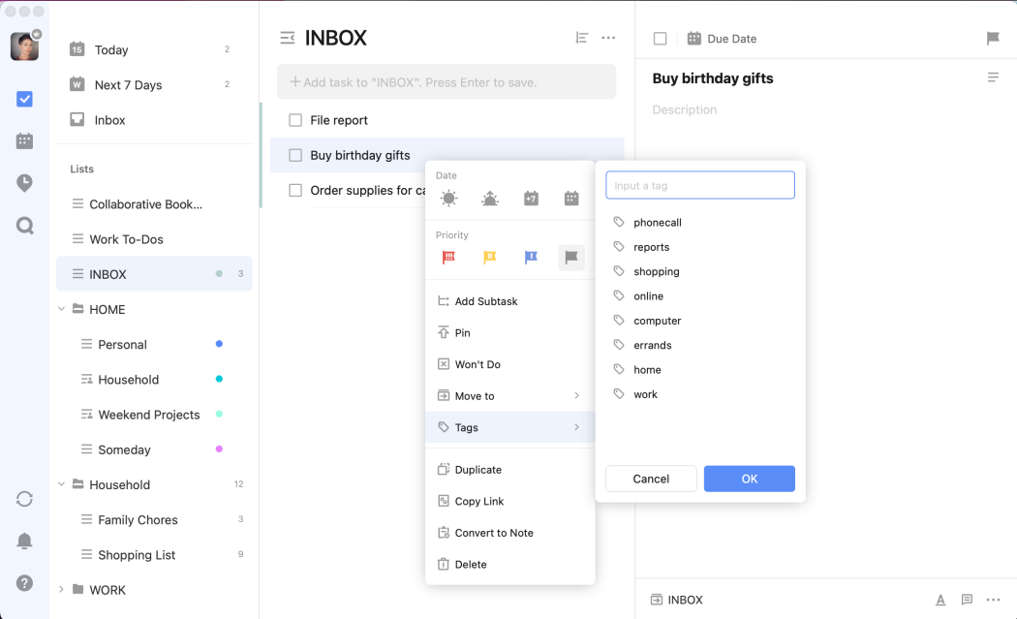
Related Designs
Todoist
  Lets you break tasks into subtasks, set reminders, and track progress with checklists. Easy to use and good for organizing tasks.
  Doesn't adapt to user behavior or offer personalized reminders based on focus.
TickTick
  Combines task management with a Pomodoro timer and calendar integration.
  Doesn’t personalize task breakdowns or reminders based on real-time performance.

Slide 29
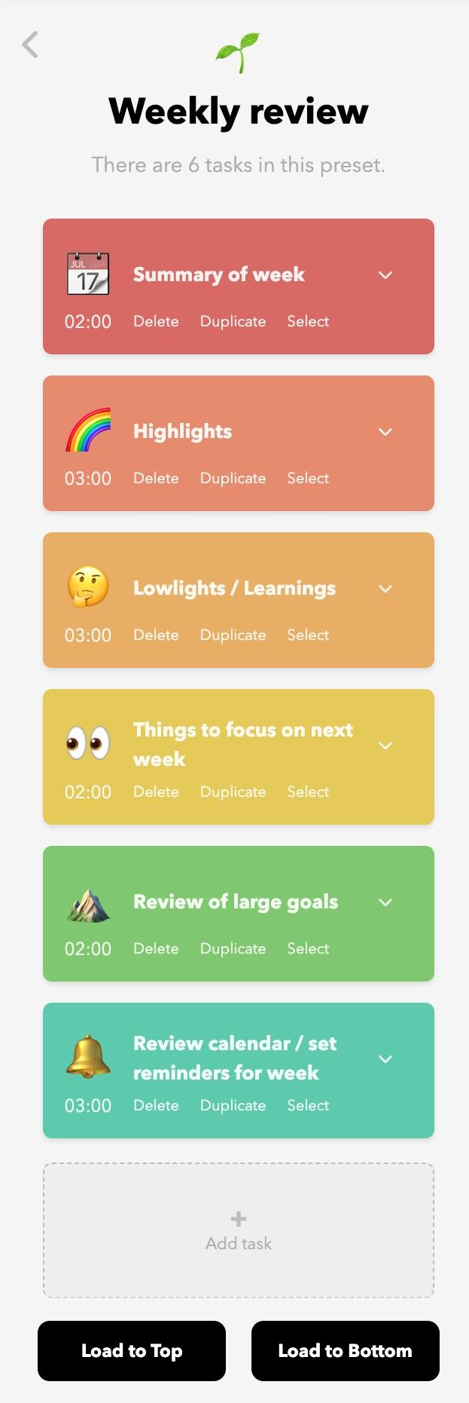
Design & Rationale
Design choice 1: Single-Page Interface
  A single-page interface allows users to see all tasks and options at once, reducing the need to navigate through multiple pages.
  By having everything on one page, users can focus on their tasks without getting distracted by navigating through different sections.
  The interface might become crowded which can be overwhelming for users with ADHD, potentially increasing anxiety and reducing productivity.
  Limited screen space can lead to information being cramped, making it difficult for users to find what they need quickly.

Slide 30
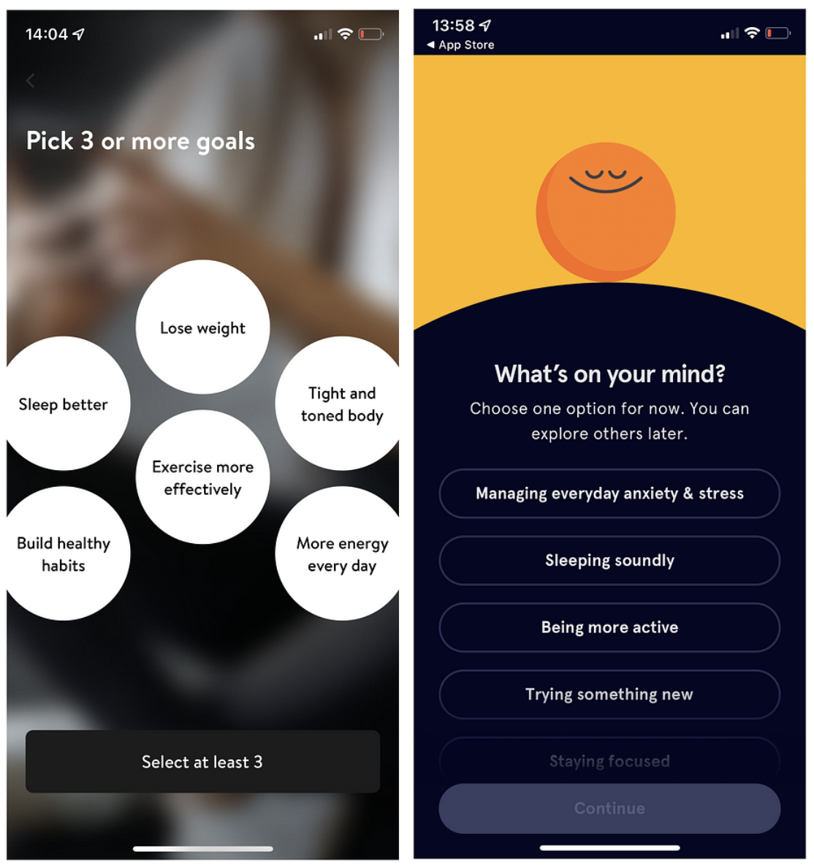
Design and Rationale
Design choice 2: Minimalistic
  Focusing on the essential tasks helps users stay away from distractions.
  Simplified interfaces are easy to navigate for individuals with ADHD.
  Highly minimalistic approach might cause under stimulation and create challenges for users to maintain focus.
  Important features may be compromised limiting the app’s functionality in the pursuit of simplicity.

Slide 31
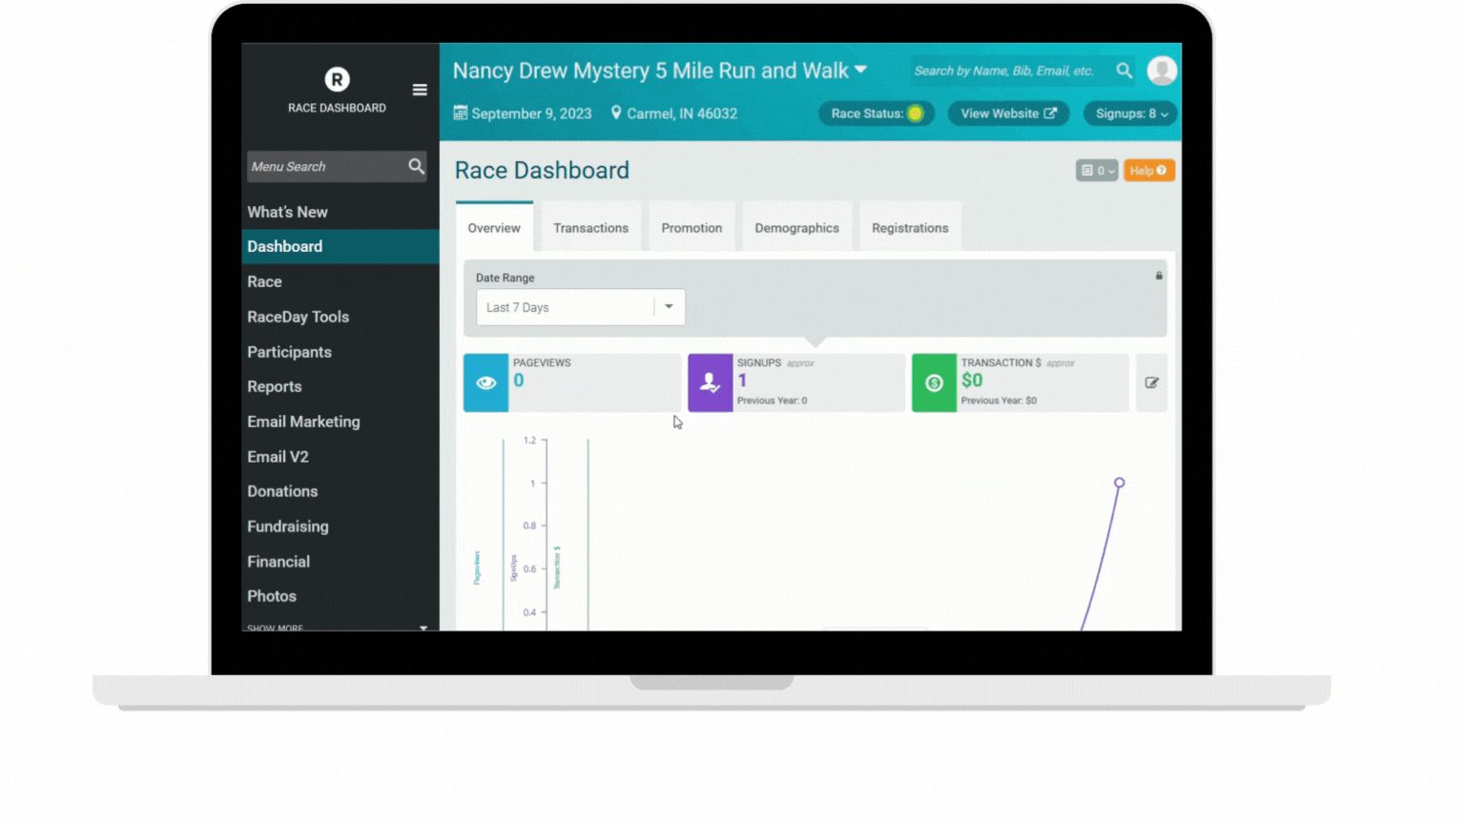
Design & Rationale
Design choice 3: Customizable Interface
  Customizable interface allows users to change the colors, fonts etc. for enhancing usability and comfort.
  Customization empowers users by giving them control over how they interact with the app, which can increase engagement and satisfaction.
  Configuration of the pages might be complex or time-consuming as users need to adjust settings to their preferences, which could be a barrier for some.
  Too many customization options might overwhelm users or lead them to spend excessive time on personalization rather than task management

Slide 32
Work Plan
Ayesha Ahmed & Shubham Chorage – Frontend Development
Prakhar Singh – Backend Development
Kexuan Shen – Data Analysis and Insights Generation
Nihar Chauhan – UI Design
Next up: IntelliFish

Slide 33
Intellifish:
Personalized Resumé/CV Builder
Yichen Tao
Lianhao Zhou
Hanyun Yin
Yafei Li
Zhenrui Wang

Slide 34
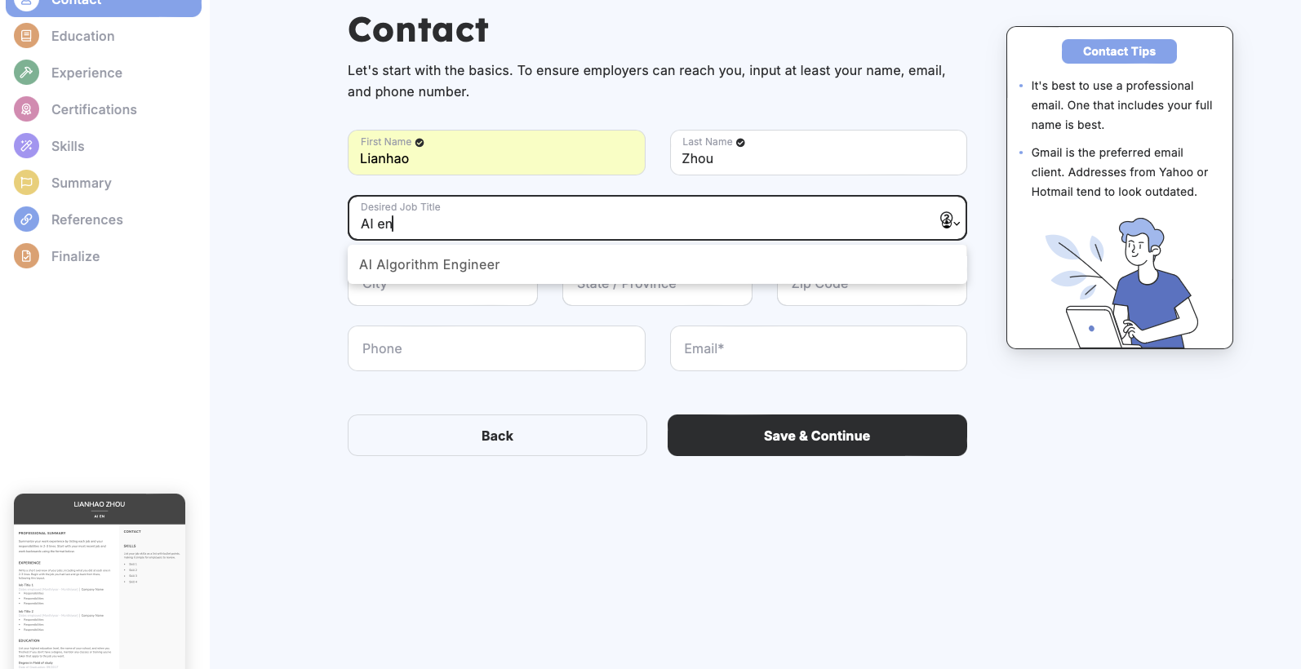
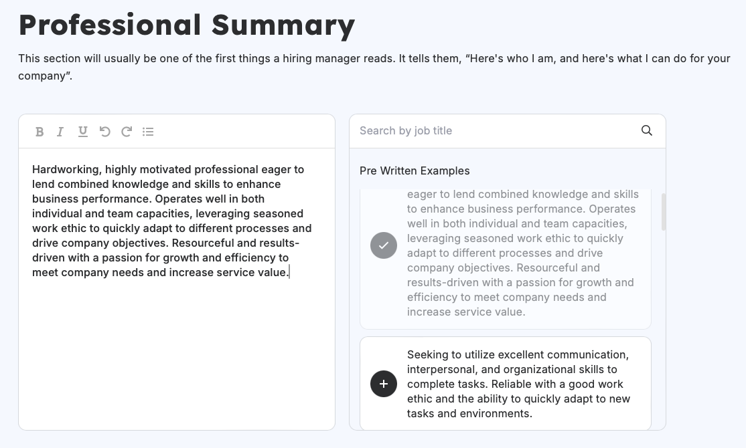
Related Designs
Novorésumé
Pros:
  Tips
  Content prompt
Cons:
  Summary lacks personalization
  limited job options
  No intelligent job matching

Slide 35
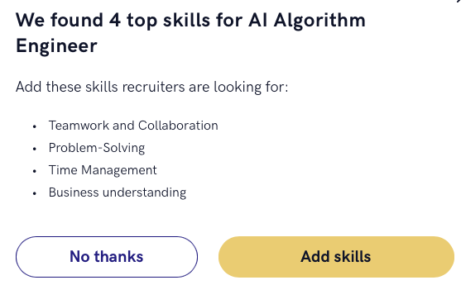
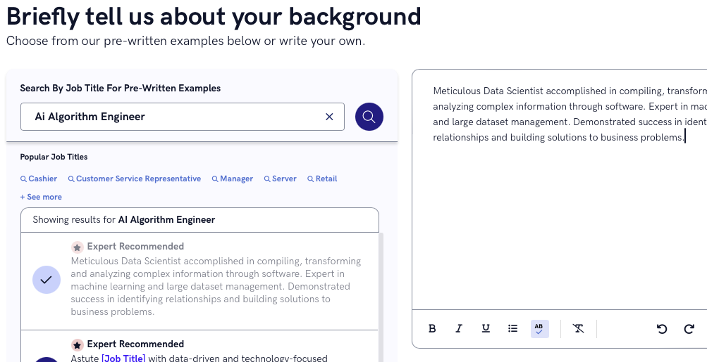
Related Designs
Zety
Pros:
  Job-oriented skills recommendation
  Intelligent summary writing
Cons:
  limited job options
  Template lacks field-specific targeting

Slide 36

Design & Rationale
Intelligent user interface
The good
Enhances user experience by simplifying interactions
Adapts to user preferences over time
The bad
Biases in recommendations
Can be perceived as intrusive or overwhelming
Require a learning curve for new users

Slide 37

Design & Rationale
Template engine
（A tool that dynamically generates content by combining predefined templates with data, allowing separation of logic and presentation.）
The good
Flexibility in Customization
providing scalability
The bad
Limited Design Creativity
Notes:
allows users to easily customize different sections of the resume.
Once templates are built, they can be reused across many users,
Users are limited by the predefined templates, which might not cater to niche formatting or unique resume styles.

Slide 38
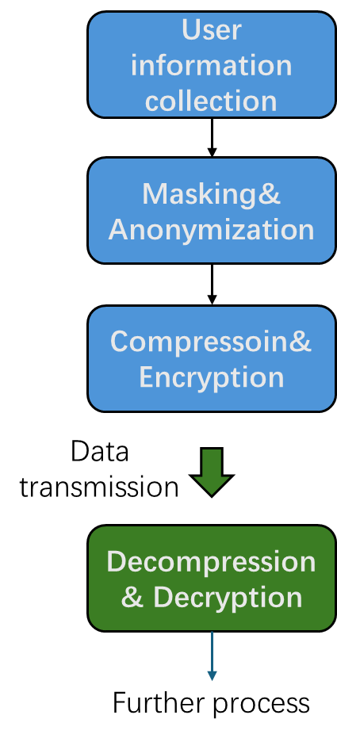
Design & Rationale
Data storage and security
Partition and Compression: Partition the database into smaller pieces based on specific keys and performs data compression respectively
Encryption at rest and in Transit: Data is encrypted when stored in databases and during transmission over networks
Data Masking and Anonymization: Sensitive data is obfuscated or masked when full access is not necessary
The Good:
  Reducing the size of storage
  Protect data against breaching
The Bad:
  Performance overhead in decompressing/decrypting
  Complex key management process

Slide 39
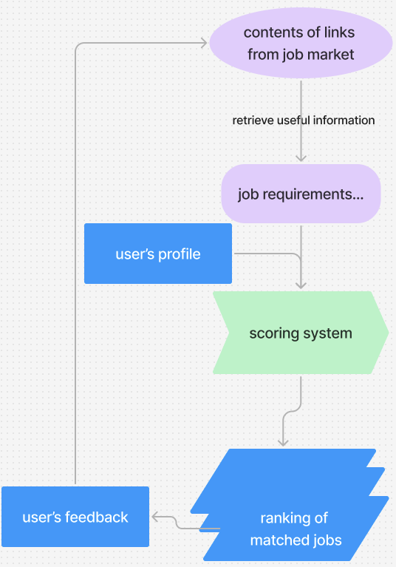
Design & Rationale
Job recommendation
Integrate job listings from various platforms
retrieve useful information from links
Develop a scoring system that weighs different factors including personality and professional knowledge
Calculate the similarity between the user’s profile and job descriptions
The good
More options and descriptions of jobs
exact match between user and job
The bad
Not that flexible

Slide 40
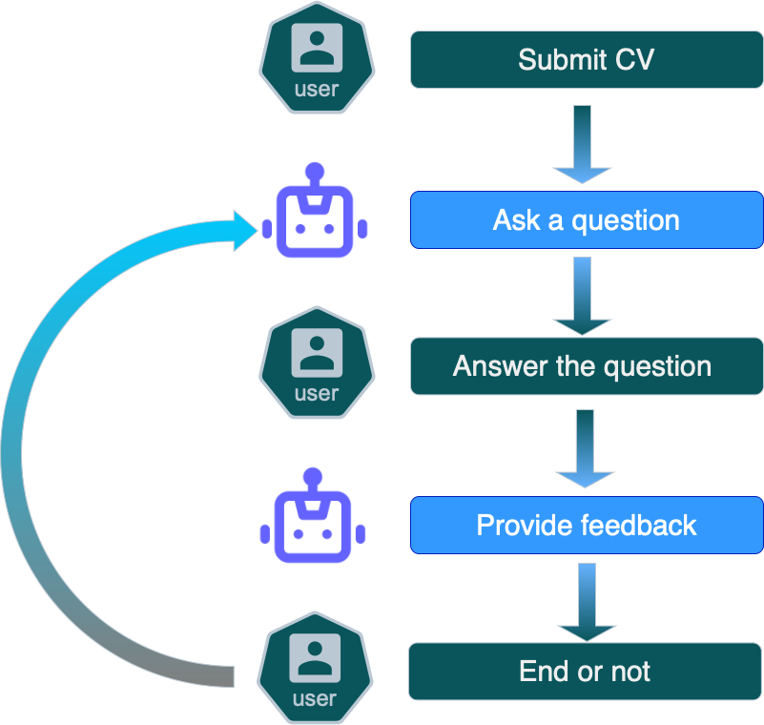
Design & Rationale
Mock Interview
（ Providing a relevant questions list and using agents to provide feedback）
The good
Expand the functions of the whole system
The bad
Only aid with general knowledge

Slide 41
Work plan (only include if significantly changed from prior presentation)
Yafei Li – User Interface
Yichen Tao – Template engine
Zhenrui Wang – Data storage and security
Hanyun Yin – Recommendation systems
Lianhao Zhou – Mock Interview systems
Next up: Intelligent Advisor

Slide 42
IntelligentAdvisor
Bidwat Pohkrel, Nazar Oladepo, Esau Hutcherson

Slide 43
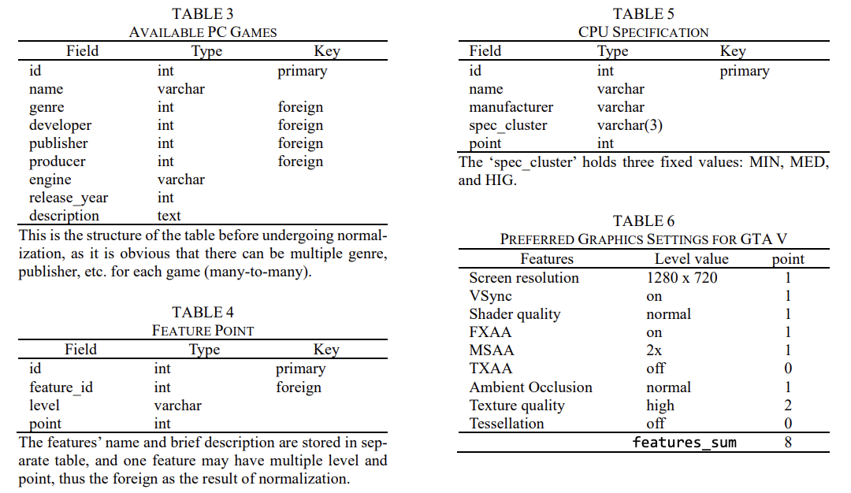
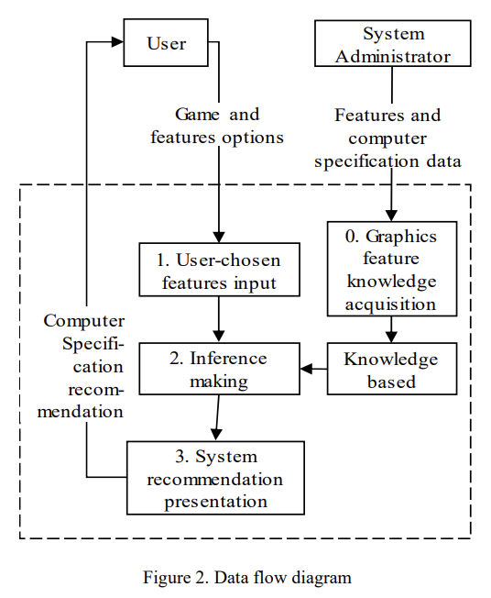
Related Design (Papers)
Information System for Analysis of Hardware Computer Components (Veres et al., 2023):
Uses mixed categorical-numerical clustering to group users on hardware and demography.
Applies a weighted hybrid mechanism to recommend hardware upgrades tailored to users.
A Data-Driven Platform for Computer Performance Analysis and Recommendation Using AI and Big Data Analysis (Chen and Sun, 2021):
Uses web scraping to collect detailed hardware performance data from various sources.
Matches requirements to optimal configurations using big data analysis.
Web-Based Expert System Application to Recommend Computer Specifications for Gaming (Prasetyadi and Mahfudin, 2021):
Uses backward chaining to determine minimum hardware requirements.
Generates cost estimates for gaming setups tailored to game requirements.

Slide 44
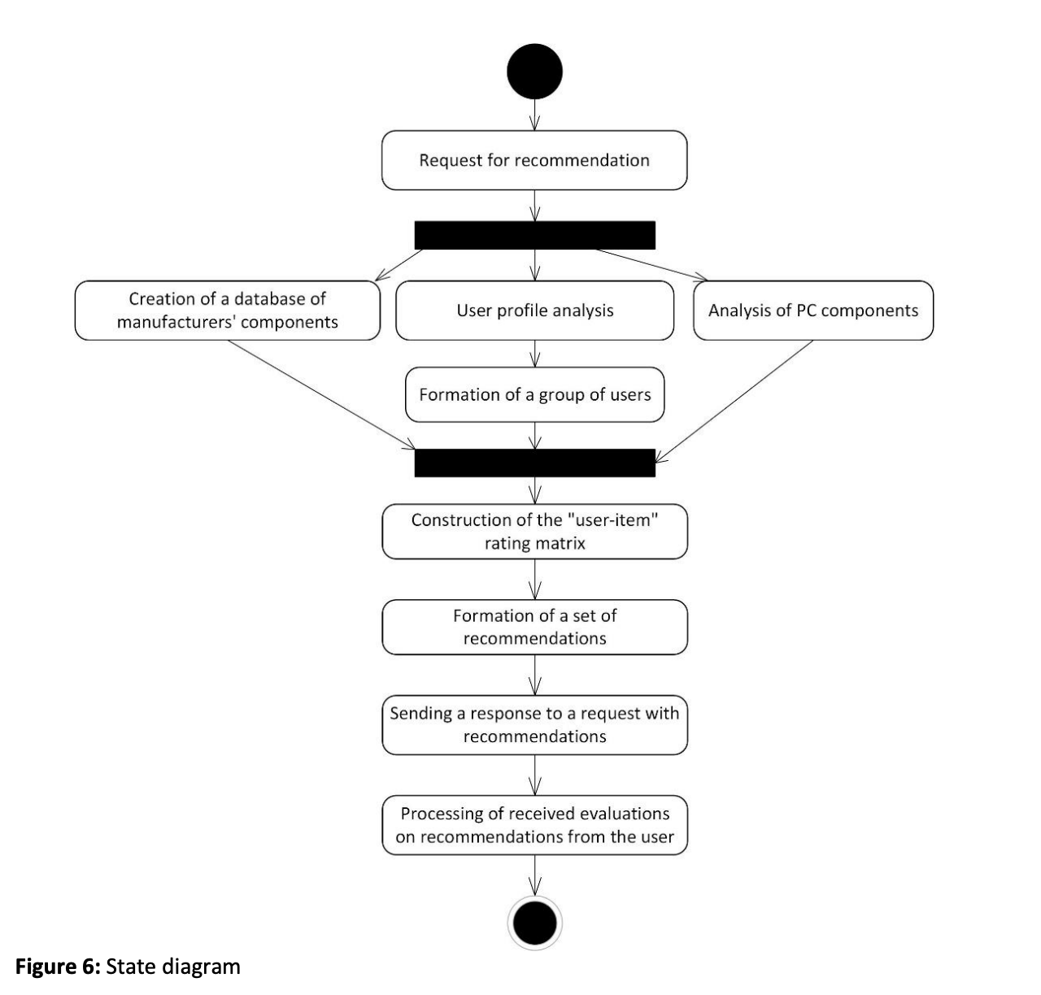
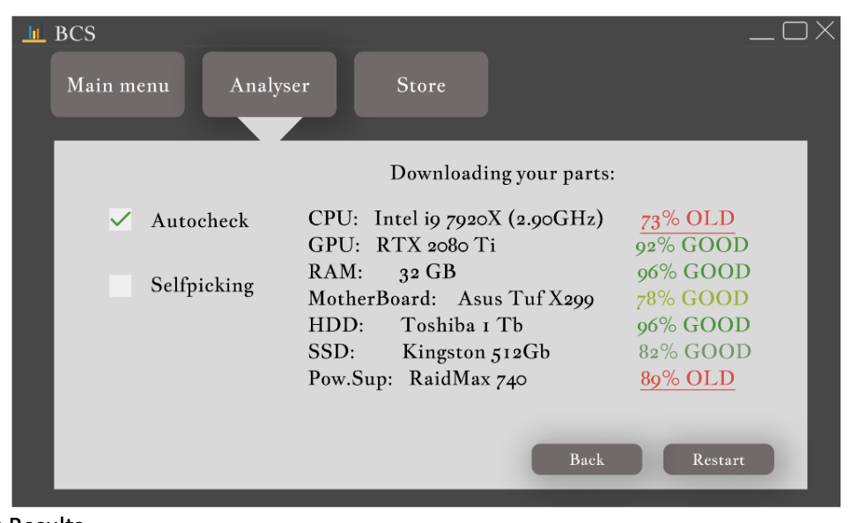
Related Design (Papers)
The Use of Web Scraping in Computer Parts and Assembly Price Comparison (Julian and Natalia, 2021):
Uses Pentaho software for web scraping to collect component prices from online stores.
Cleans the data and transform them to a real-time price comparison for optimal component selection.
Methods of Recommendations for Analysis of Computer Components (Veres et al., 2023):
Combines various filtering approaches to predict user preferences.
Uses demographic and rating data to improve recommendations.

Slide 45
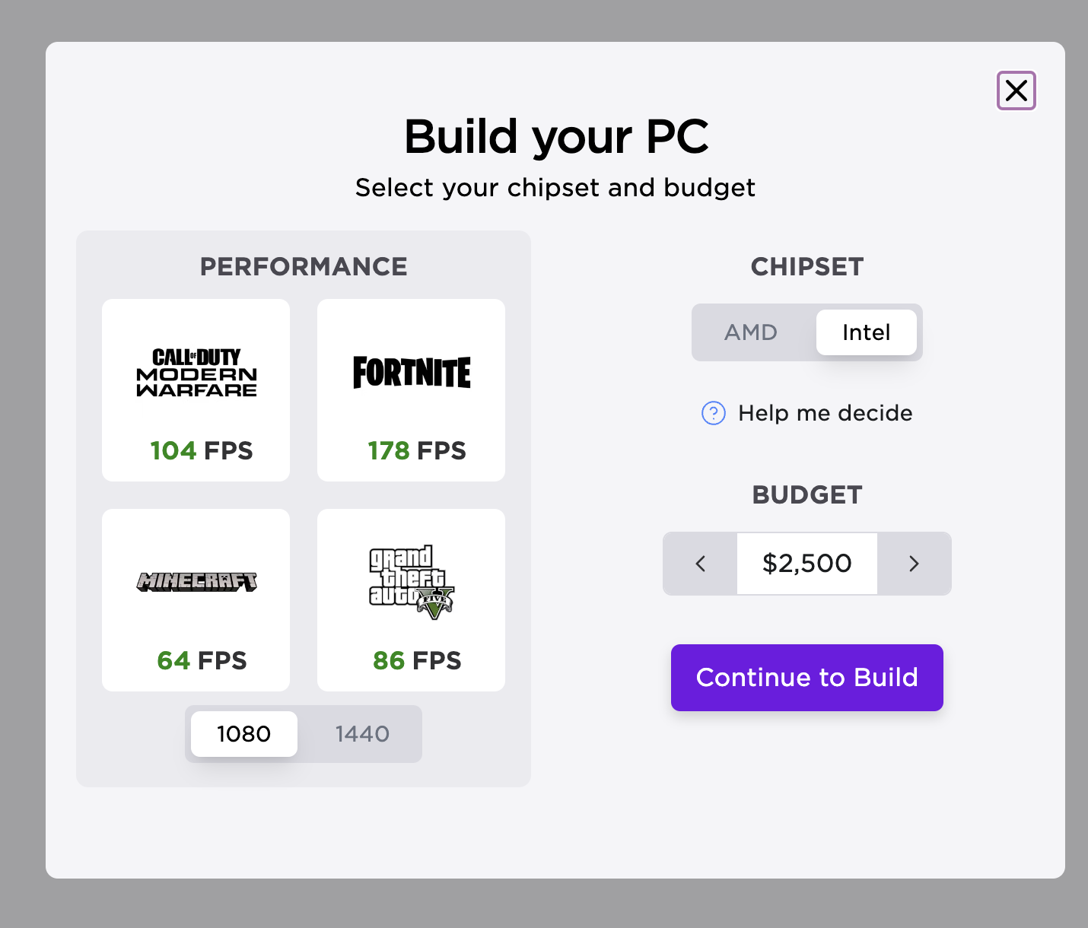
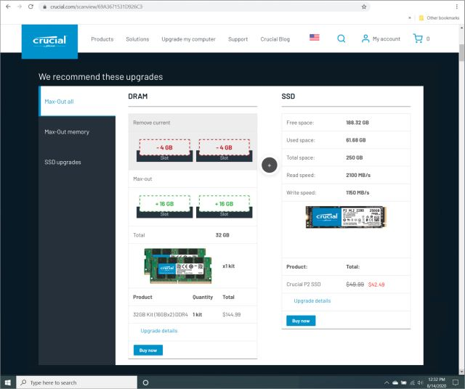
Related Design (Products)
Dell Precision Optimizer:
Remote system optimization tool for IT management. Suggests optimization using remote access.
Crucial System Scanner:
Detects hardware info and recommends compatible upgrades.
NZXT BLD:
Helps build custom PC based on performance needs and budget.
PC Part Picker:
Ensures compatibility, tracks prices and compares retailers. Polished UI for displaying hardware.

Slide 46
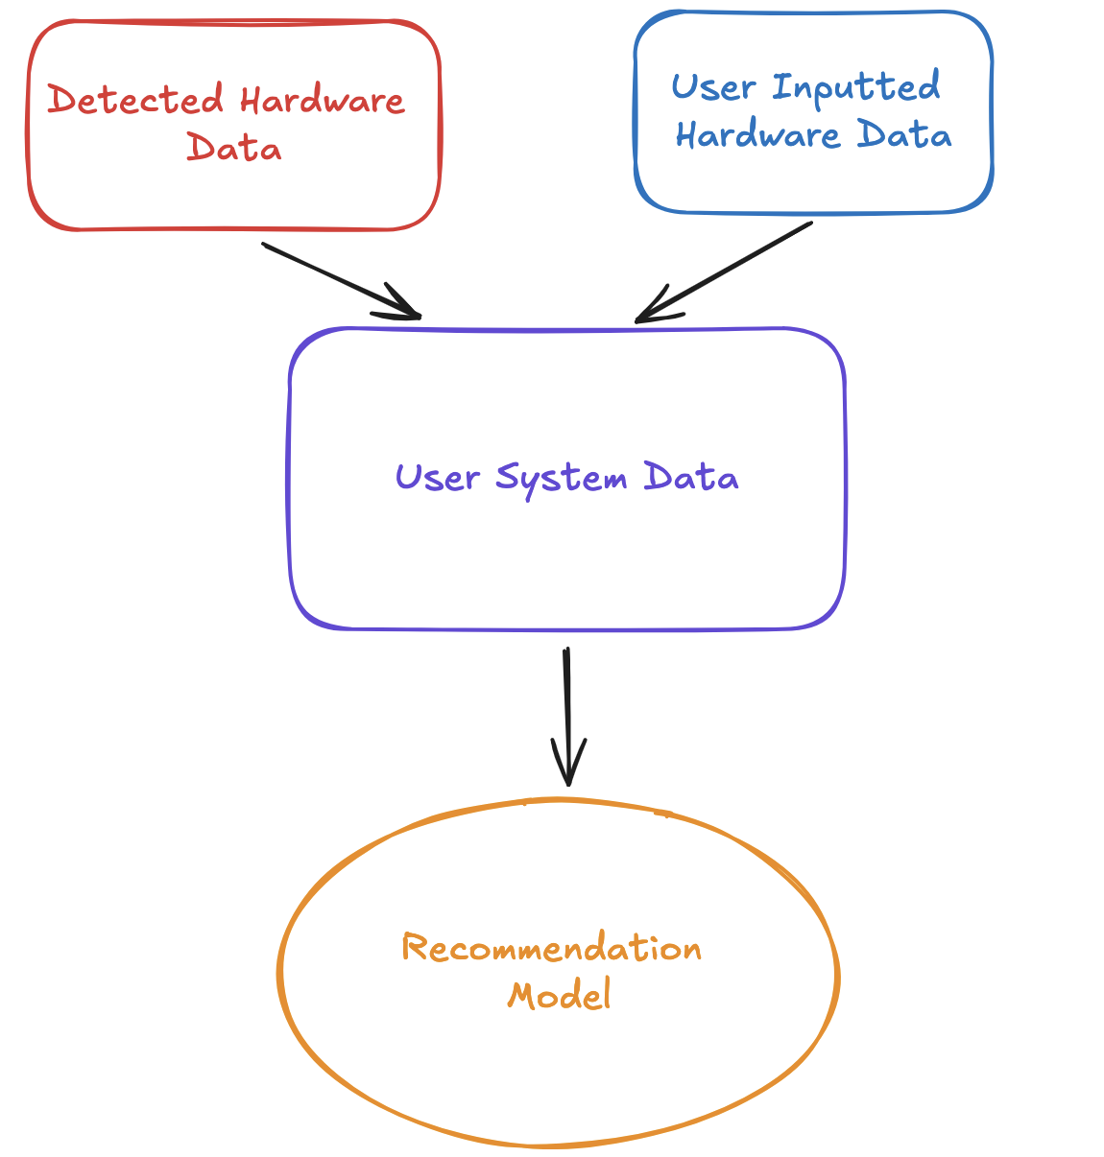
Design and Rationale: Gathering System Data for Recommendations
Two Approaches for gathering data:
Automatic Detection
  Pros: Accurate information, no human error
  Cons: Security concerns, download may be required
User-Provided Data
  Pros: User is in control of what they share
  Cons: Risk of Incorrect data, user may not know where to find the information
Conclusion: Intelligent Advisor will use a hybrid approach, where the hardware details will be automatically detected, but the user has the option to input some values.

Slide 47
Design and Rationale: Hardware Recommendations
Approach: Match user preferences against performance data to determine hardware components
Pros: Customized Recommendations, Leveraging Existing Data for insights
Cons: Novice users may have incorrect assumptions, poor quality of online data
Conclusion: Intelligent advisor will use customized recommendations but can leverage existing data for insights/verification.

Slide 48
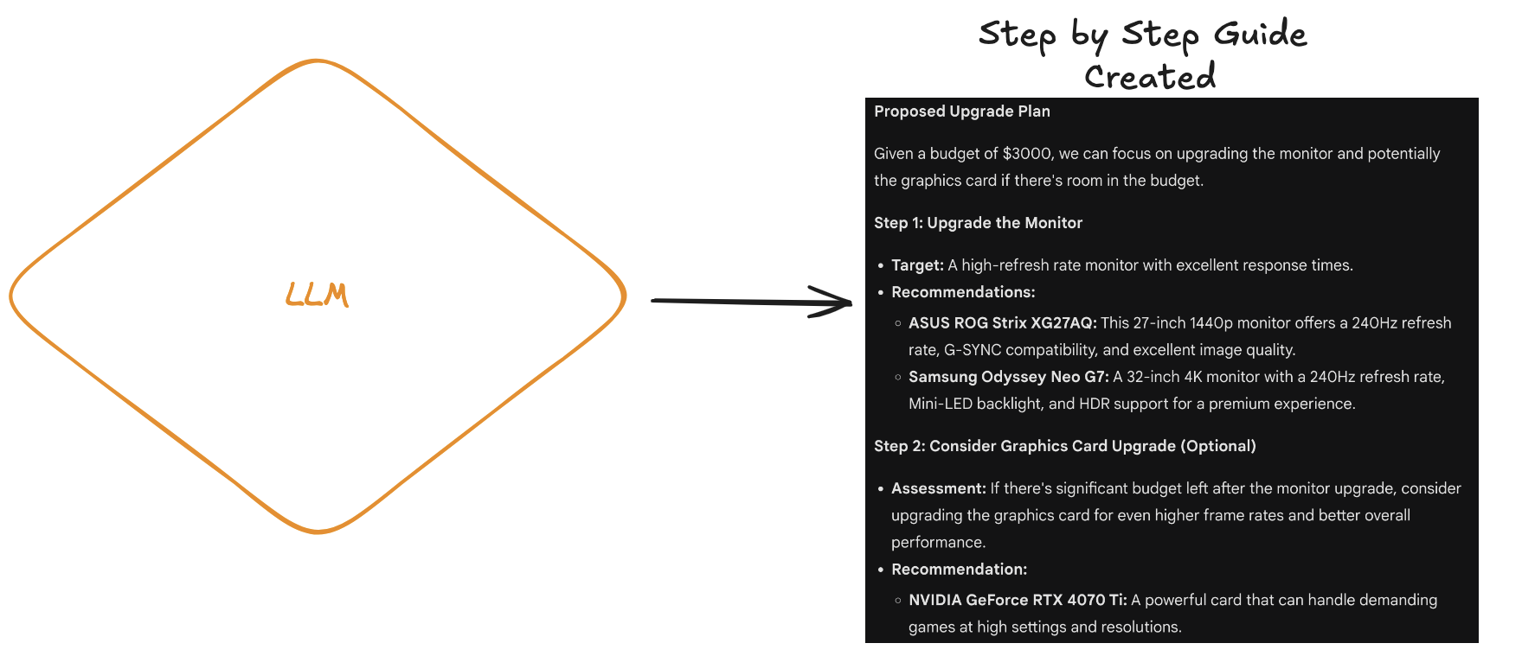
Design and Rationale: Guidance for Upgrades
Two Approaches for Guidance and Updates:
Link to Existing Resources
  Pros: Saves development time, widely available
  Cons: Tutorials may not be tailored to specific hardware
Step-by-Step Guides for optimization
  Pros: Easy for users to follow
  Cons: Limited verification since LLM is used
Conclusion: Intelligent Advisor will be provide a step by step guide to the user.
Next up: JobSeeker

Slide 49
JobSeeker: Easy Job Hunting
Amalesh Arivanan, Emory Lu, Mahirah Samah

Slide 50
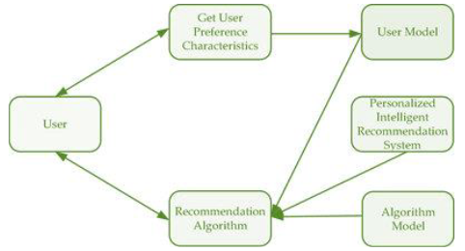
Related Designs
Intelligent Talent Recommendation
  algorithm operates by representing students and skills as latent feature vectors, capturing sequential dependencies in skill acquisition through a hidden chain structure modeled by recurrent neural networks, and predicting future skill recommendations by continuously updating and ranking skills based on the students' interactions and evolving profiles
  track how students develop skills over time, giving them personalized suggestions that fit their unique learning paths.
  complex and might take a lot of time and power to process

Slide 51
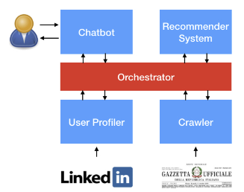
Related Designs
GUapp
  Recommender System using Latent Dirichlet Allocation or topic modeling.
  The system creates a user profile from explicit (e.g., "likes") and implicit (e.g., clickstream data) feedback, analyzing job descriptions from unstructured text.
  efficient unsupervised learning from unstructured text
  reliance on pre-trained entities (e.g., cities and job categories) for entity recognition in DialogFlow limits adaptability

Slide 52
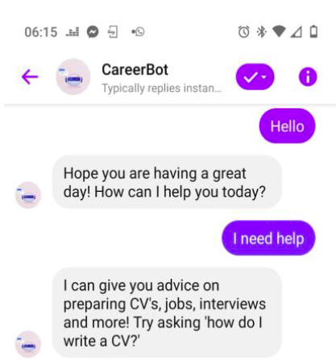
Related Designs
Career Counseling Chatbot
  uses Wit.ai for Natural Language Processing (NLP), enabling the bot to analyze and understand user queries by matching patterns and intents.
  processes the input, matches it against predefined intent tags, and retrieves structured data from JSON files to generate appropriate responses such as career advice, resources, and aptitude tests, all within a text-based interface
  leverages Wit.ai's NLP capabilities for real-time processing of user queries, enabling fast and accurate responses
  limited to text-only interactions and Facebook users

Slide 53
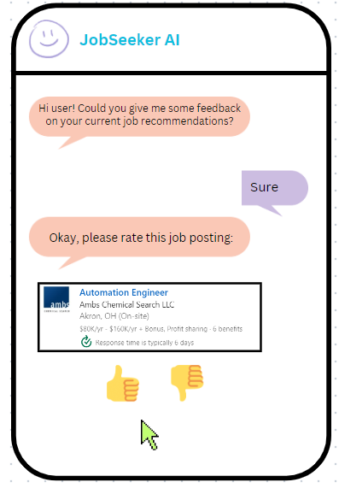
Design & Rationale
Chatbot interface should have a text message format
  The good
    Familiar format and smaller learning curve for users
    Conversational interaction
  The bad
    Might feel tedious when collecting feedback about many job positions from user

Slide 54
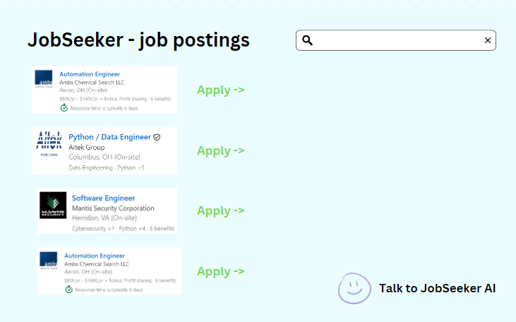
Design & Rationale
Job board has postings shown in a sequential order, and user scrolls down for more job postings
  The good
    Familiar and intuitive
    Focus on individual job postings
  The bad
    Can be difficult to keep track and navigate

Slide 55
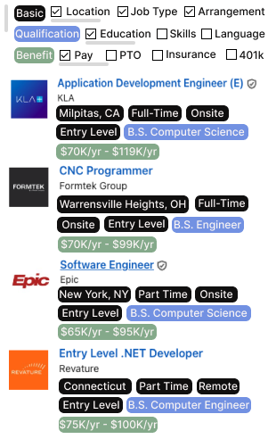
Design & Rationale
Assign tags to identify features of jobs and categorize them
  The good
    Easy to compute
    Allow users to filter jobs based on their preferences
  The bad
    Developer-provided tags may not cover all aspects
    Excessive tags could overwhelm users

Slide 56
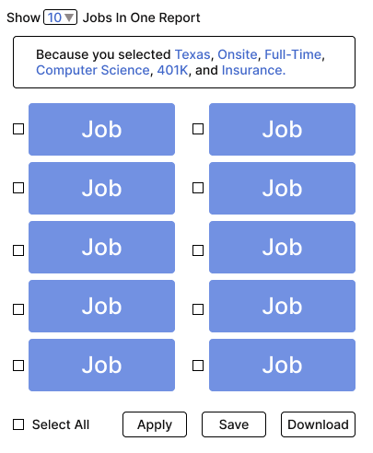
Design & Rationale
Create a job recommendation list according with brief explanation
  The good
    Users will have a clear idea of the generated recommendations.
  The bad
    Might increase the difficulty of computation.

Slide 57
Work Plan
Amalesh Arivanan: Chatbot design and refining chatbot interaction flow
Emory Lu: front-end & user-friendly framework design, connection with backend… (can have more upon needs)
Mahirah Samah: database setup/maintenance, chatbot programming
Next up: SNOOZE

Slide 58
SNOOZE
Smart Notification and Optimised Organization with Zero Effort
Kathan Vyas, Prachi Surbhi,
Ashwin Raja, Shreyas Kasetty,
Austin McCormick

Slide 59
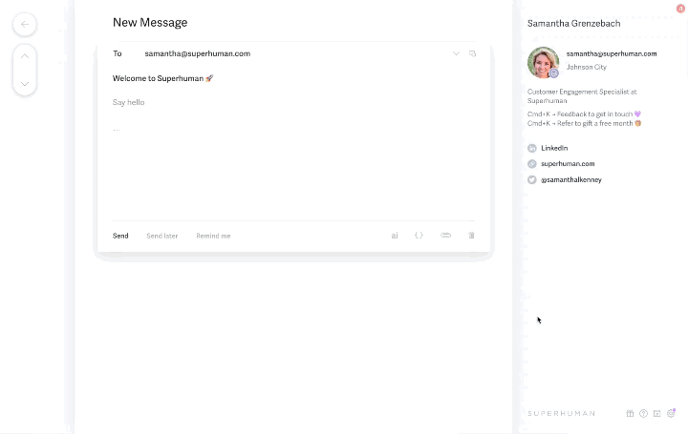
Related Designs
Superhuman AI
  Advantages: Highly effective at parsing long emails and summarization, professional and efficient, Broad utility with identifying tasks, snoozing emails, and generating replies
  Disadvantages: Expensive, cheapest option is $25/month. Only compatible with Outlook and Gmail.

Slide 60
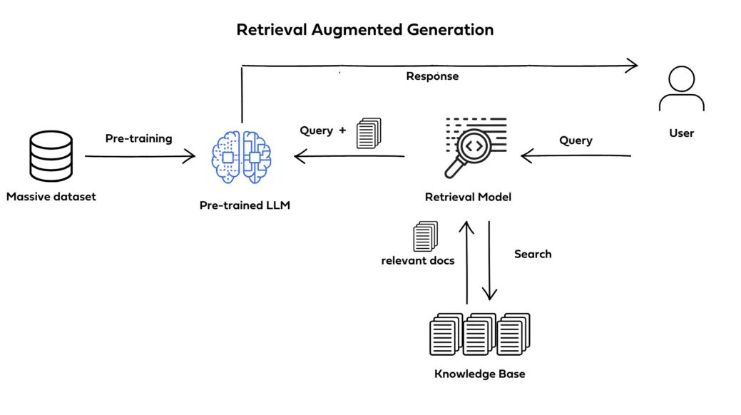
Related Designs
Retrieval Augmented Generation
  Advantages: Advanced and scalable solution for comprehensive query-focused summarization
  Disadvantages: Setting up and maintaining the graph-based system will pose a challenge

Slide 61
Design & Rationale
Design choice 1: Integrated Office Assistant "Snooze" with Chatbot Functionality
  The good
    Unified Interface: Snooze combines calendar, email, and to-do functionalities within a single application, offering a seamless experience
    Interactive Assistance: The chatbot is interactive for users to request actions like scheduling meetings or summarizing emails through conversational inputs
  The bad
    Interface Overload: Users may find the application cluttered if not designed with clear separation and intuitive navigation between different functionalities

Slide 62
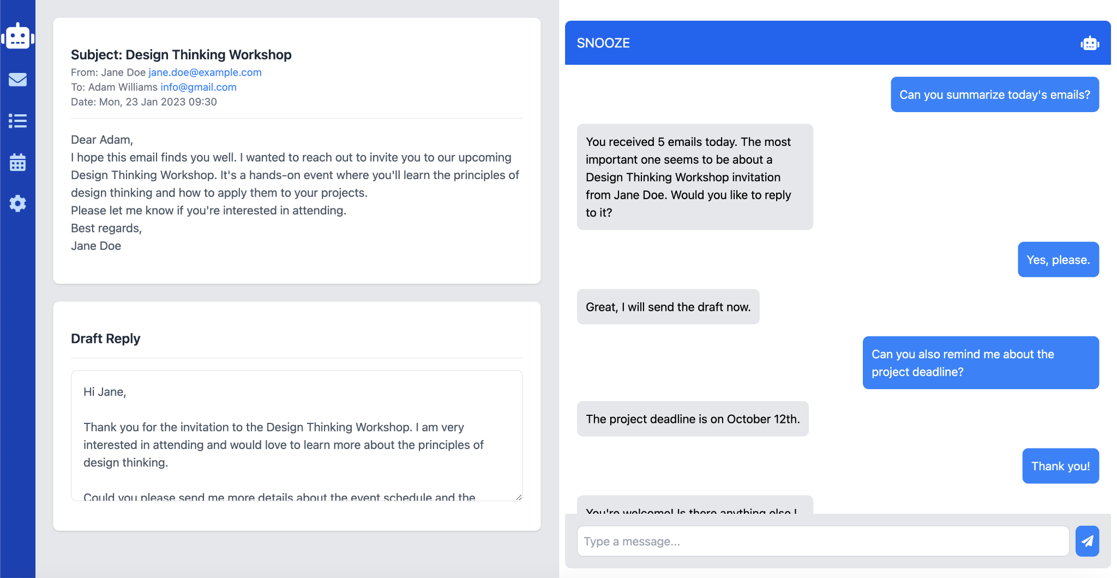
Design & Rationale

Slide 63
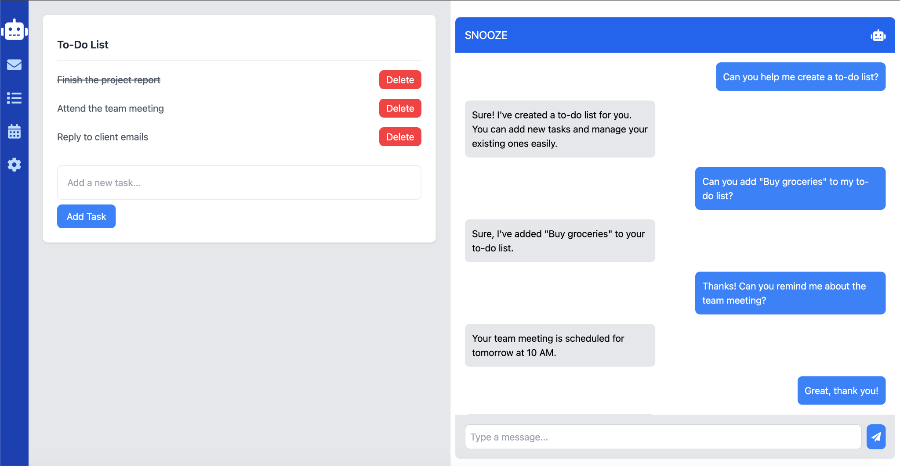
Design & Rationale

Slide 64

Design & Rationale

Slide 65
Design & Rationale
Design choice 2: Voice Assistant Integration through Web Extension
  The good
    Non-intrusive
    Easily Accessible across multiple devices
  The bad
    Can be dense when presented with a lot of information
    Platform specific, must be ported for compatibility across multiple browsers
    Inaccuracies from users with differing speech patterns, accents, dialects, and background noise interference

Slide 66

Design & Rationale

Slide 67
Design & Rationale
Design choice 3: Applications with pop-ups
  The good
    More information easily available in one screen
  The bad
    Will require a high click rate to get to tasks
    Will require a chat message to open different apps, rather than just being able to open them

Slide 68

Design & Rationale

Slide 69

Design & Rationale

Slide 70

High Level System Design
Next up: The Cashiers

Slide 71
The Cashiers: Shoptimum
Marshall McIlyar
Akshath Venkataraman
Hector Cardenas
Benson Nguyen

Slide 72


Related Designs
Yummly
  Provides recipes based on preferences
  Asks too many questions
  Does not factor budget and macro nutrient goals
Paprika
  Provides recipes and allows importing recipes
  Not very user friendly

Slide 73

Design & Rationale
Global ban of ingredient
  Full power to the user to control what they do not like
  Can impact suggestions of other recipes with the ingredient

Slide 74

Design & Rationale
Asking users for their diet preference, allergies, etc. upfront
  Creates a starting point for recommending recipes
  May turn away users who are overwhelmed or annoyed by introduction processes. ​

Slide 75
Work plan (only include if significantly changed from prior presentation)
Marshall McIlyar – Frontend & Mock Scenario Setup
  Coding up main menu screens and recipe viewing screens
Akshath Venkataraman – Frontend & Data Processing
  Coding initial recommendation screen and settings page
Hector Cardenas – UI Design & Testing
  Creating initial mock-ups for various screens of the app
  Testing current implementation by simulating different users with unique preferences
Benson Nguyen – Backend (Shopping List/Recipe Algorithm)
  Creating recipe algorithm taking into weights from user preferences
Next up: The Doctor is (In)

Slide 76
The Doctor Is [In]:
Interactive Rare Disease Database
Qizhuo Shen, Sicheng Chen, Annan Zou

Slide 77


Related Designs
zebraMD (Pure ML CDSS)
  What is good
    Advanced Machine Learning Integration: Utilizes sophisticated machine learning algorithms to analyze electronic health records, effectively identifying patients potentially at risk for rare diseases.
    Contextual Patient Data Handling: Capable of incorporating patient-specific context by allowing medical records to be uploaded directly to the platform.
    Educational Support: Provides references and supplementary readings within the search results, enhancing the informational value for medical practitioners.
  What is not so good
    Limited User Interaction: The user interface is simplified, featuring only a search box and a record upload button, which may restrict user engagement and functionality.
    Information Overload: The results, predominantly extracted from a comprehensive knowledge database, could potentially lead to an overload of information, complicating the decision-making process for healthcare providers.

Slide 78


Related Designs
RDmaster (Dialogue CDSS)
  What is good
    Enhanced Patient Context: Incorporates detailed patient data including both genotypic and phenotypic information, providing a more comprehensive view for personalized care.
    Interactive Dialogue System: Facilitates user interaction through a dialogue-based interface, promoting an engaging and dynamic user experience.
  What is not so good
    Basic Dialogue Capabilities: The dialogue system operates on a simple decision tree, lacking advanced intelligence which may limit the depth and flexibility of interactions.
    Technical Complexity in Diagnostics: Relies heavily on gene analysis for diagnostics, resulting in highly technical results that may not be easily interpretable by all healthcare providers, potentially restricting its utility in broader clinical settings.

Slide 79

Design & Rationale
Choice 1:
Combination of Chatbot and Knowledge/Context Database Interface
Advantages:
-Balances interactivity and adaptability
-Provides a degree of explainability
Disadvantages:
-Relatively strongly coupled and not very modular or portable
-High amount of textual information

Slide 80

Design & Rationale
Choice 2:
Text bot is the main input. Context is extracted from the input and added to the decision making. The contexts can be optionally manually edited.
Advantages:
-Additional manual safeguard to ensure correctness and increase reliability
Disadvantages:
-Higher cognitive load

Slide 81

Design & Rationale
Choice 3:
Upon query, newer contexts are added via embedding, and highlighted via heavier text. ML agents will weigh more recent contexts more heavily. Contexts are displayed in a tree structure.
Advantages:
-Easier for the professional to overview the entire situation and prioritize information
Disadvantages:
-Recency bias by the ML model might need correction

Slide 82
Design & Rationale
Choice 4:
ML agents take the embedded information and consult the knowledge based database to make decisions, provide rationale, and respond via both natural language and list ordered by inferred relevance.
Advantages:
-Natural language provides clearer directions for future steps -List provides structured information for decisions
Disadvantages:
-Handling information conflict between the two modes is crucial
Next up: CodeInsight

Slide 83
TeamName: CodeInsight
Jing Cao, Alex Zheng, Zihao Wang, Longxiang Li

Slide 84
Related Designs
Cursor
  Pros:
    Strong contextual understanding for relevant suggestions.
    Real-time interaction with modification and explanations.
    The UI is typically lean, with a focus on in-line suggestions, which keeps all tools readily accessible in a single space.
  Cons:
    Limited personalization and customization options.
Github Copilot
  Pros:
    Streamlines coding with fast, context-aware suggestions.
    Broad language support and deep integration with GitHub.
    Helps both beginners and experienced developers by speeding up coding tasks
  Cons:
    Suggestions can be inaccurate or irrelevant, especially in complex logic.
    May lead to over-reliance, potentially reducing developers' critical thinking.

Slide 85

Design & Rationale
Design choice 1-Single-Page Interface (vs. Multi-Page Interface)
The Good: Keeps all tools easily accessible, enabling faster interactions. Reduces the need for frequent navigation between different screens.
The Bad: Can become cluttered, especially with complex features. May lead to inefficient use of screen space, overwhelming users.

Slide 86
Design & Rationale
Design Choice 2: Active Suggestions vs. Passive Code Tips
The Good: Active Suggestions (e.g., auto-inserting or recommending code blocks) can speed up development by offering immediate, context-aware solutions that minimize manual coding.
The Bad: Active suggestions can reduce user control, potentially leading to over-reliance on the AI or introducing errors if the suggestions are incorrect or irrelevant.
Design Choice 3: Natural Language Commands (vs. Code Contextual Interaction)
The Good: Natural language is user-friendly, enabling beginners to generate code with plain instructions.
The Bad: Ambiguity in natural language may lead to incorrect code, while contextual interactions are more precise but less flexible.

