Slide 1
Project Reminders
Second phase of projects concludes next week
  Related work – should include not just work on same domain/task but also work applying types of techniques you plan to apply to other domains
  Design and rationale – What are key design issues and how are you planning to address them with what trade-offs when compared to other potential designs
  Images of planned data flow, system architecture, interface mockups
Slides for next Wednesday’s presentations are due in Canvas by Tuesday morning
Reports not due until Wednesday end of day

Slide 2
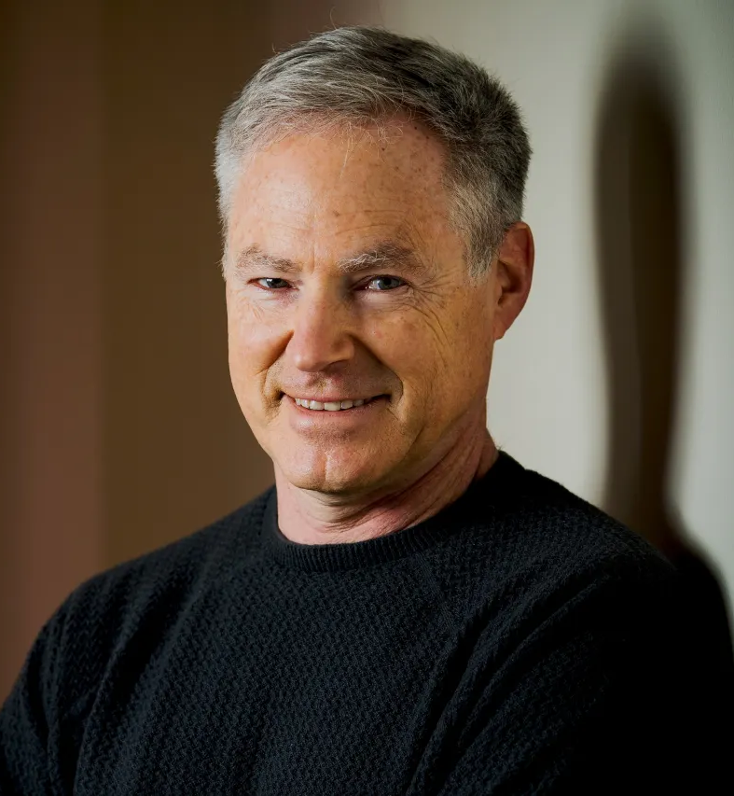
Erik Horvitz
MD, Ph.D.
Research Group Lead in AI,
HCI, and IUI
Director, Microsoft Research
Chief Scientific Officer,
Microsoft
Member, President’s Council
of Advisors on Science and
Technology
Can find talks and papers about many IUI themes online (just search)

