Slide 1
Original Plan for Today
Step 1: Discuss what forms of “intelligence” are being explored in your project.
  Does it model the user, their task, or the context of their work?
  Does the system learn/evolve over time?
  Does the system interact with the user via a "natural" interface?
  Others?
Step 2: In terms of final decisions in completing the activity
  Describe what is done by the system automatically and how the system conveys the decisions and any rationale for them to the user
  Describe what the system recommends to the user and any rationale for the recommendations
  Describe what the user must do, and any decision support provided by the system

Slide 2
Evaluation

Slide 3
Computer Science Evaluation Methods
Computer science is a broad field, so you probably have heard different activities be associated with evaluation.
When you graduate, you should know a range of evaluation techniques that you can apply to questions important to your work.

Slide 4
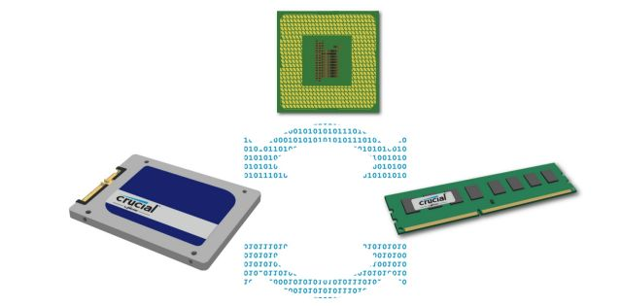
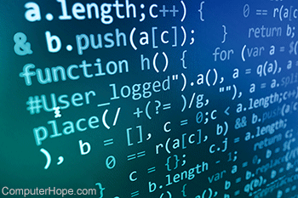
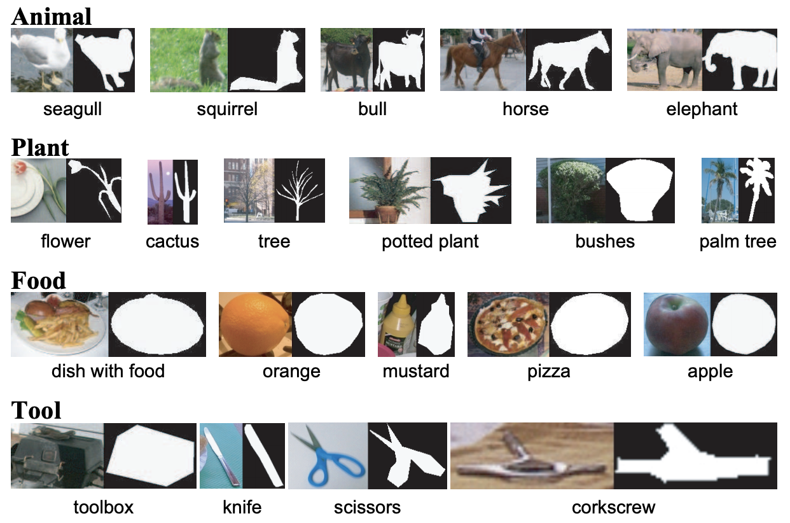

Some CS Evaluation Methods
Can this be computed? How much time/memory will be used?
  Proofs in computability and algorithm analysis
Does this implementation meet the specifications?
  Testing in software engineering
How often will this give a correct output?
  Ground truth comparison, simulation and statistical analysis
What are effects of the use of this software?
  Human-subject testing

Slide 5
Human-Subject Evaluation Methods
Why do we evaluate?
  To learn what works? But there are many metrics
    Efficiency (time to perform task, tasks per unit time)
    Effectiveness (quality of result, error rate)
    Satisfaction (user perception of process/results)
Characteristics of evaluation techniques
  Experiments vs. observations vs. professional analyses
  Quantitative vs. qualitative

Slide 6
Step 1: Hypothesis for Evaluation
Hypothesis
  Every design has numerous hypotheses – you will need to decide on a couple that match topic of this class
    E.g., does it improve content authoring/understanding or satisfaction with content, are users engaged with content?
  Evaluation can include both specific and general hypotheses
    E.g., users are more satisfied with the activity
    But do not just do a general “did you like it” study

Slide 7
Step 2: Evaluation Type
Evaluation categories
  Experiment – tends to bring users to the software
    Enables collection and comparison of quantitative data
    Tasks and environment controlled
  Field study – tends to give the software to the users
    Enables qualitative observations/feedback based on real-world scenarios
    Cannot control tasks or environment
  Additional options (will be discussed later)
    Inspection method
    Predictive modeling
The question being asked often indicates the appropriate evaluation method
“Mixed methods studies” collect both quantitative and qualitative data and triangulate an interpretation or result

Slide 8
Step 3: Participant Selection
Ideally, participants would be a representative subset of the intended users
  In practice, this is very hard to achieve
  Finding participants that share traits with user population
    In a study of software aimed at science teachers, having university students in engineering and science majors may be more practical
Population of convenience
  A set of people that is more readily available

Slide 9
Step 3: Participant Selection (cont.)
Issues in participant selection
  Wrong age groups
  Wrong education/experience
  Wrong motivations
Compare two populations of convenience
  University community – undergraduate and graduate students, staff, faculty
  Crowdsourcing workers – tend to be technically competent and not overly busy with work, etc.
  Each is better for some types of domains and hypotheses

Slide 10
Step 4: Activity for Participants
Determine the activity based on each of the hypotheses being evaluated
  Does the hypothesis include the whole activity being supported by your software or only a portion of it?
  Does it take place over time or across users?
Anticipate (or co-design) the type of data you will need for evaluation

Slide 11
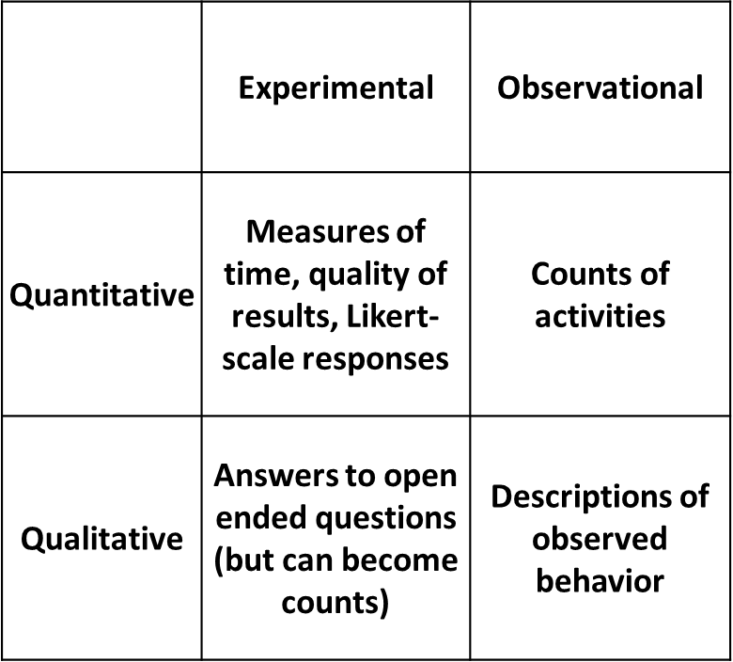
Step 5: Data Collection Techniques
Logging of activity in software
  Can easily be misinterpreted
    E.g., quantity of communication
Participant feedback after use
  Need to understand biases
Evaluation Data Captured

Slide 12
Bias in Data from Participant Reports
Courtesy bias
  tendency to withhold criticism
Acquiescence bias
  tendency to say yes
Social desirability bias
  tendency to avoid reporting features deemed socially undesirable
There are other types of reporting biases …

Slide 13
Designing an Evaluation
What do you want to evaluate?
  NOT if the code does what you intended!!!
  Should be related to data visualization features and their value to use
How would you evaluate?
  Experiment or field study?
  What are the participants doing?
Now work on the details
  Field study:
    What data will you collect? How will it be interpreted?
  Experiments:
    Within/between/matched participants?, How to balance order effects (learning/fatigue) and task differences?

Slide 14
Human-Subject Experiments
Predict the relationship between two or more variables.
Independent variable (e.g. which design) is manipulated by the researcher.
Dependent variables (e.g. time, accuracy, satisfaction) depends on the independent variable.
Typical experimental designs have one or two independent variables.

Slide 15
Experimental Designs
Different participants - single group of participants is allocated randomly to the experimental conditions.
Same participants - all participants appear in both conditions.
Matched participants - participants are matched in pairs, e.g., based on expertise, gender, etc.

Slide 16
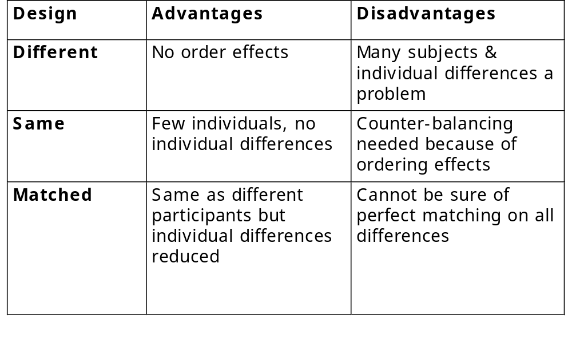
Different, Same, Matched Participant Design

Slide 17
The Need to Balance
Balancing is equally representing features of the evaluation space (e.g. tasks, designs)
Why do we balance
  For learning effects and fatigue
  For interactions among conditions
  For unexpected features of tasks (e.g. difficulty)
Latin square study design
  Used to balance conditions and ordering effects
  Consider balancing use of two systems for two tasks for a same-participant study

Slide 18
Review of Experimental Statistics
For normal distributions
  T test: for identifying differences between two independent populations
  Paired T test: for identifying differences between the same population or a well-matched pair of populations
  ANOVA: for identifying differences between more than two populations
  There are non-normal versions of all of these tests
For predicted distributions
  Chi square: to determine if difference from predicted is meaningful

Slide 19
Field Studies
Field studies are done in natural settings.
The aim is to understand what users do naturally and how technology impacts them.
Field studies can be used in product design to:
- identify opportunities for new technology;
- determine design requirements;
- decide how best to introduce new technology;
- evaluate technology in use.

Slide 20
Field Study Data & Analysis
Observation & interviews
  Notes, pictures, recordings
  Video
  Logging, diary studies
Analyses
  Categorized
  Categories can be provided by theory
    Grounded theory
    Activity theory

Slide 21
Other Evaluation Methods
Sometimes participants/time/money/etc. are not available in the amount needed
  Or the goal is to identify issues with a design and potential improvements rather than to evaluate a hypothesis
Inspection methods
  Heuristic evaluation
  Cognitive walkthroughs
Predictive models
  Use of models of human behaviour to assess/compare

Slide 22
Inspection Methods
Experts use their knowledge of users & technology to review software usability
Expert critiques (crits) can be formal or informal reports
Two main categories:
  Heuristic evaluation is a review guided by a set of heuristics
  Walkthroughs involve stepping through a pre-planned scenario noting potential problems

Slide 23
Heuristic Evaluation
Developed Jacob Nielsen in the early 1990s.
Based on heuristics distilled from an empirical analysis of 249 usability problems
These heuristics have been revised for current technology
Heuristics being developed for mobile devices, wearables, virtual worlds, etc.
Design guidelines form a basis for developing heuristics

Slide 24
Nielsen’s heuristics
Visibility of system status
Match between system and real world
User control and freedom
Consistency and standards
Error prevention
Recognition rather than recall
Flexibility and efficiency of use
Aesthetic and minimalist design
Help users recognize, diagnose, recover from errors
Help and documentation

Slide 25
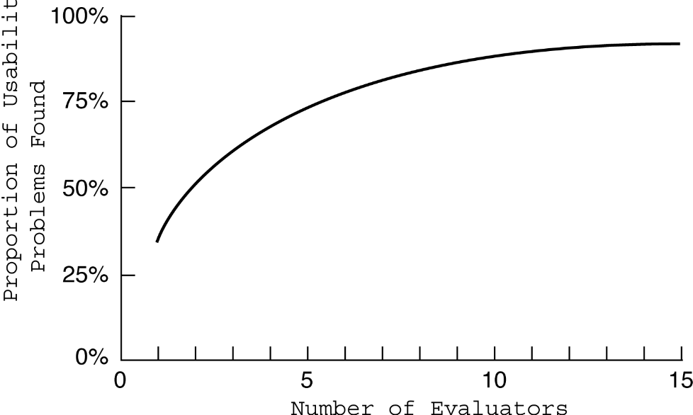
Discount Evaluation
Heuristic evaluation is referred to as discount evaluation when ~5 evaluators are used.
Empirical evidence suggests that on average 5
evaluators
identify
75-80% of
usability
problems.

Slide 26
3 stages for doing heuristic evaluation
Briefing session to tell experts what to do
Evaluation period of 1-2 hours in which:
  Each expert works separately
  Take one pass to get a feel for the product
  Take a second pass to focus on specific features
Debriefing session in which experts work together to prioritize problems

Slide 27
Cognitive Walkthroughs
Focus on ease of learning
Designer presents an aspect of the design & usage scenarios
Expert is told the assumptions about user population, context of use, task details
One of more experts walk through the design prototype with the scenario
Experts are guided by 3 questions

Slide 28
The 3 questions
Will the correct action be sufficiently evident to the user?
Will the user notice that the correct action is available?
Will the user associate and interpret the response from the action correctly?
  Note the connection to Norman’s gulf of execution and gulf of evaluation.
As the experts work through the scenario they note problems.

Slide 29
Pluralistic walkthrough
Variation on the cognitive walkthrough theme.
Performed by a carefully managed team.
The panel of experts begins by working separately.
Then there is managed discussion that leads to agreed decisions.
The approach lends itself well to participatory design.

Slide 30
Inspection Methods:
Advantages and Problems
Few ethical & practical issues to consider because users not involved
Can be difficult & expensive to find experts
Best experts have knowledge of application domain & users
Biggest problems:
  Important problems may get missed
  Many trivial problems are often identified
  Experts have biases

Slide 31
Predictive Models
Provide a way of evaluating products or designs without directly involving users
Less expensive than user testing
Usefulness limited to systems with predictable tasks - e.g., telephone answering systems, mobiles, cell phones, etc.
Most models make predictions based on expert error-free behavior

Slide 32
GOMS
Goals - the state the user wants to achieve e.g., find a website.
Operators - the cognitive processes & physical actions needed to attain the goals, e.g., decide which search engine to use.
Methods - the procedures for accomplishing the goals, e.g., drag mouse over field, type in keywords, press the go button.
Selection rules - decide which method to select when there is more than one.
Use at NYNEX and NASA

Slide 33
Keystroke level model
GOMS has also been developed to provide a quantitative model - the keystroke level model.
The keystroke model allows predictions to be made about how long it takes an expert user to perform a task.

Slide 34
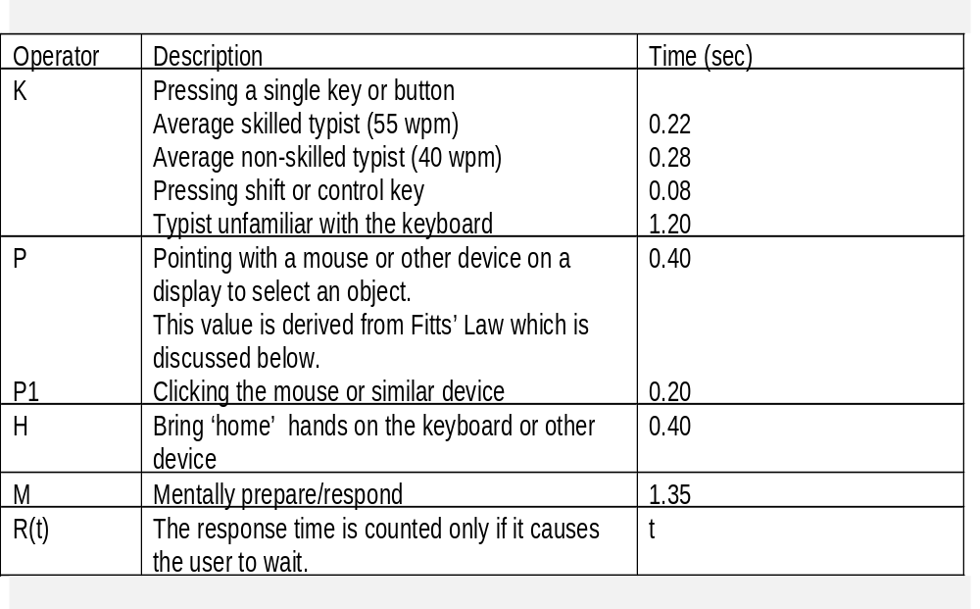
Response times for keystroke level operators (Card et al., 1983)

Slide 35
Fitts’ Law (Fitts, 1954)
Fitts’ Law predicts that the time to point at an object using a device is a function of the distance from the target object & the object’s size.
The further away & the smaller the object, the longer the time to locate it and point to it.
Fitts’ Law is useful for evaluating software for which the time to locate and move to an object is important.

Slide 36
Characteristics of approaches
 | Experiment | Field studies | Inspection
Users | do task | natural | not involved
Location | controlled | natural | anywhere
When | prototype | Early or late | prototype
Data | Mostly quantitative | Traditionally qualitative | problems
Feed back | measures & errors | descriptions | problems
Type | applied | naturalistic | expert

