Slide 1
Video-Oriented IUIs
As always, the first step is to understand the users, their tasks, and the context of use
In particular
  What are the characteristics of the video that are important to the task given the domain?
  What computed features will represent those characteristics?
  What form of interaction will be valuable
    Attention support
    Automated classification or summary
    Mixed-initiative analysis

Slide 2
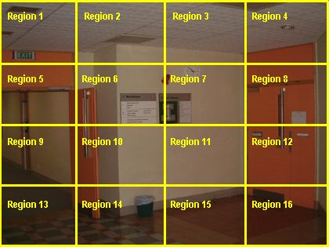
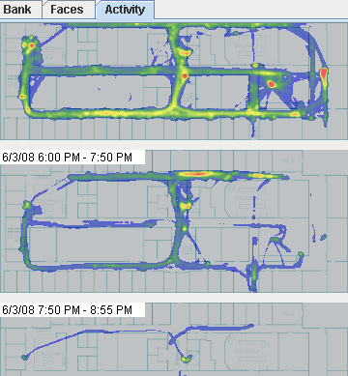
Image/Video Processing: Subdividing
Region subdivision
  Sometimes we subdivide
  images into regions
  Spread observed features
  at edges for more
  continuous model
Temporal subdivision
  Video is subdivided into segments
  Spread features into neighboring segments

Slide 3
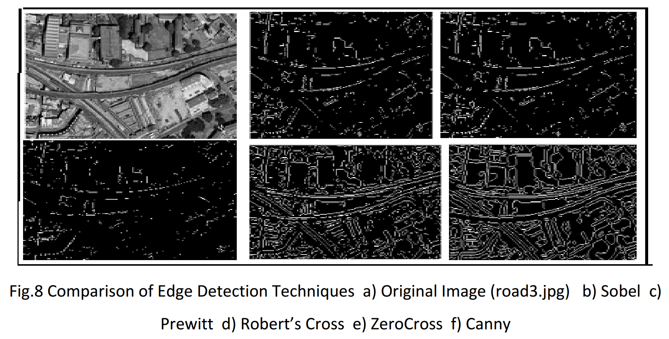
Texture Features
Edge detection can be used in generating features

Slide 4
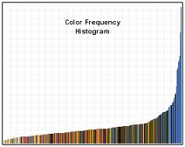
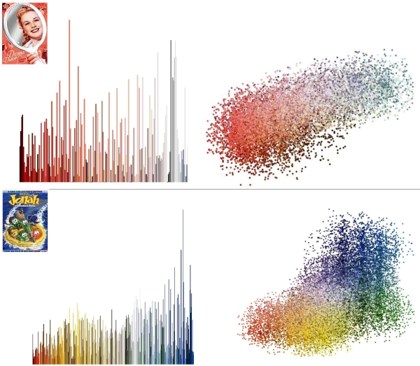
Color Features
Color histograms – how much of each color is in image
  Probability of a pixel in the image being a particular color
Color correlograms – how close colors are to each other in image
  Probability of finding a pixel of a particular color at a specific distance from a pixel of a known color

Slide 5
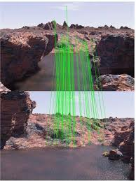
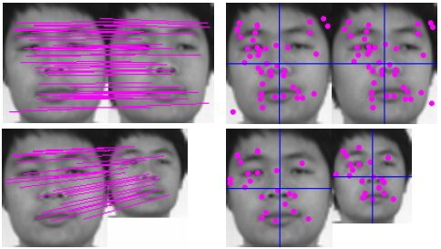
Object Features
Each image is different
  Lighting, colors
  Scale, skew, parallax
Scale Invariant Feature
Transform (SIFT)
  Identify features that
  are resilient to
  different angles
  Used for many image
  recognition tasks

Slide 6
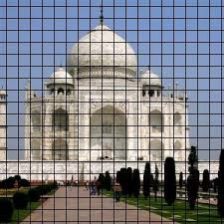
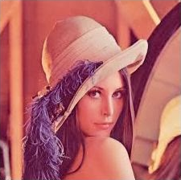
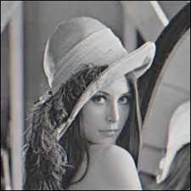
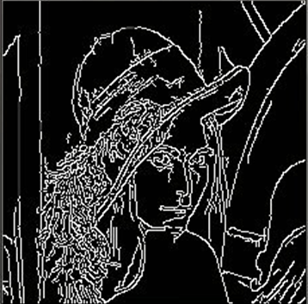
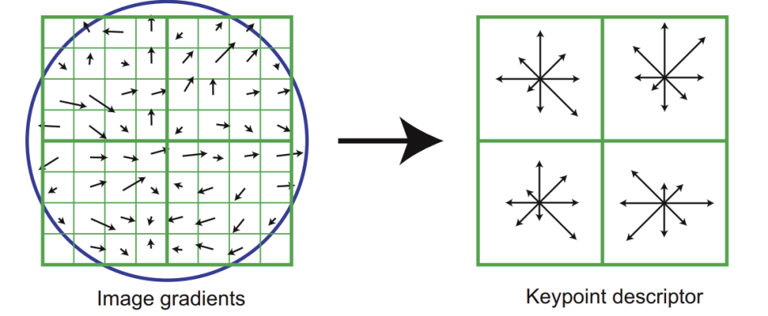
SIFT and similar techniques
Divide images into grids of different resolutions
Preprocessing for feature generation may vary
  Grayscaling and edge detection are common
Generate coding of local features at each grid
element
  Representation of local features can vary
Compare patterns of features at different resolutions

Slide 7
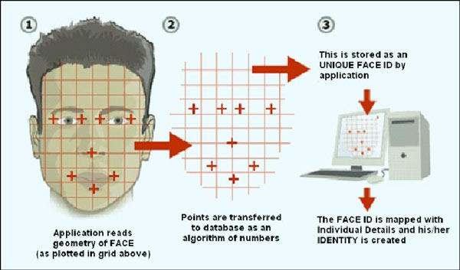
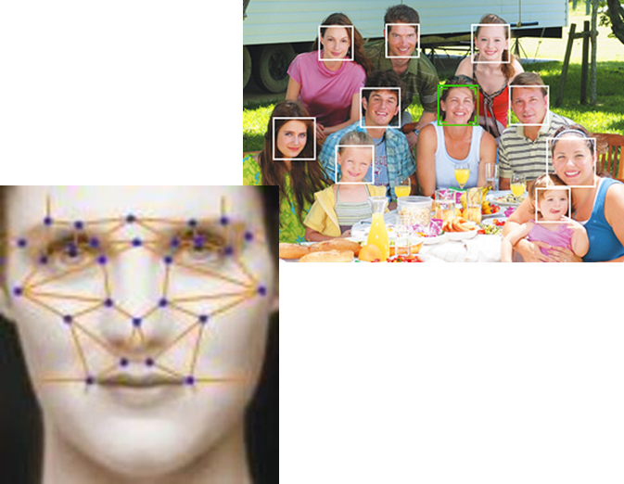
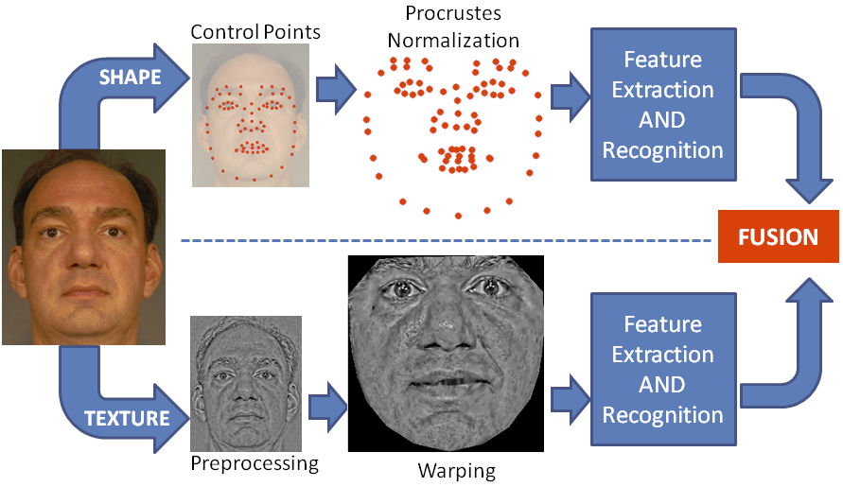
Face Detection

Slide 8
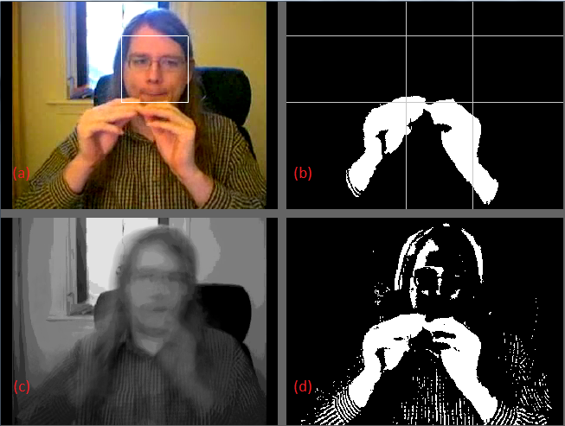
Foreground/Background Separation
Background Modeling
  Convert to greyscale
  Dynamic model (to cope with changes in signer body position and lighting)
    BP_{t} = .96 * BP_{(t-1)} + .04 P
Foreground object detection
  Pixels different from background model by more than a threshold are foreground pixels
  Spatial filter removes regions of foreground pixels smaller than a minimum threshold
Face location to determine position of foreground relative to the face
Videos without a single main face are not considered as potential SL videos

Slide 9
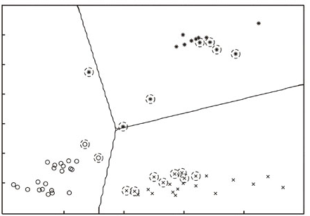
Classifying Video
Features are extracted from video content
  Features selected based on domain and intended use
  Features creates a multidimensional space of data points
Supervised learning
  Train classifier with set
  of labeled signals
  SVMs, neural nets, …
Unsupervised learning
  Cluster unlabeled signals
  based on similarity
  HAC, K-means, …
Same for most any type of signal, not just video

Slide 10

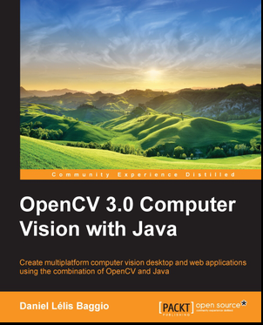

OpenCV: A Toolkit for Image Processing
The good news is you do not have to implement the image processing primitives
Can be used with a variety of programming languages

Slide 11
Recorded (Unproduced) Video
Lots of video is recorded
  Way too much for human attention
What processing and interfaces make this video more valuable?
Summarization and indexing are crucial
Recorded video applications
  Surveillance video
  Videoconferencing
  Lecture video

Slide 12
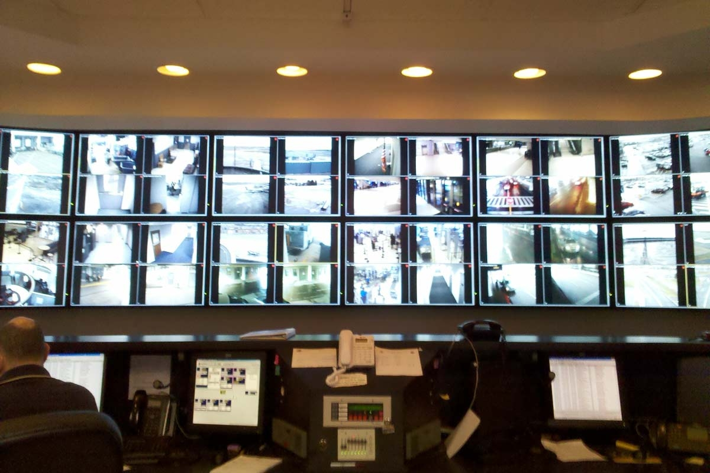
Surveillance Video
Rochester Airport

Slide 13
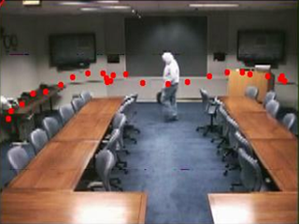
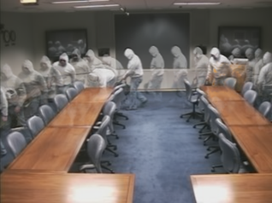
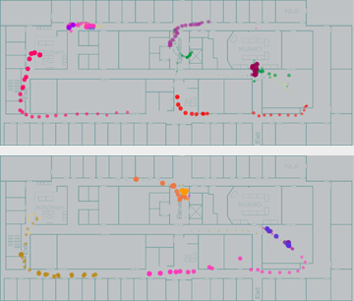
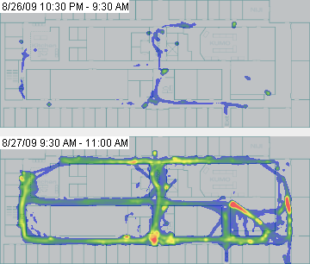
DOTS: Supporting Use of Surveillance Video
The problem
  Number and size of surveillance systems are increasing but human attention is limiting factor
Approach
  Provide summaries
  of action
  Build interfaces knowing limits of automation

Slide 14
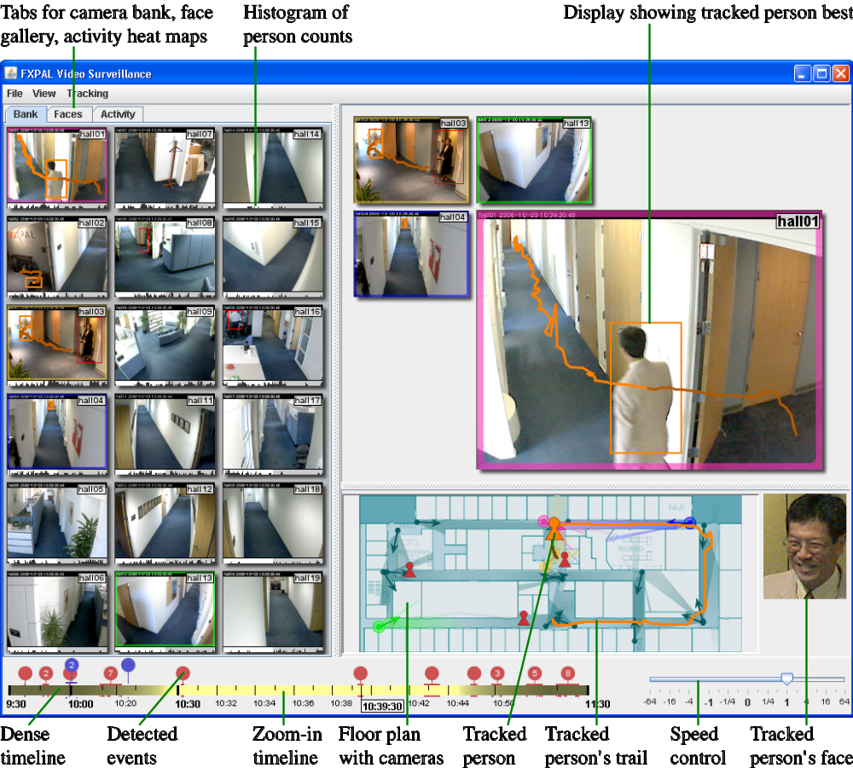
DOTS: The Main Interface
Components
  Rotating camera bank with activity graphs
  Mixed-initiative main viewer
  Map with tracking data
  Timeline with automatic events

Slide 15
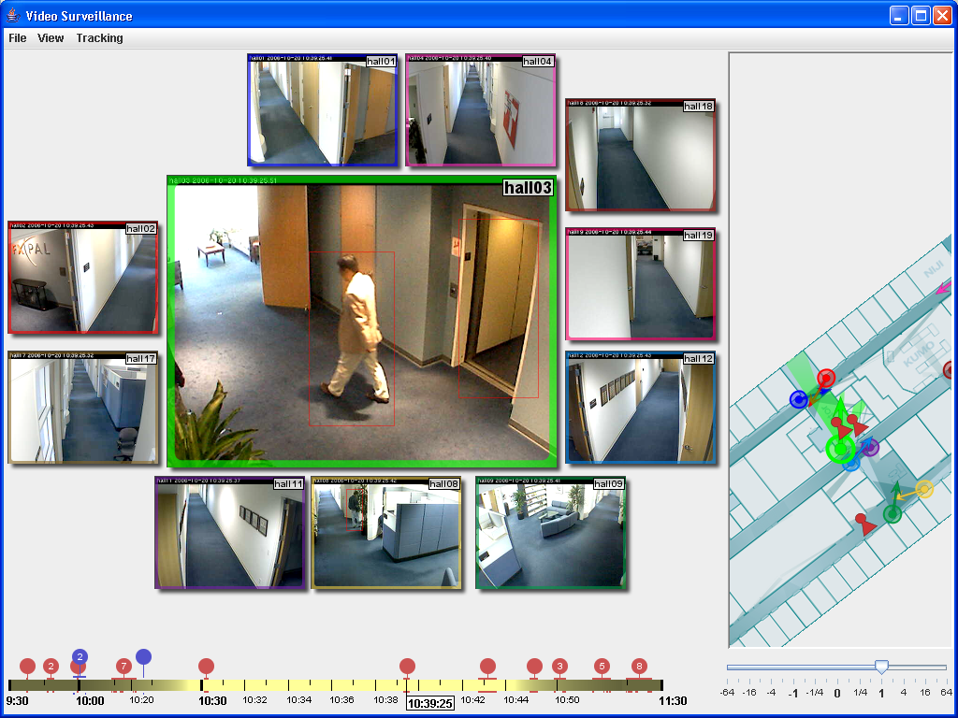
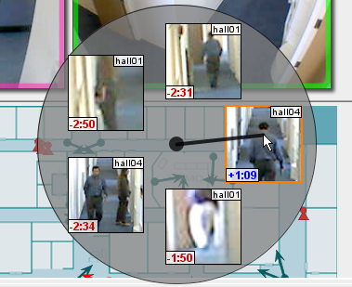
DOTS: Tracking Layout
Difficulty in tracking is that camera views are often similar
Tracking layout places cameras around the main viewer to aid tracking
Study showed significant improvement in tracking success over traditional viewer
In either layout, map can be used to find activity near a location and time.

Slide 16
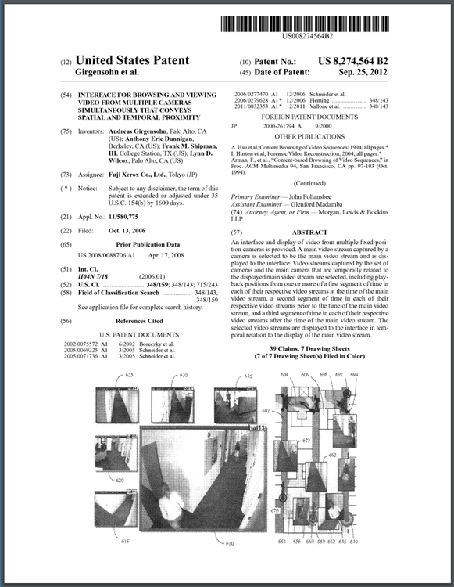
DOTS Wrap Up
Design should take into account types of video and use context
  Leads to video feature selection
  Many unique scenarios
Amount of video is often overwhelming
  So tend towards greater automation
  But design with user overrides

