Slide 1
User Interest Modeling at TAMU
Soonil Bae, DoHyoung Kim, Kostas Meintanis, Michael Moore, Anna Zacchi, Frank Shipman, Haowei Hsieh, Cathy Marshall and more

Slide 2
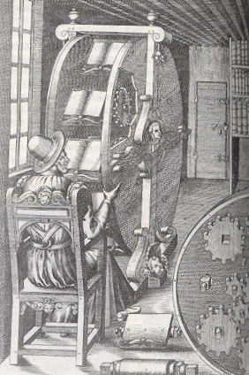
Task: Information Triage
We want to look at situations where people are reading more than one document at once
Information triage places different demands on attention than single-document reading activities
Continuum of types of reading: working in overview (metadata), reading at various levels of depth (skimming), reading intensively
Studies beginning 1995

Slide 3
User Interest Modeling
User model – a system’s representation of characteristics of its user
  Generally used to adapt/personalize system
  Can be preferences, accessibility issues, etc.
User interest model – a representation of the user’s interests
  Motivation: information overload
  History: many of the concepts found in work on information filtering (early 1990s)

Slide 4
Interest Modeling Considerations
Different from modeling of user capabilities
  User’s demographics, physical characteristics and issues tend to be relatively persistent
    E.g. Age, height, need for accessibility options, etc.
  User’s knowledge changes over time, but relatively slowly
Users have multiple interests and these change during tasks
  Consider your own interests while looking for related work for your class projects
During triage, the user’s changing understanding of the domain and content available causes interests to evolve rapidly

Slide 5
Interest Modeling for Information Triage
Prior interest models tend to assume one application
  Example: browser observing page views and time on page
  Multiple applications are involved in information triage (searching, reading, and organizing)
When applications do share a user model, it is with regard to a well-known domain model
  Example: knowledge models shared by educational applications
  Not possible since triage deals with decisions about relative value among documents of likely value (e.g. returned from a query)

Slide 6
Process for Providing Support for Document Triage
Recognize user interest in and interpretation of documents
Generate a representation of user interests
Identify documents that match these interests
Provide visual cues to indicate the potential value of documents

Slide 7
Acquiring User Interest Model
Explicit Methods
  users tend not to provide explicit feedback
  long tail assumptions not applicable
Implicit Methods
  Reading time has been used in many cases
  Scrolling and mouse events have been shown somewhat predictive
  Annotations have been used to identify passages of interest
Problem: Individuals vary greatly and have idiosyncratic work practices

Slide 8
Prior Work: First Study
Study designed to look at:
  deciding what to keep
  expressing an initial view of relationships
Part of a larger study:
  8 subjects in role of a reference librarian, selecting and organizing information on ethnomathematics for a teacher
Setting: top 20 search results from NSDL & top 20 search results from Google presented in VKB 2
  Subjects used VKB 2 to organize and Web browser to read
After task, subjects were asked to identify:
  5 documents they found most valuable
  5 documents they found least valuable

Slide 9
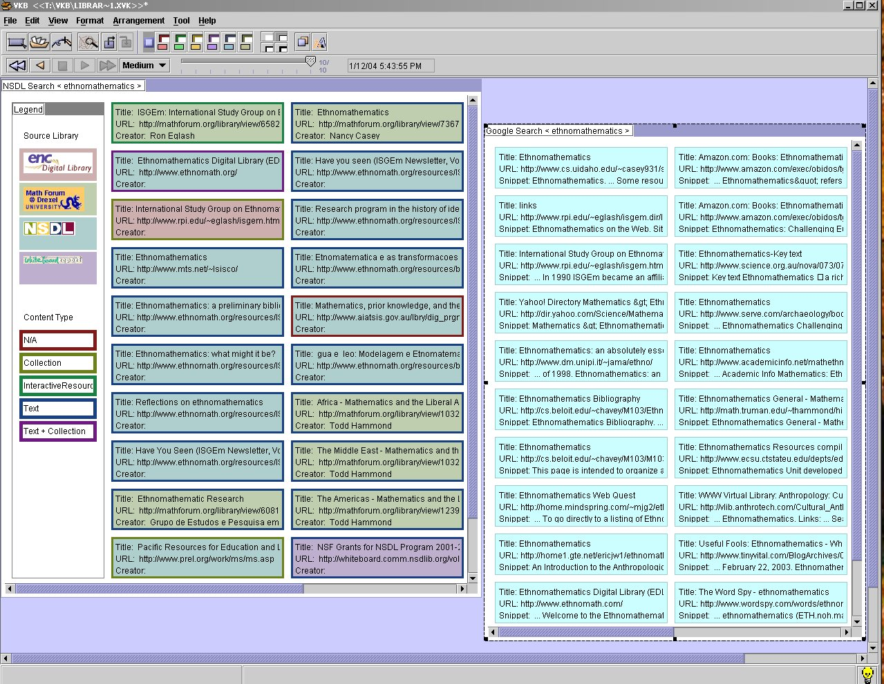

Slide 10
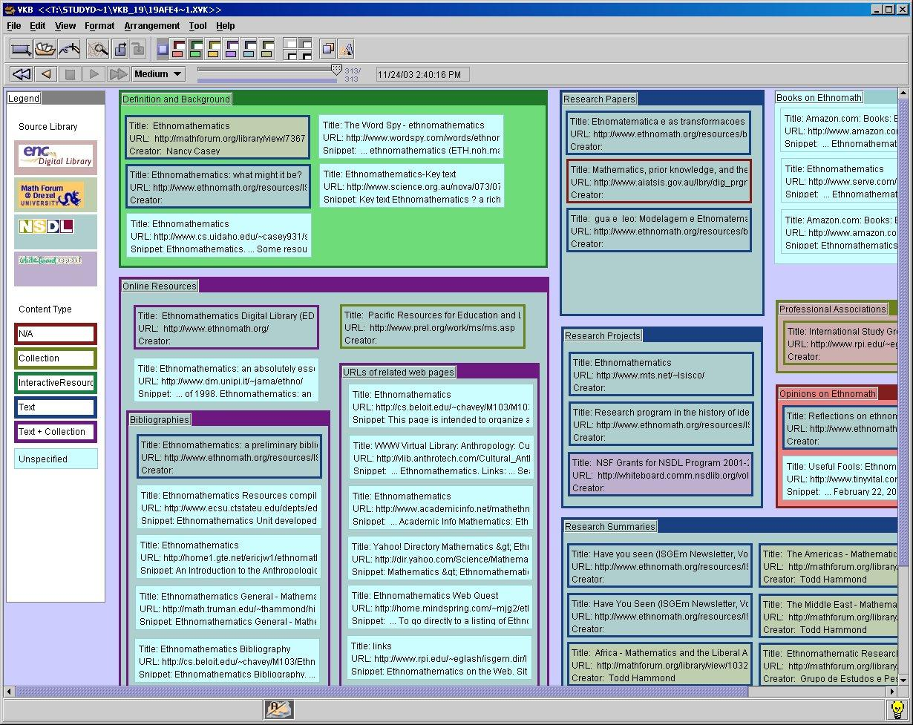

Slide 11
Many User Actions Anticipate Document Assessment
Correlated actions (p < .01) (from most to least correlated)
  Number of object moves
  Scroll offset
  Number of scrolls
  Number of border color changes
  Number of object resizes
  Total number of scroll groups
  Number of scrolling direction changes
  Number of background color changes
  Time spent in document
  Number of border width changes
  Number of object deletions
  Number of document accesses
  Length of document in characters
  Blue – from VKB White – from browser

Slide 12
Interest Models
Based on the data from first study, we developed four interest models
  Three were mathematically derived
    Reading-Activity Model
    Organizing-Activity Model
    Combined Model
  One hand-tuned model included human assessment based on observations of user activity and interviews with users.

Slide 13
Quick Comparison of Models
How much of difference in original data was modeled?
  Reading-activity model 47.7%
  Organizing-activity model 63.6%
  Combined model 70.8%
How well would models do for new data?
Study also showed that system-provided colorings reduced interpretive use of color

Slide 14
Evaluation of Models
16 subjects with same:
  Task (collecting information on ethnomathmatics for teacher) and
  Setting (20 NSDL and 20 Google results)
Different rating of documents
  Subjects rated all documents on a 5-point Likert scale (with 1 meaning “not useful” and 5 meaning “very useful”)

Slide 15
Predictive Power of Models
Models limited due to data from original study
Used aggregated user activity and user evaluations to evaluate models
Lower residue indicates better predictions
Combined model better than reading-activity model (p=0.02) and organizing-activity model (p=0.07)
Model Avg. Residue Std. Dev.
Reading-activity model 0.258 0.192
Organizing-activity model 0.216 0.146
Combined model 0.175 0.138
Hand-tuned model 0.197 0.134

Slide 16
Architecture for Interest Modeling
Results of study motivated development of infrastructure for multi-application interest modeling
Reading
Interest
Application
Profile
User Interest
Manager
Estimation Engine
Reading
Application
Reading
Application
Interest Profile
Organizing
Location/Overview
Application
Application

Slide 17
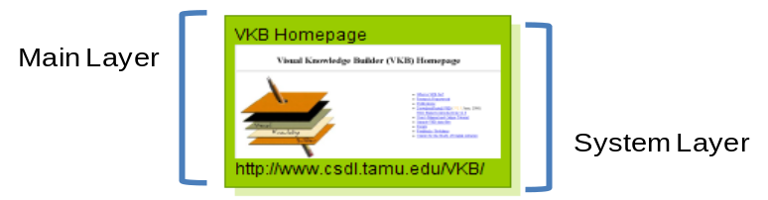
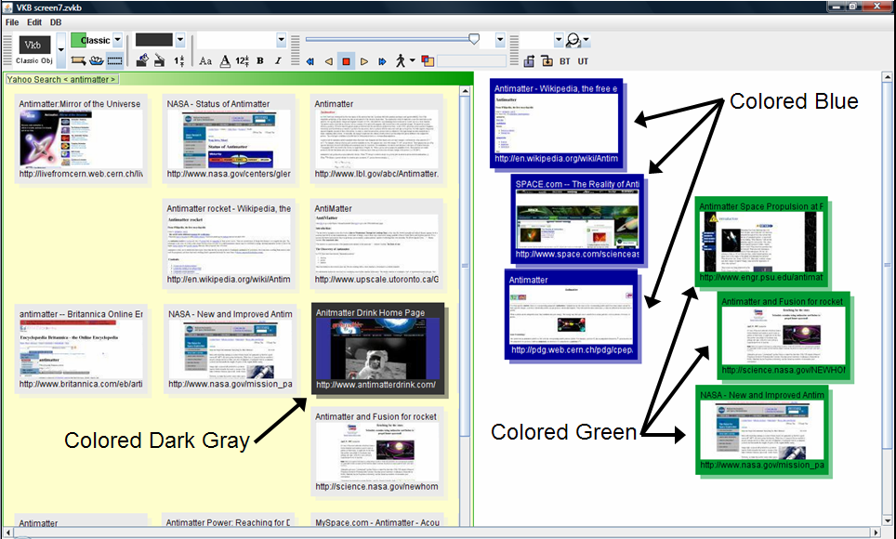
New Tools: VKB 3
New Document Object
  User expression via coloring
  document objects’ user layer leads to user interests
  System layer used
  to indicate
  documents’
  relations to
  inferred interests
Main Layer
System Layer

Slide 18
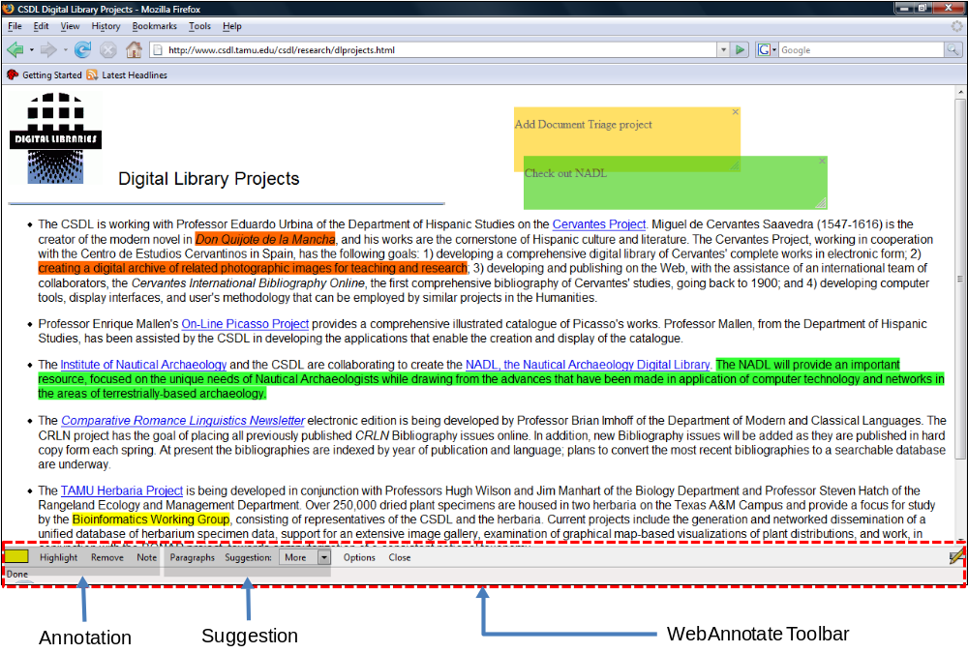
New Tools: WebAnnotate

Slide 19
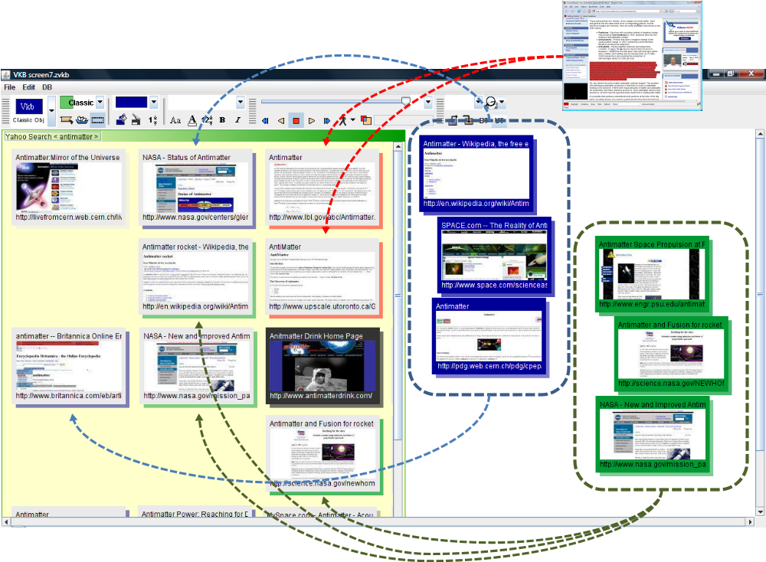
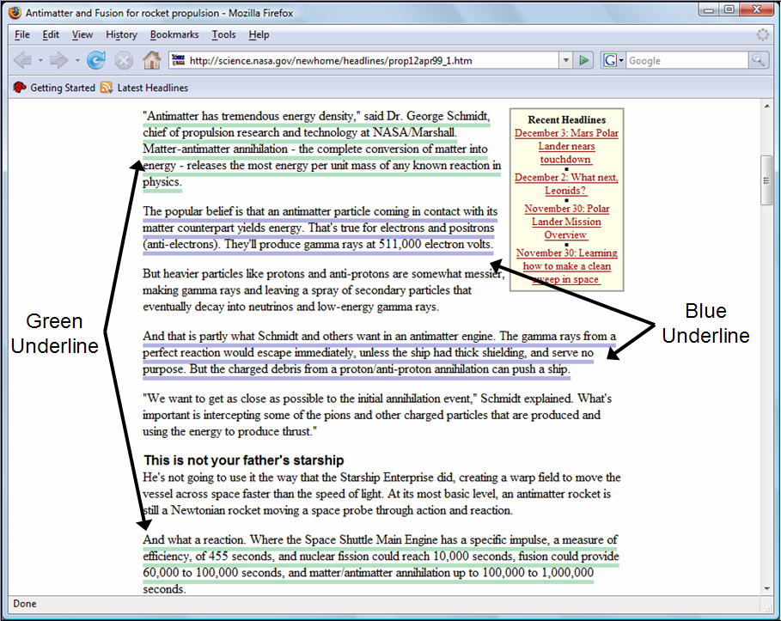
Annotation-based Visualizations

Slide 20
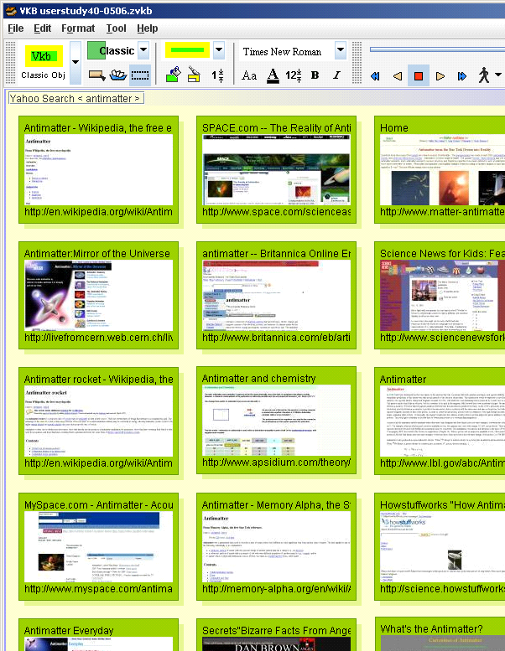
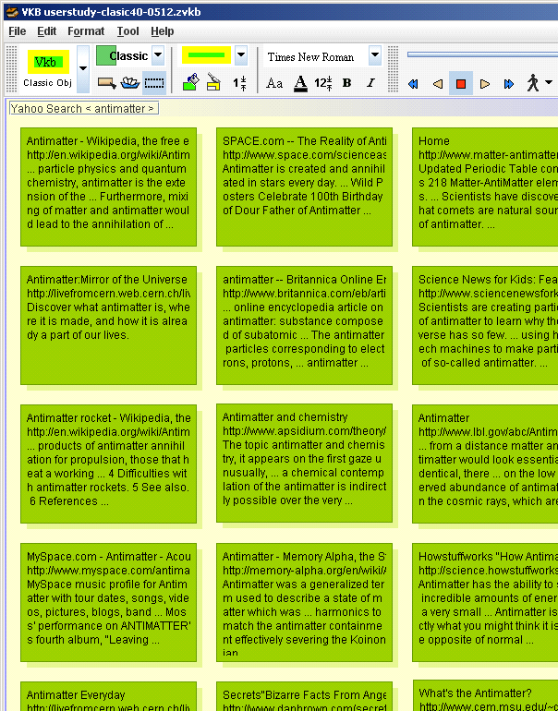
A New Study
20 subjects organized 40 documents about “antimatter” returned by Yahoo! search
Subjects assessed the relevance of each document at the end of the task
10 with and 10 without
suggestions/thumbnails
Measured
  Task switching
  Time on documents

Slide 21
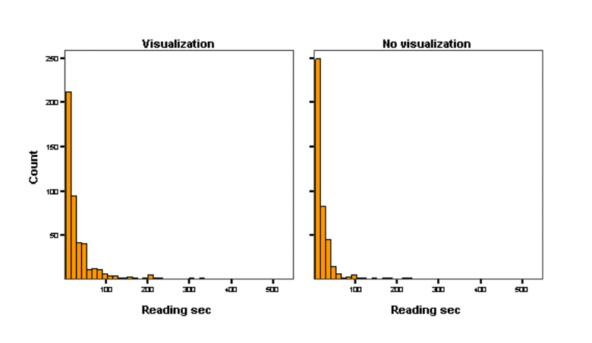
Results
Task Switching
  Fewer but longer reading sessions with new interface
  Average reading time
    10.7 seconds with new
    features
    4.3 seconds without
    p < 0.0001
  Interpretation: People are doing more in-depth reading

Slide 22
Results
Document Attention
  6 of 10 subjects with
  new interface had
  correlations between
  reading time and
  document value
  Only 2 subjects with
  old interface had significant correlations
  Interpretation: New interface users located and spent more time on documents of value to their task
Group 1 |  |  | Group 2
ID | Coef. | Sigma | ID | Coef. | Sigma
1 | 0.429 | 0.018 | 11 | 0.277 | 0.093
2 | 0.397 | 0.014 | 12 | 0.111 | 0.565
3 | 0.356 | 0.087 | 13 | 0.210 | 0.205
4 | 0.409 | 0.011 | 14 | - 0.148 | 0.376
5 | 0.576 | 0.008 | 15 | 0.367 | 0.024
6 | 0.206 | 0.214 | 16 | 0.633 | < 0.0001
7 | 0.137 | 0.412 | 17 | 0.116 | 0.489
8 | 0.438 | 0.006 | 18 | 0.114 | 0.495
9 | 0.629 | < 0.0001 | 19 | 0.101 | 0.547
10 | 0.170 | 0.309 | 20 | 0.240 | 0.147

Slide 23
Take Aways
There are many types of user modeling
  Demographics, physical characteristics, disabilities, knowledge, past experience, interests, etc.
Techniques for acquiring user model
  Ask the user, infer from user activity
Representations of models
  Stereotyping and clustering, content-specific representations (e.g. IR models of text, vision models of physical characteristics)
Interest modeling during triage is challenging
  due to evolving user understanding and ephemerality of interests

