Slide 1
Identifying Useful Passages in Documents based on Annotation Patterns
Frank Shipman, Morgan Price, Cathy Marshall, Gene Golovchinsky
FX Palo Alto Laboratory

Slide 2
Outline
Why interesting for IUI design?
Analysis of the correspondence of annotations to citations in legal domain
Design of “mark parser” to recognize and rank-order annotations
Example use of mark parser results in XLibris

Slide 3
Lessons for and Relations to Modern IUI Design
Much human activity and expression is meant for personal interpretation only
  Inferences over such activity can be valuable
  Applications need to understand limits to quality and generality of inferences
Individual styles can vary widely
  Poses a challenge to inference mechanisms
  Clustering user behavior can help

Slide 4

Reading and Annotation
Reading happens:
  for fun
  for general knowledge
  for a particular task
Annotations will likely be:
  nonexistent
  few and identifying central concepts
  task-dependent and interpretive

Slide 5
Types of Annotations
Annotations in documents can signify:
  a specific point in the text
  a reaction to the content
Annotations in a task-dependent reading may also be:
  a comparison
  a plan for future use
But what is useful?

Slide 6
Relationship of Annotation to Citation in Legal Domain
Conservative definition of useful:
passages cited in final brief
Study:
  Categorize annotations on passages from case documents cited in legal briefs.
  Count and partly categorize annotations made on all printed cases.

Slide 7
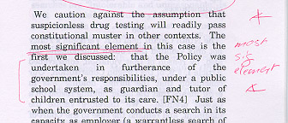
Example: Annotation and Citation
Annotation:
Citation:
  The court in Vernonia stated that the “most significant element”
  of the case was that the drug testing program “was undertaken in furtherance of the government’s responsibilities, under a public school system, as guardian and tutor of children entrusted to its care.” Vernonia, 515 U.S. at 664.

Slide 8
Details
Data:
  case printouts and final briefs for seven Stanford law students
Process:
  for each citation, identify passage in case printout and record annotation category
Confounding:
  not all cases printed (mostly recent ones as older cases were in books)

Slide 9
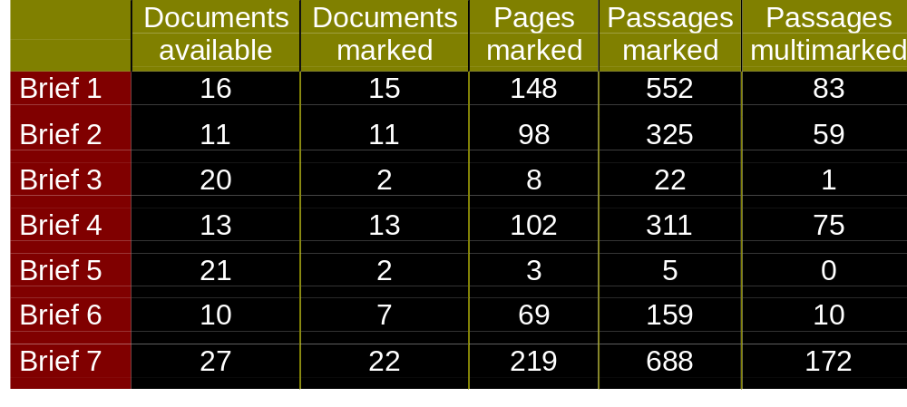
Documents, Pages, Marks

Slide 10
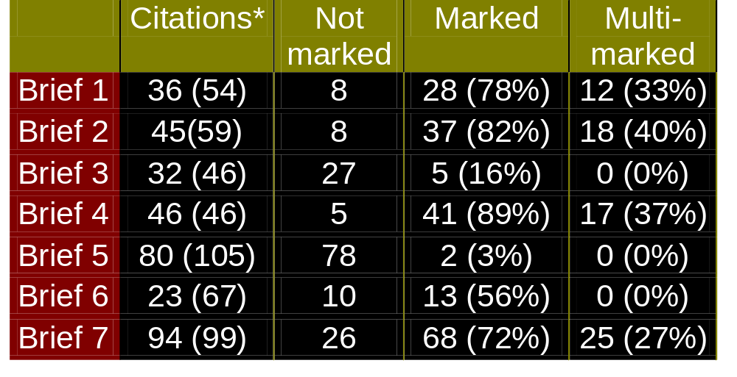
Marks on Cited Passages
* Citations from case documents available for study,
(out of number of citations overall.)

Slide 11
Selection using Marks vs. Multimarks
M2
30%
Precision
(% of
selected passages
cited)
m3
M4
m5
Meager
markers
20%
M7
M1
Happy highlighters
m4
m7
m2
10%
m6
m1
M3, M5 & M6
10%
20%
30%
40%
50%
60%
70%
80%
90%
Recall (% of cited passages retrieved)

Slide 12
Interpretation
Individual annotation styles vary greatly
  For heavier markers, multiple marks on a passage is a relatively selective criteria
  For lighter markers, any marks on a passage is a relatively selective criteria
Remember:
citation is a conservative definition of useful ...

Slide 13
Lessons for System Design
Annotations correlate with usefulness, but there is a lot of noise.
  need way of locating high-emphasis passages
Annotation styles vary greatly.
  need method of identifying more important passages in any case

Slide 14
Design of the
Mark Parser

Slide 15
The Mark Parser
1. Cluster marks based on timing,
position, and pen type
2. Assign annotation types to clusters
with default emphasis values
Individual
Marks and
Passages
Hierarchy of Marks with
Emphasis Weights
3. Group clusters based on passages,
adding emphasis for new groups.

Slide 16
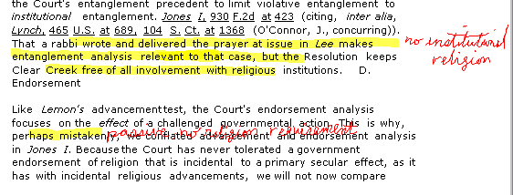
An Example: The Ideal
Multimarked
Passage
Highlighter
Comment
Multimarked
Passage
Highlighter
Comment

Slide 17
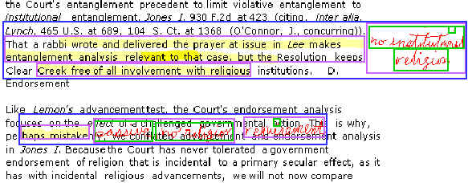
An Example: Reality

Slide 18
Mark Parser Assessment
Mark Parser tested and refined based on reading group data.
The Good News:
  Clustering, categorizing, assigning emphasis, and grouping clusters works as a whole for locating emphasized passages.
Caveat:
  All levels make mistakes, so use of any details of parse requires careful design.

Slide 19
Example Use of Recognized Annotation Structure in XLibris

Slide 20

XLibris
FXPAL reading
application supporting
pen-based annotation
Supported the storing
and sharing of
annotations
This was 1999
  8 years before first iPhone
  11 years before first iPad

Slide 21
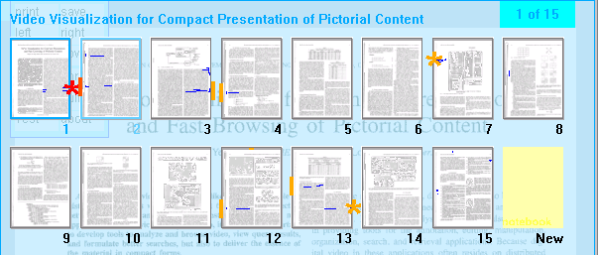
Identifying High-Value Annotations
Emphasis values in XLibris overview.

Slide 22
Overview Features
Different icons based on type of marks:
  selection marks vs. interpretive marks
Color of icons based on emphasis:
  low and high value emphasis
Potential for other information:
  more cues for relative emphasis
  more mark types
Potential for aggregation of annotations for a group/community

Slide 23
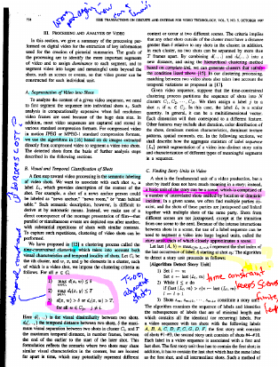
Summary
Annotation patterns are
idiosyncratic but useful
passages are relatively
distinguished.
Marks can be clustered,
categorized into types, and
given emphasis values.
XLibris provides emphasis marks in overview based on mark parsing results.
Example of automating interpretation over widely varied user behavior

Slide 24
Some Ideas and Lessons from Technical Readings So Far
Continuum of automation
Techniques for generating user models
Models for deciding when to automate, when to ask, and when to do nothing
Methods for eliciting and formalizing human knowledge
Interpreting activity in context of highly variable work practices

