Slide 1
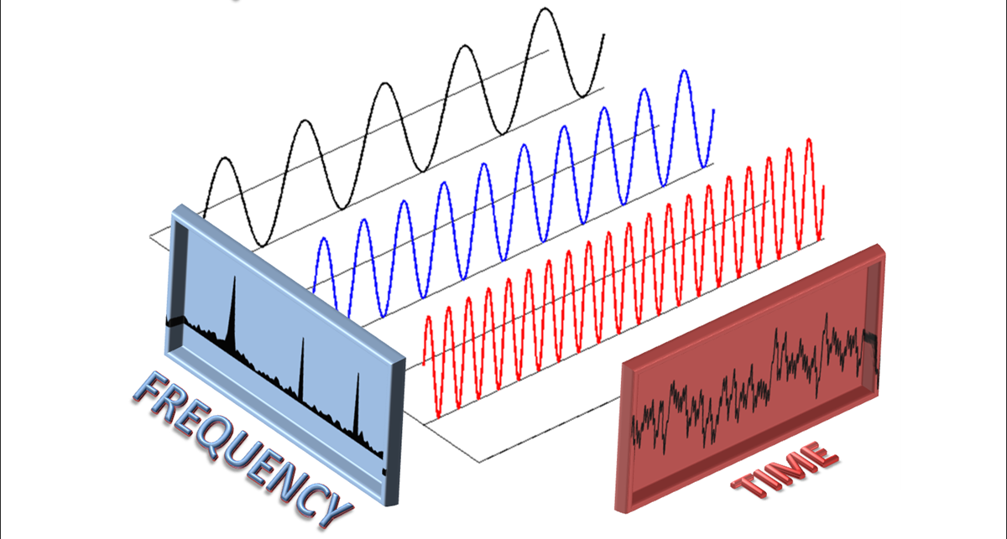
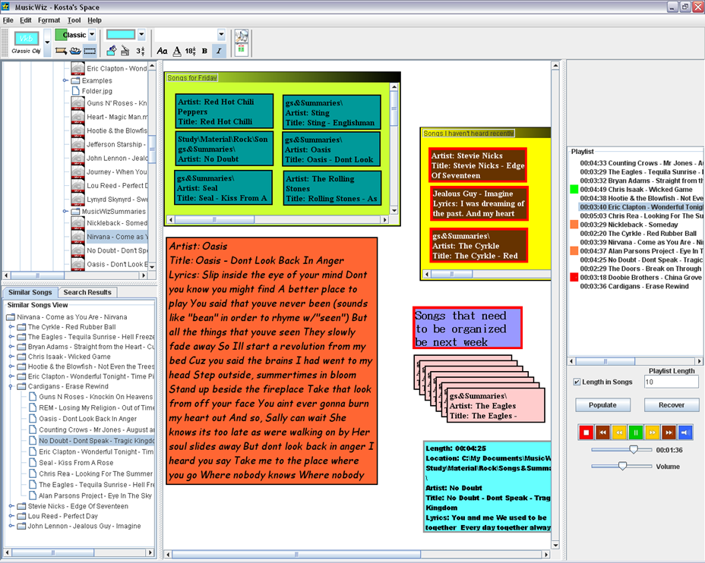
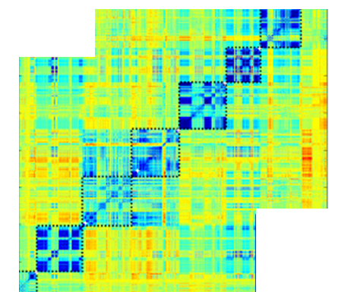
Last Class
General audio
  Features of audio signal
  Event, speech detection, segmentation, identification
  Audio generation to convey non-text data
Music
  Features of music data
  Support for composition, music management
  Song/playlist selection for individuals and groups
  Interactive music and music summarization
Basics of classifier design and segmentation
  Feature selection, training & clustering
  Self-similarity matrices

Slide 2
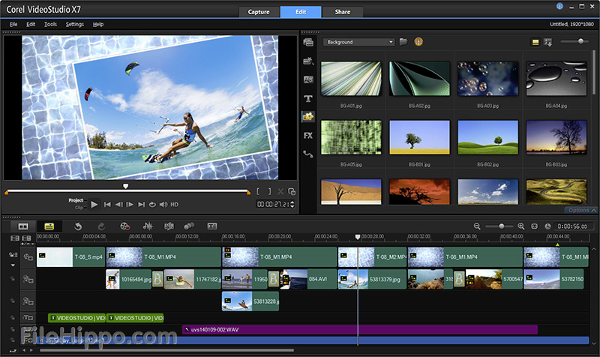
Authored Video
How many have captured and shared video?
How many have composed video by piecing together independent video segments?
Hard to separate video processing techniques from image processing
  Image and video
  processing for
  video authoring
  Image and video
  applications

Slide 3
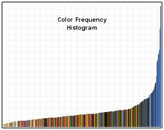
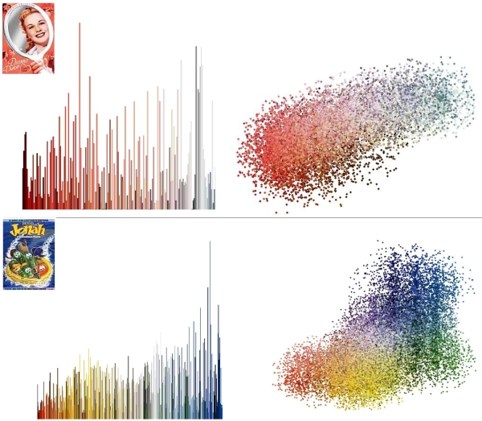
Modeling Color Features
Color histograms – how much of each color is in image
  Probability of a pixel in the image being a particular color
Color correlograms – how close colors are to each other in image
  Probability of finding a pixel of a particular color at a specific distance from a pixel of a known color

Slide 4
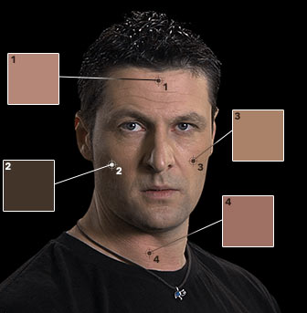
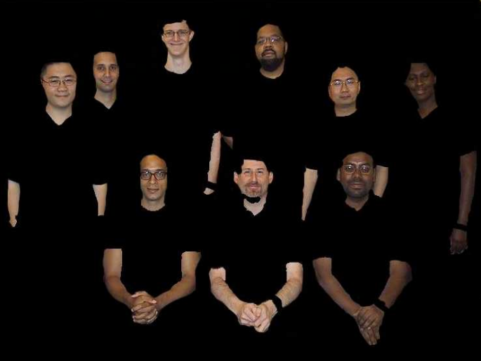
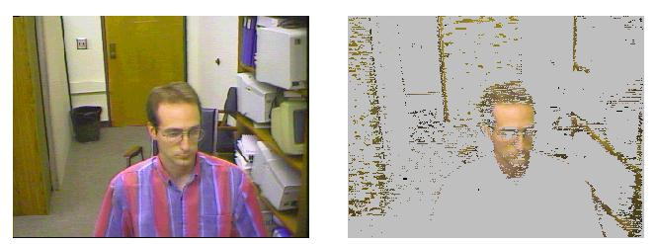
Skintone Detection
Lots of applications rely on locating people in images and video
One technique used to aid in such location is to filter images based on skintone models

Slide 5
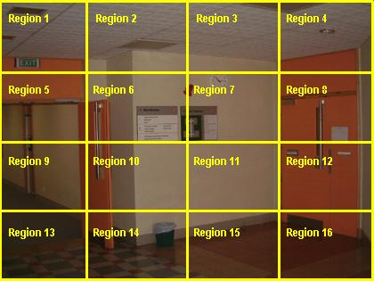
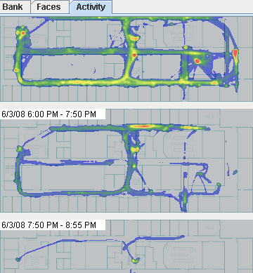
Image/Video Processing: Subdividing
Region subdivision
  Sometimes we subdivide
  images into regions
  Spread observed features
  at edges for more
  continuous model
Temporal subdivision
  Video is subdivided into segments
  Spread features into neighboring segments

Slide 6
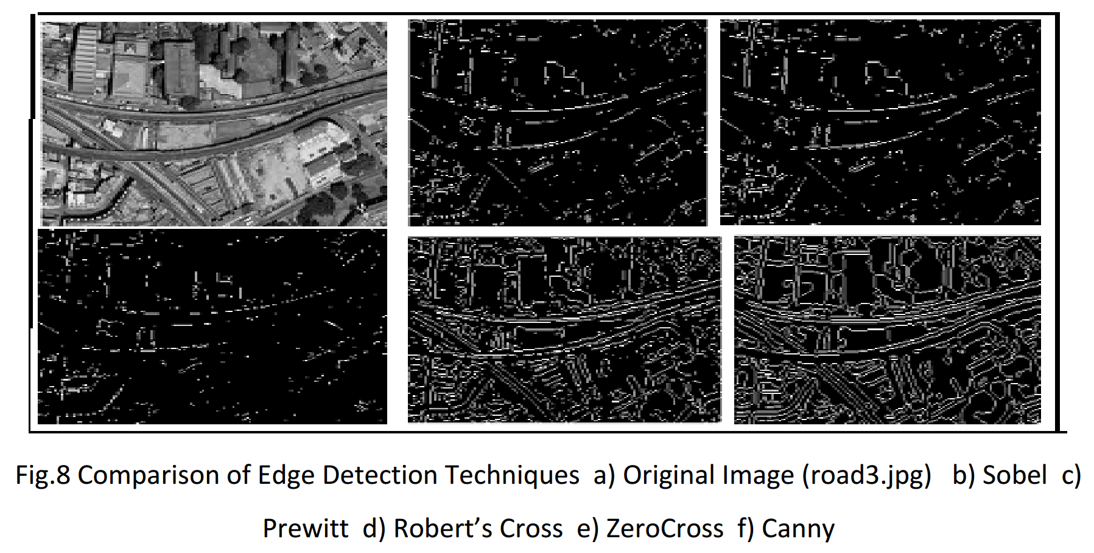
Edge Detection

Slide 7
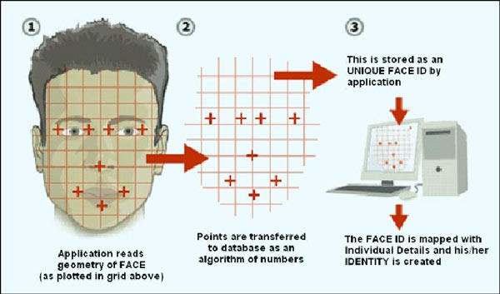
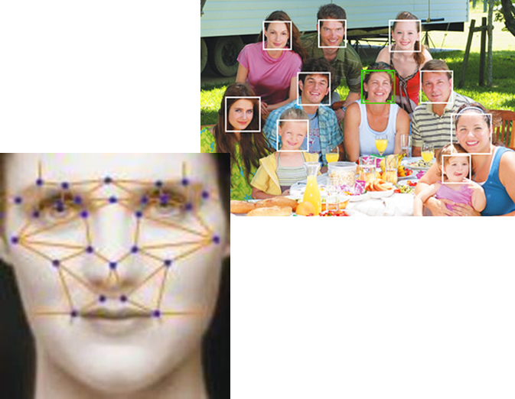
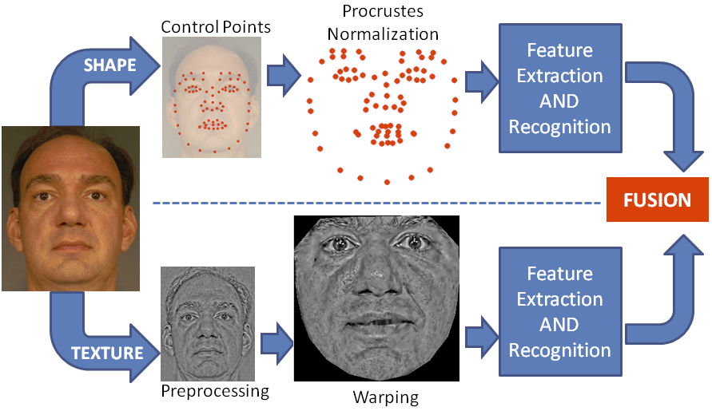
Face Detection

Slide 8
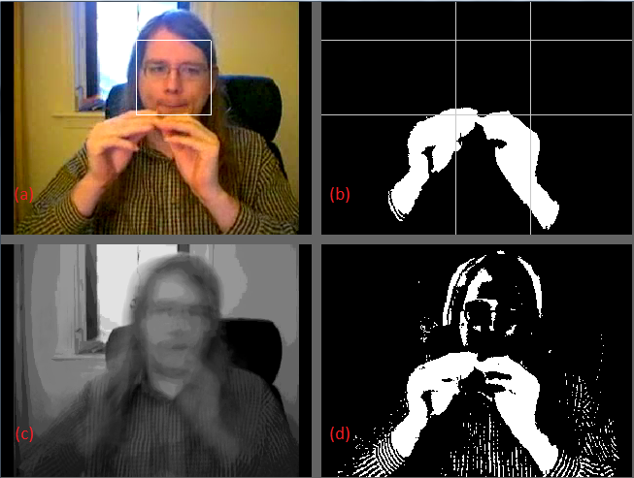
Foreground/Background Separation
Background Modeling
  Convert to greyscale
  Dynamic model (to cope with changes in signer body position and lighting)
    BP_{t} = .96 * BP_{(t-1)} + .04 P
Foreground object detection
  Pixels different from background model by more than a threshold are foreground pixels
  Spatial filter removes regions of foreground pixels smaller than a minimum threshold
Face location to determine position of foreground relative to the face
Videos without a single main face are not considered as potential SL videos

Slide 9



OpenCV: A Toolkit for Image Processing
The good news is you do not have to implement the image processing primitives
Can be used with a variety of programming languages

Slide 10
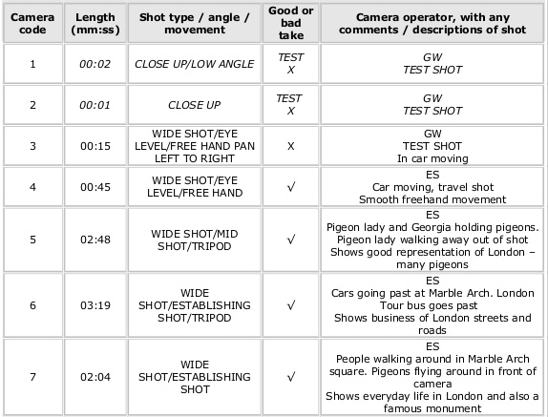
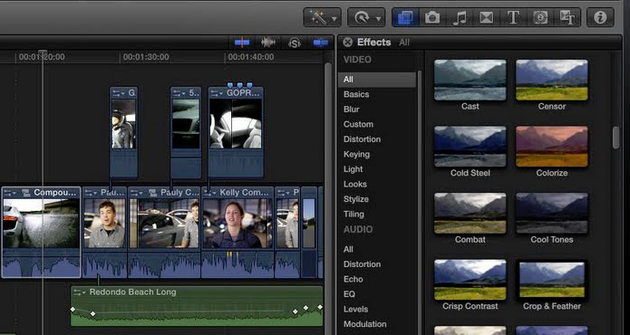
Composition: Edit Decision Lists

Slide 11
Example Authoring Applications
MediaGlow
  Supporting selection of images for presentation or other need
  Clustering images based on implicit user needs
HyperHitchcock
  Authoring and viewing interactive video

Slide 12
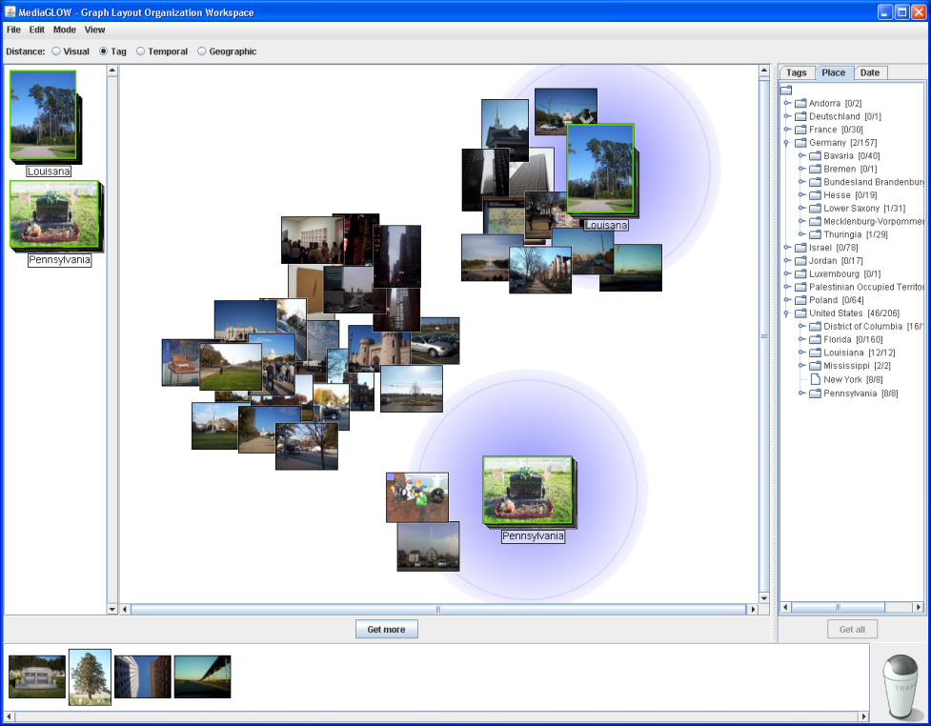
MediaGLOW: The Concept
Task and Opportunity
  Many tasks involving photo sharing or publication involve grouping a candidate photos into categories and selecting from among these groups.
  There are many different
  reasons to group photos:
  based on event, location,
  subject matter, visual
  characteristics, etc.
  There is the potential for
  systems to observe earlier
  user activity and expression
  to aid their later activity.

Slide 13
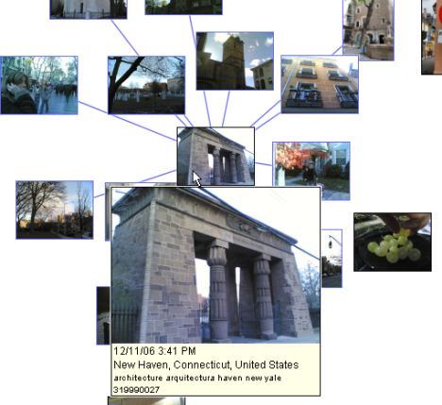
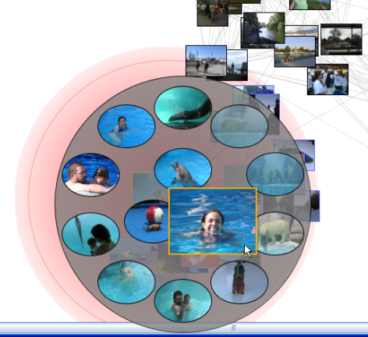
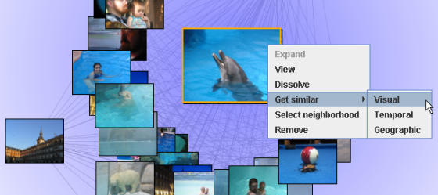
MediaGLOW: Interpreting User Action
Evolving Notion of Similarity via User Expression
  Photos presented in a graph-based workspace with “springs” between each pair of photos.
  Lengths of springs is initially based on a default distance metric based on their time, location, tags, or visual features.
  Users can pin photos in place and create piles of photos.
  Distance metric to piles change as new members are added, resulting in the dynamic layout of unpinned photos in the workspace.

Slide 14
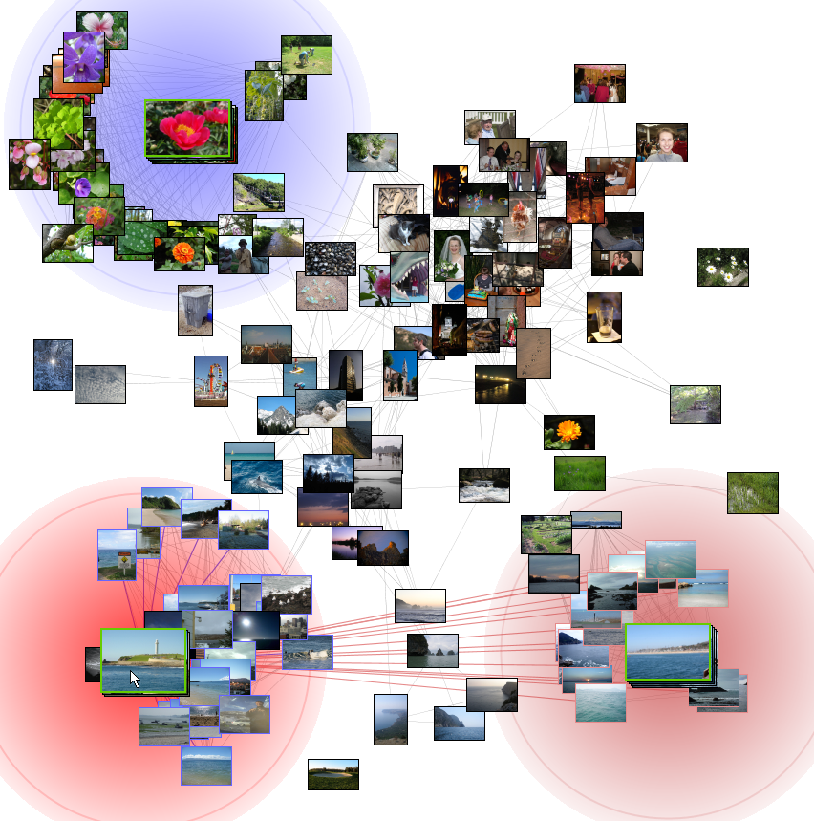
MediaGLOW: Multi-faceted Visualization of Photo Collections
System Expression through Neighborhoods
  Piles have neighborhood for photos that are similar to the pile based on the pile’s unique distance metric.
  Photos in a neighborhood are only connected to other photos in the neighborhood, enabling piles to be moved independent of each other.
  Lingering over a pile visualizes how similar other piles are to that pile, indicating system ambiguity in categories.

Slide 15
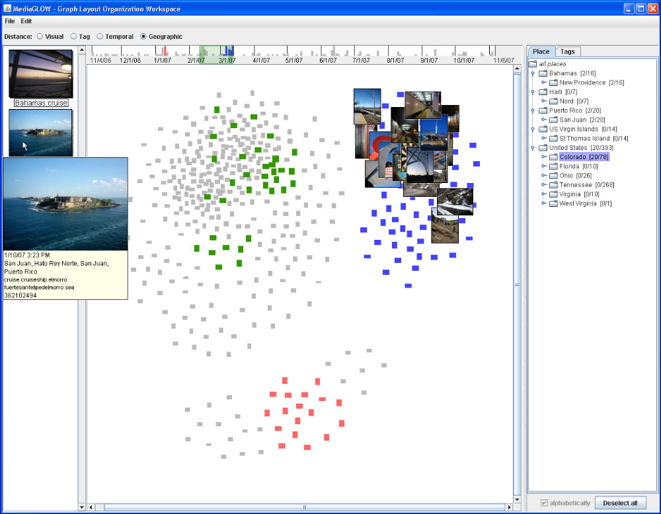
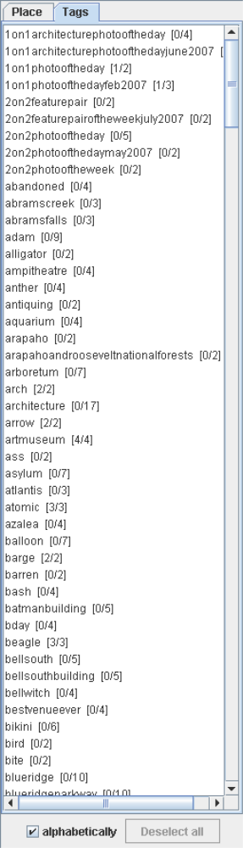
MediaGLOW 2.0

Slide 16
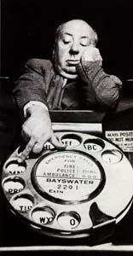
Interactive Video
Issue
  Vision: Seamlessly interact with characters
  in the show
  Reality: Difficult to author even simple
  interactive videos
Today, video is included within pages of content or by YouTube authors, but links are mostly just to related content

Slide 17
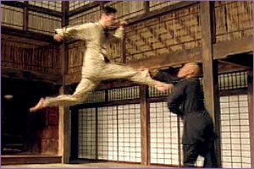

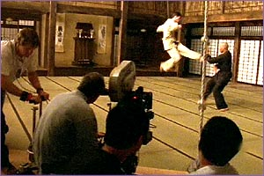
Hypervideo Use and Authoring
Hypervideo well-suited for training video
  Overview with links to more detail
  Viewers can choose video content
  based on their prior knowledge and
  current task
But general hypervideo is hard to author
  Limited the focus to hypervideos with
  a single active link at a time
Support for hypervideo authoring
  Use automatic video analysis,
  easy-to-use interface, and
  simple hypervideo format

Slide 18
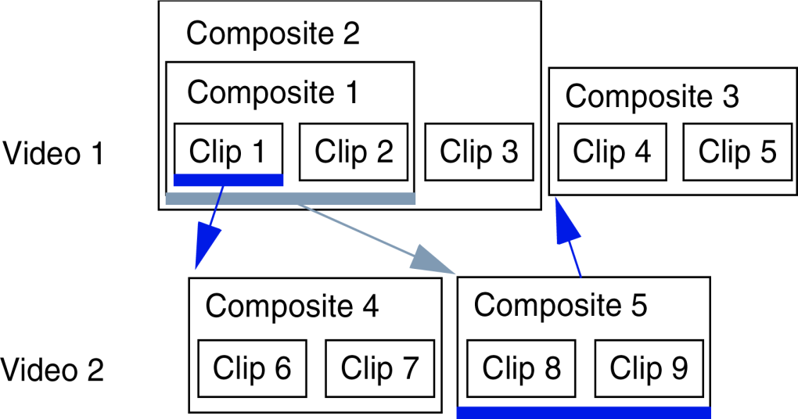
Hierarchical Video with Links
Video sequences are represented as a containment hierarchy of video elements
  Elements are video clips or composites grouping other video elements
  Elements are played in sequence
Each element can be link anchor or link destination
Anchor for innermost element is available while element is playing
After link destination
video is played,
play-back continues
at the link anchor

Slide 19
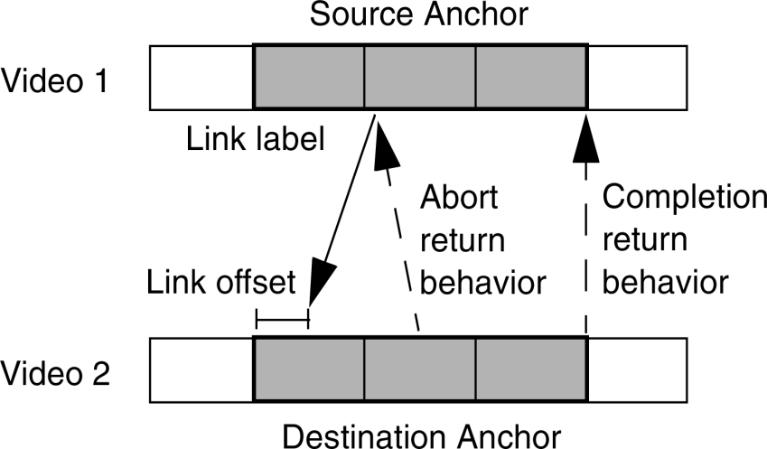
Detail-on-demand Links
Any video clip or composite can be link anchor or link destination
Optional link offsets into destination
Links have labels
Link return behaviors control the purpose of the link
  Play from where the viewer left the video
  Play from the end of the source anchor sequence
  Play from beginning of the
  source anchor sequence
  Stop playback
Different behaviors for
destination completion or
aborted playback

Slide 20
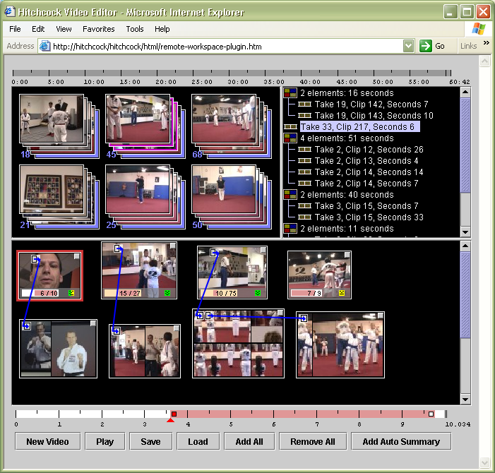
Hyper-Hitchcock Editor
Hyper-Hitchcock evolved from Hitchcock video editor
Video clips grouped in piles by similarity (e.g., recording time, etc.)
Workspace to arrange clips
  Resize keyframes to trim clips
  Clips could be ordered as
  horizontal or vertical lists
  Place links between clips
  Group clips into composites
Tree view to visualize
containment hierarchy of
composites

Slide 21
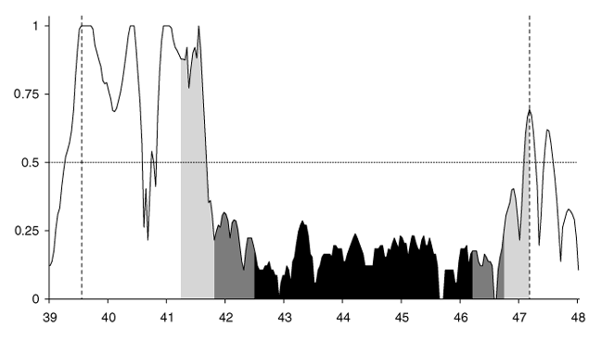
Determining Suitable Video Clips
Unsuitability score
  Single score for video features such as camera motion and brightness
  Estimate camera pan by shifting frames against each other
  Require minimum brightness
Determine clip boundaries
  Select clips that fall in “valleys” between unsuitability peaks
  Look for areas completely above unsuitability threshold
    Peak is clip boundary candidate
  Enforce the minimum length
  requirement
Trimming clips
  Select portion of clip with minimal
  area under the curve
  Expand the area for longer
  requested clips

Slide 22
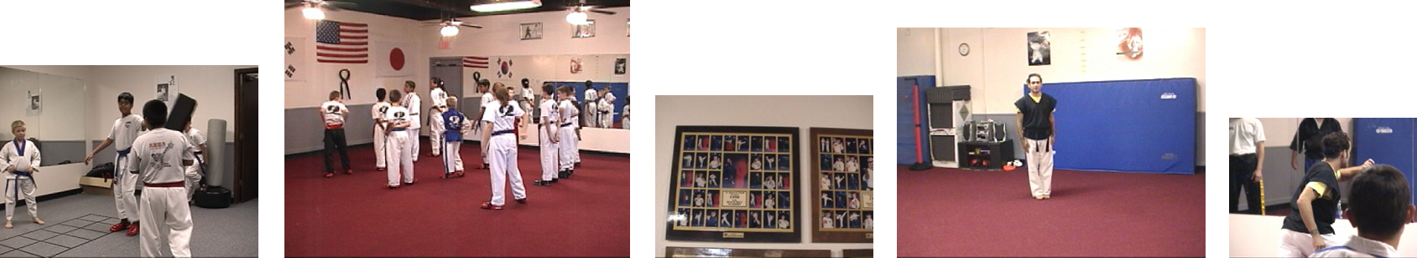
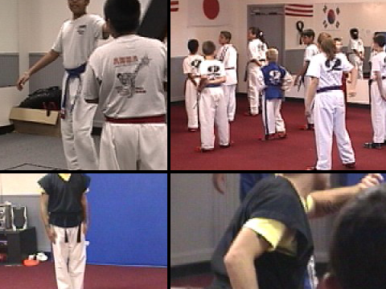
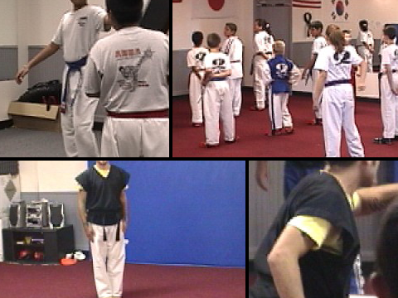
Visualizing Video Composites
Video clips to be grouped into a composite
(keyframe area proportional to clip length)
cross
(area error minimized)
sliding dividers
(area proportional to clip length)
Composite visualizations

Slide 23
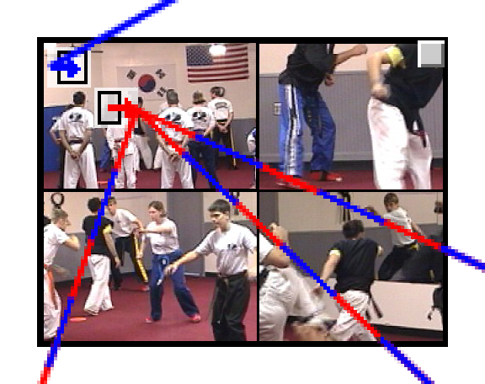
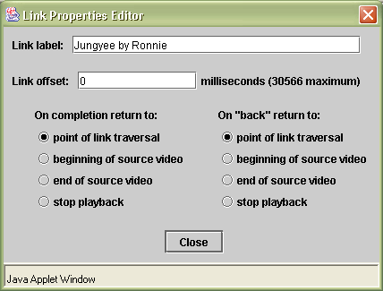
Attaching Links to Clips and Composites
Link anchors and destinations can be clips, composites, or elements inside composites
Color-coding and position indicates link attachment in workspace
Links in and out of composite
  Blue: attached to composite
  Red: attached to element
  Dashed: between composite and element

Slide 24
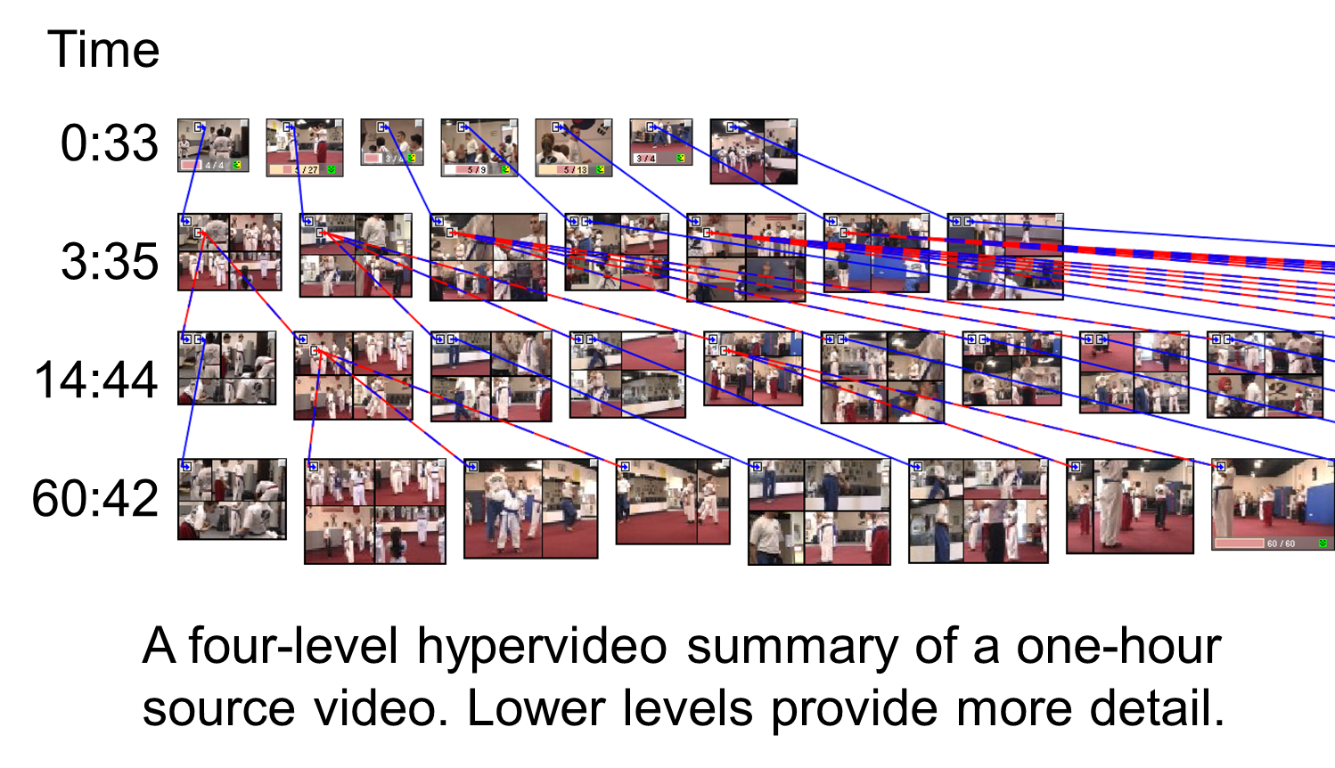
Generating Hypervideo Summaries
Locating content in video is time consuming
  Generating “good” video summaries is hard work
  What is good for one task is not good for another
Generate hypervideo summaries that allow users to determine the level of detail viewed

Slide 25
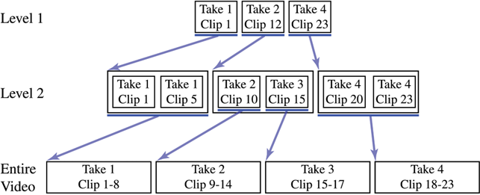
Process for Generating Summaries
Determine number of summary levels
  Based on length of source video
Select clips to include in each summary level
  Clips found by subdividing takes by camera motion
  Select clips via clip distribution, take distribution, or best-first algorithms
Add links between summary levels
  Group clips by takes and link
  clips from the same take
  Links between clips from the
  same take using simple
  take-to-take or take-to-take with offsets algorithms

Slide 26
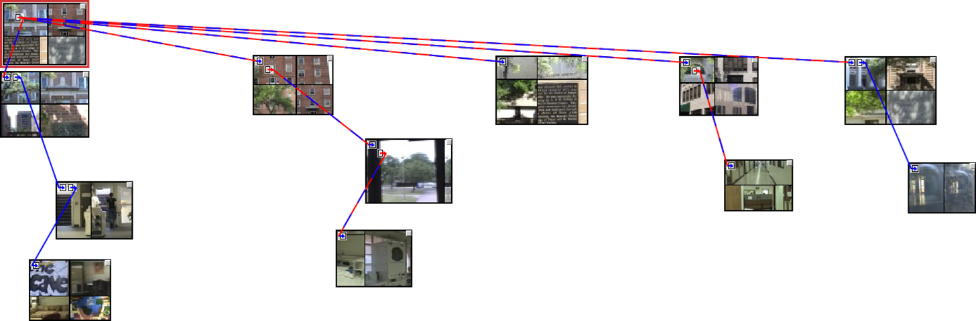
Experience with Authoring
Nine hypervideos each authored by 1-2 students in a Computers and New Media class
  Recorded up to 1 hour of digital video
  About 1 week for authoring activity
Example: “In danger” buildings at TAMU
  Visits to buildings identified for demolition on TAMU campus.
  Links are to seeing interior and details

Slide 27
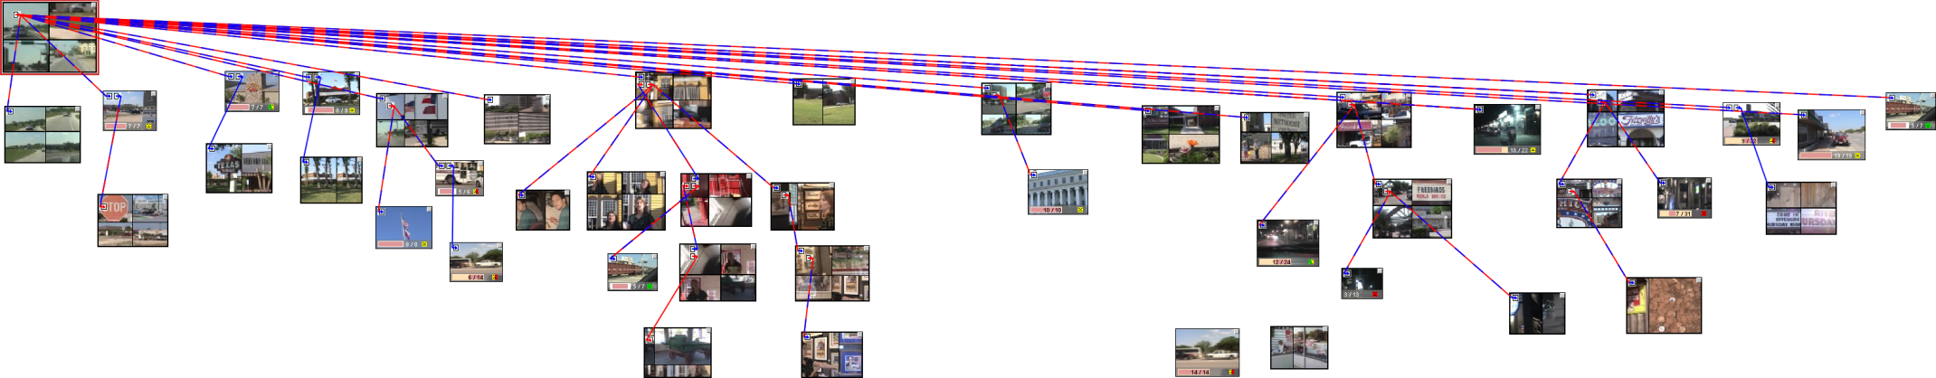
Riding Down University Drive
Most directly maps to geographic structure
Links are choices to stop in at sites along road

Slide 28
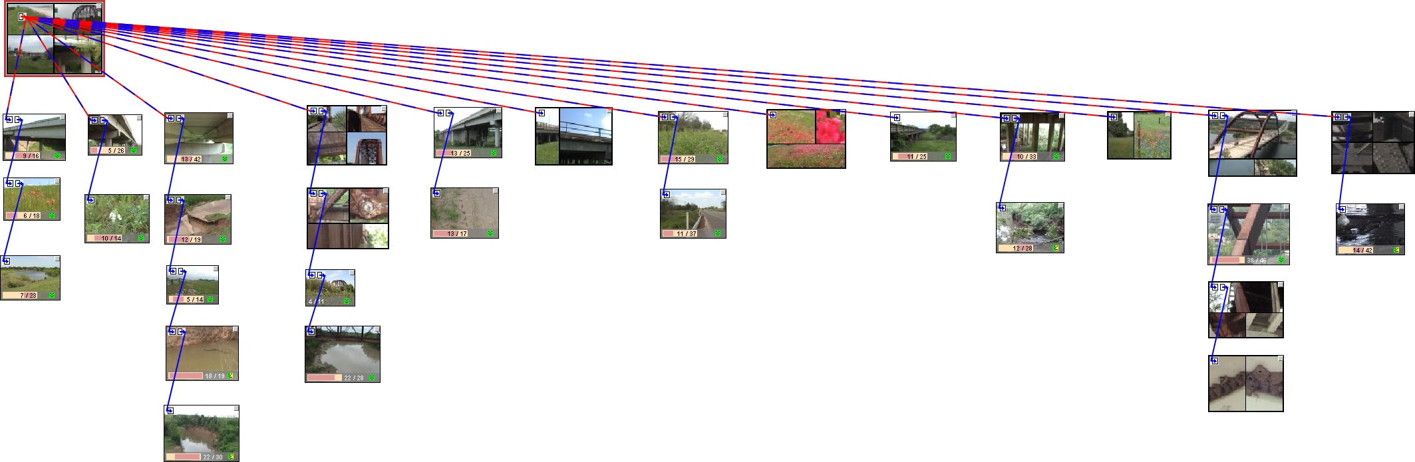
Perspectives on Bridges
Shows bridges between College Station and Austin.
Presents different perspectives (roadway, construction, wildlife) in order
Links are to seeing different perspective

Slide 29
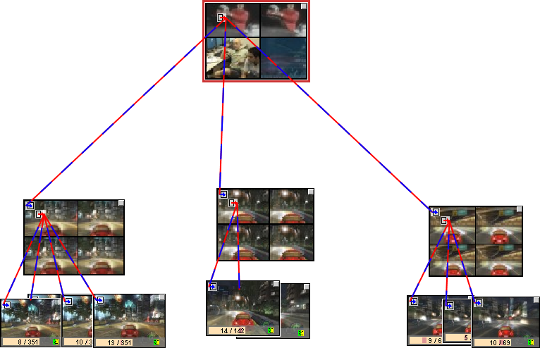
Game Walkthrough
Shows what happens while playing game
Links represent choice points in game

Slide 30
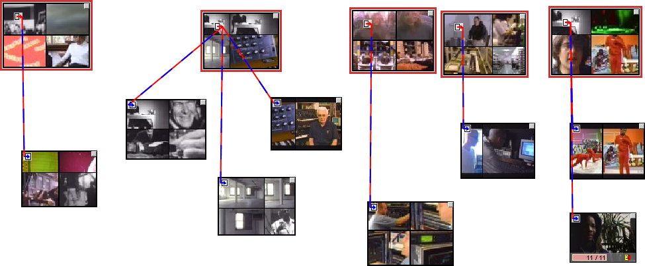
Music Hypervideo
public-domain video, remixed audio

Slide 31
Observation:
The Multiple Roles of Links
Detail Links
Prerequisite Links
Related Information Links
Alternate View Links
Action Choice Links

Slide 32
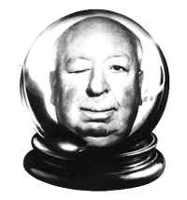
Hyper-Hitchcock
Detail-on-demand video well-suited for
training and home video
  Enables wide range of authors due to emphasis on
  ease of learning and use over richness of interaction
Hypervideo summaries
  Remove need for single context-free video summary
  Multiple clip selection and link generation algorithms
  Act as starting point for human-authored summary
Hyper-Hitchcock used to author documentary, how-to, music, and home hypervideos
Links in hypervideos used for a range of communication purposes
  To show more details, to present prerequisite knowledge, tp give alternate views, to represent action choices, and to present more generically related information

Slide 33

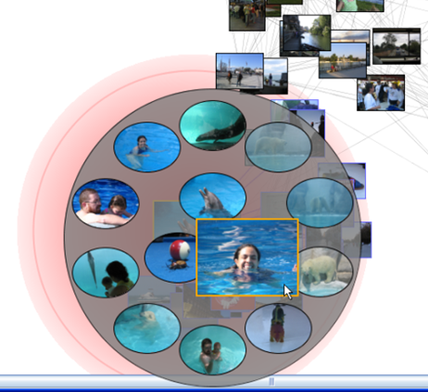
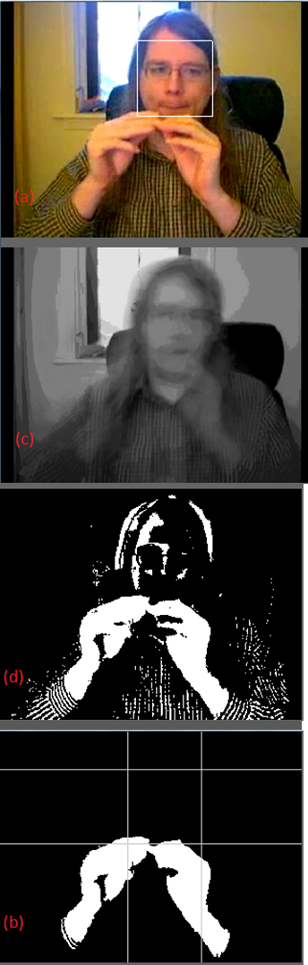
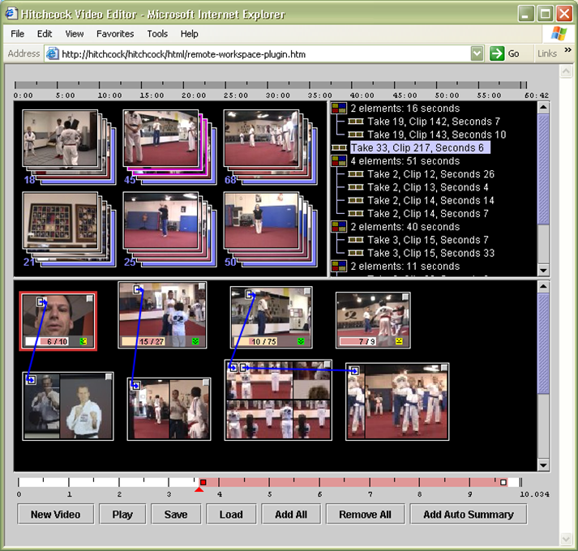
Video:
So Far
Image and video processing
  Color-oriented and skintone representations
  Region and temporal segmentation
  Edge and face detection
  Foreground-background separation
Image and video applications
  MediaGlow – image selection
  HyperHitchcock – interactive video

Slide 34
Recorded (Unproduced) Video
Lots of video is recorded
  Way too much for human attention
What processing and interfaces make this video more valuable?
Summarization and indexing are crucial
Recorded video applications
  Surveillance video
  Videoconferencing
  Lecture video

Slide 35
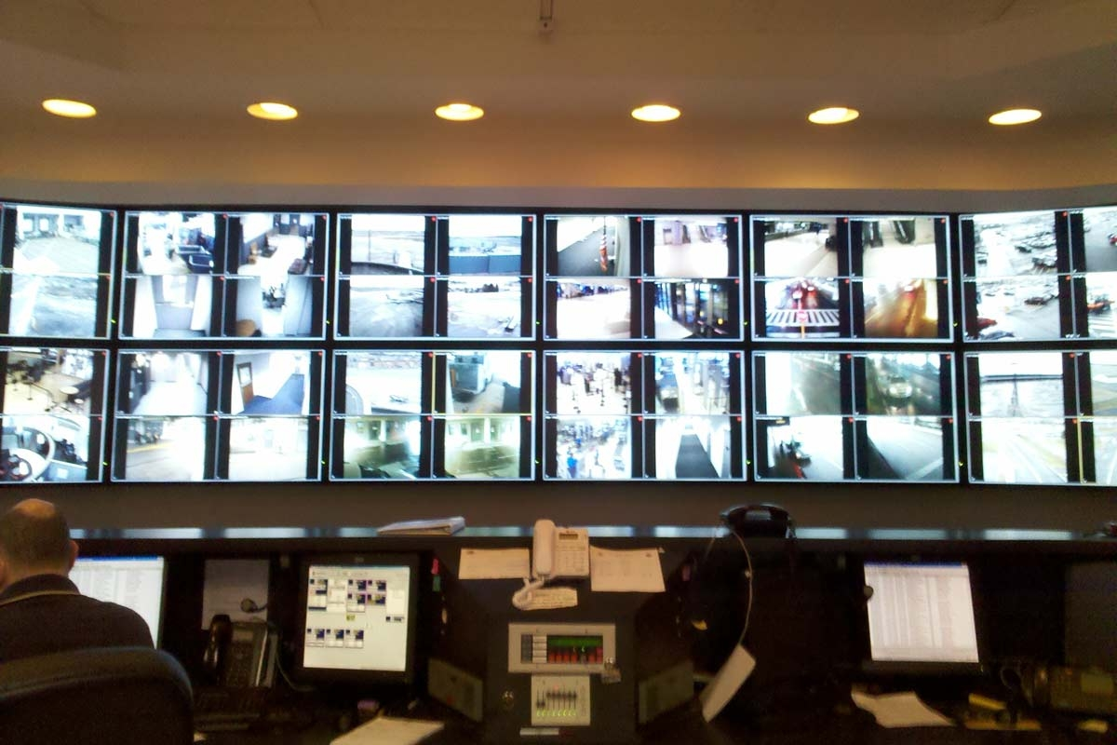
Surveillance Video
Rochester Airport

Slide 36
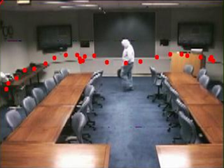



DOTS: Supporting Use of Surveillance Video
The problem
  Number and size of surveillance systems are increasing but human attention is limiting factor
Approach
  Provide summaries
  of action
  Build interfaces knowing limits of automation

Slide 37

DOTS: The Main Interface
Components
  Rotating camera bank with activity graphs
  Mixed-initiative main viewer
  Map with tracking data
  Timeline with automatic events

Slide 38


DOTS: Tracking Layout
Difficulty in tracking is that camera views are often similar
Tracking layout places cameras around the main viewer to aid tracking
Study showed significant improvement in tracking success over traditional viewer
In either layout, map can be used to find activity near a location and time.

Slide 39

Videoconferencing
Lots of meetings take place via video
Recordings of these
meetings are
undervalued because
of the difficulty of
locating the important
points in the video
Can we provide access in ways that do not require linear search by seekers or lots of human effort during creation?

Slide 40

Meeting Structures
What inherent structures exist in meetings?
  Turn-taking when speaking
  Topics/agenda items
  Others?
What about in sequences of meetings?
  Same/different participants
  Continuation of discussions

Slide 41

HyperMeeting

Slide 42

Web-based Architecture

Slide 43

Playback Plans
When accessing recorded meetings, people have different information needs
What types of patterns through the recorded meetings make sense?

Slide 44

Visualizing Playback Plans
Single, merged, and stacked views

Slide 45

User Control of Playback Plans

Slide 46
Lecture Video
Characteristics
  Generally has one primary speaker at a time
    As opposed to meetings where there is rapid turn-taking
  Includes activity/slides that are being discussed
Applications
  Manga – an interactive visual summary
  TalkMiner – topic-based indexing into lectures

Slide 47

Manga: Interactive Visual Summary
Providing a summary
based on importance
or relevance
Modeled after comic book layout
How it works
  Segmentation
    Identifying transitions
  Weighting based on
    Uniqueness
    Quality
Dynamically recreated to fill browser as user resizes

Slide 48

TalkMiner UI & Uses
Designed for students, etc.
  Locating particular portions of a lecture previously seen
  Locating
  alternative
  explanation
  Locating
  prerequisite/
  subsequent
  knowledge

Slide 49

TalkMiner: Recorded Lectures
Recorded lectures from universities, etc.
Searching through content in TalkMiner
Index based on
  Slide transitions
  Content in
  slides

Slide 50

Indexing Based on Textual Content
How to get slide content for optical character recognition (OCR)?
  Depends on the type of recording

Slide 51
Video Topics
Recorded Video Applications
  DOTS – surveillance video
  HyperMeeting –meeting video
  TalkMiner – lecture video
Previously discussed
  Image and video processing
  Applications
    MediaGlow – image selection
    HyperHitchcock – interactive video

