Slide 1
Retirement? Already?

Slide 2
Disclaimer
An attempt to provide factual information
Material is current to the best of my knowledge
Everyone’s situation is different… you should make sure the information is correct and applies to you
Information provided is not a recommendation to invest in any particular product but simply for informational purposes
Examples are not guarantees of returns

Slide 3
Retirement Accounts

Slide 4
Defined Benefit Plans
Also called “pensions”
Typically some percentage of salary is kept by employer from paycheck
Conditions for retirement eligible
At retirement, typically receive X% of salary averaged over last Y years for the rest of the employee’s life.

Slide 5
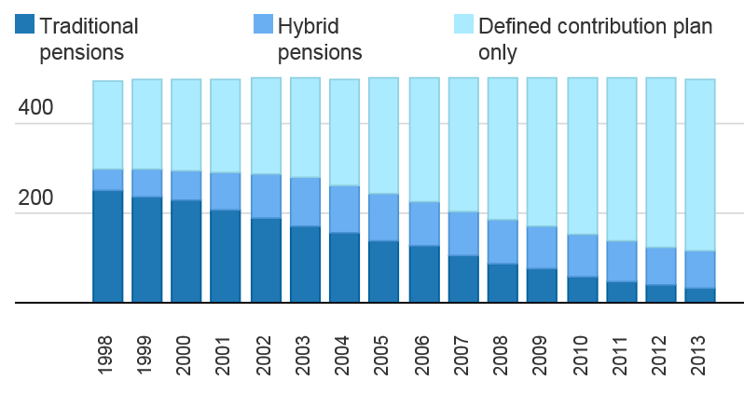
Defined Benefit Plans
Retirement Plans Offered By Fortune 500 Companies
Source: https://www.washingtonpost.com/news/get-there/wp/2014/09/05/nearly-a-quarter-of-fortune-500-companies-still-offer-pensions-to-new-hires/

Slide 6
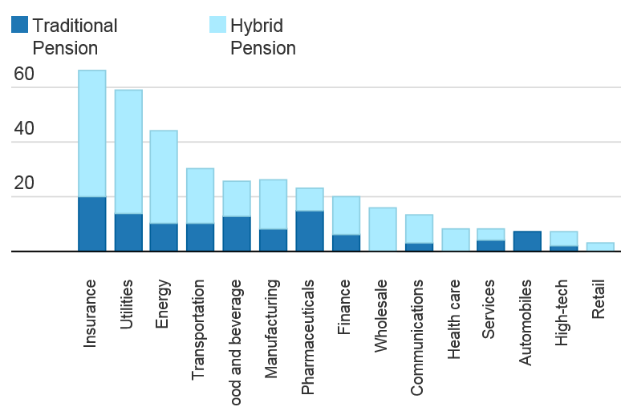
Defined Benefit Plans
Percent of Fortune 500 Companies offering Pensions to New Hires By Industry
F
Source: https://www.washingtonpost.com/news/get-there/wp/2014/09/05/nearly-a-quarter-of-fortune-500-companies-still-offer-pensions-to-new-hires/

Slide 7
Federal Taxes… Yuck…
Rate | Single Filers | Married Joint Filers | Head of Household
10% | $0 to $9,275 | $0 to $18,550 | $0 to $13,250
15% | $9,275 to $37,650 | $18,550 to $75,300 | $13,250 to $50,400
25% | $37,650 to $91,150 | $75,300 to $151,900 | $50,400 to $130,150
28% | $91,150 to $190,150 | $151,900 to $231,450 | $130,150 to $210,800
33% | $190,150 to $413,350 | $231,450 to $413,350 | $210,800 to $413,350
35% | $413,350 to $415,050 | $413,350 to $466,950 | $413,350 to $441,000
39.6% | $415,050+ | $466,950+ | $441,000+

Slide 8
Federal Taxes… Yuck…
Salary
$100,000

Slide 9
Federal Taxes… Yuck…
Salary
$100,000
$6,300 + $4,050=$10,350*0%
$0
Taxes:
$0

Slide 10
Federal Taxes… Yuck…
Salary
$100,000
$9,275*10%
$928
$6,300 + $4,050=$10,350*0%
$0
Taxes:
$928

Slide 11
Federal Taxes… Yuck…
Salary
$100,000
$28,375*15%
$4,256
$9,275*10%
$928
$6,300 + $4,050=$10,350*0%
$0
Taxes:
$5,184

Slide 12
Federal Taxes… Yuck…
Salary
$48,000*25%
$12,000
$100,000
$28,375*15%
$4,256
$9,275*10%
$928
$6,300 + $4,050=$10,350*0%
$0
Taxes:
$17,184

Slide 13
Federal Taxes… Yuck…
Derivative of taxes is called “Marginal Tax Rate”
Salary
$48,000*25%
$12,000
$100,000
$28,375*15%
$4,256
$9,275*10%
$928
$6,300 + $4,050=$10,350*0%
$0
Taxes:
$17,184

Slide 14
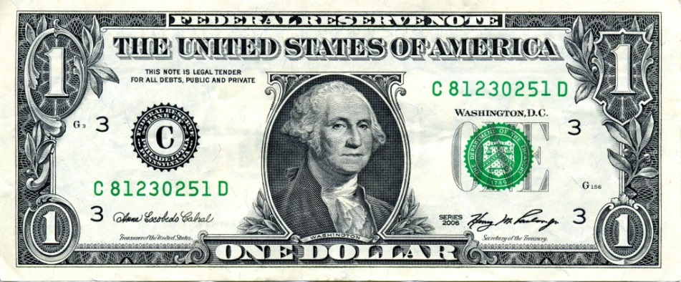
Federal Taxes… Yuck…
Derivative of taxes is called “Marginal Tax Rate”
Salary
$48,000*25%
$100,000
$28,375*15%
$9,275*10%
$6,300 + $4,050=$10,350*0%

Slide 15
Federal Taxes… Yuck…
Derivative of taxes is called “Marginal Tax Rate”
Salary
$48,000*25%
$100,000
$28,375*15%
$0.25
$9,275*10%
$6,300 + $4,050=$10,350*0%

Slide 16
Federal Taxes… Yuck…
Derivative of taxes is called “Marginal Tax Rate”
Salary
$48,000*25%
$100,000
$28,375*15%
$0.75
$9,275*10%
$6,300 + $4,050=$10,350*0%

Slide 17
Defined Contribution Plans
Employee, and sometimes employer, make contributions to a retirement account
Employee manages investments and takes on risk
Returns not guaranteed, but employer has no responsibilities for employee retirement
Typically penalties for accessing money before retirement age 59.5

Slide 18
Tax Deferred Retirement Accounts
Contributions are tax free
Earnings while in the account are tax free
Money taken out of the account is taxed at ordinary income rates
Must begin taking distributions at 70.5 (referred to as required minimum distributions, RMDs)

Slide 19
Taxable Account
$0.25

Slide 20
Taxable Account

Slide 21

Taxable Account

Slide 22

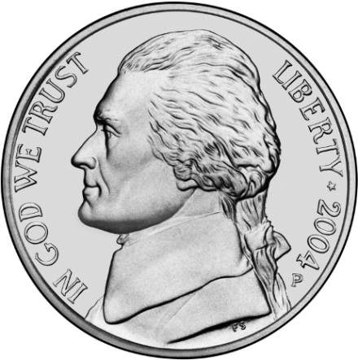
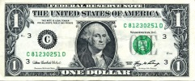
Taxable Account

Slide 23

Taxable Account

Slide 24

Taxable Account

Slide 25

Taxable Account

Slide 26

Taxable Account

Slide 27
Taxable Account

Slide 28
Taxable Account

Slide 29
Tax Deferred Retirement Accounts

Slide 30

Tax Deferred Retirement Accounts
401K

Slide 31
Tax Deferred Retirement Accounts
401K

Slide 32
Tax Deferred Retirement Accounts
401K

Slide 33
Tax Deferred Retirement Accounts
401K

Slide 34
Tax Deferred Retirement Accounts
401K

Slide 35
Tax Deferred Retirement Accounts
401K

Slide 36
Tax Deferred Retirement Accounts
401K

Slide 37

Tax Deferred Retirement Accounts
401K
Withdrawals at retirement taxed at regular income tax rates

Slide 38
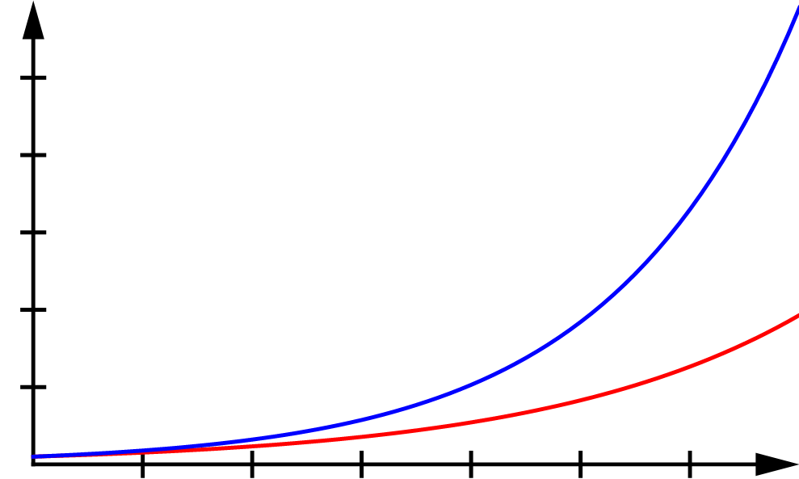
The Value of Tax-Free Growth
Growth of $10K
$590,759
$500K
$400K
$300K
Tax-Free Growth
$200K
$193,077
$100K
Taxable Growth
Years
10
20
30
40
50
60
Assumptions: Bonds with 6% dividends, 28% tax for non-qualified dividends, values are shown after tax

Slide 39
The Value of Income Smoothing
Taxes While Working
Taxes In Retirement
$48,000*25%
$28,375*15%
$9,275*10%
$10,350*0%
$0*0%

Slide 40
The Value of Income Smoothing
$8,000 Contribution to Tax Deferred Account
Taxes While Working
Taxes In Retirement
$40,000*25%
$28,375*15%
$9,275*10%
$10,350*0%
$8,000*0%

Slide 41
Post-Tax Retirement Plans
Often called “Roth” accounts
Contributions are after tax (ordinary income tax rates)
Earnings while in the account are tax free
No tax due upon withdrawal (you already paid it)
No required minimum distributions

Slide 42
Types of Accounts
401K
  Common in industry
  Often some form of company match for first X%
  $18,000/year voluntary contribution limit
403B
  Common for non-profits
  $18,000/year voluntary contribution limit
457
  Deferred compensation plan
  $18,000/year voluntary contribution limit
  Non-governmental plans are subject to employer’s creditors
IRAs
  Not tied to any employer
  $5,500/year contribution limit
  Income limitations apply

Slide 43
Closer Look at the 401K
Microsoft
  Match $0.50 for every $1.00
401K
Source: https://careers.microsoft.com/benefits

Slide 44
Closer Look at the 401K
Microsoft
  Match $0.50 for every $1.00
$18,000
401K
Source: https://careers.microsoft.com/benefits

Slide 45
Closer Look at the 401K
Microsoft
  Match $0.50 for every $1.00
$18,000
401K
$9,000
Source: https://careers.microsoft.com/benefits

Slide 46
Closer Look at the 401K
Microsoft
  Match $0.50 for every $1.00
$18,000
401K
“FREE” MONEY
$9,000
Source: https://careers.microsoft.com/benefits

Slide 47
Investments

Slide 48
Stocks
Represent a portion of ownership of a company
Warrant on future earnings of the company
Often come with voting rights
Profit=(selling price – bought price) * (1 – tax) + dividends received * (1 – tax)
Long-term stock gains and qualified dividends are taxed at a lower rate (0%-20%, usually 15%)

Slide 49
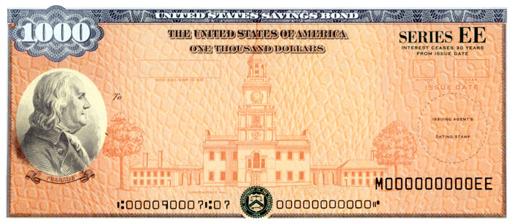
Bonds
Represent ownership of debt
Could be from corporation or government entity
In the event of bankruptcy, bond holders have priority claim on assets over stock holders
Bank CDs/savings accounts are a form of bond
Profit is mostly determined by yield (think of it like interest)

Slide 50
Mutual Funds
Represent a collection of assets (stocks and bonds)
Sometimes run by a fund manager (e.g. Bob’s Awesome Total Return Fund) – active
Sometimes run by a computer to match a particular index (e.g. S&P 500) – passive
Each charge a fee

Slide 51
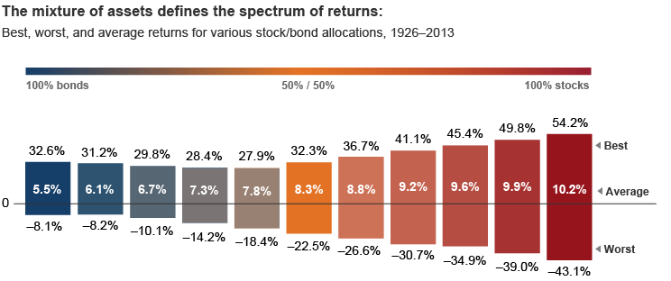
Stocks vs Bonds
Source: https://personal.vanguard.com/us/insights/investingtruths/investing-truth-about-risk

Slide 52
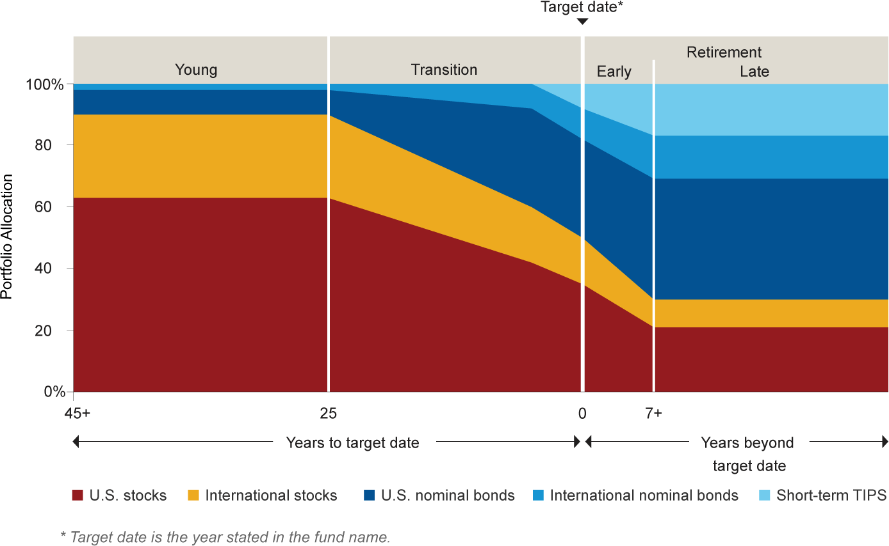
Target Date Funds
Designed to automatically change asset allocation from aggressive to conservative over the course of your career/retirement

Slide 53
Costs of Investing
Front-end load
  Charge to buy the fund
Back-end load
  Charge to sell the fund
12b-1 fee
  Fee associated with marketing a fund
Management fees
  Fee paid to manager that controls buying/selling of assets within fund
….

Slide 54
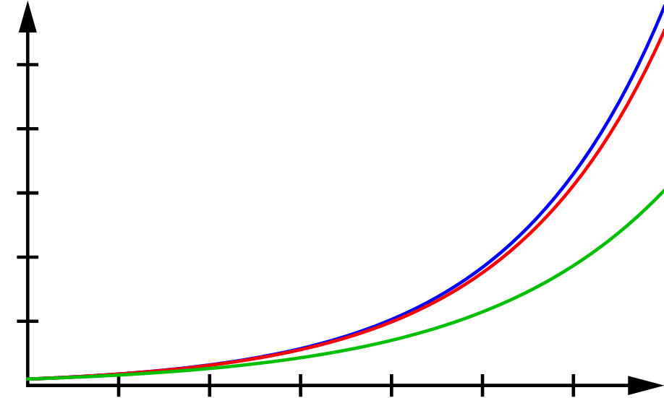
The Effect of Fees on Returns
$590,759
$552,990
$500K
$400K
0.1% Fee
$300K
No Fees
$304,264
$200K
1% Fee
$100K
Years
10
20
30
40
50
60
Assumptions: 6% growth

Slide 55
Stock Options
An option to buy company stock at a discounted rate or a fixed price
Often will “vest” over time (ex. 1/3 each year)
Example: Start at mega-corp and given 1,000 shares of stock options with a strike price of $50 (current value of company shares).
In 3 years, stock price is $60 -> options worth $10,000.
In 5 years, stock price is $40 -> options worth $0.

Slide 56
Stock Options
Advantages
  Aligns financial interest of employee with company
  Employee shares in profit of company in addition to salary
Potential disadvantage: Concentration of risk
  If employer does poorly, you may lose your job AND any money in company stock or options

Slide 57
Annuities and Social Security
An annuity is a contract with an insurance company to pay a yearly amount for some period of time (possibly until death) for a fixed sum.
Lots of different types and various complexities/expenses
Pensions and Social Security are forms of annuities

Slide 58
Other Source of Information
www.bogleheads.org/wiki/
www.etf.com/docs/IfYouCan.pdf
www.irs.gov/retirement-plans/

Slide 60
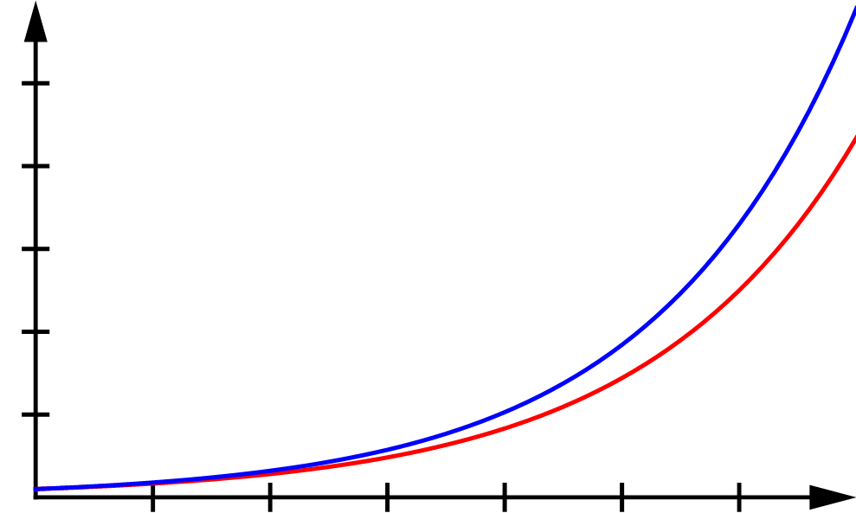
The Value of Tax-Free Growth
Growth of $10K
$590,759
$500K
$484,450
$400K
$300K
Tax-Free Growth
$200K
Taxable Growth
Stocks
$100K
Years
10
20
30
40
50
60
Assumptions: 4% growth + 2% reinvested dividends, 15% tax on long-term capital gains on all growth, values are shown after tax

Slide 61
The Value of Tax-Free Growth
Growth of $10K
$590,759
$500K
$400K
$300K
Tax-Free Growth
$200K
$193,077
$100K
Taxable Growth
Bonds
Years
10
20
30
40
50
60
Assumptions: 6% dividends, 28% tax for non-qualified dividends, values are shown after tax

