Slide 1
Legal and Ethical Issues in Computer Science,
Information Technology, and Software Engineering

Slide 2
As computer scientists and professional software engineers, you will inevitably be faced with making difficult decisions
  re-use of source code
  re-use of copyrighted material (images...)
  enforcing strength of passwords
  knowledge of a flaw or bug in software about to be released
  design of a software feature that is potentially dangerous
  discovery of a security flaw that could be used to extract users' personal info
  should a database be encrypted? what level of security is appropriate?

Slide 3
Sometimes there are clear-cut laws that tell us what is legal
  computer scientists must understand laws related to software engineering
Other situations might fall into gray areas (with pros and cons) and you have to make a choice
Thus we need to also understand what is ethical

Slide 4
Ethical Frameworks
(these will be covered in more detail
in ENGR 482 - Engineering Ethics)
Moral Principles as a framework
  the reason we make a choice matters (see philosophers like Kant...)
  most people have an intrinsic sense of what is the "right" thing to do
  is breaking a law ever ethical?
    even if you won't get caught? even if you can justify it? even if there is a benefit to others?
Utilitarian framework
  cost analysis based on risks, costs, and probabilities of outcomes (popular with engineers)
  includes consideration of legal violations (through liability, cost of fines, risk of jail)
  historically, many horrible decisions have been justified based on cost analysis
  example: illegally producing a generic version of a drug to treat diseases in a third-world country, if a pharmaceutical company that owns the patent charges an exhorbitant amount for it

Slide 5
Ethical Frameworks
Framework of Individual Rights (or Respect for Persons)
  can't put a price on life
  people are entitled to certain rights: right to dignity, right to freedom, property rights
  one's actions should not trample the rights of others
Golden Rule
  treat others as you want to be treated
  example: documenting known bugs or important assumptions in your code
  example: downloading .mp3's for free on BitTorrent because you don't want to pay 99¢ for it on iTunes

Slide 6
Topics we are going to cover in these lectures:
Intellectual Property
Software Quality
Privacy and Security
We are going to address both legal and ethical aspects of these topics.

Slide 7
Intellectual Property

Slide 8
What is Intellectual Property?
Intellectual property “is imagination made real. It is the ownership of dream, an idea, an improvement, an emotion that we can touch, see, hear, and feel. It is an asset just like your home, your car, or your bank account.“
USPTO
Notes:
OWNERSHIP: As such, it deserves PROTECTION.

Slide 9
Intellectual Property
types: patents, copyrights, trademarks, trade secrets
patents typically focuses on methods to do or make something (utility patents), or look-and-feel (design patents)
copyrights focus on expressions or implementations (books, songs, source code)

Slide 10
Reissue Patent
examples (some questionable):
  everything inside your cell phone...
  Windows look-and-feel (challenged by Apple in 1980’s)
  spreadsheet (Visicalc, Lotus 1-2-3, Excel)
  iPad design
  scroll-bounce
  Amazon One-click check-out
  point-of-sale device

Slide 11
Intellectual Property
IP is important to engineers and their companies
provides protection of investment (by charging license fees)
patent/copyright infringement can be costly
  recent example: Apple infringed on use of power efficiency method in A7/A8 processors in iPhone 5 and 6 models developed at University of Wisconsin, who was awarded $862M in damages
  accidental - submarine patents, patent trolls
  ignorance is no excuse
IP is an "asset"
patents have value and can be "traded" between companies
  IBM, Qualcomm, Motorola, Apple...

Slide 12
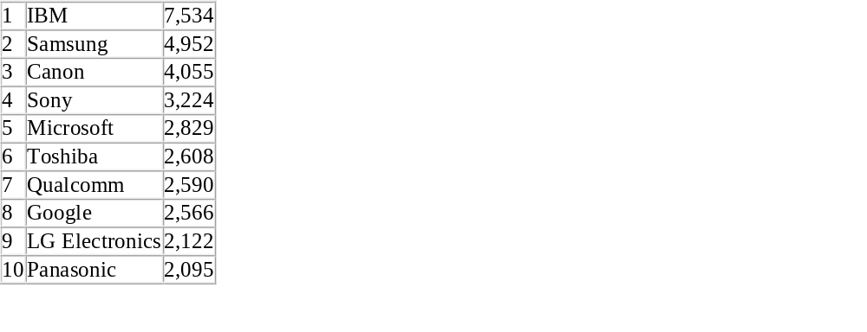
IBM Breaks U.S. Patent Record in 2014
IBM inventors earned an average of more than 20 patents per day in 2014, propelling the company to become the first to surpass more than 7,000 patents in a single year.
“IBM's continued investment in research and development is key to driving the transformation of our company, as we look to capture the emerging opportunities represented by cloud, big data and analytics, security, social and mobile," said Ginni Rometty, IBM's chairman, president and CEO. "IBM's patent leadership over more than two decades demonstrates our enduring commitment to the kind of fundamental R&D that can solve the most daunting challenges facing our clients and the world.”
IBM inventors also received more than 500 patents for inventions that will usher in the era of cognitive systems, including new Watson related cognitive technologies.
During IBM’s 22 years atop the patent list (1993-2014), the company’s inventors have received more than 81,500 U.S. patents.
The Top Ten list of 2014 U.S. patent recipients includes:
Examples of US Patents for IBM in 2014:
#8,661,132: Enabling service virtualization in a cloud
#8,874,638: Interactive analytics processing
#8,903,360: Mobile device validation
#8,706,648: Assessing social risk due to exposure from linked contacts
#8,869,274: Identifying whether an application is malicious
#8,639,497: Natural language processing (‘NLP’)
Notes:
I wanted to show some examples. IBM is the king of patents, for decades, going back to disk drive technologies, supercomputing architectures, databases, backplanes, interconnects, up to Watson currently. Employees are incentivized by getting bonuses for patents they obtain.
Wouldn't it be exciting to work on some of these projects and be applying for patents in mobile/social computing, big data, etc.?

Slide 13
Main types of patents
  Utility patents - Issued for the invention of a new and useful process, machine, manufacture, or composition of matter, or a new and useful improvement thereof;
  Design patents - Issued for a new, original, and ornamental design embodied in or applied to an article of manufacture.
  Plant patents may be granted to anyone who invents or discovers and asexually reproduces any distinct and new variety of plant.
  Reissue Patents - Issued to correct an error in an already issued
http://www.uspto.gov/web/offices/ac/ido/oeip/taf/patdesc.htm

Slide 14
Smartphone patent wars
2012 Apple brings patent infringement suit against Samsung
Samsung counter-sues in Korea
Apple sued, claimed infringement of 3 utility, 4 design patents
Samsung claimed Apple infringed 5 patents
  Scroll “bounce back”
  On screen navigation
  Tap to zoom
  “home button, rounded corners and tapered edges”

Slide 15
2012 Verdict
Jury (in California District Court) found Samsung infringed Apple patents, Apple awarded $1.049B
  Samsung not found to infringe on “rounded rectangle”
  patent on “scroll bounce” temporarily invalidated
  subsequently counter-sued, appealed, award disputed and revised...

Slide 16
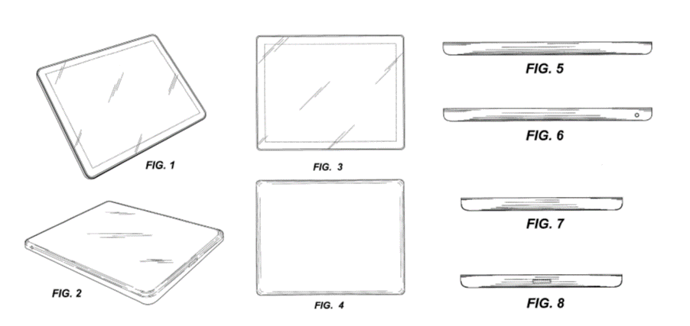
Apple design patent 504,889 – “rounded rectangle”
claim: “the ornamental design for an electronic device”
iPad patent

Slide 17
Patents
Originally to protect physical artifacts and processes
  Ideas not obvious to one “skilled in the art”
  Gives owner exclusive rights for a certain amount of time (20 years in US)
To get a patent, one must show it is:
  novel (including novel improvements)
  useful
  non-obvious (to someone "skilled in the art")
  first to file* (as opposed to: first to think of it and write it down)
engineers should keep a dated record of ideas and designs
patent office may reject claims if the claimed invention was patented, described in a publication, in public use, on sale, or otherwise available to the public before the effective filing date of the claimed invention
* this is a recent change in the US (America Invents Act, 2013)

Slide 18
Apple iPhone smoke detector patent
http://patft.uspto.gov/netacgi/nph-Parser?Sect2=PTO1&Sect2=HITOFF&p=1&u=/netahtml/PTO/search-bool.html&r=1&f=G&l=50&d=PALL&RefSrch=yes&Query=PN/9123221

Slide 19
Why do we have Patents?
(hint: not "to make money")

Slide 20
Why do we have Patents?
Rationale: grant a time-limited monopoly to incentivize creativity
  to allow companies to re-coup investment costs
  e.g. ~$1B to create a new drugs like Celebrex, Viagra, Prilosec...
It is actually in the US Constitution:
  The Congress shall have Power To...promote the Progress of Science and useful Arts, by securing for limited Times to Authors and Inventors the exclusive Right to their respective Writings and Discoveries.... (Article I, Section 8, Clause 8)
There is a "teaching" component.
  Patents are required to be explained in sufficient detail that one skilled in the art can understand. (reveal claims and methods)
Society benefits because inventors encouraged to reveal new ideas
  Samuel Morse got original patent for telegraph in 1837, which stimulated thousands of subsequent improvement patents.

Slide 21
patents cannot be used to prevent somebody from doing something, just set a license fee
Standards-essential patents (like 802.11b or 3G/CDMA)
FRAND - fair, reasonable, and non-discriminatory terms

Slide 22
Protection Lifetimes for Patents
  Give rights to inventions for up to 20 years for utility patents
  14 years for design patents
  must be maintained by paying a maintenance fee to USPTO every 3 years
  a patent must be defended; if you don't seek to enforce it, you could lose the option to do so
There is no international patent law
  patents must be filed separately in each country
  However, here is a treaty relating to patents adhered to by 176 countries that provides that each country guarantees to the citizens of the other countries the same rights in patent and trademark matters that it gives to its own citizens.
Notes:
TRADE SECRETS: e.g. formula for Coca Cola
There is really no protection. Have to prove theft of trade secret in order to prosecute.
PATENT: Infringement is sufficient for “prosecution”. Disadvantage: Have to PUBLISH the invention in order to receive protection.
UTILITY PATENT: processes, machines, articles of manufacture, composition of matter: fiber optics, computer hardware, medications.
DESIGN PATENT: new, original, ornamental designs for articles of manufacture: look of athletic shoe, bicycle helmet, Star Wars character
PLANT PATENT: invented or discovered ASEXUALLY reproduced plant varieties: Silver Queen corn, Better Boy tomatoes
THERE IS NO GENERALIZED LEGAL FRAMEWORK FOR ALL THREE (PATENT/TRADMARKS/COPYRIGHT LAW)
COPYRIGHT LAW was designed to promote authorship and art, and covers the details of expression of a work.
PATENT LAW was intended to promote the publication of useful ideas, at the price of giving the one who publishes an idea a temporary monopoly over it—a price that may be worth paying in some fields and not in others.
TRADEMARK LAW, by contrast, was not intended to promote any particular way of acting, but simply to enable buyers to know what they are buying.
Why a separate limit on corporate copyrights? Because corporations do not have lifetimes. Time recently extended due to Mickey Mouse about to go off copyright. Is it fair for someone else to be able to copy Mickey Mouse? My grandfather was a business partner of Walt Disney, producing Donald Duck orange juice, grapefruit, etc.

Slide 23
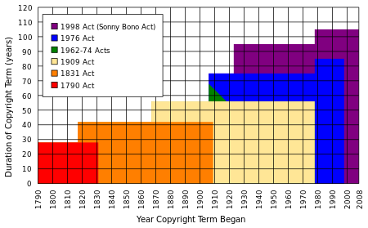
Copyrights
  Protect original works of authorship, that have been tangibly expressed
  examples: writings, music, works of art, software...
  Life of author plus 70 years (as of 1998), and 120 years after creation for corporate authorship
Notes:
TRADE SECRETS: e.g. formula for Coca Cola
There is really no protection. Have to prove theft of trade secret in order to prosecute.
PATENT: Infringement is sufficient for “prosecution”. Disadvantage: Have to PUBLISH the invention in order to receive protection.
UTILITY PATENT: processes, machines, articles of manufacture, composition of matter: fiber optics, computer hardware, medications.
DESIGN PATENT: new, original, ornamental designs for articles of manufacture: look of athletic shoe, bicycle helmet, Star Wars character
PLANT PATENT: invented or discovered ASEXUALLY reproduced plant varieties: Silver Queen corn, Better Boy tomatoes
THERE IS NO GENERALIZED LEGAL FRAMEWORK FOR ALL THREE (PATENT/TRADMARKS/COPYRIGHT LAW)
COPYRIGHT LAW was designed to promote authorship and art, and covers the details of expression of a work.
PATENT LAW was intended to promote the publication of useful ideas, at the price of giving the one who publishes an idea a temporary monopoly over it—a price that may be worth paying in some fields and not in others.
TRADEMARK LAW, by contrast, was not intended to promote any particular way of acting, but simply to enable buyers to know what they are buying.
Why a separate limit on corporate copyrights? Because corporations do not have lifetimes. Time recently extended due to Mickey Mouse about to go off copyright. Is it fair for someone else to be able to copy Mickey Mouse? My grandfather was a business partner of Walt Disney, producing Donald Duck orange juice, grapefruit, etc.

Slide 24
The copyright example everybody knows...
Happy Birthday To You
published in 1935 by Jessica Hill
ownership transferred several times, held by Time Warner
was making ~$2M/year in royalties
must pay for use in movies and restaurants
copyright finally overturned in 2016
now in public domain ☺

Slide 25
Copyright
What is protected: Original works of authorship including books, songs, etc. and computer software
Does not protect ideas behind work of authorship
In the US, Copyright exists from moment the work is created; registration is voluntary
Label your work with a copyright notice: Copyright 2014, John Doe
not required , but recommended because it can help you in infringement cases
You should register if you wish to bring a lawsuit for infringement of a U.S. work

Slide 26
Fair Use
Copyrighted works have a “fair use” clause
  Example: quoting a book in a book review
  Example: the upcoming screen shots of a new web site
  Can make copies (e.g. backups) of software for personal use
  typically OK for nonprofit or educational purposes
Fair Use Depends on:
  The purpose and character of use
  Nature of the copyrighted work
  Amount and substantiality of portion used
  Commercial benefit: Effect of re-used material on potential profits/revenues
  If real money is at stake, infringement would be "determined in court by a jury of your peers"
Can you use an image you found on the web in a powerpoint presentation? (is everything fair game?)
  when in doubt, cite it (principle: Golden Rule)

Slide 27
Can you patent/copyright algorithms?
cannot patent an "idea", only the expression of an idea
can't patent mathematical objects, like a prime number
  (except a 150-digit prime patented by Roger Schafly, as part of an encryption method)
could view it as a method for producing something, analogous to the method for making vulcanized rubber
implementation of a new encryption or image-smoothing routine
examples of algorithms that have been patented (now expired):
  GIF image format (LZW compression)
  IDEA encryption algorithm
current USPTO policy disallows patenting algorithms

Slide 28
What is software? Who owns it?
source code is a tangible expression of an idea (an implementation)
  what if we translate it to new language? or change variable names?
not an artifact (like a widget)
but the compiled version is treated as a tool; licensed for limited use
can't resell software (no first-sale doctrine)
  first-sale doctrine: if I buy a book, I can sell that copy to someone else, regardless of the copyright holder
  software in more comparable to lending a book or renting a video
can make limited copies (e.g. for backup)

Slide 29
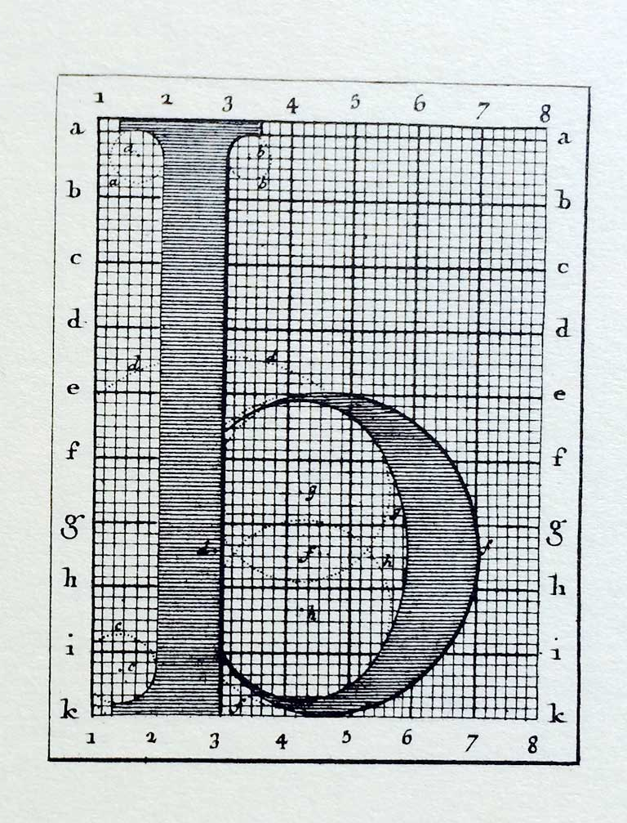
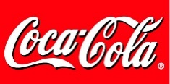

Interesting trivia...
Fonts (typefaces, like Times New Roman, Arial, Helvetica, Baskerville, Bauhaus, Chiller) are not copyrightable (1976 decision of Congressional Commitee)
some fonts are protected as design patents or trademarks
However, many fonts, especially vector-based fonts like Adobe Postscript Type I, etc. are protected as software, viewed as a sequence of instructions (little programs) for drawing each character
these must be licensed to use in print

Slide 30
Should use of the Java programming language be restricted by copyright?
Java was developed by Sun Microsystems, which was bought by Oracle, who owns various copyrights related to Java
Oracle sued Google for infringement related to use of Java in Android
2012: Jury finds that Google did infringe, but could not decide if it constitutes fair use, so damages were not determined
2015: Appeal by Google is overturned, but there are still open questions about copyright status of APIs that will have to be decided in other court trials

Slide 31
Types of software licenses
Proprietary (e.g. Microsoft Windows; what you get is a EULA)
Shareware
Berkeley (BSD), MIT license, Apache license, ...
GPL - GNU Public License
  Grants unlimited freedom to use, study, and privately modify the software, and the freedom to redistribute the software or any modifications to it.
OpenSource
  anybody may re-use code, even for commercial purposes
  owner still retains the copyright
Creative Commons - modern, flexible licenses designed for sharing
Public Domain

Slide 32
GNU Public License (GPL) - more details
GPL examples:
Linux
gcc (Gnu C compiler)
emacs
ghostscript
gzip
Qt GUI toolkit
WordPress
Grants unlimited freedom to use, study, and privately modify the software, and the freedom to redistribute the software or any modifications to it.
Can use GPL software for any purpose, including commercial
Requirements:
  Must make all modifications to source code (derivative works) publicly available
  If any part of a system is GPL (e.g. a statically-linked library), then the whole system must inherit these license terms (thus GPL-licensed code "propagates")
  This is more restrictive than OpenSource
Practical implications: should probably avoid using GPL code in a commercial product
  (effectively discourages people from making money off of your ideas)

Slide 33
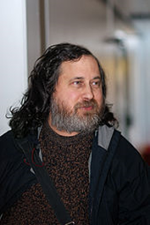
Philosophical Foundations of GPL
Free Software Foundation, led by Richard Stallman (famous MIT Computer Scientist and advocate)
The FSF argues that software should NOT have copyrights, and should be free for all to re-use.
Paraphrasing their argument:
  it is the nature of algorithms/code to build on other algorithms/code
  restricting the use a method would inhibit expression of other ideas in a way that violates freedom of speech
The GPL license was designed to encourage this free re-use of source code (also known as "copyleft").

Slide 34
Software Quality

Slide 35
What if there is a defect (bug) in a piece of software?
  software is not quite like other tangible products (like a car)
  what can consumers do?
  what are developers responsible for?
Almost all software has bugs
  this is why software licenses have a Disclaimer of Warranty and Limitation of Liability
Software is usually required to satisfy "fitness for purpose"
UTICA - Uniform Computer Information Transactions Act
  attempts to extend UCC (Uniform Commercial Code, US) to apply to warranties on software performance
  so far, only passed in Virginia and Maryland
  software does not have to be defect-free, just perform correctly under reasonable usage
Notes:
Revlon case?

Slide 36
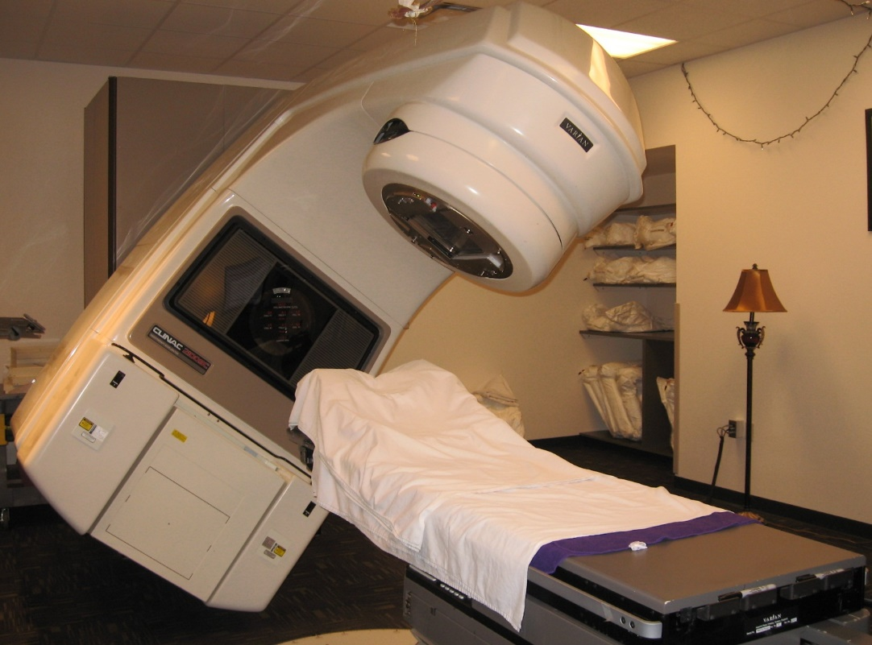
Therac-25
Radiation therapy machine produced by Atomic Energy of Canada Ltd. in 1985
Malfunction caused 100x overdoses to multiple patients, resulting in radiation burns
Protective beam-shield was controlled by software only
A software bug had caused the shield to be completely raised at high dosage settings, exposing patients to excess radiation
A rare sequence of key presses caused a counter to overflow, allowing beam to be unshielded
Code was not reviewed independently, nor was hardware/software combination tested before installation
image obtained from http://lh5.ggpht.com/

Slide 37
What are our responsibilities as software engineers?
all software has bugs (or at least some unintended effects in unanticipated circumstances)
what matters is process, follow standards of practice
good software engineering practices:

Slide 38
What are our responsibilities as software engineers?
all software has bugs (or at least some unintended effects in unanticipated circumstances)
what matters is process, follow standards of practice
good software engineering practices:
  test cases (e.g. regression testing)
  documentation, including assumptions and dependencies
  modular code design
  code reviews
  analysis tools (look for uninitialized variables, redundant code, software complexity metrics...)
  formal verification (proving invariants in a circuit or routine with tools like Spin, NuSMV, MiniSat, CBMC)
  user studies
  beta tests

Slide 39
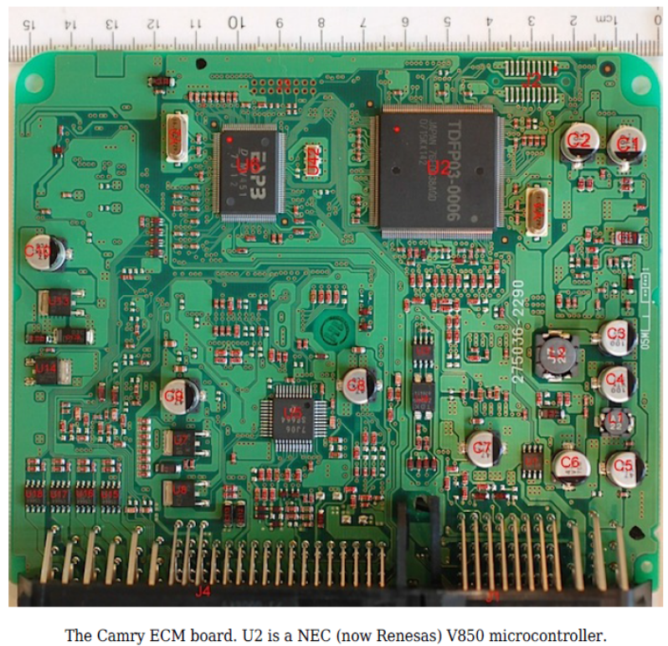
Toyota accelerator bug (2013)
bugs in software controller for accelerator caused accidents (including fatalities)
inspection of software showed that it was poorly written; not up to "standards of practice"
  Barr described the code as “spaghetti code”
  unintentional RTOS task shutdown
  running out of stack space
  code was found to have 11,000 global variables; critical data structures were not mirrored
  inadequate and untracked peer code reviews and the absence of any bugtracking system
consequence: Toyota is settling many claims out-of-court for billions of dollars
Notes:
lots of other examples: healthcare.gov, Nasdaq outage, AT&T network outage, patriot missle bug

Slide 40
What are some reasons you can imagine the Toyota team might have given for turning out such bad code?

Slide 41
What are some reasons you can imagine the Toyota team might have given for turning out such bad code?
Possible reasons for lapses of ethical decision-making in software engineering:
  laziness, greed
  pressure from boss
  arrogance (my code can't have bugs!)
  schedule pressures (e.g. forced prioritization of what needs to get fixed by release deadline, vs. what won't )
  group-think
  the Problem of Many Hands

Slide 42
The amount of effort spent on debugging is always a tradeoff
  balance with risks: cost, liability, loss of data, reputation, potential for harm/injury
  you will have to make a choice about how much effort to invest in debugging
  when is it worthwhile to spend more time debugging/testing, at the risk of delaying release of a product?
Ethical decision making requires reasoning about the magnitude and impact of software defects.
  minor flaw versus critical bug? (i.e. cost analysis, though a utilitarian framework is not the only way to make decisions)
  performance issue? potential for loss of data? injury with use? loss of life? or is it just an aesthetic flaw?
could inform users of known bug in documentation, and release a patch or revision later

Slide 43
What about plugins?
Much development of modern software involves using components or libraries or modules.
Must take responsibility for quality, or decide whether to re-implement from scratch. (faster, but is it worth the risk of bugs?)

Slide 44
What about plugins?
Example: Heartbleed bug
  bug in OpenSSL, an OpenSource implementation of cryptographic algorithms used by many browsers and other programs
  caused security flaw that could be used to steal credit-card info, etc.
  due to inadequate bounds-checking of a memory buffer

Slide 45
Beyond bugs...
What if a new aviation autopilot control panel is confusing or hard to understand?
There are real case studies of such accidents
  1994 crash of Airbus 300 in Nagoya, Japan
Who is responsible if it leads to a crash?
  coders? designers?
  or should pilots be better trained?
Design for such systems should consider human factors, perception, and cognition
Technology often needs to be viewed as a system with humans (users)

Slide 46
Much of this is codified in the ACM Code of Ethics
  Defines responsibilities and obligations of professionals in this field.
  includes being responsible for debugging, staying up-to-date, respecting copyrights, protecting peoples rights, privacy and dignity, etc.

Slide 47
ACM Code of Ethics
Associate for Computing Machinery
  http://www.acm.org/about/code-of-ethics
ACM CoE defines what it means to be a professional in the field of software engineering.
Similar to codes for other professional societies, like NSPE
focuses more on what you should do, rather than not do (restrictions)
ACM code emphasizes safety of public over interests of the employer
members are obliged to take responsibility for their work, keep informed, to honor laws, copyrights, confidentiality, privacy, etc.

Slide 48
1. GENERAL MORAL IMPERATIVES.
  1.1 Contribute to society and human well-being.
  1.2 Avoid harm to others.
  1.3 Be honest and trustworthy.
  1.4 Be fair and take action not to discriminate.
  1.5 Honor property rights including copyrights and patents.
  1.6 Give proper credit for intellectual property.
  1.7 Respect the privacy of others.
  1.8 Honor confidentiality.

Slide 49
1.1 Contribute to society and human well-being.
  This principle concerning the quality of life of all people affirms an obligation to protect fundamental human rights and to respect the diversity of all cultures. An essential aim of computing professionals is to minimize negative consequences of computing systems, including threats to health and safety. When designing or implementing systems, computing professionals must attempt to ensure that the products of their efforts will be used in socially responsible ways, will meet social needs, and will avoid harmful effects to health and welfare.

Slide 50
1.2 Avoid harm to others.
"Harm" means injury or negative consequences, such as undesirable loss of information, loss of property, property damage, or unwanted environmental impacts...
To minimize the possibility of indirectly harming others, computing professionals must minimize malfunctions by following generally accepted standards for system design and testing.
Furthermore, it is often necessary to assess the social consequences of systems to project the likelihood of any serious harm to others. If system features are misrepresented to users, coworkers, or supervisors, the individual computing professional is responsible for any resulting injury.
In the work environment the computing professional has the additional obligation to report any signs of system dangers that might result in serious personal or social damage.

Slide 51
Unethical Behavior
hacking
creating viruses
disassembly
circumventing DRM (Digital Rights Management; DVD player, iTunes)
spam
bots
  example: a script that repeatedly queries Howdy or Libcat

Slide 52
Why do hackers hack?
there have been numerous sociological studies
money (theft)
principle: "liberating information" (Kevin Mitnick, Wikileaks)
power, control
forcing social change or pushing a message
  example: defacing a website whose ideology you disagree with
and..."to show that they can" (demonstration of capability)

Slide 53
Kevin Mitnick
Gained remote access to corporate data (e.g. source code for Unix OS, manuals for phone PBX equipment) using cloned cell phones and social engineering (dumpster diving) to obtain passwords.
He claims his goal was to make proprietary information public.
In 1995, he was sentenced to 5 years in prison, and prohibited from using computers afterwards.
Even though he didn’t profit directly from it, did his punishment befit his crime (illegal access)?
(He now runs a security firm named Mitnick Security Consulting, LLC that helps test a company's security strengths, weaknesses, and potential loopholes.)

Slide 54
Ethical question: Is hacking ever justified?
discovering security flaws can be important
  some hackers view it as a responsibility
  Black hats vs. white hats
how long should you wait to publicize a security flaw?
  Google's policy: 90 days
If software distributor does not respond with a patch, then it becomes a "zero-day" bug
  Microsoft has decided not to issue patches for Windows XP any more; is this ethical?

Slide 55
Ethical question: Is hacking ever justified?
hacker group Anonymous has declared war on ISIS
  claims to have taken down pro-ISIS Twitter accounts
hacker group Ghost Security Group
  claims to have created automated software that identifies ISIS social media accounts, infiltrated private ISIS communications, taken over ISIS social media accounts and pulled IP information
  has taken down 149 Islamic State propaganda sites, 110,000 social media accounts, and over 6,000 propaganda videos
  Following the most recent attacks in Paris (Nov 2015), the crew is trying to gather intel on the attackers' digital footprints and identify social media accounts involved in the attacks.
  source: http://money.cnn.com/2015/11/20/technology/isis-ghost-security-group/

Slide 56
Apple asked by DOJ to crack into iPhone used by San Bernadino attackers
  should Apple stick to its privacy principles?

Slide 57
Is Reverse Engineering Legal?
the process of extracting knowledge or design information from anything man-made (often through disassembly) and reproducing it
mechanisms, devices, circuits, programs, protocols...
The reasons and goals for obtaining such information vary widely, from everyday or socially beneficial actions, to criminal actions
Often no intellectual property rights are breached, such as when a person or business cannot recollect how something was done, or what something does, and needs to reverse engineer it to work it out for themselves, or fix a bug, or interface with it...
Reverse engineering is also beneficial in crime prevention, where suspected malware is reverse engineered to understand what it does, and how to detect and remove it
reverse engineering can also be used to "crack" software and media to remove their copy protection
Many software licenses forbid reverse engineering as part of EULA (which is a contract)
source: https://en.wikipedia.org/wiki/Reverse_engineering

Slide 58
Is Reverse Engineering Legal?
Digital Millennium Copyright Act (DMCA) (1998)
  amended Title 17 of the United States Code to extend the reach of copyright, while limiting the liability of ISPs for copyright infringement by their users
  criminalizes production and dissemination of technology, devices, or services intended to circumvent measures (DRM) that control access to copyrighted works.
Sec. 103(f) of the DMCA says that a person who is in legal possession of a program, is permitted to reverse-engineer and circumvent its protection if this is necessary in order to achieve "interoperability" - a term broadly covering other devices and programs being able to interact with it, make use of it, and to use and transfer data to and from it, in useful ways. (interpreted by courts as fair use)

Slide 59
good resource: https://www.eff.org/issues/coders/reverse-engineering-faq
Things that affect whether Reverse Engineering might be permissible:
  You lawfully obtained the right to use a computer program;
  You disclosed the information you obtained in a good faith manner that did not enable or promote copyright infringement or computer fraud;
  Your sole purpose in circumventing is identifying and analyzing parts of the program needed to achieve interoperability;
  The reverse engineering will reveal information necessary to achieve interoperability;
  Any interoperable program you created as a result of the reverse engineering is non-infringing;
  You have authorization from the owner or operator of the reverse engineered software or the protected computer system to do your research;
  You provide timely notice of your findings to the copyright owner.

Slide 60
  1986 Computer Fraud and Abuse Act (CFAA)
  codifies what is a computer crime
  focuses on unauthorized access, stealing passwords, fraud, threats, extortion, etc.
  recent case law includes denial-of-service attacks and interruption of business, etc.

Slide 61
Morris Worm (1988)
Exploited a loophole in a Unix daemon to spread from machine to machine, shutting down the Internet.
  Robert Morris, graduate student at Cornell
  He didn’t to it to make money - it was just an experiment to gauge the size of the Internet.
  He made a mistake in the implementation that generated many more copies than intended.
  He was convicted based on CFAA (Computer Fraud and Abuse Act).

Slide 62
Privacy and Security

Slide 63
Privacy and Security
We live in a "surveillance society".
  everything is captured in videos, images, recordings, backups...
Big Data (data-mining) can be used to find or cross-reference almost anything (e.g. criminal records...)
NSA monitoring
Patriot Act
Privacy
Security Freedom
tradeoff

Slide 64
Do we have a right to privacy?
Surprisingly, a right to privacy is not in the US Constitution, but the Supreme Court has interpreted it to be implied by other rights in the Bill of Rights...

Slide 65
Do we have a right to privacy?
Surprisingly, a right to privacy is not in the US Constitution, but the Supreme Court has interpreted it to be implied by other rights in the Bill of Rights
4th Amendment, Bill of Rights:
  The right of the people to be secure in their persons, houses, papers, and effects, against unreasonable searches and seizures, shall not be violated, and no warrants shall issue, but upon probable cause, supported by oath or affirmation, and particularly describing the place to be searched, and the persons or things to be seized.

Slide 66
Things that are protected:
What information is legally private and must be kept secure?
medical records
academic records
financial records
credit records
employment records
voting records
we are going to talk about HIPAA and FERPA in a few slides...

Slide 67
Things that are not protected:
Tweets
Facebook posts
Google searches
emails
  they’re not as private as you think (especially in employer accounts)
  might as well assume your emails could become public
anonymous posts? (can be obtained from ISP via court order)
these might sound obvious, but you would be surprised how many people are not aware how public their posts are
also, once information is online, it lasts forever, including embarrassing posts and pictures

Slide 68
Are these protected?
library records (books you might not want others to know you checked out...)
video rentals
online purchases
phone records
it often depends on company policy and security measures
and most of these things can be obtained with a court order
"You have zero privacy anyway. Get over it."
Scott McNealy (Sun Microsystems) (1999)
Notes:
1. with regard library records, imagine books you might not want others to know you checked out, like on politics, building certain devices, sex...
2. generally, library records are not explicitly protected, but they are for students (under FERPA)
3. for videos, purchases, and phone records, it depends on the company, their policies, and security measures

Slide 69
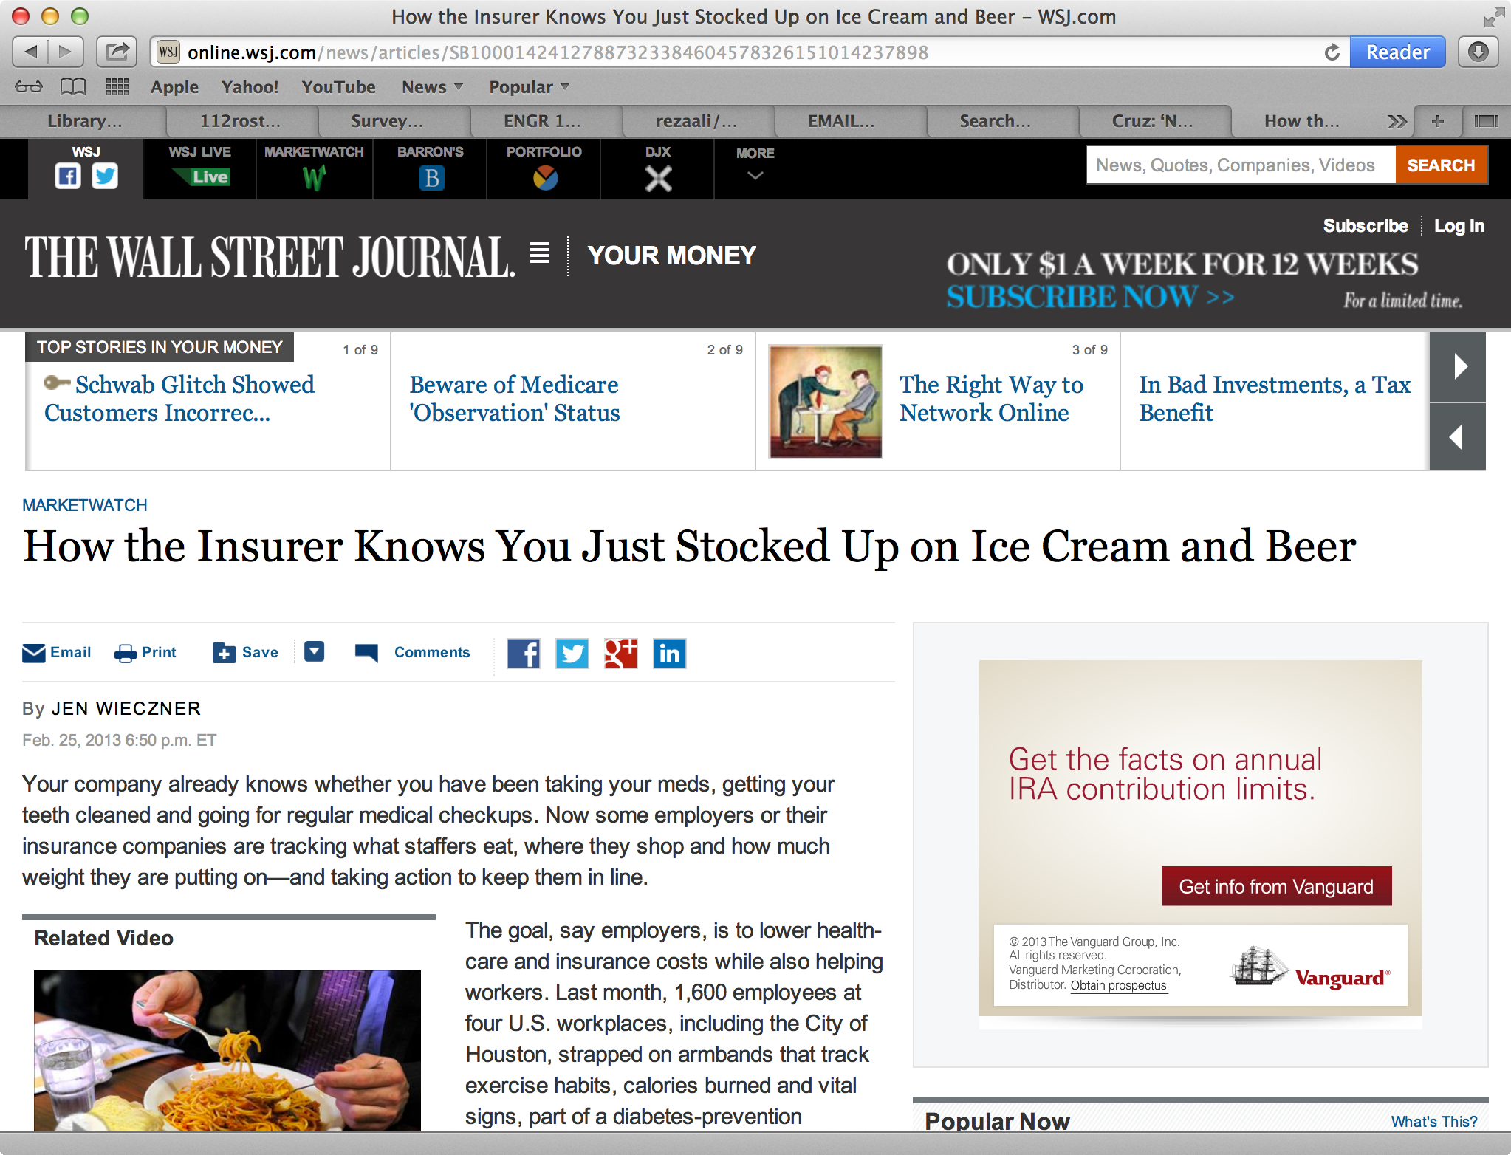
Many social media and e-commerce websites re-sell your information to advertisers.
Is this ethical?
Is it ethical if they inform you of data privacy policies?

Slide 70
Official (US) policies about public vs. private information
HIPAA - Health Insurance Portability and Accountability Act (1996)
  provides federal protections for individually identifiable health information (medical records, past conditions, test results, and treatments, etc.).
  gives patients an array of rights with respect to that information (e.g. disclosure to family only if patient chooses).
  The Privacy Rule is balanced so that it permits the disclosure of health information needed for patient care and other important purposes.

Slide 71
Official (US) policies about public vs. private information
FERPA - Family Educational Rights and Privacy Act (1974)
  gives parents certain rights with respect to their children's education records (for schools that receive funding from US Dept of Education)
  these rights transfer to the student when he or she reaches the age of 18 (hence college grades, for example, are usually protected information; release requires consent)

Slide 72
Official (US) policies about public vs. private information
Social security numbers
  are typically protected by state laws, which govern how they are displayed (e.g. last 4 digits), communicated, stored (encryption), and used
  SSNs were never intended to be used for personal identification, only for income tax purposes
  but SSNs are used this way de facto
  most applications (e.g. licenses, jobs, membership, credit) cannot lawfully request your SSN, though they can refuse to do business with you
Credit scores
  these are managed by public companies
  you have the right to obtain information collected on you, and to restrict who else gets access to this information
Security decisions driven by liability (risk of identity theft)

Slide 73
Human-subjects testing
user-interface studies are often used in software development
implications of privacy laws
software user-interface studies must:
  make users aware of risks
  obtain consent (signed release forms)
  protect users' identities and personal data
  obtain permission from IRB (Institutional Research Board), which requires submitting full description of experiment, justification of human subjects, subject selection procedures, mitigation of risks, etc.
  if you report/pubish any data, it must be "de-identified", or presented in aggregate (e.g. as statistical summary)

Slide 74
As software engineers, we have to protect things like SSN and credit card numbers
methods:
  passwords - what strength? what frequency of change?
  firewalls
  use encryption - how many bits?
there is a tradeoff: effort vs. risk
the problem is, people differ on perceive risk (probability of being hacked)

Slide 75
Disclosure-of-data-breach laws
laws depend on state
here are some examples...
  notification usually required in writing (alternatively by phone or email)
  timeliness: "as soon as expedient", or "without unreasonable delay"
    typically within 30 days
    delays allowed if it would impede criminal investigation
  media must be alerted if >5,000 people affected
  exemptions for encrypted data? "immaterial" breaches?
Personal Data Notification and Protection Act of 2015
  national standard proposed, but not yet passed by US Congress

Slide 76
Examples of Sensitive Personally Identifiable Information covered by security breach laws:
  (1) an individual’s first and last name or first initial and last name in combination with any two of the following data elements:
    (A) home address or telephone number;
    (B) Mother’s maiden name;
    (C) month, day, and year of birth;
  (2) a non-truncated social security number, driver’s license number, passport number, or alien registration number or other government-issued unique identification number;
  (3) unique biometric data such as a finger print...
  (5) a user name or electronic mail address, in combination with a password or security question and answer that would permit access to an online account; or
  (6) any combination of the following data elements:
  (A) an individual’s first and last name or first initial and last name;
  (B) a unique account identifier, including a financial account number or credit or debit card number, electronic identification number, user name, or routing code; or
  (C) any security code, access code, or password.

Slide 77
We have the capability to manipulate technology to make it do amazing things
but just because you can do something doesn't mean you should
think about consequences/impact on others

Slide 78
We have the capability to manipulate technology to make it do amazing things
but just because you can do something doesn't mean you should
think about consequences/impact on others
...or as Google's corporate motto puts it...

Slide 79
We have the capability to manipulate technology to make it do amazing things
but just because you can do something doesn't mean you should
think about consequences/impact on others
...or as Google's corporate motto puts it...
Don't be evil.

Slide 80
We have the capability to manipulate technology to make it do amazing things
but just because you can do something doesn't mean you should
think about consequences/impact on others
...or as Google's corporate motto puts it...
Don't be evil.
(application to Google engineers: they have access to an incredible amount of information about people, and Google wants the public to trust that they won't exploit it)

Slide 81
Prism
Data may seem innocuous, but can be abused
  NSA phone record collection
  Caller
  Receiver
  Date/time
  Length of call

Slide 82
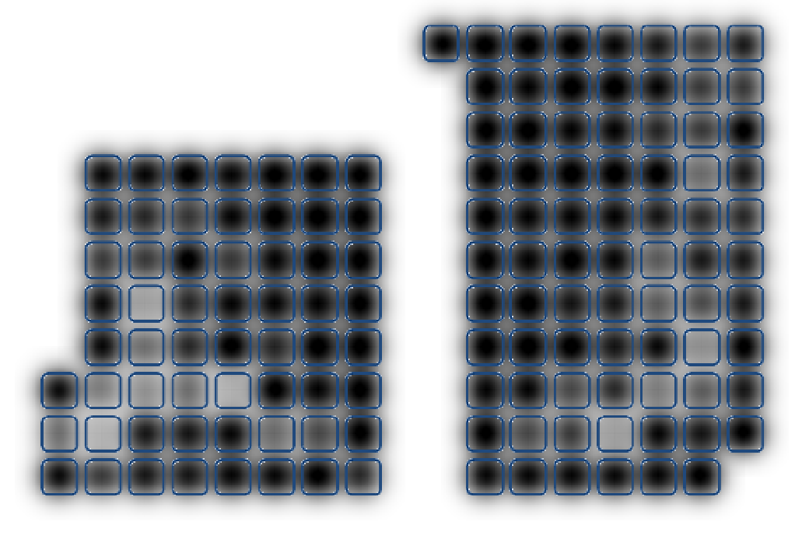

Where do people sit?

Slide 83
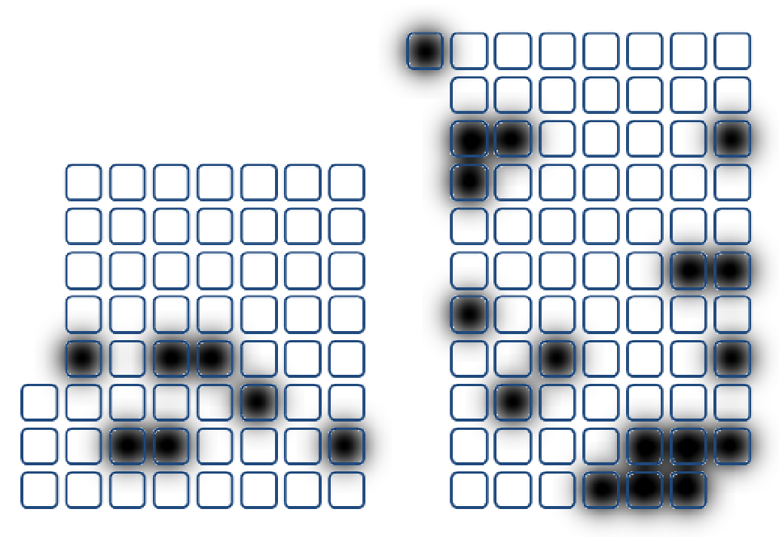
Seats often occupied by same person

Slide 84
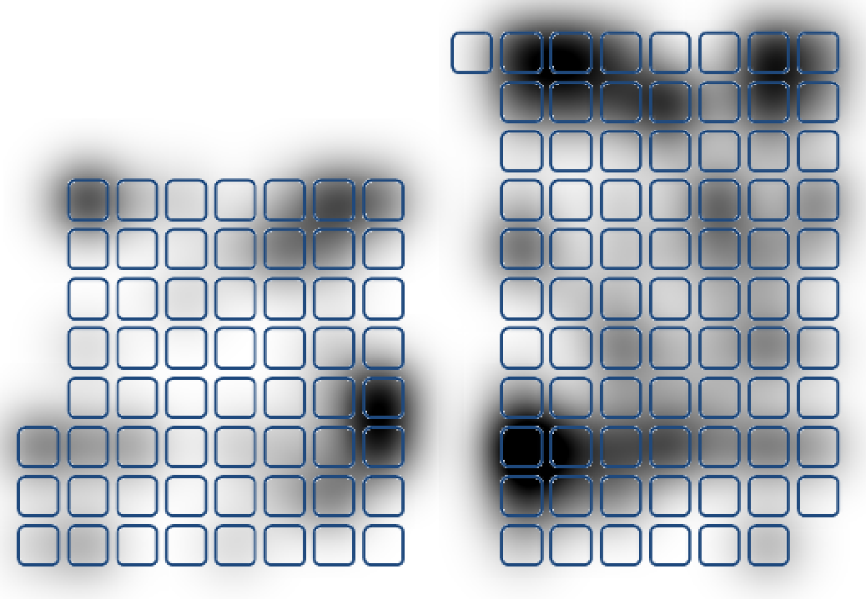
Where do absent people sit?

Slide 85
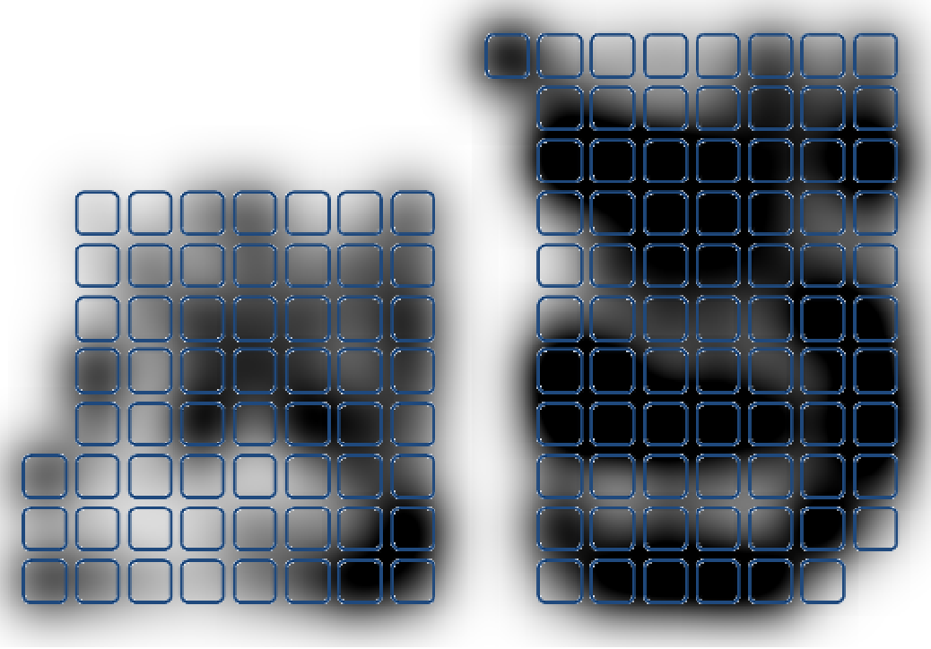
Where do people with high attendance sit?

Slide 86
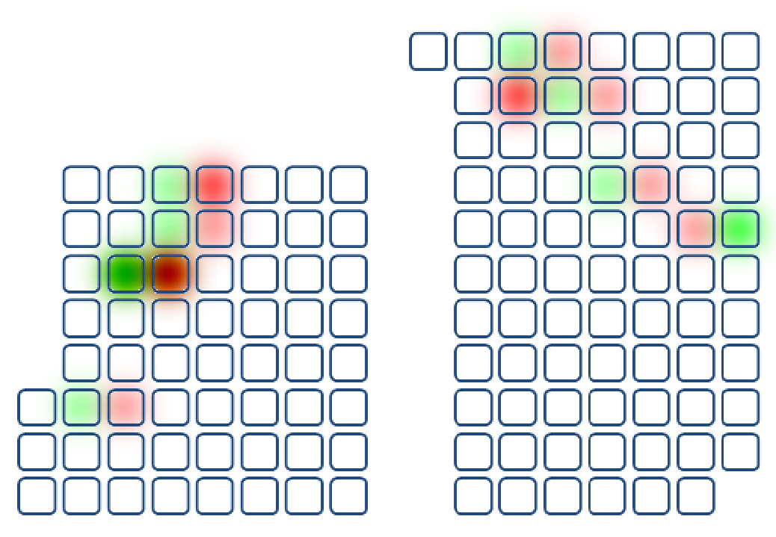
Who knows each other?

Slide 87
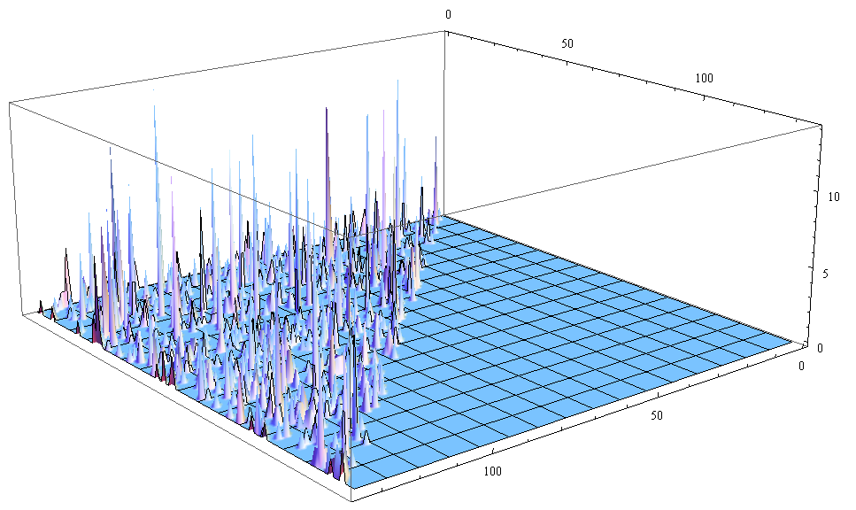
Who knows each other?

Slide 88
In Summary
Software Engineers have the power to do amazing things.
Use good judgement
Take responsibility for the code you write (testing and debugging)
Respect copyrights
Protect users' personal data and private information
Don't be disruptive
(Much of this is echoed in the ACM Code of Ethics)

Slide 89
Aspirational Ethics in Computing
making decision in software engineering has to go beyond questions of just what is legal or profitable...
William Wulf (National Academy of Engineering):
The criteria for selection of the 20 greatest engineering achievements of the 20th century were based "not on technical gee whiz, but how much an achievement improved people's quality of life. The result is a testament to the power and promise of engineering to improve the quality of human life worldwide."
The point is: software should be designed to promote human well-being.

Slide 90
The End
for more information, case studies, news articles, etc., see:
http://faculty.cs.tamu.edu/ioerger/ethics/links.html

Slide 91
Broader Impacts of Technology on Society
Undoubtedly, the Internet has benefitted society
  access to information - consumer, healthcare, political
  enhances connectivity/communication
Technological developments are not always good:

Slide 92
Broader Impacts of Technology on Society
Undoubtedly, the Internet has benefitted society
  access to information - consumer, healthcare, political
  enhances connectivity/communication
Technological developments are not always good:
  Napster/LimeWire/BitTorrent enabling sharing of copyrighted material
  link between video games and violence
  cell phones and EM radiation
  texting and driving
  use of encryption technology by terrorists
Risks of increased reliance on automation (car engines, autopilots...)

Slide 93
Broader Impacts of Technology on Society
Proliferation of electronic databases and pattern recognition can lead to feelings of dehumanization, loss of privacy, etc...
  further reading: Danah Boyd and Kate Crawford (2011). Six provocations for Big Data. Symposium on the Dynamics of the Internet and Society. http://papers.ssrn.com/sol3/papers.cfm?abstract_id=1926431
Studies suggest that social networking can lead to loss of interpersonal skills like patience, empathy, honesty
  further reading: Shannon Vallor (2010). Social networking technology and the virtues. Ethics and Information Technology, Volume 12, Issue 2, pp 157-170. http://link.springer.com/article/10.1007%2Fs10676-009-9202-1
Apple asked by DOJ to crack into iPhone used by San Bernadino attackers
  should Apple stick to its privacy principles?
  implications of use of encryption by terrorists?

Slide 94
The “Digital Divide”
Those that have access to technology and know how to use it have many advantages.
  finding cheaper products or reviews
  getting info on healthcare, finances and investing, politicians and political issues, corporate wrong-doing
  knowledge of non-local events and opportunities
This has an unfair tendency to amplify and perpetuate differences among socio-economic classes.
Public policy implications
  Should the government provide free Internet terminals to the public, e.g. in libraries?
  should computer education be mandatory in public schools?

Slide 95
Official (US) policies about public vs. private information
FOIA – Federal Open-Information Act (1967)
  The Freedom of Information Act (FOIA) has provided the public the right to request access to records from any federal agency. It is often described as the law that keeps citizens in the know about their government.
  must make formal request of specific documents

