Slide 1
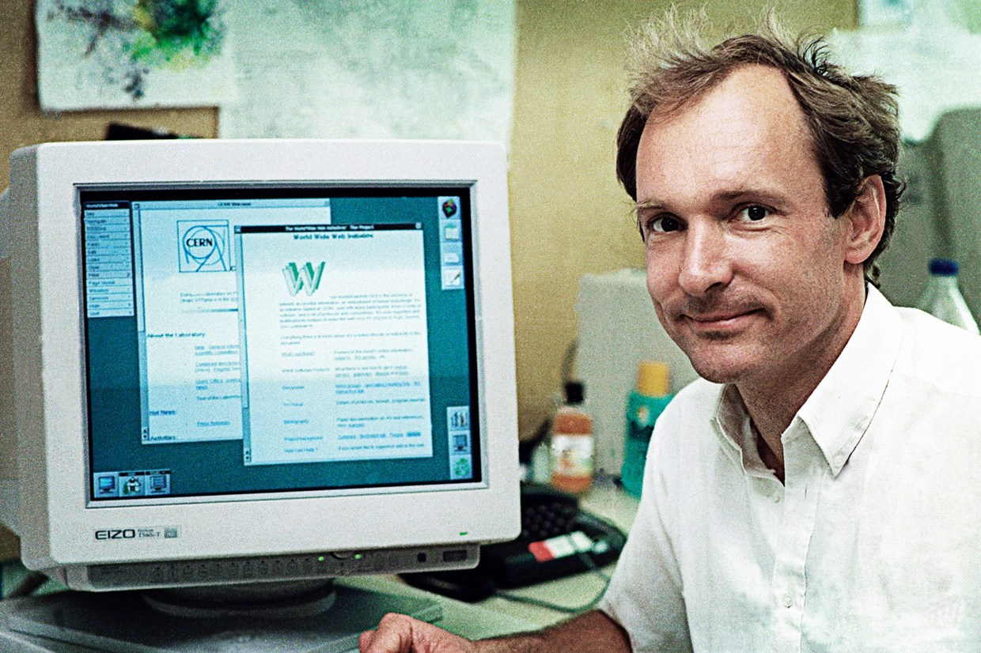


Slide 2
Who is Tim Berners-Lee?
Born 8 June 1955 in London (age 59)
World Wide Web Consortium (W3C)
World Wide Web Foundation
WSRI
MIT
Knighted by the Queen (2004)
Notes:
Who is Tim Berners-Lee?
Tim Berners-Lee invented the World Wide Web.
He was born on the 8th of June in 1955 and is the director of the
World Wide Web Consortium (W3C)
which is made up of various companies that were willing to create standards and recommendations to improve the quality of the Web.

Slide 3
Contributions
Hypertext
World Wide Web (1989)
HTTP
HTML
World Wide Web Consortium (W3C)
info.cern.ch
WWW goes global (1993)
Notes:
Hypertext
Hypertext is not something Tim Berners-Lee invented, but something that he used to define the structure of the World Wide Web. Hypertext is text displayed on a computer display with references, which we call hyperlinks, that refer to other text immediately accessible by the reader.
World Wide Web (1989)
In ‘89 Tim Berners-Lee was a physicist at CERN, the European Particle Physics Laboratory, and he proposed an initiative for global information sharing made possible by uniting hypertext with the Internet, a service that at the time wasn’t as readily available to the public as it is today. This method of communication through the Internet used browsers to view documents using a client-server architecture.
HTTP
In that same year he and his team implemented the first successful communication between a Hypertext Transfer Protocol client and server via the Internet. The first version of HTTP had only one method, called “GET”, which would request a page from a server. The response was always a page created through HTML, which was developed by Tim Berners-Lee and his team in the World Wide Web Consortium, which he also founded. HTTP defines how messages are formatted and transmitted, and what actions Web servers and browsers should take in response to various commands. HTML covers how Web pages are formatted and displayed. This system was originally meant for a more effective communication system for CERN but then Tim realized that this could be implemented throughout the world.
info.cern.ch
The world’s first web site, which ran on a NeXT computer at CERN, provided an explanation of what the World Wide Web was, and how someone could use a browser and set up a web server.
WWW goes global
Tim made his idea available freely, with no patent and no royalties due. The W3C decided that its standards should be based on royalty-free technology, so that they could easily be adopted by anyone. In 1993, the World Wide Web software in the public domain, making the next release available with an open license to assure that the dissemination of the software is maximized. This software, along with a basic browser, is required to run a web server. Its publication allowed the web to flourish.

Slide 4
Summary
Hypertext Transfer
Importance
Internet restrictions
Notes:
Hypertext Transfer
What I found most interesting as I read on about the history of the Web was the concept of hypertext and how it could be transferred between computers. It must have been a pretty cool idea, at the time where hypertext was unique to the computer it was on, to be able to transfer it between multiple computers. To think of all the possibilities that could surface from making this public must have been a hell of a daydream.
Importance
Well, obviously the development of the WWW is important. Thanks to this amazing convenience proposed and developed by Tim, we are able to access landfills of information regarding anything, instead of having to get up and walk to a library to check out books or buy collections of encyclopedias which may or may not have the answer to questions you would have. This is the most efficient form of communication and will be until science grants us psychic powers.
Internet restrictions
The thing I wonder the most about after having read about the creation of the World Wide Web is, why did it take so long to make the Internet public? In 1982 the Internet protocol suite was introduced as the standard networking protocol on the ARPANET. Some time soon after that research and education organizations were granted network access. Eventually commercial internet service providers began to emerge, but none of that was through the efficient use of hypertext transfer. Transfer protocols had existed before HTTP but none of this technology was made as readily available as the WWW software.

Slide 5

Thank You

