Slide 1
John Backus
By Cameron Gaertner

Slide 2
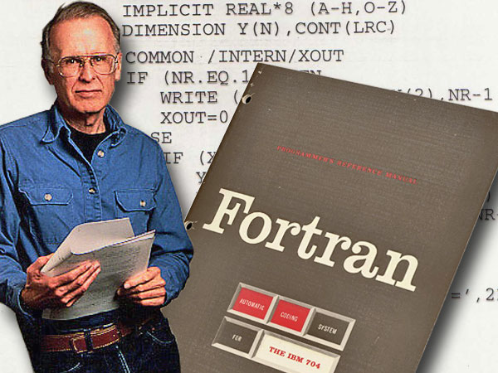
Early Life
Born December of 1924 in Philadelphia
Attended the University of Virginia
  (flunked out)
Drafted by the Army at 18
Settled at Columbia University

Slide 3
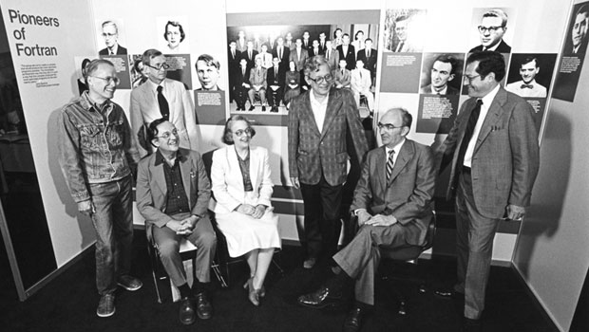
Work At IBM
Hired as a programmer for IBM
Initially worked on the Selective Sequence Electronic Calculator
Got tired of the complexities in programming, so he started a research team to simplify programming

Slide 4
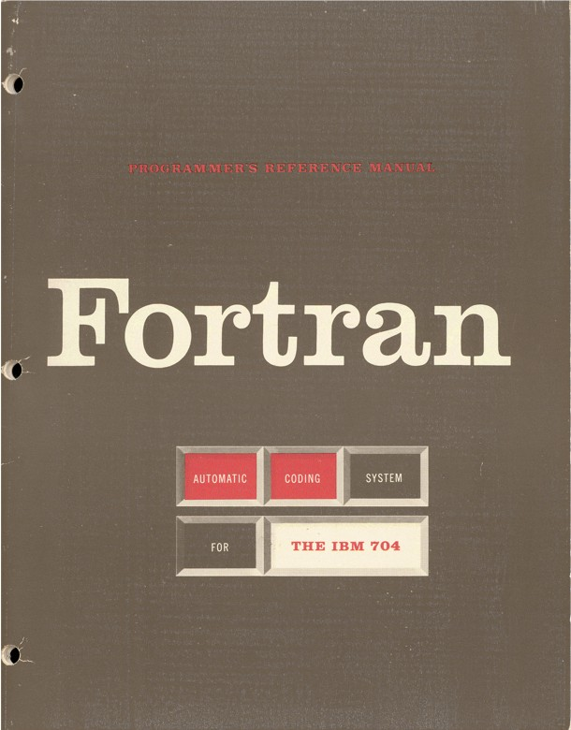
Fortran
Created Fortran (Formula Translator)
  Dominant programming language for scientists for decades
Worked on an international committee to design the ALGOrithmic programming language, ALGOL 58, and then ALGOL 60
  Backus-Naur Form (BNF)
“
For profound, influential, and lasting contributions to the design of practical high-level programming systems, notably through his work on FORTRAN, and for seminal publication of formal procedures for the specification of programming languages.
”

Slide 5
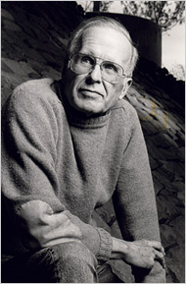
Later Work
Became an IBM fellow
Worked on a functional programming language called FP
Retired from IBM in 1991
Died in March of 2007

Slide 6
Works Cited
http://amturing.acm.org/award_winners/backus_0703524.cfm
http://www.nytimes.com/2007/03/20/business/20backus.html?_r=0
http://www.thocp.net/biographies/papers/backus_turingaward_lecture.pdf
http://www.computerhistory.org/fellowawards/hall/bios/John,Backus/

