Slide 1
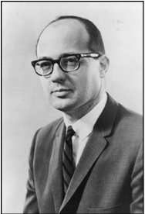
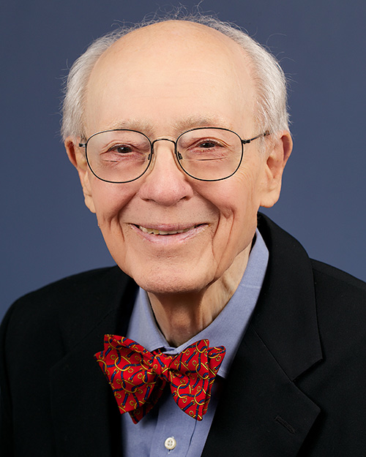
Charles Bachman
Evan Remmele

Slide 2
Early Life
Born Dec. 11, 1924, in Manhattan, Kansas
Moved to Michigan
Michigan State College 1948, bachelors in ME
Masters in ME from UPenn
  Wharton School of Business

Slide 3
Work
Dow Chemical 1950
  Data Processing Manager
  SHARE
    9PAC
GE
  MIACS
    IDS

Slide 4
Contributions
IDS
  Turing Award 1973
Navigation CODASYL Database
Bachman Information Systems 1983
  Computer-aided software engineering products

Slide 5
Thoughts
Navigational versus relational databases

Slide 6
References
http://www.tomandmaria.com/tom/Writing/BachmanBio.pdf
http://www.computerhistory.org/fellowawards/hall/bios/Charles,Bachman/
http://amturing.acm.org/award_winners/bachman_1896680.cfm

