Slide 1
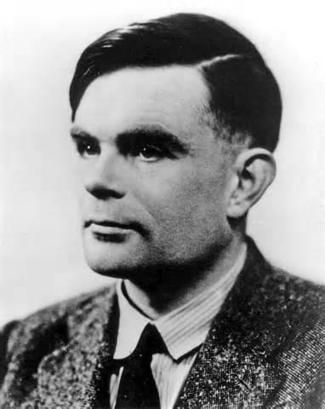
Alan M. Turing
(1912-1954)
A Natalie Cluck Presentation
Notes:
The A.M. Turing Award, sometimes referred to as the "Nobel Prize" of Computing, was named in honor of Alan Mathison Turing (1912–1954), a British mathematician and computer scientist. He made fundamental advances in computer architecture, algorithms, formalization of computing, and artificial intelligence. Turing was also instrumental in British code-breaking work during World War II

Slide 2

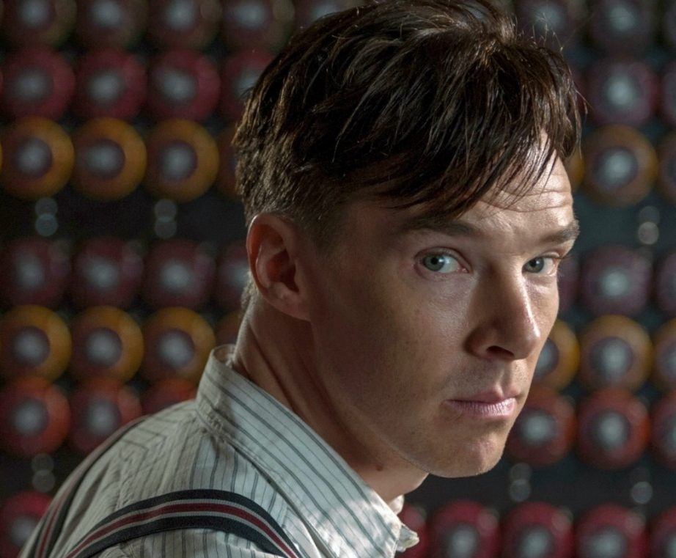
Who was Alan Turing?
An English mathematician, a cryptanalyst, a logician, a philosopher, a pioneer in computer science, a marathon and ultra distance runner.
Known for deciphering German Enigma machine encrypted messages, the Turing machine, and for being the father of theoretical computer science and artificial intelligence.
Notes:
Studied at Cambridge University and worked at the University of Manchester

Slide 3
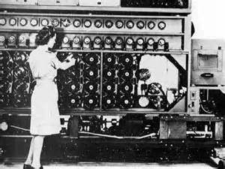
The Enigma
In World War II, Turing played a vital role in the deciphering of messages encrypted by the German Enigma machine, which provided vital intelligence for the Allies.
He lead the team that designed the Bombe.
Worked out of Bletchley Park, located half-way between Oxford and Cambridge.
Notes:
Describe German Enigma and the Bombe
Worked out of small country house in Bletchley Park

Slide 4
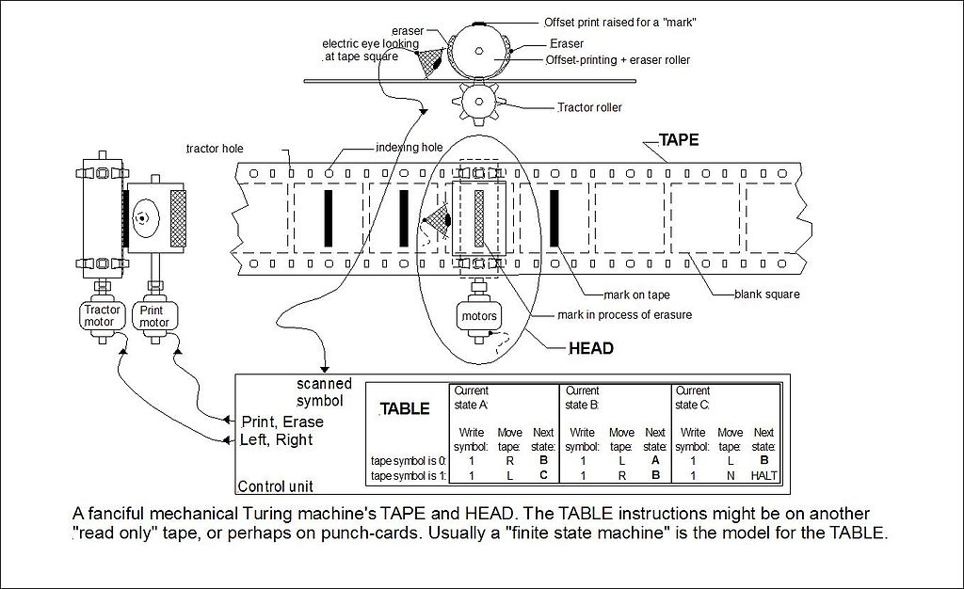
The Turing Machine
Turing’s aim was to show that there are tasks that these machines are unable to perform, even given unlimited working memory and unlimited time.
Wrote famous research piece entitled “Computing Machinery and Intelligence,” in which he proposes the question:
“Can machines think?”
Notes:
Describe turing machine in photo
Describe main points of paper
Emphasize “Imitation Game”

Slide 5
The Turing Award
ACM’s most prestigious technical award given to an individual selected for contributions of a technical nature made to the computing community
Notes:
Brief intro about Turing Award. Show video from Turing Award website

Slide 6
Questions?

