Slide 1
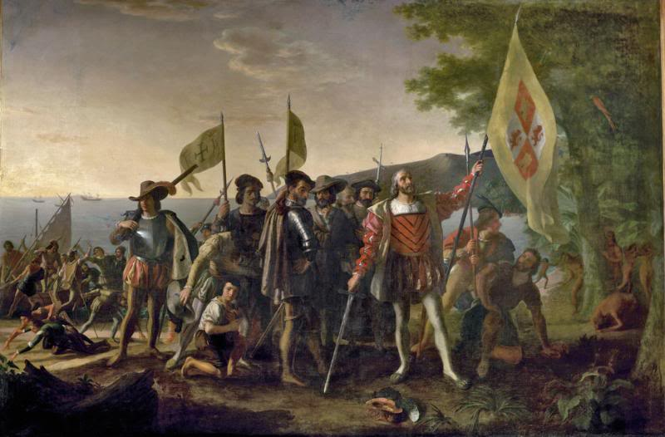
Localization, Mapping, Exploration
Why is this a problem- can’t you just use GPS or some sort of RFID beacons?
How can you simultaneously map the world and be sure where you are?
How do you explore new areas efficiently or at least consistently?
What about labeling the map with objects and features or terrain?
Landing of Columbus boringmordheimforum.forumieren.com
Notes:
Welcome to the Introduction to AI Robotics series. I’m Dr. Robin Murphy and this podcast on on Simultaneously Localization and Mapping as well as exploration. Simultaneous localization and Mapping or SLAM relies on complex probabilistic methods which I will be able to cover only at a high level, so I would recommend Probablistic Robotics by Thrun for more details. This podcast will attempt to answer…

Slide 2
Specific Learning Objectives
Define the pose of a mobile robot
Describe the difference between iconic and feature-based localization
Define each term in: bel(x_{t})=f(bel(x_{t-1}), u_{t}, z_{t}, m)
Describe the three types of localization problems
Describe the difference between the EKF, Grid, and Monte Carlo Localization algorithms and which of the three types of localization problems they are best suited for.
Be able to describe the difference between localization and simultaneous localization and mapping
Describe frontier-based and GVG based exploration
Describe the symbol-ground problem
List the possible uses of terrain data by a robot and the impact of terrain on its functions
Give examples of two types of methods for proprioceptive terrain identification and exteroceptive terrain identification and limitations of each
Motivation
Local
-Markov
--EKF
Global
-Grid
-MCL
Dynamic
Summary

Slide 3
Outline
Localization: where I am?
Mapping: where have I been?
Exploration: where haven’t I been?
Semantic World Knowledge: what am/did I see?
Note: this section incorporates additional material beyond Chapter 11 in the textbook

Slide 4
Navigation
Where am I going? Mission planning
What’s the best way there? Path planning
Where am I? Localization
Where have I been? Map making
Motivation
Local
-Markov
--EKF
Global
-Grid
-MCL
Dynamic
Summary
Carto-
grapher
Mission
Planner
deliberative
How am I going to get
there?
Behaviors
Behaviors
Behaviors
reactive
Behaviors

Slide 5
Localization

Slide 6
Localization (Position Estimation)
“Mobile robot localization is the problem of determining the pose of a robot relative to a given map of the environment”- Thrun, Burgard, Fox
  Mobile robot localization is often called position estimation
Assumes that there is some sort of a priori map and the robot is localizing itself relative to it
Motivation
Local
-Markov
--EKF
Global
-Grid
-MCL
Dynamic
Summary

Slide 7
Localization Problems
Why localization should be easy
  Just coordinate transform
What makes localization hard
  Requires model of the robot, sensors and response to the environment
  Sensor noise (proprioceptive and exteroceptive)
    Must infer position from series of uncertain sensor readings
      Computationally expensive
  May not know initial position
  Dynamic environments where objects move (did I move or did Object A move?)
  Path or task may not support localization
    E.g., would be better to hug the walls (active localization) but less optimal for path planning
Motivation
Local
-Markov
--EKF
Global
-Grid
-MCL
Dynamic
Summary

Slide 8

Indoors: Why Odometry is Insufficient
Motivation
Local
-Markov
--EKF
Global
-Grid
-MCL
Dynamic
Summary
Black
Is ground
Truth,
Purple is
Measured
Using shaft
Encoders for
Δ

Slide 9
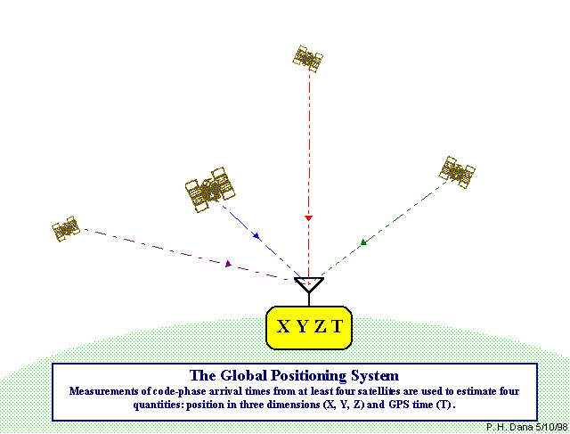
Outdoors: GPS isn’t Perfect
Motivation
Local
-Markov
--EKF
Global
-Grid
-MCL
Dynamic
Summary

Slide 10
GPS Errors
Errors relating to satellites:
  Orbital error (location of satellite)
  Satellite clock error (satellite internal timekeeping)
Atmospheric error:
  Ionospheric error (proportional to electron content),
  tropospheric error (variable moisture content)
Multipath errors: GPS signal bounce off local obstacles
Receiver noise: noise in the receiver’s circuitry
Satellite geometry: jumps occur as satellites are blocked and new fix is obtained from new satellite set
Motivation
Local
-Markov
--EKF
Global
-Grid
-MCL
Dynamic
Summary

Slide 11
3 Types of Localization
Motivation
Local
-Markov
--EKF
Global
-Grid
-MCL
Dynamic
Summary
LOCAL
(initial x_{t})
GLOBAL
(no initial x_{t})
SUSTAINED
UPDATES
INTERRUPTED
UPDATES
(kidnapped)
Notes:
Localization
Local: where you have the map, are initialized with your initial pose
Global: don’t have initial pose or it is very poor.

Slide 12
3 Types of Localization is not the same as localization algorithms
Motivation
Local
-Markov
--EKF
Global
-Grid
-MCL
Dynamic
Summary
LOCAL
(initial x_{t})
GLOBAL
(no initial x_{t})
Key: Maintain position tracking
SUSTAINED
UPDATES
INTERRUPTED
UPDATES
(kidnapped)
Key: Converge to right place quickly
Key: Notice that world is different
Notes:
Localization
Local: where you have the map, are initialized with your initial pose
Global: don’t have initial pose or it is very poor.

Slide 13
Two Approaches
Feature-based: use features extracted from raw data
  Label and match corners, walls, whatever
  Less features, so less computation
  Hard to extract features reliably
Iconic: use raw (or near raw) sensor readings
  Match observations to what would expect to see at a location
  Computationally intensive
Motivation
Local
-Markov
--EKF
Global
-Grid
-MCL
Dynamic
Summary

Slide 14
Feature-Based Algorithms
Markov Localization covers all three problems, though usually used for local
bel(x_{t})=f(bel(x_{t-1}), u_{t}, z_{t}, m), where
  bel(x) : belief that the robot is at pose x
      Remember pose for 2D is: x=(x y θ)^{T}
  u_{t} : control actions or what you told the robot to do
  z_{t} : measurements or what the robot observed
  m : map
Motivation
Local
-Markov
--EKF
Global
-Grid
-MCL
Dynamic
Summary

Slide 15
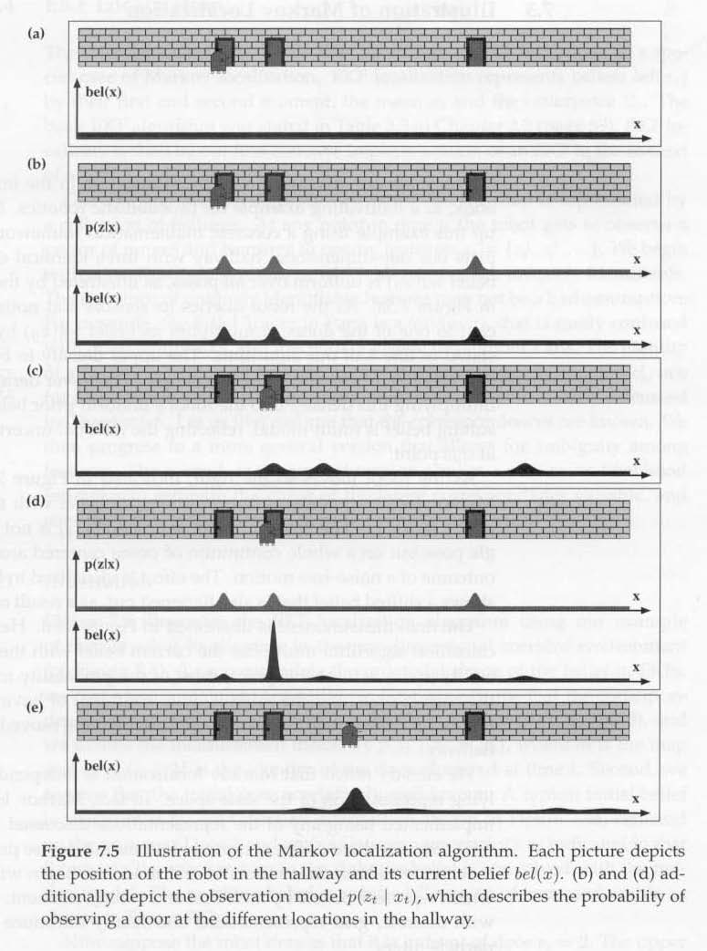
Starts out equally unsure
Senses door: could be any door
Motivation
Local
-Markov
--EKF
Global
-Grid
-MCL
Dynamic
Summary
New bel of where are in world:
3 major possibilities
As move forward, estimate of where is moves but gets wider
Senses door
Belief is mostly that at second door due to match to map
As move forward, estimate of where is moves but gets wider
Notes:
Note– it doesn’t always have to be equal– some doors may be harder to

Slide 16
How Would You Compute This?
Extended Kalman Filter is most common
Main idea:
  z is the set of observations about the features (aka landmarks)
  Need an additional vector to represent which feature in z corresponds to what feature in the map m
    “correspondence variables”
  Try to minimize the first and second moments, covariance to get the correct pose and then use those statistics about how the robot is moving to predict result of next control action
  EKF steps
    Prediction: where the robot will be, given the control action
    Correction: predict what it will measure at that location, take the difference, update the estimation for the next cycle
Motivation
Local
-Markov
--EKF
Global
-Grid
-MCL
Dynamic
Summary

Slide 17
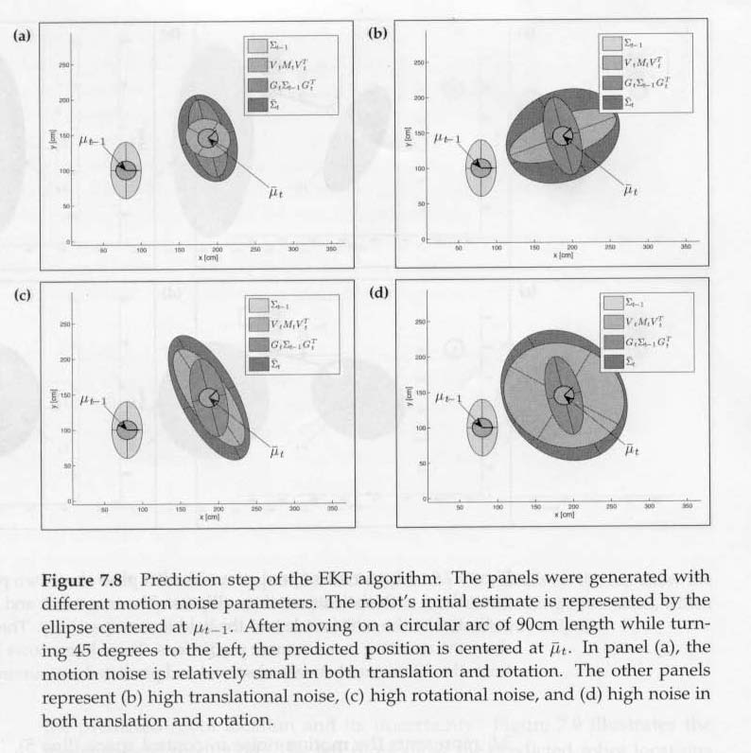
Impact of Errors on Prediction
Small translation, rotational error
High translation error
Motivation
Local
-Markov
--EKF
Global
-Grid
-MCL
Dynamic
Summary
Large translation, rotational error
High rotation error

Slide 18
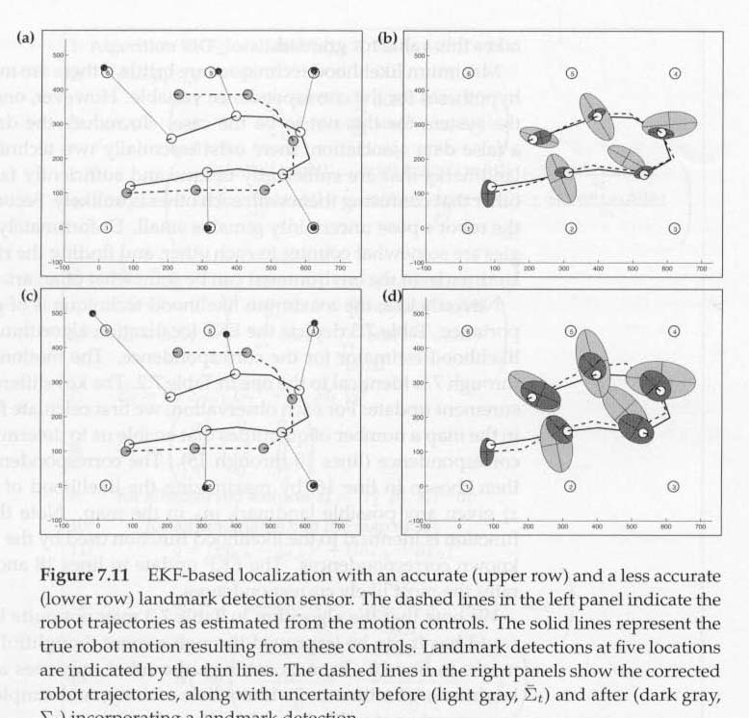
EKF Example
Can find distances to corresponding landmarks
Motivation
Local
-Markov
--EKF
Global
-Grid
-MCL
Dynamic
Summary
Less accurate

Slide 19
2 Iconic Methods
Grid-based localization
  Uses a grid as a tesselation of convex polygon
    (Other algorithms use regular grid as way to store data)
  Computes the likelihood of all possible poses within that polygon given the observation and puts in a histogram
  In practice, use just a local “sub-map” which restricts applicability to local localization
Motivation
Local
-Markov
--EKF
Global
-Grid
-MCL
Dynamic
Summary

Slide 20
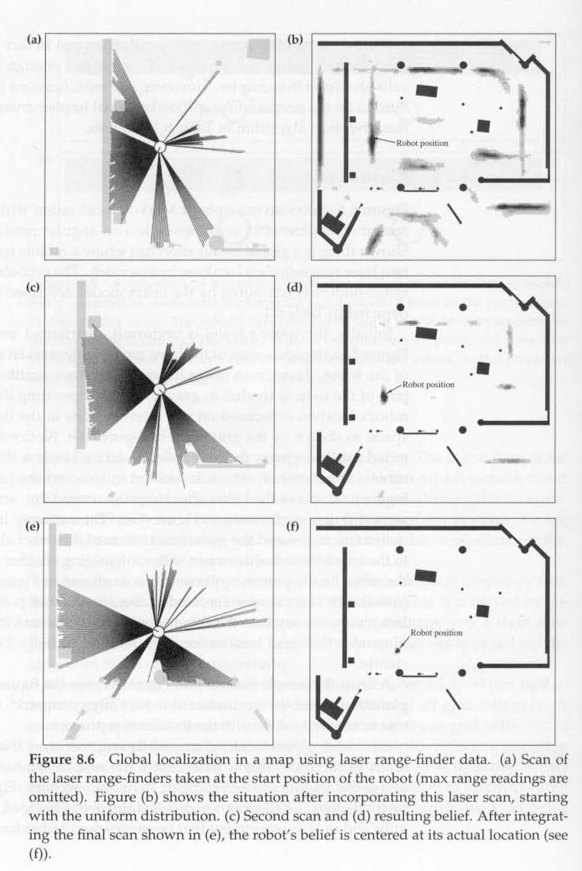
Motivation
Local
-Markov
--EKF
Global
-Grid
-MCL
Dynamic
Summary

Slide 21
2 Iconic Methods
Grid-based localization
Monte Carlo Localization (MCL)
  Technically it is not restricted to raw sensor observations, but is typically used this way
  Scatters “particles” throughout space, then computes probability given the observation
  Adds more particles at the next update, while some particles “die”
  Fun fact: noise actually helps this method!
Motivation
Local
-Markov
--EKF
Global
-Grid
-MCL
Dynamic
Summary

Slide 22
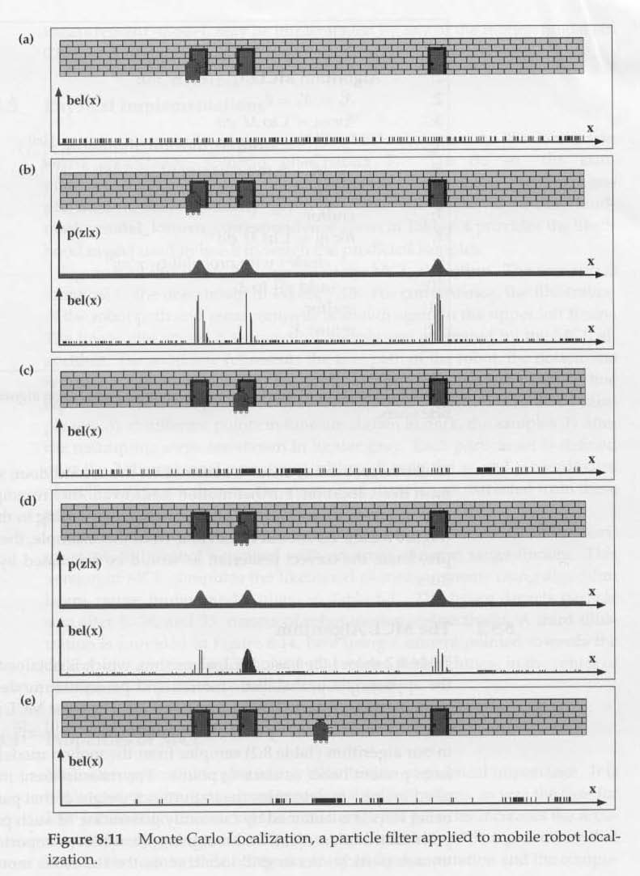
Starts out equally unsure
Senses door: could be any door
Motivation
Local
-Markov
--EKF
Global
-Grid
-MCL
Dynamic
Summary
New bel of where are in world:
3 major possibilities
Generate new particles, delete others- more dense around most likely spots
Senses door
Assign importance to particles
As move forward, estimate of where is moves but gets wider

Slide 23
Static v. Dynamic Environments
People, changes introduce a “hidden state” in the model, therefore the algorithms break
Two fundamental techniques
  State augmentation: try to make the hidden state unhidden
    Have to estimate impact of people on observations
  Outlier rejection
    Depends on sensors, environment
    Ex. Eliminate surprisingly short readings
Motivation
Local
-Markov
--EKF
Global
-Grid
-MCL
Dynamic
Summary

Slide 24
Summary
Mobile robot localization is the problem of determining the pose of a robot relative to a given map of the environment
Localization algorithms are variants of Bayes Filter algorithms, where the belief in a pose is a function of the last pose and a motion model
  Motion model must contain at a minimum pose, control actions, map
Iconic localization is more common than feature-based due to problems in reliably extracting features
Feature-based localization historically has used EKF
  Need correspondence variables to link observations to map
In practice, Monte Carlo methods (MCL) dominate localization, both for iconic and feature-based
Localization works very well for static environments with good models, but dynamic environments are difficult. State augmentation is incomplete and outlier detection hard to quantify
The results rely heavily on the ability to accurately sense the environment
  Math is there, but beyond Sick laser is problematic
Motivation
Local
-Markov
--EKF
Global
-Grid
-MCL
Dynamic
Summary

Slide 25
MAPPING

Slide 26
Navigation
Where am I going? Mission planning
What’s the best way there? Path planning
Where am I? Localization
Where have I been? Map making
Motivation
SLAM
Exploration
-Frontier
-GVG
Sym-Grnd
Terrain
Maps
Impact
Sensing
Summary
Carto-
grapher
Mission
Planner
deliberative
How am I going to get
there?
Behaviors
Behaviors
Behaviors
reactive
Behaviors

Slide 27
SLAM
Simultaneous localization and mapping
Recall that localization requires an a priori map
Mapping is when you don’t have a map, but you probably don’t have localization either…
Motivation
SLAM
Exploration
-Frontier
-GVG
Sym-Grnd
Terrain
Maps
Impact
Sensing
Summary

Slide 28
Rao-Blackwellized Filtering
Dominant method in SLAM
If you know the path that the robot has taken, computing the maximum likelihood map is easy
  It’s the map where the observations are consistent
  But you don’t know the path, because that would be localization…
Let each particle contain a path and a local map (instead of only one version of the map)
  After each observation, update only the sensed area of the maps
  Use a tree to save all the particles forming the history of the current particles
  Each particle is computed independently of the others
Will get pretty good map as go along, though probably several possible paths
  When “close the loop” will get a better path estimate (closure will propagate backwards)
Motivation
SLAM
Exploration
-Frontier
-GVG
Sym-Grnd
Terrain
Maps
Impact
Sensing
Summary

Slide 29

Rao-Blackwellized Filtering (Fox)
Motivation
SLAM
Exploration
-Frontier
-GVG
Sym-Grnd
Terrain
Maps
Impact
Sensing
Summary

Slide 30
Exploration

Slide 31
Exploration
Where HAVEN’T I been?
Can explore reactively (move to open area as per Donath), but we’d like to create maps and be purposeful about it
Two major methods
  Frontier-based
  GVG
Motivation
SLAM
Exploration
-Frontier
-GVG
Sym-Grnd
Terrain
Maps
Impact
Sensing
Summary

Slide 32
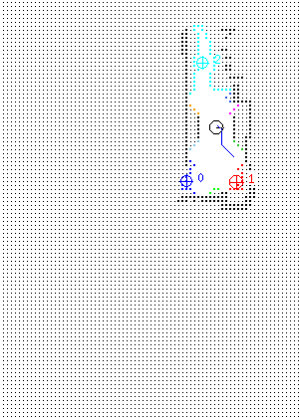
Frontier Based Exploration
Robot senses environment
Borders of low certainty form frontiers
Rate the frontiers
  Centroid
  Utility of exploring (big? Close?)
Move robot to the centroid and repeat
(continuously localize and map as you go)
Motivation
SLAM
Exploration
-Frontier
-GVG
Sym-Grnd
Terrain
Maps
Impact
Sensing
Summary

Slide 33
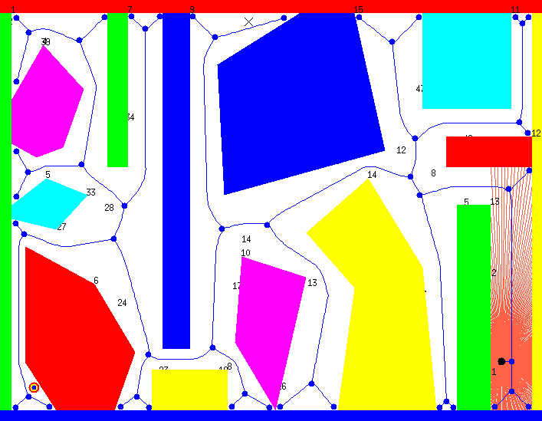
GVG
Motivation
SLAM
Exploration
-Frontier
-GVG
Sym-Grnd
Terrain
Maps
Impact
Sensing
Summary

Slide 34
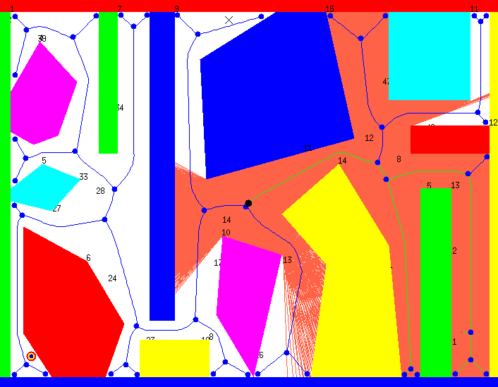
Keeps moving, ignores areas hard to get to
Motivation
SLAM
Exploration
-Frontier
-GVG
Sym-Grnd
Terrain
Maps
Impact
Sensing
Summary

Slide 35
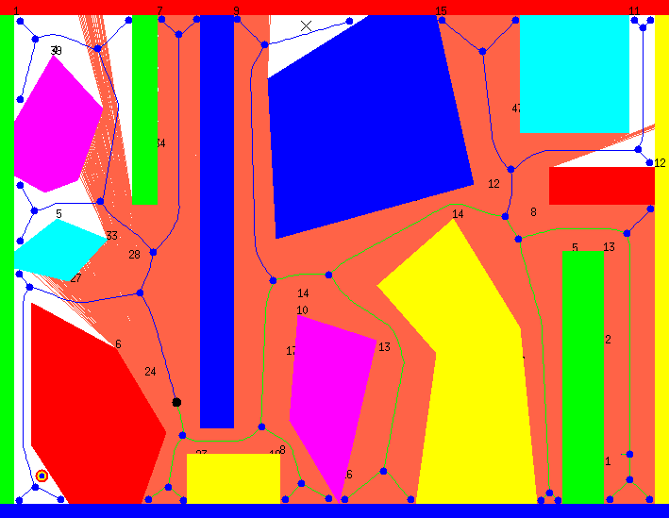
Reaches deadend at 9, backtracks
Motivation
SLAM
Exploration
-Frontier
-GVG
Sym-Grnd
Terrain
Maps
Impact
Sensing
Summary

Slide 36
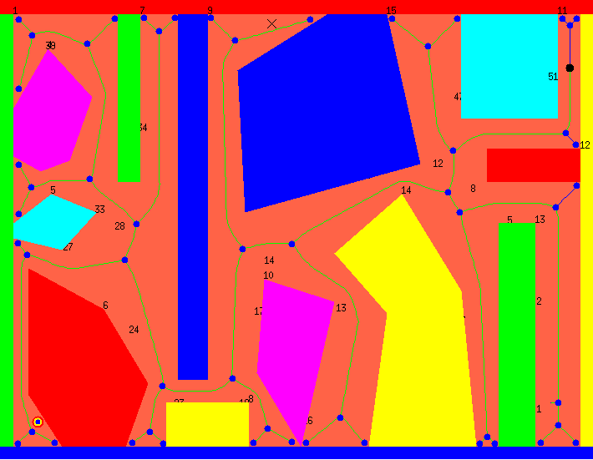
Goes back and catches missing areas
Motivation
SLAM
Exploration
-Frontier
-GVG
Sym-Grnd
Terrain
Maps
Impact
Sensing
Summary

Slide 37
Discussion of Exploration
Both methods work OK indoors, not so clear on utility outdoors
GVG
  Susceptible to noise, hard to recover nodes
Frontier
  Have to rate the frontiers so don’t trash
Motivation
SLAM
Exploration
-Frontier
-GVG
Sym-Grnd
Terrain
Maps
Impact
Sensing
Summary

Slide 38
Semantic world knowledge

Slide 39
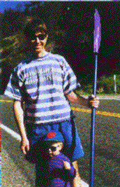
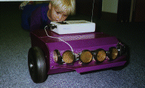
Saphira Architecture
Developed at SRI by Konolige, Myers, Saffioti
Comes with Pioneer robots
Behaviors produce fuzzy outputs, fuzzy logic combines them
Has a global rep called a Local Perceptual Structure to filter noise
Instead of RAPs, uses PRS-Lite
Motivation
SLAM
Exploration
-Frontier
-GVG
Sym-Grnd
Terrain
Maps
Impact
Sensing
Summary

Slide 40
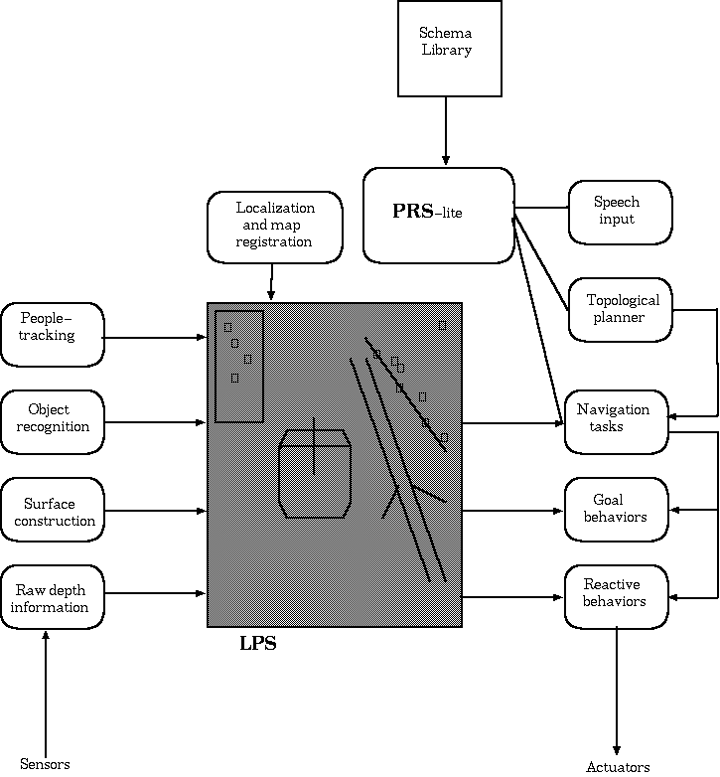
Saphira and LPS
Motivation
SLAM
Exploration
-Frontier
-GVG
Sym-Grnd
Terrain
Maps
Impact
Sensing
Summary

Slide 41
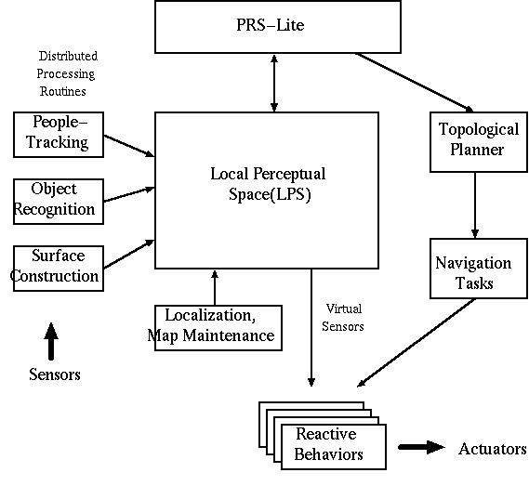
Motivation
SLAM
Exploration
-Frontier
-GVG
Sym-Grnd
Terrain
Maps
Impact
Sensing
Summary

Slide 42
Symbol-Grounding Problem
Computers (and AI) reasons using symbols
  Ex. “room”, “box,” “corner,” “door”
Robots perceive raw data
How to convert sensor readings to these labels?
Motivation
SLAM
Exploration
-Frontier
-GVG
Sym-Grnd
Terrain
Maps
Impact
Sensing
Summary

Slide 43
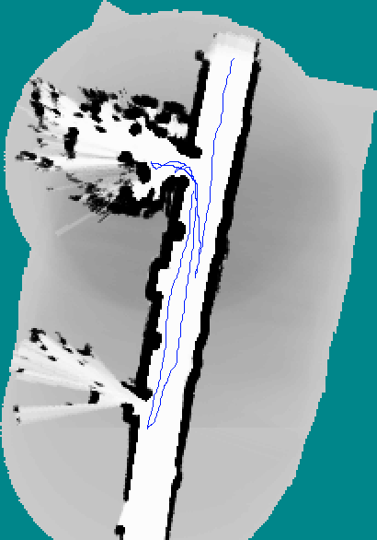
Spatial World Knowledge
What do you see?
How could a robot reliably extract the same labels?
Motivation
SLAM
Exploration
-Frontier
-GVG
Sym-Grnd
Terrain
Maps
Impact
Sensing
Summary

Slide 44
Terrain
What does terrain mapping mean?
Terrain Maps Types
  Elevation-oriented
  Imagery
    Mostly manual interpretation
Usually terrain mapping means getting elevation data
But in robotics, elevation maps are available so it’s more about mapping things that aren’t elevation
Motivation
SLAM
Exploration
-Frontier
-GVG
Sym-Grnd
Terrain
Maps
Impact
Sensing
Summary

Slide 45
Components of a Terrain Map
US Army Field Manual FM5-33 Terrain Analysis
Natural terrain
  Surface configuration: landforms, relief, slope or gradient
  Vegetation features
  Soil features
  Water features
Man-made features
  Urban areas
  Transportation: highways, railroads, bridges, culverts, tunnels, ferries, fords, … shipyards, naval bases, landings, airfields
Motivation
SLAM
Exploration
-Frontier
-GVG
Sym-Grnd
Terrain
Maps
Impact
Sensing
Summary

Slide 46
DTED Maps
Digital Terrain Elevation Data (DTED)
  Produced by NIMA (National Imagery and Mapping Agency)
  Shuttle created at least level 1, 2
Levels 3-5 are classified by US
But <10m data sets are commercially available
DTED Level | Post Spacing
1 | 100m
2 | 30m
3 | 10m
4 | 3m
5 | 1m
Motivation
SLAM
Exploration
-Frontier
-GVG
Sym-Grnd
Terrain
Maps
Impact
Sensing
Summary

Slide 47
Redux: Navigation
A priori knowledge
Mission
Cartographer
&
World model
Mission Planner
Navigator
Pilot
deliberative
reactive
behavior
behavior
behavior
behavior
behavior
SENSORS
ACTUATORS

Slide 48
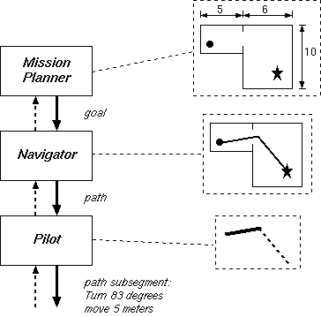
NHC Navigation Planning
Reasons about goals, ROE
Path Planning, any navigational constraints
Instantiates behaviors & monitors progress

Slide 49
Summary
SLAM works well for indoors, especially if range scans and multiple loops through an area
Frontier-based and GVG are two types of exploration, but not necessarily as intuitively efficient as might be expected
Symbol-ground problem remains a general challenge for AI and existing solutions are limited, highly domain specific
Terrain maps are available at low resolutions which are good for planning but terrible for execution
Outdoor navigation requires being able to sense terrain, but no reliable proprioceptive or exteroceptive methods, though proprioception appears more promising in the short term
Motivation
SLAM
Exploration
-Frontier
-GVG
Sym-Grnd
Terrain
Maps
Impact
Sensing
Summary

Slide 50
SLAM
Why is this a problem- can’t you just use GPS or some sort of RFID beacons?
  GPS is only for outdoors, RFID beacons for indoor encounter transmission problems
How can you simultaneously map the world and be sure where you are?
  You can use probabilistic methods to be reasonably certain where you are
How do you explore new areas efficiently or at least consistently?
  Generally use some type of frontier-based exploration method
What about labeling the map with objects and features or terrain?
  Adding semantics to a map is part of the symbol-ground problem or general recognition problem
  Some work has been done in terrain labeling but not a lot.
Notes:
This concludes this podcast and I look forward to you joining me next time.

