Slide 1

Design Principles
CSCE 489/689 (Software Security) Fall 2018
Philip Ritchey
Department of Computer Science and Engineering
Notes:
SSBSI Chapter 2

Slide 2
If you remember nothing else…
Design principles are guides to making design decisions
  Security design principles guide security design decisions
Security Design Principles are rooted in simplicity and restriction
All of the design principles are important but I will never forgive you if you don’t remember these:
  Least privilege
  Complete mediation
  Economy of mechanism
  Work factor

Slide 3
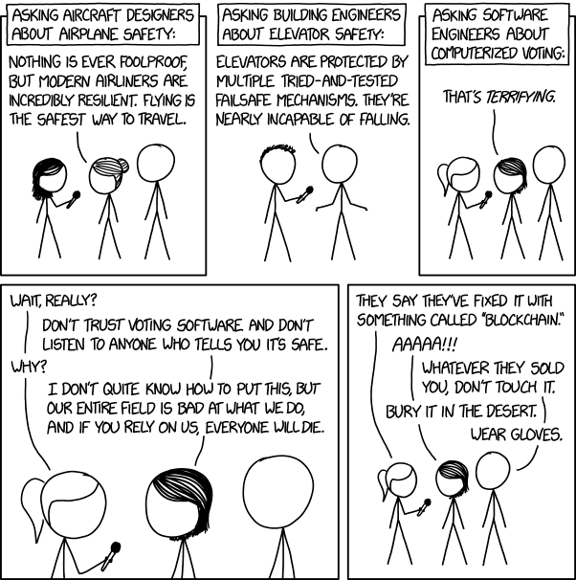
https://xkcd.com/2030/
Notes:
There are lots of very smart people doing fascinating work on cryptographic voting protocols. We should be funding and encouraging them and doing all our elections with paper ballots until everyone currently working in that field has retired.
XKCD has so many good comics that reference software and security. Find your favorite (doesn’t even have to be XKCD) and post it to Piazza.

Slide 4
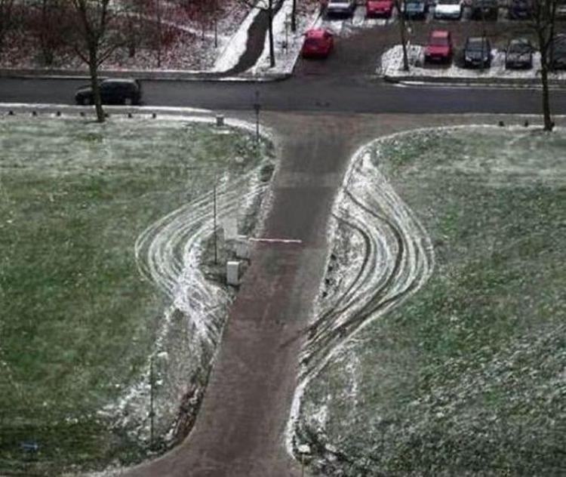
Notes:
An example of insecure design.
Also an example of compromise recording.

Slide 5
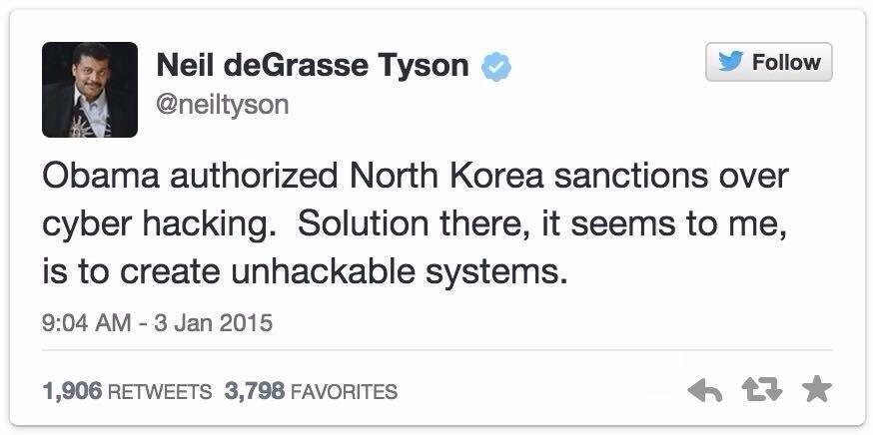
https://twitter.com/neiltyson/status/551378648578916353?lang=en
Notes:
SO MUCH easier said than done.
in fact, you should assume your system IS hackable and protect it even during an attack → defense in depth
@DeepakChopra’s reply is equally, if not more, asinine. “it’s still hackable to those who created it”
if they did their job well, then… just, no. Most devs can’t hack their own stuff, but that has never stopped others from finding vulnerabilities.

Slide 6
The Basics: Design Principles
Simplicity
  Less to go wrong
  Fewer possible inconsistencies
  Easy to understand
Restriction
  Minimize access
  Inhibit communication
Notes:
The design principles are rooted in simplicity and restrictiveness.
Simplicity lies on many levels. The basic idea is that simpler things have fewer components, so less can go wrong. Further, there are fewer interfaces, so there are fewer subjects communicating through the interfaces that can be inconsistent. Finally, they are easier to check, since the mechanism is not complex, and therefore easier to understand. There is also less to check.
Restriction minimizes the number and types of interactions between the subject and other subjects. In some (MIL/GOV) circles, an example is the “need to know” principle: only give the subject access to the information it needs to complete its task. It also should only be able to release information when required to by its goals. Note that this includes integrity, because by altering other subjects, the writer can communicate information (e.g. covert channels).

Slide 7
The Basics: Design Principles
Least privilege: Every program and every user of the system should operate using the least set of privileges necessary to complete the job.
Complete mediation: Every access to every object must be checked for authority.
Fail-safe defaults: Base access decisions on permission rather than exclusion.
Economy of mechanism: Keep the design as simple and small as possible.
Separation of privilege: Where feasible, a protection mechanism that requires two keys to unlock it is more robust and flexible than one that allows access to the presenter of only a single key.
Notes:
Saltzer and Schroeder's design principles are design principles enumerated by Jerome Saltzer and Michael Schroeder in their 1975 article The Protection of Information in Computer Systems, that from their experience are important for the design of secure software systems.
Fun example of not fail-safe default: Christmas classic movie “Diehard”. Hans Gruber and the Vault. Last stage is EM lock. Power cut, vault unlocked. Bad design!

Slide 8
The Basics: Design Principles
Open design: The design should not be secret.
Least common mechanism: Minimize the amount of mechanism common to more than one user and depended on by all users.
Psychological acceptability: It is essential that the human interface be designed for ease of use, so that users routinely and automatically apply the protection mechanisms correctly.
Work factor: Compare the cost of circumventing the mechanism with the resources of a potential attacker.
Compromise recording: It is sometimes suggested that mechanisms that reliably record that a compromise of information has occurred can be used in place of more elaborate mechanisms that completely prevent loss.
Notes:
Security is risk management

Slide 9
Least Privilege
A subject should be given only those privileges necessary to complete its task
  Function, not identity, controls
  Rights added as needed, discarded after use
  Minimal protection domain
Notes:
This is an example of restriction. Key concepts are:
Function: what is the task, and what is the minimal set of rights needed? “Minimal” here means that if the right is not present, the task cannot be performed. A good example is a UNIX network server that needs access to a port below 1024 (this access requires root).
Rights being added, discarded: if the task requires privileges for only one action, then the privileges should be added before the action and then removed. Going back to the UNIX network server, if the server need not act as root (for example, an SMTP server), then drop the root privileges immediately after the port is opened.
The protection domain statement emphasizes the other two. Protection domain is the set of things which NEED to be secure – i.e. trusted computing base.

Slide 10
Complete Mediation
Check every access
Usually done once, on first action
  UNIX: access checked on open, not checked thereafter
  This is not secure
If permissions change after, may get unauthorized access
Notes:
A common reason for relaxing this one is efficiency: if you do lots of accesses, the checks will slow you down substantially. It’s not clear if that is really true, though.
other common reasons: lazy or ignorant
Exercise: Have a process open a UNIX file for reading. From the shell, delete the read permissions that allow the process to read the file. Then have the process read from the open file. The process can do so. This shows the check is done at the open. If you want to be sure, have the process close the file. Then have the process try to reopen the file for reading. This open will fail.
Note that UNIX systems fail to enforce this principle to any degree on a superuser process, where access permissions are not even checked for an open! This is why people create management accounts (more properly, role accounts) like bin or mail: by restricting processes to those accounts, so access control checking applies. It also is an application of the principle of least privilege.
This principle is a primary underpinning for secure systems.

Slide 11
Fail-Safe Defaults
Default action is to deny access
If action fails, system as secure as when action began
Notes:
The first is well-known. Add rights explicitly; set everything to deny, and add back. This follows the Principle of Least Privilege. You see a variation when writing code that has security considerations. If you take untrusted data (such as input) that may contain meta-characters. The rule of thumb is to specify the LEGAL characters, and discard all others, rather than to specify the ILLEGAL characters and discard them.
The second is often overlooked, but goes to the meaning of “fail safe”: if something fails, the system is still safe. Failure should never change the security state of the system. Hence, if an action fails, the system should be as secure as if the action never took place.

Slide 12
Economy of Mechanism
Keep it as simple as possible
  KISS Principle
Simpler means less can go wrong
  And when errors occur, they are easier to understand and fix
Interfaces and interactions
Notes:
KISS principle: “Keep It Simple, Stupid”
Simplicity refers to all dimensions: design, implementation, operation, interaction with other components, even in specification. The toolkit philosophy of the UNIX system is excellent here; each tool is designed and implemented to perform a single task. The tools are then put together. This allows the checking of each component, and then their interfaces. It is conceptually much less complex than examining the unit as a whole. The key, though, is to define all interfaces completely (for example, environment variables and global variables as well as parameter lists).

Slide 13
Open Design
Security should not depend on secrecy of design or implementation
  Popularly misunderstood to mean that source code should be public
  “Security through obscurity is no security at all”
  Does not apply to information such as passwords or cryptographic keys
Assume the attacker has perfect knowledge
  Then obscure all you want
Notes:
Note that source code need not be available to meet this principle. It simply says that your security cannot depend upon your design being a secret. Secrecy can enhance the security, but if the design becomes exposed, the security of the mechanism cannot be affected.
The problem is that people are very good at finding out what secrets protect you. They may figure it out from the way the system works, or from reverse engineering the interface or system, or by more prosaic techniques such as dumpster diving.
This principle does not speak to secrets not involving design or implementation. For example, you can keep crypto keys and passwords secret.

Slide 14
Separation of Privilege
Require multiple conditions to grant privilege
  Separation of duty
  Defense in depth
Notes:
You need to meet more than one condition to gain access. Separation of duty says that the one who signs the checks cannot be the one who prints the checks because then a single person could steal money. To make that more difficult, the thief must compromise two people, not one.
This also provides a finer-grained control over a resource than a single condition.
Defense in depth: To get into a castle, you need to cross the moat, scale the walls, and drop down over the walls before you can get in. That is three barriers (conditions) that must be overcome (met).
add more: moat + outer walls + inner walls + buildings + rooms inside buildings = 5 barriers

Slide 15
Least Common Mechanism
Mechanisms should not be shared
  Information can flow along shared channels
  Covert channels
Isolation
  Virtual machines
  Sandboxes
Notes:
Isolation prevents communication, and communication with something—another process or a resource—is necessary for a breach of security. Limit the communication, and you limit the damage. So, if two processes share a resource, by coordinating access, they can communicate by modulating access to the resource.
Examples: percent of CPU used. To send a 1 bit, the first process uses 75% of the CPU; to send a 0 bit, it uses 25% of the CPU. The other process sees how much of the CPU it can get and from that can tell what the first process used, and hence is sending. Variations include filling disks, creating files with fixed names, and so forth.
Approaches to implementing this principle: isolate each process, via virtual machines or sandboxes (a sandbox is like a VM, but the isolation is not complete).

Slide 16
Psychological Acceptability
Security mechanisms should not add to difficulty of accessing resource
  Hide complexity introduced by security mechanisms
  Ease of installation, configuration, use
  Human factors critical here
Notes:
This recognizes the human element. General rules are:
Be clear in error messages. You don’t need to be detailed (e.g., did the user mistype the password or login name) but you do need to state the rules for using the mechanism (in the example, that the user must supply both password and login name).
Don’t be too detailed. “wrong password” tells attacker that they have a valid username.
Use (and compilation, installation, etc.) must be straightforward. It’s okay to have scripts or other aids to help here. But, for example, data types in the configuration file should either be obvious or explicitly stated. A “duration” field does not indicate if the period of time is to be expressed in hours, minutes, seconds, or something else, nor whether fractional units are allowed (a float) or not (an integer). The latter is actually a common bug. If duration is in minutes, then does “0.5” mean 30 seconds (as a float) or 0 seconds (as an integer)? If the latter, an error message should be given (“invalid type”).
This is usually interpreted as meaning the mechanism must not impose an onerous burden. Strictly speaking, passwords violate this rule (because it’s not as easy to access a resource by giving a password as accessing the resource without a password), but the password is considered a minimal burden.

Slide 17
Work Factor
Make it more expensive (time & effort) to successfully attack the system than the reward for a successful attack.
  Defense in depth has multiplicative effect on work factor: must find exploit(s) that can get past all levels of defenses
  Make explicit assumptions about attacker capabilities and motivation
Balance cost of defense against value of assets.
  100% security not possible
  Prioritize threats
Notes:
Work factor = what is “enough” security? Threat model → risk analysis / management
The best way to survive a polar bear attack is to take a friend that you can outrun.

Slide 18
Compromise Recording
Auditing: keep an append-only, tamper-resistant log of events in a secure location.
  Append-only: no editing or deleting → impossible(?) to cover tracks
  Tamper-resistant: require authentication and authorization to append AND detect unauthorized appends
  Secure location: do not put it in the same place as other data, keep backups in another secure location
Incident response relies on accurate records of events
  Can also help in troubleshooting and debugging
Notes:
Compromise recording = auditing
“It is sometimes suggested that mechanisms that reliably record that a compromise of information has occurred can be used in place of more elaborate mechanisms that completely prevent loss.”
only for when the cost of defending is too great (risk must be accepted, so accept it with auditing)
for everything, don’t only record compromise, record all actions (because all actions can lead to compromise)

Slide 19


Thanks and Gig ‘em!
WHOOP!

