Slide 1

CSCE 431
Software Engineering
Philip Ritchey
slides generously gifted by Jeff Huang

Slide 2
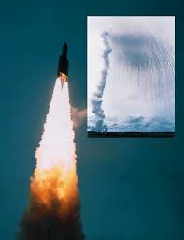

Ariane 5 Rocket Explosion
  1996 => wasted $500M
Notes:
Decollage = takeoff; 350M of satellites; save memory 16 bit
unmanned Ariane 5 rocket launched by the European Space Agency
the cause of the failure was a software error in the inertial reference system. Specifically a 64 bit floating point number relating to the horizontal velocity of the rocket with respect to the platform was converted to a 16 bit signed integer. The number was larger than 32,767, the largest integer storeable in a 16 bit signed integer, and thus the conversion failed.
June 4, 1996 -- Ariane 5 Flight 501. Working code for the Ariane 4 rocket is reused in the Ariane 5, but the Ariane 5's faster engines trigger a bug in an arithmetic routine inside the rocket's flight computer. The error is in the code that converts a 64-bit floating-point number to a 16-bit signed integer. The faster engines cause the 64-bit numbers to be larger in the Ariane 5 than in the Ariane 4, triggering an overflow condition that results in the flight computer crashing.
First Flight 501's backup computer crashes, followed 0.05 seconds later by a crash of the primary computer. As a result of these crashed computers, the rocket's primary processor overpowers the rocket's engines and causes the rocket to disintegrate 40 seconds after launch.
From wired Magazine, History's Worst Software Bugs, 2005, http://www.wired.com/software/coolapps/news/2005/11/69355?currentPage=2
French for “take off” decollage, applause
That is what a SW bug looks like
Worked in Ariane 4. Went faster, higher speed, arithmetic overflow: 64bit FP to 16bit integer

Slide 3
More SW Disasters
Therac-25 lethal radiation overdose
  1985: Reused SW from machine with HW interlock on machine without it: SW bug => 3 died
Mars Climate Orbiter disintegration
  1999: SW used wrong units (pound-seconds vs. newton-seconds) => wasted $325M
FBI Virtual Case File project abandonment
  2005: give up after 5 years of work => wasted $170M

Slide 4
How Can You Avoid Infamy?
Lessons from 60 years of SW development
This class will review many approaches in lecture, listing pros and cons
Will get hands on experience with one approach good for Software as a Service (e.g., Amazon)

Slide 5
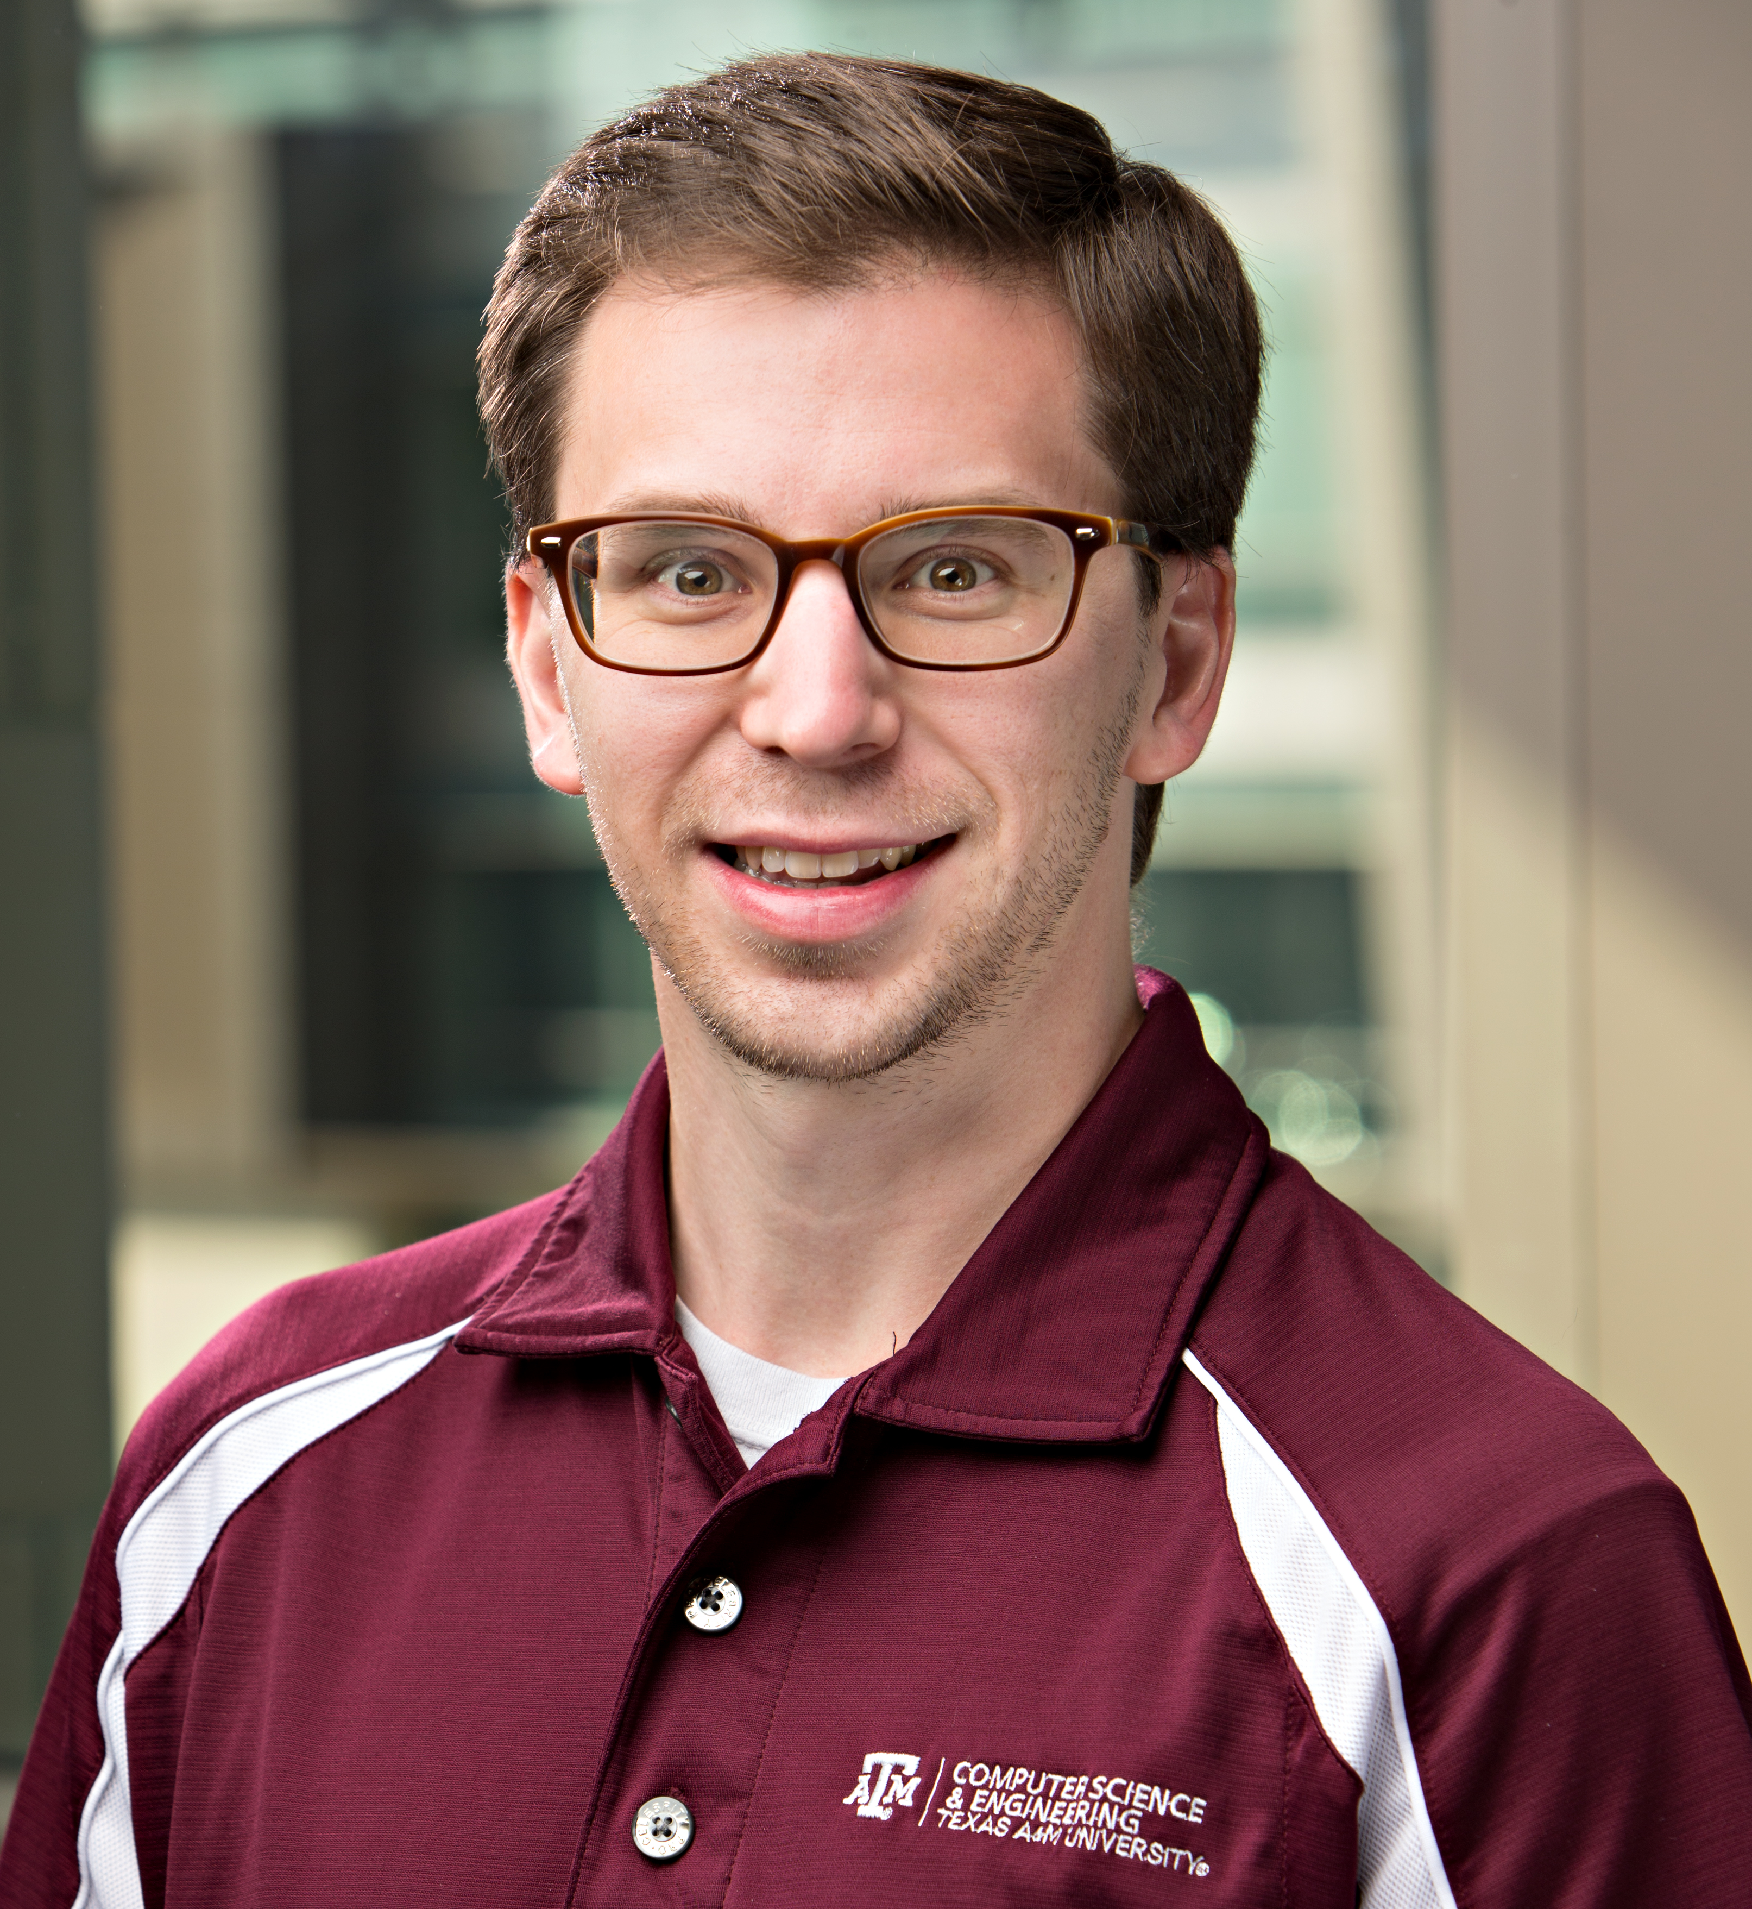
Course Staff
GitHub ID:
philipritchey (ritchey@cse.tamu.edu)
Course web:
faculty.cs.tamu.edu/ritchey/courses/csce431/winter18

Slide 6
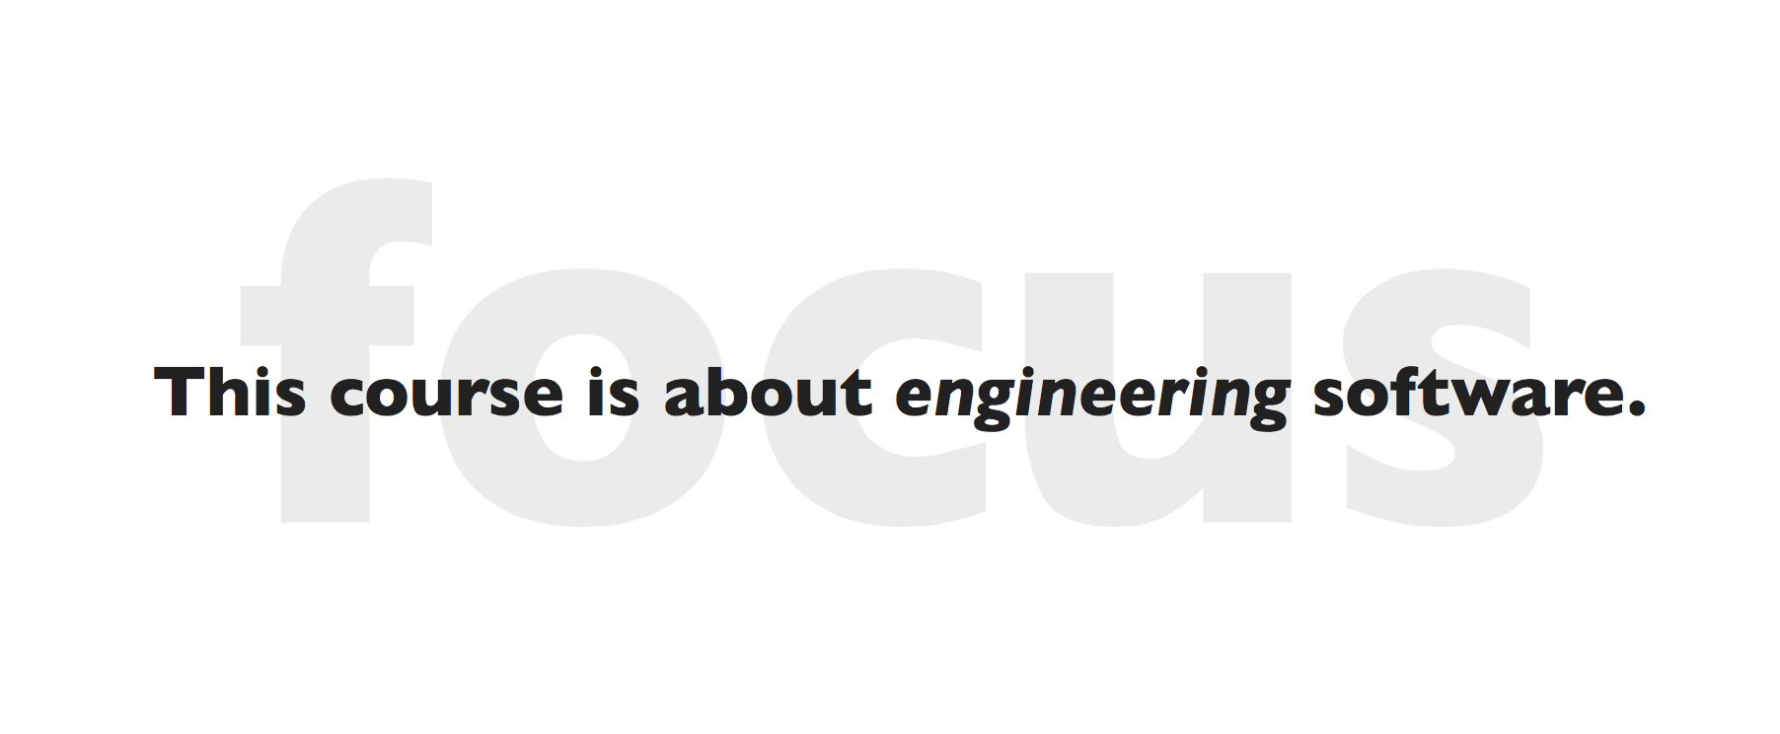
What’s This Course About

Slide 7
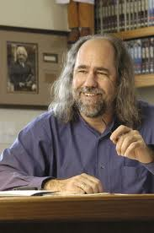
Grady Booch
“Software is the invisible writing that whispers the stories of possibilities to our hardware. We are the story makers. We are the story tellers.”
  – Grady Booch
he invented UML

Slide 8
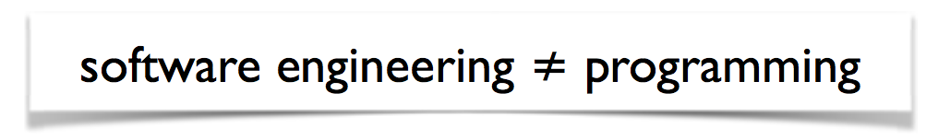
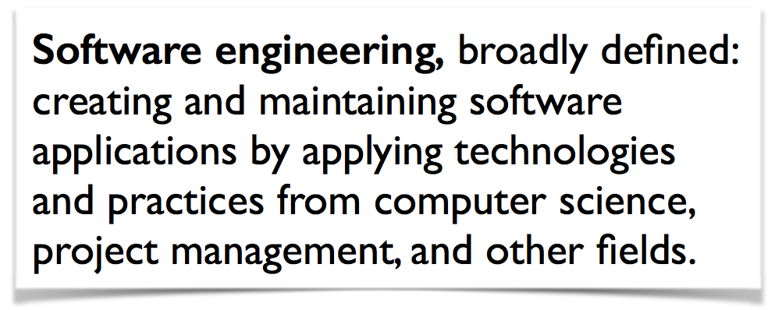
What is Software Engineering

Slide 9
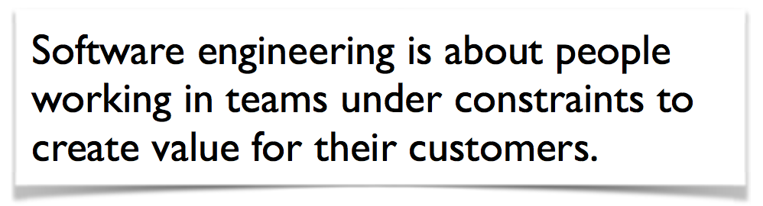
What is Software Engineering

Slide 10
Aspects of Software Engineering
Processes, methods, and techniques necessary to turn a concept into a robust deliverable that can evolve over time
Working with limited time and resources
Satisfying a customer
Managing risk
Teamwork and communication

Slide 11
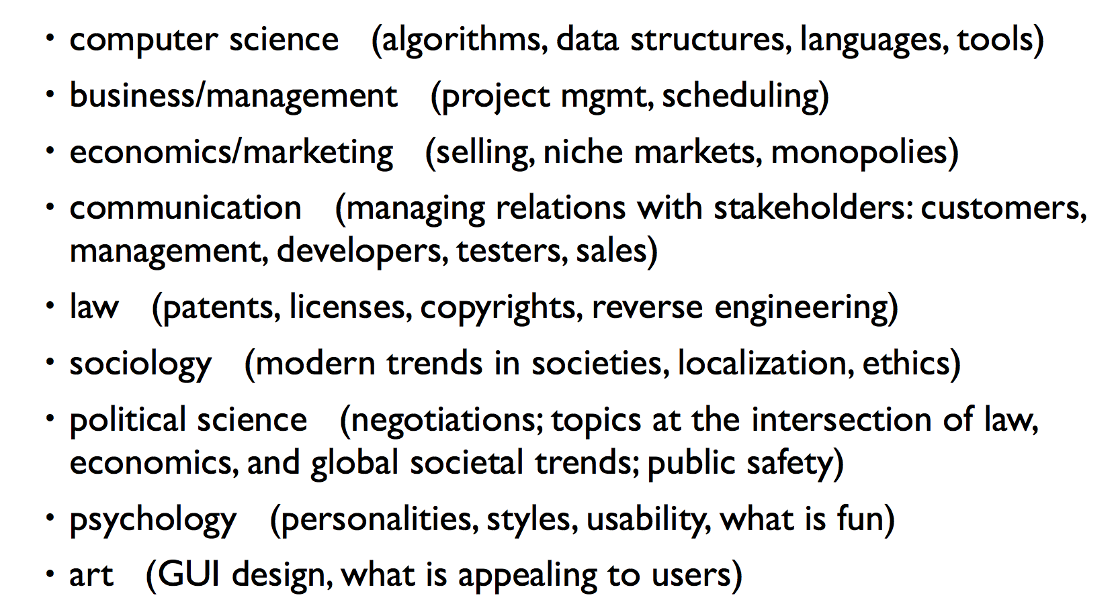
Ties to Many Fields

Slide 12
Ties to Many Fields
Necessarily “softer” than other parts of CS; fewer clearly right/wrong answers

Slide 13
Roles of People in Software

Slide 14
Roles of People in Software
customer / client: wants software built
  often doesn't know what he/she wants
managers: make plans, coordinate team
  hard to foresee all problems in advance
developers: design and write code
  hard to write complex code for large systems
testers: perform quality assurance (QA)
  impossible to test every combination of actions
users: purchase and use software product
  can be fickle and can misunderstand the product

Slide 15
Roles of People in Software
customer / client: wants software built
  often doesn't know what he/she wants
managers: make plans, coordinate team
  hard to foresee all problems in advance
developers: design and write code
  hard to write complex code for large systems
testers: perform quality assurance (QA)
  impossible to test every combination of actions
users: purchase and use software product
  can be fickle and can misunderstand the product

Slide 16
Roles of People in Software
customer / client: wants software built
  often doesn't know what he/she wants
managers: make plans, coordinate team
  hard to foresee all problems in advance
developers: design and write code
  hard to write complex code for large systems
testers: perform quality assurance (QA)
  impossible to test every combination of actions
users: purchase and use software product
  can be fickle and can misunderstand the product

Slide 17
Roles of People in Software
customer / client: wants software built
  often doesn't know what he/she wants
managers: make plans, coordinate team
  hard to foresee all problems in advance
developers: design and write code
  hard to write complex code for large systems
testers: perform quality assurance (QA)
  impossible to test every combination of actions
users: purchase and use software product
  can be fickle and can misunderstand the product

Slide 18
Roles of People in Software
customer / client: wants software built
  often doesn't know what he/she wants
managers: make plans, coordinate team
  hard to foresee all problems in advance
developers: design and write code
  hard to write complex code for large systems
testers: perform quality assurance (QA)
  impossible to test every combination of actions
users: purchase and use software product
  can be fickle and can misunderstand the product

Slide 19
Roles of People in Software
customer / client: wants software built
  often doesn't know what he/she wants
managers: make plans, coordinate team
  hard to foresee all problems in advance
developers: design and write code
  hard to write complex code for large systems
testers: perform quality assurance (QA)
  impossible to test every combination of actions
users: purchase and use software product
  can be fickle and can misunderstand the product

Slide 20
Course Goals
Learn Software Engineering Principles by understanding new challenges, opportunities, and open problems of Software as a Service (SaaS)
Take a SaaS project from conception to public deployment
  Solve Non-Technical Customer problem
  Server side: Ruby on Rails
  Client side: HTML, CSS, AJAX, JavaScript
  Deploy using cloud computing

Slide 21
Example: Online Survey System (Museum of the American G.I.)
Website
  https://warm-refuge-8672.herokuapp.com/
First interview with the customer
  https://www.youtube.com/watch?v=hj2eZI-msBg
Final interview with the customer
  https://vimeo.com/148158365
Final demo
  https://www.youtube.com/watch?v=g9gnaHs_n3Y
Your team will produce all of these for your project

Slide 22
Project Culture
This is a REAL project
  We expect you to work to build a real system
  To be used by real people
This is REAL engineering
  Take initiative
  Find and solve problems by yourselves
  Coding is only part of the job
  Good planning and design, hitting your market, and working well with your team, all are needed for success

Slide 23
From Previous Students
“I loved the project!! This is such a real world experience and I have gotten more from this project than any other project in college.”
“The team project was so great to work with in this class.”
“The course itself is a great opportunity to do real work that mimics the real world.”

Slide 24
Continued
“Such a great course and professor overall. Definitely one of the best courses offered for CSCE majors.”
“This is probably one of the most important classes I have taken at A&M because of the project alone.”
“I enjoyed this course and the projects that we did. We learned a lot about things that will actually be useful in the real world.”
“I like how the course emphasized pair programming, which is something I had not done before.”

Slide 25
Continued …
“I enjoyed this course so much. There were virtually no problems with it and the prof is a delight …”

Slide 26
Course Webpage
http://faculty.cs.tamu.edu/ritchey/courses/csce431/winter18
  Redirects to Google Classroom
  https://classroom.google.com/u/0/c/NTkyOTg3MjUyOVpa
  Class code: 4mjrzp3
All course materials & announcements will be updated on the Google Classtoom page
Check regularly!

Slide 27
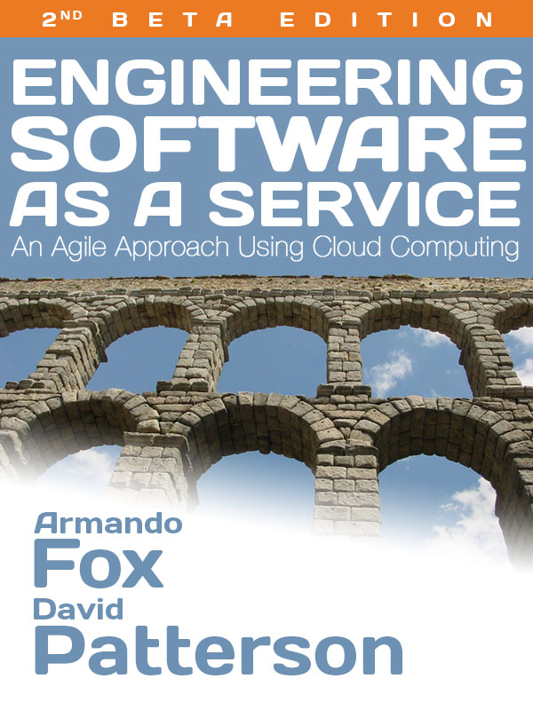
Textbook
http://saasbook.info
1st edition
(1.2.1 as of 5/2016)
  Ebook ($10)
    Kindle format
  Print book ($30)
  Print + Ebook bundle
  ($33)
Notes:
New this year is a textbook – now
Guarantees
Cheapest new textbook you’ve purchased
Best textbook you’ll ever read by a wrestler and a musical director
Will be updated as ebook if find bugs
Hoping trouble shoot beta edition

Slide 28
Course Q/A
Google Classroom
  If that sucks, then we’ll use Piazza
We will post questions and answers there

Slide 29
Grading and Academic Integrity
Grading
  Team Project: 50%
  Reading and Homework: 20%
  Midterm Exam: 15%
  Class Participation and Quiz: 15%
    several random quizzes
Late policy: cost you 25% per late day
Academic Integrity (see Syllabus)
  Do NOT cheat!
  Do individual work by yourself
  Do group work with your teammates only.
Notes:
Getting behind is a much worse penalty than the points…

Slide 30
A Typical Week
Class sessions to discuss best practices (mornings)
Lab sessions to discuss pragmatics and tools, meet with your team, and to meet with TA (afternoons)
Reading assignments to reinforce the concepts
Team project: to give you hands-on experience with the material
  Frequent team meetings (at minimum, each lab time)

Slide 31
Projects for Non-Profits
Teams of 5~6 students build projects for non-technical customers from nearby nonprofit organizations, e.g.,
  College Station Fire Department
  Museum of the American G.I.
  Health For All
  Texas Auctioneers Association
  TAMU Student Engineers' Council
  TAMU CSE, Bryan High School, etc

Slide 32
Results/Observations
Non-technical customer feedback
  90% of teams reported customers “happy” or “thrilled”
  50% of customers tried to hire students to continue work
  67% of students intend to maintain app after semester
Students engaged in process
  Projects varied in code quantity but rarely quality

Slide 33
Project Schedule
Check course webpage
Teams meet with Instructor at least once per iteration; start forming now!

Slide 34
Virtual Machine (VM)
  Option 1: Cloud9
  http://www.saasbook.info/bookware-vm-instructions
  Option 2: Vagrant+VirtualBox
    Run on your computer (for Mac, Win, Linux)
    https://gorails.com/guides/using-vagrant-for-rails-development

Slide 35
Lessons from Past Students
Communication
Scheduling
Testing and Coordination

Slide 36
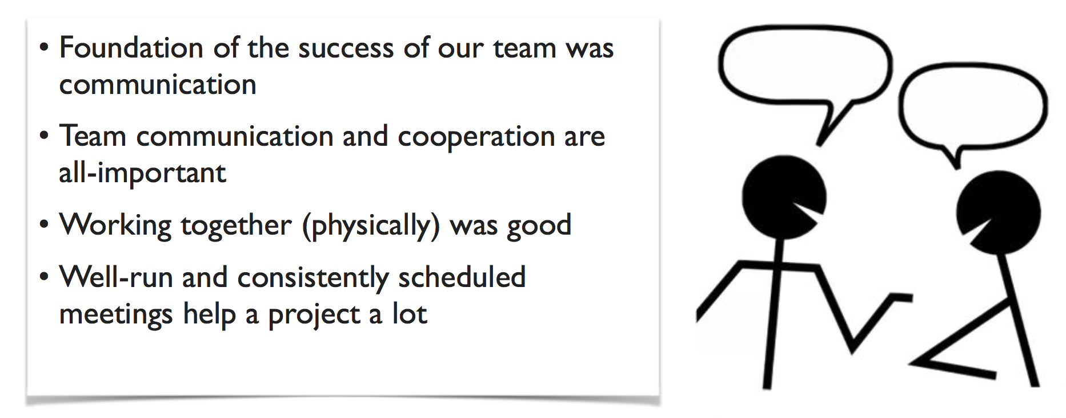
Communication

Slide 37
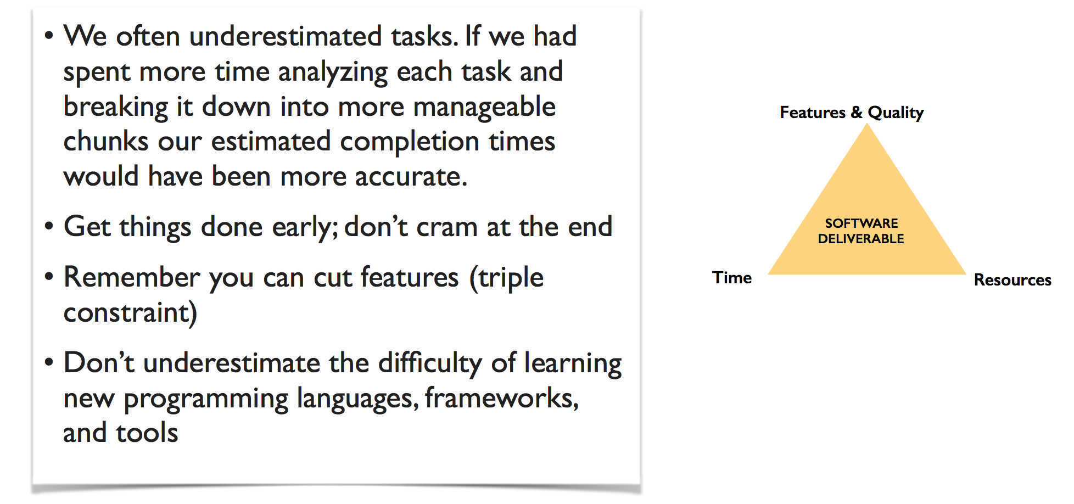
Scheduling

Slide 38
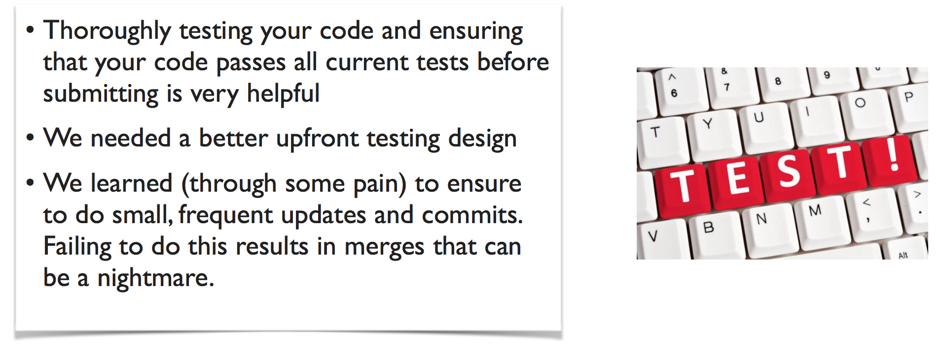
Testing and Coordination

Slide 39
Unique Aspects of This Course
Cross-disciplinary nature of the subject
Larger teams
Work with real, non-technical customers
Course staff in the "coach" role
Mistakes along the way are encouraged, not penalized
Few clearly right/wrong answers
Plans always change
Content: software design, testing, project management, etc.

Slide 40
Call for Projects
  https://parasol.tamu.edu/~jeff/course/431_spring2017/cfp.html
You are encouraged to propose your own project :
  Check the FAQ to make sure it meets our criteria (on which we must be firm, to keep the course running smoothly).
  Make sure everyone on the team agrees to this project.
  Email the instructor with the team name, customer name, email, and phone, and a summary of the proposed project.
  The instructor will let you know if this project is approved.

Slide 41
The Future of Software Engineering
“Software is the invisible writing that whispers the stories of possibilities to our hardware. We are the story makers. We are the story tellers.”
  – Grady Booch
  Reading 0: Watch this video and post one sentence in the video that you like most and explain why.
  Question on Classroom

Slide 42
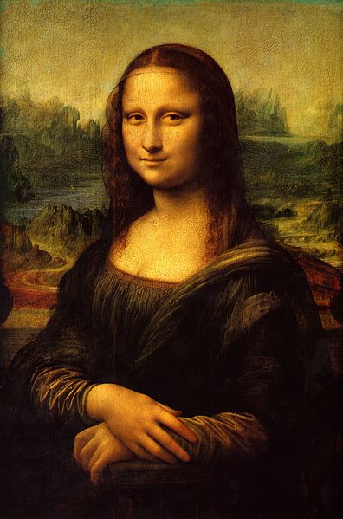
Legacy SW vs. Beautiful SW
(Engineering Software as a Service §1.7)

Slide 43
Programming Aesthetics
Do I care what others think of my code?
  If it works, does it matter what code looks like?
Notes:
Will anyone else ever look at your code?

Slide 44
Legacy SW vs. Beautiful SW
Legacy code: old SW that continues to meet customers' needs, but difficult to evolve due to design inelegance or antiquated technology
  ___% SW maintenance costs adding new functionality to legacy SW
  ___% for fixing bugs
Contrasts with beautiful code: meets customers' needs and easy to evolve
Notes:
60% SW maintenance
17% fixing bugs
Failure: Unexpectedly short-lived code
Example in book of program used for 50 years
Yet Legacy SW is successful SW
If connotation of antiquaited, old-fashioned
What is contrast to legacy code
Easy to evolve; evolution to

Slide 45
Legacy SW vs. Beautiful SW
Legacy code: old SW that continues to meet customers' needs, but difficult to evolve due to design inelegance or antiquated technology
  60% SW maintenance costs adding new functionality to legacy SW
  17% for fixing bugs
Contrasts with beautiful code: meets customers' needs and easy to evolve
Notes:
60% SW maintenance
17% fixing bugs
Failure: Unexpectedly short-lived code
Yet Legacy SW is successful SW

Slide 46
Legacy Code: Vital but Ignored
Missing from traditional SWE courses and textbooks
#1 request from industry experts we asked: What should be in new SWE course?
  Save work by reusing existing code (e.g., open source)
Will have legacy lectures and programming assignments later in course
  Helps you learn how to make beautiful code
Notes:
Our paychecks delivered with Cobol
Amazon, Google, Microsoft, all companies – chapter and programming code

Slide 47

Quality Assurance &Testing
(Engineering Software as a Service §1.8)

Slide 48
Software Quality
What is software quality, and how to we assure it? (QA)
V&V: What is the difference (if any) between Verification and Validation?

Slide 49
Software Quality
Product quality (in general): “fitness for use”
  Business value for customer and manufacturer
  Quality Assurance : processes/standards
  => high quality products & to improve quality
Software quality:
  Satisfies customers’ needs - easy to use, gets correct answers, does not crash, …
  Be easy for developer to debug and enhance
Software QA: ensure quality and improve processes in SW organization

Slide 50
Assurance
Verification: Did you build the thing right?
  Did you meet the specification?
Validation: Did you build the right thing?
  Is this what the customer wants?
  Is the specification correct?
Hardware focus generally Verification
Software focus generally Validation
Testing to Assure Software Quality
Notes:
HW on verification
SW on validation

Slide 51
Testing
Exhaustive testing infeasible
Divide and conquer: perform different tests at different phases of SW development
  Upper level doesn’t redo tests of lower level
System or acceptance test: integrated program meets its specifications
Integration test: interfaces between units have consistent assumptions, communicate correctly
Module or functional test: across individual units
Unit test: single method does what was expected
Notes:
1 ns test, 64-bit variable, 2^64 ns = 500 years!
e.g., unit testing works within a single class and functional testing works across classes
Unit test: single method does what was expected
Module or functional test: across individual units (within a class)
Integration test: interfaces between units have consistent assumptions, communicate correctly
System or acceptance test: integrated program meets its specifications

Slide 52
More Testing
Black box vs. White Box testing
  Testing based on specs vs. on implementation
Test Coverage: % of code paths tested
Regression testing: automatically rerun old tests to check that changes don’t break what used to work
Continuous Integration (CI) testing: continuous regression testing on each code check-in vs. later testing phase
Notes:
Conditional variables
Evolve over time; run every night
Modern service continuous tests as evolve it
TDD (test-driven development) seems unnatural

Slide 53
Which is NOT True About Testing?
☐
With better test coverage, you are more likely to catch faults
☐
While difficult to achieve, 100% test coverage insures design reliability
☐
Each higher level test delegates more detailed testing to lower levels
☐
Unit testing works within a single class and module testing works across classes
Notes:
Answer of what is wrong: While difficult to achieve, 100% test coverage insures design reliability

Slide 54
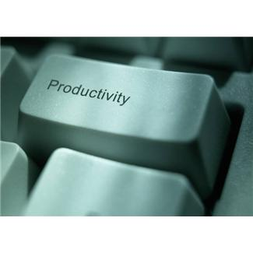
Productivity: Conciseness, Synthesis, Reuse, and Tools
(Engineering Software as a Service §1.9)

Slide 55
Productivity
50 years of Moore’s Law => 2X /1.5 years
  HW designs get bigger
  Faster processors and bigger memories
  SW designs get bigger
  Had to improve SW productivity
4 techniques
  Clarity via conciseness
  Synthesis
  Reuse
  Automation and Tools

Slide 56
Clarity via conciseness
Syntax: shorter and easier to read
assert_greater_than_or_equal_to(a,7)
vs. ________________
Notes:
a.should be ≥ 7
Bad syntax is hard to read!
Legal Ruby code!

Slide 57
Clarity via conciseness
Syntax: shorter and easier to read
assert_greater_than_or_equal_to(a,7)
vs. a.should be ≥ 7
Raise the level of abstraction:
  HLL programming languages vs. assembler
  Automatic memory management (Java vs. C)
  Scripting languages: reflection, metaprogramming
Notes:
a.should be ≥ 7

Slide 58

Synthesis
Software synthesis
  BitBlt: generate code to fit situation & remove conditional test
Research Stage: Programming by example

Slide 59
Reuse
Reuse old code vs. write new code
Techniques in historical order:
Procedures and functions
Standardized libraries (reuse single task)
Object oriented programming: reuse and manage collections of tasks
Design patterns: reuse a general strategy even if implementation varies
Notes:
Big productivity gain
To reuse

Slide 60
Automation and Tools
Replace tedious manual tasks with automation to save time, improve accuracy
  New tool can make lives better (e.g., make)
Concerns with new tools: Dependability,
UI quality, picking which one from several
Good software developer must repeatedly learn how to use new tools: lifetime learning
  Lots of chances in this course:
  Cucumber, RSpec, Pivotal Tracker, …

Slide 61
Which is TRUE About Productivity?
☐
Copy and pasting code is another good way to get reuse
☐
Metaprogramming helps productivity via program synthesis
☐
Of the 4 productivity reasons, the primary one for HLL is reuse
☐
A concise syntax is more likely to have fewer bugs and be easier to maintain
Notes:
HLL – raise the level abstraction, it does synthesis
TRUE: Metaprogramming helps productivity via program synthesis
Χονχισε – 50 λινεσ οφ ϑαϖα; ηοω μανψ δοινγ σομετηινγ, ϖσ. γιϖινγ ιντεντ οφ ωηατ γοινγ το δο
(νοτ Περλ – τοο χονχισε το βε υνδερστανδαβλε)

Slide 62
DRY
“Every piece of knowledge must have a single, unambiguous, authoritative representation within a system.”
  Andy Hunt and Dave Thomas, 1999
Don't Repeat Yourself (DRY)
  Don’t want to find many places have to apply same repair
Refactor code so that it has a single place to do things

