Slide 1
CSCE 315: Programming Studio
Artificial Intelligence

Slide 2
What is AI?
 | Human | Rational
Think | Systems that think like humans. | Systems that think rationally.
Behave | Systems that act like humans. | Systems that act rationally.

Slide 3
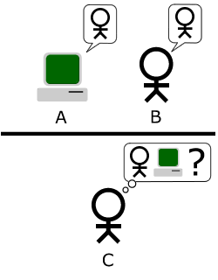
Acting Human: The Turing Test Approach
Computer Requires:
Natural Language Processing (NLP)
Knowledge Representation
Automated Reasoning
Machine Learning
[Computer Vision]
[Robotics]
Little effort devoted to passing the test.
The goal of aeronautical engineering is not to make “machines that fly so exactly like pidgeons that they can fool even other pidgeons”.

Slide 4
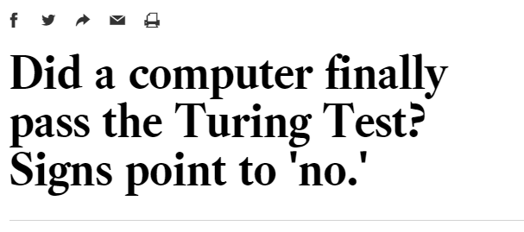
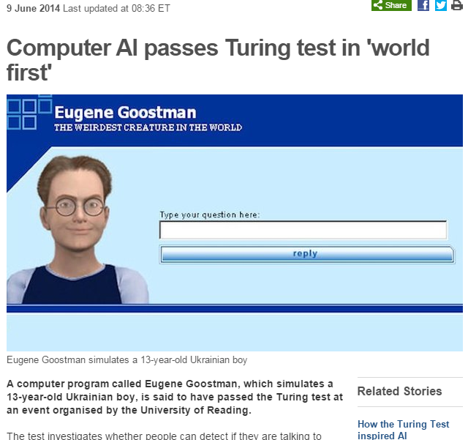

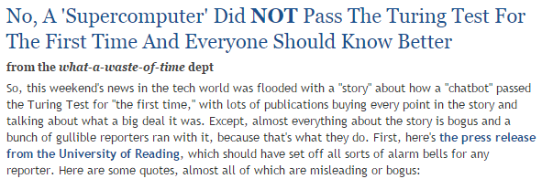
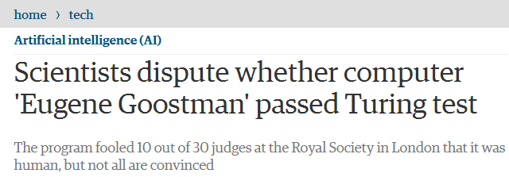
Eugene Goostman

Slide 5
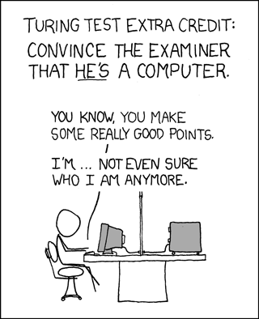
Hit Turing right in the test-ees.

Slide 6
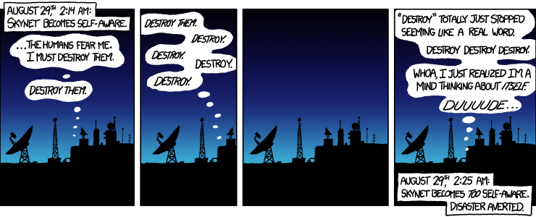
'YOUR CLOTHES. GIVE THEM TO ME.'
'Shit, uh ... you are now breathing manually!'
'I AM ALWAYS BREATHING MANUALLY.'

Slide 7
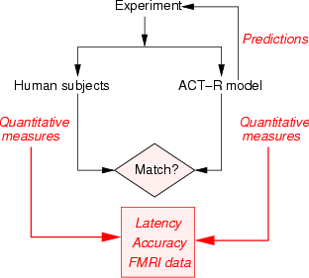
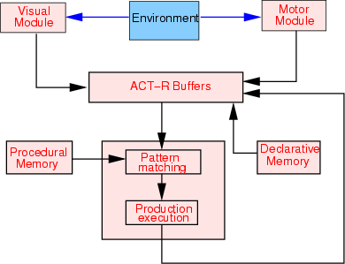
Thinking Humanly: Cognitive Modeling

Slide 8
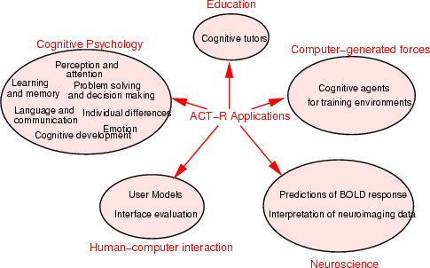
Thinking Humanly: Cognitive Modeling

Slide 9
Thinking Rationally: The Laws of Thought
Identity:
  First then this at least is obviously true, that the word "be" or "not be" has a definite meaning, so that not everything will be "so and not so". Again, if "man" has one meaning, let this be "two-footed animal"; by having one meaning I understand this:—if "man" means "X", then if A is a man "X" will be what "being a man" means for him. (It makes no difference even if one were to say a word has several meanings, if only they are limited in number; for to each definition there might be assigned a different word. For instance, we might say that "man" has not one meaning but several, one of which would have one definition, viz. "two-footed animal", while there might be also several other definitions if only they were limited in number; for a peculiar name might be assigned to each of the definitions. If, however, they were not limited but one were to say that the word has an infinite number of meanings, obviously reasoning would be impossible; for not to have one meaning is to have no meaning, and if words have no meaning our reasoning with one another, and indeed with ourselves, has been annihilated; for it is impossible to think of anything if we do not think of one thing; but if this is possible, one name might be assigned to this thing.)
Non-contradiction:
  It is impossible, then, that "being a man" should mean precisely not being a man, if "man" not only signifies something about one subject but also has one significance ... And it will not be possible to be and not to be the same thing, except in virtue of an ambiguity, just as if one whom we call "man", and others were to call "not-man"; but the point in question is not this, whether the same thing can at the same time be and not be a man in name, but whether it can be in fact.
Excluded Middle:
  But on the other hand there cannot be an intermediate between contradictories, but of one subject we must either affirm or deny any one predicate. This is clear, in the first place, if we define what the true and the false are. To say of what is that it is not, or of what is not that it is, is false, while to say of what is that it is, and of what is not that it is not, is true; so that he who says of anything that it is, or that it is not, will say either what is true or what is false.

Slide 10
Acting Rational: Rational Agents
Agent: anything which acts.
Computer agents have attributes distinguishing them from programs:
  Autonomous control
  Perception of environment
  Persistence for prolonged period of time
  Adaptation
  Taking on the goals of others
Rational Agents act to achieve the best [expected] outcome.

Slide 11
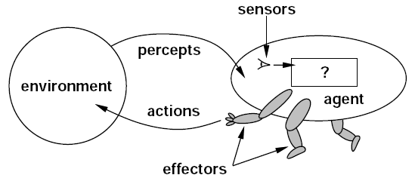
Acting Rational: Rational Agents

Slide 12
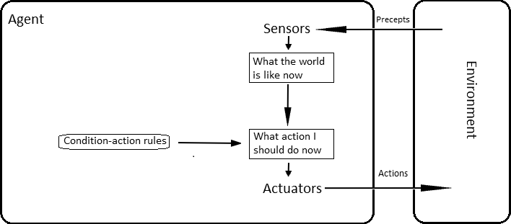
Acting Rational: Rational Agents
Many kinds of agents:
  simple reflex agents
  model-based reflex agents
  goal-based agents
  utility-based agents
  learning agents
Simple Reflex Agent

Slide 13
The Foundations of AI
Philosophy
  Can formal rules be used to draw valid conclusions?
  How does the mental mind arise from a physical brain?
  Where does knowledge come from?
  How does knowledge lead to action?
Mathematics
  What are the formal rules to draw valid conclusions?
  What can be computed?
  How do we reason with uncertain information?

Slide 14
The Foundations of AI
Economics
  How should we make decisions so as to maximize profit (or utility)?
  How should we do this when others may not go along?
  How should we do this when the payoff may be far in the future?
Neuroscience
  How do brains process information?
Psychology
  How do humans and animals think and act?

Slide 15
The Foundations of AI
Computer Engineering
  How can we build an efficient computer?
Control Theory and Cybernetics
  How can artifacts operate under their own control?
Linguistics
  How does language relate to thought?

Slide 16
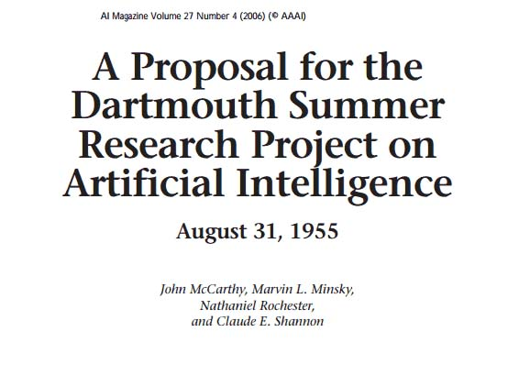
The Birth of AI

Slide 17
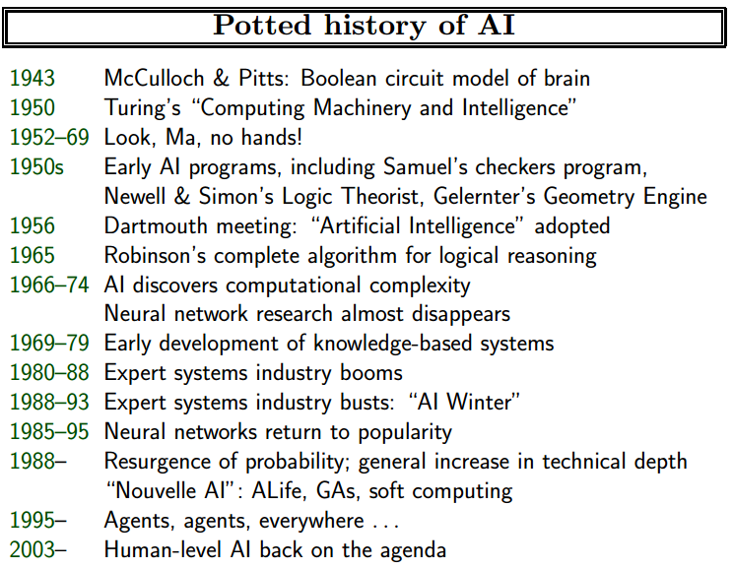

Slide 18
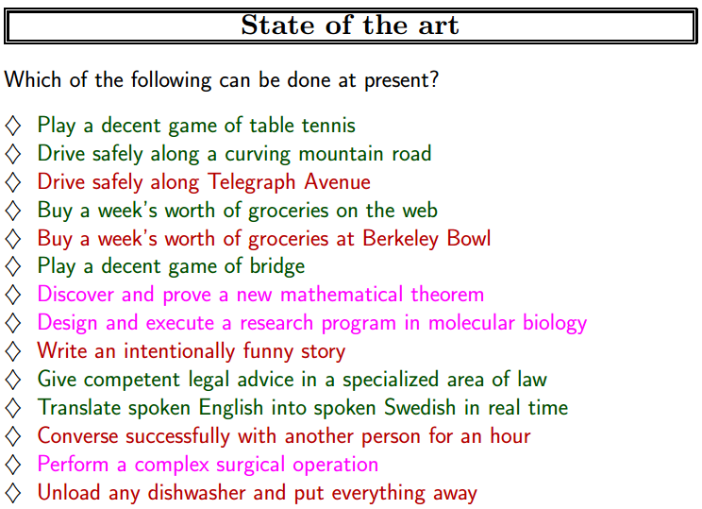
(2003)

