Slide 1
Programming
J. Michael Moore
CSCE 121

Slide 2
Programming
Discovering how, in principle, a problem can be solved by a computer
Translating this solution into a form (a program, or software) that can be executed by a computer

Slide 3
Our civilization runs on software
Most engineering activities involve software
Most programs do not run on things that look like a PC…

Slide 4


Aircraft
Communication
Control
Display
Signal Processing
Monitoring

Slide 5
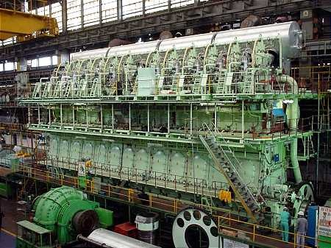
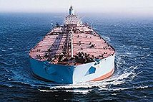
Ships
Design
Construction
Management
Monitoring
Hull Design
Pumps

Slide 6
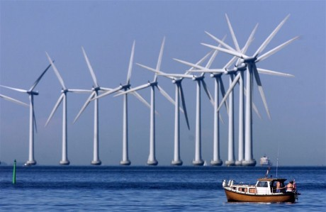

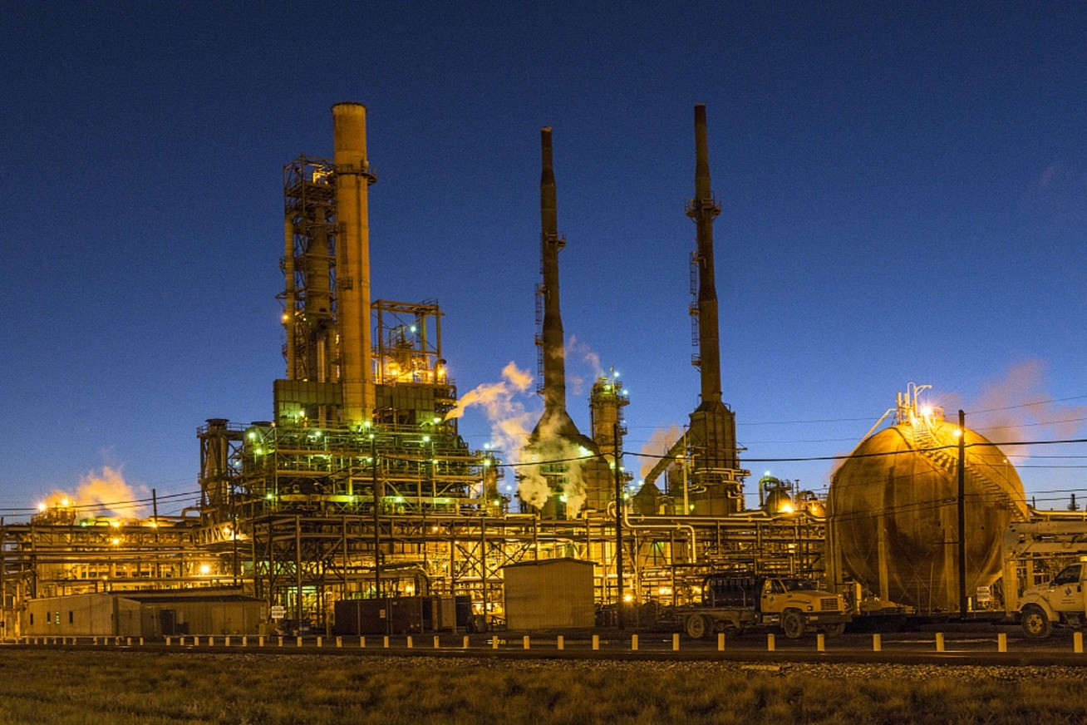
Energy
Control
Monitoring
Analysis
Design
Communications
Manufacturing
Vizualization

Slide 7
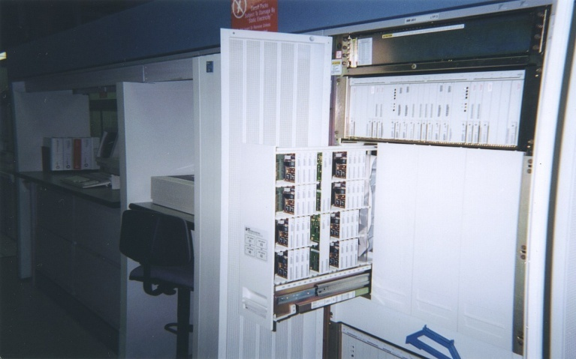
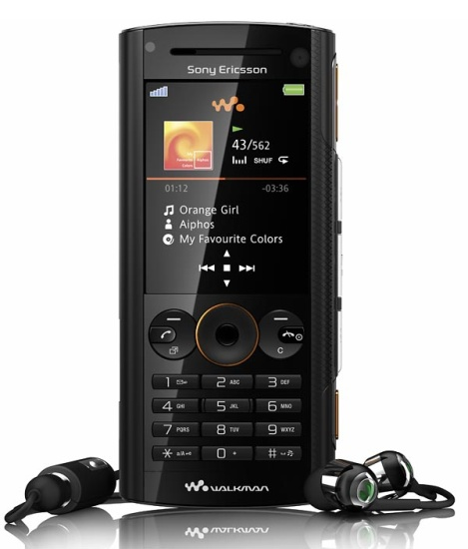
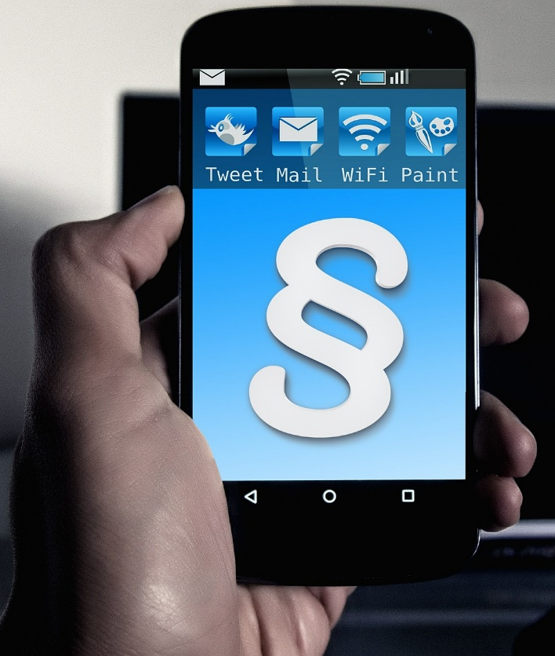
Phones
Voice Quality
User Interfaces
Billing
Mobility
Switching
Reliability
Provisioning
Images

Slide 8
C++ allows direct expression of ideas from many application areas
C++ is most widely used language in engineering areas
C++ is precisely and completely defined by an ISO standard
C++ is widely available
Concepts you learn with C++ are directly applicable to many other languages

Slide 9
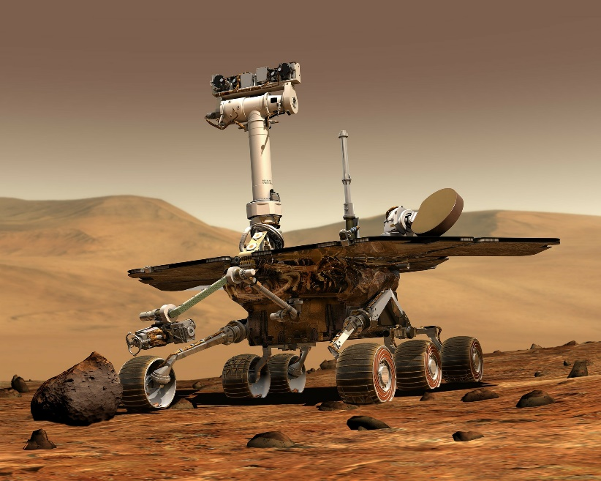

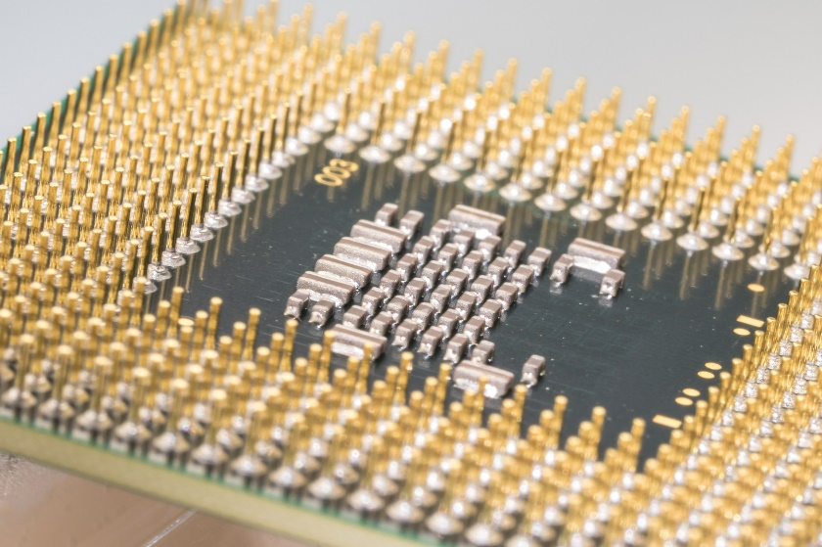
Where is C++ Used
Mars Rovers,
Animation,
Graphics,
Photoshop,
GUIs,
Embedded Systems,
OS’s, Compilers, Slides,
Chip Design,
Chip Manufacturing,
Semiconductor Tools,…

Slide 10
Programming Language Tree
https://ccrma.stanford.edu/courses/250a-fall-2005/docs/ComputerLanguagesChart.png

Slide 11
Who are programmers…

Slide 12
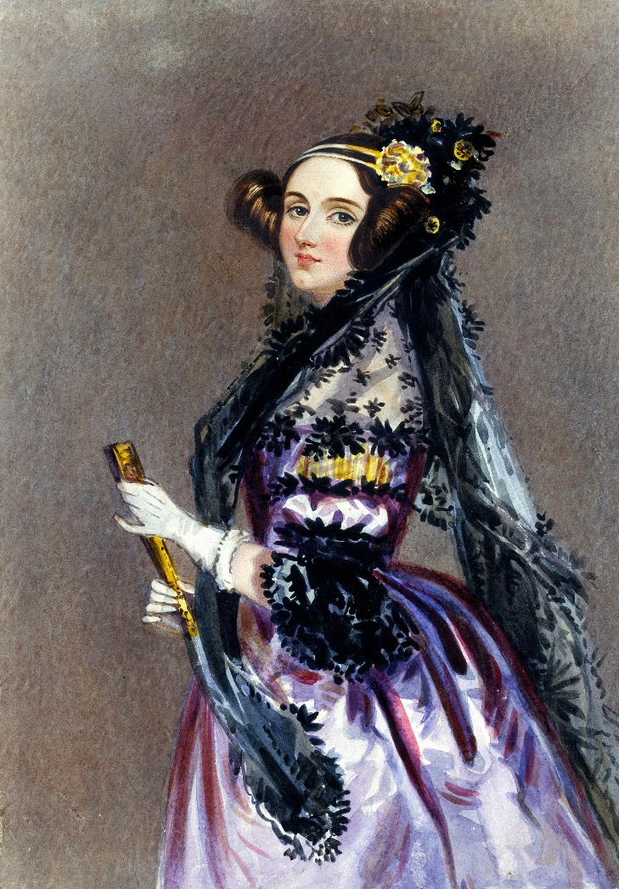
Ada Lovelace
“First Computer Programmer”
Born 1815
Worked with Charles Babbage
"Ada Lovelace portrait" by Alfred Edward Chalon - Science & Society Picture Library. Licensed under Public Domain via Commons

Slide 13
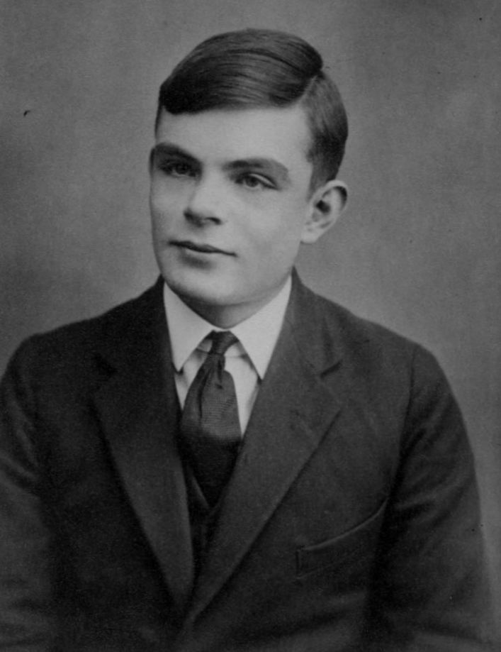
Alan Turing
British
Formalized idea of algorithm and computation
WWII codebreaker
Turing Award named in his honor
Three movies about him…
Prosecuted for being gay
"Sackville Park Turing plaque" by User Lmno on en.wikipedia - Photograph taken by Lmno. Licensed under CC BY-SA 3.0 via Commons
"Alan Turing Aged 16" by Unknown
Licensed under Public Domain via Commons

Slide 14
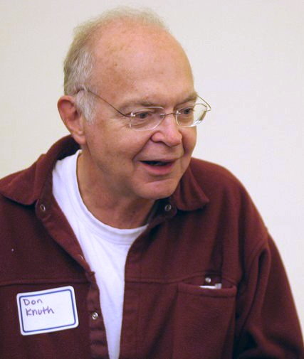
Donald Knuth
The Art of Computer Programming
Father of analysis of algorithms
Popularized asymptotic notation
Creator of Tex
"KnuthAtOpenContentAlliance" by Flickr user Jacob Appelbaum,
uploaded to en.wikipedia by users BeSherman, Duozmo - Flickr.com (via en.wikipedia).
Licensed under CC BY-SA 2.5 via Commons

Slide 15
Acknowledgement
Based on slides created by Bjarne Stroustrup and Jennifer Welch
Many images from pixabay.com

