Slide 1
Selection
CSCE 121
J. Michael Moore
&
Philip Ritchey

Slide 2
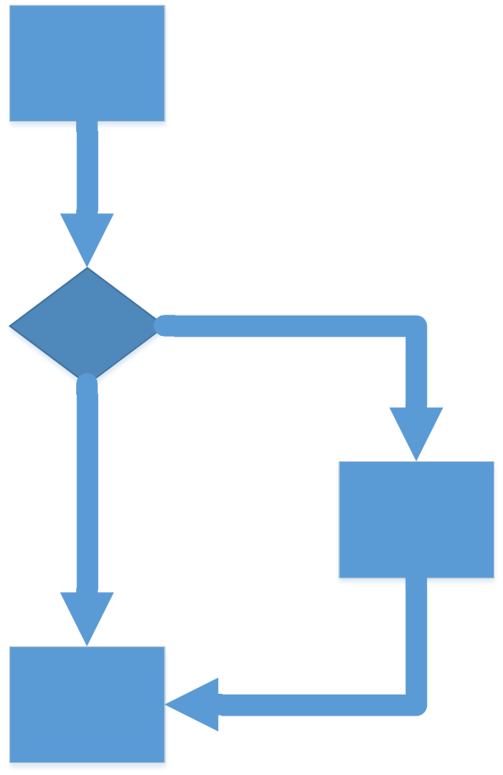
If
However, it is good practice to go ahead and use them.
You might need to add more statements later and forget to add curly braces.
if (bool expression) {
}
if (bool expression)
// single statement
true
Note: Curly braces are optional
if there is a single statement.
false

Slide 3
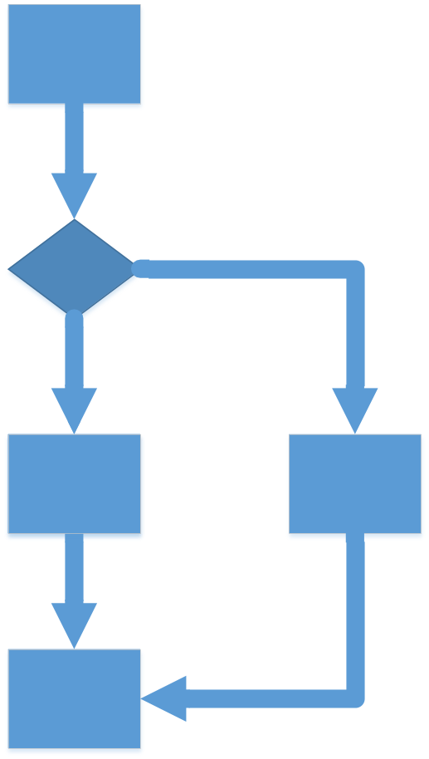
If-else
if (boolean expression) {
// do if true
} else {
// do if false
}
true
false
Note: Curly braces are optional
if there is a single statement.

Slide 4
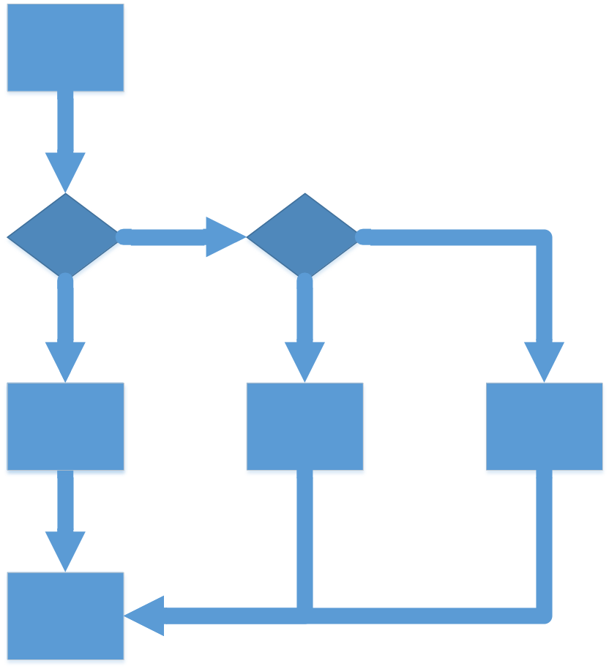
Multiple if-else
Note: Curly braces are optional
if there is a single statement.
if (boolean expression) {
// do stuff
} else if (bool expr) {
// do other stuff
} else {
// do yet other stuff
}
false
false
true
true

Slide 5
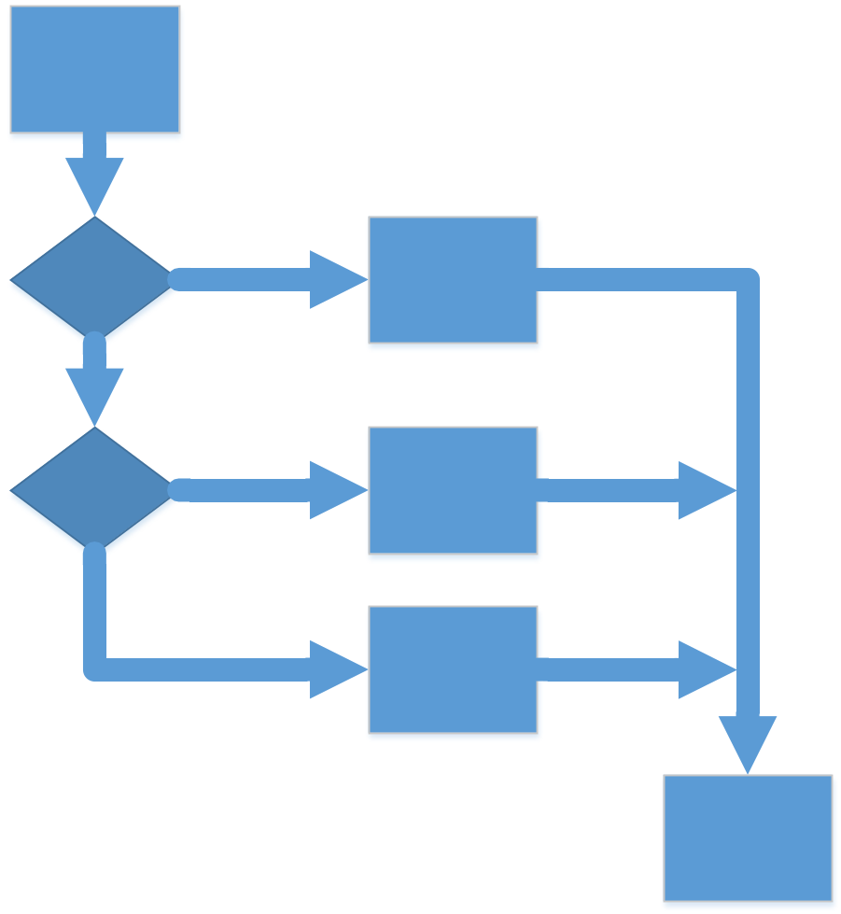
Switch
Note: Curly braces are optional
if all cases are single statements.
BUT USE THEM ALWAYS.
switch (value) {
case val1:
// do stuff
break;
case val2:
// do other stuff
break;
default:
// yet other stuff
}
true
false
true
false

Slide 6
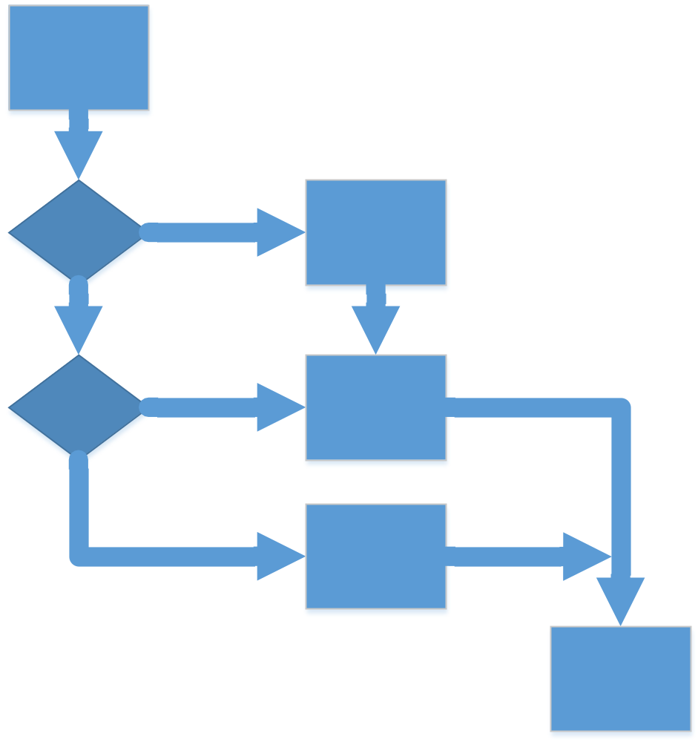
Switch with fall-through
Note: Curly braces are optional
if all cases are single statements.
BUT USE THEM ALWAYS.
switch (value) {
case val1:
// do stuff
case val2:
// do other stuff
break;
default:
// yet other stuff
}
true
false
true
false

Slide 7
Switch
Value used for comparison must be an integer, char, or enumeration.
  enumeration := identifier that maps to an integer
When a matching case is found, code is executed until encountering a break. This can result in code for multiple cases executing for a single case.
  Tip: when debugging, check for missing or mistaken break statements.

