Slide 1
The Arts of Satisfiability:
Algorithms and Complexity
Jianer Chen
Computer Science and Engineering
Texas A&M University

Slide 2
The Satisfiability Problem (SAT)
Given a CNF formula F, decide if there is an assignment to F that makes F = 1?

Slide 3
The Satisfiability Problem (SAT)
Given a CNF formula F, decide if there is an assignment to F that makes F = 1?
(x₁∨¬x₂∨¬x₃∨x₄)∧(x₂∨¬x₅∨x₃)∧( x₆∨x₅)∧(¬x₆∨x₂∨¬x₁)

Slide 4
The Satisfiability Problem (SAT)
Given a CNF formula F, decide if there is an assignment to F that makes F = 1?
(x₁∨¬x₂∨¬x₃∨x₄)∧(x₂∨¬x₅∨x₃)∧( x₆∨x₅)∧(¬x₆∨x₂∨¬x₁)
x₁ = 1, x₂ = 1, x₃ = 1, x₄ = 0, x₅ = 0, x₆ = 1

Slide 5
The Satisfiability Problem (SAT)
Given a CNF formula F, decide if there is an assignment to F that makes F = 1?
(x₁∨¬x₂∨¬x₃∨x₄)∧(x₂∨¬x₅∨x₃)∧( x₆∨x₅)∧(¬x₆∨x₂∨¬x₁)
x₁ = 1, x₂ = 1, x₃ = 1, x₄ = 0, x₅ = 0, x₆ = 1

Slide 6
The Satisfiability Problem (SAT)
Given a CNF formula F, decide if there is an assignment to F that makes F = 1?
(x₁∨¬x₂∨¬x₃∨x₄)∧(x₂∨¬x₅∨x₃)∧( x₆∨x₅)∧(¬x₆∨x₂∨¬x₁)
x₁ = 1, x₂ = 1, x₃ = 1, x₄ = 0, x₅ = 0, x₆ = 1
An example of unsatisfiable formulas

Slide 7
The Satisfiability Problem (SAT)
Given a CNF formula F, decide if there is an assignment to F that makes F = 1?
(x₁∨¬x₂∨¬x₃∨x₄)∧(x₂∨¬x₅∨x₃)∧( x₆∨x₅)∧(¬x₆∨x₂∨¬x₁)
x₁ = 1, x₂ = 1, x₃ = 1, x₄ = 0, x₅ = 0, x₆ = 1
An example of unsatisfiable formulas
(x₁∨x₂)∧(¬x₁∨x₂)∧( x₁∨¬x₂)∧(¬x₁∨¬x₂)

Slide 8
Why SAT ?
Many applications

Slide 9
Why SAT ?
Many applications
Satisfiability stands at the crossroads of logic, graph theory, computer science, computer engineering, and operations research. Thus, many problems originating in one of these fields typically have multiple translations to SAT and there exist many mathematical tools available to the SAT solver to assist in solving them with improved performance.
Handbook of Satisfiability (2009)

Slide 10
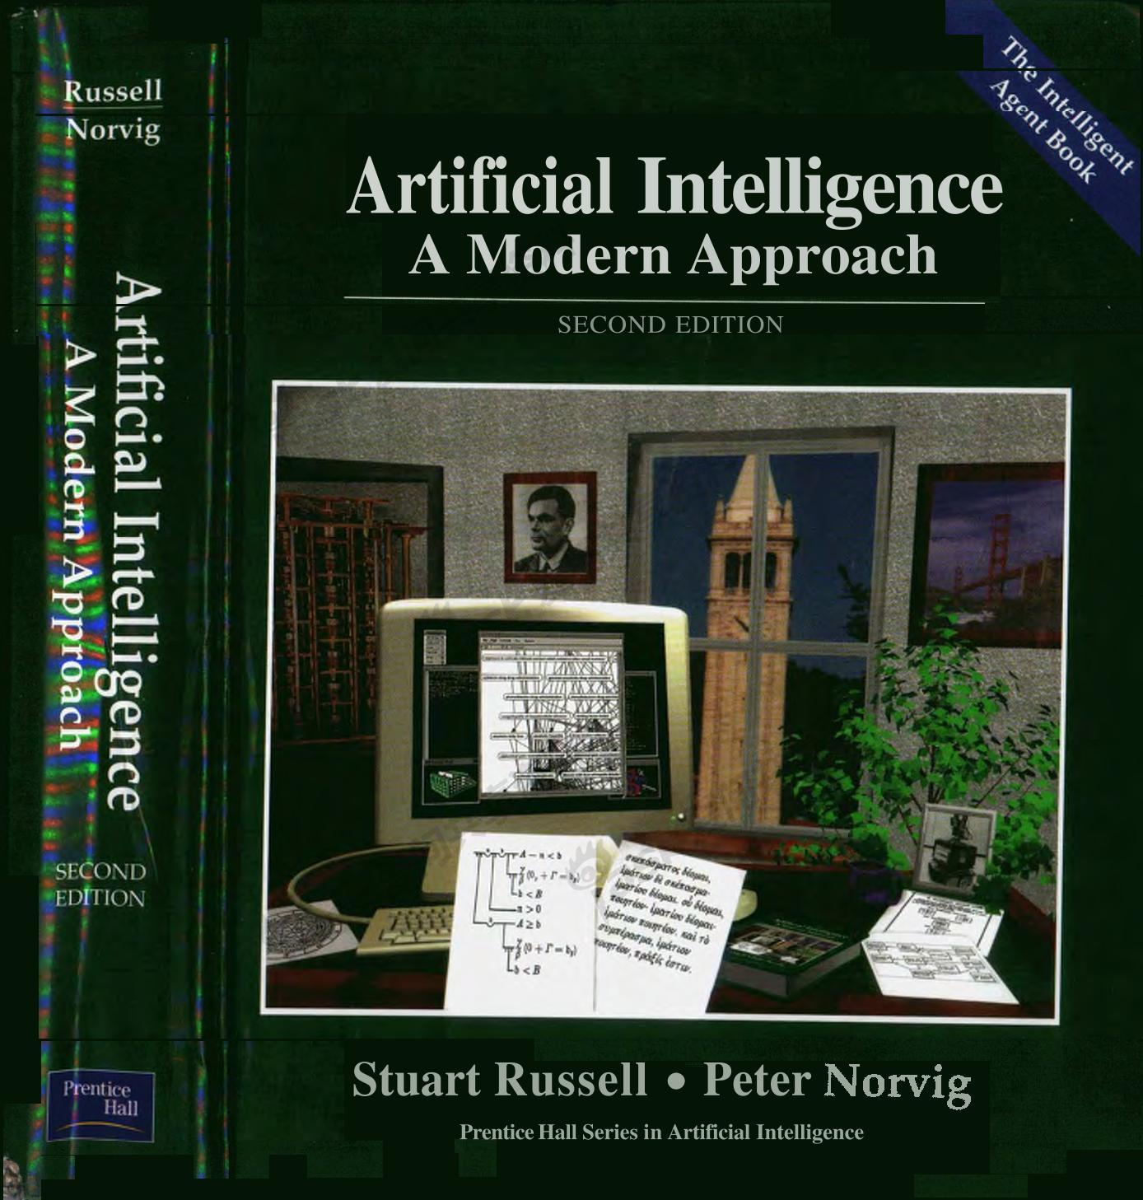
Why SAT ?

Slide 11
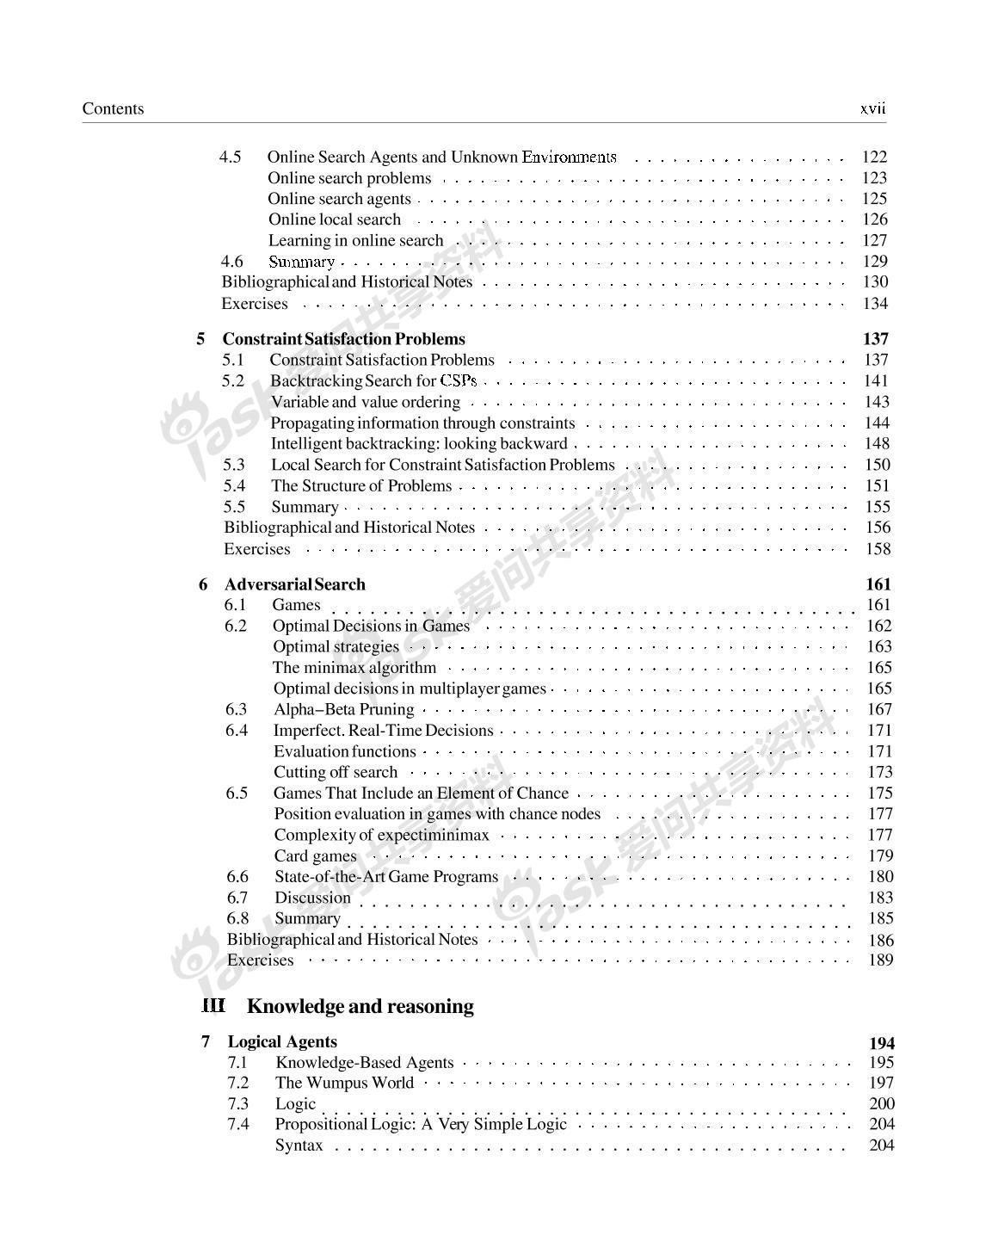
Why SAT ?

Slide 12
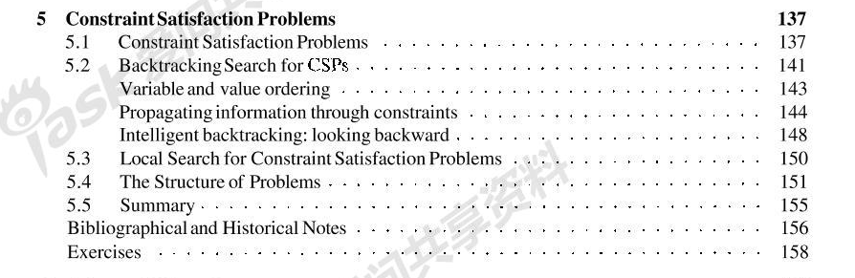
Why SAT ?

Slide 13
Why SAT ?
Many applications

Slide 14
Why SAT ?
Many applications
The first NP-complete problem [Cook’71]

Slide 15
Why SAT ?
Many applications
The first NP-complete problem [Cook’71]
Thus, it is the first identified problem in a famous class of problems (i.e., NP-complete problems) that are extremely important in practice, but have no known efficient algorithms, even after exhaustive efforts of thousands of scientists over the world, including the smartest computer scientists, mathematicians, and engineers.

Slide 16
Why SAT ?
Many applications
The first NP-complete problem [Cook’71]
The most important problem in computer science

Slide 17
Why SAT ?
Many applications
The first NP-complete problem [Cook’71]
The most important problem in computer science
A central problem in the research in algorithms and complexity theory

Slide 18
Why SAT ?
Many applications
The first NP-complete problem [Cook’71]
The most important problem in computer science
A central problem in the research in algorithms and complexity theory
Closely related to Hilbert’s 10th problem [Davis-Putnam’60]

Slide 19
Why SAT ?
Many applications
The first NP-complete problem [Cook’71]
The most important problem in computer science
A central problem in the research in algorithms and complexity theory
Closely related to Hilbert’s 10th problem [Davis-Putnam’60]

Slide 20
SAT: Algorithms
Given a CNF formula F = C₁∧ …∧C_{m} on n variables x₁, …, x_{n}, decide if there is an assignment to x₁, …, x_{n} that makes F = 1?
F = (x₁∨¬x₂∨¬x₃∨x₄)∧(x₂∨¬x₅∨x₃)∧( x₆∨x₅)∧(¬x₆∨x₂∨¬x₁)

Slide 21
SAT: Algorithms
Given a CNF formula F = C₁∧ …∧C_{m} on n variables x₁, …, x_{n}, decide if there is an assignment to x₁, …, x_{n} that makes F = 1?
Parameters for measuring the complexity of SAT algorithms:
n: the number of variables
m: the number of clauses
L: the length of the input
F = (x₁∨¬x₂∨¬x₃∨x₄)∧(x₂∨¬x₅∨x₃)∧( x₆∨x₅)∧(¬x₆∨x₂∨¬x₁)

Slide 22
SAT: Algorithms
Given a CNF formula F = C₁∧ …∧C_{m} on n variables x₁, …, x_{n}, decide if there is an assignment to x₁, …, x_{n} that makes F = 1?
Parameters for measuring the complexity of SAT algorithms:
best algorithm
n: the number of variables
m: the number of clauses O*(1.234^{m}) [Yamamoto 2005]
L: the length of the input O*(1.066^{L}) [Chen-Liu 2009]
F = (x₁∨¬x₂∨¬x₃∨x₄)∧(x₂∨¬x₅∨x₃)∧( x₆∨x₅)∧(¬x₆∨x₂∨¬x₁)

Slide 23
SAT: Algorithms
Given a CNF formula F = C₁∧ …∧C_{m} on n variables x₁, …, x_{n}, decide if there is an assignment to x₁, …, x_{n} that makes F = 1?
Parameters for measuring the complexity of SAT algorithms:
best algorithm
n: the number of variables
m: the number of clauses O*(1.234^{m}) [Yamamoto 2005]
L: the length of the input O*(1.066^{L}) [Chen-Liu 2009]
F = (x₁∨¬x₂∨¬x₃∨x₄)∧(x₂∨¬x₅∨x₃)∧( x₆∨x₅)∧(¬x₆∨x₂∨¬x₁)

Slide 24
SAT: Algorithms
Given a CNF formula F = C₁∧ …∧C_{m} on n variables x₁, …, x_{n}, decide if there is an assignment to x₁, …, x_{n} that makes F = 1?

Slide 25
SAT: Algorithms
Given a CNF formula F = C₁∧ …∧C_{m} on n variables x₁, …, x_{n}, decide if there is an assignment to x₁, …, x_{n} that makes F = 1?
Algorithm 1.
1. for each assignment σ to x₁, …, x_{n} do
compute the value of F on σ (x₁), …, σ (x_{n});
if F = 1 under the assignment σ then return (‘yes’); stop;
2. return (‘no’)

Slide 26
SAT: Algorithms
Given a CNF formula F = C₁∧ …∧C_{m} on n variables x₁, …, x_{n}, decide if there is an assignment to x₁, …, x_{n} that makes F = 1?
Algorithm 1.
1. for each assignment σ to x₁, …, x_{n} do
compute the value of F on σ (x₁), …, σ (x_{n});
if F = 1 under the assignment σ then return (‘yes’); stop;
2. return (‘no’)
time complexity: O(2^{n}nm)= O*(2^{n})

Slide 27
SAT: Algorithms
Given a CNF formula F = C₁∧ …∧C_{m} on n variables x₁, …, x_{n}, decide if there is an assignment to x₁, …, x_{n} that makes F = 1?
Algorithm 1.
1. for each assignment σ to x₁, …, x_{n} do
compute the value of F on σ (x₁), …, σ (x_{n});
if F = 1 under the assignment σ then return (‘yes’); stop;
2. return (‘no’)
time complexity: O(2^{n}nm)= O*(2^{n})
A better algorithm?

Slide 28
SAT: Algorithms
Given a CNF formula F = C₁∧ …∧C_{m} on n variables x₁, …, x_{n}, decide if there is an assignment to x₁, …, x_{n} that makes F = 1?
Algorithm 1.
1. for each assignment σ to x₁, …, x_{n} do
compute the value of F on σ (x₁), …, σ (x_{n});
if F = 1 under the assignment σ then return (‘yes’); stop;
2. return (‘no’)
time complexity: O(2^{n}nm)= O*(2^{n})
A better algorithm?
No better algorithm!

Slide 29
SAT: Algorithms
Open Problem: is there an algorithm of time complexity O*(c^{n}) for SAT, where c is a constant less than 2 (e.g., O*(1.99^{n}) )?

Slide 30
SAT: Algorithms
Open Problem: is there an algorithm of time complexity O*(c^{n}) for SAT, where c is a constant less than 2 (e.g., O*(1.99^{n}) )?
No progress in the last 20 years.

Slide 31
SAT: Algorithms
Open Problem: is there an algorithm of time complexity O*(c^{n}) for SAT, where c is a constant less than 2 (e.g., O*(1.99^{n}) )?
No progress in the last 20 years.
Strong Exponential Time Hypothesis (SETH):
no such algorithm exists.

Slide 32
SAT: Algorithms
So, what do we do?

Slide 33
SAT: Algorithms
So, what do we do?
3-SAT:
Given a CNF formula F = C₁∧ …∧C_{m} on n variables x₁, …, x_{n}, where each C_{i} has at most 3 literals, decide if there is an assignment to x₁, …, x_{n} that makes F = 1?

Slide 34
SAT: Algorithms
So, what do we do?
3-SAT:
Given a CNF formula F = C₁∧ …∧C_{m} on n variables x₁, …, x_{n}, where each C_{i} has at most 3 literals, decide if there is an assignment to x₁, …, x_{n} that makes F = 1?
(x₁∨¬x₂∨x₃)∧(x₂∨x₅∨¬x₃)∧(¬x₄∨x₅)∧(x₄∨¬x₂∨x₁)

Slide 35
SAT: Algorithms
So, what do we do?
3-SAT:
Given a CNF formula F = C₁∧ …∧C_{m} on n variables x₁, …, x_{n}, where each C_{i} has at most 3 literals, decide if there is an assignment to x₁, …, x_{n} that makes F = 1?
Still NP-complete
(x₁∨¬x₂∨x₃)∧(x₂∨x₅∨¬x₃)∧(¬x₄∨x₅)∧(x₄∨¬x₂∨x₁)

Slide 36
SAT: Algorithms
So, what do we do?
3-SAT:
Given a CNF formula F = C₁∧ …∧C_{m} on n variables x₁, …, x_{n}, where each C_{i} has at most 3 literals, decide if there is an assignment to x₁, …, x_{n} that makes F = 1?
Still NP-complete
General SAT can be reduced to 3-SAT.
(x₁∨¬x₂∨x₃)∧(x₂∨x₅∨¬x₃)∧(¬x₄∨x₅)∧(x₄∨¬x₂∨x₁)

Slide 37
3-SAT: Algorithms

Slide 38
3-SAT: Algorithms
2-SAT is solvable in linear time.

Slide 39
3-SAT: Algorithms
2-SAT is solvable in linear time.
An algorithm for 3-SAT
Algorithm-3SAT-I(F) [Monien-Speckenmeyer’ 85]
1. if there is no 3-clauses then solve the problem directly, stop;
2. pick a 3-clause (l₁∨l₂∨l₃);
3. recursively call
Algorithm-3SAT-I(F[l₁= 1]);
Algorithm-3SAT-I(F[l₁= 0; l₂= 1]);
Algorithm-3SAT-I(F[l₁= 0; l₂= 0; l₃= 1]);
4. return (“yes”) if and only if at least one of the above return “yes”).

Slide 40
3-SAT: Algorithms
2-SAT is solvable in linear time.
An algorithm for 3-SAT
Algorithm-3SAT-I(F) [Monien-Speckenmeyer’ 85]
1. if there is no 3-clauses then solve the problem directly, stop;
2. pick a 3-clause (l₁∨l₂∨l₃);
3. recursively call
Algorithm-3SAT-I(F[l₁= 1]);
Algorithm-3SAT-I(F[l₁= 0; l₂= 1]);
Algorithm-3SAT-I(F[l₁= 0; l₂= 0; l₃= 1]);
4. return (“yes”) if and only if at least one of the above return “yes”).
Time complexity T(n) on n variables?

Slide 41
3-SAT: Algorithms
2-SAT is solvable in linear time.
An algorithm for 3-SAT
Algorithm-3SAT-I(F) [Monien-Speckenmeyer’ 85]
1. if there is no 3-clauses then solve the problem directly, stop;
2. pick a 3-clause (l₁∨l₂∨l₃);
3. recursively call
Algorithm-3SAT-I(F[l₁= 1]);
Algorithm-3SAT-I(F[l₁= 0; l₂= 1]);
Algorithm-3SAT-I(F[l₁= 0; l₂= 0; l₃= 1]);
4. return (“yes”) if and only if at least one of the above return “yes”).
Time complexity T(n) on n variables?
T(n) = T(n-1) + T(n-2) + T(n-3) ⇒ T(n) = O*(1.84^{n})

Slide 42
3-SAT: Algorithms
2-SAT is solvable in linear time.
An algorithm for 3-SAT
Algorithm-3SAT-I(F) [Monien-Speckenmeyer’ 85]
1. if there is no 3-clauses then solve the problem directly, stop;
2. pick a 3-clause (l₁∨l₂∨l₃);
3. recursively call
Algorithm-3SAT-I(F[l₁= 1]);
Algorithm-3SAT-I(F[l₁= 0; l₂= 1]);
Algorithm-3SAT-I(F[l₁= 0; l₂= 0; l₃= 1]);
4. return (“yes”) if and only if at least one of the above return “yes”).
Time complexity T(n) on n variables?
T(n) = T(n-1) + T(n-2) + T(n-3) ⇒ T(n) = O*(1.84^{n})
Better than O*(2^{n})!

Slide 43
3-SAT: Algorithms
Schöning’s algorithm [Schöning’99]

Slide 44
3-SAT: Algorithms
Schöning’s algorithm [Schöning’99]
Schoning-Algorithm-3SAT(F)
1. repeat (4/3)^{n} times
1.1 randomly pick an assignment σ;
1.2 if σ satisfies F then return (“yes”); stop;
1.3 else \\ F is not satisfied by σ
randomly pick a clause (l₁∨l₂∨l₃) not satisfied by σ;
randomly pick one of l₁, l₂, l₃ and flip it;
1.4 repeat steps1.2-1.3 n times;
2. return (“no”).

Slide 45
3-SAT: Algorithms
Schöning’s algorithm [Schöning’99]
Schoning-Algorithm-3SAT(F)
1. repeat (4/3)^{n} times
1.1 randomly pick an assignment σ;
1.2 if σ satisfies F then return (“yes”); stop;
1.3 else \\ F is not satisfied by σ
randomly pick a clause (l₁∨l₂∨l₃) not satisfied by σ;
randomly pick one of l₁, l₂, l₃ and flip it;
1.4 repeat steps1.2-1.3 n times;
2. return (“no”).
Time complexity of Schöning’s algorithm: T(n) = O*((4/3)^{n})

Slide 46
3-SAT: Algorithms
Schöning’s algorithm [Schöning’99]
Schoning-Algorithm-3SAT(F)
1. repeat (4/3)^{n} times
1.1 randomly pick an assignment σ;
1.2 if σ satisfies F then return (“yes”); stop;
1.3 else \\ F is not satisfied by σ
randomly pick a clause (l₁∨l₂∨l₃) not satisfied by σ;
randomly pick one of l₁, l₂, l₃ and flip it;
1.4 repeat steps1.1-1.3 n times;
2. return (“no”).
Time complexity of Schöning’s algorithm: T(n) = O*((4/3)^{n})
O*(1.334^{n}) [99], O*(1.324^{n}) [04], O*(1.323^{n}) [05], O*(1.322^{n}) [10], O*(1.321^{n}) [11], ……

Slide 47
3-SAT: Algorithms
Schöning’s algorithm [Schöning’99]
Schoning-Algorithm-3SAT(F)
1. repeat (4/3)^{n} times
1.1 randomly pick an assignment σ;
1.2 if σ satisfies F then return (“yes”); stop;
1.3 else \\ F is not satisfied by σ
randomly pick a clause (l₁∨l₂∨l₃) not satisfied by σ;
randomly pick one of l₁, l₂, l₃ and flip it;
1.4 repeat steps1.2-1.3 n times;
2. return (“no”).
Time complexity of Schöning’s algorithm: T(n) = O*((4/3)^{n})
O*(1.334^{n}) [99], O*(1.324^{n}) [04], O*(1.323^{n}) [05], O*(1.322^{n}) [10], O*(1.321^{n}) [11], ……
Currently the best algorithm for 3-SAT: O*(1.308^{n}) [Hertli’11]

Slide 48
3-SAT: Algorithms
Schöning’s algorithm [Schöning’99]
Schoning-Algorithm-3SAT(F)
1. repeat (4/3)^{n} times
1.1 randomly pick an assignment σ;
1.2 if σ satisfies F then return (“yes”); stop;
1.3 else \\ F is not satisfied by σ
randomly pick a clause (l₁∨l₂∨l₃) not satisfied by σ;
randomly pick one of l₁, l₂, l₃ and flip it;
1.4 repeat steps1.2-1.3 n times;
2. return (“no”).
Time complexity of Schöning’s algorithm: T(n) = O*((4/3)^{n})
O*(1.334^{n}) [99], O*(1.324^{n}) [04], O*(1.323^{n}) [05], O*(1.322^{n}) [10], O*(1.321^{n}) [11], ……
Currently the best algorithm for 3-SAT: O*(1.308^{n}) [Hertli’11]
????? 1.308^{n} → 1.305^{n} → 1.250^{n} → 1.201^{n} → 1.199^{n} → 1.151^{n} → 1.001^{n} ?????

Slide 49
3-SAT: Algorithms
Open Problem: for 3-SAT, is it possible to develop algorithms of time complexity O*((1+δ)^{n}) , for an arbitrary constant δ>0?

Slide 50
3-SAT: Algorithms
Open Problem: for 3-SAT, is it possible to develop algorithms of time complexity O*((1+δ)^{n}) , for an arbitrary constant δ>0?
Exponential Time Hypothesis (ETH):
there is no subexponential time algorithm,
i.e., there is a constant c > 0 such that all 3-SAT
algorithms take time at least O*((1+c)^{n}) .

Slide 51
The Max-SAT problem

Slide 52
The Max-SAT problem
Given a CNF formula F, find an assignment to F that satisfies the largest number of clauses in F.

Slide 53
The Max-SAT problem
Given a CNF formula F, find an assignment to F that satisfies the largest number of clauses in F.
F = (x₁∨x₂)∧(x₁∨¬x₂)∧(¬x₁∨x₂)∧(¬x₁∨¬x₂)

Slide 54
The Max-SAT problem
Given a CNF formula F, find an assignment to F that satisfies the largest number of clauses in F.
F = (x₁∨x₂)∧(x₁∨¬x₂)∧(¬x₁∨x₂)∧(¬x₁∨¬x₂)
x₁ = 1, x₂ = 1, x₃ = 0, x₄ = 1,

Slide 55
The Max-SAT problem
Given a CNF formula F, find an assignment to F that satisfies the largest number of clauses in F.
F = (x₁∨x₂)∧(x₁∨¬x₂)∧(¬x₁∨x₂)∧(¬x₁∨¬x₂)
x₁ = 1, x₂ = 1, x₃ = 0, x₄ = 1,

Slide 56
The Max-SAT problem
Given a CNF formula F, find an assignment to F that satisfies the largest number of clauses in F.
F = (x₁∨x₂)∧(x₁∨¬x₂)∧(¬x₁∨x₂)∧(¬x₁∨¬x₂)
x₁ = 1, x₂ = 1, x₃ = 0, x₄ = 1,
An optimization version of the SAT problem

Slide 57
The Max-SAT problem
Given a CNF formula F, find an assignment to F that satisfies the largest number of clauses in F.
F = (x₁∨x₂)∧(x₁∨¬x₂)∧(¬x₁∨x₂)∧(¬x₁∨¬x₂)
x₁ = 1, x₂ = 1, x₃ = 0, x₄ = 1,
An optimization version of the SAT problem
A fundamental problem in computational optimization

Slide 58
The Max-SAT problem
Given a CNF formula F, find an assignment to F that satisfies the largest number of clauses in F.
F = (x₁∨x₂)∧(x₁∨¬x₂)∧(¬x₁∨x₂)∧(¬x₁∨¬x₂)
x₁ = 1, x₂ = 1, x₃ = 0, x₄ = 1,
An optimization version of the SAT problem
A fundamental problem in computational optimization
The first APX-complete problem

Slide 59


The Max-SAT problem
Algorithms for Maximum Satisfiability
with Applications to AI
Fahiem Bacchus¹ Matti Jarvisalo²
¹ University of Toronto
Canada
² University of Helsinki
Finland
February 13, 2016 AAAI-16, Phoenix, AZ, USA

Slide 60
The Max-SAT problem
Given a CNF formula F, find an assignment to F that satisfies the largest number of clauses in F.
The Max-SAT problem is NP-hard

Slide 61
The Max-SAT problem
Given a CNF formula F, find an assignment to F that satisfies the largest number of clauses in F.
The Max-SAT problem is NP-hard
Approaches to solving Max-SAT:
(polynomial-time) approximation algorithms,
exact algorithms, parameterized algorithms,
heuristic algorithms, …

Slide 62
Approximation algorithms for Max-SAT
Johnson’s algorithm [Johnson’74]

Slide 63
Approximation algorithms for Max-SAT
Johnson’s algorithm [Johnson’74]
Johnson-Algorithm(F = C₁∧ …∧C_{m} )
1. for i = 1 to m do wt(C_{i}) = (½)^{|Ci|};
2. L = {C₁, …, C_{m}};
3. for i = 1 to n do
let P be the clauses in L that contain x_{i};
let N be the clauses in L that contain ¬x_{i};
if wt(P) > wt(N) then x_{i} = 1; remove P from L;
for each C_{h} in N do wt(C_{h}) = 2*wt(C_{h});
else x_{i} = 0; remove N from L;
for each C_{h} in P do wt(C_{h}) = 2*wt(C_{h});

Slide 64
Approximation algorithms for Max-SAT
Johnson’s algorithm [Johnson’74]
Johnson-Algorithm(F = C₁∧ …∧C_{m} )
1. for i = 1 to m do wt(C_{i}) = (½)^{|Ci|};
2. L = {C₁, …, C_{m}};
3. for i = 1 to n do
let P be the clauses in L that contain x_{i};
let N be the clauses in L that contain ¬x_{i};
if wt(P) > wt(N) then x_{i} = 1; remove P from L;
for each C_{h} in N do wt(C_{h}) = 2*wt(C_{h});
else x_{i} = 0; remove N from L;
for each C_{h} in P do wt(C_{h}) = 2*wt(C_{h});
Theorem [Johnson’74] Johnson’s algorithm has an
approximation ratio (= max/apx) ≤ 2.

Slide 65
Approximation algorithms for Max-SAT
Johnson’s algorithm [Johnson’74]
Johnson-Algorithm(F = C₁∧ …∧C_{m} )
1. for i = 1 to m do wt(C_{i}) = (½)^{|Ci|};
2. L = {C₁, …, C_{m}};
3. for i = 1 to n do
let P be the clauses in L that contain x_{i};
let N be the clauses in L that contain ¬x_{i};
if wt(P) > wt(N) then x_{i} = 1; remove P from L;
for each C_{h} in N do wt(C_{h}) = 2*wt(C_{h});
else x_{i} = 0; remove N from L;
for each C_{h} in P do wt(C_{h}) = 2*wt(C_{h});
Theorem [Johnson’74] Johnson’s algorithm has an
approximation ratio (= max/apx) ≤ 2.
Theorem [Chen-Friesen-Zheng’99] Johnson’s algorithm has
an approximation ratio 3/2, which is tight.

Slide 66
Approximation algorithms for Max-SAT
Authors Ratio Year
Johnson 2 1974
Hansen-Jaumard < 2 ? 1990

Slide 67
Approximation algorithms for Max-SAT
Authors Ratio Year
Johnson 2 1974
Hansen-Jaumard < 2 ? 1990
Chen-Friesen-Zheng 1.5 1999

Slide 68
Approximation algorithms for Max-SAT
Authors Ratio Year
Johnson 2 1974
Hansen-Jaumard < 2 ? 1990
Chen-Friesen-Zheng 1.5 1999
Yannakakis 4/3 1994
Goemans-Williams 4/3 1994
Karloff-Zwick 8/7 1997

Slide 69
Approximation algorithms for Max-SAT
Authors Ratio Year
Johnson 2 1974
Hansen-Jaumard < 2 ? 1990
Chen-Friesen-Zheng 1.5 1999
Yannakakis 4/3 1994
Goemans-Williams 4/3 1994
Karloff-Zwick 8/7 1997
Hastad ≥ 8/7 1997
[Godel Prize 2011]

Slide 70
Parameterized algorithms for Max-SAT
Given a CNF formula F and an integer k, is there an assignment that satisfies at least k clauses in F?

Slide 71
Parameterized algorithms for Max-SAT
Given a CNF formula F and an integer k, is there an assignment that satisfies at least k clauses in F?
Simple-Algorithm(F, k) [Mahajan-Raman’99]
1. pick a variable x in F;
2. case 1. only x or only ¬x appears in F
assign the value v of x directly, recursively work on F[x=v];
case 2. each of x and ¬x appears exactly once in F
apply Davis-Putnam’s resolution;
case 3. otherwise
recursively work on F[x=0] and F[x=1];

Slide 72
Parameterized algorithms for Max-SAT
Given a CNF formula F and an integer k, is there an assignment that satisfies at least k clauses in F?
Simple-Algorithm(F, k) [Mahajan-Raman’99]
1. pick a variable x in F;
2. case 1. only x or only ¬x appears in F
assign the value v of x directly, recursively work on F[x=v];
case 2. each of x and ¬x appears exactly once in F
apply Davis-Putnam’s resolution;
case 3. otherwise
recursively work on F[x=0] and F[x=1];
Time complexity on instance (F, k)?

Slide 73
Parameterized algorithms for Max-SAT
Given a CNF formula F and an integer k, is there an assignment that satisfies at least k clauses in F?
Simple-Algorithm(F, k) [Mahajan-Raman’99]
1. pick a variable x in F;
2. case 1. only x or only ¬x appears in F
assign the value v of x directly, recursively work on F[x=v];
case 2. each of x and ¬x appears exactly once in F
apply Davis-Putnam’s resolution;
case 3. otherwise
recursively work on F[x=0] and F[x=1];
Time complexity on instance (F, k)?
T(k) = T(k-1) + T(k-2) ⇒ T(k) = O*(1.618^{k})

Slide 74
Parameterized algorithms for Max-SAT
Authors Complexity Year
Mahajan-Raman O*(1.618^{k}) 1999
Niedermeier-Rossmanith O*(1.400^{k}) 2000
Bansal-Raman O*(1.381^{k}) 1999
Chen-Kanj O*(1.370^{k}) 2004
Bliznets-Golovnev O*(1.358^{k}) 2012*
* Best paper award at IPEC 2012

Slide 75
Parameterized algorithms for Max-SAT
Exponential Time Hypothesis (ETH):
There is a constant c > 1 such that Max3SAT cannot be solved in time O*(c^{n}).
Strong Exponential Time Hypothesis (SETH): There is no constant c < 2 such that MaxSAT can be solved in time O*(c^{n}).

Slide 76
Parameterized algorithms for Max-SAT
Exponential Time Hypothesis (ETH):
There is a constant c > 1 such that Max3SAT cannot be solved in time O*(c^{n}).
Strong Exponential Time Hypothesis (SETH): There is no constant c < 2 such that MaxSAT can be solved in time O*(c^{n}).
ETH and SETH show, to some extent, a popular opinion that branch-and-search is perhaps unavoidable in solving the SAT and Max-SAT problems.

Slide 77
On Variables of small degree
These resolution* rules are sufficient to convert a degree-3 CNF formula into a linear degree-3 CNF formula (with no two variables having their literals appear in more than one clause), on which direct branching becomes more efficient. This gives:
Xu-Chen-Wang (TCS 2018)
An O*(1.194^{k})-time parameterized algorithm for MaxSAT on deg-3 CNF formulas → improving previous best upper bound O*(1.2721^{k})
An O*(1.237^{n})-time exact algorithm for MaxSAT on deg-3 CNF formulas → improving previous best upper bound O*(1.26^{n})

Slide 78
On Variables of small degree
These resolution* rules are sufficient to eliminate clauses that cause inefficient branchings. Thus, with some other commonly used methods, we get
Chen-Xu-Wang (WADS 2018)
An O*(1.325^{k})-time parameterized algorithm for MaxSAT → improving previous best upper bound O*(1.358^{k})

Slide 79
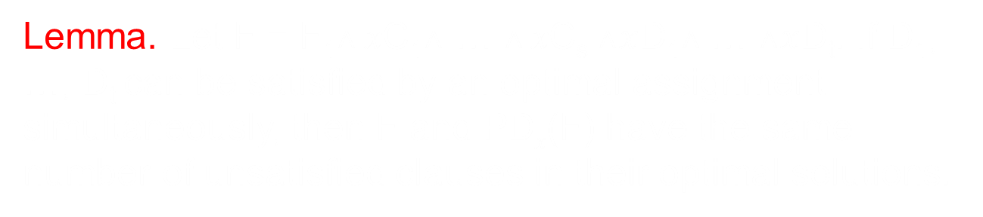
More on Resolution
This, plus some other rules, gives
Xu, Chen, et al. (IJCAI 2019)
An O*(1.2981^{m})-time exact algorithm for MaxSAT → improving previous best upper bound O*(1.325^{m})

Slide 80
Heuristic algorithms for SAT/MaxSAT

Slide 81
Heuristic algorithms for SAT/MaxSAT
Heuristic algorithms solve SAT/MaxSAT practically, but either do not guarantee the correctness or do not guarantee efficiency.

Slide 82
Heuristic algorithms for SAT/MaxSAT
Heuristic algorithms solve SAT/MaxSAT practically, but either do not guarantee the correctness or do not guarantee efficiency.
A large collection of SAT/MaxSAT Solvers

Slide 83
Heuristic algorithms for SAT/MaxSAT
Heuristic algorithms solve SAT/MaxSAT practically, but either do not guarantee the correctness or do not guarantee efficiency.
A large collection of SAT/MaxSAT Solvers
Solving most practical SAT instances efficiently

Slide 84
Heuristic algorithms for SAT/MaxSAT
Heuristic algorithms solve SAT/MaxSAT practically, but either do not guarantee the correctness or do not guarantee efficiency.
A large collection of SAT/MaxSAT Solvers
Solving most practical SAT instances efficiently
Can solve instances of millions of variables and clauses;

Slide 85
Heuristic algorithms for SAT/MaxSAT
Heuristic algorithms solve SAT/MaxSAT practically, but either do not guarantee the correctness or do not guarantee efficiency.
A large collection of SAT/MaxSAT Solvers
Solving most practical SAT instances efficiently
Can solve instances of millions of variables and clauses;
SAT Solvers
From 100 variables, 200 constraints (early 90s)
Up to > 10,000,000 variables and > 50,000,000 clauses in 20 years

Slide 86
Heuristic algorithms for SAT/MaxSAT
Annual conferences for SAT/MaxSAT:
The International Conference on Theory and applications of Satisfiability Testing (SAT), 1996-2019
The Conference on Evaluation of Max-SAT Solvers (Max-SAT), 2006-2019

Slide 87
Go SAT!

