Slide 1
CSCE-637 Complexity Theory
Fall 2020
Instructor: Jianer Chen
Office: HRBB 338C
Phone: 845-4259
Email: chen@cse.tamu.edu
Notes 3: Halting problem and nondeterministic TMs

Slide 2
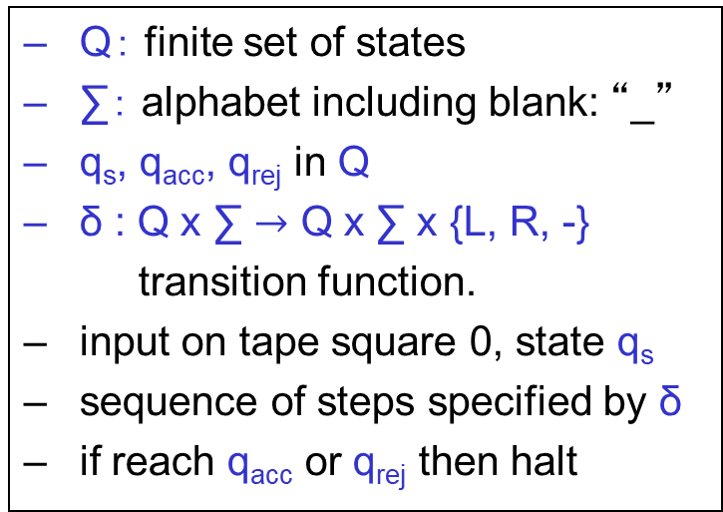
Turing Machines
infinite tape
. . .
a | b | a | b
read/write head
finite control
Q： finite set of states
∑： alphabet including blank: “_”
q_{s}, q_{acc}, q_{rej} in Q
δ : Q x ∑ $→$ Q x ∑ x {L, R, -}
transition function.
input on tape square 0, state q_{s}
sequence of steps specified by δ
if reach q_{acc} or q_{rej} then halt
A Turing machine:
M = (Q, ∑, δ, q_{s}, q_{acc}, q_{rej})

Slide 3
Turing Machines
Remarks.
A TM is a program (i.e., an algorithm);
A TM can be encoded into a finite string;
Thus, we can construct a TM U that is a general simulator, which, on the input (M, x) that encodes a TM M and an input x to M, simulates M on input x.
This is the invention of computers!!
1. δ(q_{s},0) = (q₀,$,R)
2. δ(q_{s},1) = (q₁,$,R)
δ(q₀,0/1) = (q₀,0/1,R)
δ(q₁,0/1) = (q₁,0/1,R)
δ(q₀,#) = (q₂,#,R)
δ(q₂,#) = (q₂,#,R)
δ(q₂,0) = (q₄,#,L)
δ(q₁,#) = (q₃,#,R)
δ(q₃,#) = (q₃,#,R)
δ(q₃,1) = (q₄,#,L)
δ(q₄,0/1/#) = (q₄,0/1/#,L)
δ(q₄,$) = (q_{s},$,R)
δ(q_{s},#) = (q_{s},#,R)
δ(q_{s},_) = (q_{acc},_,-)
For any case not listed above
δ(*,*) = (q_{rej},*,-)
A Turing machine:
M = (Q, ∑, δ, q_{s}, q_{acc}, q_{rej})

Slide 4
Turing Machines
multi-tape Turing Machine:

Slide 5
Turing Machines
multi-tape Turing Machine:
. . .
a | b | a | b
. . .
b | b | b
k tapes
。。。。。。
. . .
a | a | a | b
finite control

Slide 6
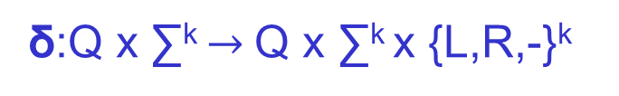
Turing Machines
multi-tape Turing Machine:
. . .
a | b | a | b
. . .
b | b | b
k tapes
。。。。。。
. . .
a | a | a | b
δ:Q x ∑^{k} $→$ Q x ∑^{k} x {L,R,-}^{k}
finite control
A Turing machine:
M = (Q, ∑, δ, q₀, q_{acc}, q_{rej})

Slide 7
Turing Machines
multi-tape Turing Machine:
. . .
a | b | a | b
. . .
b | b | b
k tapes
。。。。。。
. . .
a | a | a | b
δ:Q x ∑^{k} $→$ Q x ∑^{k} x {L,R,-}^{k}
finite control
Usually:
read-only input tape
write-only output tape
k-2 read/write work tapes
A Turing machine:
M = (Q, ∑, δ, q₀, q_{acc}, q_{rej})

Slide 8
Multitape TMs
simulation of k-tape TM by single-tape TM:
. . .
a | b | a | b
. . .
b | b | b
. . .
a | a | a | b
q
finite control

Slide 9
Multitape TMs
simulation of k-tape TM by single-tape TM:
. . .
a | b | a | b
. . .
b | b | b
. . .
a | a | a | b
q
finite control
add new symbol x for each old x to mark the locations of the heads
use combined symbols

Slide 10
Multitape TMs
simulation of k-tape TM by single-tape TM:
. . .
a | b | a | b
. . .
b | b | b
. . .
a | a | a | b
q
finite control
. . .
aba | bba | aba | b-b
add new symbol x for each old x to mark the locations of the heads
use combined symbols
q
finite control

Slide 11
Multitape TMs
simulation of k-tape TM by single-tape TM:
. . .
Repeat: O(t(n)) times
  scan the tape, remembering the symbols under heads in the state; time = O(t(n))
  make changes in state & symbols for one step of M; time = O(t(n))
a | b | a | b
. . .
b | b | b
. . .
a | a | a | b
q
finite control
. . .
aba | bba | aba | b-b
add new symbol x for each old x to mark the locations of the heads
use combined symbols
q
finite control

Slide 12
Multitape TMs
simulation of k-tape TM by single-tape TM:
. . .
Repeat: O(t(n)) times
  scan the tape, remembering the symbols under heads in the state; time = O(t(n))
  make changes in state & symbols for one step of M; time = O(t(n))
  Total time: O((t(n)²)
a | b | a | b
. . .
b | b | b
. . .
a | a | a | b
q
finite control
. . .
aba | bba | aba | b-b
add new symbol x for each old x to mark the locations of the heads
use combined symbols
q
finite control

Slide 13
Extended Church-Turing Thesis
the belief that TMs formalize our intuitive notion of an efficient algorithm is:
The “extended” Church-Turing Thesis
everything we can compute in time t(n) on a physical computer can be computed on a Turing Machine in time t^{O(1)}(n) (polynomial slowdown)

Slide 14
Extended Church-Turing Thesis
the belief that TMs formalize our intuitive notion of an efficient algorithm is:
The “extended” Church-Turing Thesis
everything we can compute in time t(n) on a physical computer can be computed on a Turing Machine in time t^{O(1)}(n) (polynomial slowdown)
quantum computers challenge this belief

Slide 15
Extended Church-Turing Thesis
consequence of extended Church-Turing Thesis: all reasonable physically realizable models of computation can be efficiently simulated by a Turing machine
e.g. multi-tape vs. single tape TM
e.g. RAM model
e.g. your desktop/laptop

Slide 16
Turing Machines
Amazing fact: there exist (natural) undecidable problems, i.e., problems that cannot be solved by computers
HALT = { (M, x) : M halts on input x }
Theorem. HALT is undecidable.

Slide 17
Turing Machines
Theorem. HALT is undecidable.
Proof:
  Suppose TM H decides HALT
  Define new TM H’: on input <M>
    if H accepts (M, <M>) then loop
    if H rejects (M, <M>) then halt
  Consider H’ on input <H’> :
    if H’ halts on <H’>, then H rejects (H’, <H’>), which implies H’ does not halt on <H’>
    if H’ loops on <H’>, then H accepts (H’, <H’>), which implies H’ halts on <H’>
  contradiction.

Slide 18
Diagonalization
inputs
TMs
x₁
x₂
x₃
x₄
x₅
x₆
x₇
H₁
H₂
H₃
H₄
H₅
H₆
H₇

Slide 19
Diagonalization
inputs
x₁
x₂
x₃
x₄
x₅
x₆
x₇
box (M₃, x₆): does TM M₃ halt on input x₆?
TMs
H₁
H₂
H₃
H₄
H₅
H₆
H₇

Slide 20
Diagonalization
inputs
x₁
x₂
x₃
x₄
x₅
x₆
x₇
box (M₃, x₆): does TM M₃ halt on input x₆?
TMs
H₁
yes
H₂
no
H₃
no
H₄
no
H₅
yes
H₆
yes
H₇
no

Slide 21
Diagonalization
inputs
x₁
x₂
x₃
x₄
x₅
x₆
x₇
box (M₃, x₆): does TM M₃ halt on input x₆?
TMs
H₁
yes
H₂
no
H₃
no
H₄
no
H₅
yes
H₆
yes
H₇
no
H’
no
yes
yes
yes
no
no
yes

Slide 22
Diagonalization
inputs
x₁
x₂
x₃
x₄
x₅
x₆
x₇
box (M₃, x₆): does TM M₃ halt on input x₆?
TMs
H₁
yes
H₂
no
H₃
no
The existence of H which tells us yes/no for each box allows us to construct a TM H’ that cannot be in the table.
H₄
no
H₅
yes
H₆
yes
H₇
no
H’
no
yes
yes
yes
no
no
yes

Slide 23
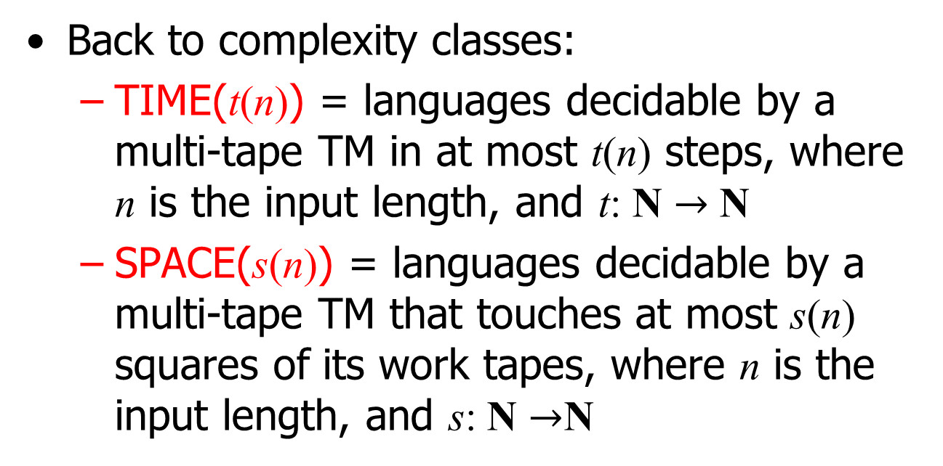
Turing Machines
Back to complexity classes:
  TIME(t(n)) = languages decidable by a multi-tape TM in at most t(n) steps, where n is the input length, and t: N $→$ N
  SPACE(s(n)) = languages decidable by a multi-tape TM that touches at most s(n) squares of its work tapes, where n is the input length, and s: N $→$N

Slide 24

Turing Machines
Back to complexity classes:
  TIME(t(n)) = languages decidable by a multi-tape TM in at most t(n) steps, where n is the input length, and t: N $→$ N
  SPACE(s(n)) = languages decidable by a multi-tape TM that touches at most s(n) squares of its work tapes, where n is the input length, and s: N $→$N
Note: P = $∪$_{k ≥1} TIME(n^{k})

Slide 25
Turing Machines
Back to complexity classes:
  TIME(t(n)) = languages decidable by a multi-tape TM in at most t(n) steps, where n is the input length, and t: N $→$ N
  SPACE(s(n)) = languages decidable by a multi-tape TM that touches at most s(n) squares of its work tapes, where n is the input length, and s: N $→$N
Note: P = $∪$_{k ≥1} TIME(n^{k})
This can be interpreted as on a single-taple TM

Slide 26
Interlude
In an ideal world, given a language (problem) L
  develop an algorithm solving L
  prove that no algorithm does better

Slide 27
Interlude
In an ideal world, given a language (problem) L
  develop an algorithm solving L
  prove that no algorithm does better
we are pretty good at part 1

Slide 28
Interlude
In an ideal world, given a language (problem) L
  develop an algorithm solving L
  prove that no algorithm does better
we are pretty good at part 1
we are currently completely helpless when it comes to part 2, for most problems that we care about

Slide 29
Interlude
In an ideal world, given a language (problem) L
  develop an algorithm solving L
  prove that no algorithm does better
we are pretty good at part 1
we are currently completely helpless when it comes to part 2, for most problems that we care about
in place of part 2 we can
  relate the difficulty of problems to each other via reductions
  prove that a problem is a “hardest” problem in a complexity class via completeness

Slide 30
Interlude
In an ideal world, given a language (problem) L
  develop an algorithm solving L
  prove that no algorithm does better
we are pretty good at part 1
we are currently completely helpless when it comes to part 2, for most problems that we care about
in place of part 2 we can
  relate the difficulty of problems to each other via reductions
  prove that a problem is a “hardest” problem in a complexity class via completeness
powerful, successful surrogate for lower bounds

Slide 31
Nondeterminism
Motivations.
Turing machine was proposed originally to study human’s way of thinking.
On each given situation, a Turing machine has a unique reaction (deterministically): δ(q₀, a₀) = (q₁, a₁, V₁).
However, on a given situation, a human may have options of choosing a reaction from a set of more than one reactions. A smart(est) person may be able to always pick the best option (e.g., the best chess player, who seems to be able to always, magically, pick the best option in each step).
Our deterministic Turing machine cannot simulate this kind of magical operations. In fact, we do not understand how such a magical decision is made by humans.
We want our Turing machines to be able to simulate such magic steps, that on a set of options always pick the best one.

Slide 32
Nondeterminism
Example 1.
Problem SHORSTEST-PATH.
Given a graph G, two vertices s and t, and integer k, is there an s-t path of length ≤ k?

Slide 33
Nondeterminism
Example 1.
Problem SHORSTEST-PATH.
Given a graph G, two vertices s and t, and integer k, is there an s-t path of length ≤ k?
Algorithm.
1. magically pick an integer h ≤ k;
v₀ = s;
for (i=1; i++; i≤h)
magically pick a vertex v_{i};
for (i=1; i++; i≤h)
check [v_{i-1}, v_{i}] is an edge;
check v_{h} = t;
if (any test in steps 4-5 fails)
return (‘no’)
else return (‘yes’)

Slide 34
Nondeterminism
Example 1.
Example 2.
Problem SHORSTEST-PATH.
Given a graph G, two vertices s and t, and integer k, is there an s-t path of length ≤ k?
Problem Traveling-Salesman.
Given a weighted n-vertex graph G and integer k, is there a traveling salesman tour of weight ≤ k?
Algorithm.
1. magically pick an integer h ≤ k;
v₀ = s;
for (i=1; i++; i≤h)
magically pick a vertex v_{i};
for (i=1; i++; i≤h)
check [v_{i-1}, v_{i}] is an edge;
check v_{h} = t;
if (any test in steps 4-5 fails)
return (‘no’)
else return (‘yes’)

Slide 35
Nondeterminism
Example 1.
Example 2.
Problem SHORSTEST-PATH.
Given a graph G, two vertices s and t, and integer k, is there an s-t path of length ≤ k?
Problem Traveling-Salesman.
Given a weighted n-vertex graph G and integer k, is there a traveling salesman tour of weight ≤ k?
Algorithm.
1. magically pick an integer h ≤ k;
v₀ = s;
for (i=1; i++; i≤h)
magically pick a vertex v_{i};
for (i=1; i++; i≤h)
check [v_{i-1}, v_{i}] is an edge;
check v_{h} = t;
if (any test in steps 4-5 fails)
return (‘no’)
else return (‘yes’)
Algorithm.
1. for (i=1; i++; i≤n)
magically pick a vertex v_{i};
2. check that all vertices picked in
step 1 are different;
3. for (i=1; i++; i≤n-1)
check [v_{i}, v_{i+1}] is an edge;
check (Σ weight[v_{i}, v_{i+1}] ≤ k);
if (any test in steps 2-4 fails)
return (‘no’)
else return (‘yes’)

