Slide 1
CSCE-637 Complexity Theory
Fall 2020
Instructor: Jianer Chen
Office: HRBB 338C
Phone: 845-4259
Email: chen@cse.tamu.edu
Notes 27: The PCP Theorem

Slide 2
Probabilistic Checkable Proofs (PCP)
x
O(r(n))
only O(b(n)) times
A
(det. poly-time)
random string
y, |y|≤p(|x|)
A (r(n), b(n))-verifier: A poly-time randomized algorithm A that makes O(r(n)) random moves, and reads O(b(n)) bits from the proof y, such that
If A accepts x, then A accepts x with probability 1; and
If A rejects x, then A rejects x with probability at least 1/2.
We can assume that A reads the O(b(n)) bits of the proof non-adaptively.
PCP(r(n), b(n)): The class of languages accepted by (r(n), b(n))-verifiers.

Slide 3
Probabilistic Checkable Proofs (PCP)
x
O(r(n))
only O(b(n)) times
A
(det. poly-time)
random string
y, |y|≤p(|x|)
A (r(n), b(n))-verifier: A poly-time randomized algorithm A that makes O(r(n)) random moves, and reads O(b(n)) bits from the proof y, such that
If A accepts x, then A accepts x with probability 1; and
If A rejects x, then A rejects x with probability at least 1/2.
We can assume that A reads the O(b(n)) bits of the proof non-adaptively.
PCP(r(n), b(n)): The class of languages accepted by (r(n), b(n))-verifiers.
Example 1. NP = PCP(0, poly).

Slide 4
Probabilistic Checkable Proofs (PCP)
x
O(r(n))
only O(b(n)) times
A
(det. poly-time)
random string
y, |y|≤p(|x|)
A (r(n), b(n))-verifier: A poly-time randomized algorithm A that makes O(r(n)) random moves, and reads O(b(n)) bits from the proof y, such that
If A accepts x, then A accepts x with probability 1; and
If A rejects x, then A rejects x with probability at least 1/2.
We can assume that A reads the O(b(n)) bits of the proof non-adaptively.
PCP(r(n), b(n)): The class of languages accepted by (r(n), b(n))-verifiers.
Example 1. NP = PCP(0, poly).
Example 2. PCP(log n, 1) $⊆$ NP.

Slide 5
Probabilistic Checkable Proofs (PCP)
x
O(r(n))
only O(b(n)) times
A
(det. poly-time)
random string
y, |y|≤p(|x|)
PCP Theorem. NP = PCP(log n, 1).

Slide 6
Probabilistic Checkable Proofs (PCP)
x
O(r(n))
only O(b(n)) times
A
(det. poly-time)
random string
y, |y|≤p(|x|)
PCP Theorem. NP = PCP(log n, 1).
Significance: NP problems have poly-length proofs that can be verified in poly-time with high probability by reading only constant number of bits in the proof.

Slide 7
PCP Theorem for Non-Approximability
Max-SAT. Given a CNF formula F, find an assignment to F that satisfies the largest number of clauses in F.

Slide 8
PCP Theorem for Non-Approximability
Max-SAT. Given a CNF formula F, find an assignment to F that satisfies the largest number of clauses in F.
Theorem. Unless P = NP, Max-SAT has no PTAS (i.e., poly-time approximation algorithms of ratio 1+ϵ for all ϵ > 0.)

Slide 9
PCP Theorem for Non-Approximability
Max-SAT. Given a CNF formula F, find an assignment to F that satisfies the largest number of clauses in F.
Theorem. Unless P = NP, Max-SAT has no PTAS (i.e., poly-time approximation algorithms of ratio 1+ϵ for all ϵ > 0.)
Proof. Let Q be any problem in NP.

Slide 10
PCP Theorem for Non-Approximability
Max-SAT. Given a CNF formula F, find an assignment to F that satisfies the largest number of clauses in F.
Theorem. Unless P = NP, Max-SAT has no PTAS (i.e., poly-time approximation algorithms of ratio 1+ϵ for all ϵ > 0.)
Proof. Let Q be any problem in NP. We first reduce Q to Max-SAT.

Slide 11
PCP Theorem for Non-Approximability
Max-SAT. Given a CNF formula F, find an assignment to F that satisfies the largest number of clauses in F.
Theorem. Unless P = NP, Max-SAT has no PTAS (i.e., poly-time approximation algorithms of ratio 1+ϵ for all ϵ > 0.)
Proof. Let Q be any problem in NP. We first reduce Q to Max-SAT.
Q $∈$ PCP(log n, 1) is accepted by a (log n, 1)-verifier A

Slide 12
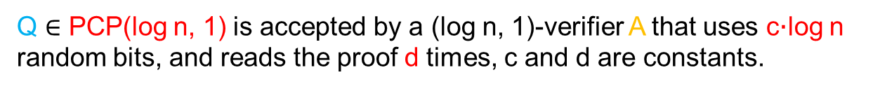
PCP Theorem for Non-Approximability
Max-SAT. Given a CNF formula F, find an assignment to F that satisfies the largest number of clauses in F.
Theorem. Unless P = NP, Max-SAT has no PTAS (i.e., poly-time approximation algorithms of ratio 1+ϵ for all ϵ > 0.)
Proof. Let Q be any problem in NP. We first reduce Q to Max-SAT.
Q $∈$ PCP(log n, 1) is accepted by a (log n, 1)-verifier A that uses c‧log n random bits, and reads the proof d times, c and d are constants.

Slide 13
PCP Theorem for Non-Approximability
Max-SAT. Given a CNF formula F, find an assignment to F that satisfies the largest number of clauses in F.
Theorem. Unless P = NP, Max-SAT has no PTAS (i.e., poly-time approximation algorithms of ratio 1+ϵ for all ϵ > 0.)
Proof. Let Q be any problem in NP. We first reduce Q to Max-SAT.
Q $∈$ PCP(log n, 1) is accepted by a (log n, 1)-verifier A that uses c‧log n random bits, and reads the proof d times, c and d are constants.
Let x be an instance of Q.

Slide 14
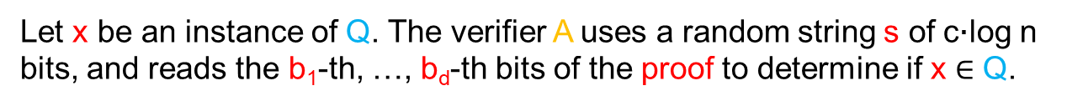
PCP Theorem for Non-Approximability
Max-SAT. Given a CNF formula F, find an assignment to F that satisfies the largest number of clauses in F.
Theorem. Unless P = NP, Max-SAT has no PTAS (i.e., poly-time approximation algorithms of ratio 1+ϵ for all ϵ > 0.)
Proof. Let Q be any problem in NP. We first reduce Q to Max-SAT.
Q $∈$ PCP(log n, 1) is accepted by a (log n, 1)-verifier A that uses c‧log n random bits, and reads the proof d times, c and d are constants.
Let x be an instance of Q. The verifier A uses a random string s of c‧log n bits, and reads the b₁-th, …, b_{d}-th bits of the proof to determine if x $∈$ Q.

Slide 15
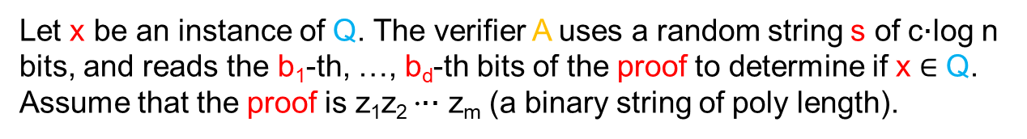
PCP Theorem for Non-Approximability
Max-SAT. Given a CNF formula F, find an assignment to F that satisfies the largest number of clauses in F.
Theorem. Unless P = NP, Max-SAT has no PTAS (i.e., poly-time approximation algorithms of ratio 1+ϵ for all ϵ > 0.)
Proof. Let Q be any problem in NP. We first reduce Q to Max-SAT.
Q $∈$ PCP(log n, 1) is accepted by a (log n, 1)-verifier A that uses c‧log n random bits, and reads the proof d times, c and d are constants.
Let x be an instance of Q. The verifier A uses a random string s of c‧log n bits, and reads the b₁-th, …, b_{d}-th bits of the proof to determine if x $∈$ Q. Assume that the proof is z₁z₂ ‧‧‧ z_{m} (a binary string of poly length).

Slide 16
PCP Theorem for Non-Approximability
Max-SAT. Given a CNF formula F, find an assignment to F that satisfies the largest number of clauses in F.
Theorem. Unless P = NP, Max-SAT has no PTAS (i.e., poly-time approximation algorithms of ratio 1+ϵ for all ϵ > 0.)
Proof. Let Q be any problem in NP. We first reduce Q to Max-SAT.
Q $∈$ PCP(log n, 1) is accepted by a (log n, 1)-verifier A that uses c‧log n random bits, and reads the proof d times, c and d are constants.
Let x be an instance of Q. The verifier A uses a random string s of c‧log n bits, and reads the b₁-th, …, b_{d}-th bits of the proof to determine if x $∈$ Q. Assume that the proof is z₁z₂ ‧‧‧ z_{m} (a binary string of poly length).
When x and s are given, the decision of A entirely depends the values
z_{b1}, z_{b2}, …, z_{bd},

Slide 17
PCP Theorem for Non-Approximability
Max-SAT. Given a CNF formula F, find an assignment to F that satisfies the largest number of clauses in F.
Theorem. Unless P = NP, Max-SAT has no PTAS (i.e., poly-time approximation algorithms of ratio 1+ϵ for all ϵ > 0.)
Proof. Let Q be any problem in NP. We first reduce Q to Max-SAT.
Q $∈$ PCP(log n, 1) is accepted by a (log n, 1)-verifier A that uses c‧log n random bits, and reads the proof d times, c and d are constants.
Let x be an instance of Q. The verifier A uses a random string s of c‧log n bits, and reads the b₁-th, …, b_{d}-th bits of the proof to determine if x $∈$ Q. Assume that the proof is z₁z₂ ‧‧‧ z_{m} (a binary string of poly length).
When x and s are given, the decision of A entirely depends the values
z_{b1}, z_{b2}, …, z_{bd}, thus, is a Boolean function φ_{x,s}(z_{b1},…, z_{bd}) of z_{b1}, …, z_{bd},

Slide 18
PCP Theorem for Non-Approximability
Max-SAT. Given a CNF formula F, find an assignment to F that satisfies the largest number of clauses in F.
Theorem. Unless P = NP, Max-SAT has no PTAS (i.e., poly-time approximation algorithms of ratio 1+ϵ for all ϵ > 0.)
Proof. Let Q be any problem in NP. We first reduce Q to Max-SAT.
Q $∈$ PCP(log n, 1) is accepted by a (log n, 1)-verifier A that uses c‧log n random bits, and reads the proof d times, c and d are constants.
Let x be an instance of Q. The verifier A uses a random string s of c‧log n bits, and reads the b₁-th, …, b_{d}-th bits of the proof to determine if x $∈$ Q. Assume that the proof is z₁z₂ ‧‧‧ z_{m} (a binary string of poly length).
When x and s are given, the decision of A entirely depends the values
z_{b1}, z_{b2}, …, z_{bd}, thus, is a Boolean function φ_{x,s}(z_{b1},…, z_{bd}) of z_{b1}, …, z_{bd}, which can be computed in poly-time.

Slide 19
PCP Theorem for Non-Approximability
Max-SAT. Given a CNF formula F, find an assignment to F that satisfies the largest number of clauses in F.
Theorem. Unless P = NP, Max-SAT has no PTAS (i.e., poly-time approximation algorithms of ratio 1+ϵ for all ϵ > 0.)
Proof. Let Q be any problem in NP. We first reduce Q to Max-SAT.
Q $∈$ PCP(log n, 1) is accepted by a (log n, 1)-verifier A that uses c‧log n random bits, and reads the proof d times, c and d are constants.
Let x be an instance of Q. The verifier A uses a random string s of c‧log n bits, and reads the b₁-th, …, b_{d}-th bits of the proof to determine if x $∈$ Q. Assume that the proof is z₁z₂ ‧‧‧ z_{m} (a binary string of poly length).
When x and s are given, the decision of A entirely depends the values
z_{b1}, z_{b2}, …, z_{bd}, thus, is a Boolean function φ_{x,s}(z_{b1},…, z_{bd}) of z_{b1}, …, z_{bd}, which can be computed in poly-time.
Write φ_{x,s}(z_{b1},…, z_{bd}) in CNF of ≤ 2^{d} clauses.

Slide 20
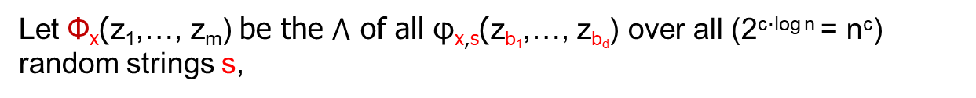
PCP Theorem for Non-Approximability
Max-SAT. Given a CNF formula F, find an assignment to F that satisfies the largest number of clauses in F.
Theorem. Unless P = NP, Max-SAT has no PTAS (i.e., poly-time approximation algorithms of ratio 1+ϵ for all ϵ > 0.)
Proof. Let Q be any problem in NP. We first reduce Q to Max-SAT.
Q $∈$ PCP(log n, 1) is accepted by a (log n, 1)-verifier A that uses c‧log n random bits, and reads the proof d times, c and d are constants.
Let x be an instance of Q. The verifier A uses a random string s of c‧log n bits, and reads the b₁-th, …, b_{d}-th bits of the proof to determine if x $∈$ Q. Assume that the proof is z₁z₂ ‧‧‧ z_{m} (a binary string of poly length).
When x and s are given, the decision of A entirely depends the values
z_{b1}, z_{b2}, …, z_{bd}, thus, is a Boolean function φ_{x,s}(z_{b1},…, z_{bd}) of z_{b1}, …, z_{bd}, which can be computed in poly-time.
Write φ_{x,s}(z_{b1},…, z_{bd}) in CNF of ≤ 2^{d} clauses.
Let Φ_{x}(z₁,…, z_{m}) be the $⋀$ of all φ_{x,s}(z_{b1},…, z_{bd}) over all (2^{c‧log n} = n^{c}) random strings s,

Slide 21
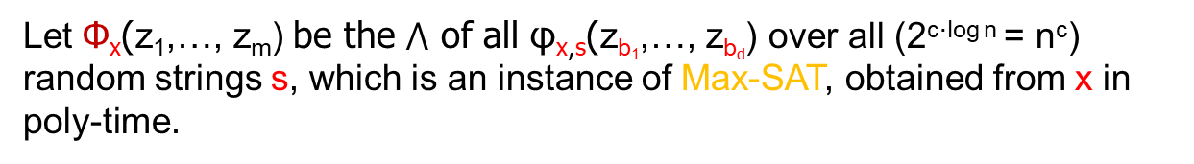
PCP Theorem for Non-Approximability
Max-SAT. Given a CNF formula F, find an assignment to F that satisfies the largest number of clauses in F.
Theorem. Unless P = NP, Max-SAT has no PTAS (i.e., poly-time approximation algorithms of ratio 1+ϵ for all ϵ > 0.)
Proof. Let Q be any problem in NP. We first reduce Q to Max-SAT.
Q $∈$ PCP(log n, 1) is accepted by a (log n, 1)-verifier A that uses c‧log n random bits, and reads the proof d times, c and d are constants.
Let x be an instance of Q. The verifier A uses a random string s of c‧log n bits, and reads the b₁-th, …, b_{d}-th bits of the proof to determine if x $∈$ Q. Assume that the proof is z₁z₂ ‧‧‧ z_{m} (a binary string of poly length).
When x and s are given, the decision of A entirely depends the values
z_{b1}, z_{b2}, …, z_{bd}, thus, is a Boolean function φ_{x,s}(z_{b1},…, z_{bd}) of z_{b1}, …, z_{bd}, which can be computed in poly-time.
Write φ_{x,s}(z_{b1},…, z_{bd}) in CNF of ≤ 2^{d} clauses.
Let Φ_{x}(z₁,…, z_{m}) be the $⋀$ of all φ_{x,s}(z_{b1},…, z_{bd}) over all (2^{c‧log n} = n^{c}) random strings s, which is an instance of Max-SAT, obtained from x in poly-time.

Slide 22
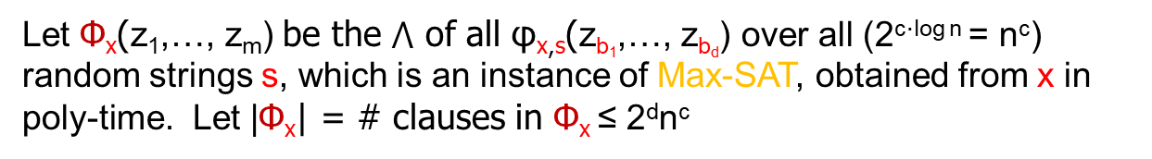
PCP Theorem for Non-Approximability
Max-SAT. Given a CNF formula F, find an assignment to F that satisfies the largest number of clauses in F.
Theorem. Unless P = NP, Max-SAT has no PTAS (i.e., poly-time approximation algorithms of ratio 1+ϵ for all ϵ > 0.)
Proof. Let Q be any problem in NP. We first reduce Q to Max-SAT.
Q $∈$ PCP(log n, 1) is accepted by a (log n, 1)-verifier A that uses c‧log n random bits, and reads the proof d times, c and d are constants.
Let x be an instance of Q. The verifier A uses a random string s of c‧log n bits, and reads the b₁-th, …, b_{d}-th bits of the proof to determine if x $∈$ Q. Assume that the proof is z₁z₂ ‧‧‧ z_{m} (a binary string of poly length).
When x and s are given, the decision of A entirely depends the values
z_{b1}, z_{b2}, …, z_{bd}, thus, is a Boolean function φ_{x,s}(z_{b1},…, z_{bd}) of z_{b1}, …, z_{bd}, which can be computed in poly-time.
Write φ_{x,s}(z_{b1},…, z_{bd}) in CNF of ≤ 2^{d} clauses.
Let Φ_{x}(z₁,…, z_{m}) be the $⋀$ of all φ_{x,s}(z_{b1},…, z_{bd}) over all (2^{c‧log n} = n^{c}) random strings s, which is an instance of Max-SAT, obtained from x in poly-time. Let |Φ_{x}| = # clauses in Φ_{x} ≤ 2^{d}n^{c}

Slide 23
PCP Theorem for Non-Approximability
Max-SAT. Given a CNF formula F, find an assignment to F that satisfies the largest number of clauses in F.
Theorem. Unless P = NP, Max-SAT has no PTAS (i.e., poly-time approximation algorithms of ratio 1+ϵ for all ϵ > 0.)
Proof. Let Q be any problem in NP.
Q Max-SAT
x Φ_{x}(z₁,…, z_{m}) = $⋀$_{s} φ_{x,s}(z_{b1},…, z_{bd})

Slide 24
PCP Theorem for Non-Approximability
Max-SAT. Given a CNF formula F, find an assignment to F that satisfies the largest number of clauses in F.
Theorem. Unless P = NP, Max-SAT has no PTAS (i.e., poly-time approximation algorithms of ratio 1+ϵ for all ϵ > 0.)
Proof. Let Q be any problem in NP.
Q Max-SAT
x Φ_{x}(z₁,…, z_{m}) = $⋀$_{s} φ_{x,s}(z_{b1},…, z_{bd})
There are n^{c} φ_{x,s}(z_{b1},…, z_{bd})’s, each has ≤ 2^{d} clauses. |Φ_{x}| ≤ 2^{d}n^{c}.

Slide 25
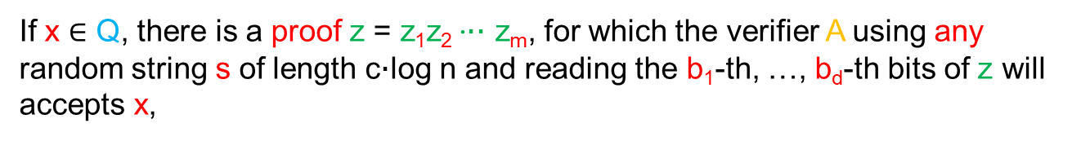
PCP Theorem for Non-Approximability
Max-SAT. Given a CNF formula F, find an assignment to F that satisfies the largest number of clauses in F.
Theorem. Unless P = NP, Max-SAT has no PTAS (i.e., poly-time approximation algorithms of ratio 1+ϵ for all ϵ > 0.)
Proof. Let Q be any problem in NP.
Q Max-SAT
x Φ_{x}(z₁,…, z_{m}) = $⋀$_{s} φ_{x,s}(z_{b1},…, z_{bd})
There are n^{c} φ_{x,s}(z_{b1},…, z_{bd})’s, each has ≤ 2^{d} clauses. |Φ_{x}| ≤ 2^{d}n^{c}.
If x $∈$ Q, there is a proof z = z₁z₂ ‧‧‧ z_{m}, for which the verifier A using any random string s of length c‧log n and reading the b₁-th, …, b_{d}-th bits of z will accepts x,

Slide 26
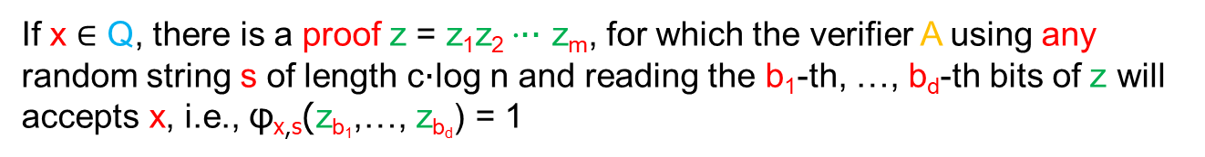
PCP Theorem for Non-Approximability
Max-SAT. Given a CNF formula F, find an assignment to F that satisfies the largest number of clauses in F.
Theorem. Unless P = NP, Max-SAT has no PTAS (i.e., poly-time approximation algorithms of ratio 1+ϵ for all ϵ > 0.)
Proof. Let Q be any problem in NP.
Q Max-SAT
x Φ_{x}(z₁,…, z_{m}) = $⋀$_{s} φ_{x,s}(z_{b1},…, z_{bd})
There are n^{c} φ_{x,s}(z_{b1},…, z_{bd})’s, each has ≤ 2^{d} clauses. |Φ_{x}| ≤ 2^{d}n^{c}.
If x $∈$ Q, there is a proof z = z₁z₂ ‧‧‧ z_{m}, for which the verifier A using any random string s of length c‧log n and reading the b₁-th, …, b_{d}-th bits of z will accepts x, i.e., φ_{x,s}(z_{b1},…, z_{bd}) = 1

Slide 27
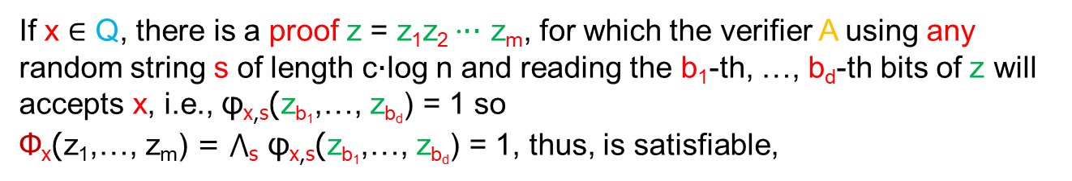
PCP Theorem for Non-Approximability
Max-SAT. Given a CNF formula F, find an assignment to F that satisfies the largest number of clauses in F.
Theorem. Unless P = NP, Max-SAT has no PTAS (i.e., poly-time approximation algorithms of ratio 1+ϵ for all ϵ > 0.)
Proof. Let Q be any problem in NP.
Q Max-SAT
x Φ_{x}(z₁,…, z_{m}) = $⋀$_{s} φ_{x,s}(z_{b1},…, z_{bd})
There are n^{c} φ_{x,s}(z_{b1},…, z_{bd})’s, each has ≤ 2^{d} clauses. |Φ_{x}| ≤ 2^{d}n^{c}.
If x $∈$ Q, there is a proof z = z₁z₂ ‧‧‧ z_{m}, for which the verifier A using any random string s of length c‧log n and reading the b₁-th, …, b_{d}-th bits of z will accepts x, i.e., φ_{x,s}(z_{b1},…, z_{bd}) = 1 so
Φ_{x}(z₁,…, z_{m}) = $⋀$_{s} φ_{x,s}(z_{b1},…, z_{bd}) = 1, thus, is satisfiable,

Slide 28
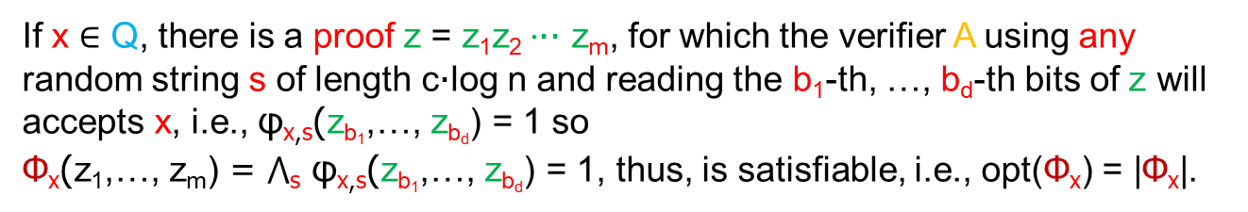
PCP Theorem for Non-Approximability
Max-SAT. Given a CNF formula F, find an assignment to F that satisfies the largest number of clauses in F.
Theorem. Unless P = NP, Max-SAT has no PTAS (i.e., poly-time approximation algorithms of ratio 1+ϵ for all ϵ > 0.)
Proof. Let Q be any problem in NP.
Q Max-SAT
x Φ_{x}(z₁,…, z_{m}) = $⋀$_{s} φ_{x,s}(z_{b1},…, z_{bd})
There are n^{c} φ_{x,s}(z_{b1},…, z_{bd})’s, each has ≤ 2^{d} clauses. |Φ_{x}| ≤ 2^{d}n^{c}.
If x $∈$ Q, there is a proof z = z₁z₂ ‧‧‧ z_{m}, for which the verifier A using any random string s of length c‧log n and reading the b₁-th, …, b_{d}-th bits of z will accepts x, i.e., φ_{x,s}(z_{b1},…, z_{bd}) = 1 so
Φ_{x}(z₁,…, z_{m}) = $⋀$_{s} φ_{x,s}(z_{b1},…, z_{bd}) = 1, thus, is satisfiable, i.e., opt(Φ_{x}) = |Φ_{x}|.

Slide 29
PCP Theorem for Non-Approximability
Max-SAT. Given a CNF formula F, find an assignment to F that satisfies the largest number of clauses in F.
Theorem. Unless P = NP, Max-SAT has no PTAS (i.e., poly-time approximation algorithms of ratio 1+ϵ for all ϵ > 0.)
Proof. Let Q be any problem in NP.
Q Max-SAT
x Φ_{x}(z₁,…, z_{m}) = $⋀$_{s} φ_{x,s}(z_{b1},…, z_{bd})
There are n^{c} φ_{x,s}(z_{b1},…, z_{bd})’s, each has ≤ 2^{d} clauses. |Φ_{x}| ≤ 2^{d}n^{c}.
If x $∈$ Q, then opt(Φ_{x}) = |Φ_{x}|.

Slide 30
PCP Theorem for Non-Approximability
Max-SAT. Given a CNF formula F, find an assignment to F that satisfies the largest number of clauses in F.
Theorem. Unless P = NP, Max-SAT has no PTAS (i.e., poly-time approximation algorithms of ratio 1+ϵ for all ϵ > 0.)
Proof. Let Q be any problem in NP.
Q Max-SAT
x Φ_{x}(z₁,…, z_{m}) = $⋀$_{s} φ_{x,s}(z_{b1},…, z_{bd})
There are n^{c} φ_{x,s}(z_{b1},…, z_{bd})’s, each has ≤ 2^{d} clauses. |Φ_{x}| ≤ 2^{d}n^{c}.
If x $∈$ Q, then opt(Φ_{x}) = |Φ_{x}|.
If x $∉$ Q,

Slide 31
PCP Theorem for Non-Approximability
Max-SAT. Given a CNF formula F, find an assignment to F that satisfies the largest number of clauses in F.
Theorem. Unless P = NP, Max-SAT has no PTAS (i.e., poly-time approximation algorithms of ratio 1+ϵ for all ϵ > 0.)
Proof. Let Q be any problem in NP.
Q Max-SAT
x Φ_{x}(z₁,…, z_{m}) = $⋀$_{s} φ_{x,s}(z_{b1},…, z_{bd})
There are n^{c} φ_{x,s}(z_{b1},…, z_{bd})’s, each has ≤ 2^{d} clauses. |Φ_{x}| ≤ 2^{d}n^{c}.
If x $∈$ Q, then opt(Φ_{x}) = |Φ_{x}|.
If x $∉$ Q, for any proof z = z₁z₂ ‧‧‧ z_{m}, there are at least n^{c}/2 random strings s, φ_{x,s}(z_{b1},…, z_{bd}) = 0,

Slide 32
PCP Theorem for Non-Approximability
Max-SAT. Given a CNF formula F, find an assignment to F that satisfies the largest number of clauses in F.
Theorem. Unless P = NP, Max-SAT has no PTAS (i.e., poly-time approximation algorithms of ratio 1+ϵ for all ϵ > 0.)
Proof. Let Q be any problem in NP.
Q Max-SAT
x Φ_{x}(z₁,…, z_{m}) = $⋀$_{s} φ_{x,s}(z_{b1},…, z_{bd})
There are n^{c} φ_{x,s}(z_{b1},…, z_{bd})’s, each has ≤ 2^{d} clauses. |Φ_{x}| ≤ 2^{d}n^{c}.
If x $∈$ Q, then opt(Φ_{x}) = |Φ_{x}|.
If x $∉$ Q, for any proof z = z₁z₂ ‧‧‧ z_{m}, there are at least n^{c}/2 random strings s, φ_{x,s}(z_{b1},…, z_{bd}) = 0, i.e., at least one clause in φ_{x,s}(z_{b1},…, z_{bd}) is not satisfied.

Slide 33
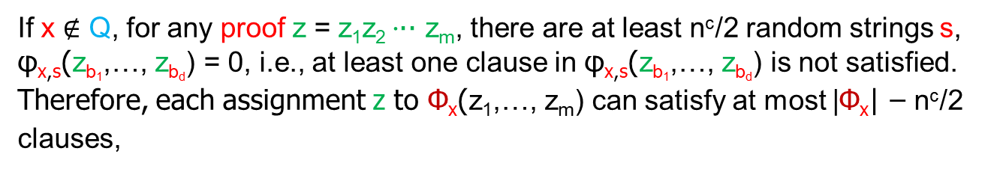
PCP Theorem for Non-Approximability
Max-SAT. Given a CNF formula F, find an assignment to F that satisfies the largest number of clauses in F.
Theorem. Unless P = NP, Max-SAT has no PTAS (i.e., poly-time approximation algorithms of ratio 1+ϵ for all ϵ > 0.)
Proof. Let Q be any problem in NP.
Q Max-SAT
x Φ_{x}(z₁,…, z_{m}) = $⋀$_{s} φ_{x,s}(z_{b1},…, z_{bd})
There are n^{c} φ_{x,s}(z_{b1},…, z_{bd})’s, each has ≤ 2^{d} clauses. |Φ_{x}| ≤ 2^{d}n^{c}.
If x $∈$ Q, then opt(Φ_{x}) = |Φ_{x}|.
If x $∉$ Q, for any proof z = z₁z₂ ‧‧‧ z_{m}, there are at least n^{c}/2 random strings s, φ_{x,s}(z_{b1},…, z_{bd}) = 0, i.e., at least one clause in φ_{x,s}(z_{b1},…, z_{bd}) is not satisfied.
Therefore, each assignment z to Φ_{x}(z₁,…, z_{m}) can satisfy at most |Φ_{x}| ‒ n^{c}/2
clauses,

Slide 34
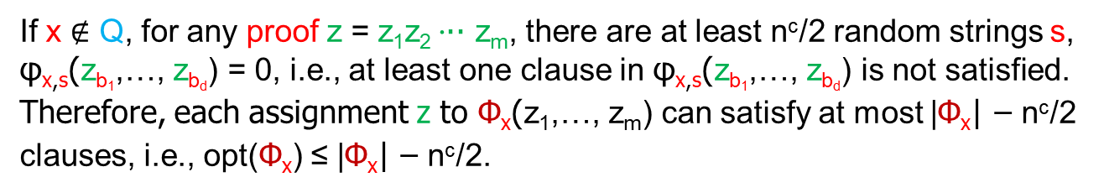
PCP Theorem for Non-Approximability
Max-SAT. Given a CNF formula F, find an assignment to F that satisfies the largest number of clauses in F.
Theorem. Unless P = NP, Max-SAT has no PTAS (i.e., poly-time approximation algorithms of ratio 1+ϵ for all ϵ > 0.)
Proof. Let Q be any problem in NP.
Q Max-SAT
x Φ_{x}(z₁,…, z_{m}) = $⋀$_{s} φ_{x,s}(z_{b1},…, z_{bd})
There are n^{c} φ_{x,s}(z_{b1},…, z_{bd})’s, each has ≤ 2^{d} clauses. |Φ_{x}| ≤ 2^{d}n^{c}.
If x $∈$ Q, then opt(Φ_{x}) = |Φ_{x}|.
If x $∉$ Q, for any proof z = z₁z₂ ‧‧‧ z_{m}, there are at least n^{c}/2 random strings s, φ_{x,s}(z_{b1},…, z_{bd}) = 0, i.e., at least one clause in φ_{x,s}(z_{b1},…, z_{bd}) is not satisfied.
Therefore, each assignment z to Φ_{x}(z₁,…, z_{m}) can satisfy at most |Φ_{x}| ‒ n^{c}/2
clauses, i.e., opt(Φ_{x}) ≤ |Φ_{x}| ‒ n^{c}/2.

Slide 35
PCP Theorem for Non-Approximability
Max-SAT. Given a CNF formula F, find an assignment to F that satisfies the largest number of clauses in F.
Theorem. Unless P = NP, Max-SAT has no PTAS (i.e., poly-time approximation algorithms of ratio 1+ϵ for all ϵ > 0.)
Proof. Let Q be any problem in NP.
Q Max-SAT
x Φ_{x}(z₁,…, z_{m}) = $⋀$_{s} φ_{x,s}(z_{b1},…, z_{bd})
There are n^{c} φ_{x,s}(z_{b1},…, z_{bd})’s, each has ≤ 2^{d} clauses. |Φ_{x}| ≤ 2^{d}n^{c}.
If x $∈$ Q, then opt(Φ_{x}) = |Φ_{x}|.
If x $∉$ Q, then opt(Φ_{x}) ≤ |Φ_{x}| ‒ n^{c}/2.

Slide 36
PCP Theorem for Non-Approximability
Max-SAT. Given a CNF formula F, find an assignment to F that satisfies the largest number of clauses in F.
Theorem. Unless P = NP, Max-SAT has no PTAS (i.e., poly-time approximation algorithms of ratio 1+ϵ for all ϵ > 0.)
Proof. Let Q be any problem in NP.
Q Max-SAT
x Φ_{x}(z₁,…, z_{m}) = $⋀$_{s} φ_{x,s}(z_{b1},…, z_{bd})
There are n^{c} φ_{x,s}(z_{b1},…, z_{bd})’s, each has ≤ 2^{d} clauses. |Φ_{x}| ≤ 2^{d}n^{c}.
If x $∈$ Q, then opt(Φ_{x}) = |Φ_{x}|.
If x $∉$ Q, then opt(Φ_{x}) ≤ |Φ_{x}| ‒ n^{c}/2.
If Max-SAT has PTAS, let ε = 1/2^{d+1}.

Slide 37
PCP Theorem for Non-Approximability
Max-SAT. Given a CNF formula F, find an assignment to F that satisfies the largest number of clauses in F.
Theorem. Unless P = NP, Max-SAT has no PTAS (i.e., poly-time approximation algorithms of ratio 1+ϵ for all ϵ > 0.)
Proof. Let Q be any problem in NP.
Q Max-SAT
x Φ_{x}(z₁,…, z_{m}) = $⋀$_{s} φ_{x,s}(z_{b1},…, z_{bd})
There are n^{c} φ_{x,s}(z_{b1},…, z_{bd})’s, each has ≤ 2^{d} clauses. |Φ_{x}| ≤ 2^{d}n^{c}.
If x $∈$ Q, then opt(Φ_{x}) = |Φ_{x}|.
If x $∉$ Q, then opt(Φ_{x}) ≤ |Φ_{x}| ‒ n^{c}/2.
If Max-SAT has PTAS, let ε = 1/2^{d+1}. So there is an approximation algorithm A_{SAT} for Max-SAT that on Φ_{x} gives an assignment S that satisfies S(Φ_{x}) ≥ opt(Φ_{x})/(1+ ε) clauses in Φ_{x}.

Slide 38
PCP Theorem for Non-Approximability
Max-SAT. Given a CNF formula F, find an assignment to F that satisfies the largest number of clauses in F.
Theorem. Unless P = NP, Max-SAT has no PTAS (i.e., poly-time approximation algorithms of ratio 1+ϵ for all ϵ > 0.)
Proof. Let Q be any problem in NP.
Q Max-SAT
x Φ_{x}(z₁,…, z_{m}) = $⋀$_{s} φ_{x,s}(z_{b1},…, z_{bd})
There are n^{c} φ_{x,s}(z_{b1},…, z_{bd})’s, each has ≤ 2^{d} clauses. |Φ_{x}| ≤ 2^{d}n^{c}.
If x $∈$ Q, then opt(Φ_{x}) = |Φ_{x}|.
If x $∉$ Q, then opt(Φ_{x}) ≤ |Φ_{x}| ‒ n^{c}/2.
If Max-SAT has PTAS, let ε = 1/2^{d+1}. So there is an approximation algorithm A_{SAT} for Max-SAT that on Φ_{x} gives an assignment S that satisfies S(Φ_{x}) ≥ opt(Φ_{x})/(1+ ε) clauses in Φ_{x}. If opt(Φ_{x})=|Φ_{x}|, S(Φ_{x}) > |Φ_{x}| ‒ n^{c}/2.

Slide 39
PCP Theorem for Non-Approximability
Max-SAT. Given a CNF formula F, find an assignment to F that satisfies the largest number of clauses in F.
Theorem. Unless P = NP, Max-SAT has no PTAS (i.e., poly-time approximation algorithms of ratio 1+ϵ for all ϵ > 0.)
Proof. Let Q be any problem in NP.
Q Max-SAT
x Φ_{x}(z₁,…, z_{m}) = $⋀$_{s} φ_{x,s}(z_{b1},…, z_{bd})
There are n^{c} φ_{x,s}(z_{b1},…, z_{bd})’s, each has ≤ 2^{d} clauses. |Φ_{x}| ≤ 2^{d}n^{c}.
If x $∈$ Q, then opt(Φ_{x}) = |Φ_{x}|.
If x $∉$ Q, then opt(Φ_{x}) ≤ |Φ_{x}| ‒ n^{c}/2.
If Max-SAT has PTAS, let ε = 1/2^{d+1}. So there is an approximation algorithm A_{SAT} for Max-SAT that on Φ_{x} gives an assignment S that satisfies S(Φ_{x}) ≥ opt(Φ_{x})/(1+ ε) clauses in Φ_{x}. If opt(Φ_{x})=|Φ_{x}|, S(Φ_{x}) > |Φ_{x}| ‒ n^{c}/2.
Thus, to decide if x $∈$ Q, first transform x to Φ_{x}, then call A_{SAT} to compute S(Φ_{x})

Slide 40
PCP Theorem for Non-Approximability
Max-SAT. Given a CNF formula F, find an assignment to F that satisfies the largest number of clauses in F.
Theorem. Unless P = NP, Max-SAT has no PTAS (i.e., poly-time approximation algorithms of ratio 1+ϵ for all ϵ > 0.)
Proof. Let Q be any problem in NP.
Q Max-SAT
x Φ_{x}(z₁,…, z_{m}) = $⋀$_{s} φ_{x,s}(z_{b1},…, z_{bd})
There are n^{c} φ_{x,s}(z_{b1},…, z_{bd})’s, each has ≤ 2^{d} clauses. |Φ_{x}| ≤ 2^{d}n^{c}.
If x $∈$ Q, then opt(Φ_{x}) = |Φ_{x}|.
If x $∉$ Q, then opt(Φ_{x}) ≤ |Φ_{x}| ‒ n^{c}/2.
If Max-SAT has PTAS, let ε = 1/2^{d+1}. So there is an approximation algorithm A_{SAT} for Max-SAT that on Φ_{x} gives an assignment S that satisfies S(Φ_{x}) ≥ opt(Φ_{x})/(1+ ε) clauses in Φ_{x}. If opt(Φ_{x})=|Φ_{x}|, S(Φ_{x}) > |Φ_{x}| ‒ n^{c}/2.
Thus, to decide if x $∈$ Q, first transform x to Φ_{x}, then call A_{SAT} to compute S(Φ_{x}) (all in poly-time).

Slide 41
PCP Theorem for Non-Approximability
Max-SAT. Given a CNF formula F, find an assignment to F that satisfies the largest number of clauses in F.
Theorem. Unless P = NP, Max-SAT has no PTAS (i.e., poly-time approximation algorithms of ratio 1+ϵ for all ϵ > 0.)
Proof. Let Q be any problem in NP.
Q Max-SAT
x Φ_{x}(z₁,…, z_{m}) = $⋀$_{s} φ_{x,s}(z_{b1},…, z_{bd})
There are n^{c} φ_{x,s}(z_{b1},…, z_{bd})’s, each has ≤ 2^{d} clauses. |Φ_{x}| ≤ 2^{d}n^{c}.
If x $∈$ Q, then opt(Φ_{x}) = |Φ_{x}|.
If x $∉$ Q, then opt(Φ_{x}) ≤ |Φ_{x}| ‒ n^{c}/2.
If Max-SAT has PTAS, let ε = 1/2^{d+1}. So there is an approximation algorithm A_{SAT} for Max-SAT that on Φ_{x} gives an assignment S that satisfies S(Φ_{x}) ≥ opt(Φ_{x})/(1+ ε) clauses in Φ_{x}. If opt(Φ_{x})=|Φ_{x}|, S(Φ_{x}) > |Φ_{x}| ‒ n^{c}/2.
Thus, to decide if x $∈$ Q, first transform x to Φ_{x}, then call A_{SAT} to compute S(Φ_{x}) (all in poly-time). x $∈$ Q iff S(Φ_{x}) > |Φ_{x}| ‒ n^{c}/2,

Slide 42
PCP Theorem for Non-Approximability
Max-SAT. Given a CNF formula F, find an assignment to F that satisfies the largest number of clauses in F.
Theorem. Unless P = NP, Max-SAT has no PTAS (i.e., poly-time approximation algorithms of ratio 1+ϵ for all ϵ > 0.)
Proof. Let Q be any problem in NP.
Q Max-SAT
x Φ_{x}(z₁,…, z_{m}) = $⋀$_{s} φ_{x,s}(z_{b1},…, z_{bd})
There are n^{c} φ_{x,s}(z_{b1},…, z_{bd})’s, each has ≤ 2^{d} clauses. |Φ_{x}| ≤ 2^{d}n^{c}.
If x $∈$ Q, then opt(Φ_{x}) = |Φ_{x}|.
If x $∉$ Q, then opt(Φ_{x}) ≤ |Φ_{x}| ‒ n^{c}/2.
If Max-SAT has PTAS, let ε = 1/2^{d+1}. So there is an approximation algorithm A_{SAT} for Max-SAT that on Φ_{x} gives an assignment S that satisfies S(Φ_{x}) ≥ opt(Φ_{x})/(1+ ε) clauses in Φ_{x}. If opt(Φ_{x})=|Φ_{x}|, S(Φ_{x}) > |Φ_{x}| ‒ n^{c}/2.
Thus, to decide if x $∈$ Q, first transform x to Φ_{x}, then call A_{SAT} to compute S(Φ_{x}) (all in poly-time). x $∈$ Q iff S(Φ_{x}) > |Φ_{x}| ‒ n^{c}/2, i.e, Q $∈$ P

Slide 43
PCP Theorem for Non-Approximability
Max-SAT. Given a CNF formula F, find an assignment to F that satisfies the largest number of clauses in F.
Theorem. Unless P = NP, Max-SAT has no PTAS (i.e., poly-time approximation algorithms of ratio 1+ϵ for all ϵ > 0.)
Proof. Let Q be any problem in NP.
Q Max-SAT
x Φ_{x}(z₁,…, z_{m}) = $⋀$_{s} φ_{x,s}(z_{b1},…, z_{bd})
There are n^{c} φ_{x,s}(z_{b1},…, z_{bd})’s, each has ≤ 2^{d} clauses. |Φ_{x}| ≤ 2^{d}n^{c}.
If x $∈$ Q, then opt(Φ_{x}) = |Φ_{x}|.
If x $∉$ Q, then opt(Φ_{x}) ≤ |Φ_{x}| ‒ n^{c}/2.
If Max-SAT has PTAS, let ε = 1/2^{d+1}. So there is an approximation algorithm A_{SAT} for Max-SAT that on Φ_{x} gives an assignment S that satisfies S(Φ_{x}) ≥ opt(Φ_{x})/(1+ ε) clauses in Φ_{x}. If opt(Φ_{x})=|Φ_{x}|, S(Φ_{x}) > |Φ_{x}| ‒ n^{c}/2.
Thus, to decide if x $∈$ Q, first transform x to Φ_{x}, then call A_{SAT} to compute S(Φ_{x}) (all in poly-time). x $∈$ Q iff S(Φ_{x}) > |Φ_{x}| ‒ n^{c}/2, i.e, Q $∈$ P → P = NP.

Slide 44
APX-Hardness and APX-Completeness

Slide 45
APX-Hardness and APX-Completeness
NPO: the class of all NP optimization problems
Examples: most optimization problems, e.g., max-Clique, max-IS, TSP
APX: the class of NP optimization problems that have poly-time approximation algorithms of constant ratio.
Examples: max-SAT, min-VC, including all PTAS and FPTAS problems
PTAS (poly-time approximation scheme): the class of NP optimization problems that have poly-time approximation algorithms of ratio 1+ϵ for all ϵ > 0.
Examples: ETSP, Makespan, planar-IS, including all FPTAS problems
FPTAS (fully poly-time approximation scheme): the class of NP optimization problems that have O(poly(n/ϵ))-time approximation algorithms of ratio 1+ϵ for all ϵ > 0.
Examples: 2-Machine-Makespan, Knapsack

