Slide 1
CSCE-637 Complexity Theory
Fall 2020
Instructor: Jianer Chen
Office: HRBB 338C
Phone: 845-4259
Email: chen@cse.tamu.edu
Notes 23: Relativized Complexity

Slide 2
Relativized Complexity

Slide 3
Relativized Complexity
Central problem: P = NP?

Slide 4
Relativized Complexity
Central problem: P = NP?
So we do not know if deterministic poly-time algorithms (i.e., P-algorithms) and nondeterministic poly-time algorithms (i.e., NP-algorithms) are equally powerful.

Slide 5
Relativized Complexity
Central problem: P = NP?
So we do not know if deterministic poly-time algorithms (i.e., P-algorithms) and nondeterministic poly-time algorithms (i.e., NP-algorithms) are equally powerful.
What if we equip both kinds of algorithms with an oracle? Would that make them the same or different?

Slide 6
Relativized Complexity
Central problem: P = NP?
So we do not know if deterministic poly-time algorithms (i.e., P-algorithms) and nondeterministic poly-time algorithms (i.e., NP-algorithms) are equally powerful.
What if we equip both kinds of algorithms with an oracle? Would that make them the same or different?
Theorem 1. There is an oracle set A such that P^{A} = NP^{A}.

Slide 7
Relativized Complexity
Central problem: P = NP?
So we do not know if deterministic poly-time algorithms (i.e., P-algorithms) and nondeterministic poly-time algorithms (i.e., NP-algorithms) are equally powerful.
What if we equip both kinds of algorithms with an oracle? Would that make them the same or different?
Theorem 1. There is an oracle set A such that P^{A} = NP^{A}.
Proof.

Slide 8

Relativized Complexity
Central problem: P = NP?
So we do not know if deterministic poly-time algorithms (i.e., P-algorithms) and nondeterministic poly-time algorithms (i.e., NP-algorithms) are equally powerful.
What if we equip both kinds of algorithms with an oracle? Would that make them the same or different?
Theorem 1. There is an oracle set A such that P^{A} = NP^{A}.
Proof. Let A be a PSPACE-complete problem, i.e., A is in PSPACE and for every problem Q’ in PSPACE, Q’ $≤_{m}^{p}$ A.

Slide 9
Relativized Complexity
Central problem: P = NP?
So we do not know if deterministic poly-time algorithms (i.e., P-algorithms) and nondeterministic poly-time algorithms (i.e., NP-algorithms) are equally powerful.
What if we equip both kinds of algorithms with an oracle? Would that make them the same or different?
Theorem 1. There is an oracle set A such that P^{A} = NP^{A}.
Proof. Let A be a PSPACE-complete problem, i.e., A is in PSPACE and for every problem Q’ in PSPACE, Q’ $≤_{m}^{p}$ A.
Example. PSPACE-complete problem:
QBF = {$∃$x₁$\text{∀}$x₂ ⸱⸱⸱ Qx_{n} F (x₁, x₂, …, x_{n}) = 1 }

Slide 10

Relativized Complexity
Central problem: P = NP?
So we do not know if deterministic poly-time algorithms (i.e., P-algorithms) and nondeterministic poly-time algorithms (i.e., NP-algorithms) are equally powerful.
What if we equip both kinds of algorithms with an oracle? Would that make them the same or different?
Theorem 1. There is an oracle set A such that P^{A} = NP^{A}.
Proof. Let A be a PSPACE-complete problem, i.e., A is in PSPACE and for every problem Q’ in PSPACE, Q’ $≤_{m}^{p}$ A.
Fact 1. PSPACE $⊆$P^{A}.

Slide 11
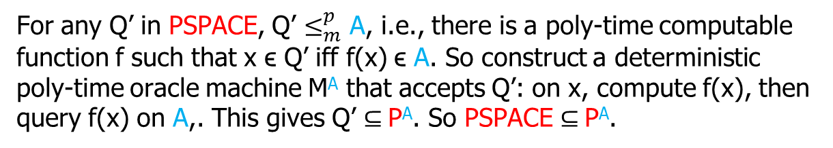
Relativized Complexity
Central problem: P = NP?
So we do not know if deterministic poly-time algorithms (i.e., P-algorithms) and nondeterministic poly-time algorithms (i.e., NP-algorithms) are equally powerful.
What if we equip both kinds of algorithms with an oracle? Would that make them the same or different?
Theorem 1. There is an oracle set A such that P^{A} = NP^{A}.
Proof. Let A be a PSPACE-complete problem, i.e., A is in PSPACE and for every problem Q’ in PSPACE, Q’ $≤_{m}^{p}$ A.
Fact 1. PSPACE $⊆$P^{A}.
For any Q’ in PSPACE, Q’ $≤_{m}^{p}$ A, i.e., there is a poly-time computable function f such that x ϵ Q’ iff f(x) ϵ A. So construct a deterministic poly-time oracle machine M^{A} that accepts Q’: on x, compute f(x), then query f(x) on A,. This gives Q’ $⊆$P^{A}. So PSPACE $⊆$P^{A}.

Slide 12
Relativized Complexity
Central problem: P = NP?
So we do not know if deterministic poly-time algorithms (i.e., P-algorithms) and nondeterministic poly-time algorithms (i.e., NP-algorithms) are equally powerful.
What if we equip both kinds of algorithms with an oracle? Would that make them the same or different?
Theorem 1. There is an oracle set A such that P^{A} = NP^{A}.
Proof. Let A be a PSPACE-complete problem, i.e., A is in PSPACE and for every problem Q’ in PSPACE, Q’ $≤_{m}^{p}$ A.
Fact 1. PSPACE $⊆$P^{A}.

Slide 13


Relativized Complexity
Central problem: P = NP?
So we do not know if deterministic poly-time algorithms (i.e., P-algorithms) and nondeterministic poly-time algorithms (i.e., NP-algorithms) are equally powerful.
What if we equip both kinds of algorithms with an oracle? Would that make them the same or different?
Theorem 1. There is an oracle set A such that P^{A} = NP^{A}.
Proof. Let A be a PSPACE-complete problem, i.e., A is in PSPACE and for every problem Q’ in PSPACE, Q’ $≤_{m}^{p}$ A.
Fact 1. PSPACE $⊆$P^{A}.
Fact 2. NP^{A} $⊆$PSPACE.

Slide 14
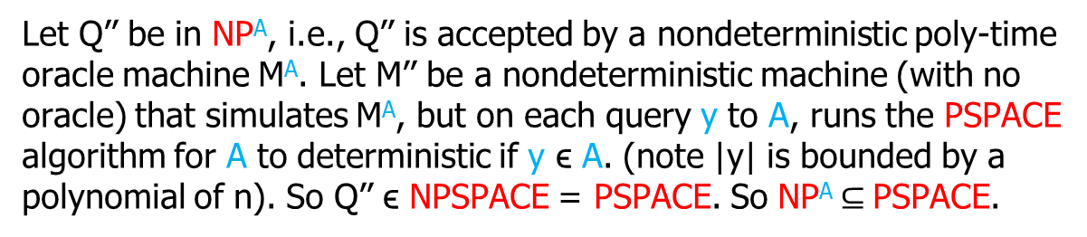
Relativized Complexity
Central problem: P = NP?
So we do not know if deterministic poly-time algorithms (i.e., P-algorithms) and nondeterministic poly-time algorithms (i.e., NP-algorithms) are equally powerful.
What if we equip both kinds of algorithms with an oracle? Would that make them the same or different?
Theorem 1. There is an oracle set A such that P^{A} = NP^{A}.
Proof. Let A be a PSPACE-complete problem, i.e., A is in PSPACE and for every problem Q’ in PSPACE, Q’ $≤_{m}^{p}$ A.
Fact 1. PSPACE $⊆$P^{A}.
Fact 2. NP^{A} $⊆$PSPACE.
Let Q’’ be in NP^{A}, i.e., Q’’ is accepted by a nondeterministic poly-time oracle machine M^{A}. Let M’’ be a nondeterministic machine (with no oracle) that simulates M^{A}, but on each query y to A, runs the PSPACE algorithm for A to deterministic if y ϵ A. (note |y| is bounded by a polynomial of n). So Q’’ ϵ NPSPACE = PSPACE. So NP^{A} $⊆$PSPACE.

Slide 15
Relativized Complexity
Central problem: P = NP?
So we do not know if deterministic poly-time algorithms (i.e., P-algorithms) and nondeterministic poly-time algorithms (i.e., NP-algorithms) are equally powerful.
What if we equip both kinds of algorithms with an oracle? Would that make them the same or different?
Theorem 1. There is an oracle set A such that P^{A} = NP^{A}.
Proof. Let A be a PSPACE-complete problem, i.e., A is in PSPACE and for every problem Q’ in PSPACE, Q’ $≤_{m}^{p}$ A.
Fact 1. PSPACE $⊆$P^{A}.
Fact 2. NP^{A} $⊆$PSPACE.

Slide 16

Relativized Complexity
Central problem: P = NP?
So we do not know if deterministic poly-time algorithms (i.e., P-algorithms) and nondeterministic poly-time algorithms (i.e., NP-algorithms) are equally powerful.
What if we equip both kinds of algorithms with an oracle? Would that make them the same or different?
Theorem 1. There is an oracle set A such that P^{A} = NP^{A}.
Proof. Let A be a PSPACE-complete problem, i.e., A is in PSPACE and for every problem Q’ in PSPACE, Q’ $≤_{m}^{p}$ A.
Fact 1. PSPACE $⊆$P^{A}.
Fact 2. NP^{A} $⊆$PSPACE.
Now PSPACE $⊆$P^{A} $⊆$ NP^{A} $⊆$ PSPACE, So P^{A} $=$ NP^{A}.

Slide 17
Relativized Complexity
Central problem: P = NP?
So we do not know if deterministic poly-time algorithms (i.e., P-algorithms) and nondeterministic poly-time algorithms (i.e., NP-algorithms) are equally powerful.
What if we equip both kinds of algorithms with an oracle? Would that make them the same or different?
Theorem 1. There is an oracle set A such that P^{A} = NP^{A}.

Slide 18


Relativized Complexity
Central problem: P = NP?
So we do not know if deterministic poly-time algorithms (i.e., P-algorithms) and nondeterministic poly-time algorithms (i.e., NP-algorithms) are equally powerful.
What if we equip both kinds of algorithms with an oracle? Would that make them the same or different?
Theorem 1. There is an oracle set A such that P^{A} = NP^{A}.
=
？

Slide 19


Relativized Complexity
Central problem: P = NP?
So we do not know if deterministic poly-time algorithms (i.e., P-algorithms) and nondeterministic poly-time algorithms (i.e., NP-algorithms) are equally powerful.
What if we equip both kinds of algorithms with an oracle? Would that make them the same or different?
Theorem 1. There is an oracle set A such that P^{A} = NP^{A}.
=
？

Slide 20
Relativized Complexity
Theorem 2 （Baker-Gill-Solovay）
There is an oracle set B such that P^{B} ≠ NP^{B}.

Slide 21
Relativized Complexity
Theorem 2 （Baker-Gill-Solovay）
There is an oracle set B such that P^{B} ≠ NP^{B}.
Proof.

Slide 22
Relativized Complexity
Theorem 2 （Baker-Gill-Solovay）
There is an oracle set B such that P^{B} ≠ NP^{B}.
Proof. For any language B’, let
L(B’) = {0^{n} | Ǝ x ϵ B’: |x| = n}.

Slide 23
Relativized Complexity
Theorem 2 （Baker-Gill-Solovay）
There is an oracle set B such that P^{B} ≠ NP^{B}.
Proof. For any language B’, let
L(B’) = {0^{n} | Ǝ x ϵ B’: |x| = n}. Then, L(B’) is in NP^{B’} for any B’.

Slide 24
Relativized Complexity
Theorem 2 （Baker-Gill-Solovay）
There is an oracle set B such that P^{B} ≠ NP^{B}.
Proof. For any language B’, let
L(B’) = {0^{n} | Ǝ x ϵ B’: |x| = n}. Then, L(B’) is in NP^{B’} for any B’.
We try to construct a B such that L(B) is not in P^{B}.

Slide 25
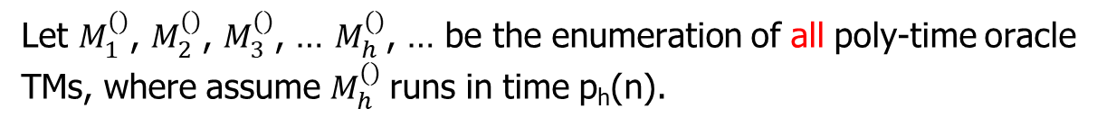
Relativized Complexity
Theorem 2 （Baker-Gill-Solovay）
There is an oracle set B such that P^{B} ≠ NP^{B}.
Proof. For any language B’, let
L(B’) = {0^{n} | Ǝ x ϵ B’: |x| = n}. Then, L(B’) is in NP^{B’} for any B’.
Let $M_{1}^{()}$, $M_{2}^{()}$, $M_{3}^{()}$, … $M_{h}^{()}$, … be the enumeration of all poly-time oracle TMs, where assume $M_{h}^{()}$runs in time p_{h}(n).

Slide 26
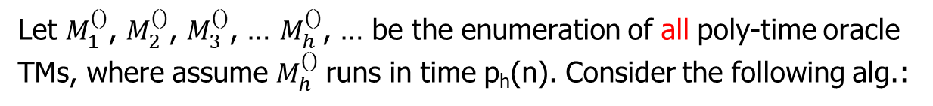
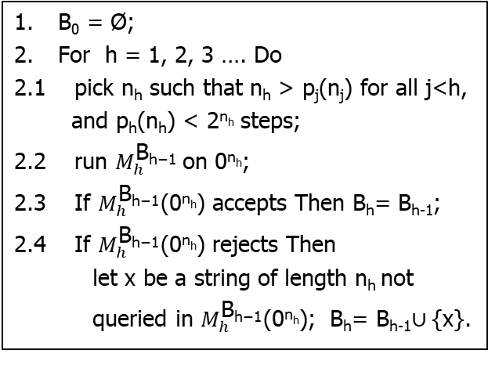
Relativized Complexity
Theorem 2 （Baker-Gill-Solovay）
There is an oracle set B such that P^{B} ≠ NP^{B}.
Proof. For any language B’, let
L(B’) = {0^{n} | Ǝ x ϵ B’: |x| = n}. Then, L(B’) is in NP^{B’} for any B’.
Let $M_{1}^{()}$, $M_{2}^{()}$, $M_{3}^{()}$, … $M_{h}^{()}$, … be the enumeration of all poly-time oracle TMs, where assume $M_{h}^{()}$runs in time p_{h}(n). Consider the following alg.:
B₀ = Ø;
For h = 1, 2, 3 …. Do
2.1 pick n_{h} such that n_{h} > p_{j}(n_{j}) for all j<h,
and p_{h}(n_{h}) < 2^{nh} steps;
2.2 run $M_{h}^{\text{B}\text{h}\text{−1}}$on 0^{nh};
2.3 If $M_{h}^{\text{B}\text{h}\text{−1}}$(0^{nh}) accepts Then B_{h}= B_{h-1};
2.4 If $M_{h}^{\text{B}\text{h}\text{−1}}$(0^{nh}) rejects Then
let x be a string of length n_{h} not
queried in $M_{h}^{\text{B}\text{h}\text{−1}}$(0^{nh}); B_{h}= B_{h-1}$∪${x}.

Slide 27

Relativized Complexity
Theorem 2 （Baker-Gill-Solovay）
There is an oracle set B such that P^{B} ≠ NP^{B}.
Proof. For any language B’, let
L(B’) = {0^{n} | Ǝ x ϵ B’: |x| = n}. Then, L(B’) is in NP^{B’} for any B’.
Let $M_{1}^{()}$, $M_{2}^{()}$, $M_{3}^{()}$, … $M_{h}^{()}$, … be the enumeration of all poly-time oracle TMs, where assume $M_{h}^{()}$runs in time p_{h}(n). Consider the following alg.:
B₀ = Ø;
For h = 1, 2, 3 …. Do
2.1 pick n_{h} such that n_{h} > p_{j}(n_{j}) for all j<h,
and p_{h}(n_{h}) < 2^{nh} steps;
2.2 run $M_{h}^{\text{B}\text{h}\text{−}\text{1}}$on 0^{nh};
2.3 If $M_{h}^{\text{B}\text{h}\text{−}\text{1}}$(0^{nh}) accepts Then B_{h}= B_{h-1};
2.4 If $M_{h}^{\text{B}\text{h}\text{−}\text{1}}$(0^{nh}) rejects Then
let x be a string of length n_{h} not
queried in $M_{h}^{\text{B}\text{h}\text{−}\text{1}}$(0^{nh}); B_{h}= B_{h-1}$∪${x}.
Let B = B₁ $∪$ B₂$∪$‧‧‧$∪$ B_{h} $∪$‧‧‧

Slide 28
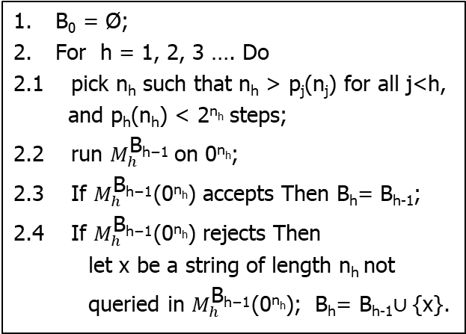
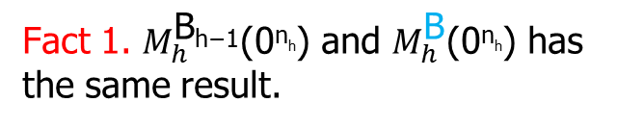
Relativized Complexity
Theorem 2 （Baker-Gill-Solovay）
There is an oracle set B such that P^{B} ≠ NP^{B}.
Proof. For any language B’, let
L(B’) = {0^{n} | Ǝ x ϵ B’: |x| = n}. Then, L(B’) is in NP^{B’} for any B’.
Let $M_{1}^{()}$, $M_{2}^{()}$, $M_{3}^{()}$, … $M_{h}^{()}$, … be the enumeration of all poly-time oracle TMs, where assume $M_{h}^{()}$runs in time p_{h}(n). Consider the following alg.:
Fact 1. $M_{h}^{\text{B}\text{h}\text{−}\text{1}}$(0^{nh}) and $M_{h}^{\text{B}}$(0^{nh}) has the same result.
B₀ = Ø;
For h = 1, 2, 3 …. Do
2.1 pick n_{h} such that n_{h} > p_{j}(n_{j}) for all j<h,
and p_{h}(n_{h}) < 2^{nh} steps;
2.2 run $M_{h}^{\text{B}\text{h}\text{−}\text{1}}$on 0^{nh};
2.3 If $M_{h}^{\text{B}\text{h}\text{−}\text{1}}$(0^{nh}) accepts Then B_{h}= B_{h-1};
2.4 If $M_{h}^{\text{B}\text{h}\text{−}\text{1}}$(0^{nh}) rejects Then
let x be a string of length n_{h} not
queried in $M_{h}^{\text{B}\text{h}\text{−}\text{1}}$(0^{nh}); B_{h}= B_{h-1}$∪${x}.
Let B = B₁ $∪$ B₂$∪$‧‧‧$∪$ B_{h} $∪$‧‧‧

Slide 29
Relativized Complexity
Theorem 2 （Baker-Gill-Solovay）
There is an oracle set B such that P^{B} ≠ NP^{B}.
Proof. For any language B’, let
L(B’) = {0^{n} | Ǝ x ϵ B’: |x| = n}. Then, L(B’) is in NP^{B’} for any B’.
Let $M_{1}^{()}$, $M_{2}^{()}$, $M_{3}^{()}$, … $M_{h}^{()}$, … be the enumeration of all poly-time oracle TMs, where assume $M_{h}^{()}$runs in time p_{h}(n). Consider the following alg.:
Fact 1. $M_{h}^{\text{B}\text{h}\text{−}\text{1}}$(0^{nh}) and $M_{h}^{\text{B}}$(0^{nh}) has the same result.
B₀ = Ø;
For h = 1, 2, 3 …. Do
2.1 pick n_{h} such that n_{h} > p_{j}(n_{j}) for all j<h,
and p_{h}(n_{h}) < 2^{nh} steps;
2.2 run $M_{h}^{\text{B}\text{h}\text{−}\text{1}}$on 0^{nh};
2.3 If $M_{h}^{\text{B}\text{h}\text{−}\text{1}}$(0^{nh}) accepts Then B_{h}= B_{h-1};
2.4 If $M_{h}^{\text{B}\text{h}\text{−}\text{1}}$(0^{nh}) rejects Then
let x be a string of length n_{h} not
queried in $M_{h}^{\text{B}\text{h}\text{−}\text{1}}$(0^{nh}); B_{h}= B_{h-1}$∪${x}.
Fact 2. L(B) is not in P^{B}.
Let B = B₁ $∪$ B₂$∪$‧‧‧$∪$ B_{h} $∪$‧‧‧

Slide 30

Relativized Complexity
Theorem 2 （Baker-Gill-Solovay）
There is an oracle set B such that P^{B} ≠ NP^{B}.
Proof. For any language B’, let
L(B’) = {0^{n} | Ǝ x ϵ B’: |x| = n}. Then, L(B’) is in NP^{B’} for any B’.
Let $M_{1}^{()}$, $M_{2}^{()}$, $M_{3}^{()}$, … $M_{h}^{()}$, … be the enumeration of all poly-time oracle TMs, where assume $M_{h}^{()}$runs in time p_{h}(n). Consider the following alg.:
Fact 1. $M_{h}^{\text{B}\text{h}\text{−1}}$(0^{nh}) and $M_{h}^{\text{B}}$(0^{nh}) has the same result.
B₀ = Ø;
For h = 1, 2, 3 …. Do
2.1 pick n_{h} such that n_{h} > p_{j}(n_{j}) for all j<h,
and p_{h}(n_{h}) < 2^{nh} steps;
2.2 run $M_{h}^{\text{B}\text{h}\text{−1}}$on 0^{nh};
2.3 If $M_{h}^{\text{B}\text{h}\text{−1}}$(0^{nh}) accepts Then B_{h}= B_{h-1};
2.4 If $M_{h}^{\text{B}\text{h}\text{−1}}$(0^{nh}) rejects Then
let x be a string of length n_{h} not
queried in $M_{h}^{\text{B}\text{h}\text{−1}}$(0^{nh}); B_{h}= B_{h-1}$∪${x}.
Fact 2. L(B) is not in P^{B}.
Proof. If L(B) is in P^{B}, then by some $M_{h}^{\text{B}}$.
Let B = B₁ $∪$ B₂$∪$‧‧‧$∪$ B_{h} $∪$‧‧‧

Slide 31
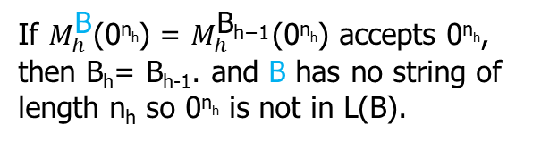
Relativized Complexity
Theorem 2 （Baker-Gill-Solovay）
There is an oracle set B such that P^{B} ≠ NP^{B}.
Proof. For any language B’, let
L(B’) = {0^{n} | Ǝ x ϵ B’: |x| = n}. Then, L(B’) is in NP^{B’} for any B’.
Let $M_{1}^{()}$, $M_{2}^{()}$, $M_{3}^{()}$, … $M_{h}^{()}$, … be the enumeration of all poly-time oracle TMs, where assume $M_{h}^{()}$runs in time p_{h}(n). Consider the following alg.:
Fact 1. $M_{h}^{\text{B}\text{h}\text{−}\text{1}}$(0^{nh}) and $M_{h}^{\text{B}}$(0^{nh}) has the same result.
B₀ = Ø;
For h = 1, 2, 3 …. Do
2.1 pick n_{h} such that n_{h} > p_{j}(n_{j}) for all j<h,
and p_{h}(n_{h}) < 2^{nh} steps;
2.2 run $M_{h}^{\text{B}\text{h}\text{−}\text{1}}$on 0^{nh};
2.3 If $M_{h}^{\text{B}\text{h}\text{−}\text{1}}$(0^{nh}) accepts Then B_{h}= B_{h-1};
2.4 If $M_{h}^{\text{B}\text{h}\text{−}\text{1}}$(0^{nh}) rejects Then
let x be a string of length n_{h} not
queried in $M_{h}^{\text{B}\text{h}\text{−}\text{1}}$(0^{nh}); B_{h}= B_{h-1}$∪${x}.
Fact 2. L(B) is not in P^{B}.
Proof. If L(B) is in P^{B}, then by some $M_{h}^{\text{B}}$.
If $M_{h}^{\text{B}}$(0^{nh}) = $M_{h}^{\text{B}\text{h}\text{−}\text{1}}$(0^{nh}) accepts 0^{nh}, then B_{h}= B_{h-1}. and B has no string of length n_{h} so 0^{nh} is not in L(B).
Let B = B₁ $∪$ B₂$∪$‧‧‧$∪$ B_{h} $∪$‧‧‧

Slide 32
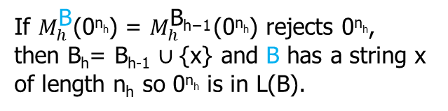
Relativized Complexity
Theorem 2 （Baker-Gill-Solovay）
There is an oracle set B such that P^{B} ≠ NP^{B}.
Proof. For any language B’, let
L(B’) = {0^{n} | Ǝ x ϵ B’: |x| = n}. Then, L(B’) is in NP^{B’} for any B’.
Let $M_{1}^{()}$, $M_{2}^{()}$, $M_{3}^{()}$, … $M_{h}^{()}$, … be the enumeration of all poly-time oracle TMs, where assume $M_{h}^{()}$runs in time p_{h}(n). Consider the following alg.:
Fact 1. $M_{h}^{\text{B}\text{h}\text{−}\text{1}}$(0^{nh}) and $M_{h}^{\text{B}}$(0^{nh}) has the same result.
B₀ = Ø;
For h = 1, 2, 3 …. Do
2.1 pick n_{h} such that n_{h} > p_{j}(n_{j}) for all j<h,
and p_{h}(n_{h}) < 2^{nh} steps;
2.2 run $M_{h}^{\text{B}\text{h}\text{−}\text{1}}$on 0^{nh};
2.3 If $M_{h}^{\text{B}\text{h}\text{−}\text{1}}$(0^{nh}) accepts Then B_{h}= B_{h-1};
2.4 If $M_{h}^{\text{B}\text{h}\text{−}\text{1}}$(0^{nh}) rejects Then
let x be a string of length n_{h} not
queried in $M_{h}^{\text{B}\text{h}\text{−}\text{1}}$(0^{nh}); B_{h}= B_{h-1}$∪${x}.
Fact 2. L(B) is not in P^{B}.
Proof. If L(B) is in P^{B}, then by some $M_{h}^{\text{B}}$.
If $M_{h}^{\text{B}}$(0^{nh}) = $M_{h}^{\text{B}\text{h}\text{−}\text{1}}$(0^{nh}) accepts 0^{nh}, then B_{h}= B_{h-1}. and B has no string of length n_{h} so 0^{nh} is not in L(B).
If $M_{h}^{\text{B}}$(0^{nh}) = $M_{h}^{\text{B}\text{h}\text{−}\text{1}}$(0^{nh}) rejects 0^{nh}, then B_{h}= B_{h-1} $∪${x} and B has a string x of length n_{h} so 0^{nh} is in L(B).
Let B = B₁ $∪$ B₂$∪$‧‧‧$∪$ B_{h} $∪$‧‧‧

Slide 33
Relativized Complexity
Theorem 2 （Baker-Gill-Solovay）
There is an oracle set B such that P^{B} ≠ NP^{B}.
Proof. For any language B’, let
L(B’) = {0^{n} | Ǝ x ϵ B’: |x| = n}. Then, L(B’) is in NP^{B’} for any B’.
Let $M_{1}^{()}$, $M_{2}^{()}$, $M_{3}^{()}$, … $M_{h}^{()}$, … be the enumeration of all poly-time oracle TMs, where assume $M_{h}^{()}$runs in time p_{h}(n). Consider the following alg.:
Fact 1. $M_{h}^{\text{B}\text{h}\text{−1}}$(0^{nh}) and $M_{h}^{\text{B}}$(0^{nh}) has the same result.
B₀ = Ø;
For h = 1, 2, 3 …. Do
2.1 pick n_{h} such that n_{h} > p_{j}(n_{j}) for all j<h,
and p_{h}(n_{h}) < 2^{nh} steps;
2.2 run $M_{h}^{\text{B}\text{h}\text{−1}}$on 0^{nh};
2.3 If $M_{h}^{\text{B}\text{h}\text{−1}}$(0^{nh}) accepts Then B_{h}= B_{h-1};
2.4 If $M_{h}^{\text{B}\text{h}\text{−1}}$(0^{nh}) rejects Then
let x be a string of length n_{h} not
queried in $M_{h}^{\text{B}\text{h}\text{−1}}$(0^{nh}); B_{h}= B_{h-1}$∪${x}.
Fact 2. L(B) is not in P^{B}.
Thus, L(B) ϵ NP^{B} ̶ P^{B}
Let B = B₁ $∪$ B₂$∪$‧‧‧$∪$ B_{h} $∪$‧‧‧

Slide 34
Relativized Complexity
Theorem 2 （Baker-Gill-Solovay）
There is an oracle set B such that P^{B} ≠ NP^{B}.
Proof. For any language B’, let
L(B’) = {0^{n} | Ǝ x ϵ B’: |x| = n}. Then, L(B’) is in NP^{B’} for any B’.
Let $M_{1}^{()}$, $M_{2}^{()}$, $M_{3}^{()}$, … $M_{h}^{()}$, … be the enumeration of all poly-time oracle TMs, where assume $M_{h}^{()}$runs in time p_{h}(n). Consider the following alg.:
Fact 1. $M_{h}^{\text{B}\text{h}\text{−}\text{1}}$(0^{nh}) and $M_{h}^{\text{B}}$(0^{nh}) has the same result.
B₀ = Ø;
For h = 1, 2, 3 …. Do
2.1 pick n_{h} such that n_{h} > p_{j}(n_{j}) for all j<h,
and p_{h}(n_{h}) < 2^{nh} steps;
2.2 run $M_{h}^{\text{B}\text{h}\text{−}\text{1}}$on 0^{nh};
2.3 If $M_{h}^{\text{B}\text{h}\text{−}\text{1}}$(0^{nh}) accepts Then B_{h}= B_{h-1};
2.4 If $M_{h}^{\text{B}\text{h}\text{−}\text{1}}$(0^{nh}) rejects Then
let x be a string of length n_{h} not
queried in $M_{h}^{\text{B}\text{h}\text{−}\text{1}}$(0^{nh}); B_{h}= B_{h-1}$∪${x}.
Fact 2. L(B) is not in P^{B}.
Thus, L(B) ϵ NP^{B} ̶ P^{B}, and
P^{B} ≠ NP^{B}
Let B = B₁ $∪$ B₂$∪$‧‧‧$∪$ B_{h} $∪$‧‧‧

Slide 35
Relativized Complexity
Therefore,
1. There is an oracle set A such that P^{A} = NP^{A}; and
2. There is an oracle set B such that P^{B} ≠ NP^{B}.

Slide 36
Relativized Complexity
Therefore,
1. There is an oracle set A such that P^{A} = NP^{A}; and
2. There is an oracle set B such that P^{B} ≠ NP^{B}.
What do these mean?

Slide 37
Relativized Complexity
Therefore,
1. There is an oracle set A such that P^{A} = NP^{A}; and
2. There is an oracle set B such that P^{B} ≠ NP^{B}.
What do these mean?
This means that settling the P = NP problem probably cannot be trivial.

Slide 38
Relativized Complexity
Therefore,
1. There is an oracle set A such that P^{A} = NP^{A}; and
2. There is an oracle set B such that P^{B} ≠ NP^{B}.
What do these mean?
This means that settling the P = NP problem probably cannot be trivial.
A possible way to prove P = NP is to develop a “smart” deterministic polynomial time algorithm that can simulate a nondeterministic polynomial-time algorithm.

Slide 39
Relativized Complexity
Therefore,
1. There is an oracle set A such that P^{A} = NP^{A}; and
2. There is an oracle set B such that P^{B} ≠ NP^{B}.
What do these mean?
This means that settling the P = NP problem probably cannot be trivial.
A possible way to prove P = NP is to develop a “smart” deterministic polynomial time algorithm that can simulate a nondeterministic polynomial-time algorithm.
However, such a simulation would seem to be carried over to algorithms with oracles (by simulating the oracle query steps by oracle query steps). But this would contradict P^{B} ≠ NP^{B}.

Slide 40
Relativized Complexity
Therefore,
1. There is an oracle set A such that P^{A} = NP^{A}; and
2. There is an oracle set B such that P^{B} ≠ NP^{B}.
What do these mean?
This means that settling the P = NP problem probably cannot be trivial.
A possible way to prove P = NP is to develop a “smart” deterministic polynomial time algorithm that can simulate a nondeterministic polynomial-time algorithm.
However, such a simulation would seem to be carried over to algorithms with oracles (by simulating the oracle query steps by oracle query steps). But this would contradict P^{B} ≠ NP^{B}.
The study of oracles that separate complexity classes has been extensive.

Slide 41
Relativized Complexity
Therefore,
1. There is an oracle set A such that P^{A} = NP^{A}; and
2. There is an oracle set B such that P^{B} ≠ NP^{B}.
What do these mean?
This means that settling the P = NP problem probably cannot be trivial.
A possible way to prove P = NP is to develop a “smart” deterministic polynomial time algorithm that can simulate a nondeterministic polynomial-time algorithm.
However, such a simulation would seem to be carried over to algorithms with oracles (by simulating the oracle query steps by oracle query steps). But this would contradict P^{B} ≠ NP^{B}.
Similarly, a proof for P ≠ NP should not translate to oracle Turing machines because of the existence of the oracle set A that makes P^{A} = NP^{A}

